Slide 1
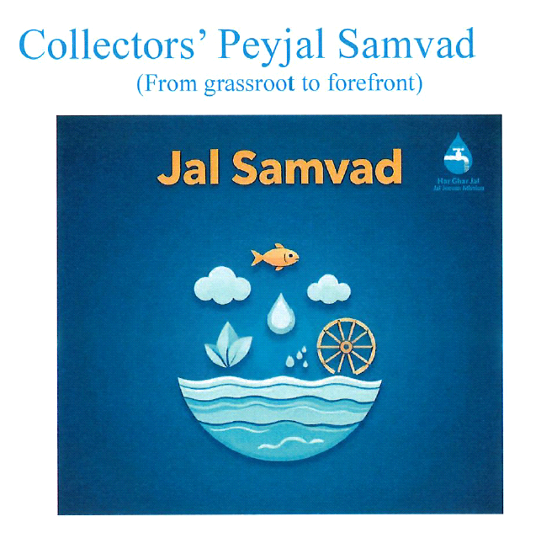
PWSS Functionality & Best Practices
DWSM, Charaideo District
District Administration, Charaideo • PHED Nazira Division

Slide 2
Charaideo District – Brief Profile
PHE Division: Nazira: Subdivision: Sonari
Blocks: 4: Gram Panchayats: 36: Villages: 321
Sanctioned Schemes: 443: Completed: 240: Handed over: 240
Jal Mitras engaged: 240: PWSS with Tariff collection: 175
Total Water Tariff collected so far: ₹ 18.54 lakh

Slide 3
Best Practice: Strong Governance & Coordination
Continuous involvement of DWSM; regular coordination with PHED (Nazira Division)
District-level reviews and timely decisions on functionality & tariff matters
Regular updates to the DC through the Additional District Commissioner
Outcome: quicker repairs and steady tariff collections

Slide 4
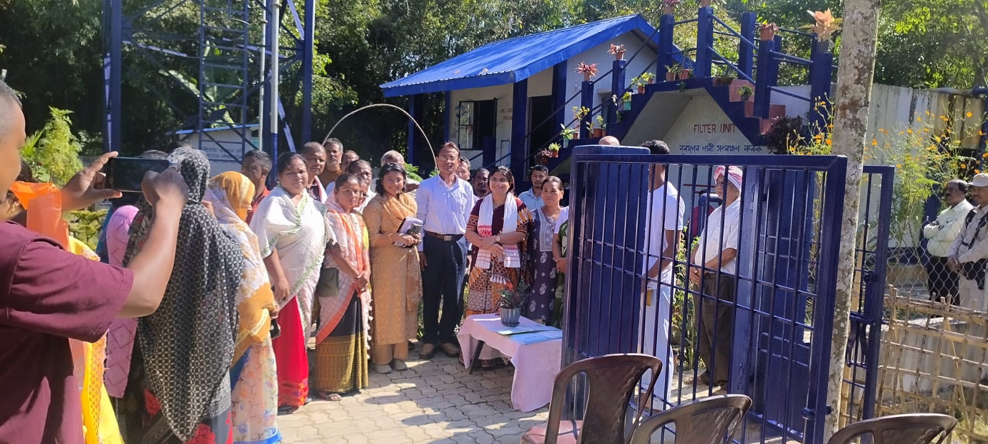
Glimpses of site visit by the District Commissioner at Choladhara PWSS

Slide 5
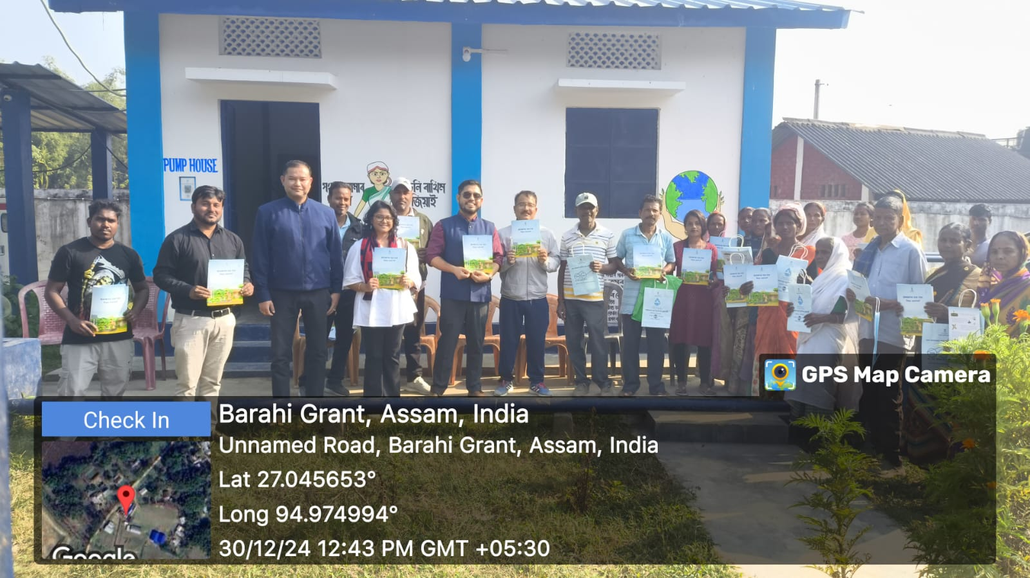
Glimpses of Site Visit by the Administrative Department
Site visit by the ADC (JJM) Charaideo District along with the concerned PHED officials at Borahi TE New PWSS for interaction with the beneficiaries( awareness generation ) and subsequent troubleshooting discussions.

Slide 6
Best Practice: On-site Meetings & Field Oversight
Block/Section-level on-site meetings with WUCs, Jal Mitras, SAs and Khalasis
Focused troubleshooting at PWSS locations (e.g. PoitakhatPWSS)
Community problem-solving and responsibility-sharing culture

Slide 7
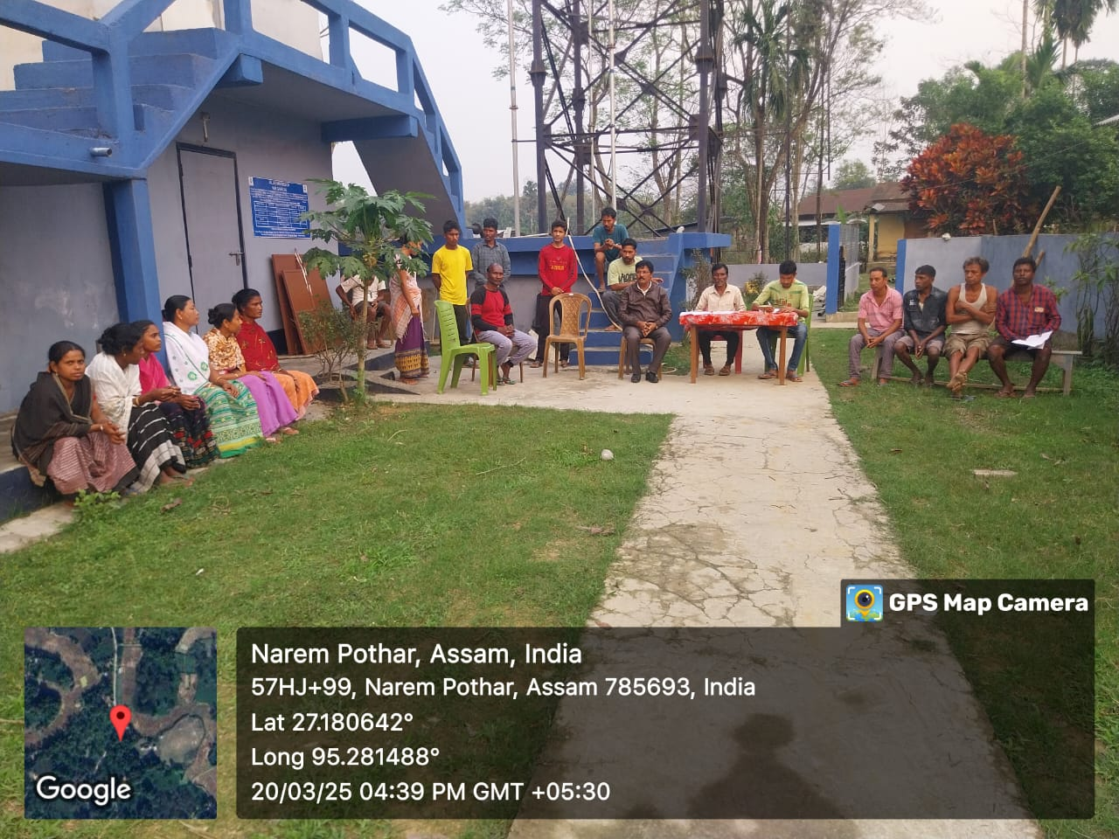
Glimpses of onsite meeting
Onsite meeting inside the PWSS campus and discussion on various issues at Paitakhat PWSS

Slide 8
Best Practice: Review Cadence & Issue Closure
Monthly review meeting for each block by PHED
WUC meetings every 15 days with Khalasis and Sectional Assistants
Issues logged → actions assigned → closure verified in the next review

Slide 9
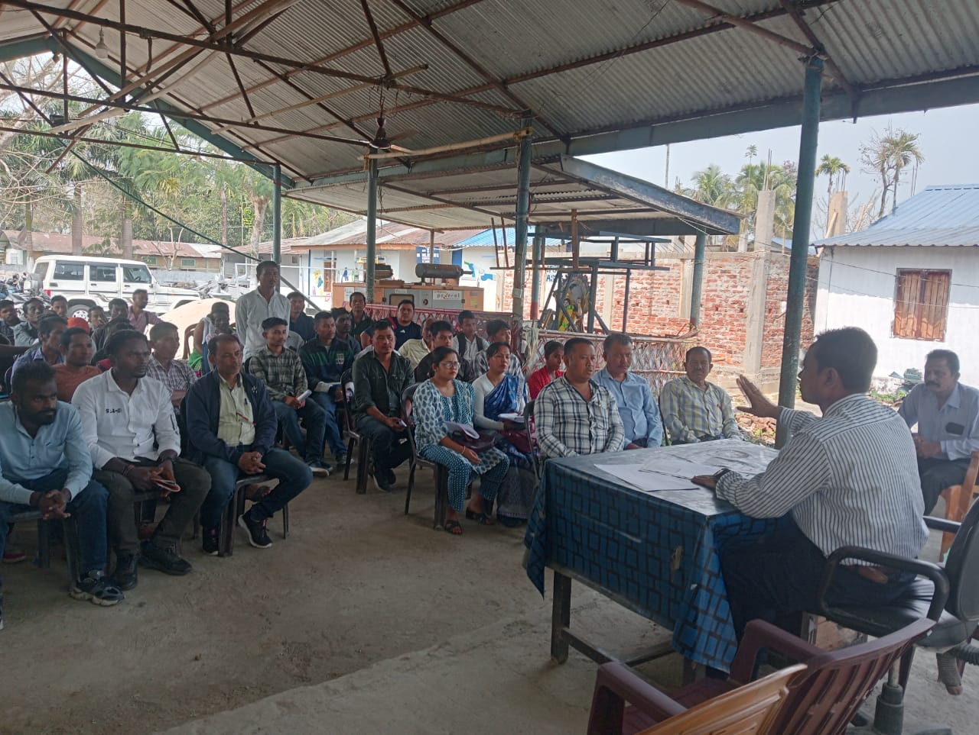
Glimpses of Jal Mitra Review Meeting
Conversation of Executive Engineer, Nazira Division with Jal Mitas and other stakeholders of Lakwa Block

Slide 10
Best Practice: Minor Repairs – Simple, Fast Workflow
Step 1: Defect identified by Jal Mitra / community
Step 2: Materials procured by WUC
Step 3: Repairs executed by Jal Mitra + skilled/semiskilled/unskilled labour
Step 4: Expenses booked from WUC account (minor-repair head)
Result: downtime reduced; trust in the system increased

Slide 11
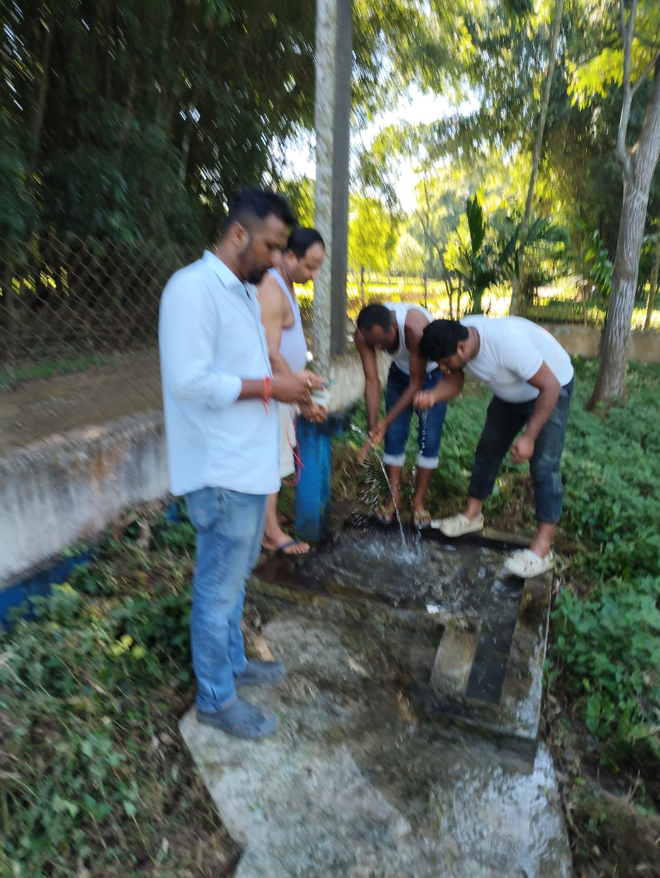
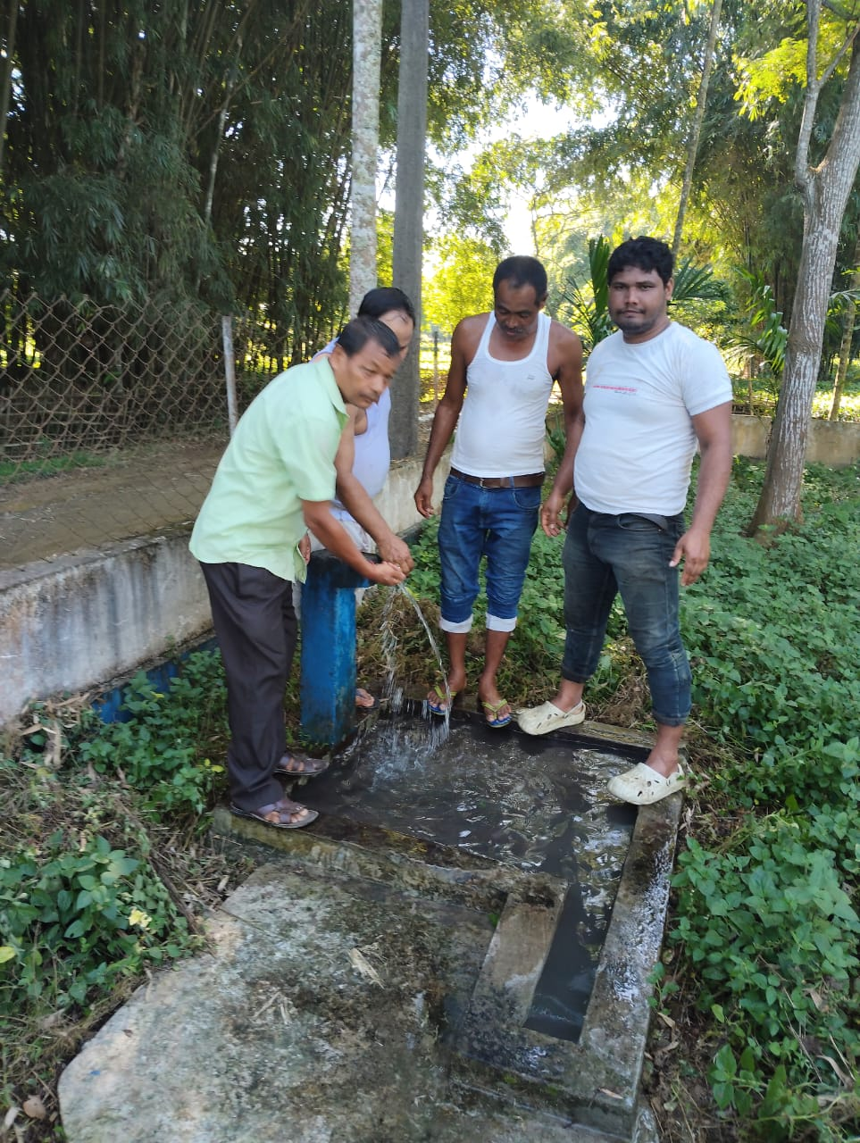
A Small Showcase of Community Ownership
Successful restoration of functionality of Madhupur PWSS by the joint efforts of Jal Mitra, WUC, Khalasi as well as the concerned PHED Sectional Officer.

Slide 12
Best Practice: Reviving & Empowering Water Users’ Committees
Constitute/renew WUCs where dormant: clarify roles & SOPs
Special drives at Bhuyankhat and Dhuniapothar PWSS
Capacity-building on tariff, O&M, grievances and water safety
Transparent record-keeping and social audit orientation

Slide 13
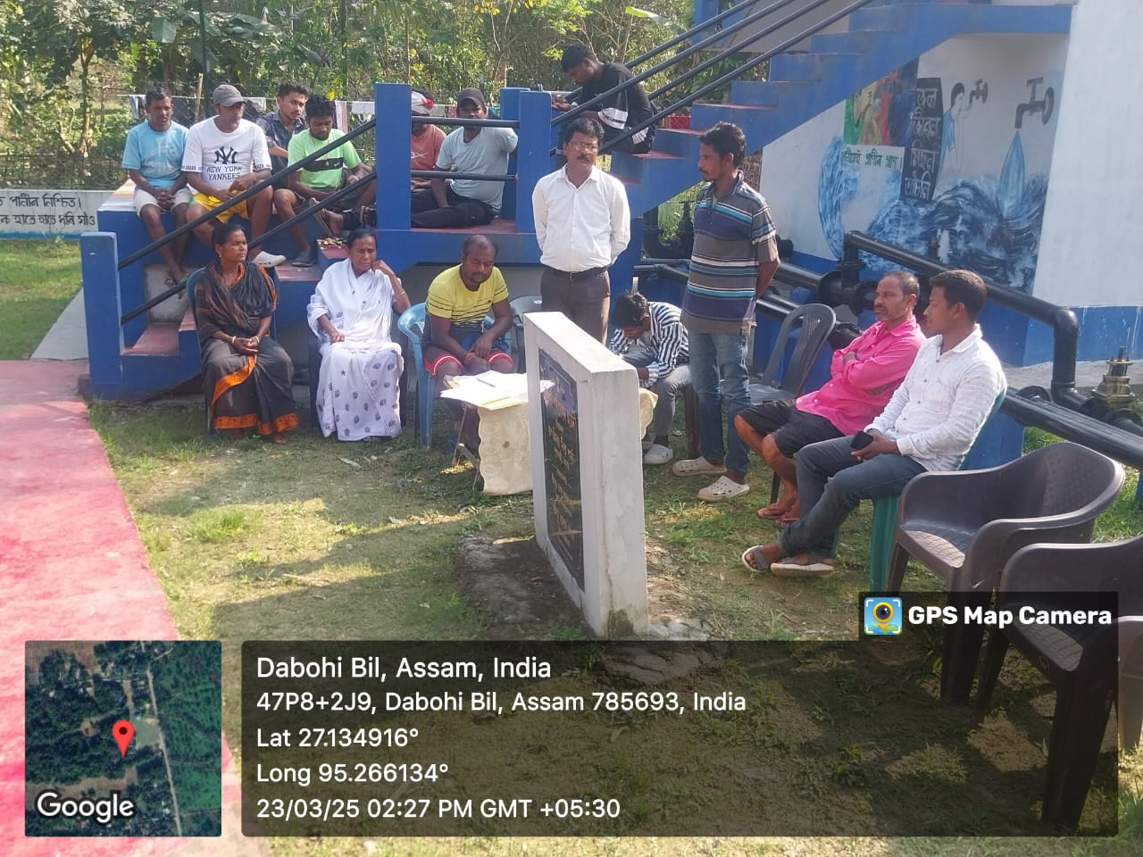
Glimpses of Formation of New Committee
Formation of New WUC and discussion on tariff collection at Bhuyankhat PWSS

Slide 14
Tariff Collection – What Improved in Charaideo (Methodology)
Door-to-door tariff drives by AEE, SO, District Coordinator, YPs and Jal Mitras
Standardised receipt books/ledgers; weekly deposit to WUC account
Incentives: Jal Mitra ₹7,500/month; Tariff collector ₹3,000 (plus performance top-up)
IEC & community meetings linking timely payment to reliable service
Dedicated grievance window; issue resolution within defined TAT
Special outreach in tea garden areas; inclusion of vulnerable users
Piloting digital payments (UPI/QR) and monthly collection dashboards at PWSS
Public display of monthly collection & expenditure at scheme notice boards

Slide 15
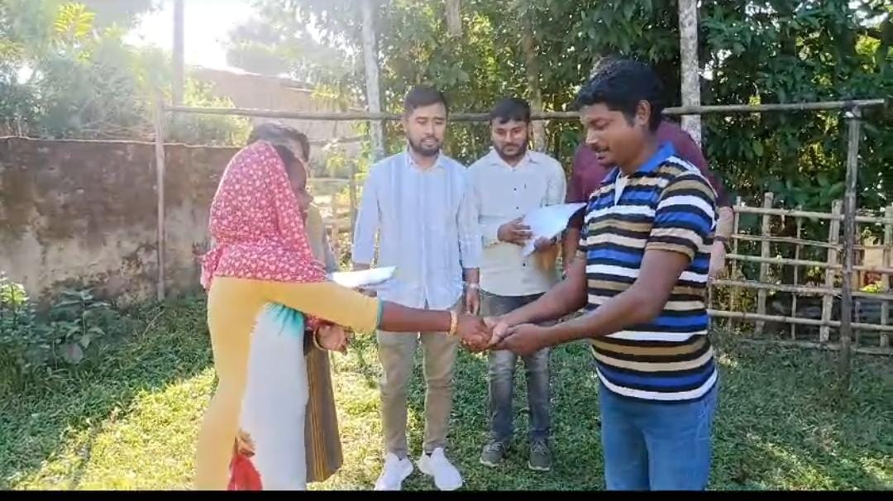
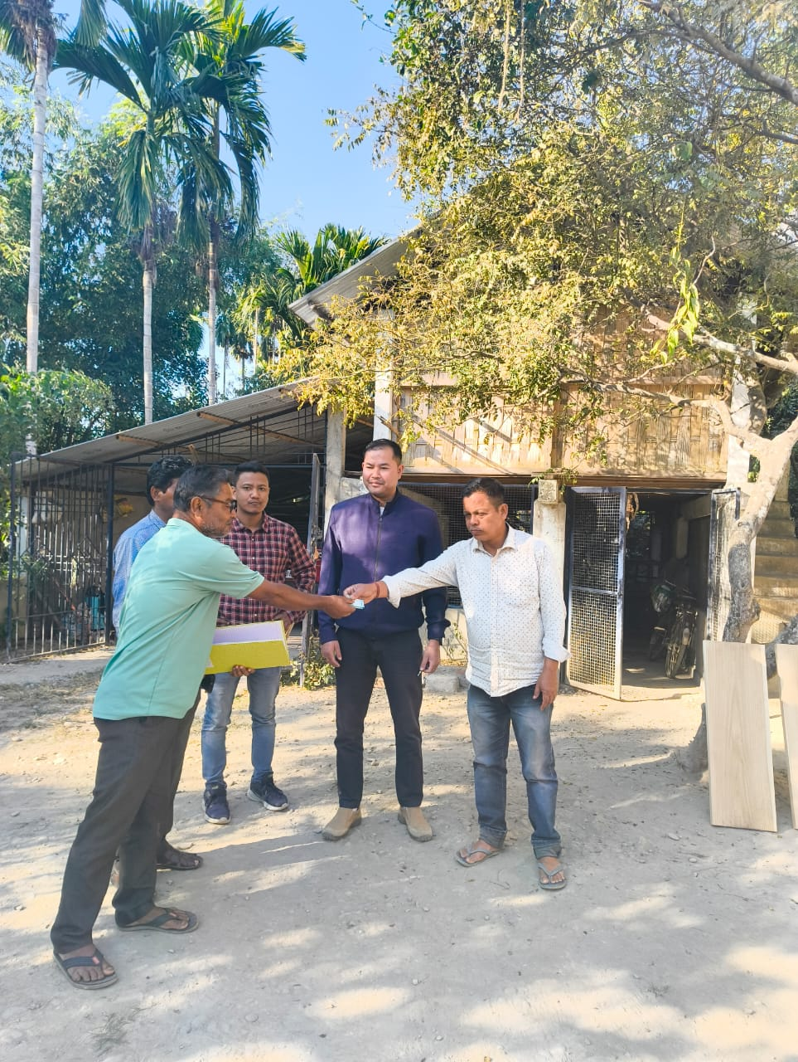
Tariff Collection Drive Through Door-to-Door Outreach by AEE,SO,District Coordinator,YP and Jalmitra.

Slide 16
Water Quality: Mobilising Women FTK Groups
Mobilised 5 women FTK groups for routine testing and community demos
On-site testing and immediate escalation when parameters deviate
Builds confidence in water safety; encourages regular tariff payment

Slide 17
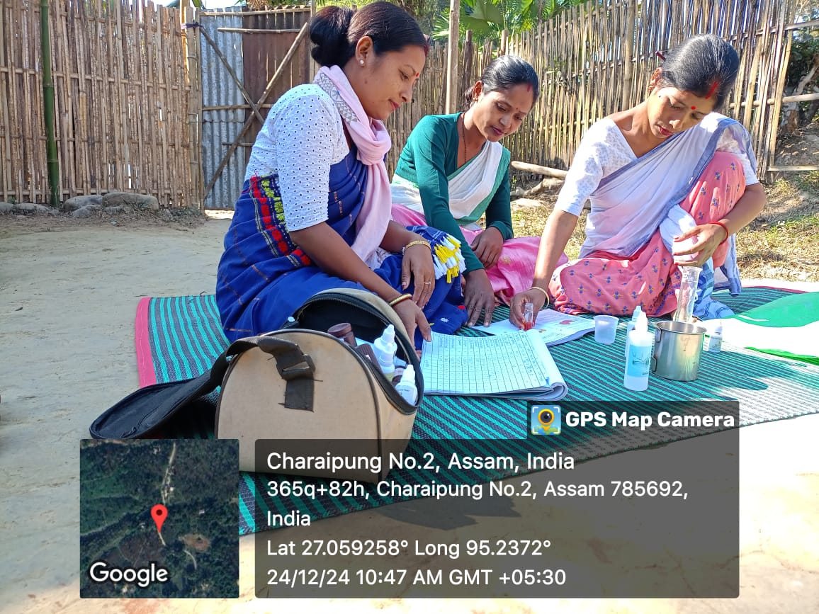
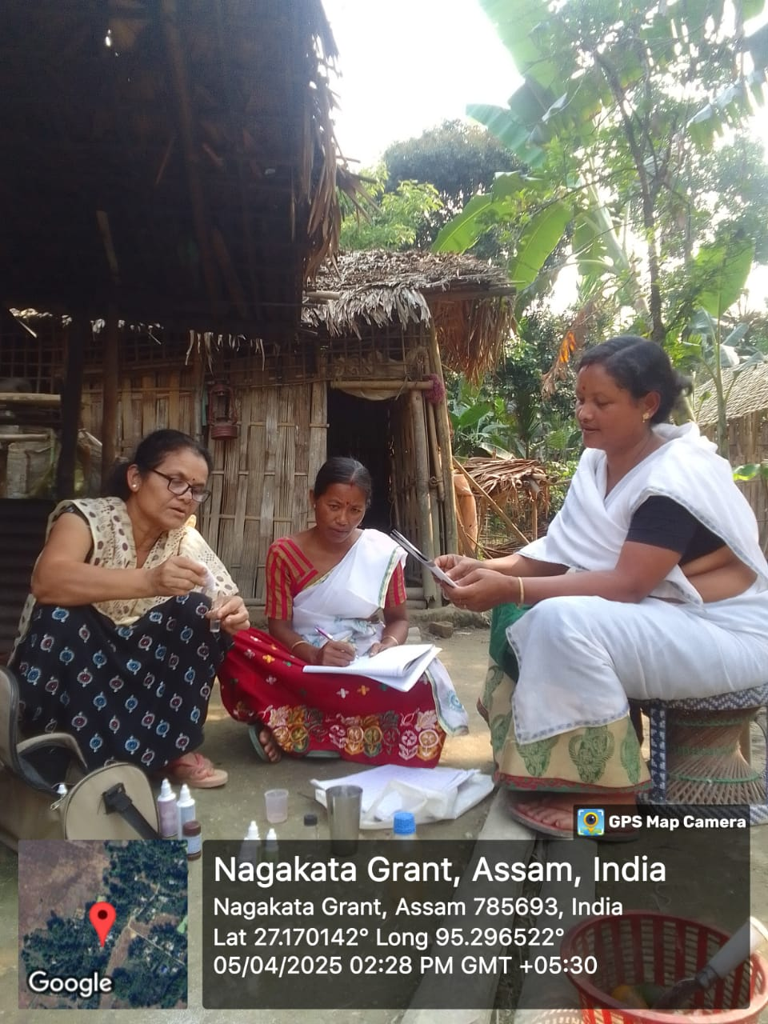
Glimpses of Water Quality Testing On site
Water being tested and compared on site
Water being tested and compared on site

Slide 18
Special Focus on Tea Garden Areas
Inspection drives (e.g. Salkathoni TE PWSS) and targeted IEC
Improved connectivity, reliability and safety for workers quarters
Children and women benefit the most from nearby safe tap connections

Slide 19
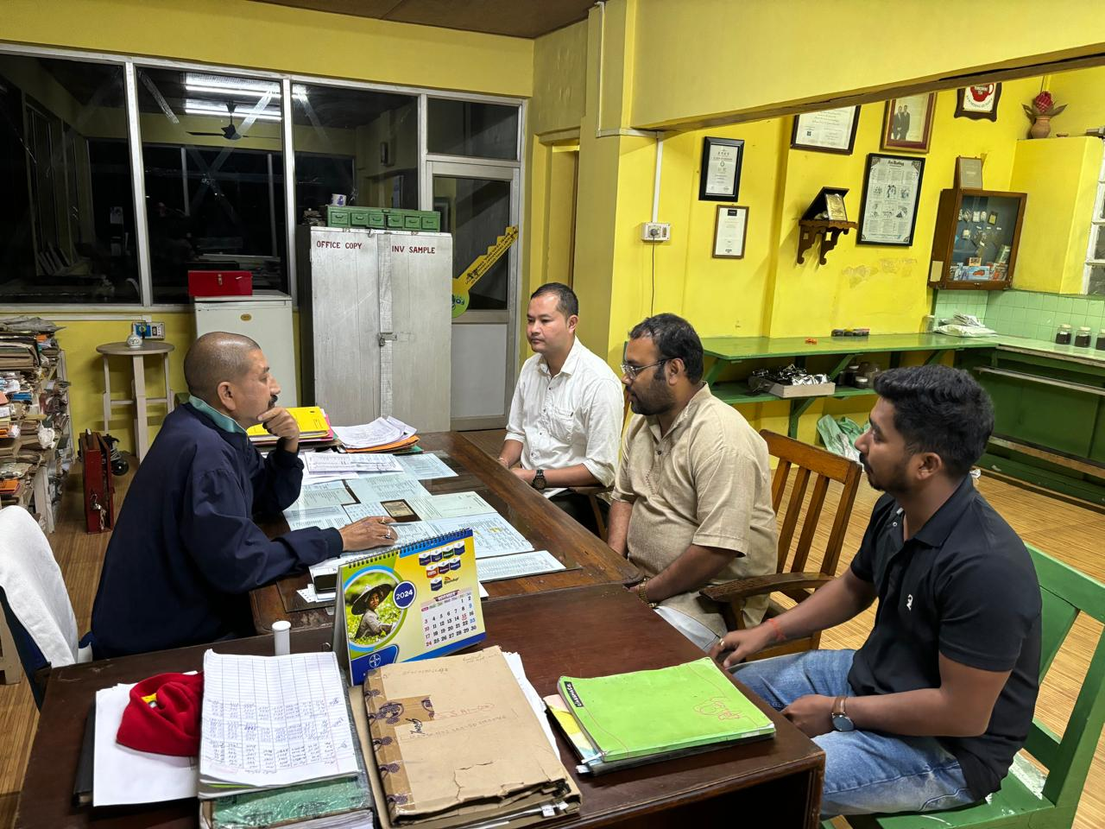
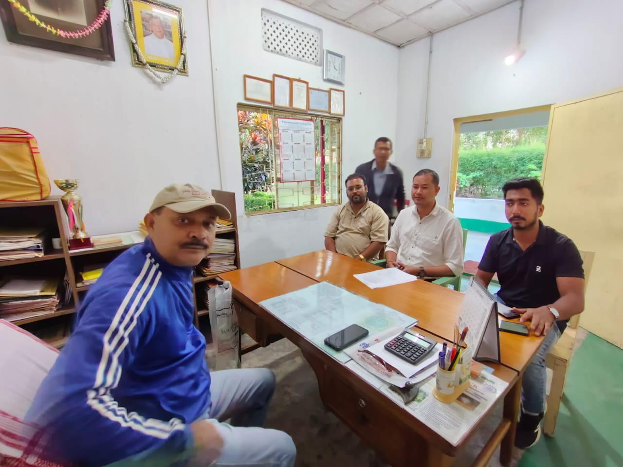
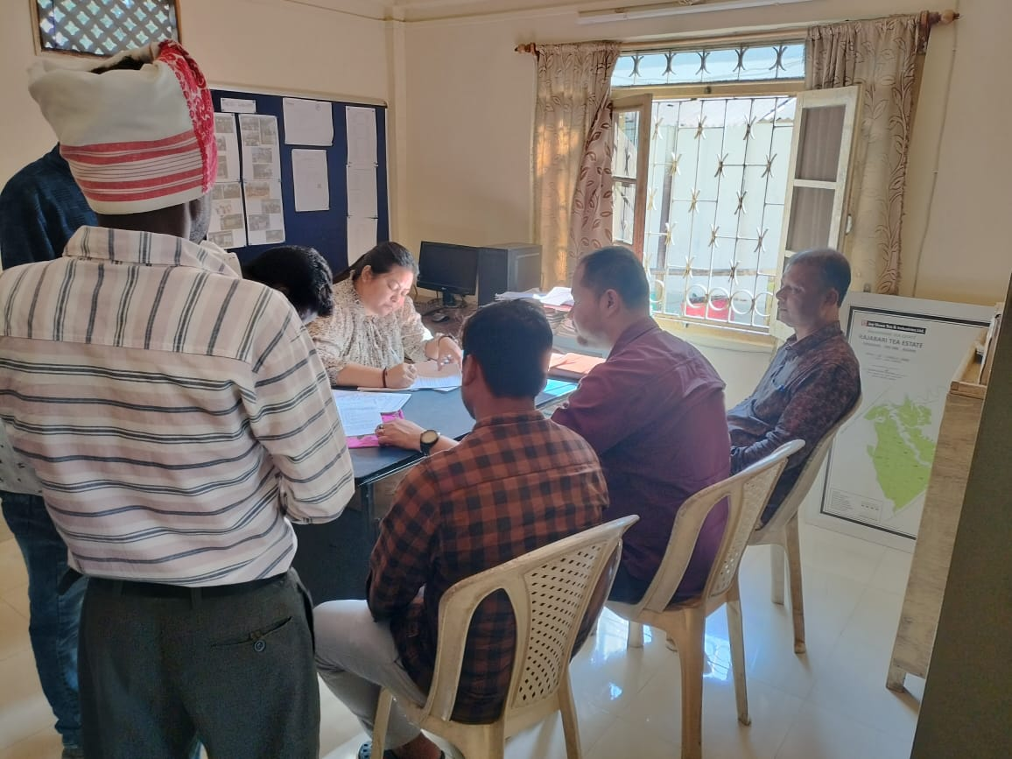
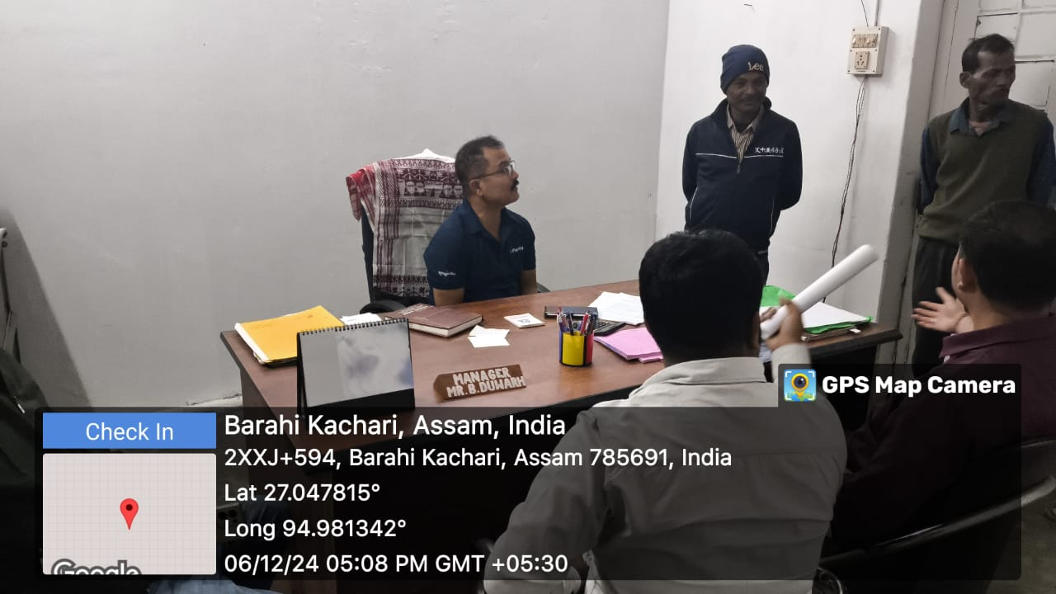
Tea Garden Authority Involvement in WUC under Discussion

Slide 20
Success Story – Maibella PWSS
Project Cost: ₹49.22 lakh; FHTC: 318; Handed over: 2022
Infra: UGR 80 KL & 30 KL; ESR 50 KL; Pumps 5 HP (submersible) & 7.5 HP (centrifugal)
Distribution Network: 6.97 km
Tariff: ₹50/HH/month; Paying HHs: 318; Total collected: ₹3.10 lakh
Benefits:
Distance & time to fetch water reduced; more time for livelihoods/education
Reduced water-borne illnesses; lower medical spend; better hygiene
Quicker minor repairs via community contribution and WUC funds

Slide 21
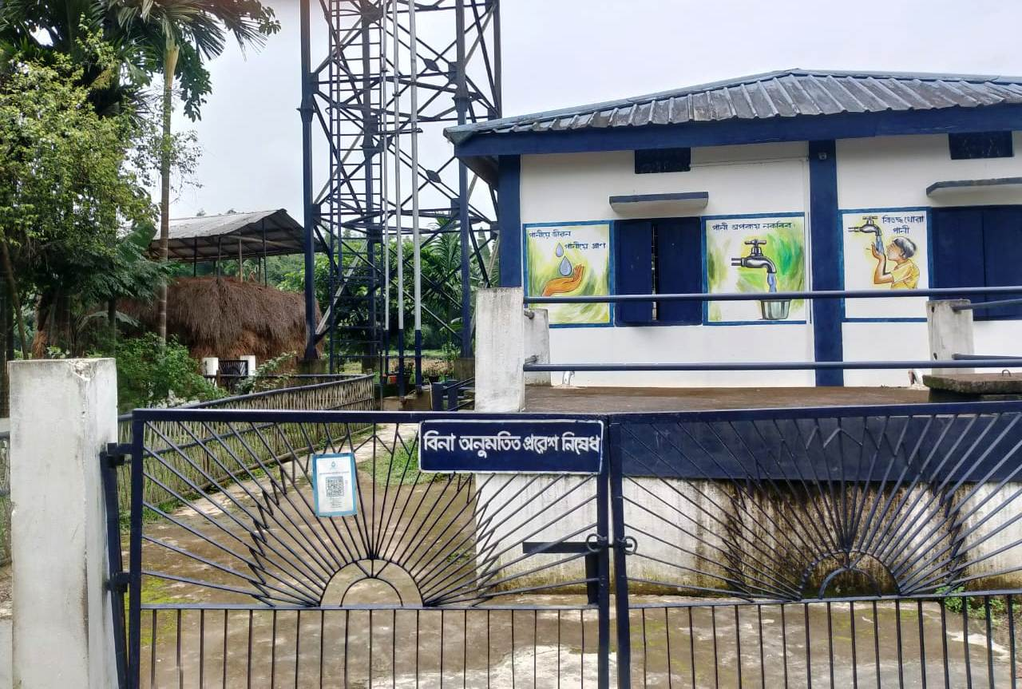
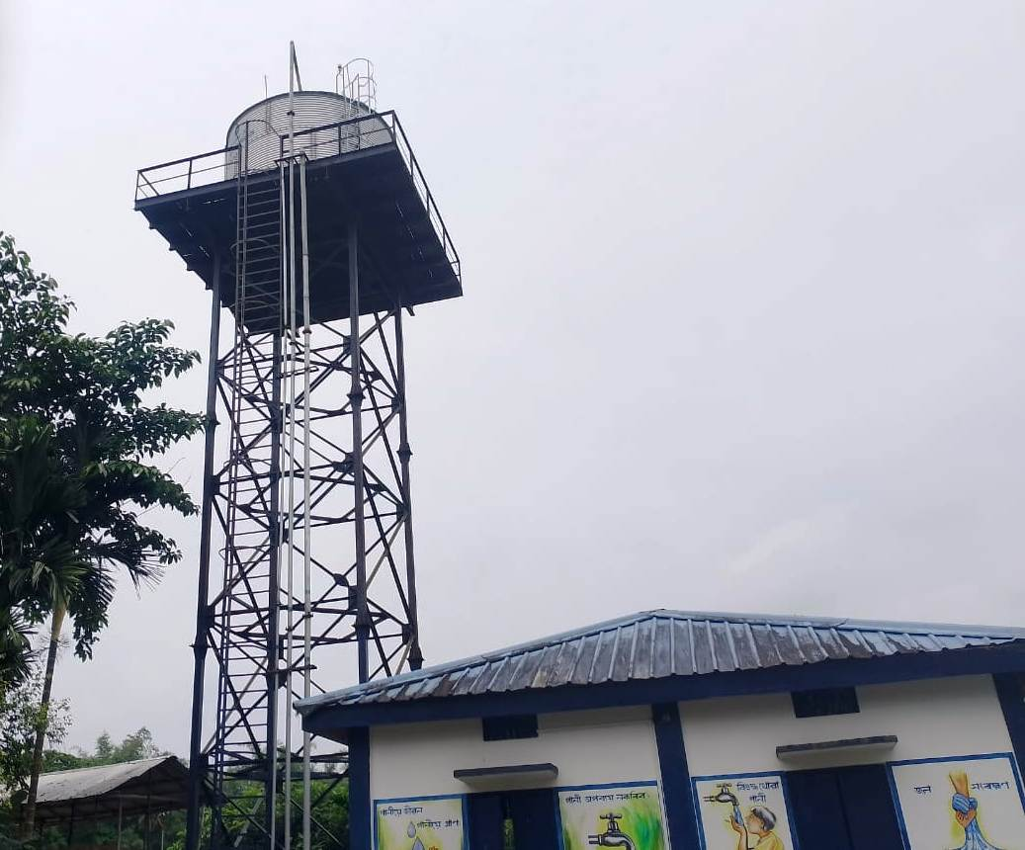
Snapshots of the Maibella PWSS
Underground Reservoir with Pump House
Elevated Service Reservoir

Slide 22
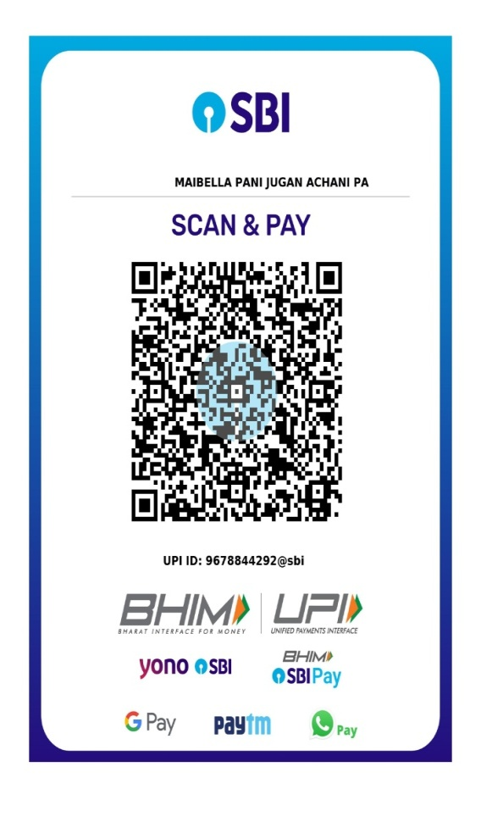
Snapshots showing the successful O&M of the Maibella WUC
QR Code to facilitate ease of Tariff Collection by WUC

Slide 23
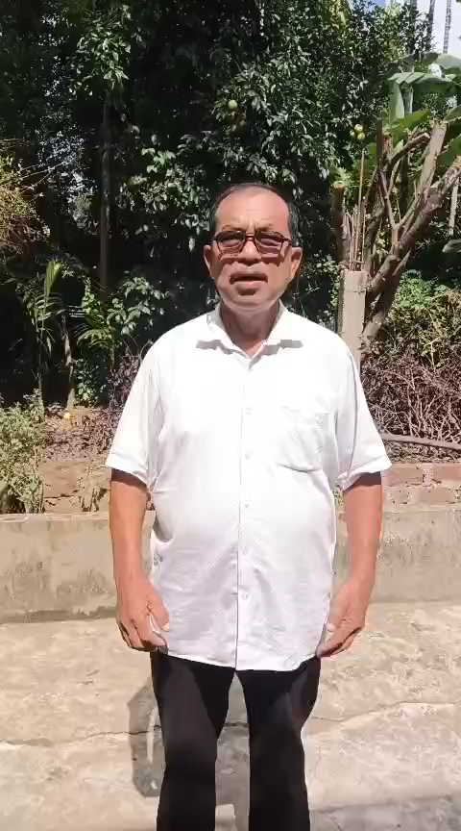
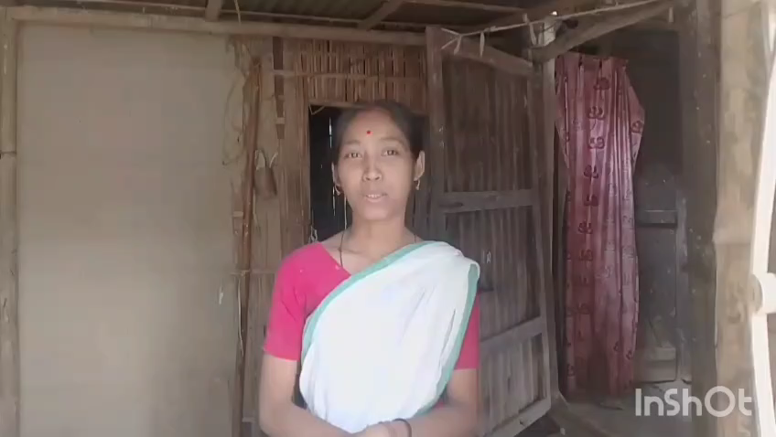
Beneficiary Feedback at Maibella PWSS
Feedback from the WUC President at Maibella PWSS
Feedback from FHTC beneficiaries at Maibella PWSS

Slide 24
Success Story – Michajan 5 No. Ward PWSS
Project Cost: ₹105.69 lakh; FHTC: 172; Handed over: July 2024
Infra: UGR 30 KL; ESR 30 KL; Pumps 5 HP (submersible & centrifugal)
Distribution Network: 7 km
Tariff: ₹50/HH/month; Paying HHs: 106; Total collected: ₹73,502
Benefits:
Safe, piped water close to home; reduced drudgery for women & girls
Fewer diarrhoeal cases reported; improved school attendance
Gradual culture of pay-and-service reliability

Slide 25
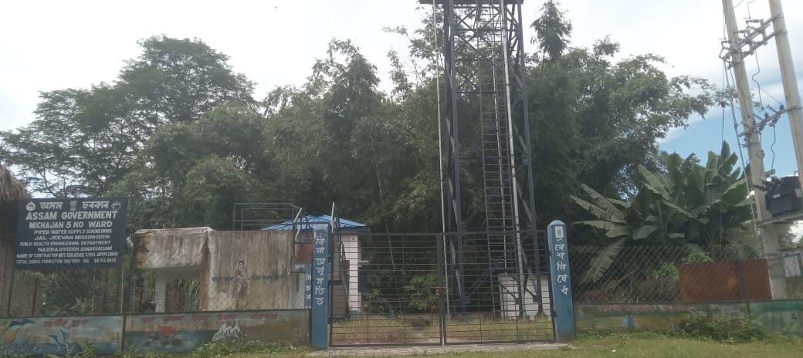
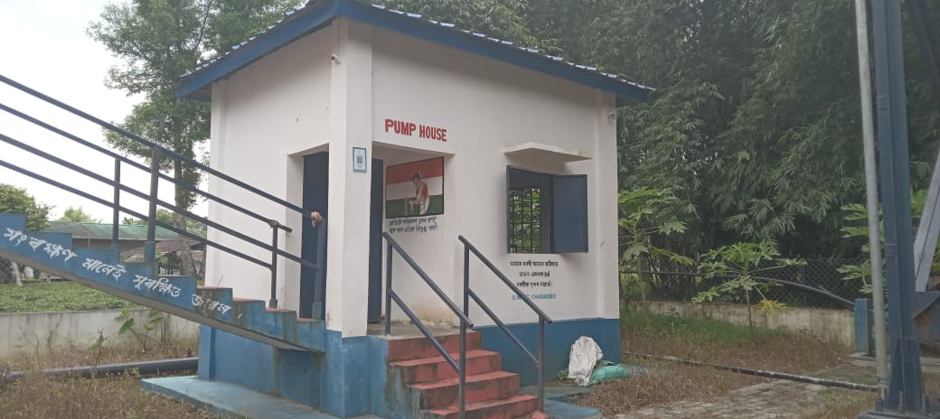
Snapshots of MICHAJAN 5 NO. WARD PWSS
Michajan 5 No. Ward PWSS (Front View)
Pump House with Underground Reservoir

Slide 26
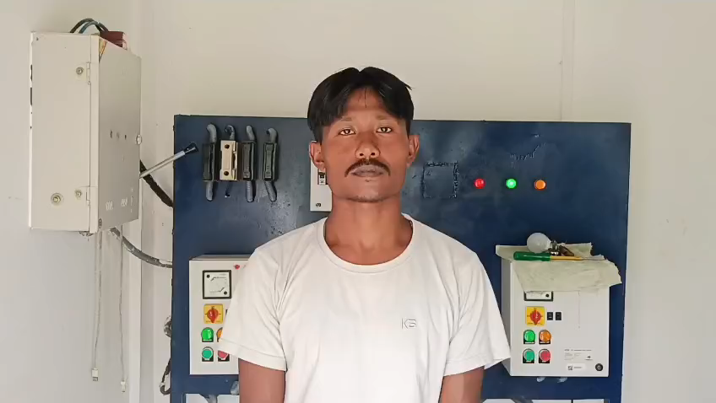
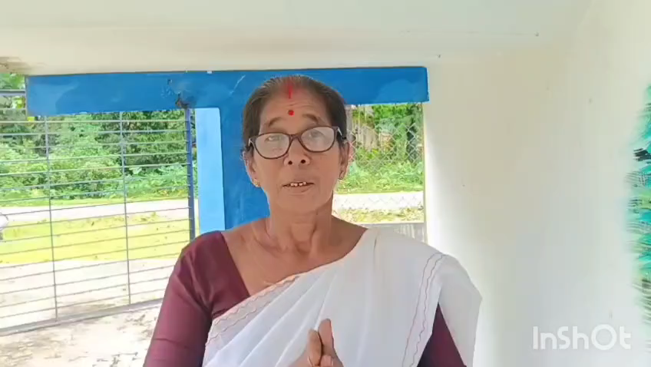
Beneficiary Feedback at Michajan 5 No. Ward PWSS
Feedback from the Jal Mitra at Michajan 5 No. Ward PWSS
Feedback from FHTC beneficiaries at Michajan 5 No. Ward PWSS

Slide 27
District-wide Outcomes & Impact
Tariff culture strengthened; more PWSS reporting consistent monthly collections
Faster fault reporting and repair closure due to empowered Jal Mitras & WUCs
Increased user satisfaction, pressure/reliability, and community ownership
Better data visibility for administration; targeted interventions possible

Slide 28
Takeaways & Future Plans
Reduce dependence on 15th Finance Commission grants by boosting own-source O&M revenue
Move towards universal safe drinking water: Water Safety Plans, residual chlorine checks, sanitary surveys
Ring-fence O&M funds at WUC level: publish monthly statements
Introduce digital payments & scheme-level dashboards:SMS reminders
Institutionalise preventive maintenance schedules and spare-part kits
Focus on last-mile & tea garden habitations for equity and reliability

Slide 29
Thank You

