Slide 1

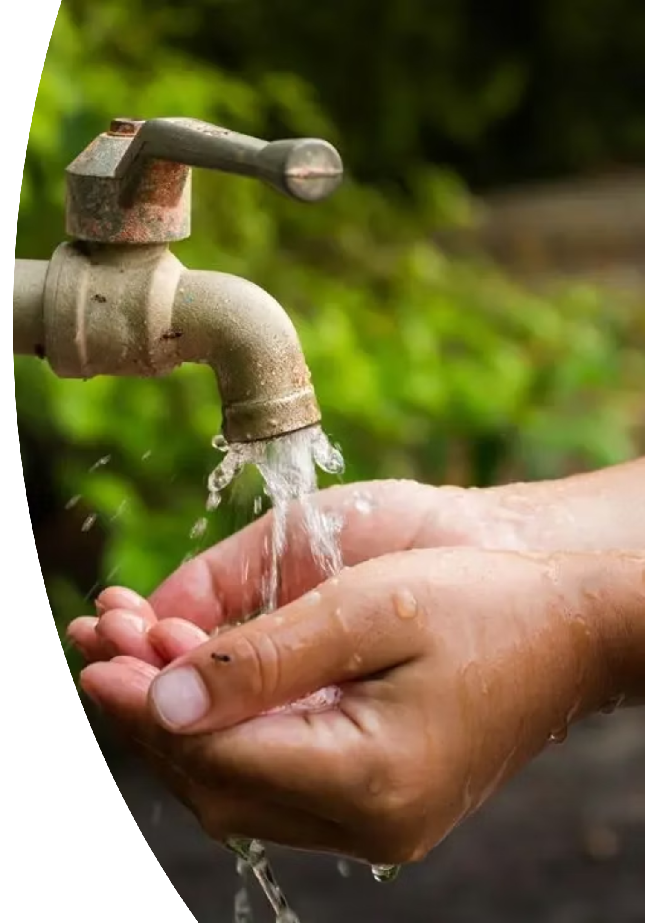

JAL SAMVAD
East Khasi Hills District

Slide 2
EAST KHASI HILLS DISTRICT FRAMEWORK
Superintending Engineer,PHE
cum
Member Secretary ,DWSM
G.S.W.S I
Electrical Division, Shillong
Electrical Division, Mawphlang
Sohra Divsion
Investigation Division
Hills Division
Mawkyrwat Division
S&D
G.S.W.S II
VWSCs-3
VWSCs - 71
VWSCs – 67
VWSCs - 19
VWSCs - 207
VWSCs - 150
VWSCs - 156
VWSCs - 246
VWSCs - 4
Divisions
Deputy Commissioner
cum
Chairman ,DWSM

Slide 3
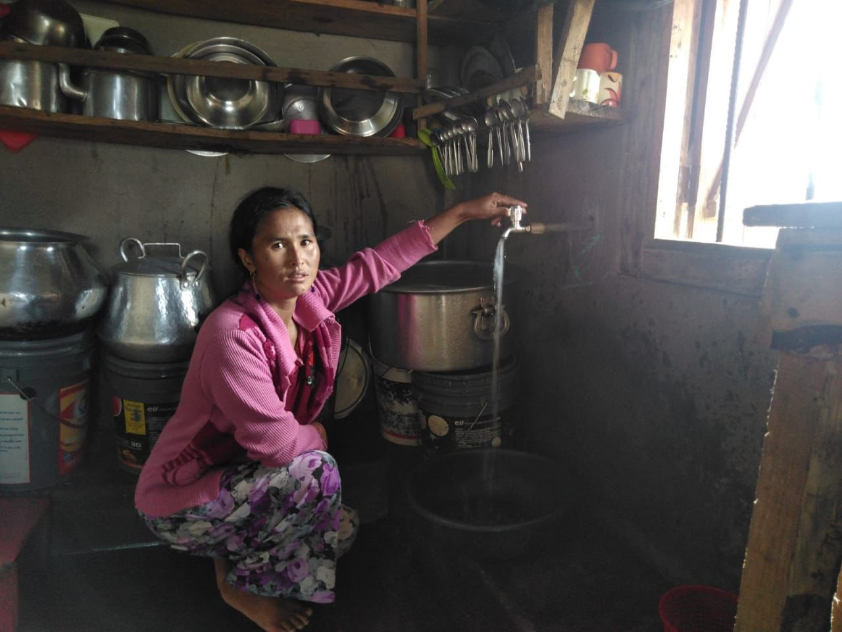
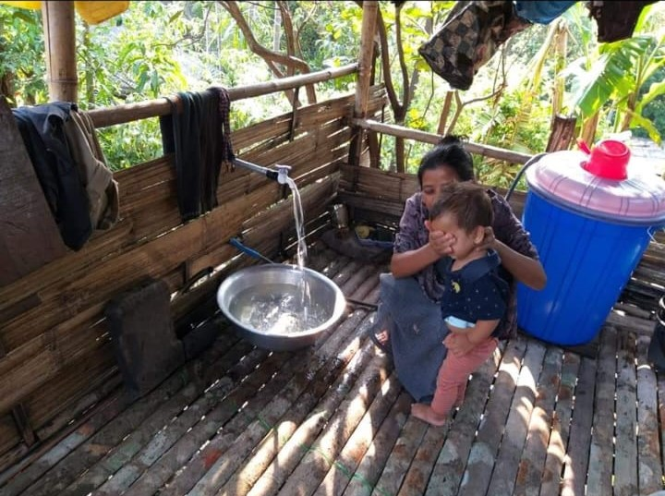
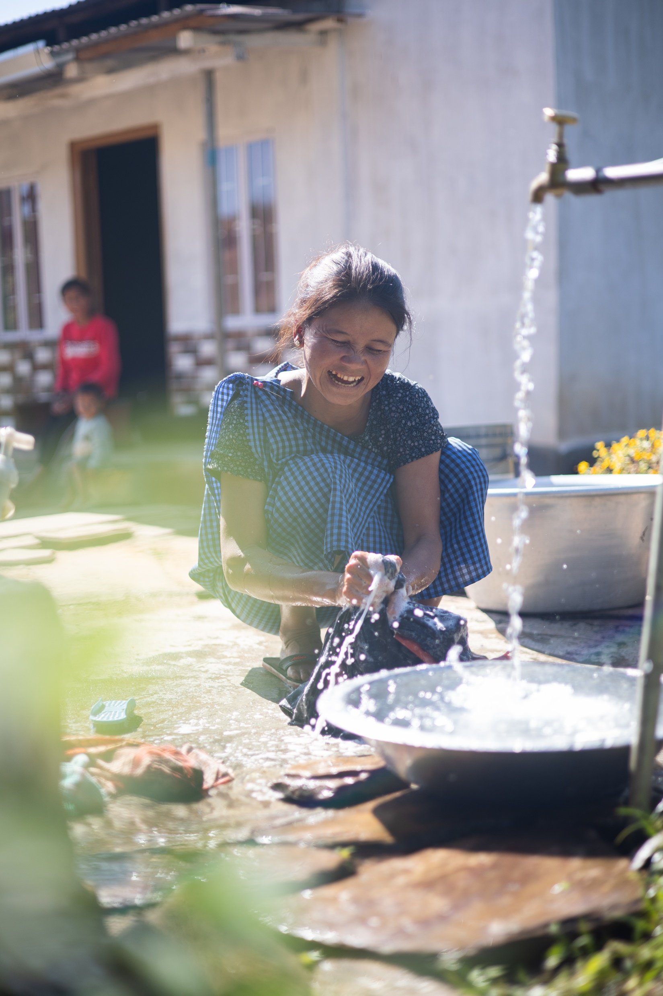
Coverage of FTHCs before JJM As of 15th Aug 2019 | Coverage of FTHCs since the launch of JJM As of 1st Oct 2025
No. of Households - 139829 | No. of Households-139829
FTHCs – 3085 (2.21%) | FTHCs – 114585 (81.95%)

Slide 4
Total Fund Received
FY 2019-2020 (Crore) | FY 2020-2021 (Crore) | FY 2021-2022 (Crore) | FY 2022-2023 (Crore) | FY 2023-2024 (Crore) | FY 2024-2025 (Crore) | TOTAL (Crore) | FUND UNTILISED (%)
3.033062 | 14.981004 | 70.0909677 | 106.3628651 | 396.208918 | 173.1688734 | 763.8456902 | 100%

Slide 5
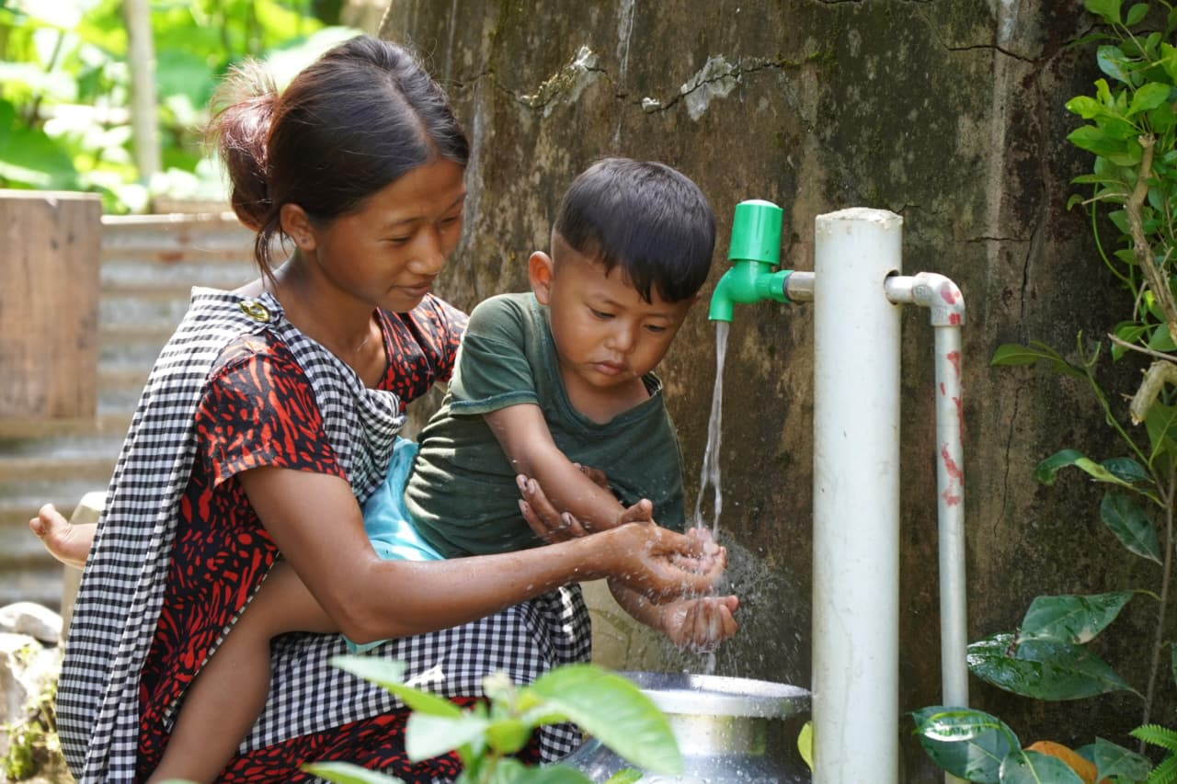

Block-wise Household Connection Progress
S.No. | Block | Total Rural household as on (01/04/2025) | Total Household connections reported till (0/10/2025) | % of total household connections with PWS reported till (01/10/2025) | Balance | Target for completions
1 | Khadarshnong-Laitkroh | 9194 | 5678 | 61.76 % | 3516 | March, 2026
2 | Mawkynrew | 11052 | 11052 | 100 % | 0
3 | MAWLAI | 8181 | 4431 | 54.16 % | 3750
4 | Mawpat | 9569 | 8650 | 90.4 % | 919
5 | Mawphlang | 11065 | 9241 | 83.52 % | 1824
6 | Mawryngkneng | 17785 | 15907 | 89.44 % | 1878
7 | Mawsynram | 12352 | 9653 | 78.15 % | 2699
8 | Mylliem | 18678 | 15480 | 82.88 % | 3198
9 | Pynursla | 16284 | 12744 | 78.26 % | 3540
10 | Shella Bholaganj | 13561 | 11244 | 82.91 % | 2317
11 | SOHIONG | 12108 | 10505 | 86.76 % | 1603
Total |  | 139829 | 114585 | 81.95 % | 25244

Slide 6
Block-wise School tap Connection Progress
S. No. | Block | Nos. of Schools (As Approved by State)
 |  | Total entry done | Availability of drinking water through tap connection | % of achievement | Balance | Target
1 | Khadarshnong-Laitkroh | 198 | 153 | 77% | 45 | March, 2026
2 | Mawkynrew | 253 | 246 | 97% | 7
3 | MAWLAI | 44 | 42 | 95% | 2
4 | Mawpat | 58 | 51 | 88% | 7
5 | Mawphlang | 226 | 159 | 70% | 67
6 | Mawryngkneng | 292 | 215 | 74% | 77
7 | Mawsynram | 291 | 199 | 68% | 92
8 | Mylliem | 184 | 143 | 78% | 41
9 | Pynursla | 290 | 256 | 88% | 34
10 | Shella Bholaganj | 245 | 210 | 86% | 35
11 | SOHIONG | 267 | 211 | 79% | 56
Total |  | 2348 | 1885 | 80% | 463

Slide 7
Block-wise Anganwadi tap Connection Progress
S. No. | Block | Nos. of Balwadi/ Anganwadi (As Approved by State)
 |  | Total entry done | Availability of drinking water through tap connection | % of achievement | Balance | Target
1 | Khadarshnong-Laitkroh | 67 | 58 | 87% | 9 | March , 2026
2 | Mawkynrew | 89 | 89 | 100% | 0 | -
3 | MAWLAI | 13 | 13 | 100% | 0 | -
4 | Mawpat | 24 | 24 | 100% | 0 | -
5 | Mawphlang | 118 | 115 | 97% | 3 | November, 2025
6 | Mawryngkneng | 105 | 79 | 75% | 26 | March , 2026
7 | Mawsynram | 132 | 131 | 99% | 1 | November, 2025
8 | Mylliem | 92 | 75 | 82% | 17 | March , 2026
9 | Pynursla | 124 | 98 | 79% | 26 | March , 2026
10 | Shella Bholaganj | 102 | 73 | 72% | 29 | March , 2026
11 | SOHIONG | 132 | 130 | 98% | 2 | November, 2025
Total |  | 998 | 885 | 89% | 113 | March , 2026

Slide 8
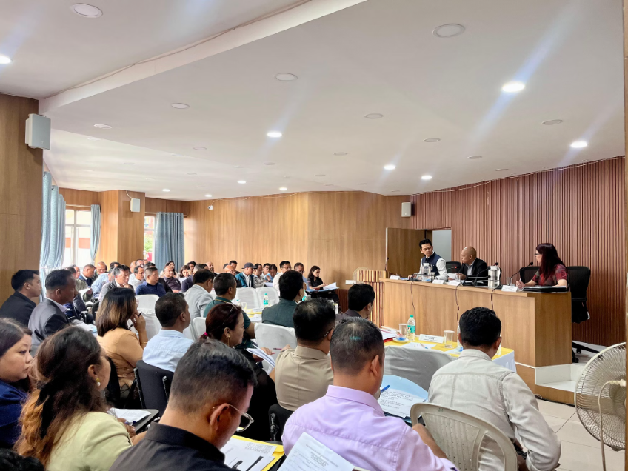
Strategic In Monitoring & Implementation Framework
Regular DWSM meeting
Number of Meeting Conducted - 23
Regular assess the progress of implementation
Identifying Challenges
Setting a target for completion of FHTCs
DWSM Meeting
Year | 2020-2021 | 2021-2022 | 2022-2023 | 2023-2024 | 2024-2025 | 2025-2026
No. of Meeting | 4 | 4 | 4 | 4 | 4 | 3

Slide 9
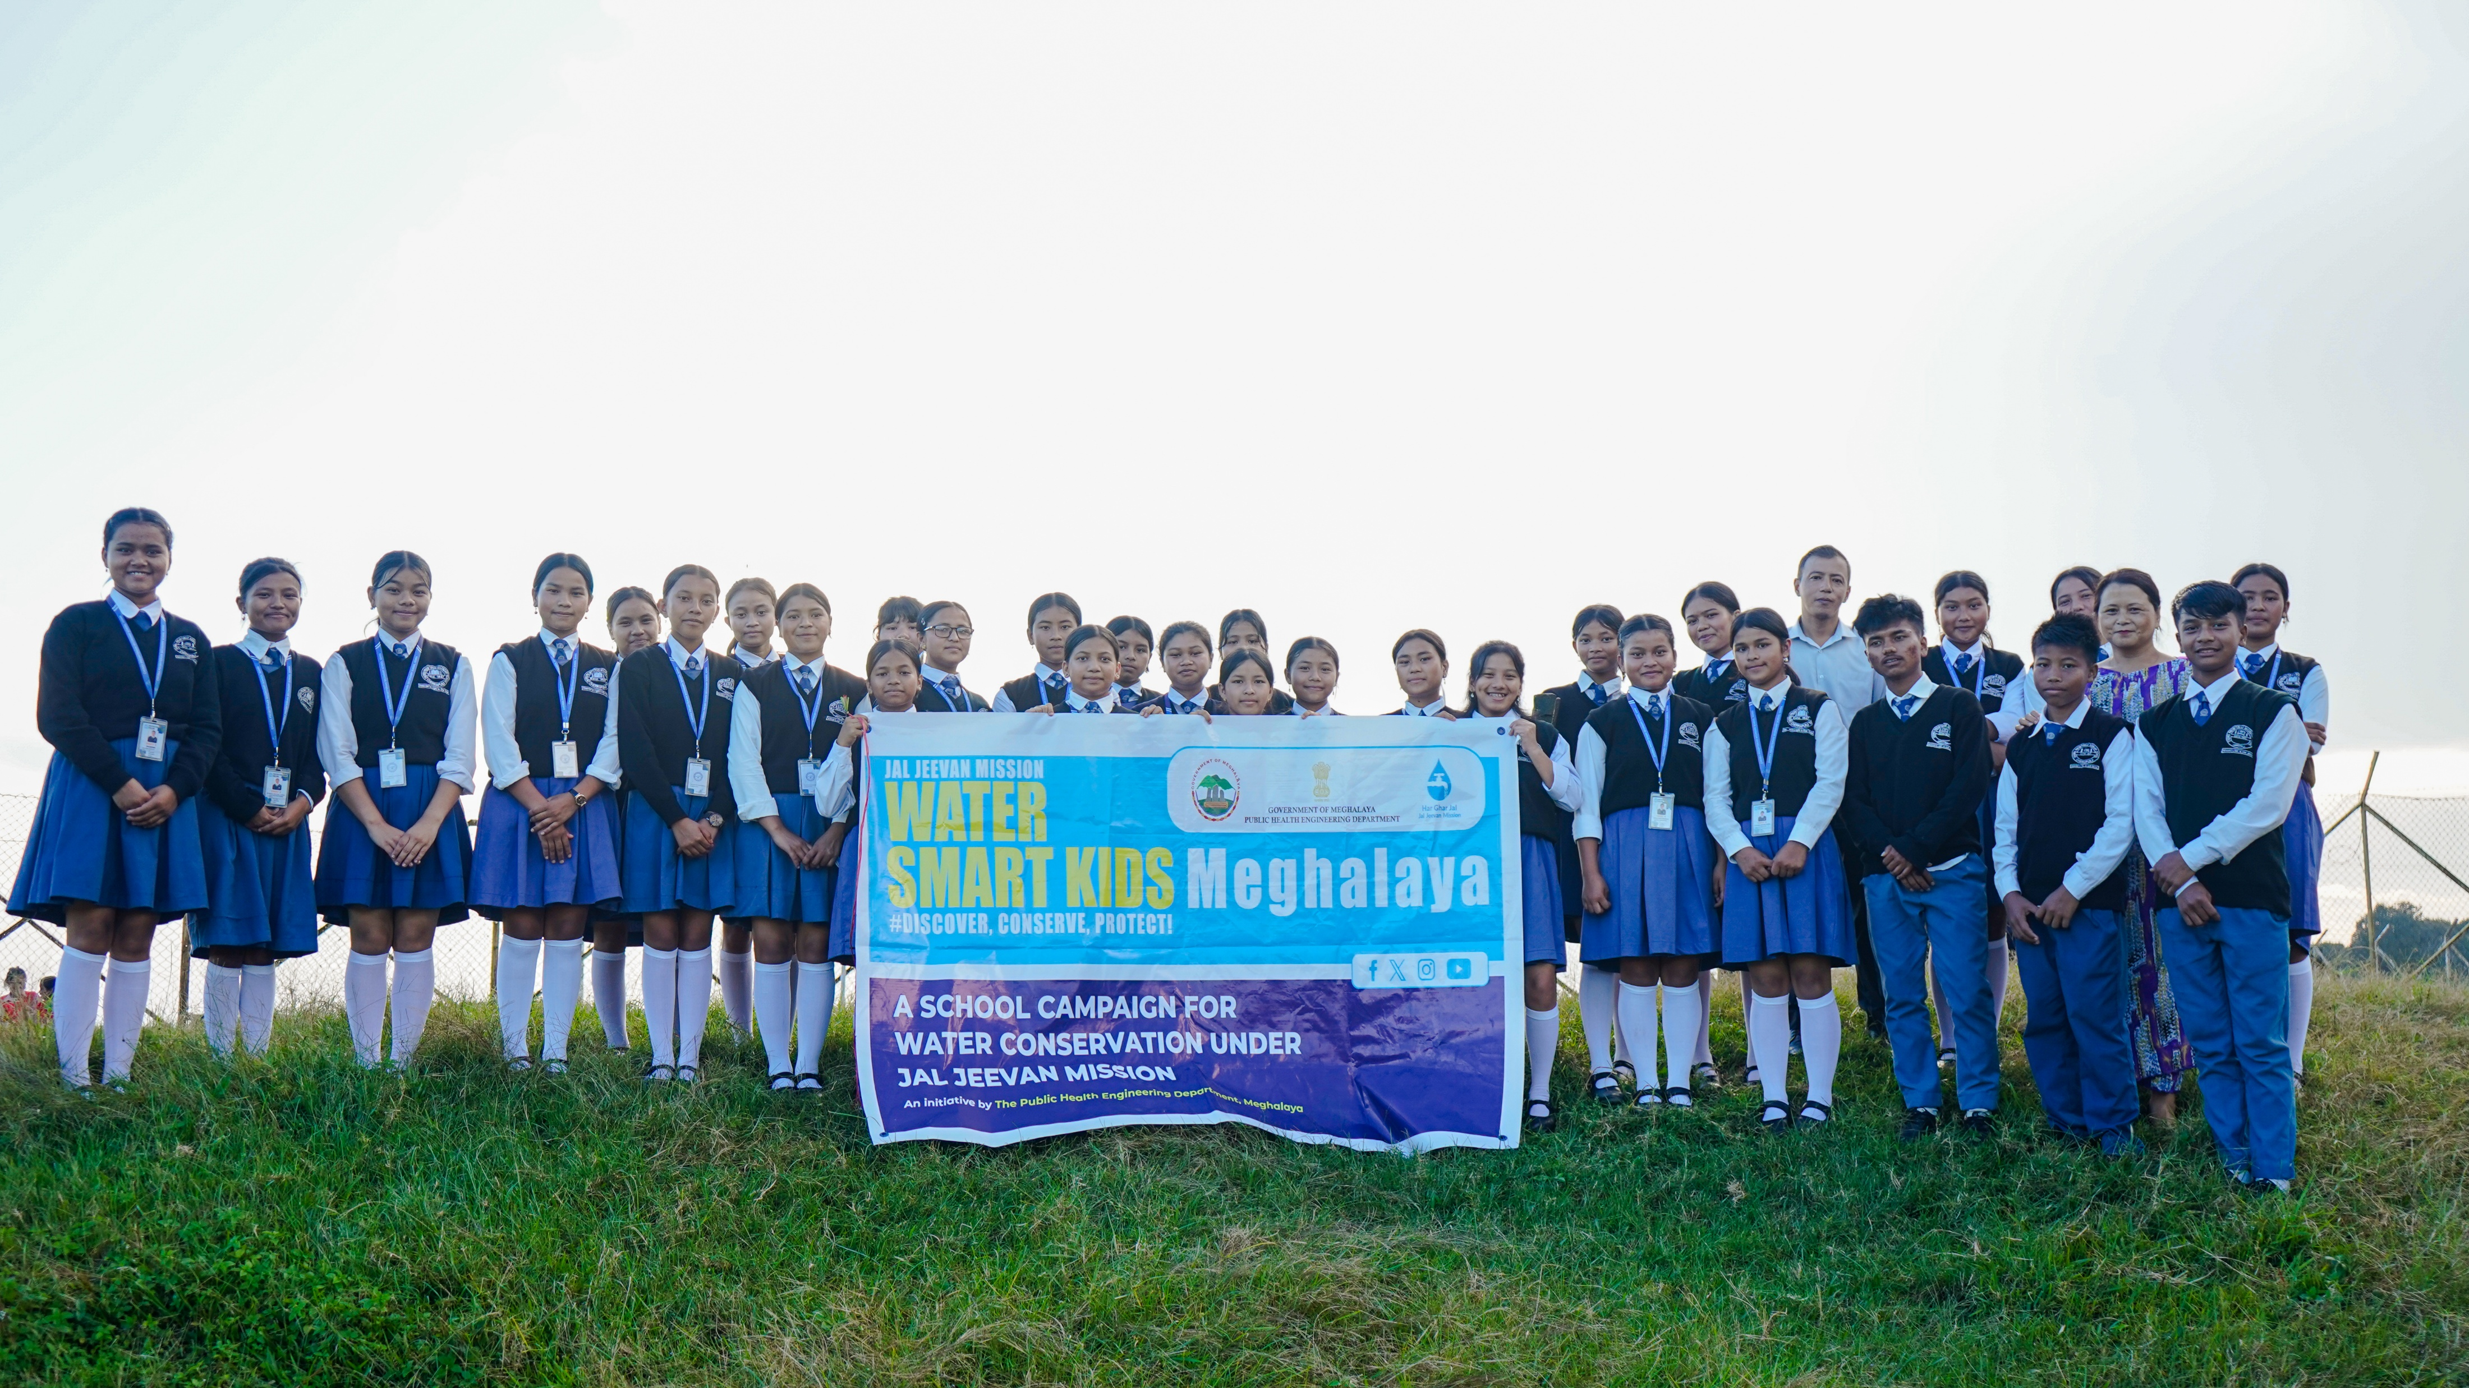
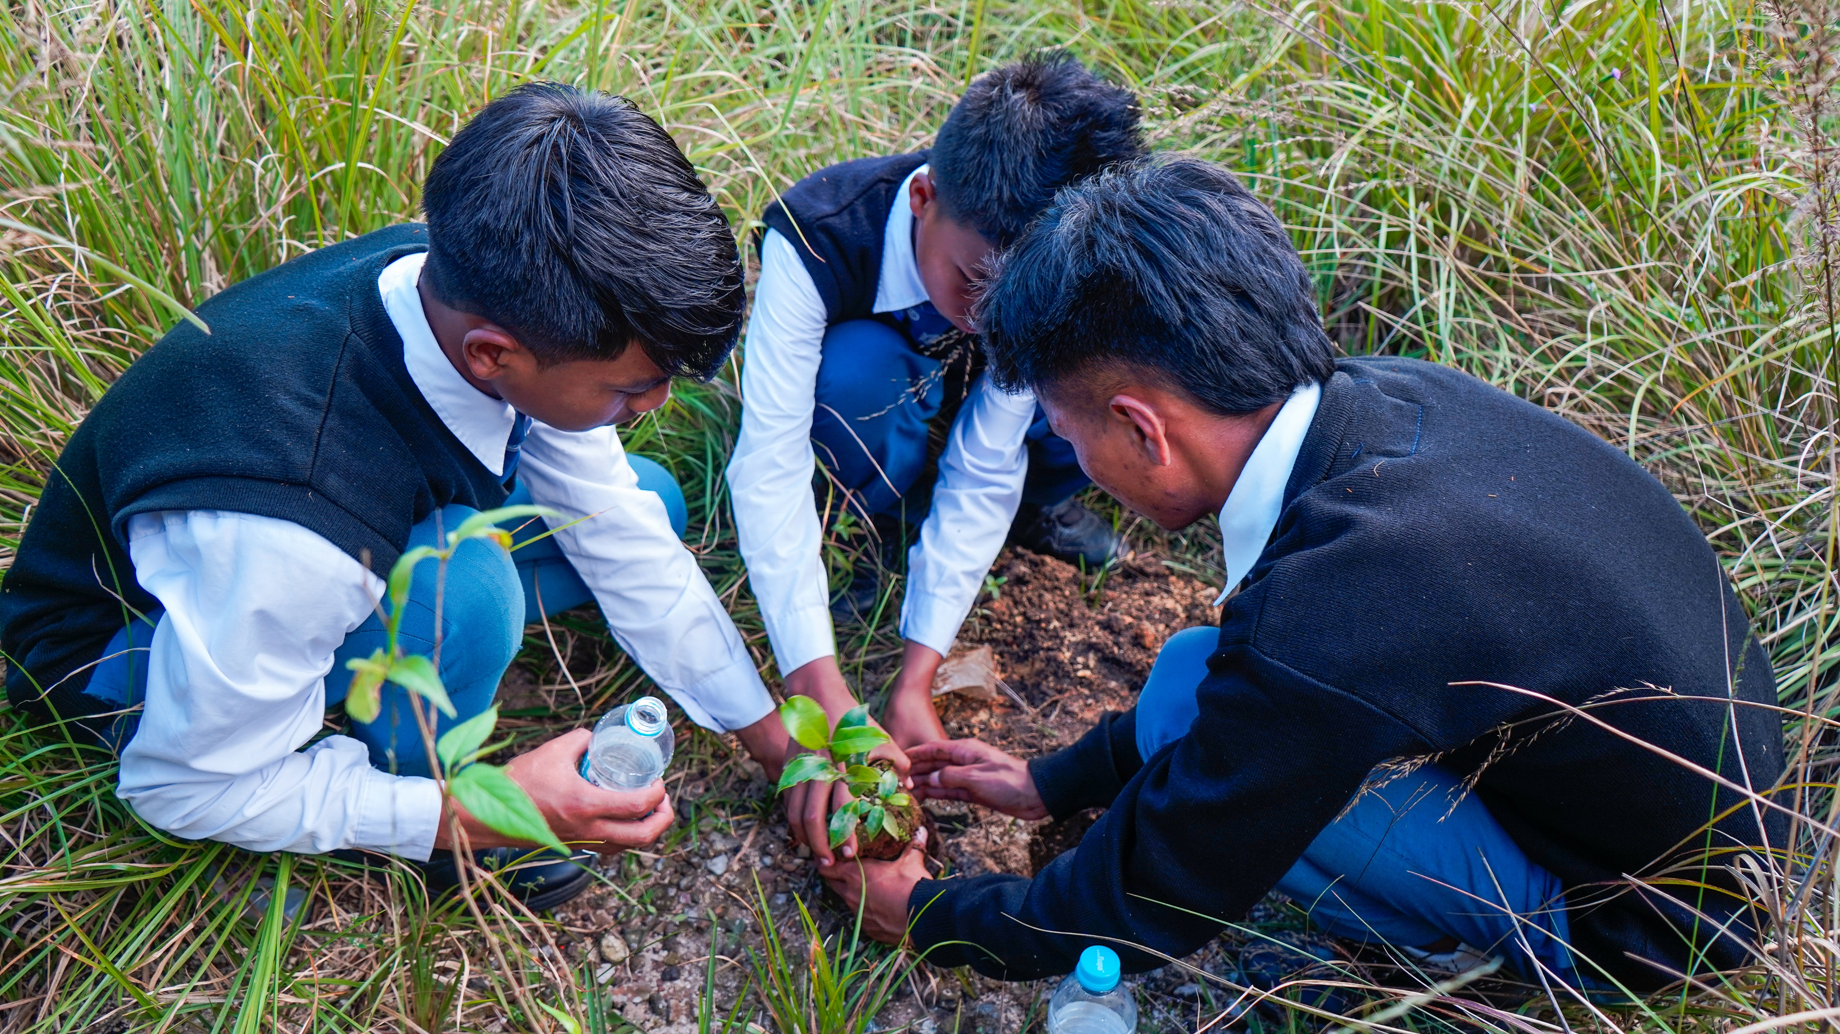
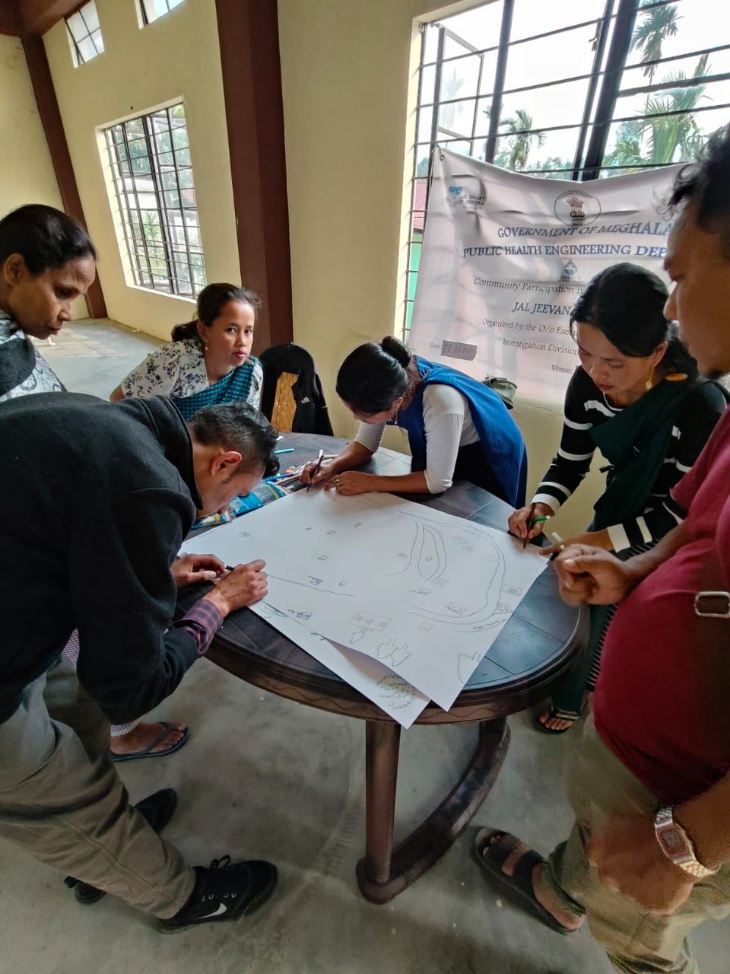
2. Community Engagement & Capacity Building
Engaging the community in and spreading awareness through
Street play
Posters
Schools participations
self-help groups participate in spreading awareness
IEC activities

Slide 10
IEC ACTIVITIES UNDERTAKEN
District Name: East Khasi Hills District
No. | Activity | FY 2019-20 | FY 2020-21 | FY 2021-22 | FY 2022-23 | FY 2023-24 | FY 2024-25
1 | Gram Sabha | - | - | 232 | - | - | -
2 | School competition (Drawing, Essay, Poetry, Exhibition) | - | - | 10 | - | - | -
3 | Posters at School | - | - | 383 | - | - | -
4 | Water Resource Mapping | - | - | 232 | 157 | 163 | 70
5 | Water Budgeting Exercise | - | - | 232 | 157 | 163 | 70
6 | Posters for Anganwadi Centres | - | - | 247 | - | - | -
7 | Announcement through vans | - | - | 8 | - | - | -
9 | Posters at Tourist Location | - | - | 770 | - | - | -
10 | Posters at PHE Office | - | - | 30 | - | - | -
11 | Wall painting/Writings | - | 24 | - | - | 21 | 3
12 | World Environment Day | - | - | - | - |  | -
13 | Water Smart Kids | - | - | - | - | - | 26
14 | Video Documentation on Success Stories | - | - | - | - | - | 8
15 | Street Play |  |  | 10
16 | Self Help Group Involvement |  |  | 10
17 | Water Safety Planning Exercise |  |  | 10
18 | Rally |  |  | 1
Total |  |  | 24 | 2175 | 314 | 347 | 177

Slide 11
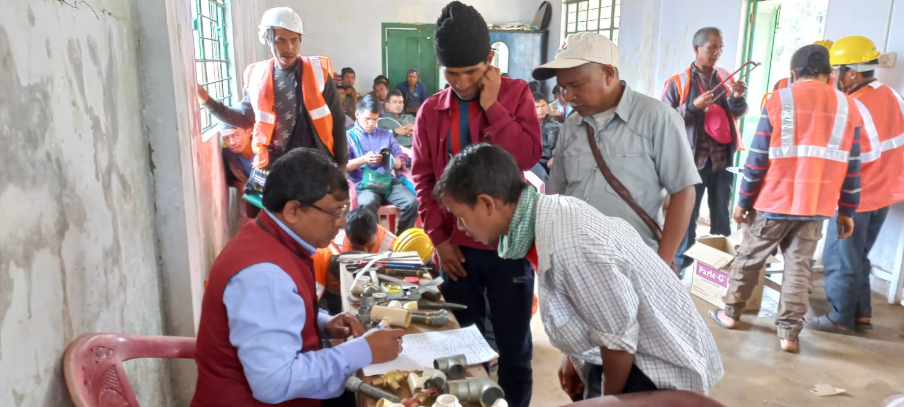
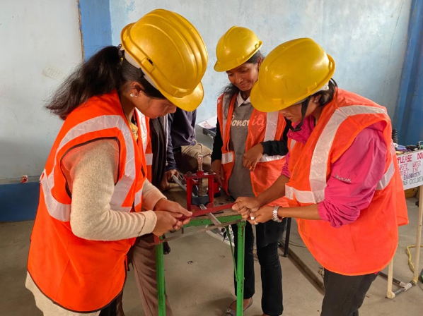
Skills Development
O&M training, financial literacy, and technical capacity building
Capacity Building of VWSC
Outcomes
Skill training and capacity building of VWSC members under the Jal Jeevan Mission enable villages
To independently manage their water supply systems.
With enhanced technical, financial, and managerial skills, VWSCs can plan, operate, and maintain schemes sustainably without external support.
This self-reliance ensures a continuous water supply, transparency, and long-term sustainability while strengthening community ownership and participation.

Slide 12
Capacity Building & Training Activities under Support Activities, JJM East Khasi Hills District
Sl.no | Activity | FY 2019-20 | FY 2020-21 | FY 2021-22 | FY 2022-23 | FY 2023-24 | FY 2024-25
1 | Capacity Building & Training Activities to Key State Holders at Block Level, GP Level and VWSC/ Pani Samities on JJM | - | 9 | - | - | - | -
2 | Skill Training on Plumbing | - | - | 8 | - | - | -
3 | Skill Training on Masonry | - | - | 8 | - | - | -
4 | Multi- Skilling (Plumbing, Electrician & Mason) | - | - | - | 1 | - | -
Total |  |  | 9 | 16 | 1

Slide 13
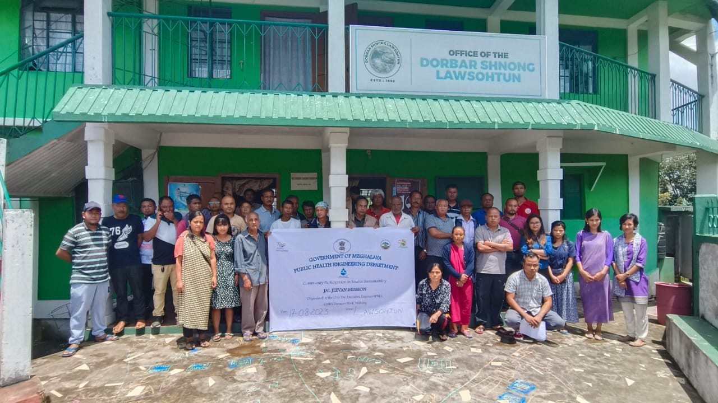




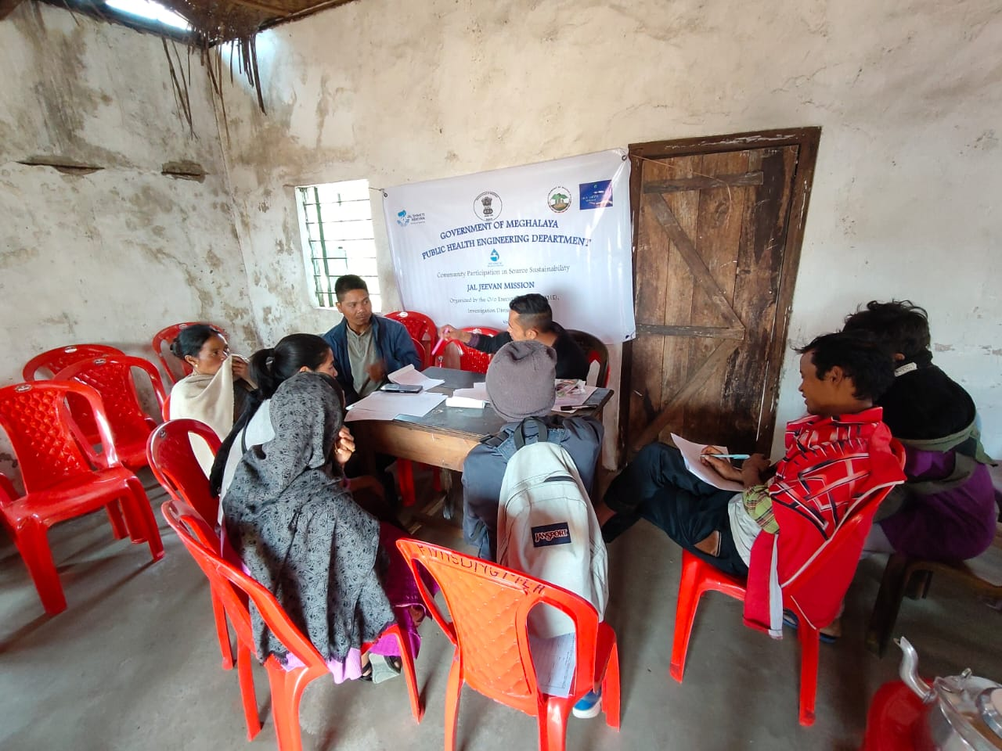


Sustainable Water Management Through User Charges
Community Awareness
Extensive awareness programs sensitize VWSC members about the critical importance of financial self-reliance after scheme completion, ensuring long-term sustainability of water supply systems.
VWSCs independently determine user charges based on local economic conditions and operational costs, with rates ranging from ₹10 to ₹200 per household monthly, ensuring affordability and adequacy.
Flexible Pricing
Collected funds support essential expenses, including pump operator salaries, electricity charges, routine maintenance, minor repair works, and emergency interventions, ensuring an uninterrupted water supply.
Fund Utilization

Slide 14
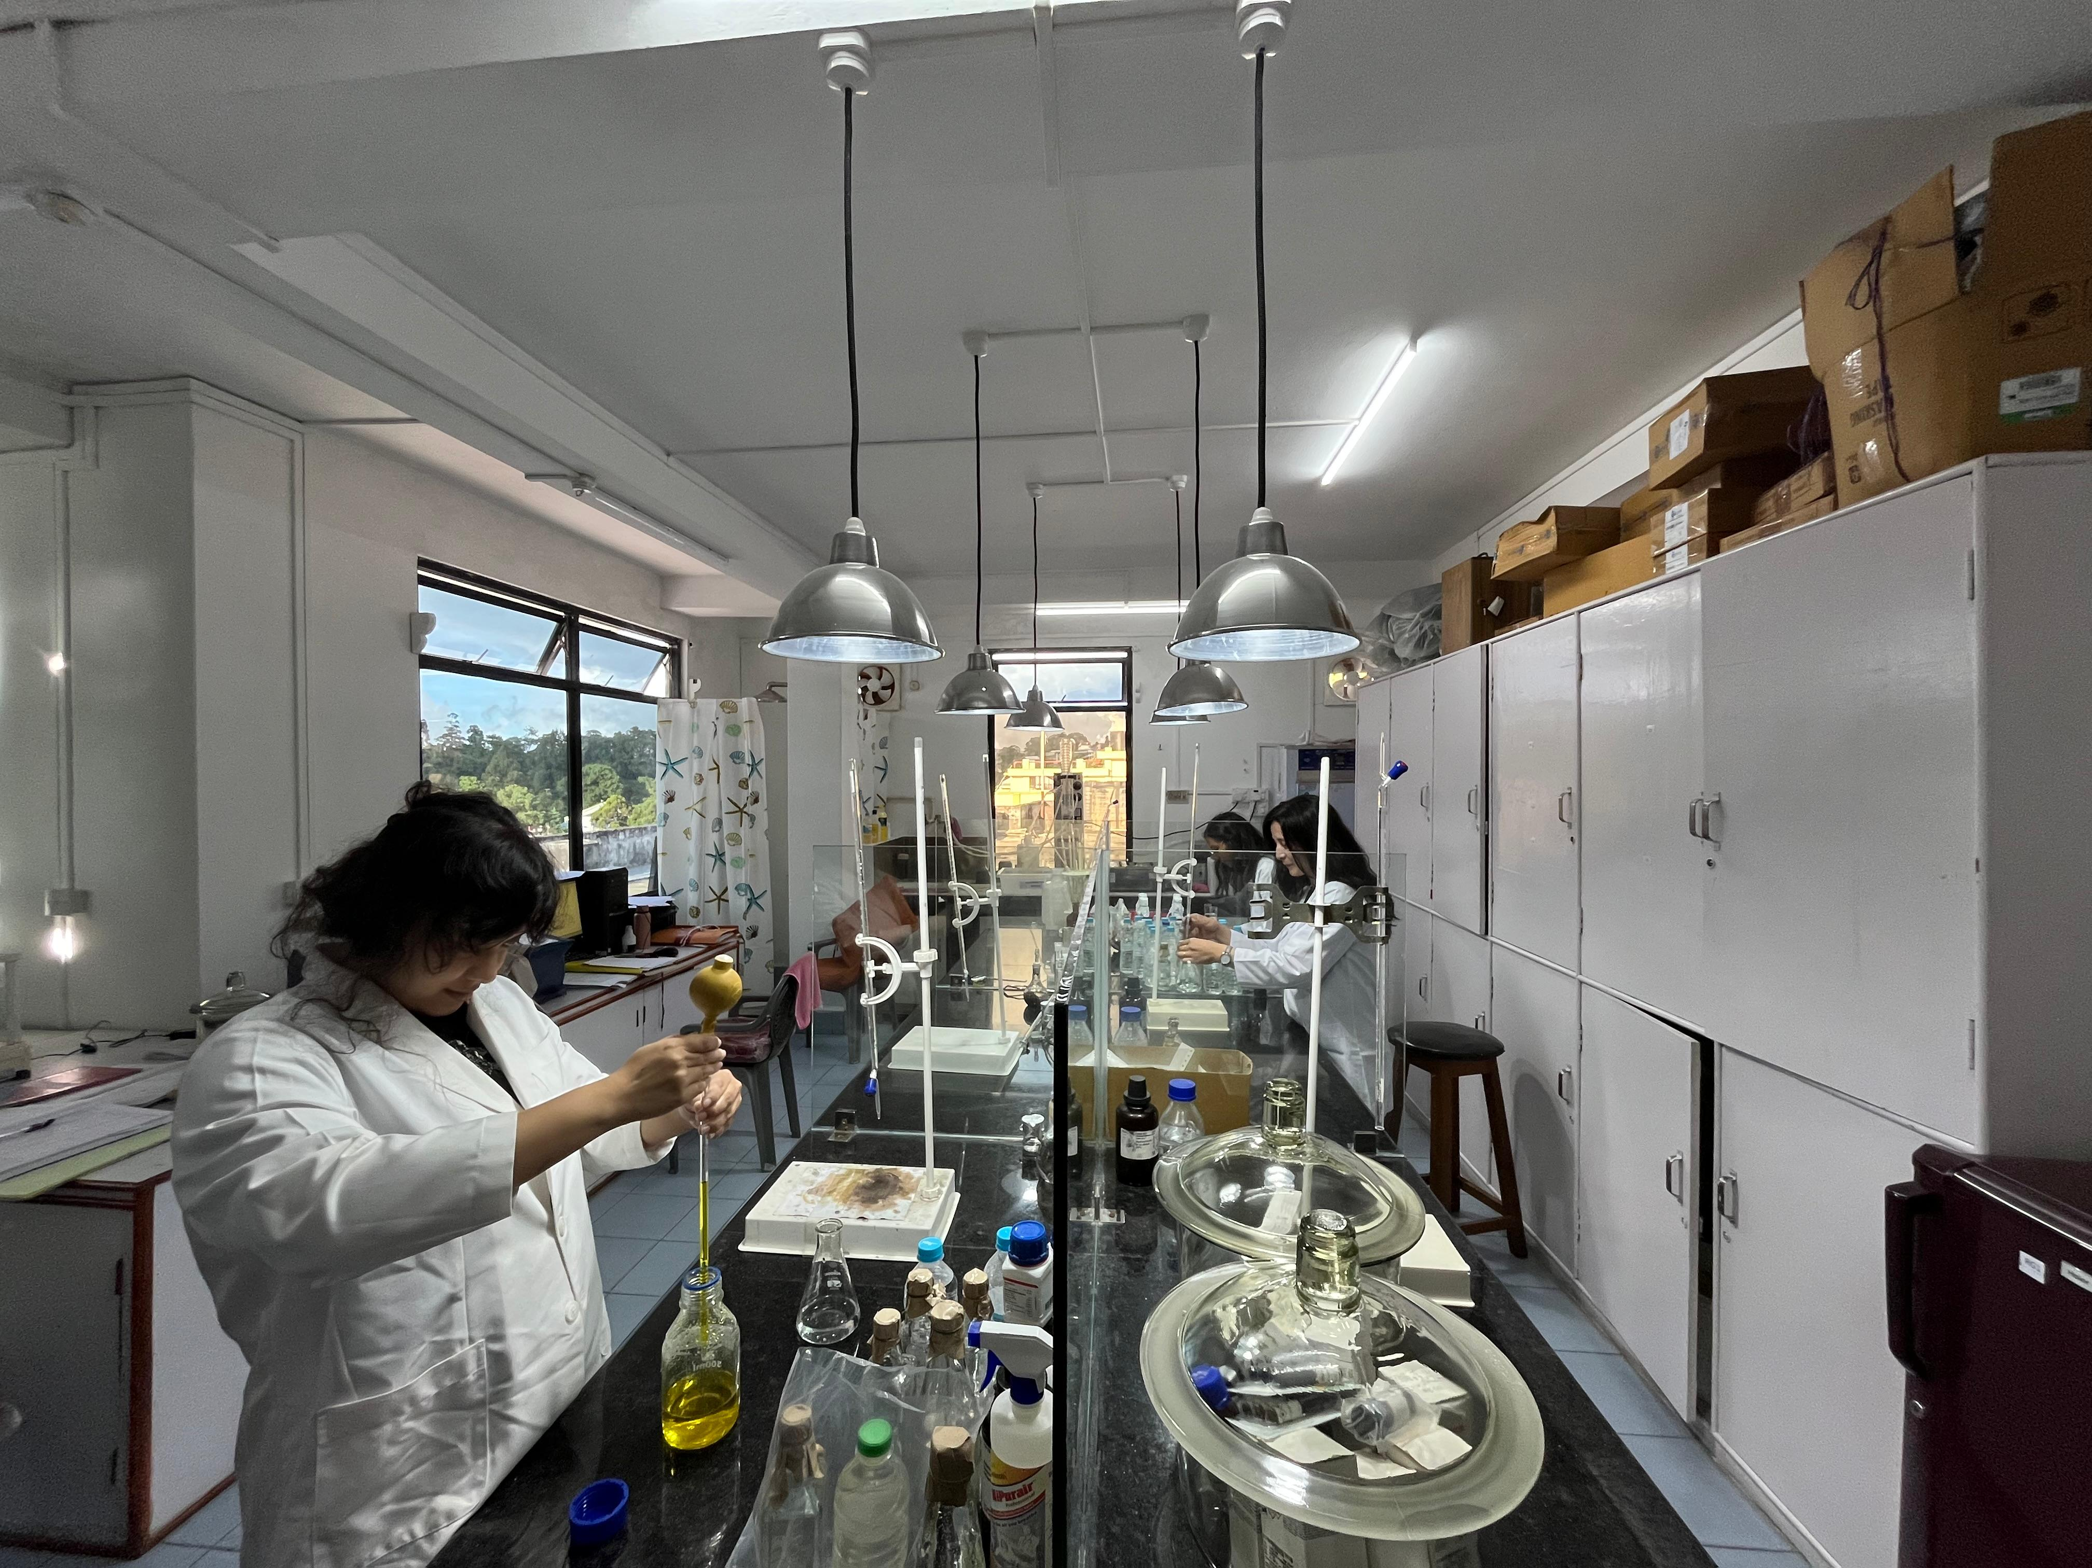
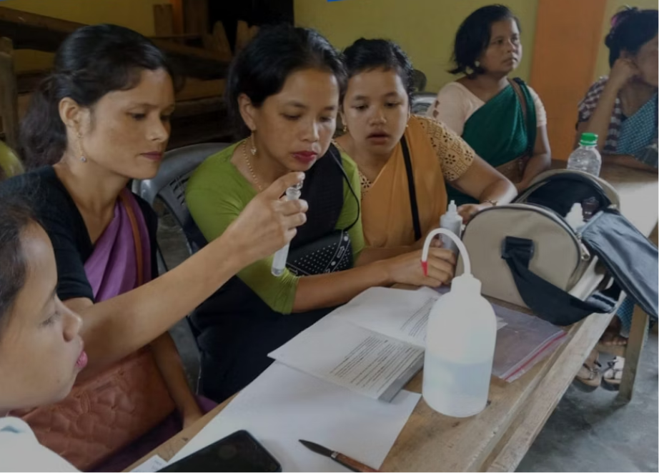
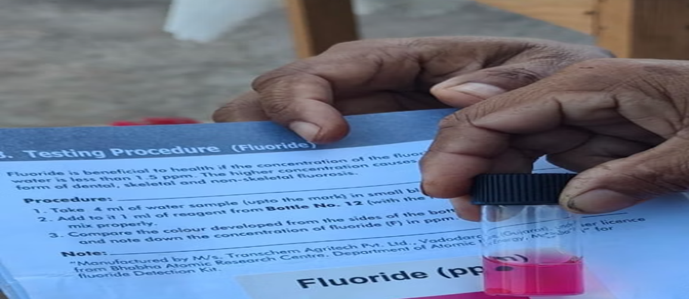
Water Quality Surveillance
Water quality is strictly monitored by the department through systematic testing protocols to ensure safe drinking water for all villages.
Regular Monitoring
Community Empowerment
Five trained women Field Test Kit users empower villages to monitor their own water supply at the local level, building community capacity.
Any deviations in water quality are immediately reported through mobile apps and examined by lab technicians who carry out necessary treatments.
Real-Time Reporting

Slide 15
Water Quality Surveillance – Training of 5 women using FTKs at each GP level
Block | Total no. of villages | Number of FTK users | No. of villages where 5 women have been trained using FTK | No. of women trained using FTKs
12-shnong | 94 | 337 | 94 | 450
Mawkynrew | 68 | 357 | 68 | 352
MAWLAI | 9 | 47 | 9 | 42
Mawpat | 11 | 34 | 11 | 64
Mawphlang | 93 | 299 | 90 | 445
Mawryngkneng | 64 | 127 | 64 | 345
Mawsynram | 148 | 216 | 148 | 743
Mylliem | 63 | 265 | 60 | 298
Pynursla | 132 | 400 | 128 | 543
Shella Bholaganj | 120 | 264 | 117 | 539
SOHIONG | 120 | 289 | 115 | 543
Total | 922 | 2635 | 904 | 4364

Slide 16
Block | Total no. of Villages | No. of samples tested using FTKs/ H2S vials |  |  |  |  | No. of Samples found contaminated | Remedial measures taken | No of Villages wherein testing done for chemical/ bacteriological parameters using FTK/ H2S
 |  |  |  |  |  |  | (2025-2026) | (2025-2026) | In No. | In %age | In No. | In %age | In No. | In %age | In No. | In %age | In No. | In %age
 |  | FY 2021-22 | FY 2022-23 | FY 2023-24 | FY 2024-25 | FY 2025-2026 |  |  | FY 2021-22 |  | FY 2022-23 |  | FY 2023-24 |  | FY 2024-25 |  | FY 2025-26
12-shnong | 94 | 299 | 141 | 294 | 482 | 489 | 0 | 0 | 6 | 6.38 | 14 | 14.89 | 63 | 67.02 | 38 | 40.43 | 32 | 34.04
Mawkynrew | 68 | 56 | 618 | 1212 | 1470 | 700 | 0 | 0 | 29 | 42.65 | 61 | 89.71 | 62 | 91.18 | 62 | 91.18 | 61 | 89.71
MAWLAI | 9 | 0 | 0 | 4 | 0 | 0 | 0 | 0 | 0 | 0.00 | 0 | 0.00 | 1 | 11.11 | 0 | 0.00 | 0 | 0.00
Mawpat | 11 | 0 | 0 | 0 | 0 | 5 | 0 | 0 | 0 | 0.00 | 0 | 0.00 | 0 | 0.00 | 0 | 0.00 | 2 | 18.18
Mawphlang | 93 | 23 | 9 | 96 | 90 | 12 | 0 | 0 | 5 | 5.38 | 7 | 7.53 | 23 | 24.73 | 15 | 16.13 | 3 | 3.23
Mawryngkneng | 64 | 9 | 31 | 67 | 34 | 21 | 0 | 0 | 2 | 3.13 | 6 | 9.38 | 15 | 23.44 | 17 | 26.56 | 4 | 6.25
Mawsynram | 148 | 127 | 145 | 144 | 225 | 0 | 0 | 0 | 24 | 16.22 | 34 | 22.97 | 27 | 18.24 | 37 | 25.00 | 0 | 0.00
Mylliem | 63 | 1 | 47 | 147 | 212 | 77 | 0 | 0 | 1 | 1.59 | 9 | 14.29 | 18 | 28.57 | 21 | 33.33 | 14 | 22.22
Pynursla | 132 | 49 | 50 | 79 | 269 | 114 | 0 | 0 | 10 | 7.58 | 21 | 15.91 | 27 | 20.45 | 57 | 43.18 | 33 | 25.00
Shella Bholaganj | 120 | 87 | 18 | 114 | 304 | 205 | 0 | 0 | 12 | 10.00 | 4 | 3.33 | 19 | 15.83 | 38 | 31.67 | 26 | 21.67
SOHIONG | 120 | 0 | 0 | 12 | 18 | 4 | 0 | 0 | 0 | 0.00 | 0 | 0.00 | 5 | 4.17 | 5 | 4.17 | 1 | 0.83
Total | 922 | 651 | 1059 | 2169 | 3104 | 1627 | 0 | 0 | 89 | 9.65 | 156 | 16.92 | 260 | 28.20 | 290 | 31.45 | 176 | 19.09

Slide 17
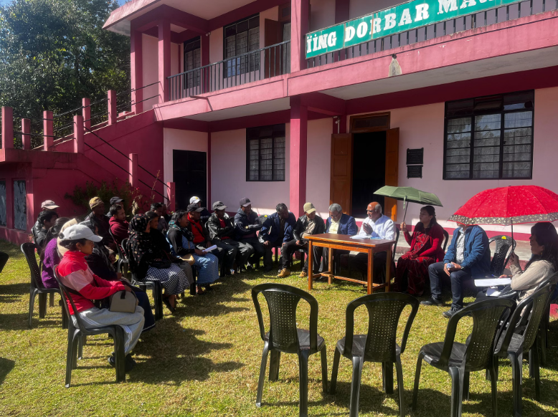
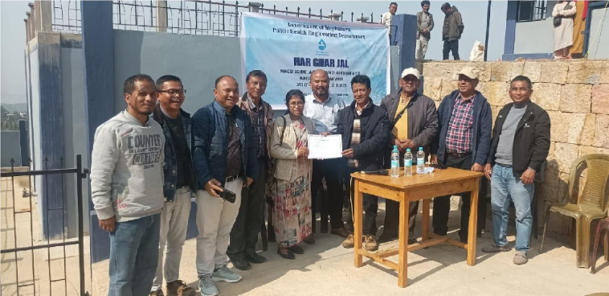
Accelerating Har Ghar Jal Certification
DIGITAL MONITORING & REAL-TIME REPORTING
JJM IMIS portal and Field user app Real-time entry of household connections and functionality data.
District Level Monitoring
DPMU staffs operating at the district level coordinate with the VWSCs and the Field Engineers in streamlining paperwork, expediting documentation processes, and fast-tracking state-level approvals for certification, reducing processing time significantly.

Slide 18
Har Ghar Jal (100 % FHTC Coverage) panchayats
S.No. | Block | Number of Har Ghar Jal Certified as on 1/10/2025
1 | Khadarshnong-Laitkroh | 37
2 | Mawkynrew | 62
3 | MAWLAI | 7
4 | Mawpat | 2
5 | Mawphlang | 17
6 | Mawryngkneng | 15
7 | Mawsynram | 18
8 | Mylliem | 22
9 | Pynursla | 18
10 | Shella Bholaganj | 41
11 | SOHIONG | 16
TOTAL |  | 255

Slide 19
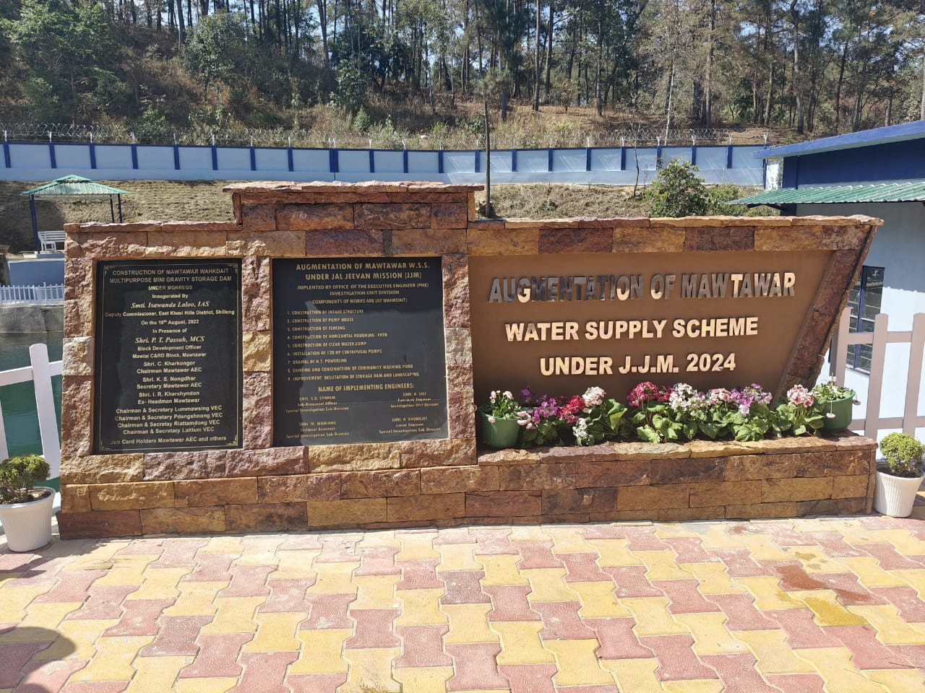
Best Practice
CONVERGENCE: JJM and MGNREGA

Slide 20
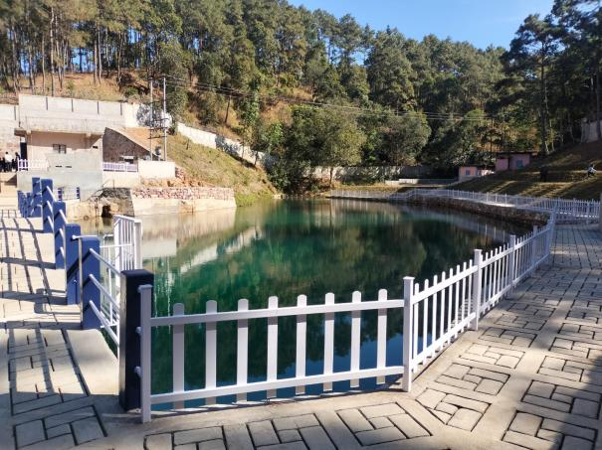
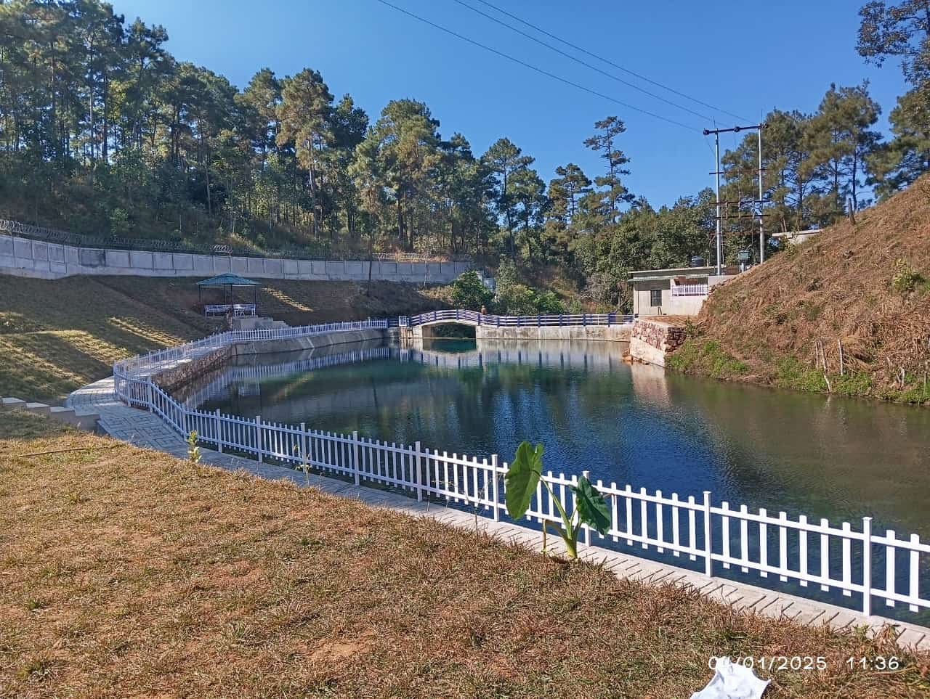
Multipurpose mini gravity check-dam
Mawtawar

Slide 21
Brief about Mawtawar
demography
Mawtawar covers an area of about 5012 Sqm.
It is situated in Mawlai C&RD Block which bifurcated from the erstwhile Mylliem C&RD Block of East Khasi Hills District
It has 2,541 households with a population of 10,180 people
With the fast-growing population, new emerging households, the village faced challenges which are encountered by any growing population

Slide 22
What is the greatest of these challenges?
Water- became one of the greatest challenge to cater to the growing need of the households and the community

Slide 23
The community’s
Strategy
01. Existing options
02. Exploring alternative options
The village has an existing water supply Scheme under PHE Department which has been serving the community.
MGNREGA- giving an annual definite budget, and with Water Conservation & Water Harvesting being a focus area, the village decided to take up the projects through MGNREGA
Four Village Employment Councils (VECs) under the Mawtawar Area Employment Council (AEC) took up the task

Slide 24
STRATEGY
Planning

Slide 25
01.
Mawtawar AEC took the lead and met with three VECs
Collective responsibility of four VECs- Mawtawar Pdengshnong VEC, Lummawsing VEC, Riattamdong VEC and Laitlum VEC
MEETING
02.
The source of funds was identified through MGNREGA. With four VECs working together, maximum persondays can be drawn for the overall benefit of the community and the villagers
FUNDING
03.
Technical convergence through plan and estimates prepared in collaboration with line departments viz. Water Resources Department, Public Health Engineering Department and Soil and Water Conservation Department.
CONVERGENCE

Slide 26
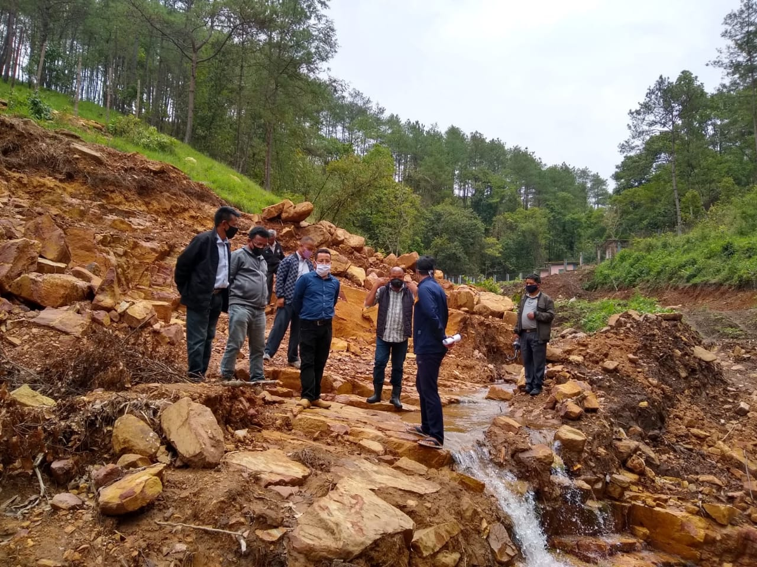
IMPLEMENTATION
Collective efforts and responsibility

Slide 27
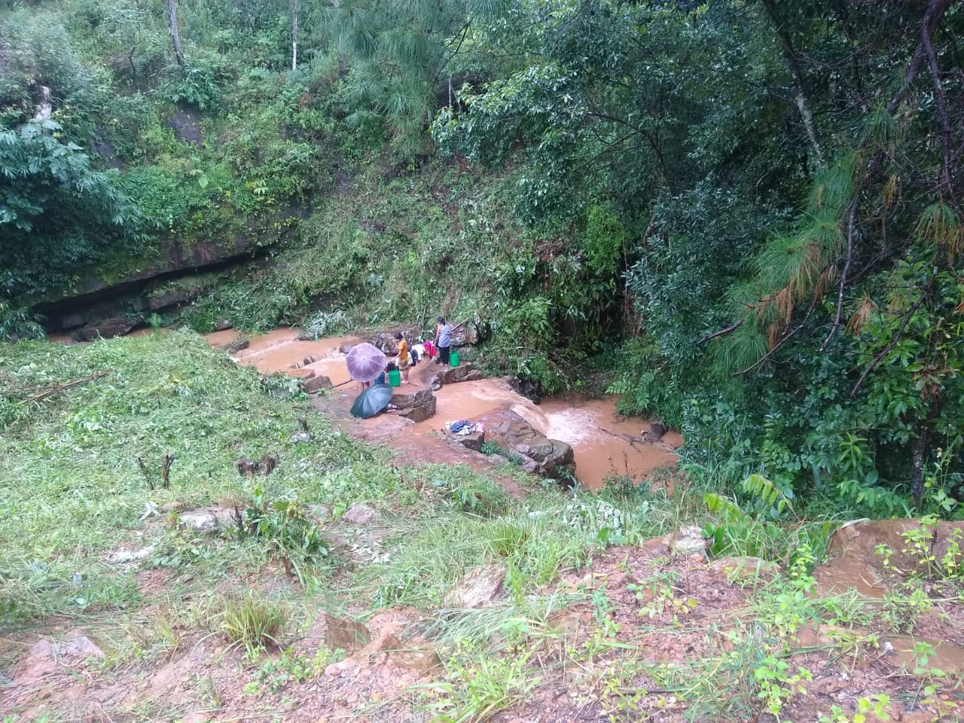
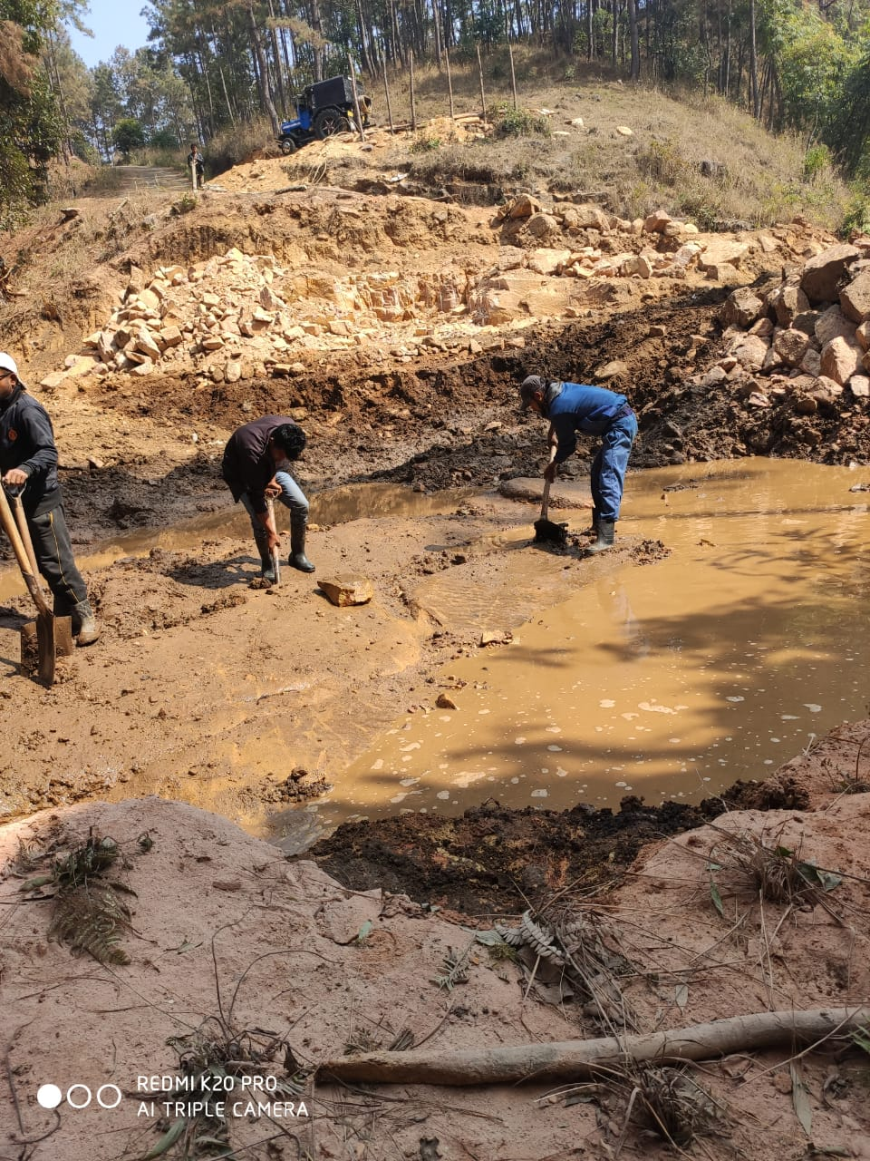
IMPLEMENTATION
Solution
MGNREGA/ Line Departments
The collective efforts of the four VECs under the AEC along with the constant monitoring and support of all officials made the project a success
The project was initiated on 2nd December 2019
Hiccups that delayed the implementation is due to COVID 19
Completed on 22nd October 2020

Slide 28
Sanctioned
A total cost of ₹ 90,57,800/- was sanctioned fully under MGNREGA
Material Expenditure - ₹ 45,32,400
Wage Expenditure - ₹ 45,12,400
Persondays Generated – 24,200
Augmentation of Mawtawar WSS - ₹ 21,64,98,282.00 (was sanctioned fully by PHE)
Output
The storage capacity is about 3,925 cubic metre or approx 40 lakh litres.
The dam is comprised of 6 Blocks (A, B, C, D, E and F). The spillway is through Block B. The spillway is designed as Ski jump bucket structure to dissipate the velocity from 11.17 m/sec to 2.58 m/sec.
Value addition
Through convergence with JJM under MoJS, a pump house was set-up near the Storage Dam and the project was properly fenced and beautified.
Output

Slide 29
Outcome
Addressed the water insufficiency of the area
Through JJM, approximately 5,50,000 liters of water is being pumped daily to supply water to households.
Through this convergence, it can now provide potable drinking water to 2,500 village households.
Added benefits and way forward
The check-dam became a Source for PHE to implement JJM
It acts as an Eco-walks under Tourism
Further convergence with Forest Department/ MBDA for works on plantation and trenches to recharge the source and retain the water in the aquifers.

Slide 30
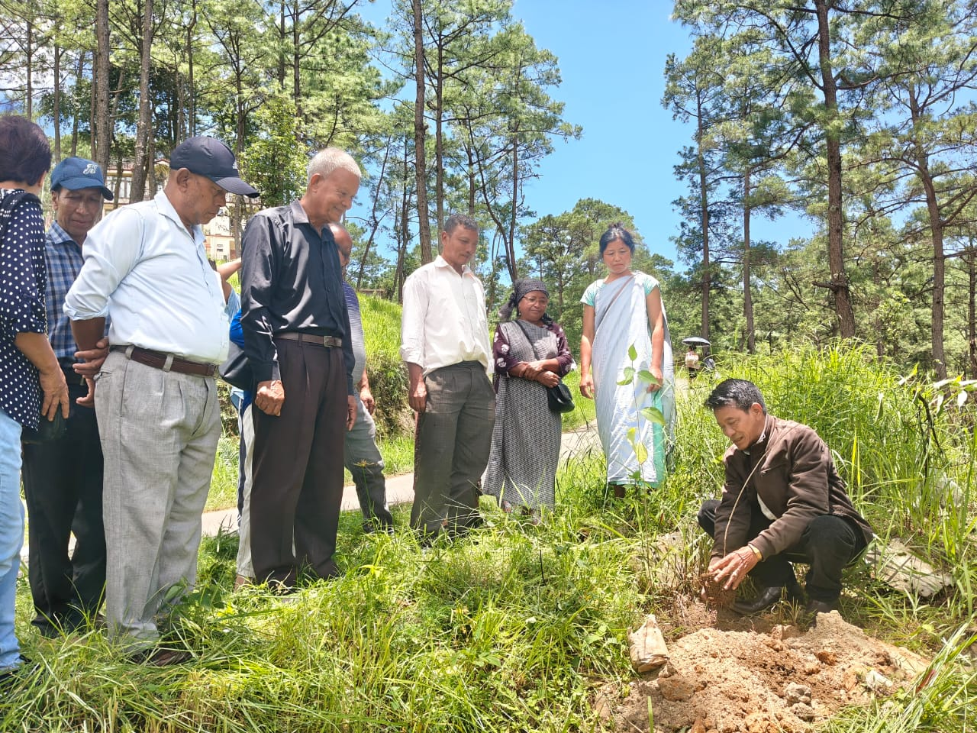
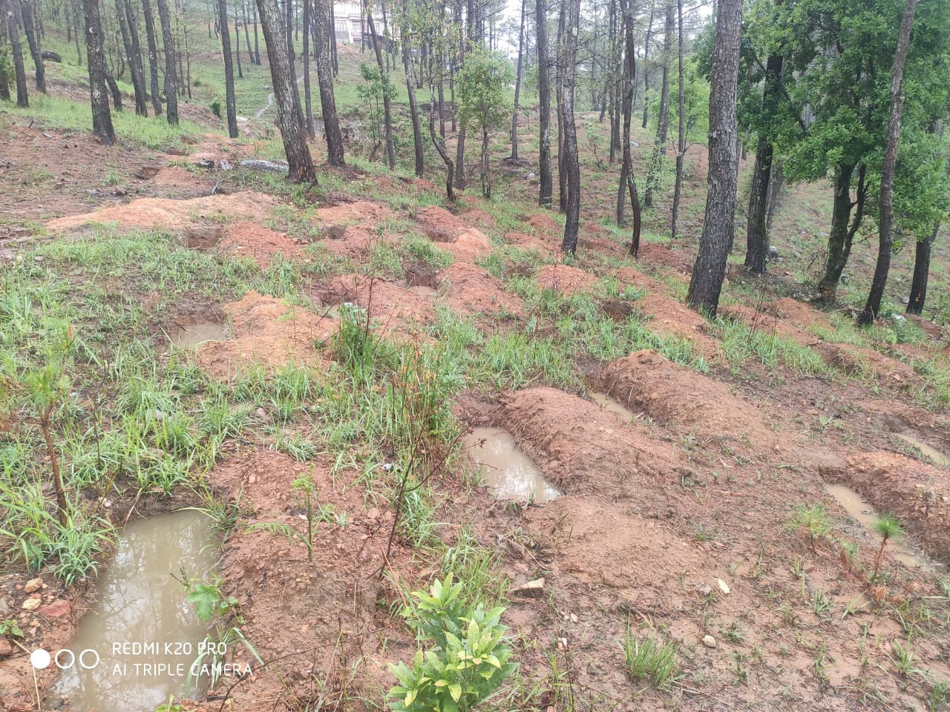
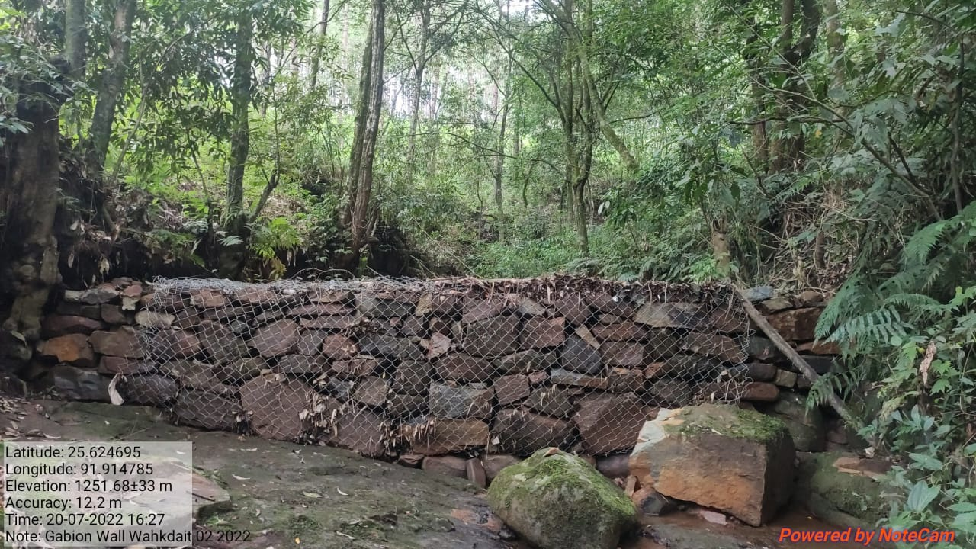
Source
Sustainability
Initiatives
To ensure the sustainability of the project, the VEC undertook several supplementary activities in and around the catchment area of this water source.
Action
Plantation of 8,000 saplings in the nearby areas
Excavation of 1,000 trenches in the catchment area
Construction of 8 gabion walls for maintenance and safeguarding of the water source.

Slide 31
SUCCES STORIES
TYNRIANG VILLAGE
(VIDEO)

Slide 32
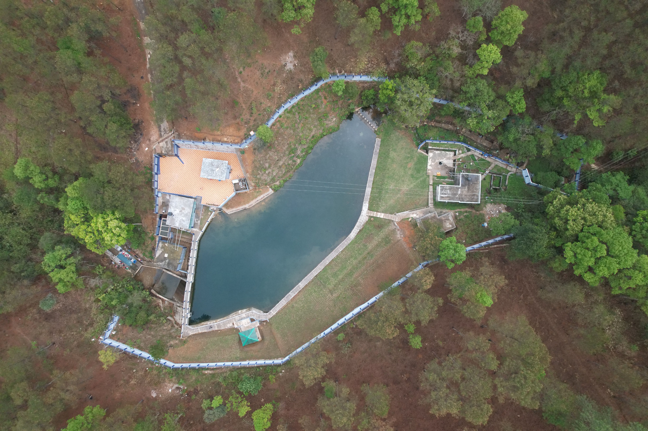
Thank You

