Slide 1

Implementation of JJM Schemes in Rural Areas of Ganjam District
(Peyjal Samvad)
District Administration, Ganjam
Presented by: Mr. Keerthi Vasan V, I.A.S. Collector‑cum‑District Magistrate, Ganjam

Slide 2
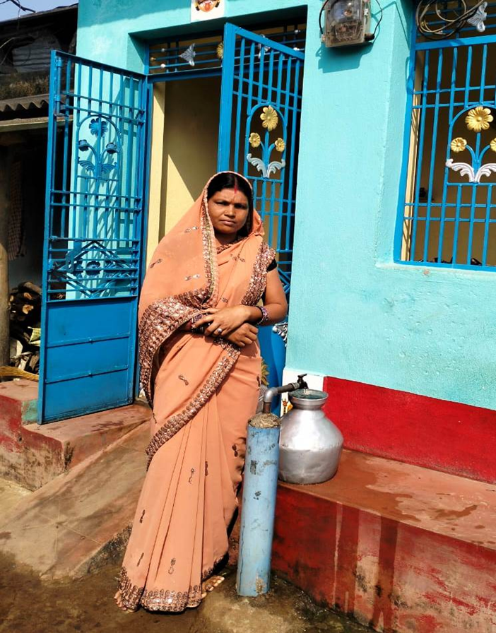
🛠️ Implementation
Overview of Projects in the District

Slide 3
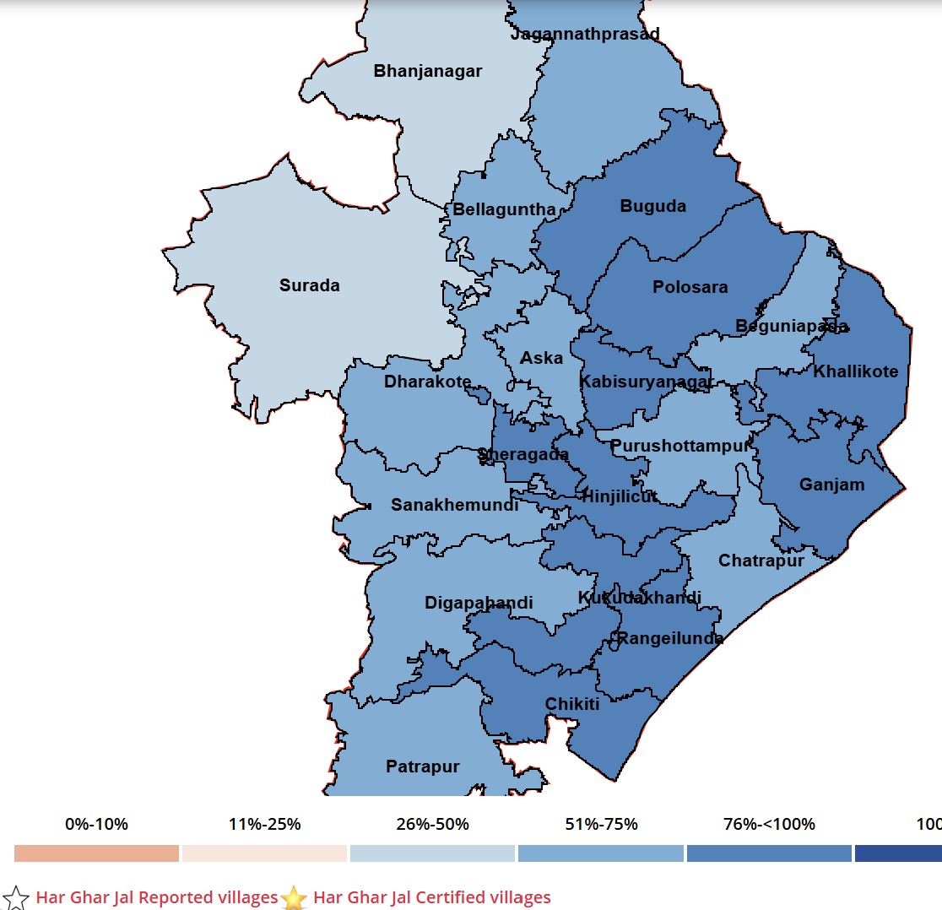
Har Ghar Jal Status- Ganjam District
No of House holds: 7,20,435
House holds covered as on date: 5,24,824
Percentage of Coverage: 72.77%
Total villages: 2741
No. of villages certified as HGJ: 838
No of GPs certified as HGJ: 58

Slide 4
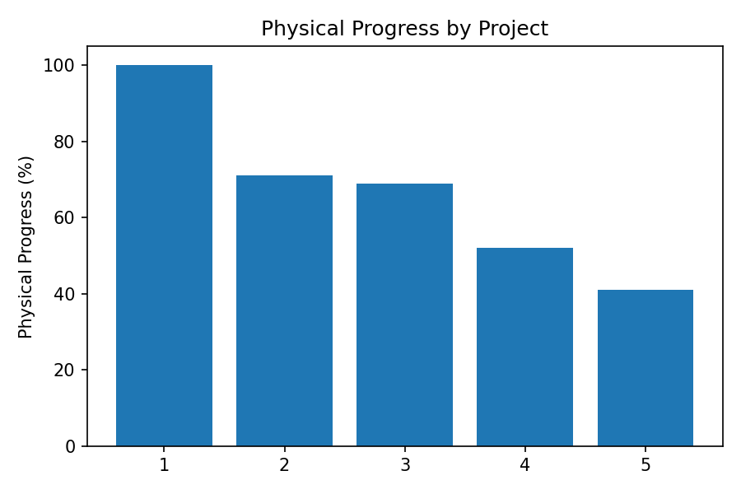
Mega PWS Projects under Ganjam District
Key Metrics & Progress
Projects: 6
Villages: 1,618
Population: ≈2M
FHTC Connections: ≈251K
OHT: ≈219

Slide 5
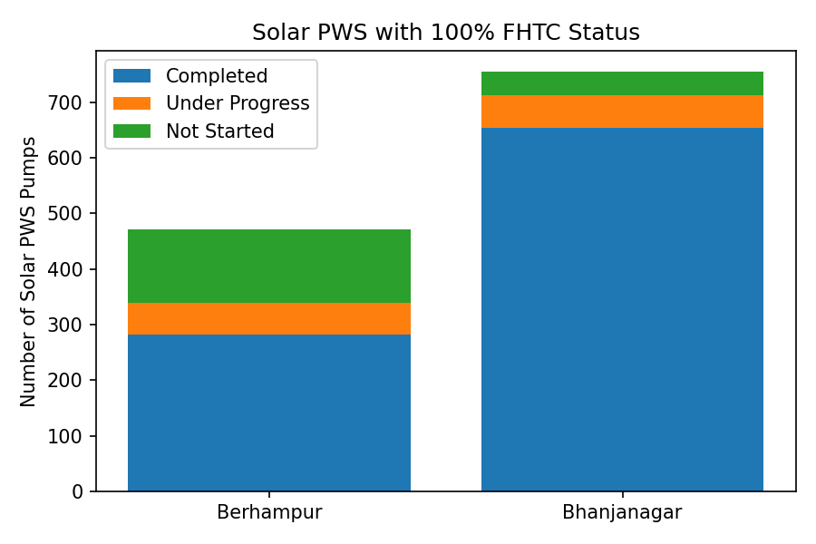
Village & Solar PWS Schemes Overview
Multi / Single Village PWS Schemes
Berhampur: 466 completed, 5 in progress
Bhanjanagar: 464 completed, 0 in progress
Total: 930 completed, 5 in progress
Solar PWS with 100% FHTC
Berhampur: 282 completed, 58 in progress, 131 not started
Bhanjanagar: 654 completed, 58 in progress, 43 not started
Total: 936 completed, 116 in progress, 174 not started

Slide 6
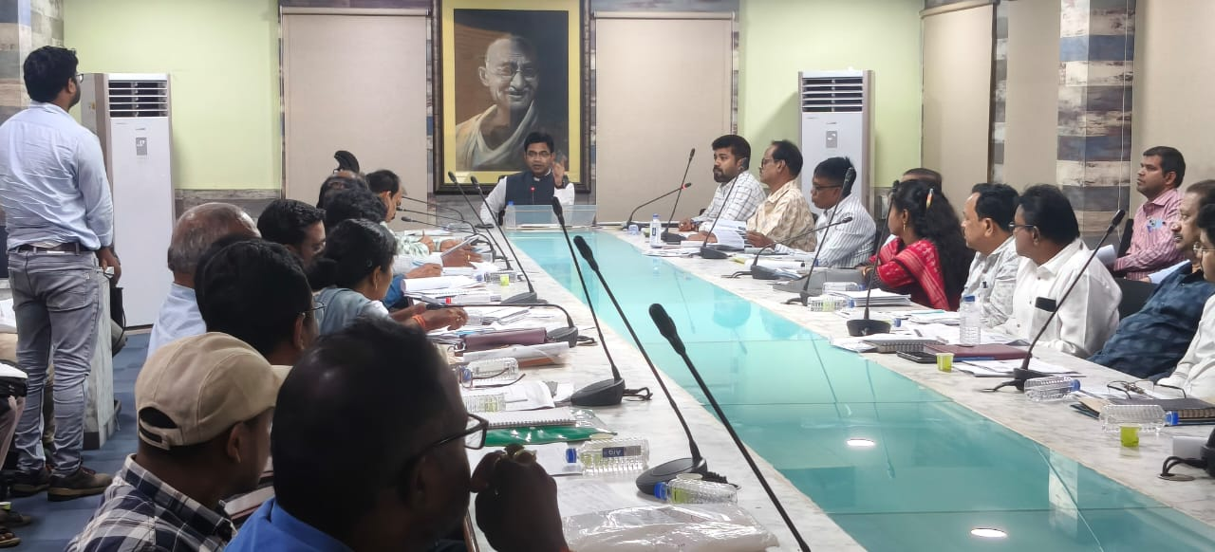
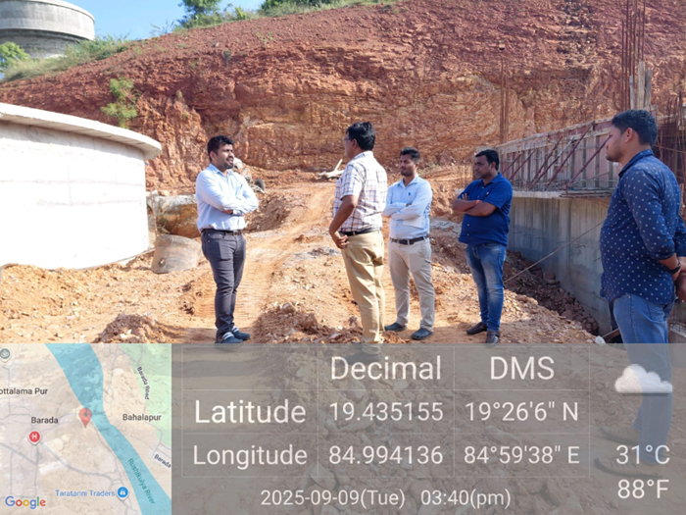
🔍 Monitoring
🔍 Monitoring
Regular Supervision by SDOs , JE/AEs and Third Party inspection Agencies (M/s WAPCOS & M/s Arki techno)
Regular site visit by SE / EEs.
Fort- night review meeting by SE / EEs with agencies
Monthly review meeting by Collector with all RWS&S officials and agencies.

Slide 7
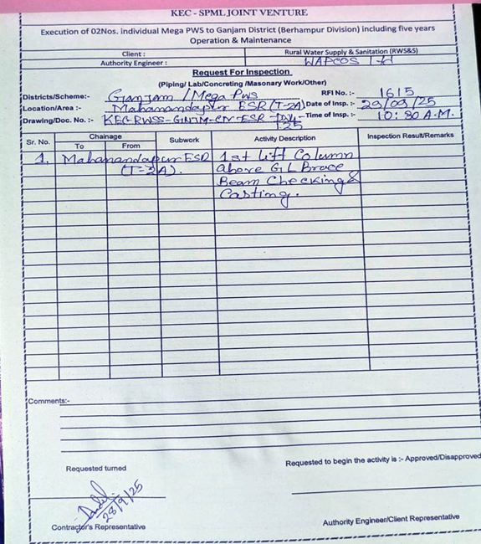
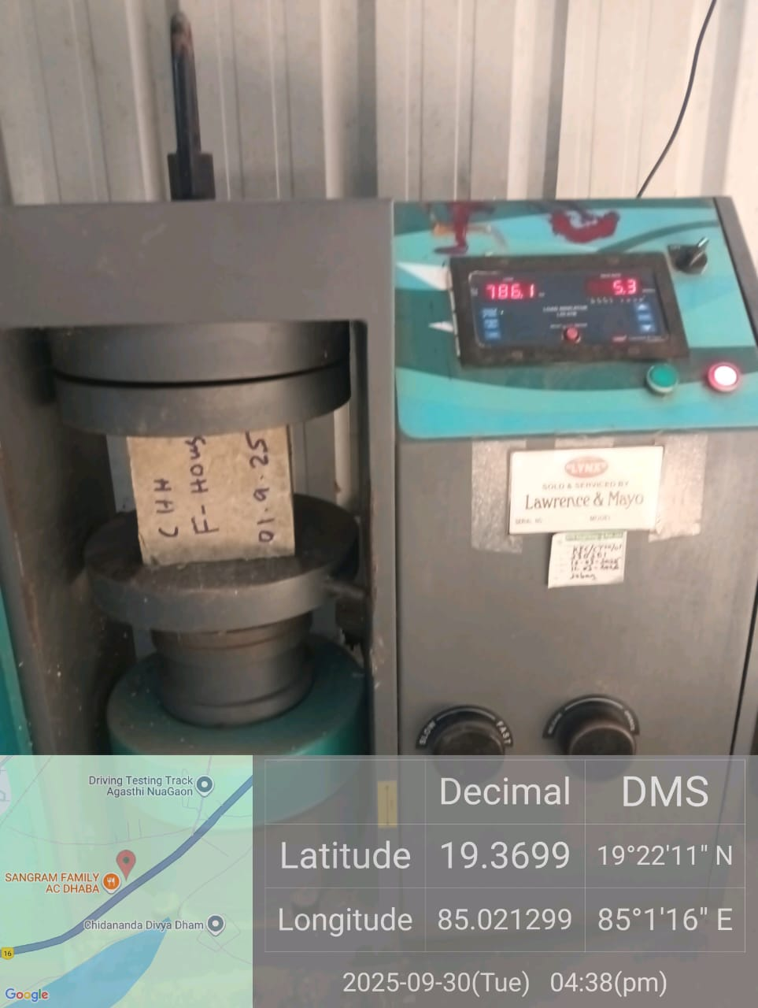
✅ Quality Assurance
Regular Quality Checking through inspection prior to / during execution of works on daily basis
Dedicated Quality Control Labs at sites of Mega PWS Projects.
Testing of Cement , Reinforcements ,aggregate concrete, etc in Govt. approved Quality Control labs.
Request for Inspection
UTM Machine at site

Slide 8
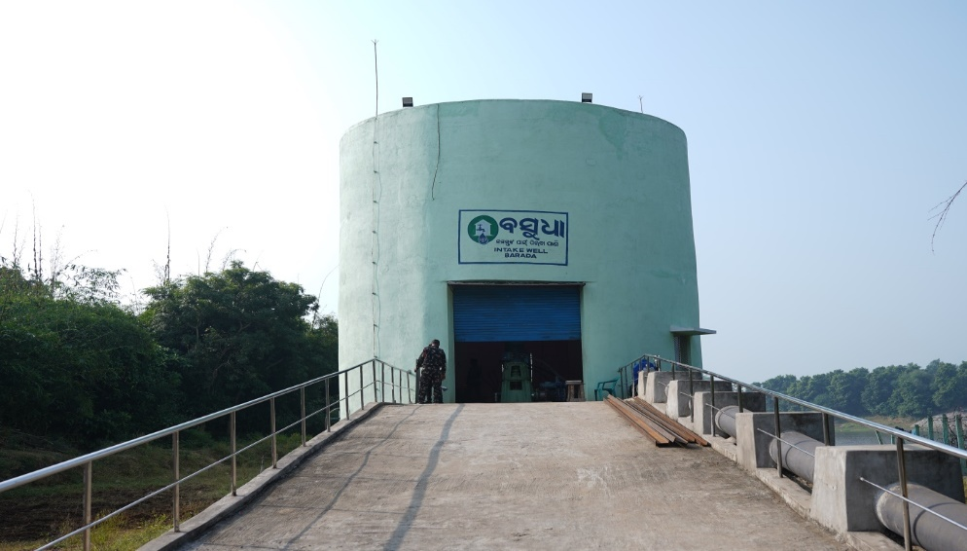
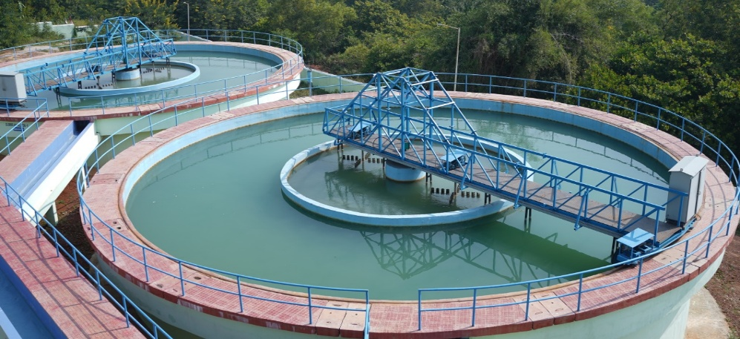
Case Study: Mega PWS to 55 Villages (Ganjam Block)
Key Project Details
Villages: 55 (7 GPs)
Population: 81,024
Source: Rushikulya River
Cost: ₹146.97 Cr
Completion: 20 Jun 2024
Water Treatment Plant Capacity: 15 MLD
Pipeline: 3.27 km (450mm)
OHTs: 12
FHTC: 14,871
Intake Well at Barad, Ganjam
Water Treatment Plant at Mallad

Slide 9
Best practices adopted in the project
During Execution:
Efficient land & site acquisition through inter-dept coordination
2 Acres of land(Gramin Jungle) handed over by forest dept within 3 months of application
Rapid ROW clearance & dispute resolution
ROW permission for NHAI Road and railway crossings cleared within 3 months
All disputes cleared in time with complete coordination of district administration
During Operations and Maintenance
Automation
Monitoring of potable water supply through automation
Regular monitoring and service in fixed timeframe
Leak detection & repair within 24 hours with documentation
Routine disinfection & cleaning of mains and WTP
Disconnection of unauthorized connections
Regular water quality & residual chlorine testing

Slide 10
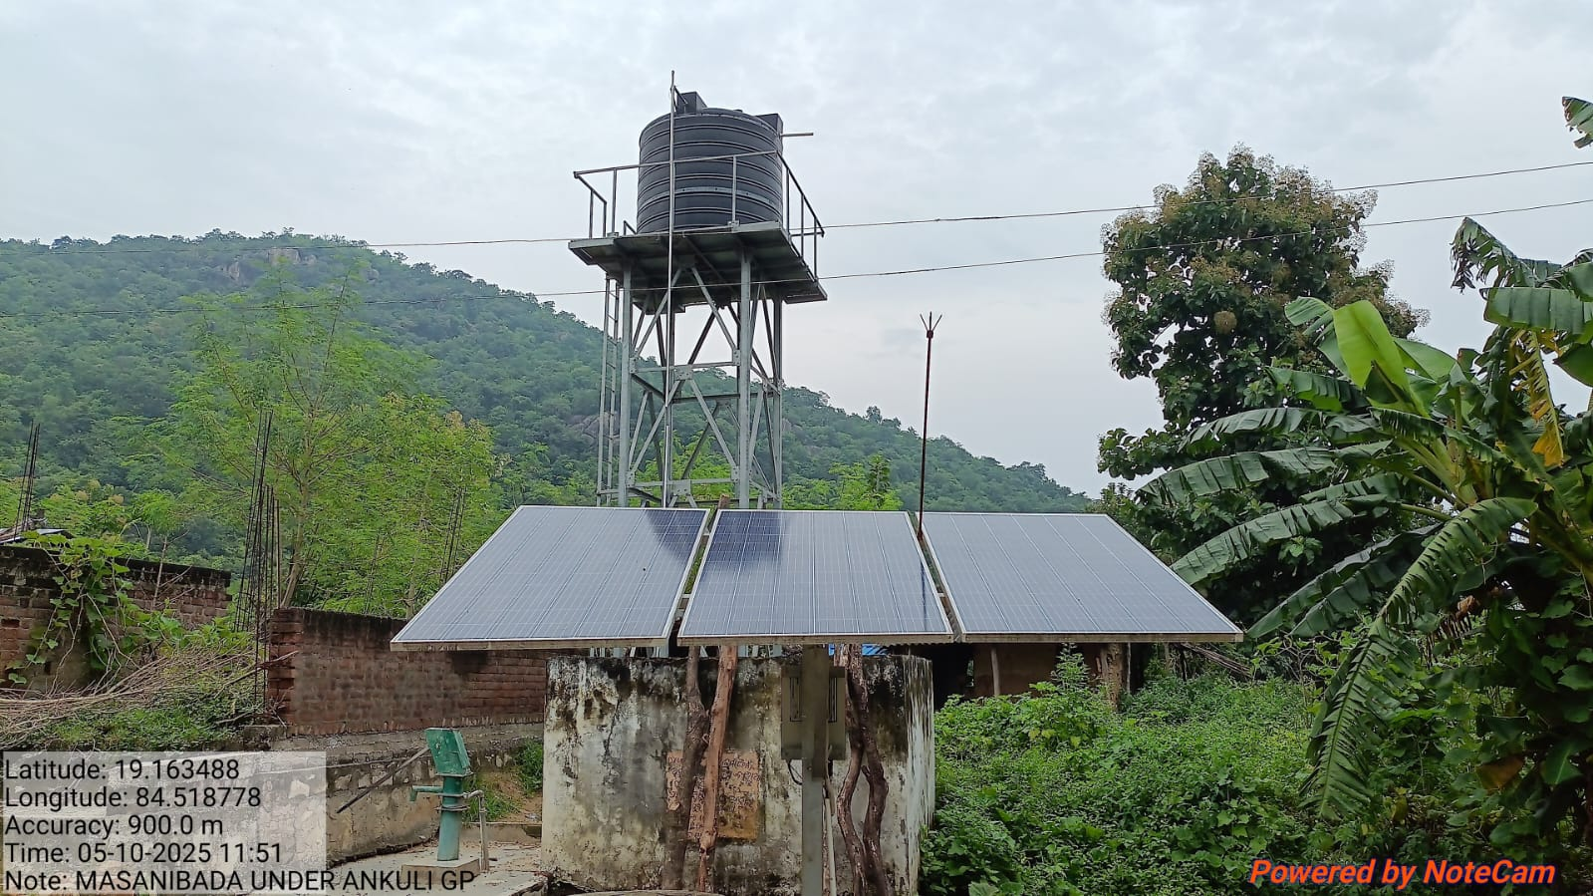
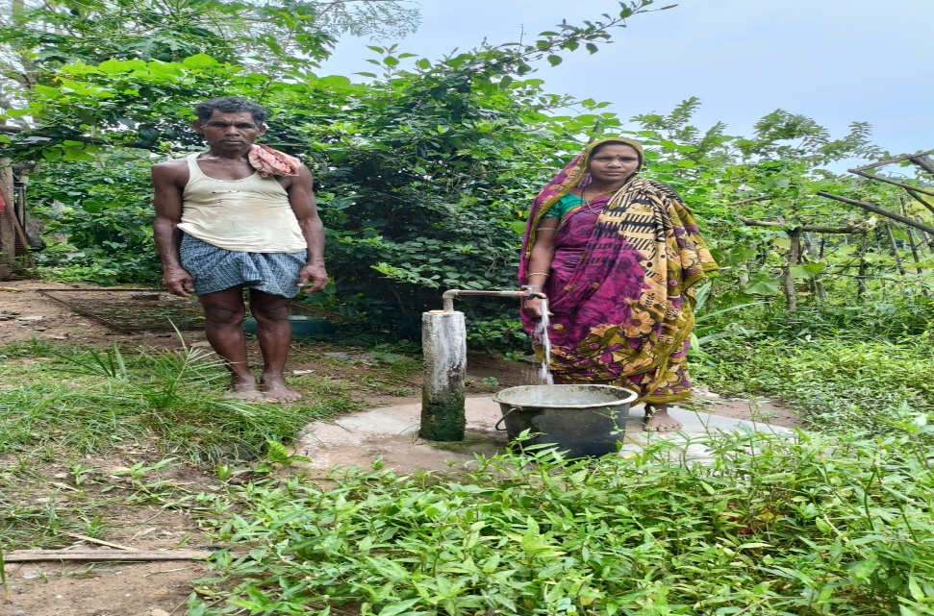
Case Study: Solar PWS (Masanibada, Ankuli GP)
Case Study: Solar PWS (Masanibada, Ankuli GP)
Key Project Details Block: Patrapur
GP: Ankuli (PVTG Area)
Households: 21
Population: 99
Solar PWS: 1
OHT Capacity: 5 kL
Best Practices & Impact
Solar-powered OHT ensures sustainable water supply in remote PVTG area
Compact system serves 21 households (population 99)
Quick leak detection and repair within 24 hours; documented for transparency
Supports community by providing reliable drinking water with minimal infrastructure
Low-cost, low-maintenance design scalable to other small villages

Slide 11
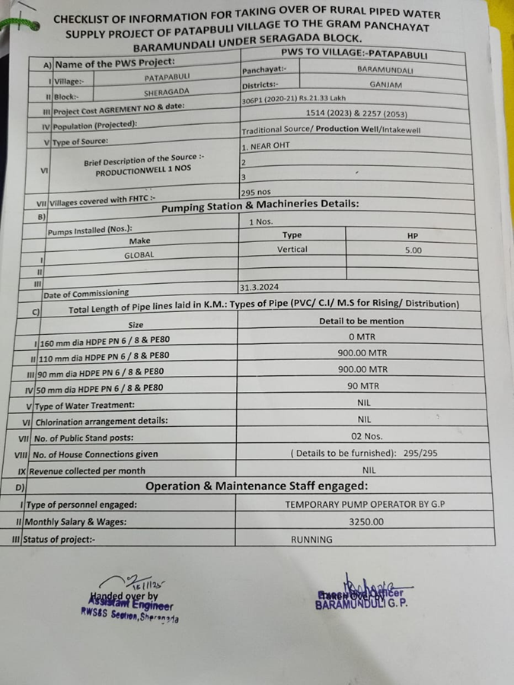
🔧 Handover & O&M
5‑year O&M including 1‑year defect liability
Assets handed to VWSC- Village Water and Sanitation Committee/GP
Minor repairs by VWSC; major repairs by RWS&S
Handing Over Copy

Slide 12
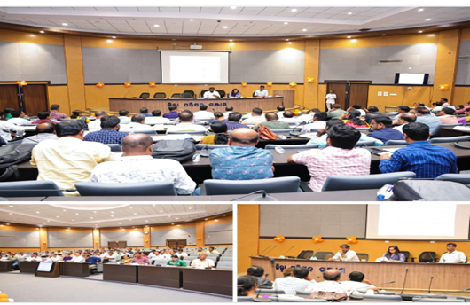
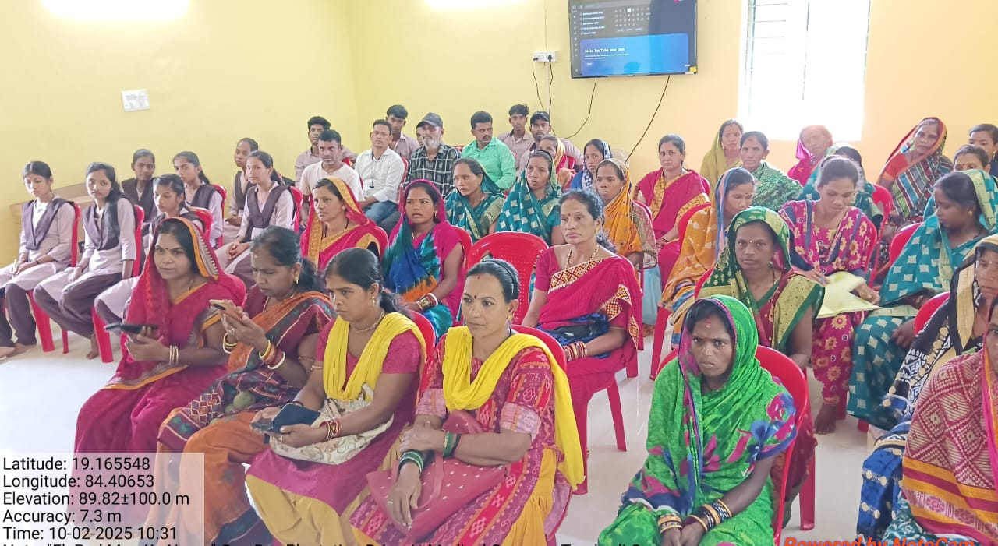
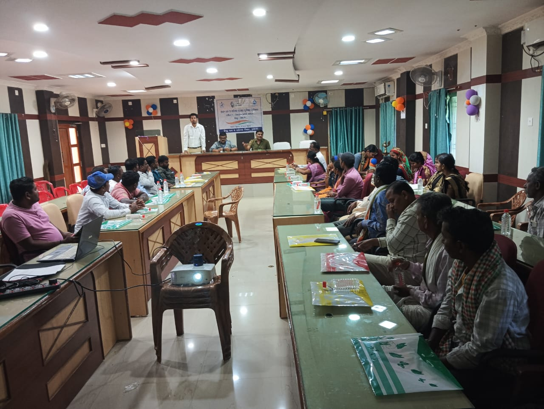
👥 Capacity Building at the local level
Formation of Village Water & Sanitation Committee (VWSC)- increased involvement of women SHGs
Training programs at district/block/GP levels
Empowerment for sustainable management
District Level Training of VWSCs
GP level Training of VWSC at Turubudi, Patrapur
Block Level VWSC Training at Ganjam

Slide 13
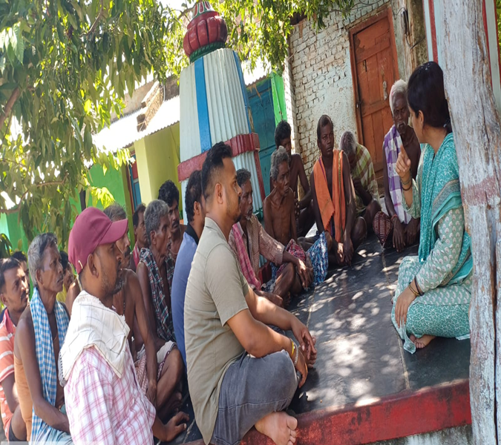
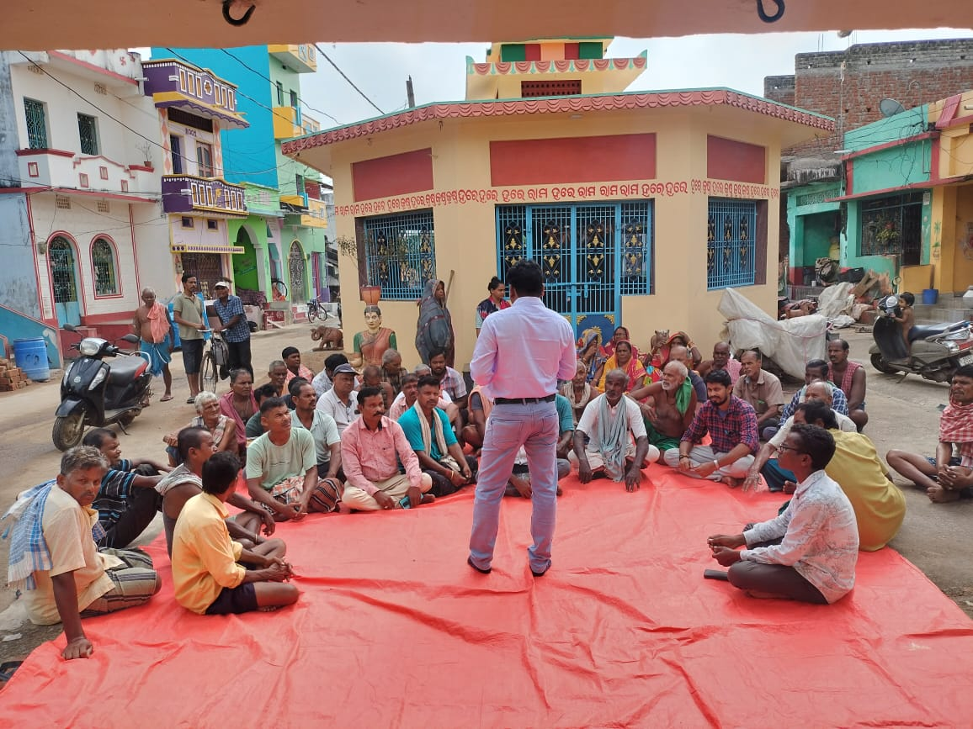
IEC Plans & Effectiveness
📢 Community awareness on water tax collection
💧 Education to minimize wastage of water
🤝 Engagement of stakeholders through campaigns
🌱 Promotion of Jan‑bhagidari for sustainable use

Slide 14
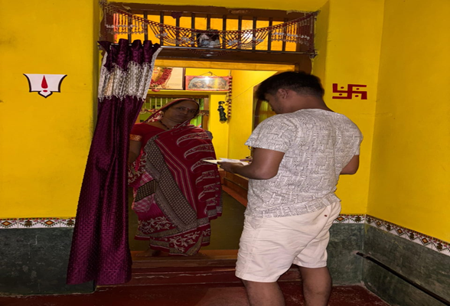
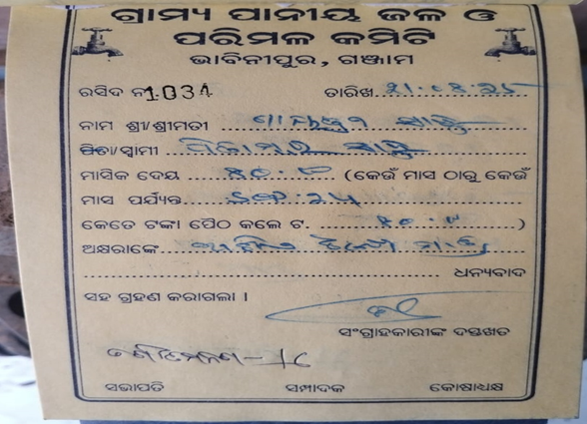
Best Practices in Water Tax Collection by VWSCs
Case Study 1
Case Study 2
Block: Hinjilicut
Block: Rangeilunda
GP: Putiapadar
GP: Bhabinipur
Village: Balakrushnapur
Village: Bhabinipur
Households: 620
Households: 920
Tax/HH: Rs.60/-
Tax/HH: Rs.80/-
Est. Collection: Rs.37,200
Est. Collection: Rs.73,600
Avg. Collection: Rs.33,000
Avg. Collection: Rs.50,000
Collection Rate: 88.7%
Collection Rate: 67.9%
Utilisation: Energy dues, sanitation & salaries
Utilisation: Energy dues & salaries
Door‑to‑door collection, proper receipts and complete transparency in utilization and regular follow ups ensure community trust and high compliance.

Slide 15
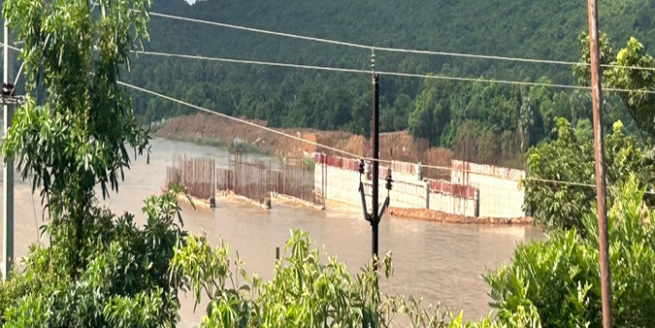
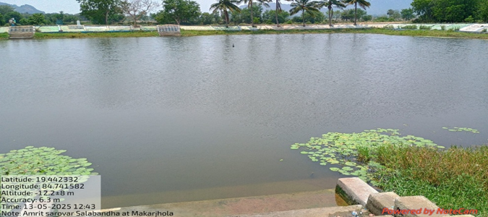
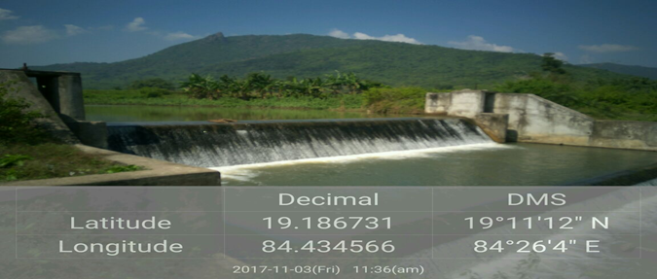
Source Sustainability of PWS Schemes
🏗️ Construction
💧 Recharge
🌊 Check
Construction of ISS/Barrages
near intake wells
Recharge ponds & Serovars
under Amrit Sarovar
Check dams and weirs
for groundwater recharge
Under construction Dam near Kansari Ganda
Amrit Sarovar in Makarjhola
Batradanala Check Dam, Digapahandi

Slide 16
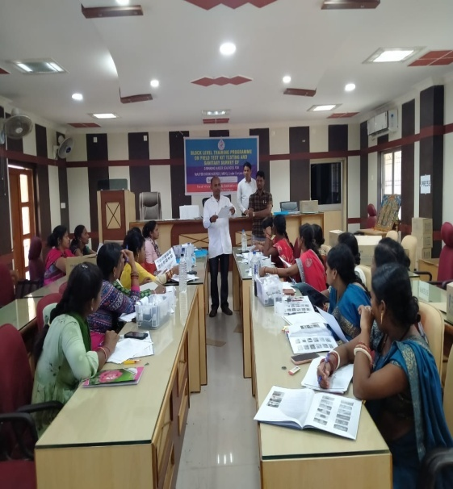
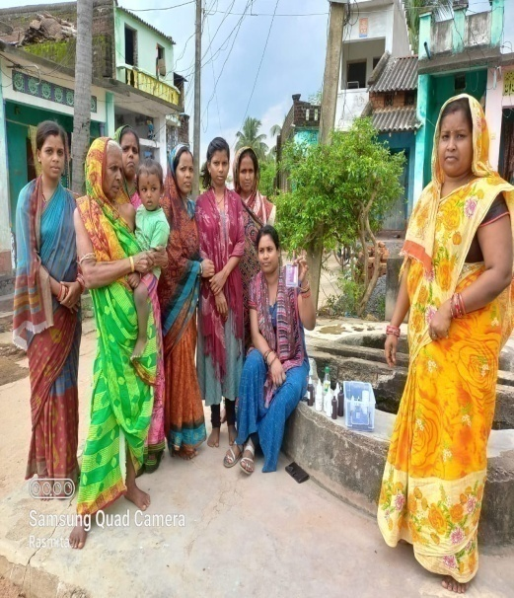
SHG Engagements for Water Quality
👥 Identify SHG/MBK groups for
water sample collection
🎓 Train MBK/SHGs at block level
with lab assistants
Block Level training of MBK/SHGs
🧪 FTK testing and upload results to
WQMIS
FTK testing by MBK/SHGs

Slide 17
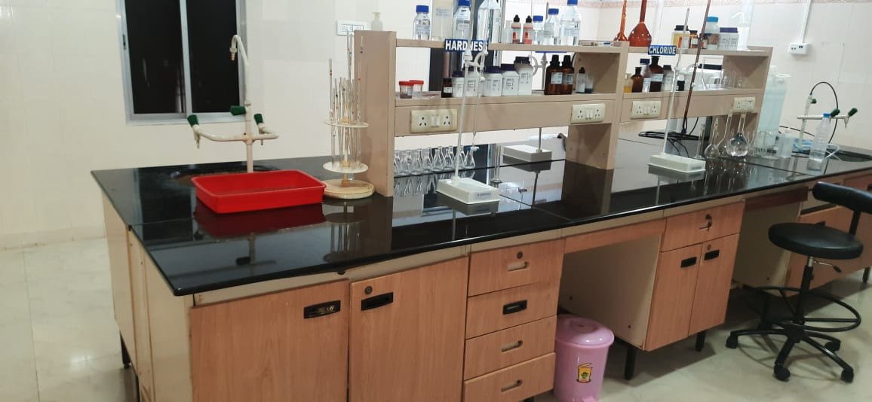
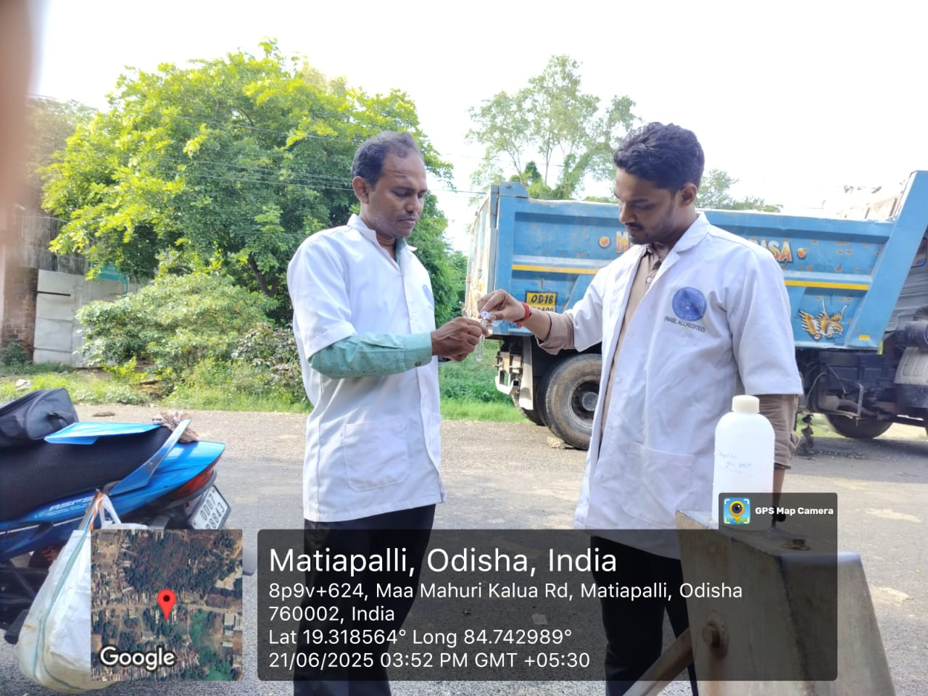
Water Quality Surveillance
🏭 Testing in two divisional labs
(1 NABL accredited)
🔬 Testing in three sub‑divisional
laboratories
🧪 FTK testing by MBK/SHGs
✅ Cross‑checking 2.5% of samples in
state lab

Slide 18
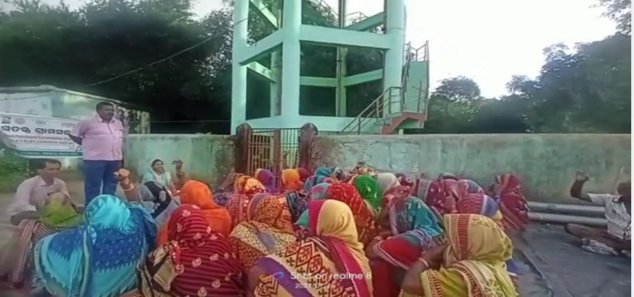
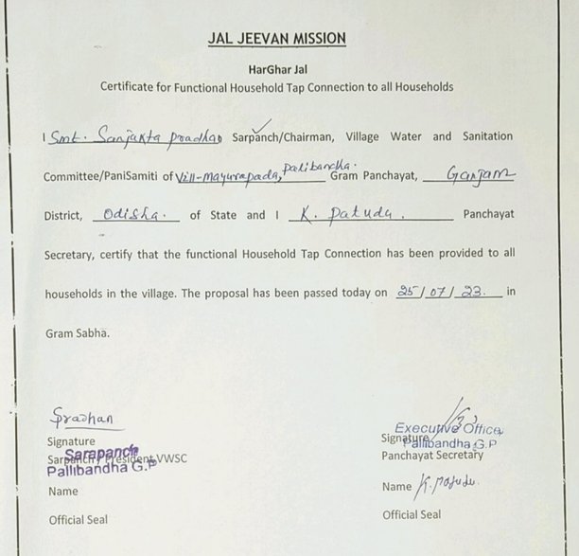
Har Ghar Jal Certification
Special Gram-Sabha organized to declare village as HGJ village.
Gram-Sabha video & HGJ Certificates to be uploaded in JJM-IMIS portal.
All HHs, school, AWC, etc of the village are covered

Slide 19
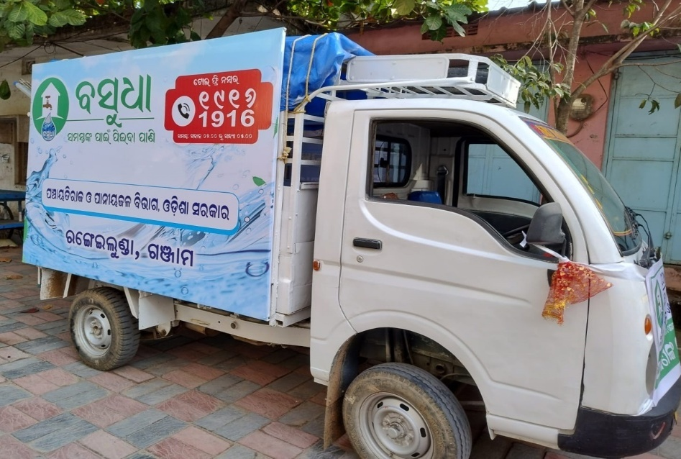
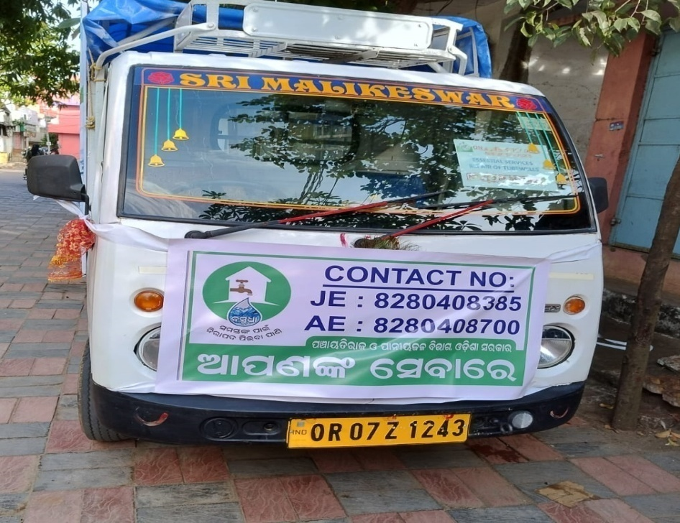
Grievance Redressal
☎️ 24×7 helpline BASUDHA for water supply issues
⚡ TWs are to be repaired within 48 hours
⚡ Minor repairs to be done within 3 days
⚡ Major repairs to be done within 7 days

Slide 20
Thank You
Together towards a sustainable water future
District Administration, Ganjam | Jal Jeevan Mission

