Slide 1
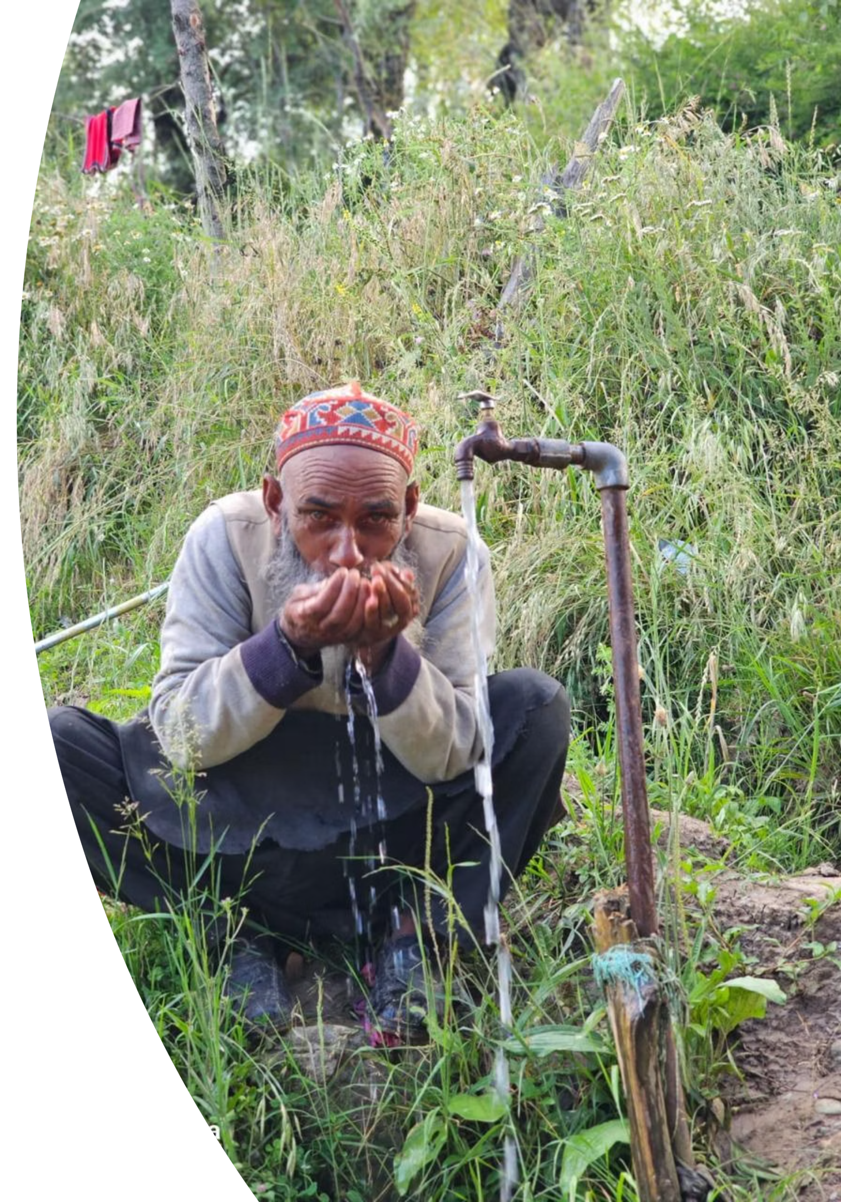
PEYJAL SAMAVAD- 2025
Transforming Water Resources in District Baramulla
PRESENTED BY
SHRI MINGA SHERPA, IAS
DEPUTY COMMISSIONER, BARAMULLA

Slide 2
District Overview
District Baramulla is the largest District in Kashmir Division of J&K with a population of 1008039 souls as per 2011 census and 82% of the total population resides in rural areas.
Coverage Matrices | Status
Total No of Rural House Holds | 146181
FHTC’s Provided | 129336 (88.5%)
No of HGJ Villages Reported | 111
Schools covered | 1338 (100%)
AWCs Covered | 2425 (100%)
DAP Cost | 851.56 Crores
Water Tests Conducted in last 3 years | 67364
No of Water Testing Labs | 09 Nos (Including 01 District Water Lab)

Slide 3
Infrastructure being Developed
Pipe Network
6600 Kms
No of Filtration Plants
228 Nos
No of Service Reservoir's
391 Nos
No. of OHTs
59 Nos

Slide 4
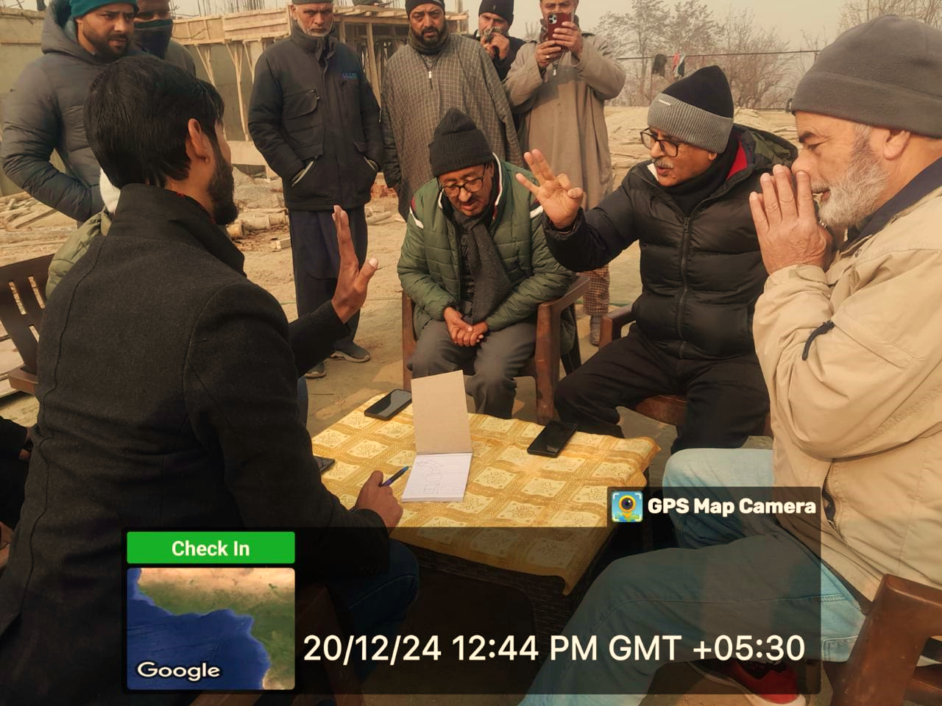
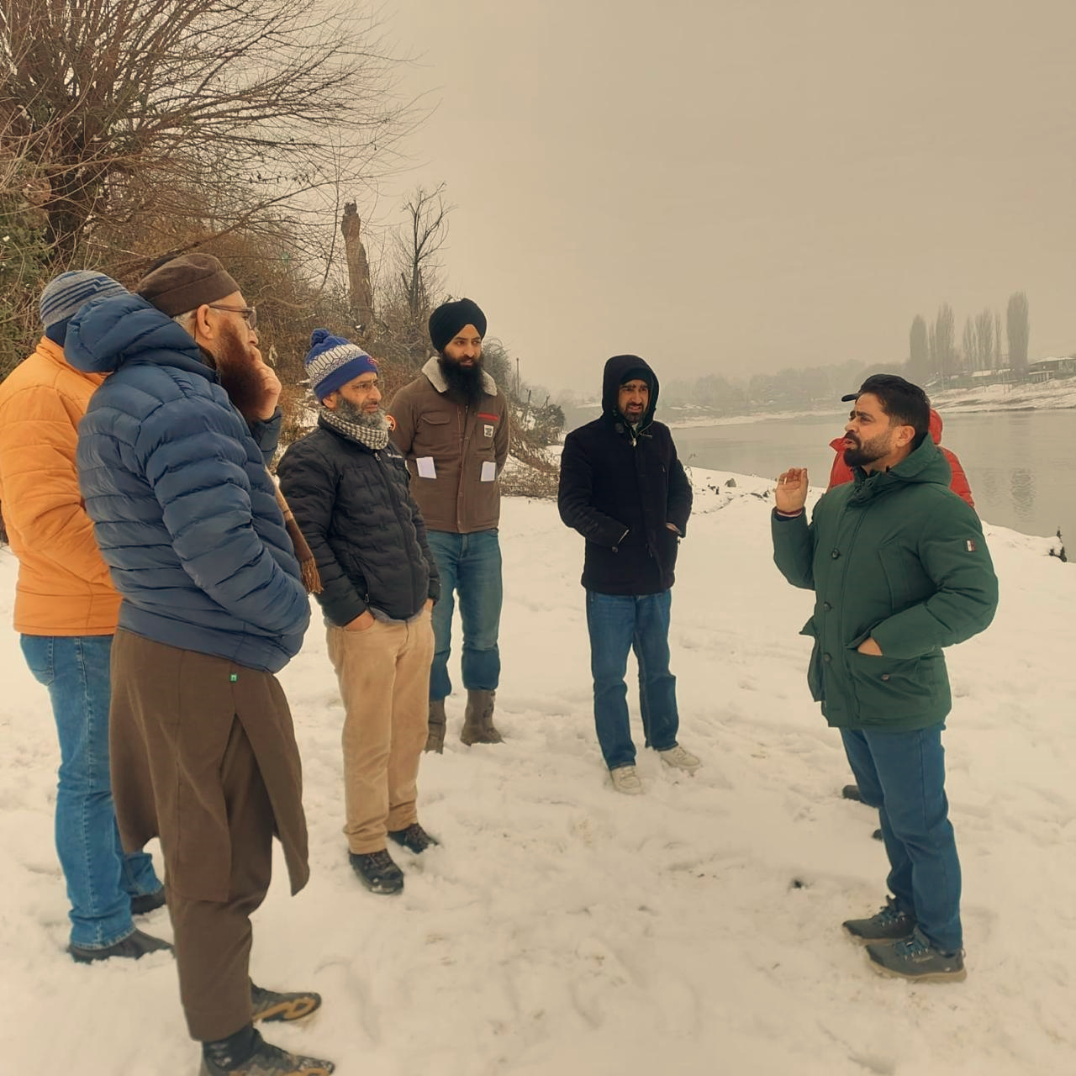
DWSM Monitoring & Implementation
Retired Chief Engineers were appointed as consultants to check the viability of schemes and sustainability of sources.
DPMU Is Housed within DC Office for swift issue resolution.
Third Party Monitoring (TPIA) for quality checks during all stages of works.
District Monitoring Committees Formulated for random checking of works.
JJM Grievance Cell Created for redressal of Public Issues.
In House Design Cell created to issue economical designs from design bank to save the exchequer, time and to keep uniformity.
Deadlines Were Fixed For AAs, TSs, and tendering process.
Every work duly authorized By Chairperson DJJM .

Slide 5
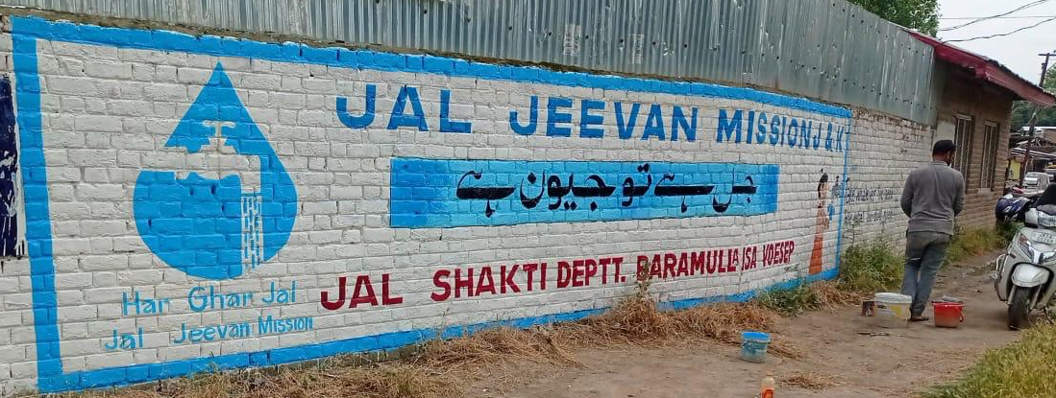
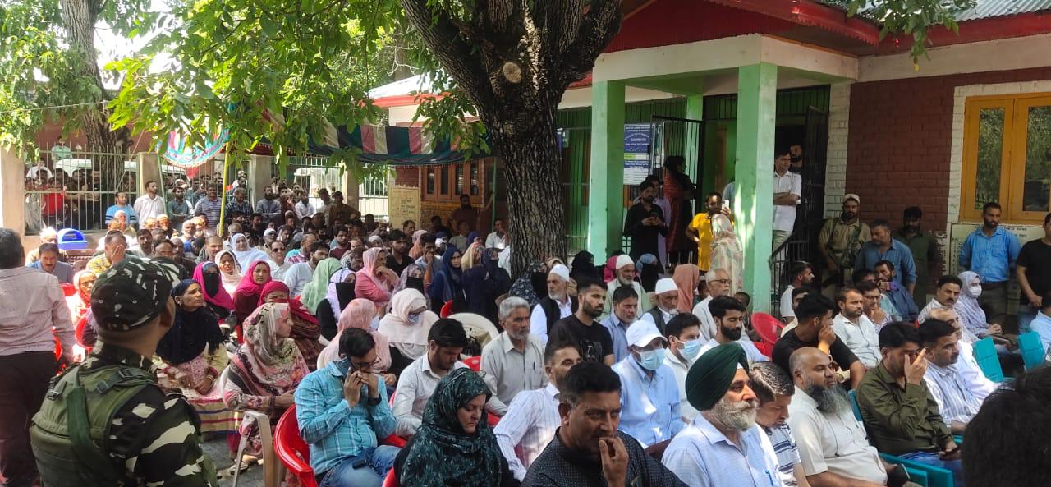
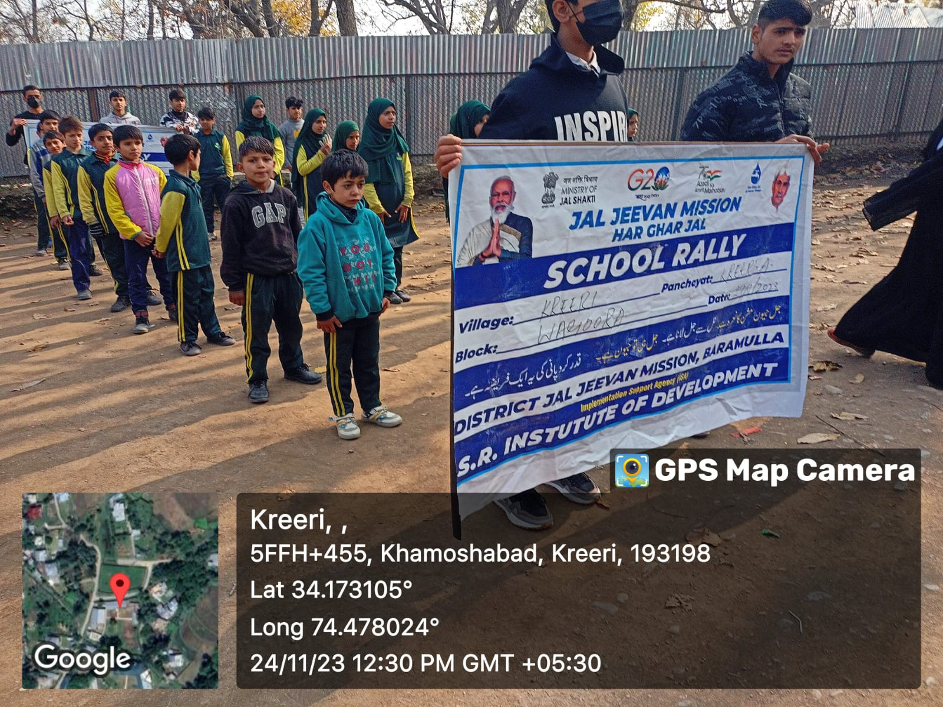
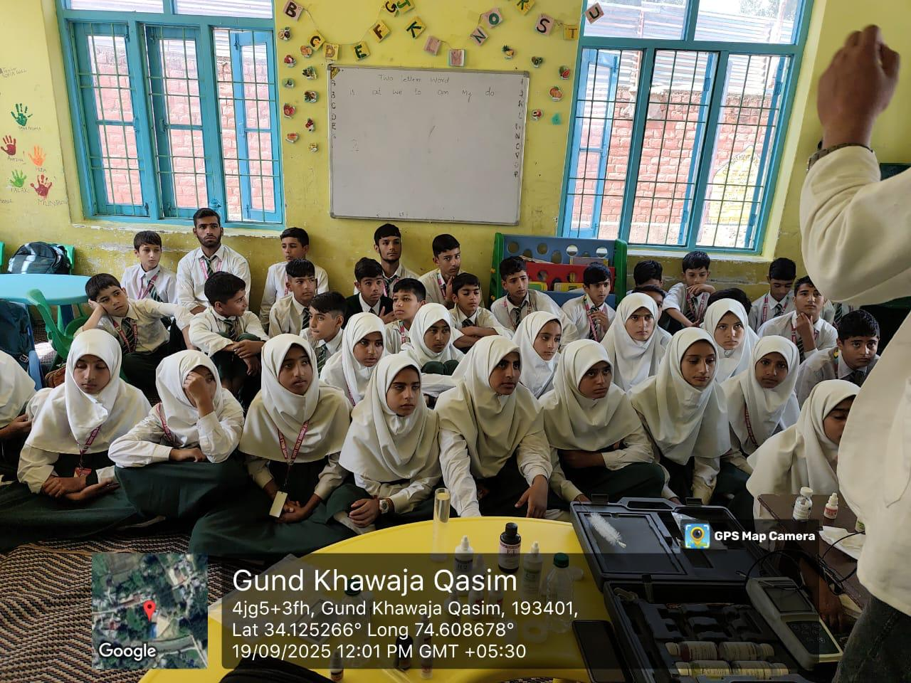
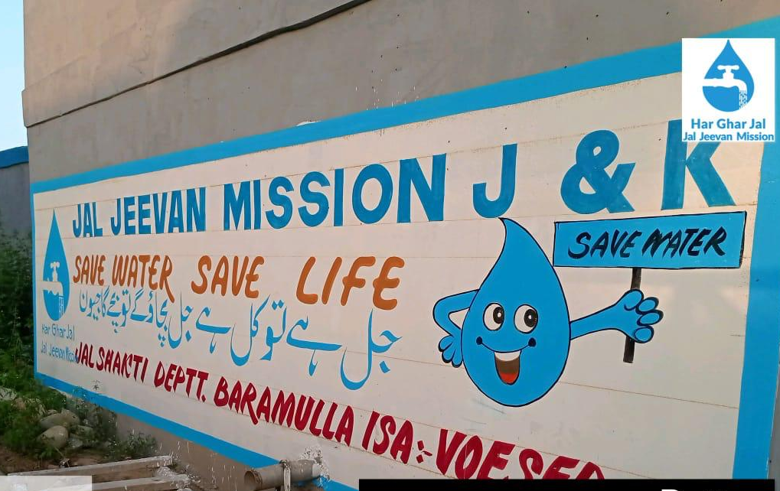
IEC Initiatives
IEC & ISA Activities implemented in all the 518 villages.
08 Number ISA in place for building awareness, training of women for using FTKS, conducting school rallies, Street Play, Puppet Shows, Rath, Jan Sabha and Gram Sabhas etc for encouraging community participation for maintaining village level infrastructure.
Awareness and motivation program of JJM at block level among Sarpanchs, Panchs, Pani Samithi Members, Asha workers, Anganwadi's workers about consuming safe water, sanitation and protection of water bodies and resources in convergence with other departments.
FTKs Distributed among all panchayats for real-time field testing.
Wall Paintings across District for Awareness and Slogans.
Recognition Awards distributed among best performing Villages presented to Panchs & Sarpanchs Contributing to JJM Success.

Slide 6
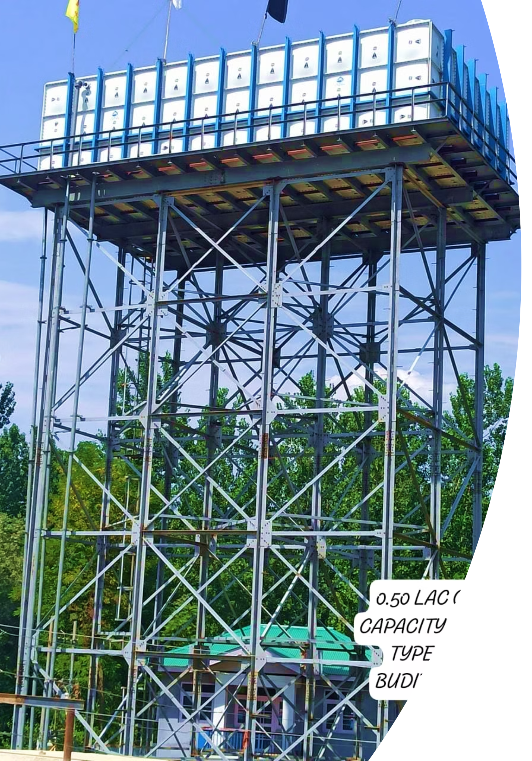
Real-Time Practices
Department faced shortage of skilled labor for construction of RCC OHTs and accordingly Baramulla district was first to shift to FRP OHTs (fiber-reinforced plastic) which not only saved time but cost as well.
Similarly, JJM was going across India and shortage of GI/DI Pipes was replaced by HDPE wherever feasible.
Schemes were taken in convergence mode and funded through NABARD, UT CAPEX, DISTRICT CAPEX, SASCI, JKIDFC to achieve FHTCS And HGJ where ever necessary.
Borewells are being recharged in real time where ever possible near gravity lines or irrigation khuls.
Real-time testing of 14 parameters at 8 sub-divisional labs and 1 district lab to check the quality of water being supplied.

Slide 7
JSA:- CTR Campaign
Water Conservation & Rain Water Harvesting
Works No(s): 1,478
*Ongoing No(s): 1,579
*TOTAL: 3057
Renovation of Traditional
Water Bodies
Works No(s): 56
*Ongoing No(s): 22
TOTAL : 78
Reuse and Recharge
Structures
Works No(s): 468
*Ongoing No(s): 13
TOTAL : 481
Watershed Development
Works No(s): 1,826
*Ongoing No(s): 946
TOTAL :2772
Total Water Related
Works:
6388
Intensive Afforestation
Works No(s): 3
Ongoing: 6
Total :9
JSJB 2.0
Target 2025: 2720
Total Completed Works: 401
Ongoing Works:1538
Total Works:1939

Slide 8
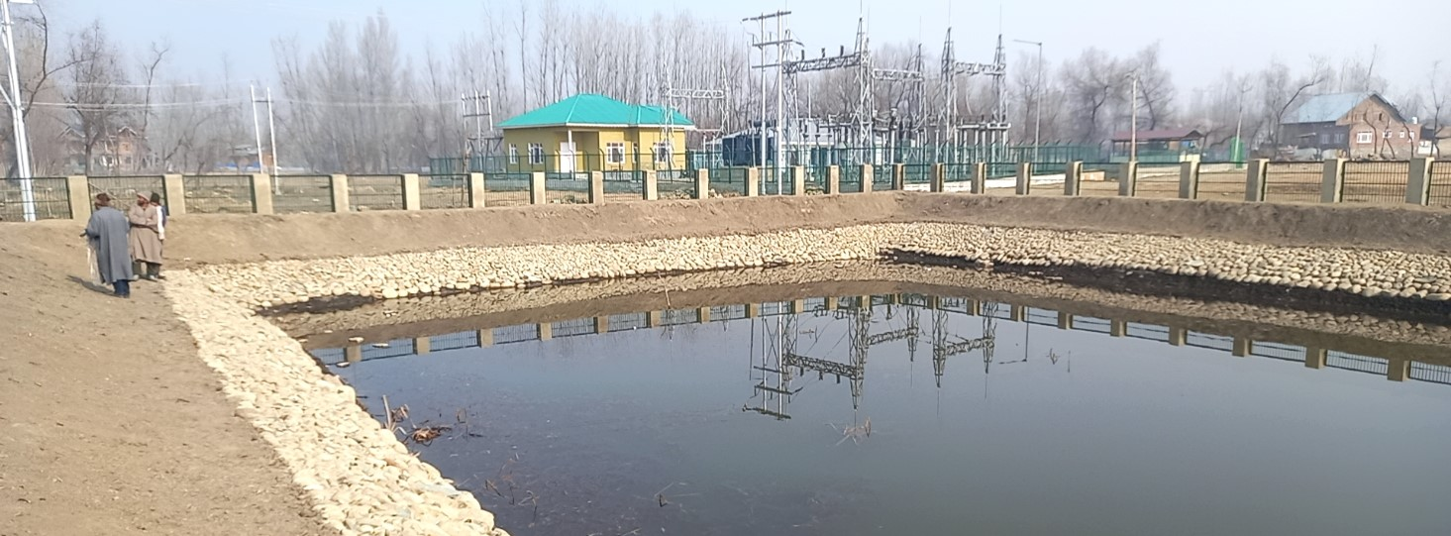
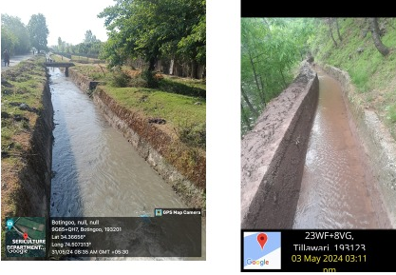
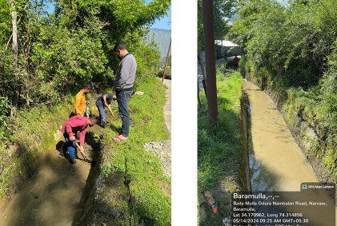
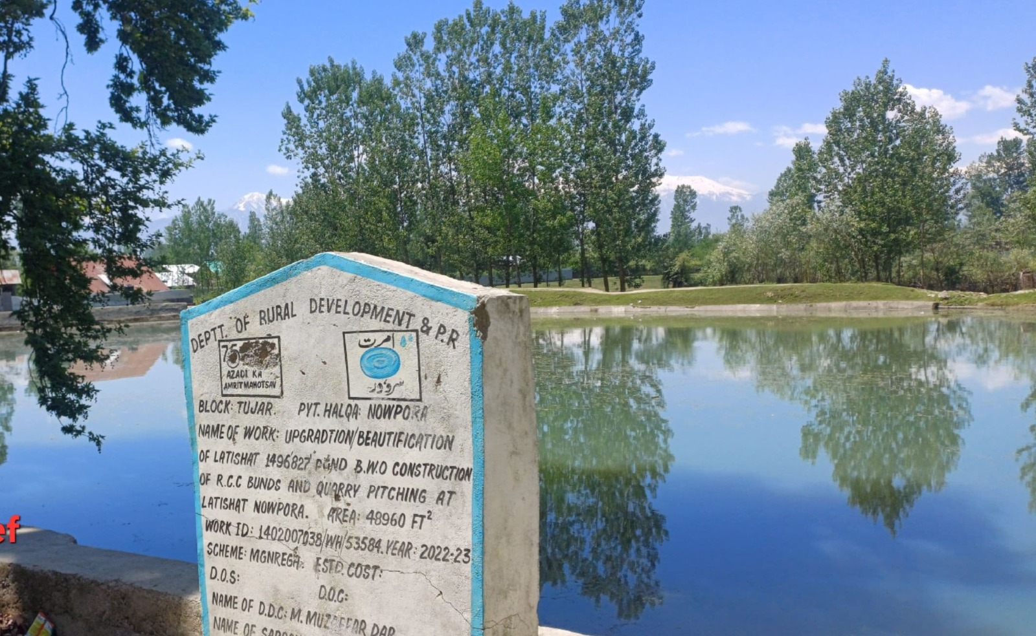

Slide 9
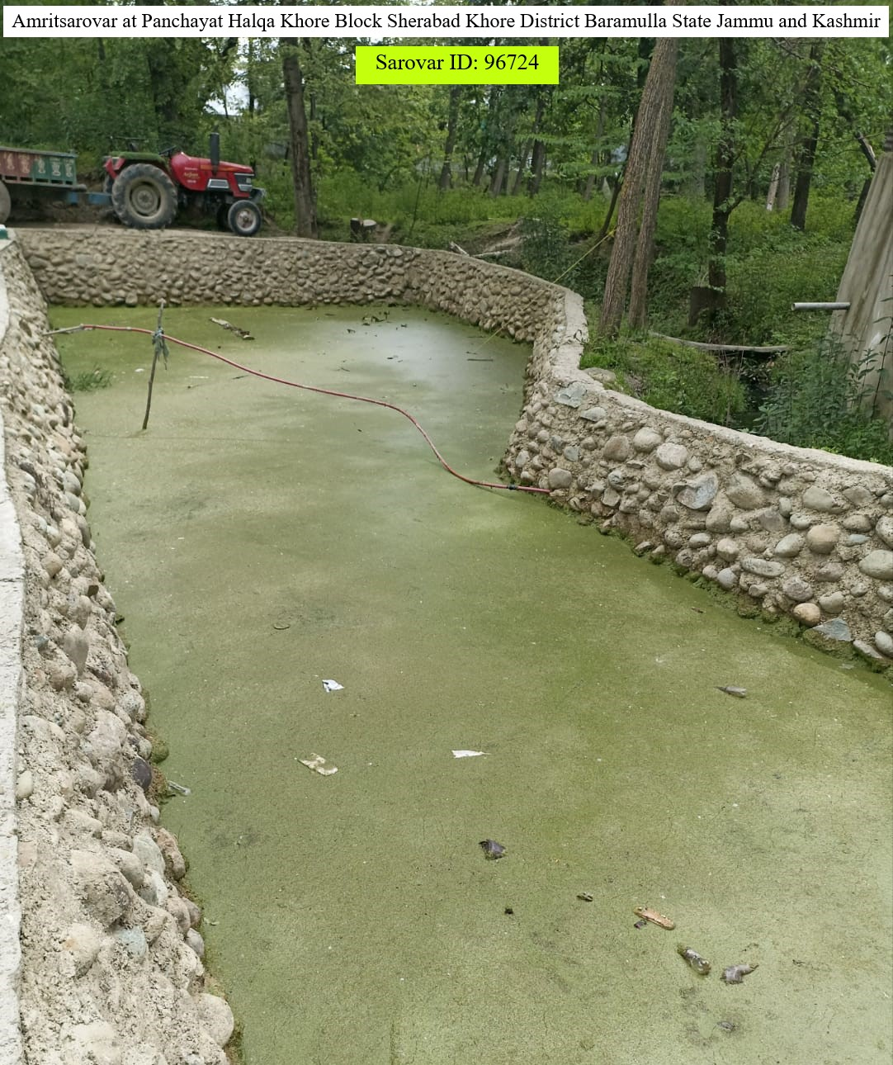
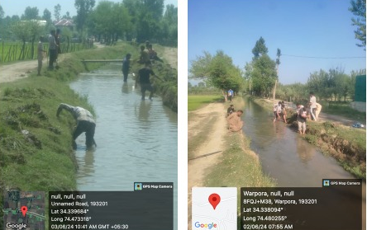
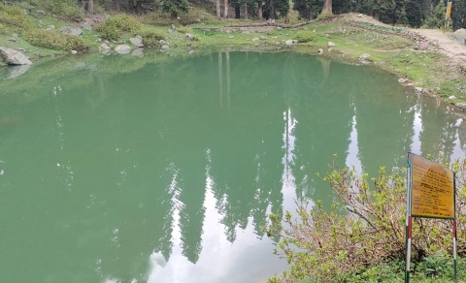
Photo Gallery

Slide 10
Source Sustainability
Massive plantation drives in upper reaches through forest department.
Source protection and catchment management through convergence.
Collaboration with REW and I&FC for cleaning and rejuvenation of water bodies.
Ban on ruthless sand extraction from rivers.
Recharge pits and spring restoration projects implemented.
Geo tagging of all the sources within the forest as well as outside being recorded.

Slide 11
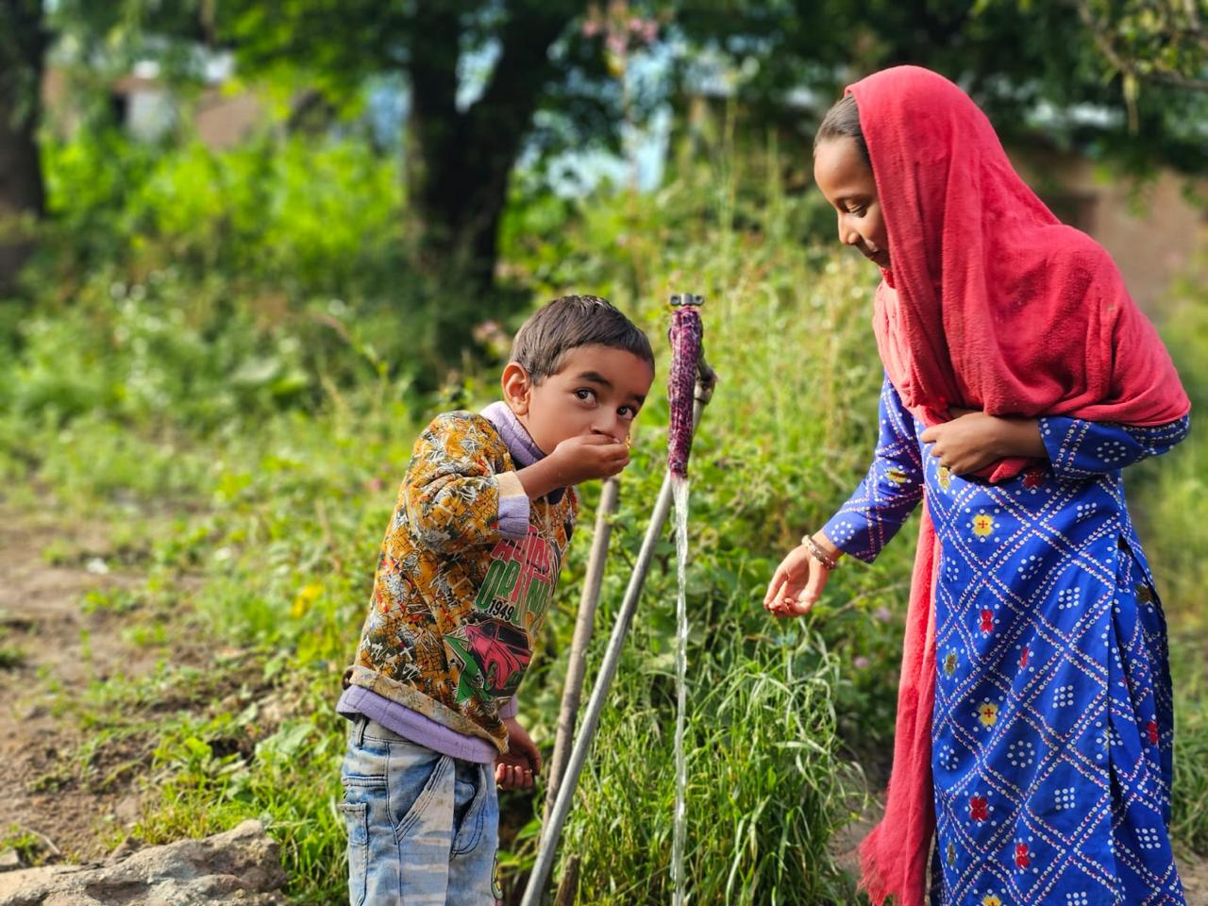
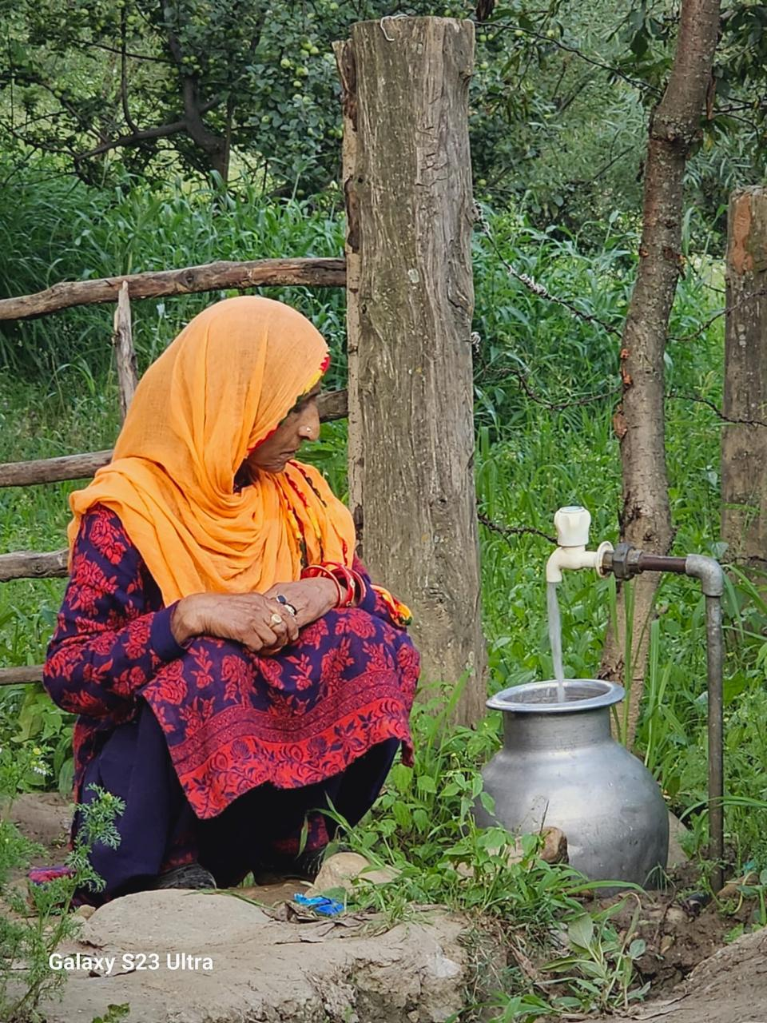
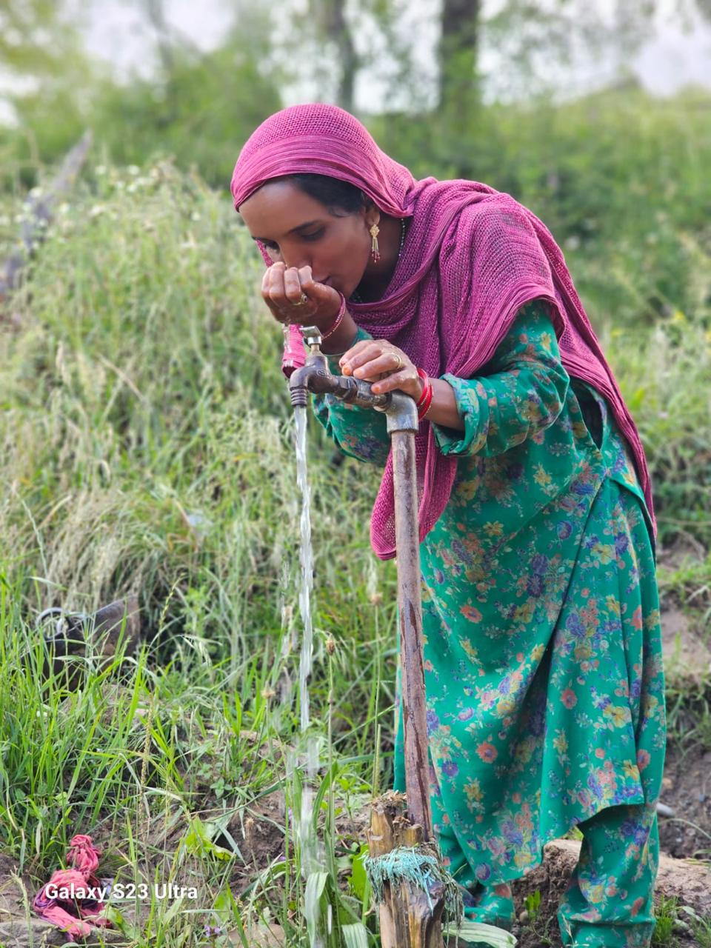
HGC & FHTC Achievements
Highest number of FHTCs in UT of J&K provided in District Baramulla.
Highest number of HGJ Villages certified by and achieved by District Baramulla in UT of J&K .
Partially treated water supply (after proper alum and chlorine dosage) ensured to 95% of rural population. The service levels as well as quality issues shall be redressed soon.

Slide 12
Way Forward
1. Geotagging and mapping of all the water resources within the District.
2. Geotagging and mapping of all the assets (Filtration Plants, Service Reservoirs, OHTs, Tubewells, STPs etc for real-time monitoring.
3. Achieve 100% HGJ certification across all villages by 2026.
4. Complete NABL accreditation for all district and sub-divisional labs.
5. Implement IoT/SCADA, for real-time monitoring.
6. Strengthen source sustainability (recharge pits, spring rejuvenation).
7. Expand digital water fee collection & Pani Samiti participation.
8. Capacity building for engineers, PRI members & consultants.

Slide 13










Community Participation &
Stakeholder Engagement
Panchayat Integration
Village Water Committees
Collaborative partnership with Panchayati Raj Institutions for decentralised decision-making and local governance.
Formation of local committees with 50% women representation for planning, implementation, and management of water schemes.
Awareness Campaigns
Regular workshops, school programmes, and media campaigns to promote water conservation and hygiene practices.
Youth Engagement
Mobilising young volunteers as water warriors and change agents in their communities for sustained impact.
Grievance Redressal
Transparent complaint mechanisms and citizen feedback systems to ensure accountability and service quality.

Slide 14
Innovative Practices
More than 92% schemes conceived on surface water to preserve the ground water resources.
Drinking water being regulated in such a way to avoid misuse for irrigation purposes.
Regular campaigns, through print and social media for awareness about conservation of drinking water and sanitation.
Announcements in local Mosques, Gurdwaras, markets etc about protection of water bodies and saving of water.
Encouraging plantation drives.
Creation of Jal Shakti Kendra and strengthening same.
Creation of District grievances cells for real-time monitoring of water supply schemes.
Creation of local social network groups (WhatsApp) and District officers Twitter, Instagram and Facebook pages for public outreach.
Planning for installation of SCADA/IOT and water meters to check misuse of water.

Slide 15

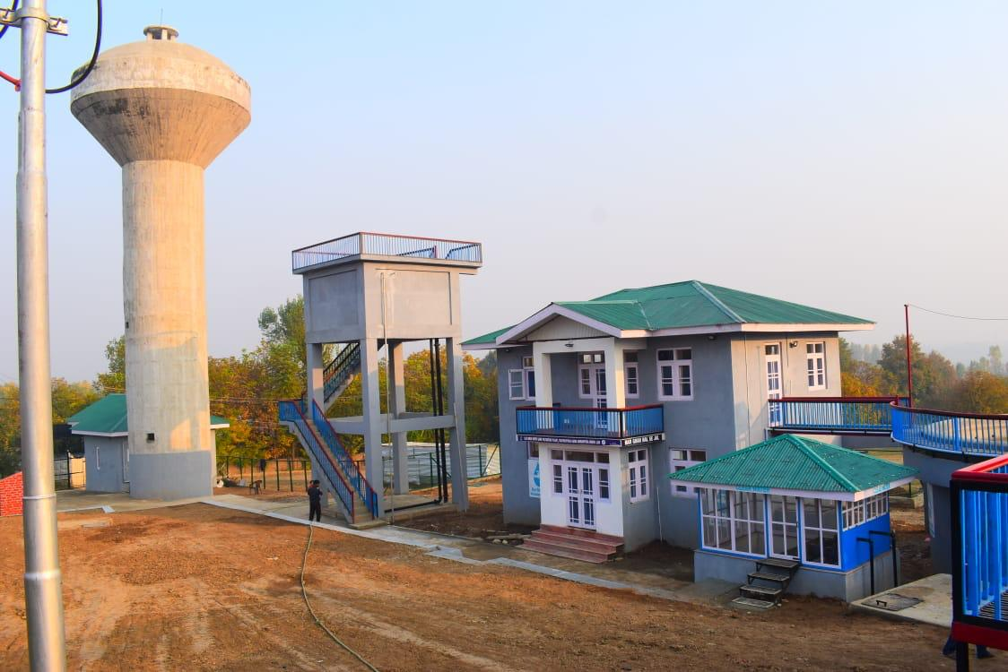
SUCCESS STORY – FROM TANKERS TO TAP WATER
District Baramulla | Jal Shakti Department, Government of J&K;
From Scarcity to Sustainability
For decades, several villages of District Baramulla — including Bonichakal, Goom Ahmadpora, and Budibug — survived on tanker-supplied water delivered on a rotational roster. Each habitation received water once every 5–6 days. Women and young girls would walk 1–2 km daily to fetch water from ponds or unfiltered streams. The scarcity was so severe that families avoided marrying their daughters or sons into these areas due to the struggle for water.
Through the Jal Jeevan Mission (JJM), and the completion of the WSS Jeelpora–Bonichakal, WSS Budibug and WSS Tantraypora–Goom Ahmadpora schemes worth 21.00 Crores, over 2,500 households were connected with filtered, pressurized tap water for the first time. This marks a generational shift — from tanker dependency to tap assurance.
Today women no longer queue behind tankers, children attend school regularly, and families proudly host marriages within their villages. For them, tap water is not just convenience — it is dignity, health, and hope restored.
“We used to wait for the sound of the tanker horn like it was a festival. Now clean water flows right into our homes — every day, every hour. This is a dream fulfilled after seventy years.” — Elderly villager, Bonichakal.

Slide 16
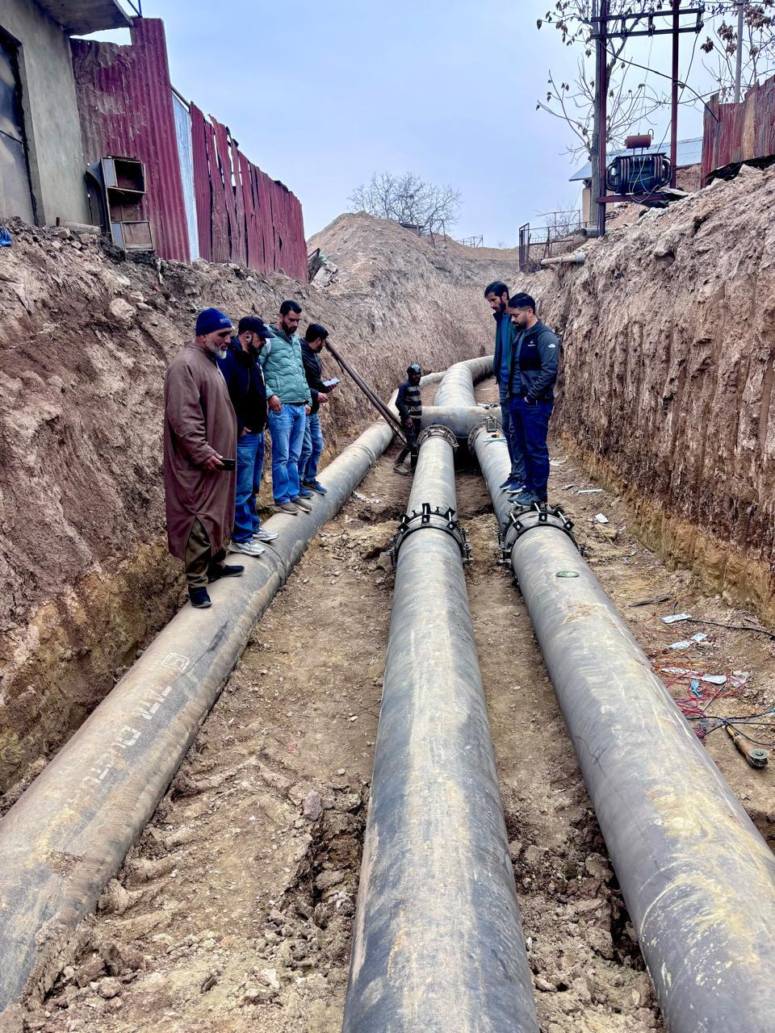
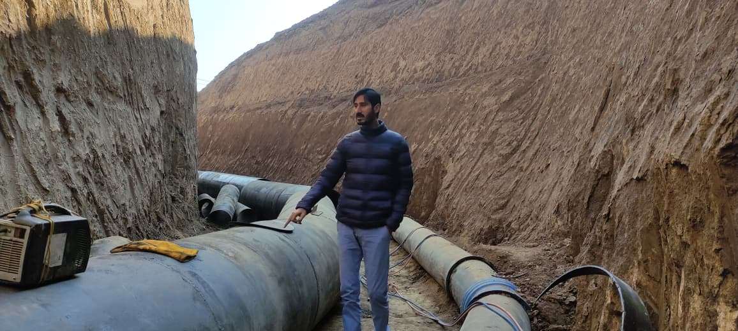
Parihaspora: From the ‘Rajasthan of Kashmir’ to the Symbol of Renewal :
The story of Parihaspora and its adjoining belt is even more profound. For generations, the area — once the ancient capital of Kashmir — had no water supply scheme at all. Every household depended on rotational tanker services, and in summer, the parched landscape was known as the ‘Rajasthan of Kashmir’. Under JJM, the 60 Crore Parihaspora Multi-District Water Supply Scheme was launched, covering 35–36 villages and nearly 75,000 people. Drawing water from Sindh Nallah (Ganderbal District), it includes a 2 MGD Rapid Sand Filtration Plant, an 8 lakh-gallon Service Reservoir, and a 1 lakh-gallon Overhead Tank, ensuring BIS-standard safe drinking water for all households. With 95% work completed and commissioning expected before Eid 2025, this project stands as a symbol of historic justice and modern progress — transforming the narrative of Parihaspora from a water-starved heritage site to a model of resilience and development. “For the first time since Independence, we have a water scheme — not a tanker. Our children now study under running taps, not empty buckets.” — Local Teacher, Malbuchan A Model of People-Centric Development Baramulla’s transformation under JJM proves that infrastructure can be humane when aligned with people’s dignity. From tanker dependency to tap assurance, from delayed marriages to developing markets — these villages are no longer waiting for water; they are flowing forward with it. From ‘Rajasthan of Kashmir’ to ‘Water-Secure Baramulla’ — a journey from deprivation to dignity.

Slide 17
The Iconic & Biggest JJM, Parihaspora Water Supply Scheme of UT in Baramulla District
Covers 35–36 Villages, Benefiting ~75,000 People
2 MGD Rapid Sand Filtration Plant Connected designed on River Sindh Nallah in Ganderbal District.
8 Lakh-gallon Service Reservoir And 1 Lakh-gallon Overhead Tank.
Historically Significant — Restoring Pride to the Ancient Capital Parihaspora.
95% Work Complete, Commissioning on cards.
Socio-Economic Transformation:
Women empowered – freed from hours of daily water collection.
Children educated – girls now attend school regularly.
Health improved – BIS-standard water reduces disease burden.
Communities uplifted – restored dignity, livelihoods, and pride.
Recognition:
Featured by Indian Masterminds, DD India, Rising Kashmir.
Adopted as model JJM project for replication across J&K.
From 'Rajasthan of Kashmir' to 'Water-Secure Baramulla' – a story of resilience and renewal.

Slide 18
Thank You

