Slide 1


महाराष्ट्र शासन
Peyjal Samvad
DWSM, District : Gadchiroli

Slide 2
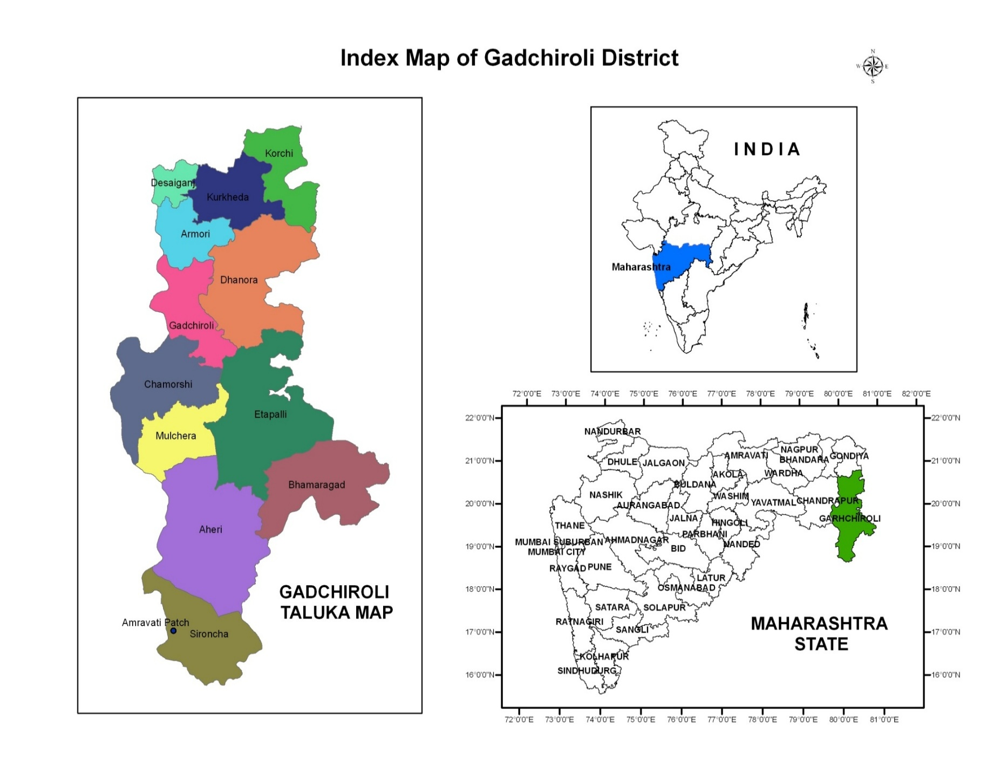

Slide 3
Rural Gadchiroli – Drinking Water Challenges (Pre-Intervention)
Low Tap Water Access: Only 8.37% of rural households had tap connections majority relied on public wells and handpumps before JJM.
Challenging Geography: Dense forests and hilly terrain impede infrastructure development and water supply networks.
Inaccessibility & Fragmentation:
Poor road, electricity, and mobile network connectivity.
Naxal-affected blocks face severe logistical challenges.
Numerous small, scattered hamlets make service delivery difficult.
Low Gram Panchayat revenue affects operation and maintenance capacity.
Sustainability Issues: High costs of electricity, repairs, and maintenance hinder continuous tap water supply.

Slide 4
Implementation Under JJM
In Gadchiroli District Water Supply Schemes are categorized in
two parts viz. Pipe Water Supply Schemes and Solar Energy Based
Mini Water Supply Schemes
For Populations above 500 – PWS schemes are executed
For Populations below 500 – Solar Energy Based Mini Water
Supply Schemes are executed
By implementing this model FHTC coverage of 8.37% has been
reached to 93%.

Slide 5
JJM & PM-JANMAN Abstract
Schemes Under Jal Jeevan Mission
Sr. No. | District | Total No. of Schemes | Total No. of Schemes Completed | Pipe Water Supply Scheme | Pipe Water Supply Scheme Completed | Solar Mini Water Supply Scheme | Solar Mini Water Supply Scheme Completed
1 | Gadchiroli | 1082 | 1033 | 318 | 272 | 764 | 761
Schemes Under PM-JANMAN (PVTG)
Sr. No. | District | Total No. of Schemes | Total No. of Schemes Completed | Pipe Water Supply Scheme | Pipe Water Supply Scheme Completed | Solar Mini Water Supply Scheme | Solar Mini Water Supply Scheme Completed
1 | Gadchiroli | 126 | 126 | 6 | 6 | 120 | 120

Slide 6
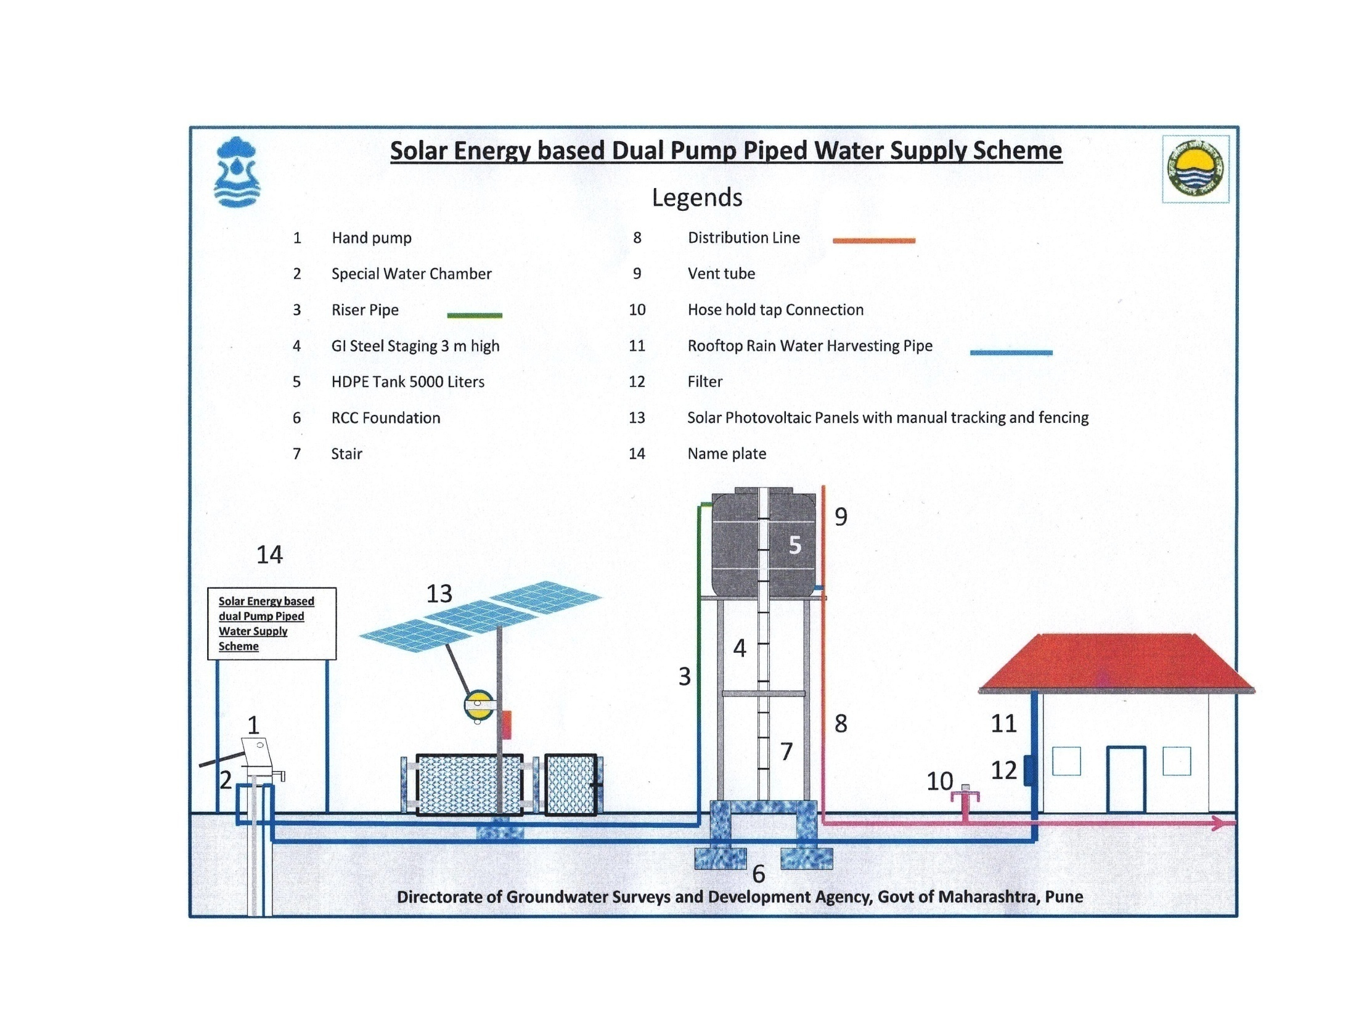
Solar Energy Based Mini Water Supply Scheme - Solution to On-Ground Challenges
To overcome challenges in Gadchiroli District Solar Dual Pump is implemented where Hand Pump and Solar Pump both runs simultaneously

Slide 7
Working Principle
The system works on two main modes, which utilize the same borewell:- 1. Solar-Powered Mode (Daytime) This is the primary and automated function of the pump. • Energy Generation: Photovoltaic (PV) solar panels installed near the borewell convert sunlight directly into DC electricity. • Pumping: The generated electricity is fed to a DC submersible pump (typically 1 HP or more), which is installed deep inside the borewell, below the mechanism of the hand pump. • Water Collection: The submersible pump automatically draws water and sends it through a pipe to an elevated storage tank (often 5,000 liters or more). • Distribution: From the storage tank, water is distributed via a piped network to community standposts or household tap connections, providing piped water supply to the habitation during the day. • Automation: The system is often equipped with sensors and a controller for protection (like dry-run protection to prevent damage if the borewell runs dry) and tank level monitoring.

Slide 8
Working Principle
2. Manual Hand Pump Mode (Backup) This is the secondary, manual function, which ensures supply when solar power is not available. • Hand Pump Operation: The pre-existing manual hand pump mechanism remains operational and is physically located above the submersible pump. • Backup Power: This mode is used when there is no sunlight (at night, during heavy clouds, or in case of a fault in the solar system). • Immediate Access: Users can operate the hand pump manually to draw water directly from the borewell for immediate needs. The "dual" aspect refers to the combination of the automated, high-volume solar pump for community supply to a tank, and the manual hand pump for direct, on-demand, backup access.

Slide 9
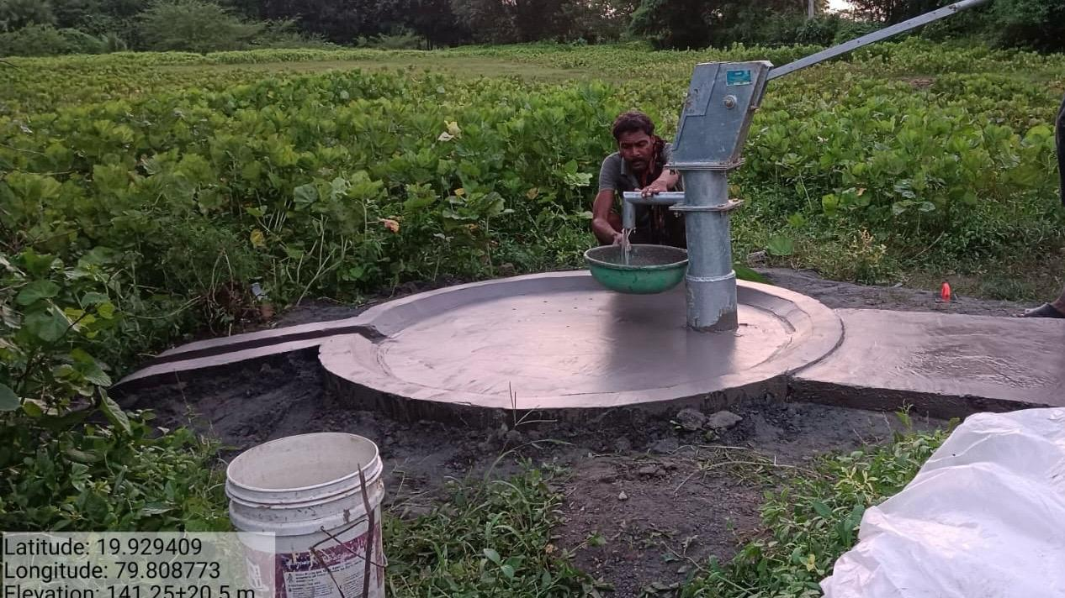
Innovative Practices and Scheme Features
Groundwater Source : Finalized existing Handpump/Borewell in village with yield of more than 2000 ltr/hr to reduce expenditure on new source

Slide 10
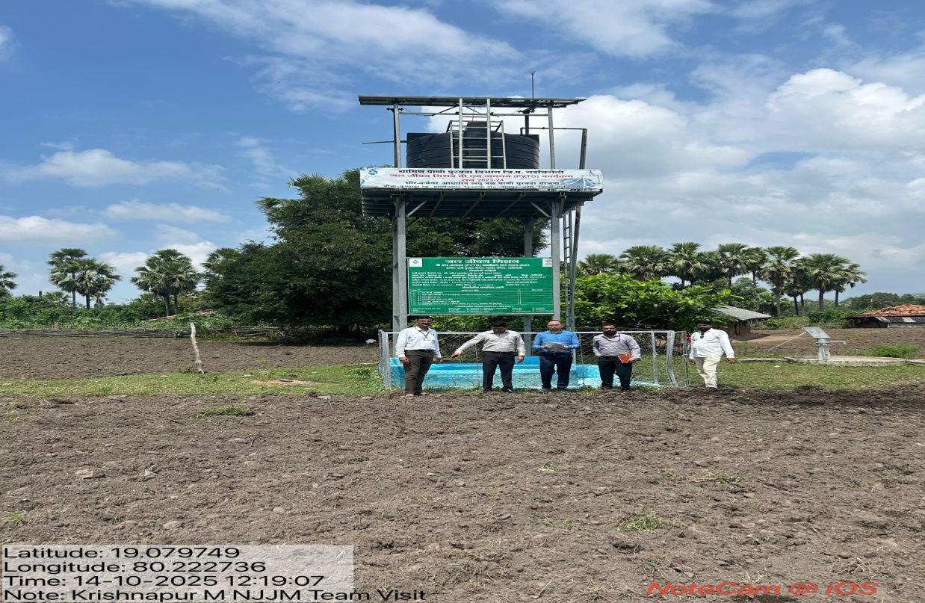
Innovative Practices and Scheme Features
Components : GI Structure Based ESR, 5000 Ltr LLDPE Tank, 1 HP DC Pumpset, 1 KW PV Module, Distribution System HDPE Pipe (63 mm dia.), FHTC’s for 40-45 Households in GI
Automatic Pump On/Off System (Tank Float Sensor)

Slide 11
Highlights of Solar base dual pump type Scheme
Ideal for habitation upto 40 HHs(200 people)
Negligible maintenance cost – Community can operate
Auto-switch on-off system- 24x7 Water supply
Saving in land area against installation of solar panel
Protection against vandalism
Cleaning system for solar plates to maintain production
Off- grid installation
Lightning arrester
Comprehensive maintenance contract (repairs & replaceable included in scope) of 5 years.
Adaptable to install digital monitoring system for whole block/ district to ensure compliance of O&M

Slide 12
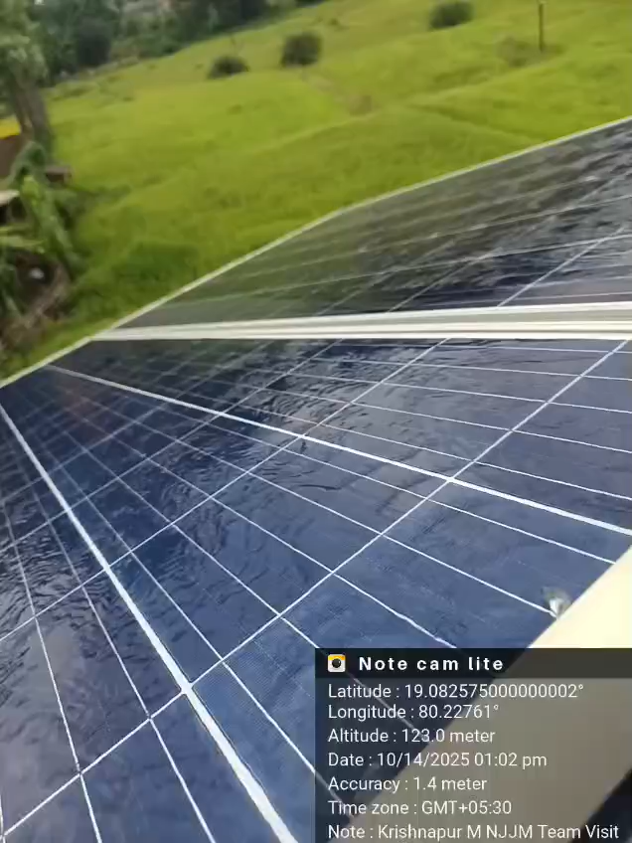
Salient features of scheme
Pump - 2500 LPH
Solar Panel size – 335 x 3 = 1005 wp
Motor – 1.4 kw (2 HP)
Outlet pipe – GI 50mm dia.
Inlet pipe – GI 25mm dia.
Cleaning pipe for solar panel – PVC 25mm dia.
Distribution network pipeline – HDPE 63mm dia.
HDPE water tank capacity – 5000 lt. (1.8m dia, 2.0m ht.)
Float in tank – upper limit of 1.9m & lower limit of 0.1m
Lightning arrester- 1 no.
Comprehensive maintenance contract (repairs & replaceable included in scope) of 5 years .

Slide 13
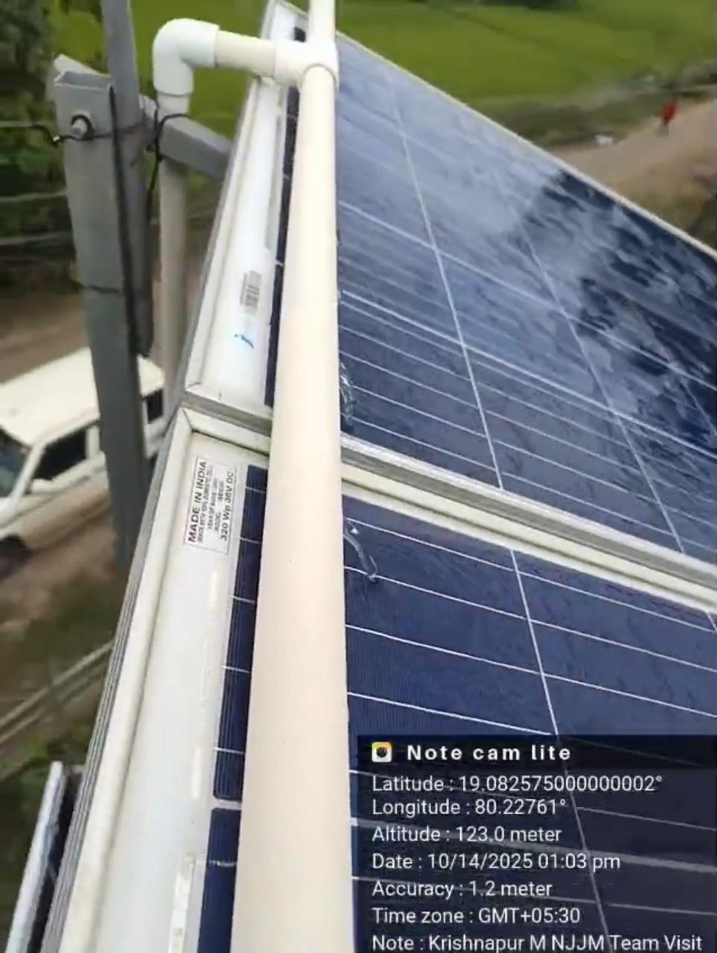
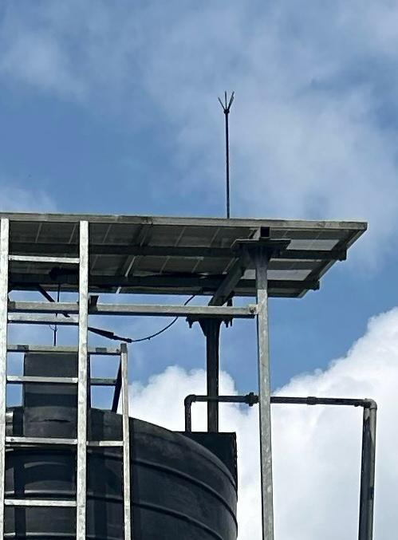
Solar Panel Cleaning System : - Sprinkler-type cleaning system installed for efficient solar panel maintenance. - Ensures dust-free panels, leading to improved solar efficiency and continuous system performance.
Lightning Arrestor System :
- Lightning arrestor system installed to protect solar-
powered equipment and water supply infrastructure
from lightning strikes.
- Provides safety benefits to villagers, animals, and
livestock within a 5 km radius.

Slide 14
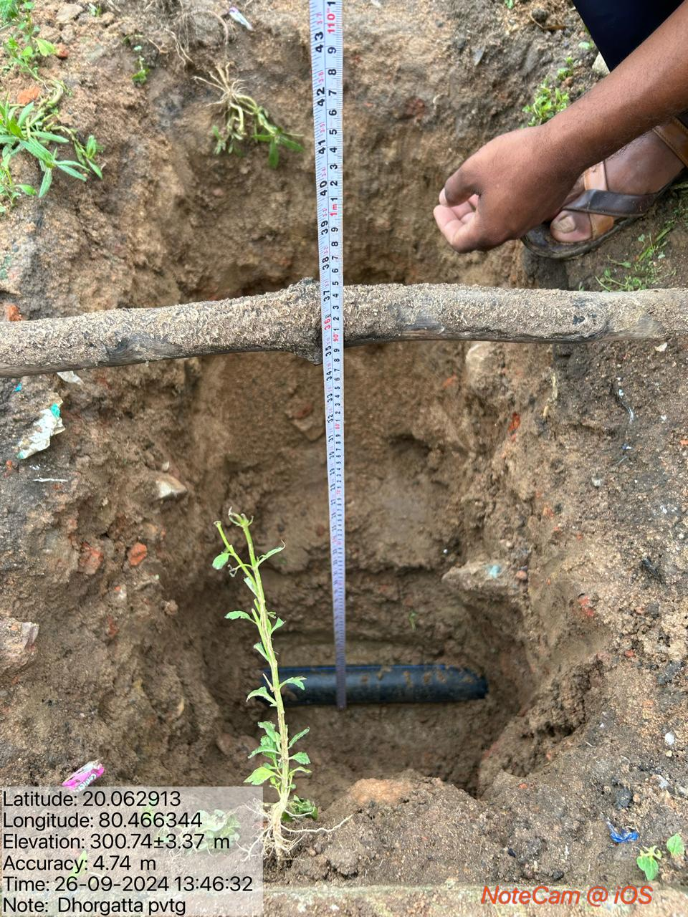
Distribution System :
63 mm diameter 6 kg/cm2
HDPE pipes used for the
water distribution network.
Pipes offer high flexibility,
corrosion resistance, and
strong jointing strength.
Ensures a leak-proof and
durable distribution system.

Slide 15
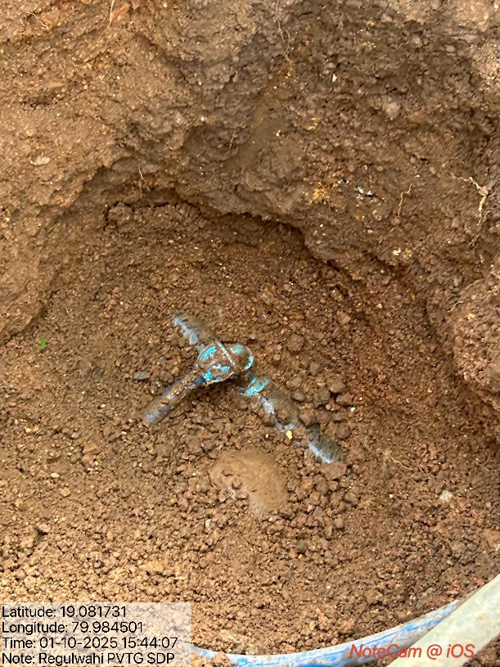
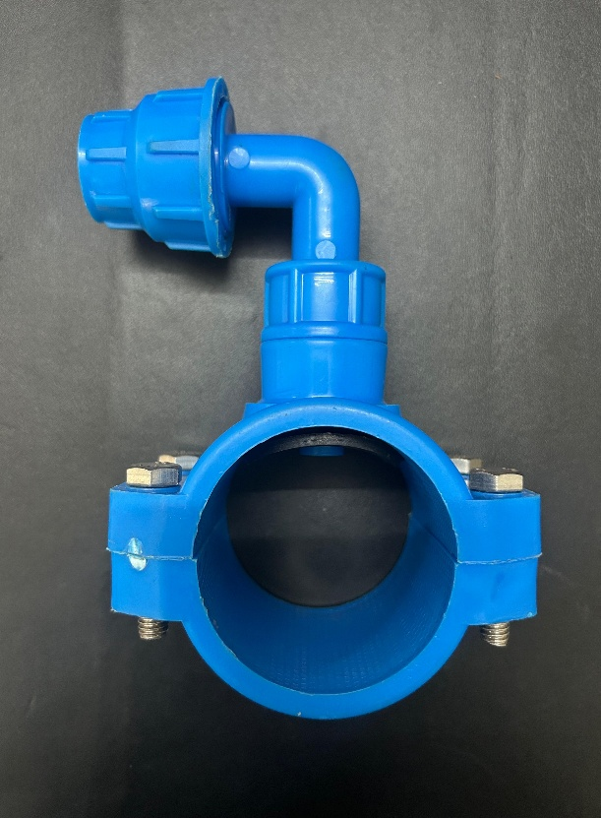
Integrated Ferrule :
Integrated ferrules used along
with MDPE pipes for providing
Functional Household Tap
Connections (FHTCs) from the
main distribution line.
Ensures equal water
distribution to every
household,maintaining uniform
pressure across the network.
Reduces the risk of water
misuse and uneven supply.
Flexible and durable MDPE
pipes provide leak-proof
connections and easy
installation.

Slide 16
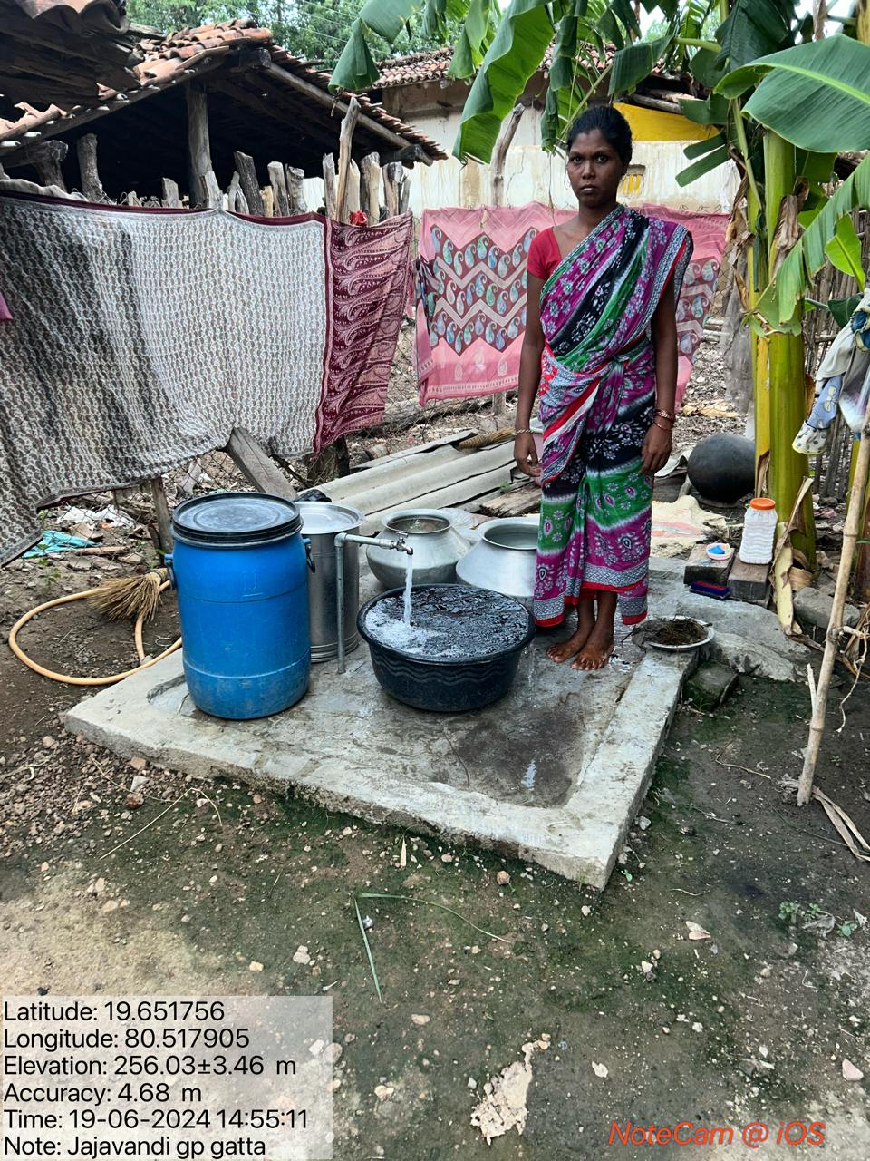
Sturdy FHTC :
All household Functional
Household Tap Connections
(FHTCs) installed with G.I.
(Galvanized Iron) standposts and
G.I. taps.
Each installation includes a P.C.C.
(Plain Cement Concrete) platform
for stability and hygiene.
Provides strong structural support
and ensures long-term durability.
Ensures convenient, user-friendly
access to safe drinking water for
beneficiaries.

Slide 17
Benefits of Solar Energy Based Mini Water Supply Scheme
Provides household tap connections to 45–50 households per scheme.
Operates without electricity costs and avoids power load issues.
Dual operation of hand pump and solar pump ensures uninterrupted water access.
Reliable during summer when hand pumps fail due to low groundwater levels.
Effective even in monsoon, with sufficient output despite low sunlight..
Maintenance and servicing covered by contractor for the first five years.
Low water tax for beneficiaries enables effective revenue collection by Gram Panchayat.

Slide 18
Operation and Maintenance Policy
Completed JJM schemes handed over to respective Gram Panchayats.
Contractor responsible for operation and maintenance during the first 5 years (CMC period).
After the CMC period, Gram Panchayats assume full maintenance responsibility.
Workshops and training conducted for Sarpanch, Gram Sevak, and Jal Surakshak on Scheme maintenance and repair, Water quality management, Water tax levy, collection, and record-keeping.
Standard spare part rates being finalized through e-tendering for transparency and uniformity.
Panel of approved repair agencies formed with taluka-level service centers for prompt technical support.
Weekly functionality checks carried out by Junior Engineers (JE) with village-level coordination for continuous monitoring.
Solar hybrid pumping system – For regional PWS Schemes and SVS Solar hybrid pumps are installed/planned from DMF/15th Finance

Slide 19
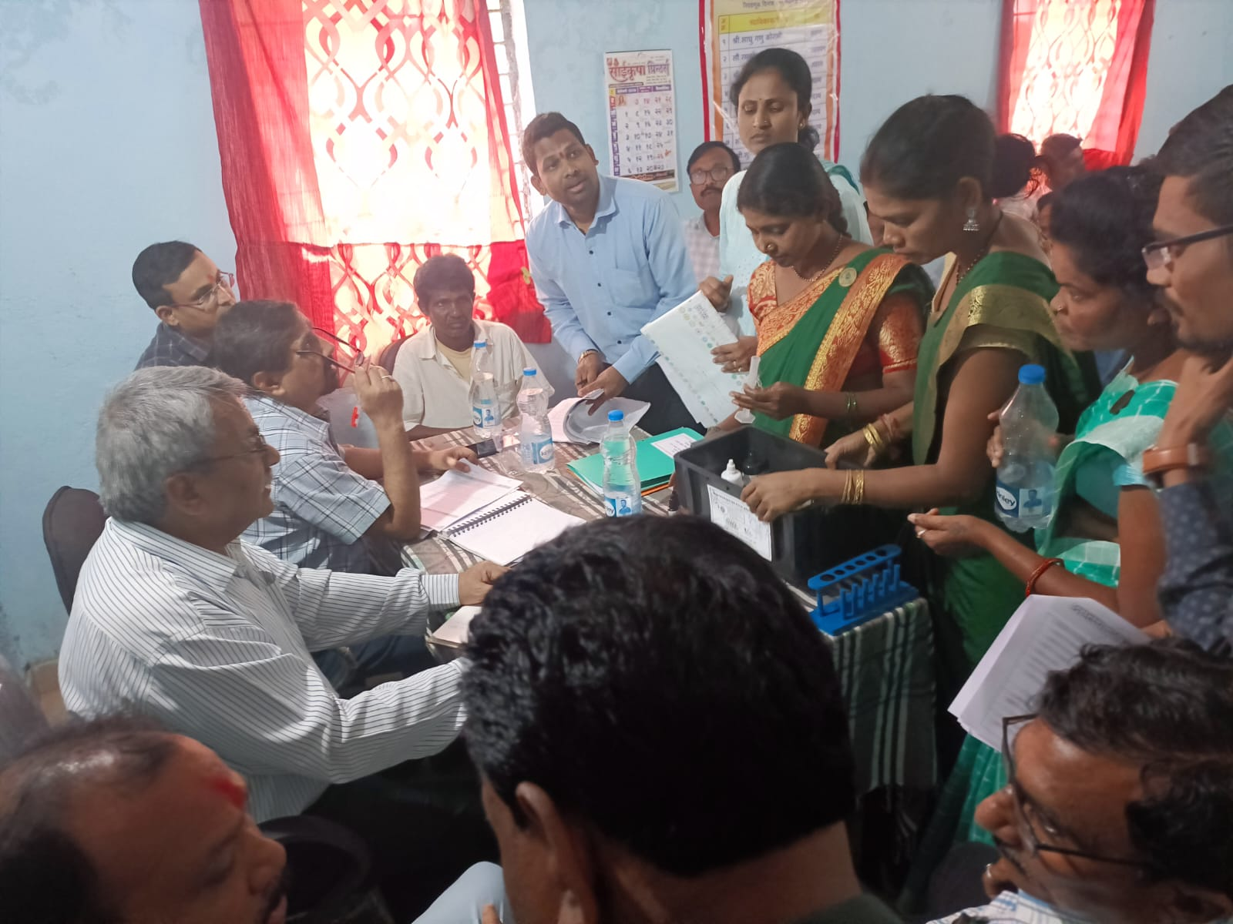
Water Quality Testing
Field Test Kit (FTK) has been provided at Gram Panchayat for water quality testing
Five FTK women coordinators has been trained for water quality testing out of which three women are from same village and other two are Anganwadi Sevika and ASHA worker.
Regular water quality testing of tap water is done by these coordinators

Slide 20
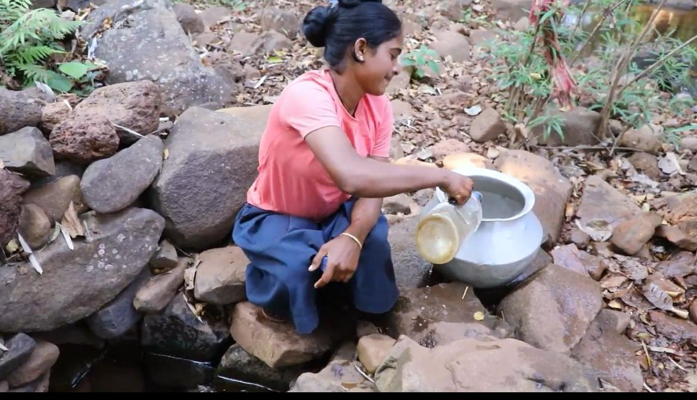
Kuwakodi Success Story - Janbhagidari
Villages Binagunda, Turremarka,
Fodewada, Kuwakodi and Permilbhatti in
Bhamragad Taluka are located along the
Maharashtra Chhattisgarh border.
These areas are extremely remote, hilly,
and Naxal affected, with no proper road
connectivity.
Due to the terrain, it was impossible to
transport construction materials or
drilling machinery for water supply
schemes.
Villagers earlier depended on natural
springs that dried up in summer, forcing
women to travel long distances for water.

Slide 21
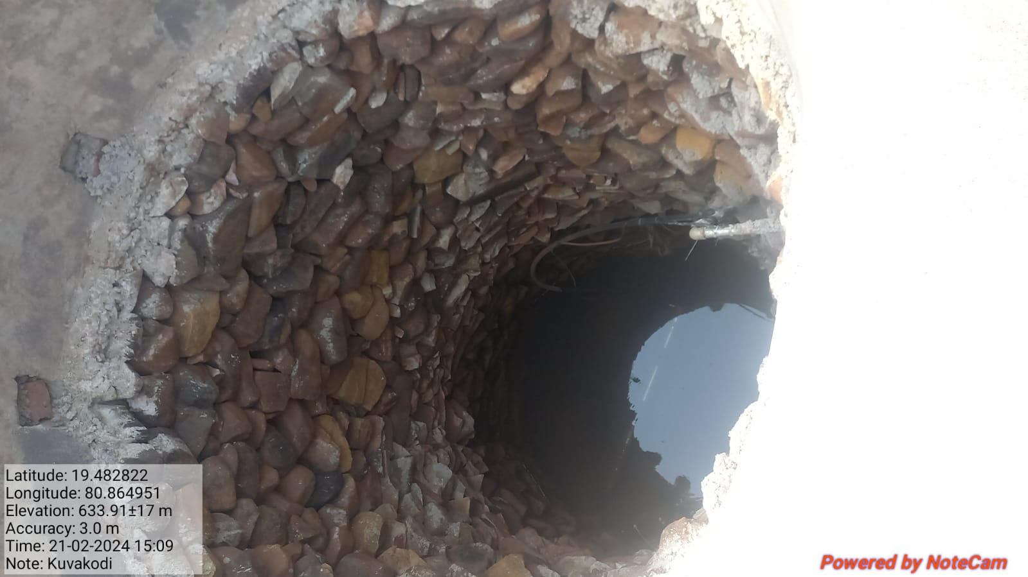
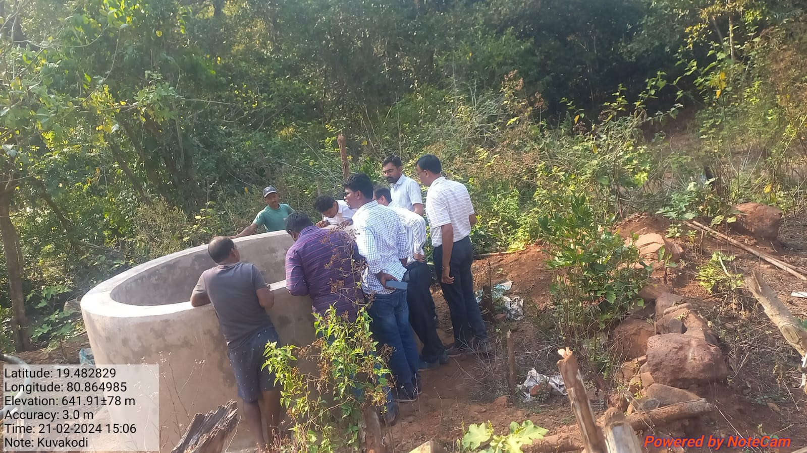
Kuwakodi Success Story - Janbhagidari
With the initiative of the
Gram Panchayat Sarpanch
and community
participation, a 15-foot-
deep well was manually
dug and stone-lined for
stability.
The well provided
adequate water yield and
was tested safe for
drinking.

Slide 22
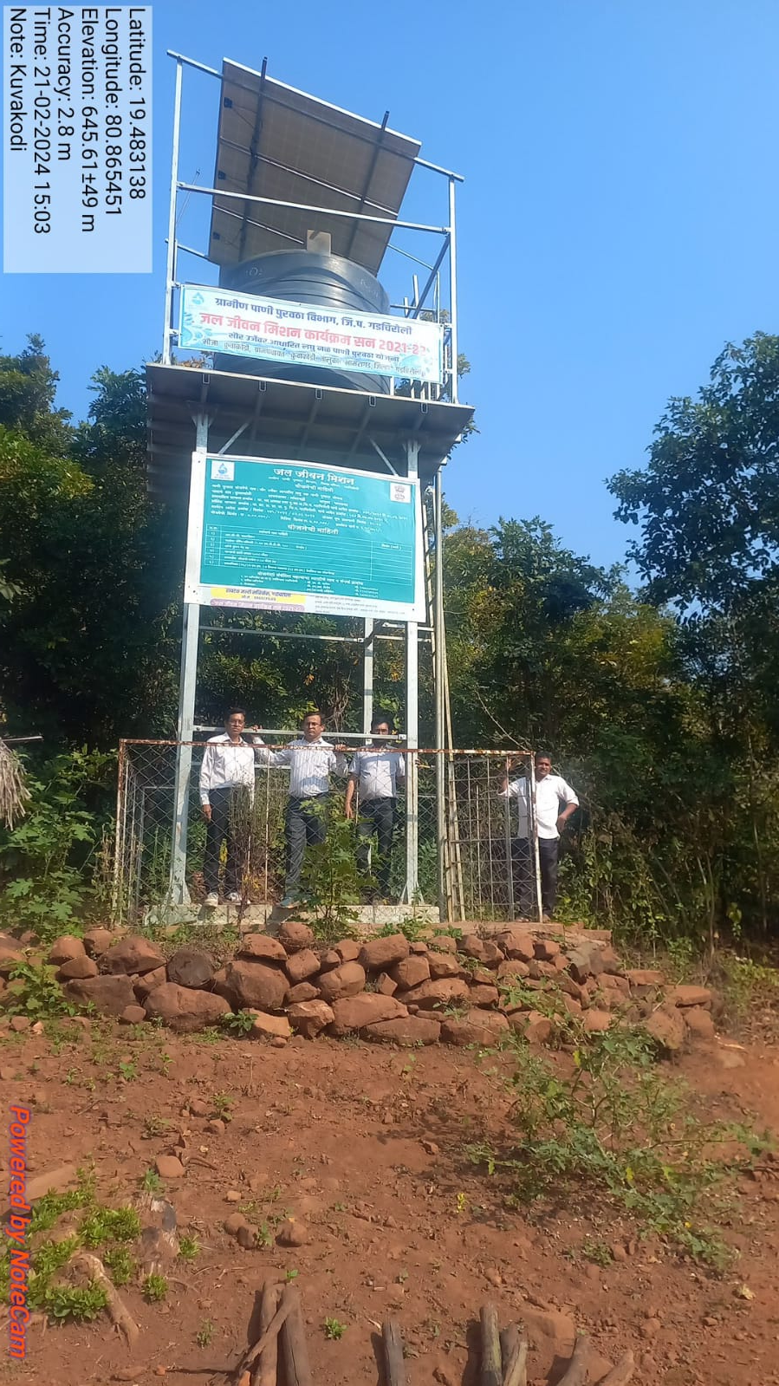
Kuwakodi Success Story - Janbhagidari
After source finalization Solar Energy Based Mini Water Supply Scheme was Successfully implemented in Kuwakodi.

Slide 23
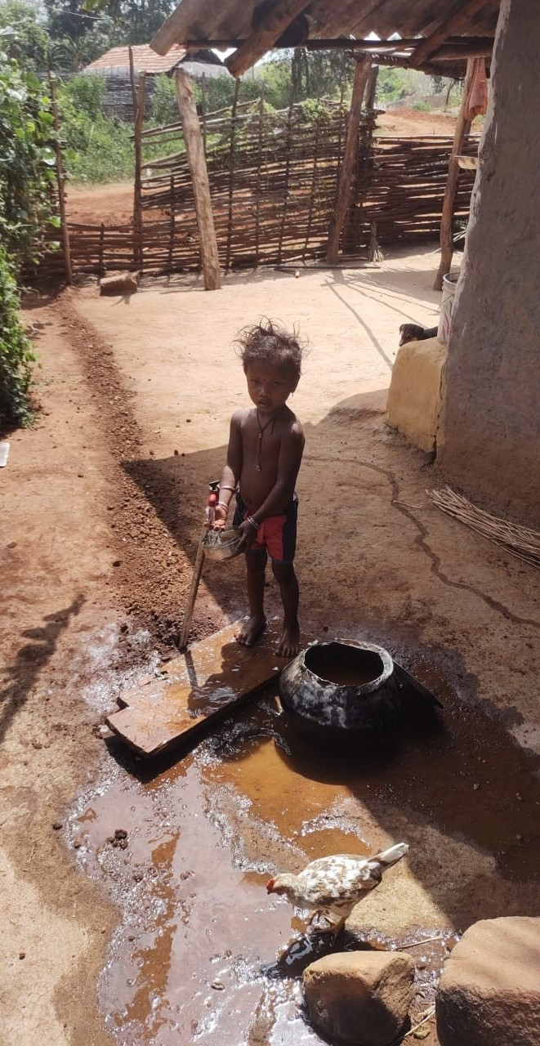
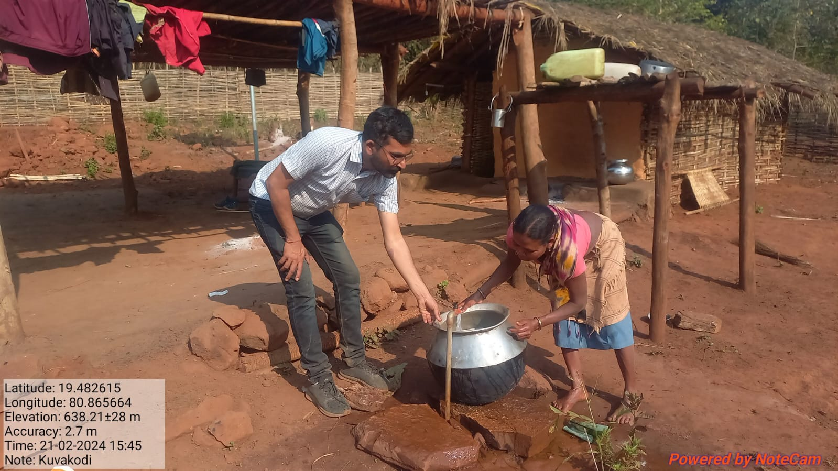
Kuwakodi Success Story - Janbhagidari
Ensured Functional Household
Tap Connections (FHTCs) to every
household.
Scheme has been functioning
successfully for the past two
years, ensuring regular and
reliable drinking water for all
residents.

Slide 24
Source Sustainability- Honey Comb Technology Based Rain Water Harvesting System
Honeycomb Technology–based Rainwater Harvesting System is being proposed in JJM 2.0.
It is well suited for deep acquifier recharge.
This RWH system can be implemented on SDP source or its nearby defunct borewell.

Slide 25
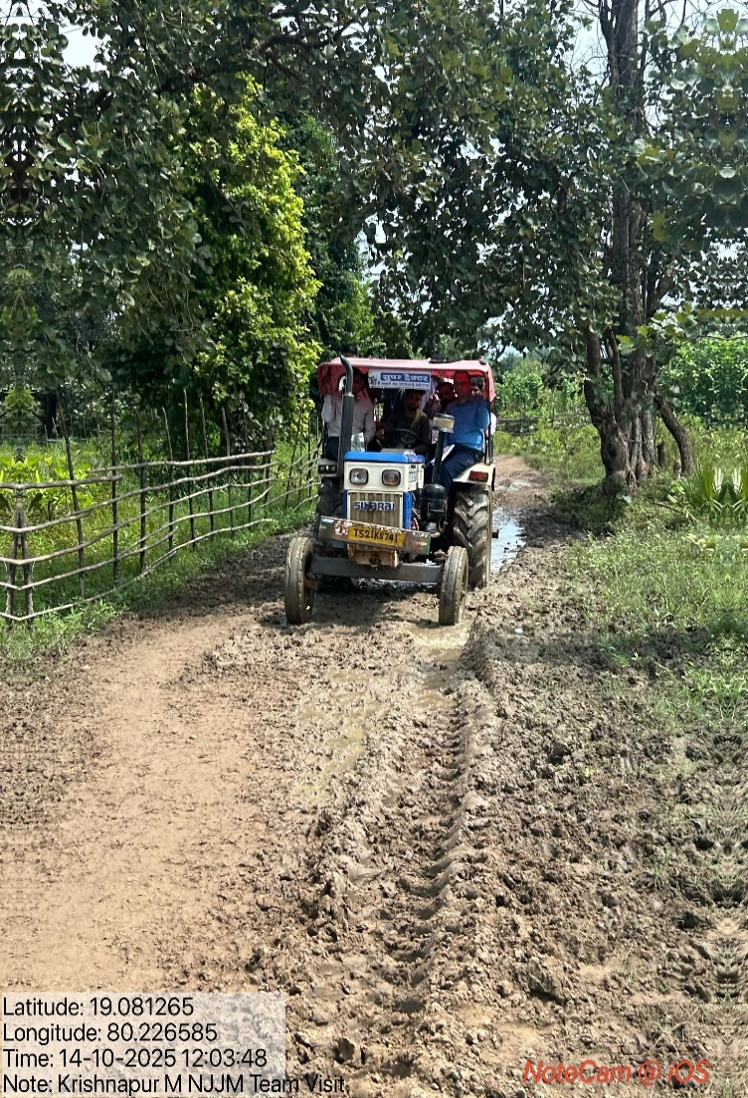
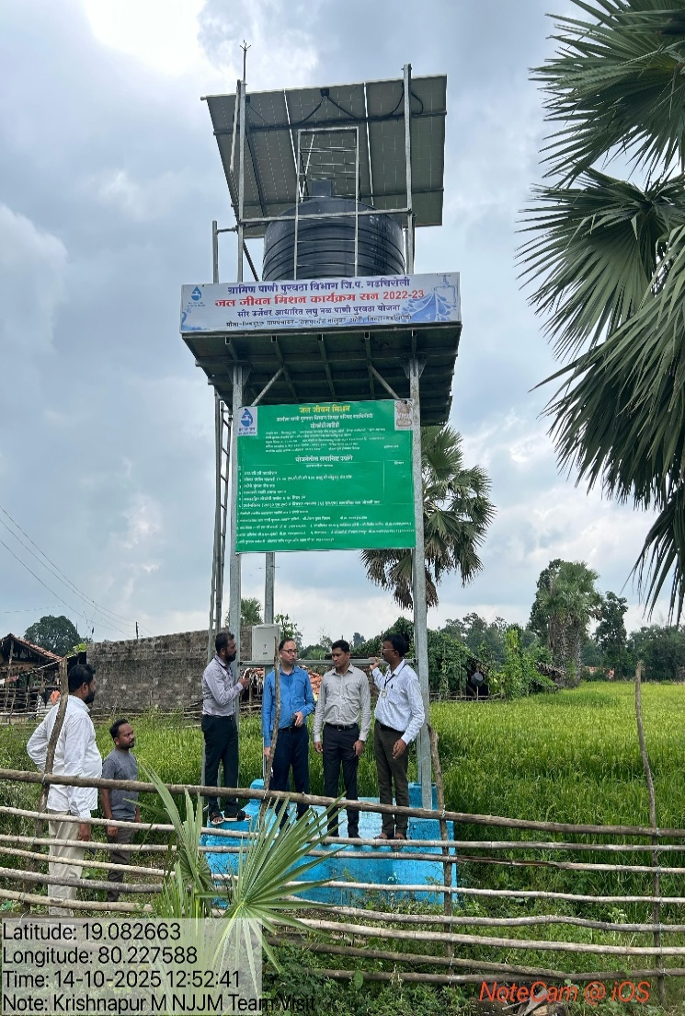
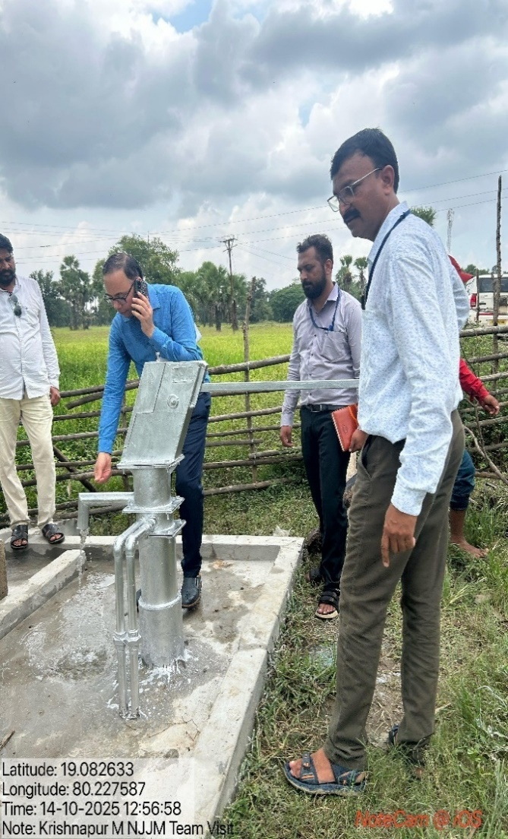
NJJM Team Field Visit 14th and 15th October,2025
Recently NJJM Team Officials Mr. Pradeep Singh (Director-NJJM), Mr. Ujjwal Jain (NJJM) and Mr. Vijay Waikar SE (SWSM) have visited remote village Krishnapur M Taluka-Aheri of Gadchiroli District.
This village is in remote area and is not accessible via roads
NJJM visited this village and it has been observed that schemes are functional from past two years

Slide 26
🙏 Har Ghar Nal Se Jal 🙏

