Slide 1
Collectors' Peyjal Samvad – Under Jal Jeevan Mission
Sustainable O&M and Effective Governance
District Water and Sanitation Mission, DWSM- DANG
Ms Shalini Duhan, IAS
Collector & District Magistrate, Dang
Date: 30th October, 2025

Slide 2
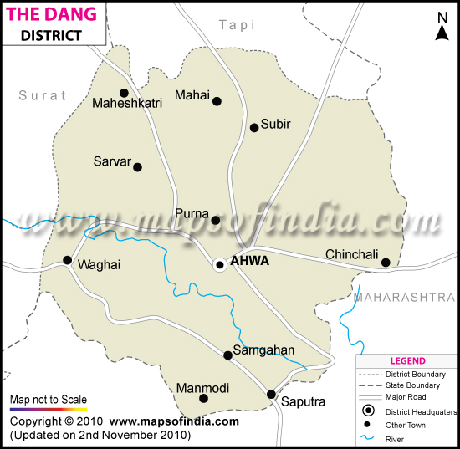
Dang - An Overview
1764 Sq. km
Area
~2.77 lakh
Population
~47K
Total HH
3
No. of Talukas
311
No. of Villages
Least populous district of Gujarat- 2.77 Lakh
Significant land area is covered by forests (Purna Wildlife Sanctuary)
Taluka | Population | No of Villages | No. of Household | FHTC | %
Ahwa | 123107 | 123 | 17546 | 17546 | 100
Subir | 67361 | 92 | 14478 | 14478 | 100
Waghai | 87272 | 96 | 15487 | 15487 | 100
Total | 277740 | 311 | 47511 | 47511 | 100

Slide 3
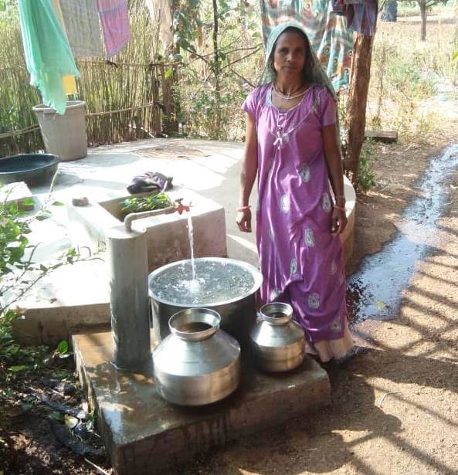
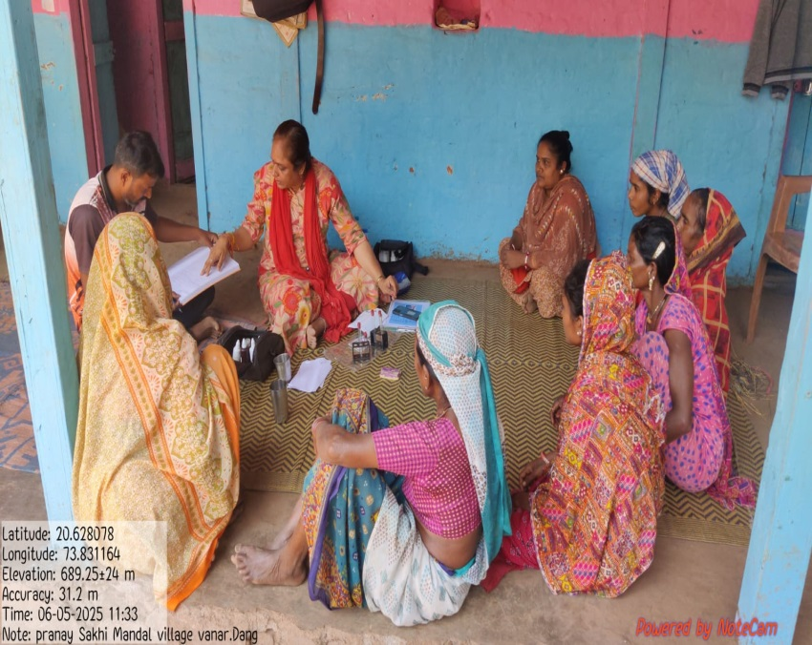
Performance overview
Quantitative aspects
100% of households covered with FHTC.
100% schools and anganwadis provided with tap water connection,
A total of 311 villages and 47,511 households have been covered by FHTC. All villages have access to clean and safe drinking water
Governance & Qualitative Aspects
100% villages where:
Village Water & Sanitation Committee (VWSC) have been constituted,
Village Action Plan (VAP) have been prepared, and
Women have been trained for water quality testing using FTK.
Water samples from 100% of villages are tested in laboratories for bacteriological and chemical parameters.

Slide 4


Sustainable O&M and Effective Governance

Slide 5
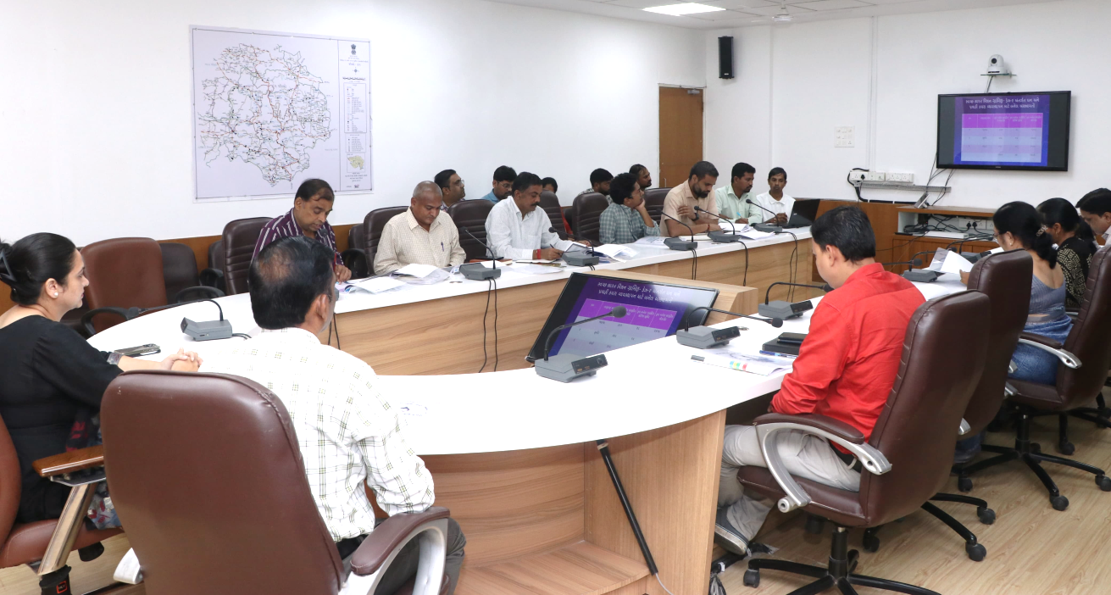
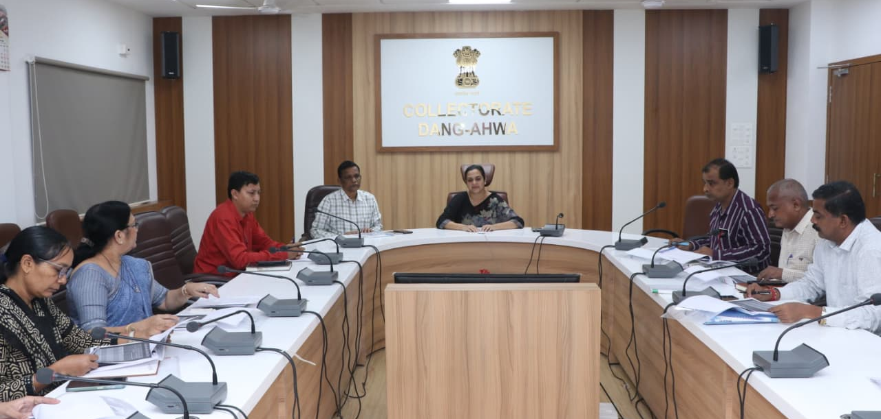
Regular monitoring by DWSU
01
Review of ongoing schemes and progress
02
Discussion on delayed/stalled schemes
03
Issues related to village-level water supply
04
O&M activities by PACS and SHGs
05
Discussion on water tax collection
06
Discussion on water quality testing and progress reports from FTKs
07
Discussion on the Nal Jal Mitra Programme
08
Pani samiti meetings, chaired by the Collector, are held every 15 days during summer

Slide 6
Engagement of SHGs and PACS in O&M of Village-level Water Supply Schemes
Promoting JAN BHAGIDARI
Training & Capacity Building of PACS
6 sessions, 193 PACS/SHG members trained
Agreement/ MOUs
01 PACS-GP MoUs : Work started
04 SHGs-GP MoUs : Work started in all GPs
Activities taken up
Water tax collection and deposit in GP
Support/ Coordination with Gram Panchayat for regular water supply and O&M
Tax collection performance
Significant improvement in water tax collection observed from last FY
WASMO has prepared O&M SOP for in-village water supply schemes for GP, PACS and SHGs

Slide 7

Effective Grievance Redressal Mechanism:
24 x 7 Public Grievance Redressal Mechanism
A toll-free number “1916” for water supply related issues
Website based grievance registration https://wasmows.gujarat.gov.in
Complaint status tracking possible
SMS based real-time complaint status
Confirmation SMS after resolution for service feedback
96%
2.03 days
99.93%
Grievances resolved within 72 hours
Average grievance resolution time
Positive feedback on proactive call centre

Slide 8
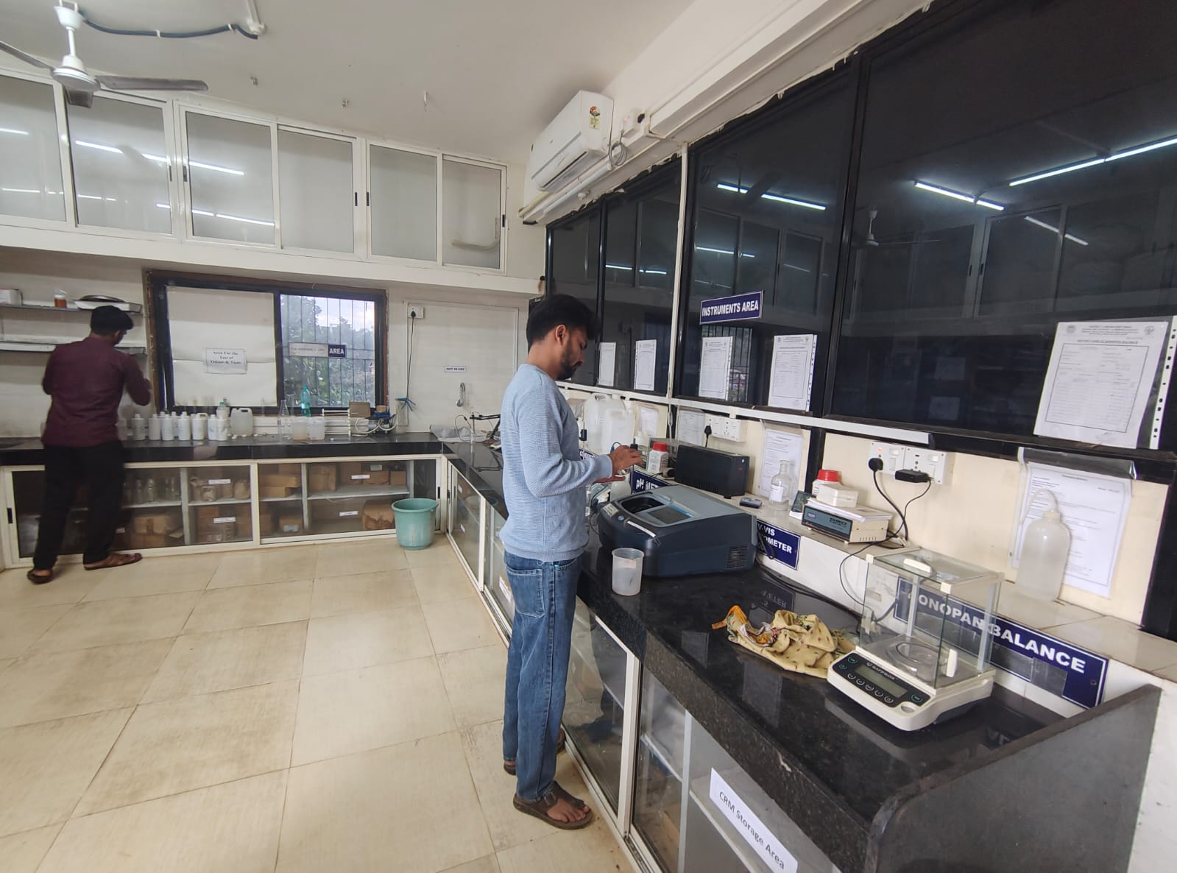
Testing Infrastructure
District has 1 fully functional NABL accredited laboratories for Water Quality Testing.
Testing and Remedial Action taken monitored through Dashboard (WQMIS).

Slide 9
Capacity Building and IEC

Slide 10
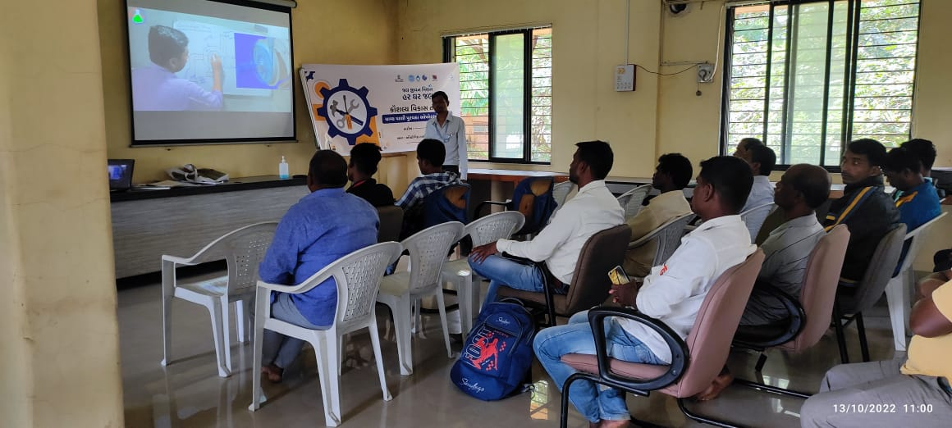
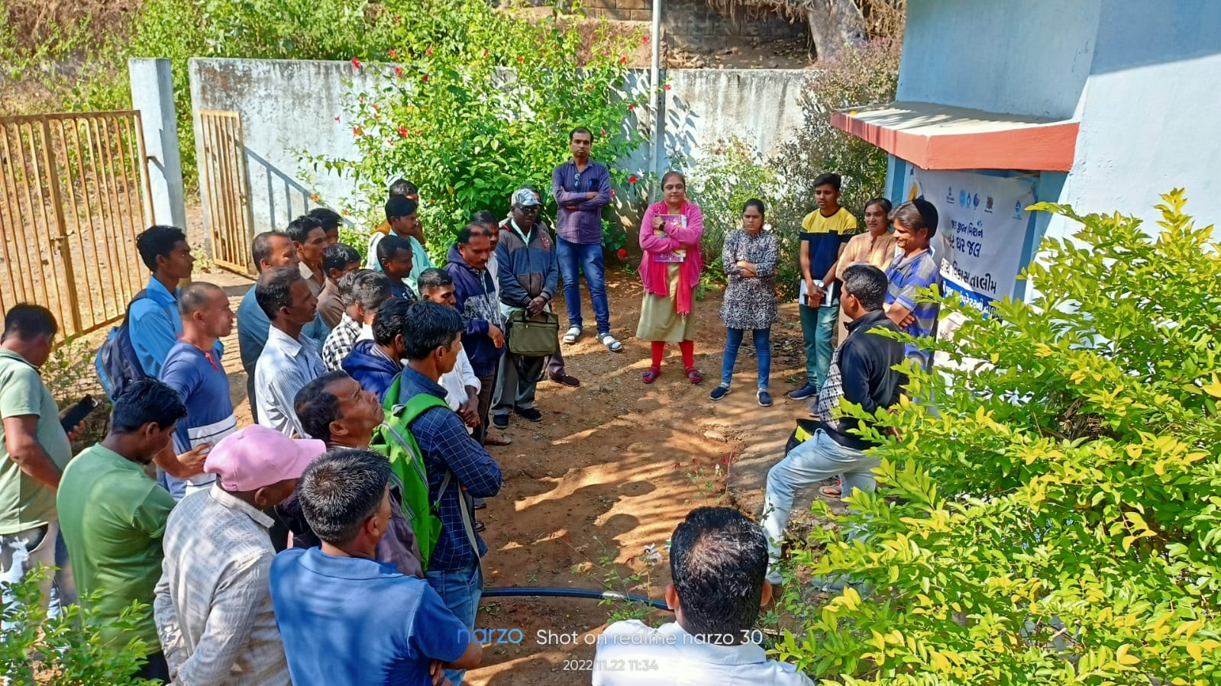
Training of water supply operators at ITI
A special 10-day course for Water Supply Operators conducted at various ITIs, along with certification.
An advanced tool-kit for all operational activities to all water supply operators.
All 311 village operators have received ITI training

Slide 11
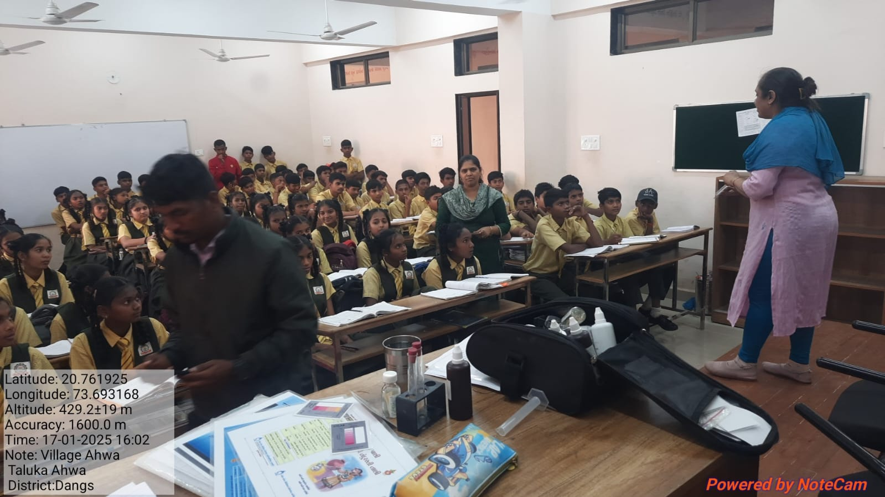
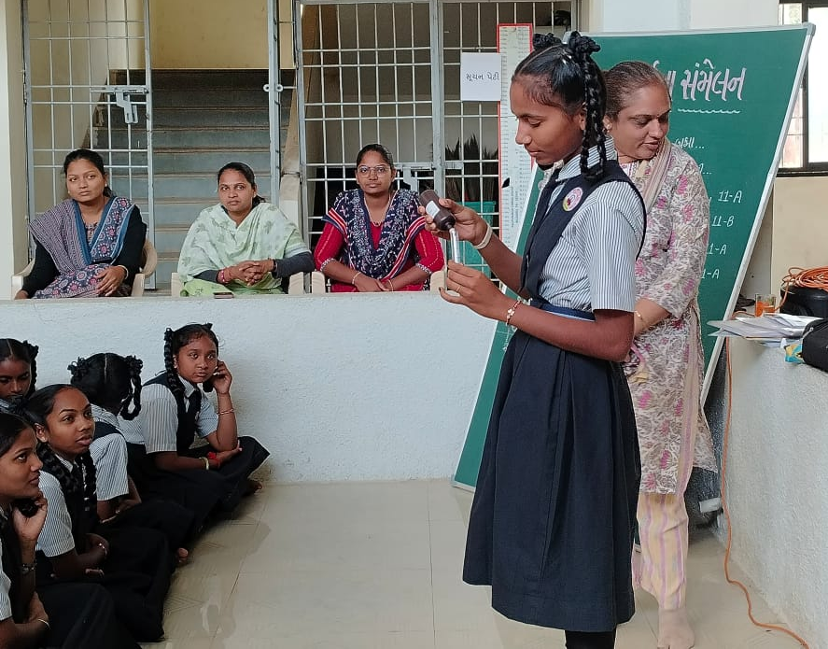
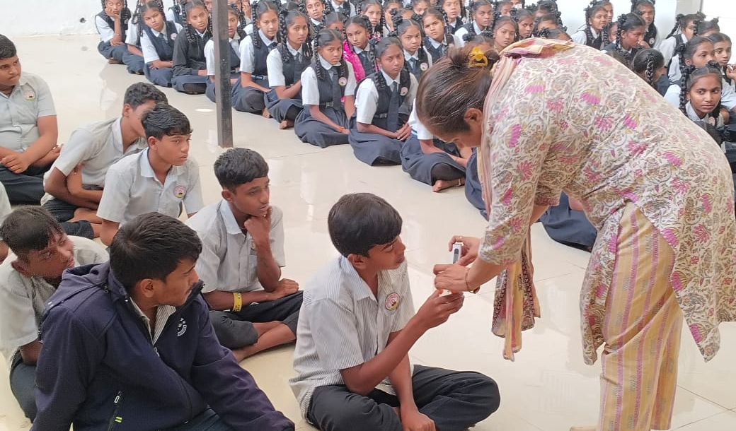
Water Quality Awareness: At Schools & Health Centres
Water quality testing
awareness campaign at schools
Water quality testing awareness campaign at schools

Slide 12
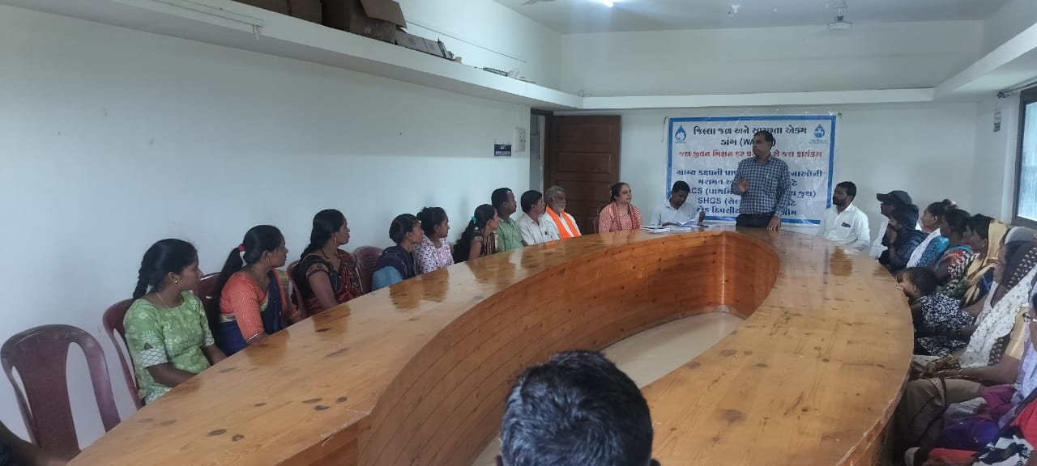
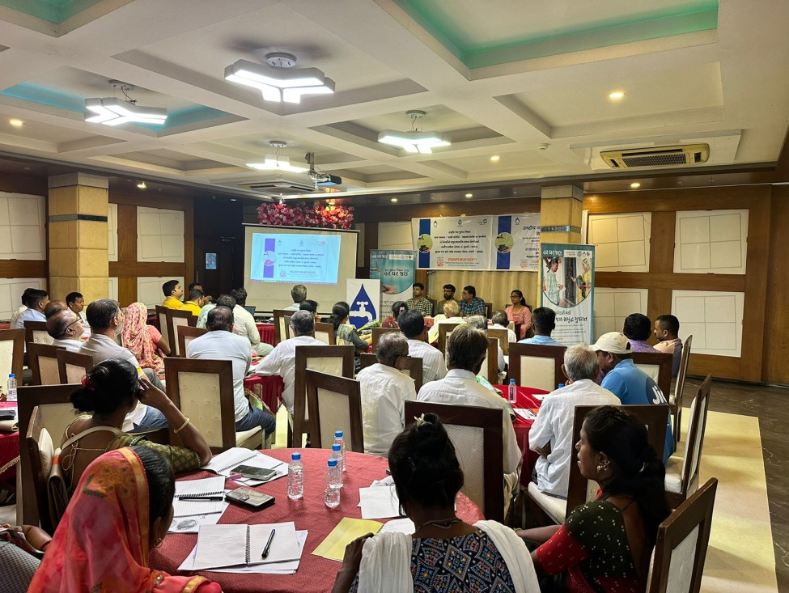
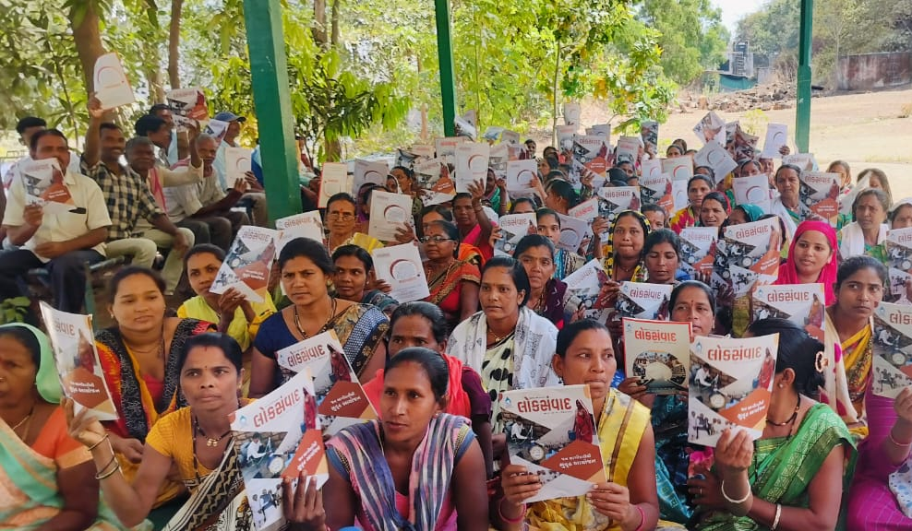
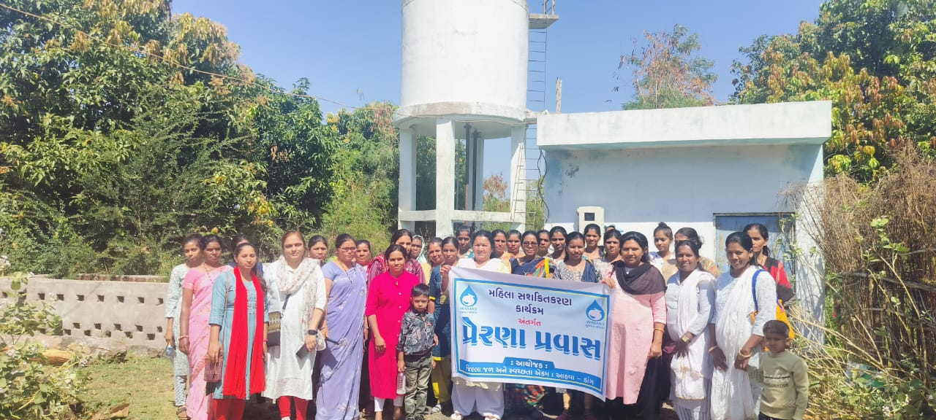
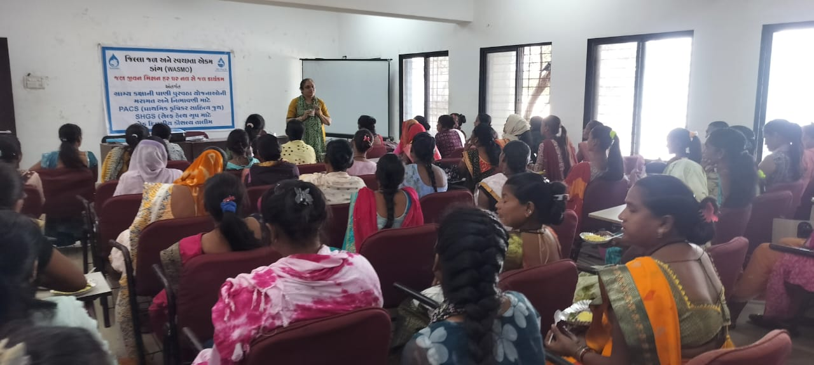
SHG/ PACS members training
Pani Samiti members training
Women empowerment campaign
Capacity building of Pani Samiti, SHGs and PACS
H/W Prerna Pravas: VWSC members
SHGs members training
Prerna Pravaas to Headworks: 898 Pani Samiti members participated

Slide 13
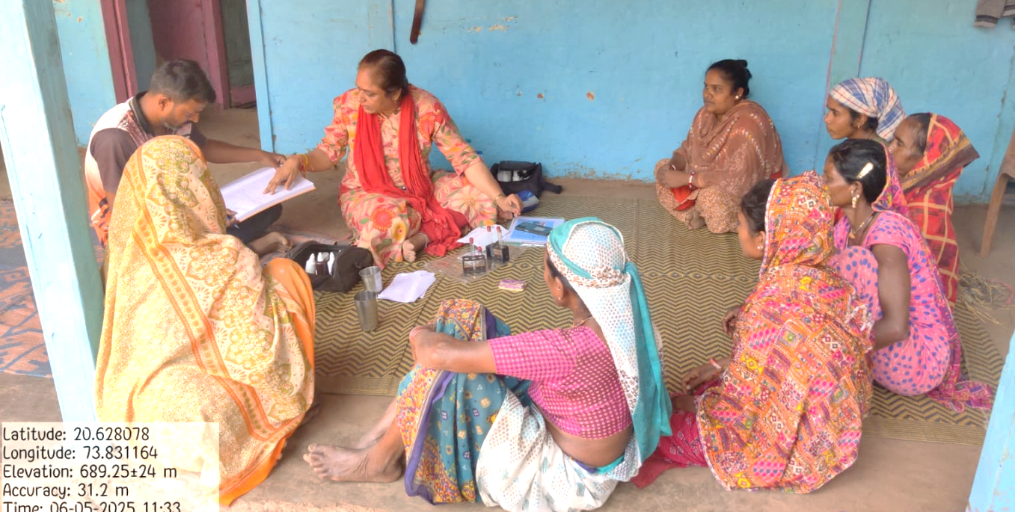
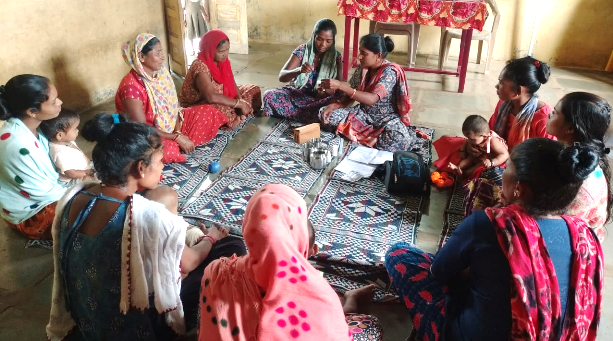
Training Provided to Village Water Committee by WASMO
Practical training on using Field Test Kit (FTK) for water quality testing.
Committee members can independently test village drinking water.
Parameters checked: pH, color, taste, chlorine, TDS, etc.
Builds awareness on safe and clean drinking water.

Slide 14
Best Practices

Slide 15
Water Tax Collection: Incentive Scheme
Water Tax Collection Scheme Overview:
Financial stability is a critical success factor for sustaining the in-village water supply schemes.
As per Panchayat Department data for FY 2023-24, water tax collection in approximately 5,900 villages was below 30% against the raised demand.
To achieve effective management of village-level water supply scheme, GPs shall be financially self reliant (steady source of revenue). To address this, WASMO has initiated efforts to enhance water tax collection.
To improve tax collection in underperforming villages, an incentive scheme has been proposed with following conditions:
This scheme is planned for 2 years (2025-26, 2026-27)
Budget allocation for the first year is ₹53 crore.
The funds to be used for O&M activities.
Beneficiaries: GP/ VWSC, PACS/SHGs and VCEs

Slide 16
Incentive Framework for Each Beneficiary
Beneficiaries of the Incentive Scheme: Gram Panchayat/Water Committee, PACS/ SHGs and Village Computer Entrepreneur (VCE)
1
2
3
Gram Panchayats /
Pani Samitis
PACS and
SHGs
VCE
1.1 GP that collect 50% or more of the total water tax demand will receive Incentive equal to the amount collected, up to ₹1,50,000.
1.2 Pani Samitis/ GP that achieve 100% collection then additional ₹50,000 incentive for achieving full water tax collection from all households.
PACS and SHGs that collect 50% or more of the total water tax demand will be eligible for an incentive of ₹30,000.
Additionally, if PACS and SHGs collect 100% of the demand, they will receive an additional ₹20,000, bringing the total incentive to ₹50,000.
During the financial year, VCEs will be eligible for an incentive of ₹7 per house for the water tax collected from each house.

Slide 17
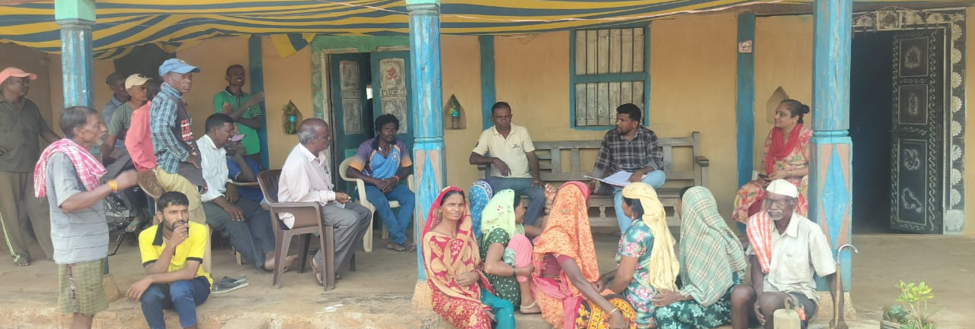
Performance of Dang district: Water tax collection incentive scheme
Villages with 0-30% targeted for improvement program.
Collection increased from ₹2.09 lakh to ₹13.07 lakh in one year.
Average collection increase of ₹14,000 per village.
Demonstrates financial sustainability and participatory governance.
Water tax collection increased in 57 out of 79 target villages in the district

Slide 18
O&M Incentive and Reward Scheme
O&M incentive scheme for good performing Gram Panchayats in tribal areas
(grievance management, daily water supply, quality etc.)
Selection Parameter for incentive
Process:
Gram Panchayats are eligible for incentives up to ₹2,00,000 for excellence in O&M, assessed through complaint resolution, water distribution efficiency, timely repairs, tax collection, and overall management performance.
Sr. No. | Parameters
1. | Prompt and effective resolutions of complaints Steps taken by GP to reduce complaints Prompt and effective action taken to resolve complaints
2. | Repair and Maintenance Regular water distribution Motor/leakage repair arrangements Timely performance of repairs
3. | Operator salary
4. | Water tax and Collection Revenue and Expenditure of water tax Levy of water tax
5. | Water Quality Water testing through FTK Chlorination
News Paper Advertisement
Evaluation
Approval by district level committee
State level committee

Slide 19
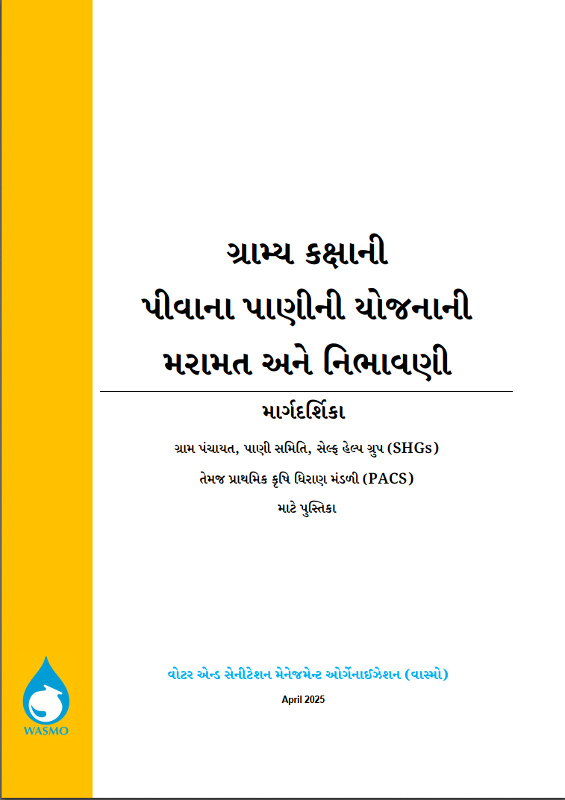
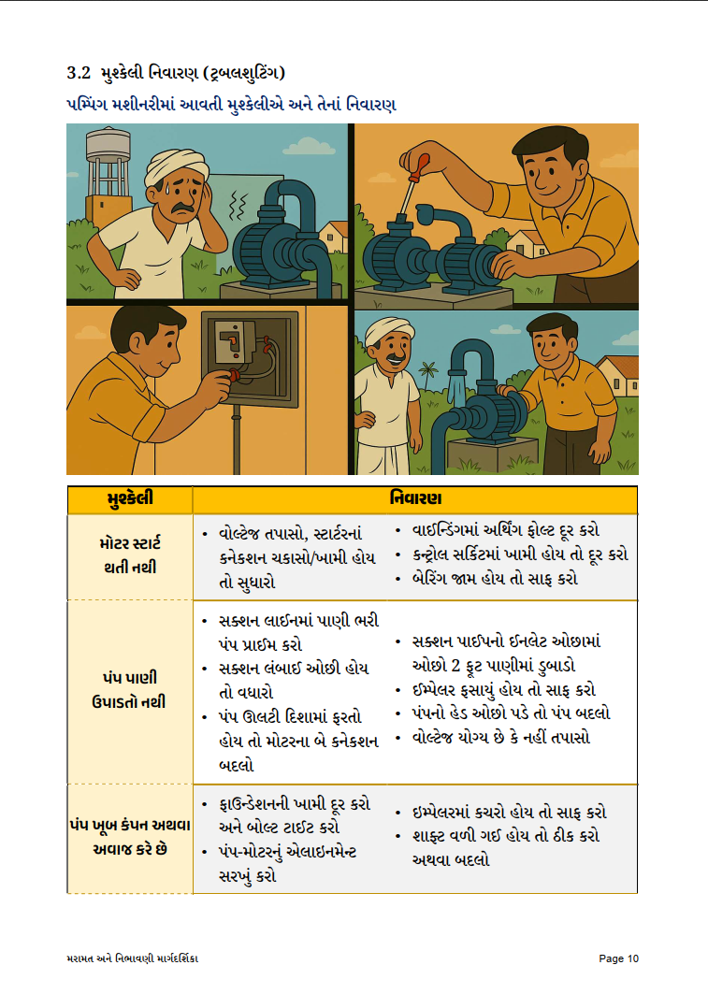
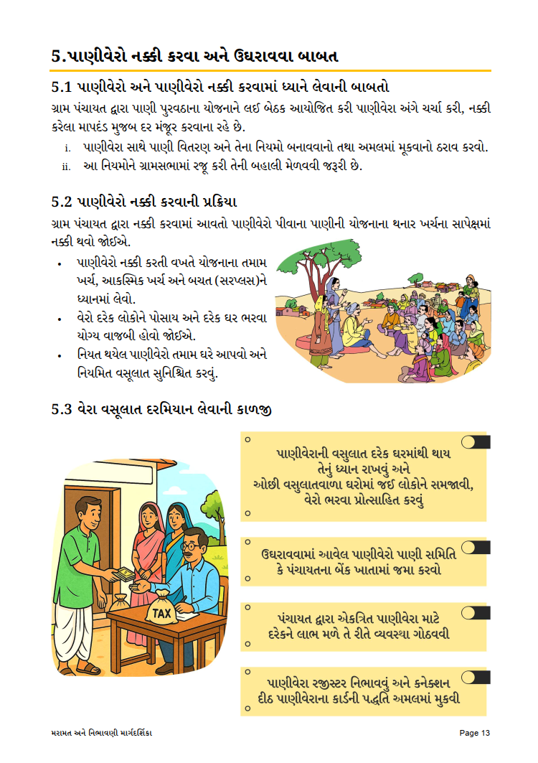
O&M SOP for in-village water supply schemes for GP, PACS and SHGs

Slide 20
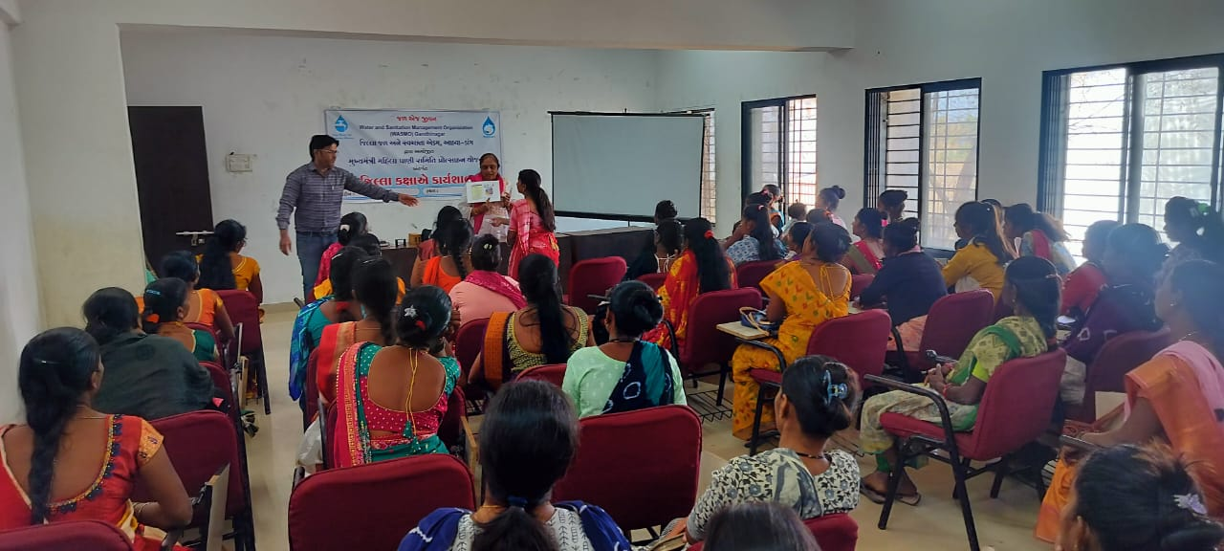
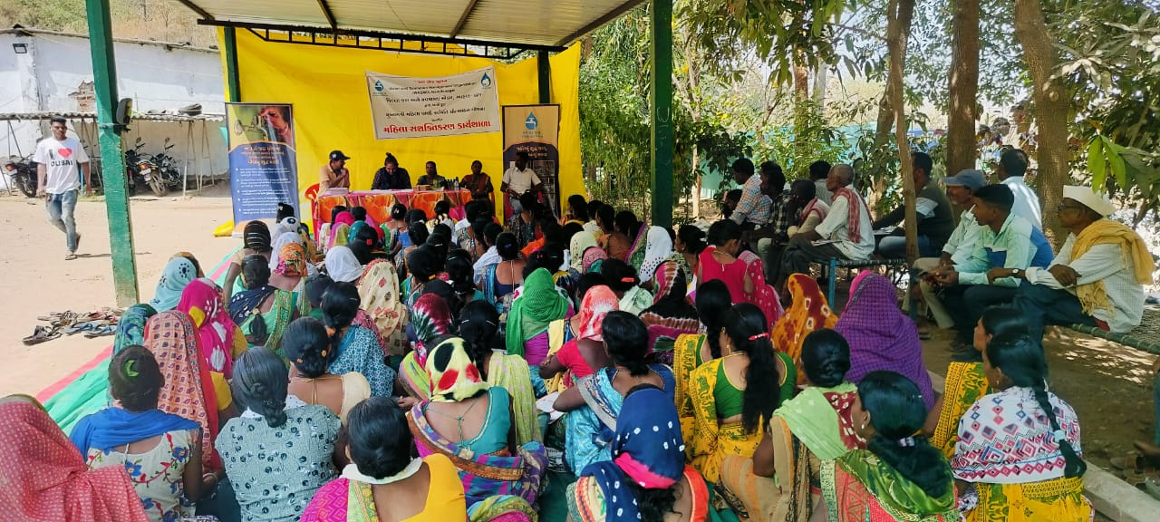
Mahila Pani Samiti Protsahan Yojana - Best Practice
To enhance women’s participation in rural water supply schemes, WASMO promoted the formation of Women’s Water Committees.
The Water Supply Department, Government of Gujarat, launched the Mukhyamantri Mahila Pani Samiti Protsahan Yojana to strengthen this initiative.
Workshops, training sessions, and exposure visits were organized to empower women in water management and governance.
Progress in Dang district:
Block/Dist workshop: 5 workshop, 597 Women Participant
Exposure Visit: 174 Women Participant
Women's committees were encouraged by awarding ₹50,000 each. Total 21 Women Pani Samiti (above 70% women member)
Performance-based Rewards: Given to Women Pani Samitis excelling in tax collection, maintenance, and scheme management.

Slide 21
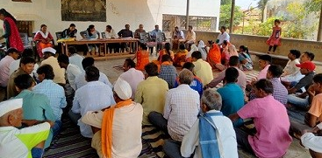
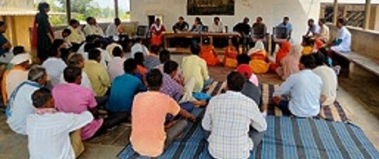
Case Study: Malegam Village (Ta: Ahwa, Dist: Dang)
Malegam village, Ta. Ahwa is located in Dang district. The village with 330 households, achieved 100% tap water coverage under the functional scheme.
Daily water supply ensured with regular chlorination and adequate pressure across all zones.
100% households pay ₹50/month; full recovery maintained by Pani Samiti. Monthly review meetings held by Sarpanch; no grievances pending, system monitored daily.
Scheme completed in 2021 and handed over to women-led Pani Samiti for community-led operation and maintenance.
Pani Samiti ensures effective management. Despite the geographical challenges of Dang, the village ensures regular, clean, and reliable water supply through active community participation.
Recognized under Mahila Pani Samiti Puraskar Yojna for outstanding women-led management and community contribution.

Slide 22
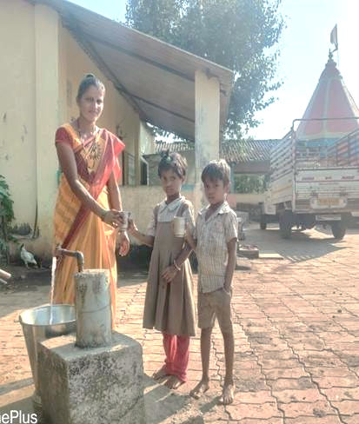
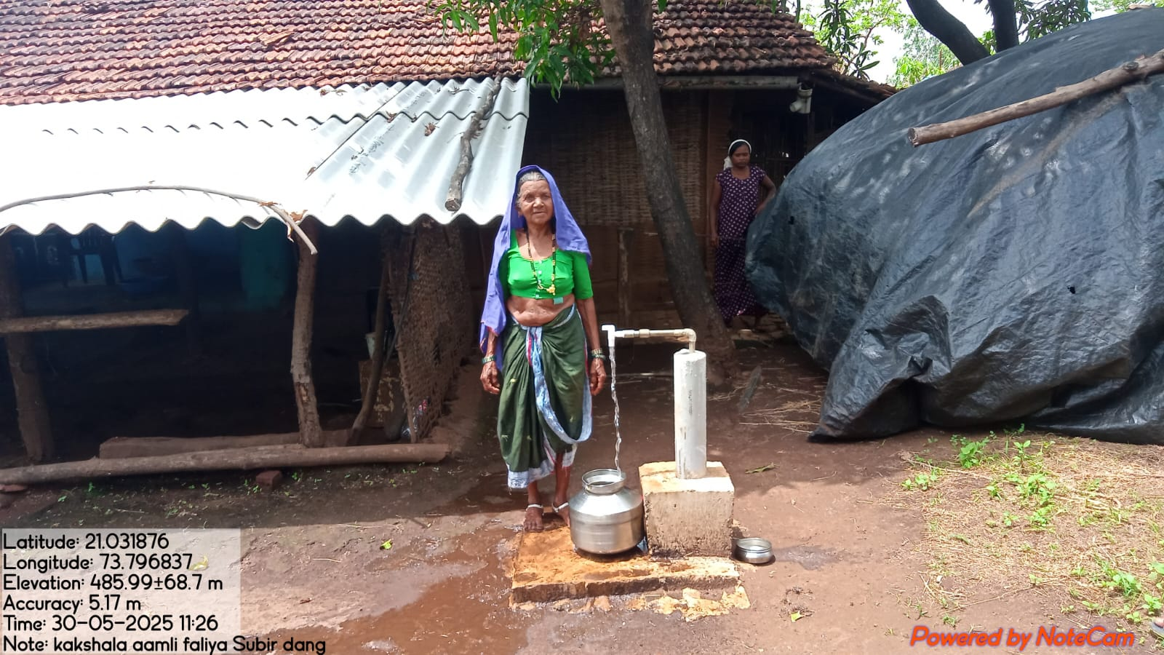

Slide 23
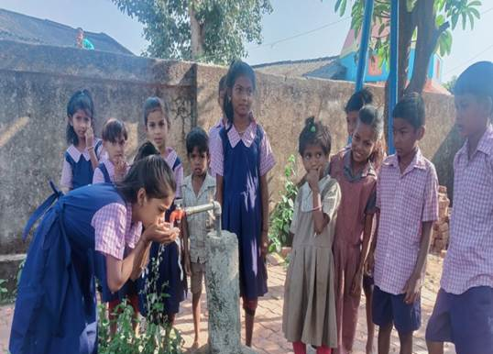
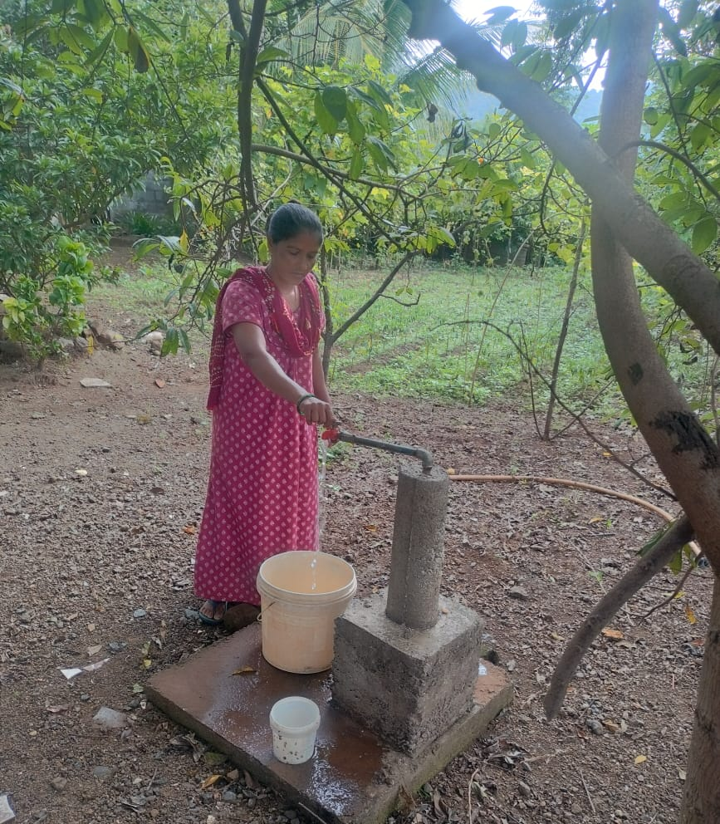
THANK YOU

