Slide 1



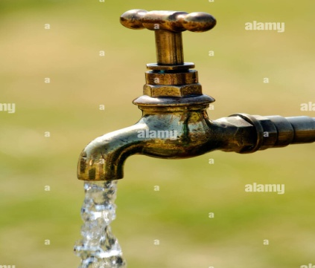
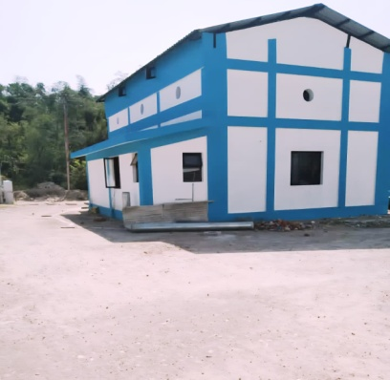
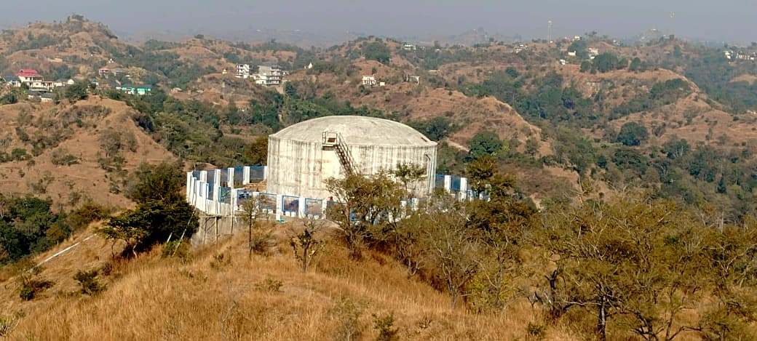

Jal Shakti Vibhag
GOVERNMENT OF HIMACHAL PRADESH
DISTRICT WATER & SANITATION MISSION (DWSM), HAMIRPUR DISTRICT HIMACHAL PRADESH
Peyjal Samvad Report
30th October, 2025

Slide 2
District Summary
Particulars | Status
Total GPs/VCs | 248
Total Households | 1,12,658
FHTCs Provided | 1,12,658
Balance Households | 0
% Coverage (Overall) | 100 %
Har Ghar Jal Villages | 1675 Villages
Schools with Tap Water | 100 % (920 of 920)
Anganwadis with Tap Water | 100 % (1304 of 1304)
PVTG Household Coverage | No PVTG House hold exist in District, Hence not applicable in this District.
Bru Settlements Coverage | No Bru Community settlement in District, Hence not applicable in this District.

Slide 3
1. DWSM Planning & Implementation
District Action Plan (DAP) and Village Action Plans (VAPs) prepared for all 248 GPs, integrating source sustainability and O&M.
Implementation follows community-led JJM approach through VWSCs with technical support from JSV Division of District Hamirpur.
Scheme mix (as on 30.09.2025): 66 No. Lift Water Supply Schemes distributed across Hamirpur District amounting to Rs. 41554.72 Lakh. Out of 66 No. Schemes 23 No. Schemes are completed and 43 No. Schemes are ongoing and further funds to the tune of Rs. 9712.62 Lakh required to complete these Schemes.
Annual implementation target for FY 2025-26 is nil in respect of District Hamirpur.

Slide 4
Monitoring Mechanism
Quartly review meetings held under the Chairmanship of District Collector & Executive Engineer (JSV) cum Member Secy.
IMIS portal used for real-time data entry and functionality tracking.
Grievance redressal system functional through CM Sankalp Portal, CP Gram, e-Grievance, through Complaint Registers, through Mobile and field visits by JSV officers/official.
Independent functionality survey conducted quarterly covering parameters of quantity, quality, reliability and equity.

Slide 5
2. DWSM Issuance of Protocols for Handing over
All the 248 Nos. GP’s were encouraged to take over in village infrastructure of PWS through motivational programme and out of which 120 Nos. GP’s had submitted their consent to takeover the in village infrastructure of PWS.
Efforts are being made to motivate the balance GP’s to takeover the in village infrastructure of the PWS.
There are 120 Nos. Nal Jal Mitar had been trained in various ITI’s of the district for ensuring their capacity building for O&M.

Slide 6
3. Effective IEC Plans
Jan Bhagidari campaigns conducted in all 248 Nos. Panchayats of 6 Nos. blocks to promote community ownership and water quality awareness.
School & Anganwadi IEC activities conducted in coordination with the Education Department and BRC’s posted in all blocks of the District.
Mass IEC tools used: wall paintings, posters, folk songs, and street plays highlighting Har Ghar Jal objectives and quality/quantity of drinking water in all Blocks of the District.
Swachhata Pakhwada and Jal Jeevan Utsav observed to enhance behaviour change communication.

Slide 7
4. Best Practices in Real Time
Real-time monitoring of PWS schemes via mobile reporting by Junior Engineers and VWSCs and through field visits by JSV officers/official.
100 % household coverage achieved as on 30.09.2025 across all 6 blocks of the District.

Slide 8
5. Source Sustenance Plans
Village Water Security Plans (VWSPs) prepared for all 248 Nos. GPs.
Dams, Check Dams, Dykes etc, are provided for source sustainability of various LWSS through out the District and in future JSV is planning other structures for source sustainability.

Slide 9
6. Engagement of SHGs / PACS
Village Water Security Plans (VWSPs) prepared for all 248 Nos GPs.
All the GP’s of this District were encouraged for water charges collection and take over the O&M of in Village Infrastructure of PWS.
2 Nos. PRI representatives from each Panchayat of this District have been trained for Water Quality Testing and in addition to this 5 Nos. Women from each Village of the District have been trained for Water Quality Testing through FTK.
All the Govt. Sr. Sec. Schools (95Nos.) and Govt. High Schools (66Nos.) of the District have been trained for Water Quality Testing through FTK.
120 Nos. Jal Nal Mitars of the District Were trained for Water Quality Testing through FTK by BRC’s of JSV and for O&M of in Village Infrastructure of PWS these 120 Nos. Jal Nal Mitar were trained through various ITI’s of the District and in future it is planned to trained 128 Nos Jal Nal Mitar.

Slide 10
7. Innovative & Replicable Initiatives
Community WhatsApp monitoring system used for real-time functionality updates – replicable in other districts.
Grievance redressal system functional through CM Sankalp Portal, CP Gram, e-Grievance, through Complaint Registers, through Mobile and field visits by JSV.
120 Nos. Jal Nal Mitars of the District Were trained for Water Quality Testing through FTK by BRC’s of JSV and for O&M of in Village Infrastructure of PWS these 120 Nos. Jal Nal Mitar were trained through various ITI’s of the District and in future it is planned to trained 128 Nos Jal Nal Mitar.

Slide 11
8 .Best Practices for Har Ghar Jal (HGJ) Certification
All 248 Nos. GPs of the District have been declared Har Ghar Jal till 30.09.2025.
Third-party investigation conducted in every running/completed work by Third-party Agency for proper implementation of JJM work.
Community awareness on strengthened through VWSC meetings regularly.

Slide 12
Additional Highlights
School and Anganwadi coverage 100%, ensuring safe drinking water for students and children.
100% FHTC coverage achieved in the District.

Slide 13
Conclusion
District Hamirpur Himachal Pradesh has achieved 100 % household tap connection coverage.
All 248 Nos. GPs of the District have been declared Har Ghar Jal till 30.09.2025.
2 Nos. PRI representatives from each Panchayat of this District had trained for Water Quality Testing and in addition to this 5 Nos. Women from each Village of the District have been trained for Water Quality Testing through FTK.
120 Nos. Jal Nal Mitars of the District Were trained for Water Quality Testing through FTK by BRC’s of JSV and for O&M of in Village Infrastructure of PWS these 120 Nos. Jal Nal Mitar were trained through various ITI’s of the District and in future it is planned to trained 128 Nos Jal Nal Mitar.

Slide 14
Jal Jeevan Mission
A Success Story

Slide 15
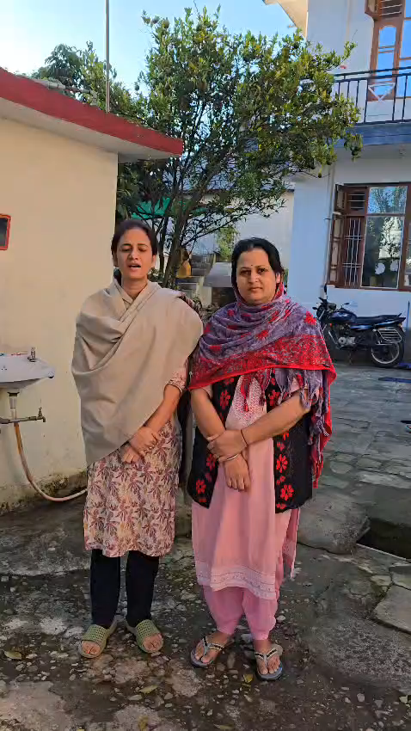
Beneficiaries of Jal Jeevan Mission

Slide 16
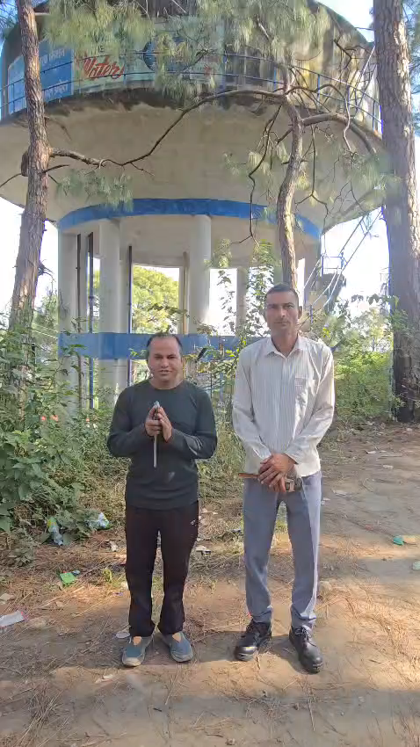
Training of Jal Nal Mitra

Slide 17
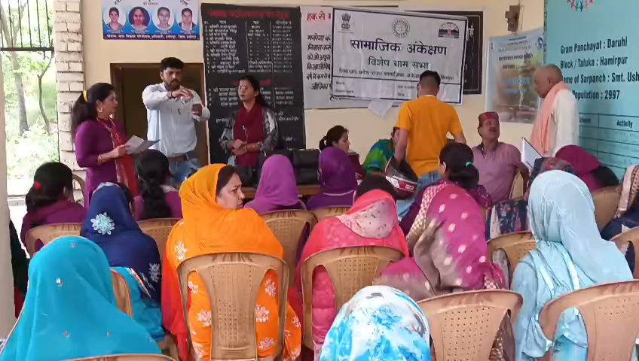
Water Testing Training of PRI’s at Panchayat Level

Slide 18

Training of 5 Nos. Women from each Village for Water Testing Through FTK

Slide 19

School Children Participation on World Water Day

Slide 20
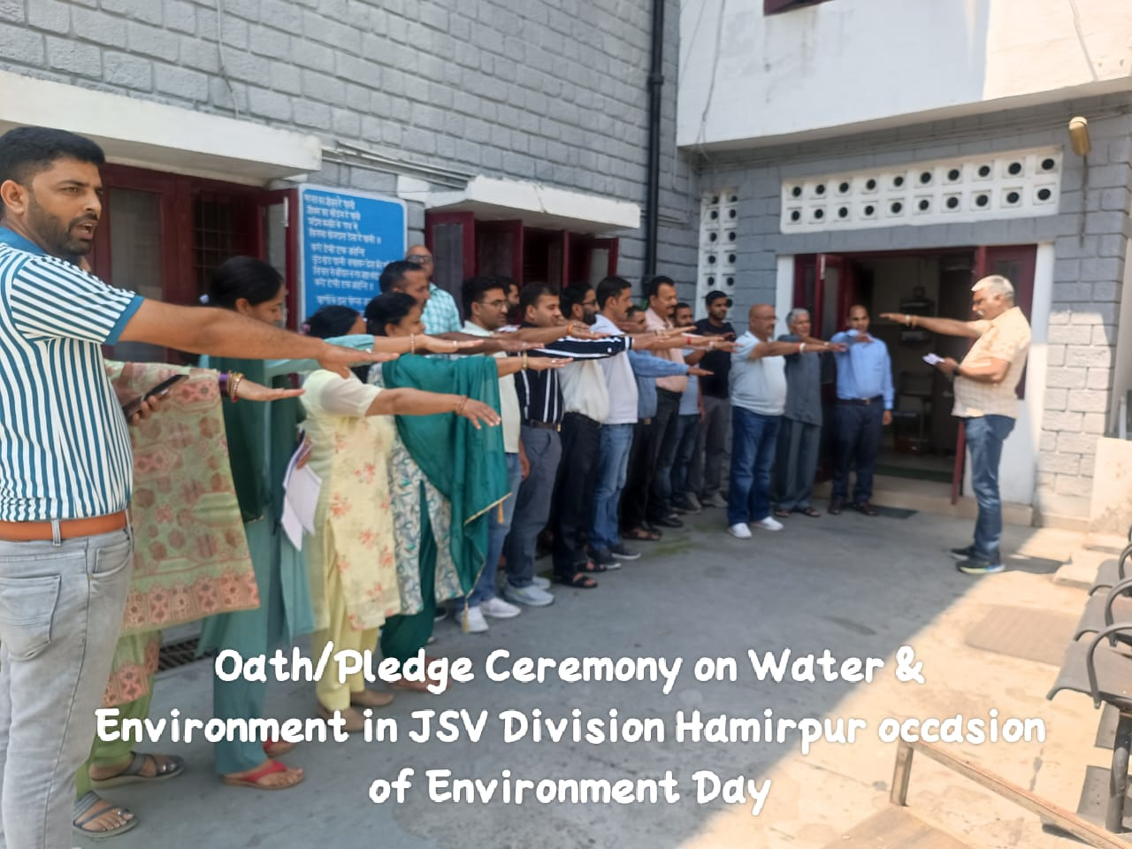

Slide 21

THANKS

