Slide 1
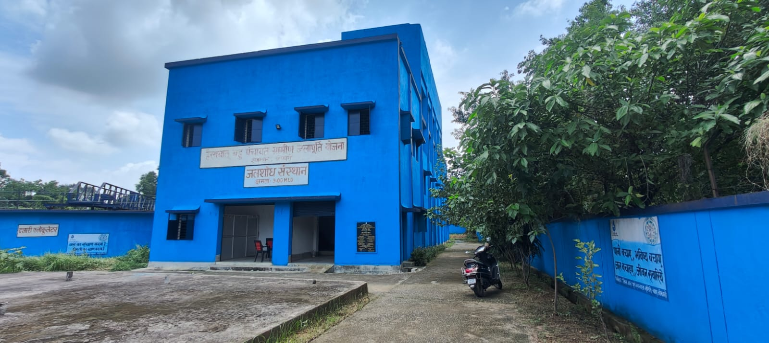

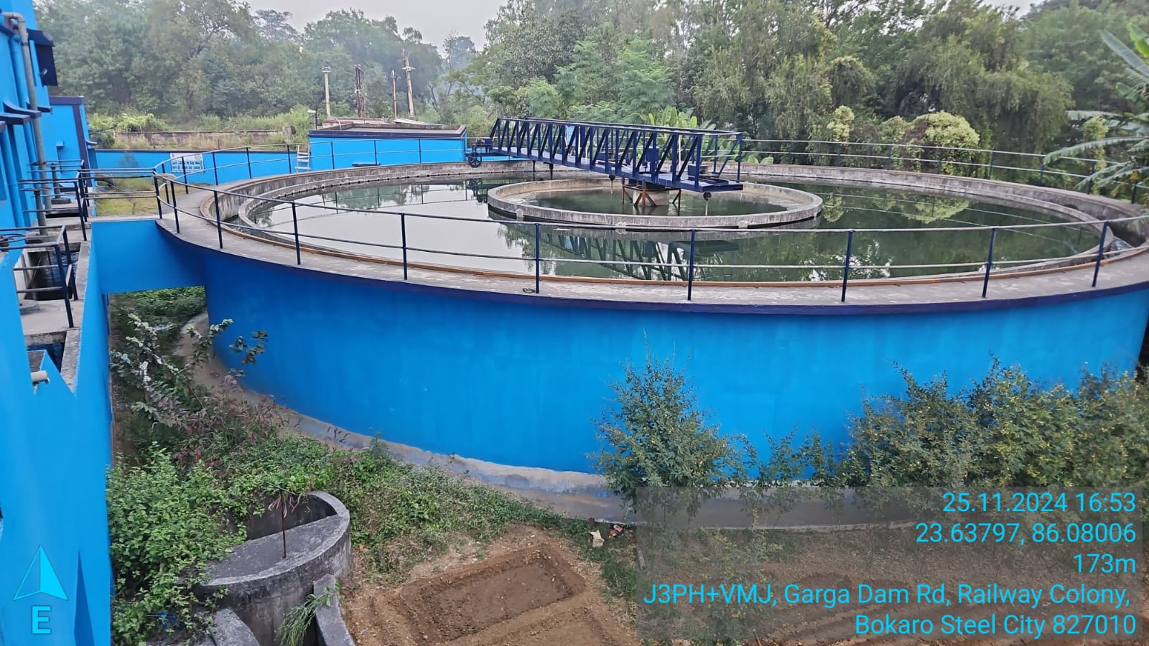
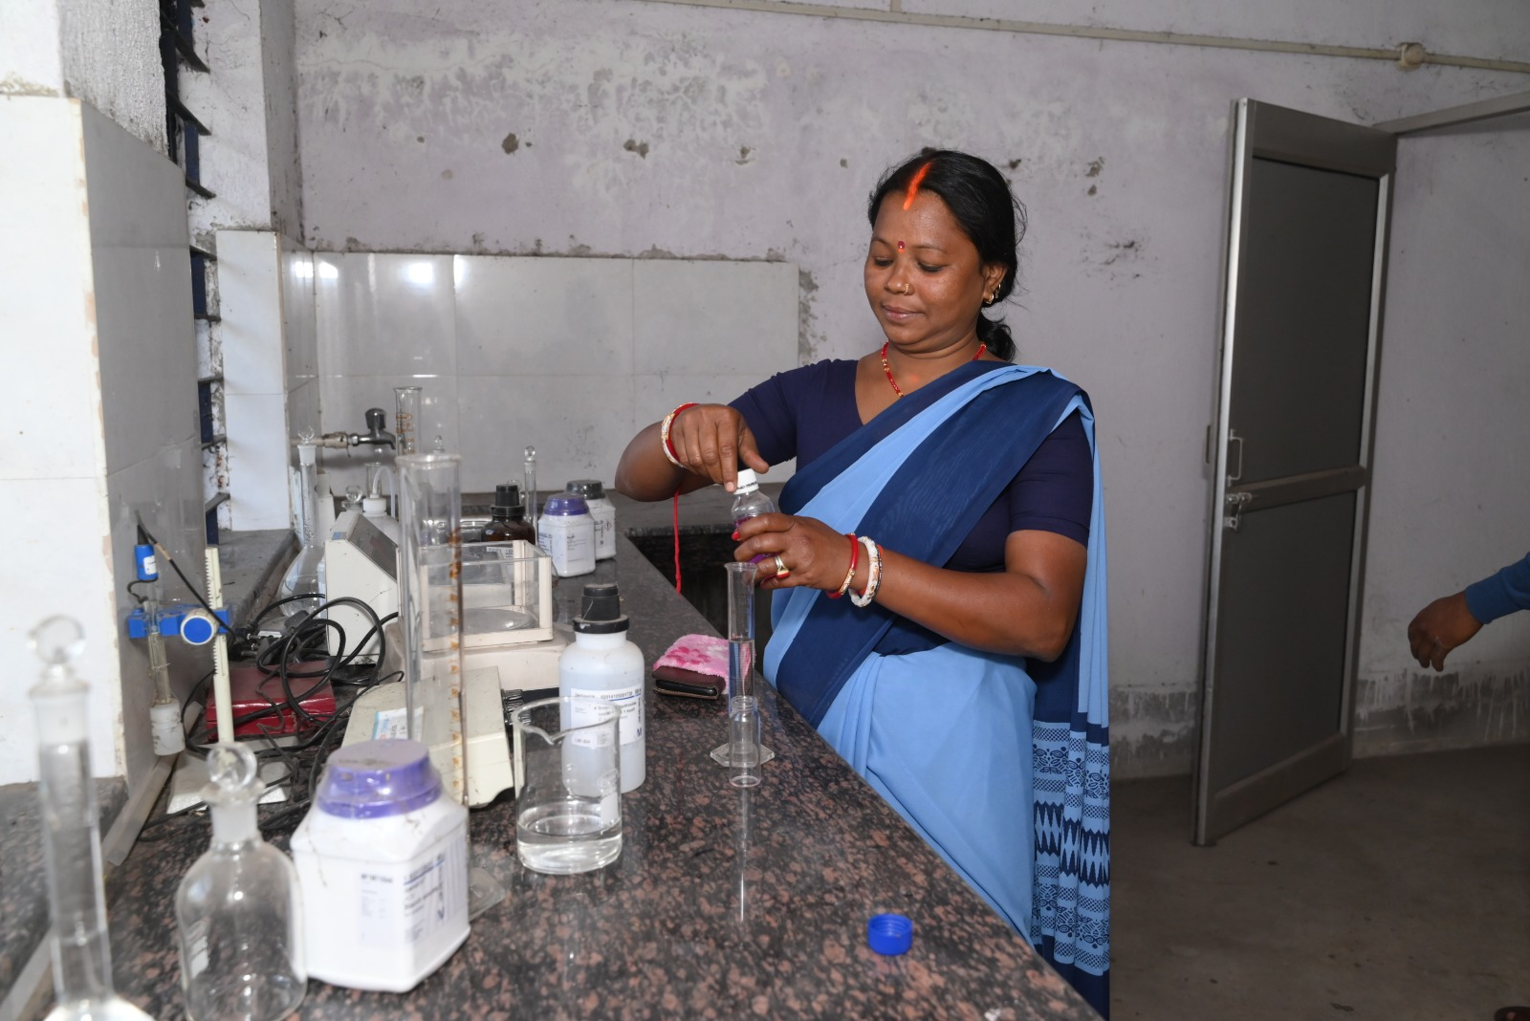
Govt. of
Jharkhand
Drinking Water
&
Sanitation Department
Peyjal Samvad with District Collectors
District-Bokaro
Topic: Women Leadership in O&M of water supply schemes

Slide 2
Jal Jeevan Mission: FHTC Coverage

Slide 3
Progress of Schemes and HGJ Villages
No. of Schemes under JJM | Total Schemes as per IMIS | Physically Completed Schemes as per IMIS | Physically Completed Schemes Handed Over to VWSCs as per IMIS
Multi Village Schemes (MVS) | 436 | 352 (80.73%) | 352 (100%)
Status of Village Coverage
Total Villages | Villages with 100% | Har Ghar Jal Reported Villages | Har Ghar Jal Certified Villages
691 | 91 | 75 | 67

Slide 4
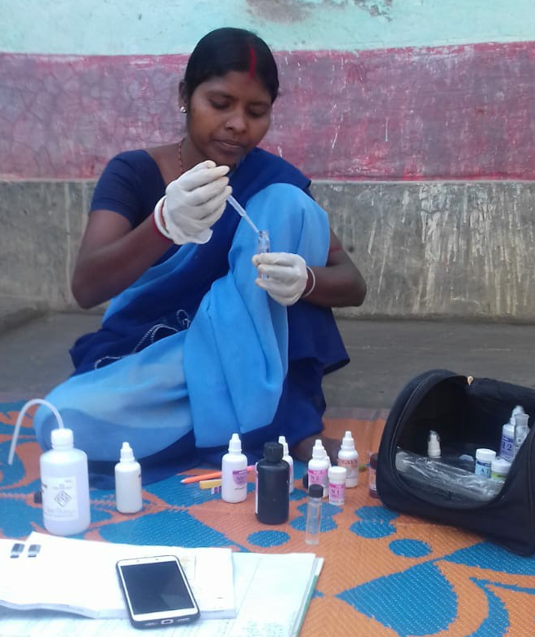
Jal Sahiyas: Jal Doots
As grass root cadres, the Department initiated the concept of Jalsahiyas in 2011 and selected the frontline women workers from Gram Sabhas for the delivering services of Water Sanitation & Hygiene (WASH) to every rural family.
As treasurer of the village water sanitation committees (VWSC), Jalsahiyas are joint signatory for O&M under JJM and SBM-G funds for selected Village Water and Sanitation Committee (VWSCs)
Jalsahiyas are responsible for implementation water, sanitation and hygiene programmes and WASH awareness activities in their respective villages.
Jalsahiyas conducts water quality testing using FTKs for assured quality drinking water distribution in their respective villages, and collect water user charges for O&M of water supply schemes.

Slide 5
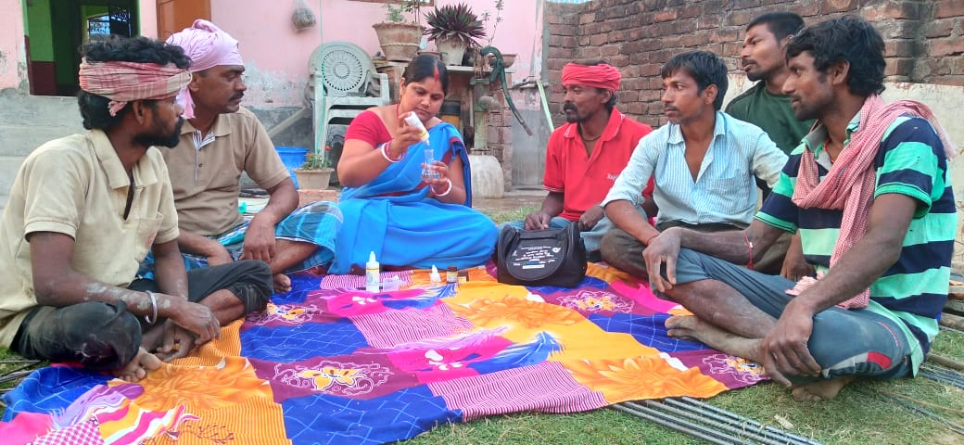
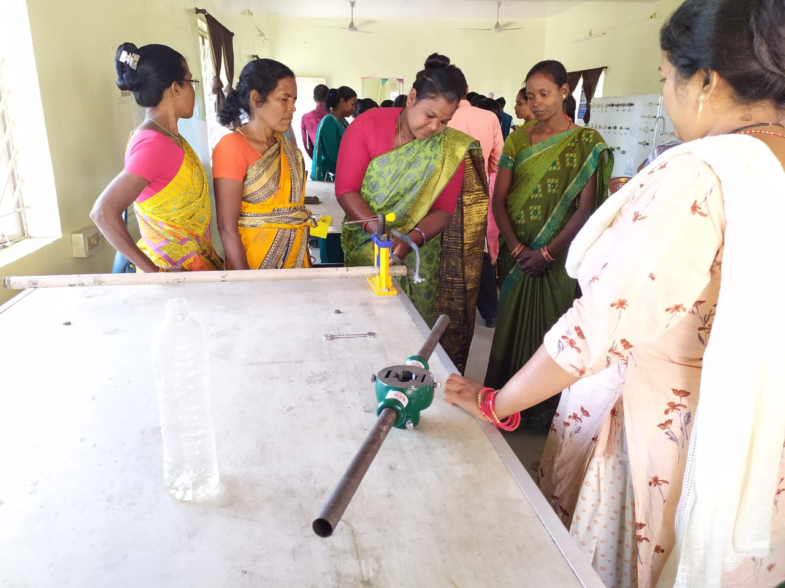
Jan Bhagidari of Jalsahiyas in Drinking Water Services
Jalsahiyas ensure coverage of FHTC to every household in their villages.They reach out to last household for assured drinking water service.
Manage the tasks of O&M of water supply schemes
Conduct awareness activities and Gram Sabhas for water user charges collection and sensitisation on consumption of quality water for public health.
Breaking stereotypes leading to an equitable and equal society
Support in achieving Sustainable Development Goals of 5 (Gender Equality and Women Empowerment) and Goal 10 (Reduce inequality).

Slide 6
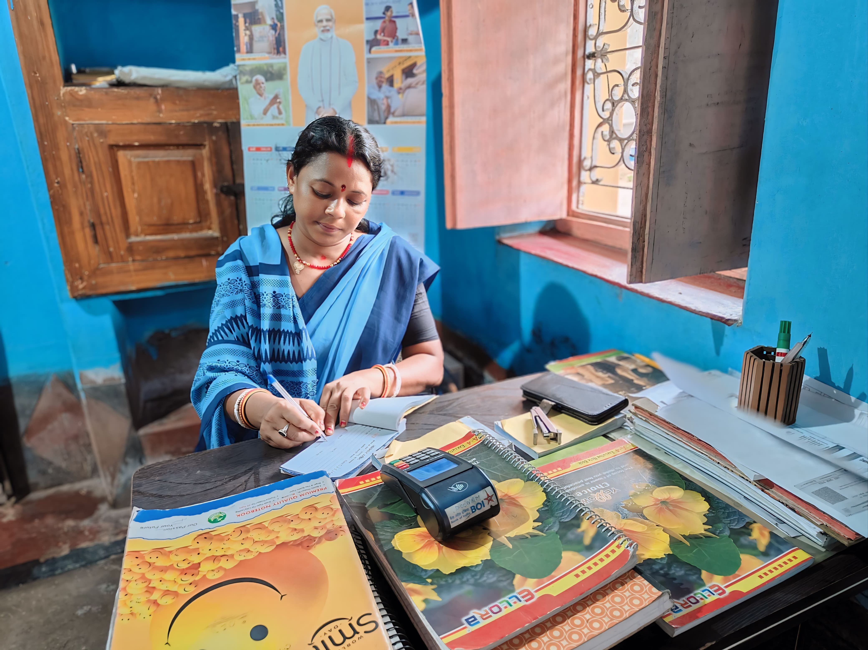
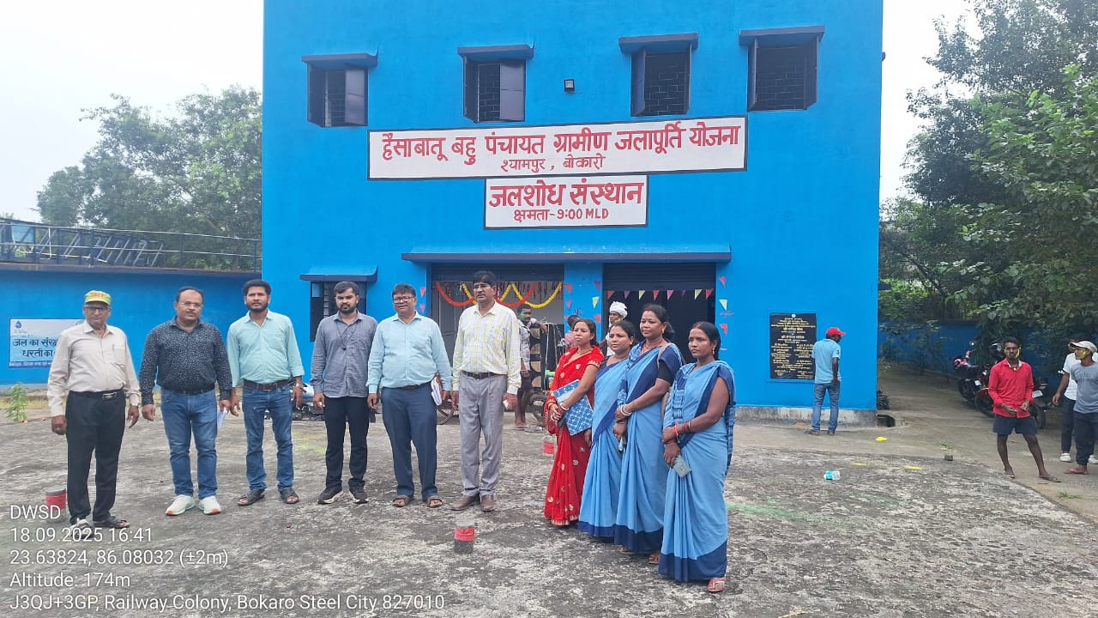
Nari Shakti se Jal Shakti
Jalsahiyas are playing pivotal role in implementation of JJM and O&M of water supply schemes along with taking rigorous water quality testing in Bokaro district. District Bokaro has taken an initiative for digitally collect the water tariffs. The initiative is called E-Jal Kar. An ePOS machine has been given to the selected Jalsahiyas. They are collecting water user charges from beneficiaries through e-payment using QR code. For Hesabatu Rural Supply Scheme, Jalsahiyas have collected 1.72 Cr.

Slide 7
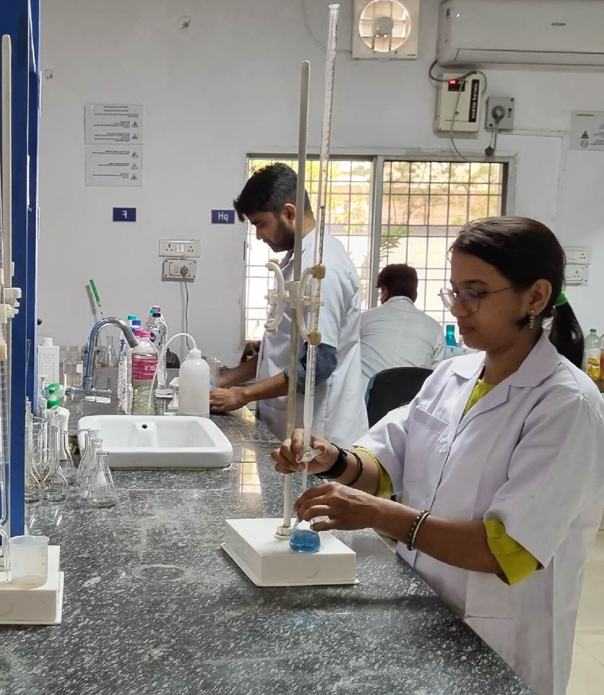
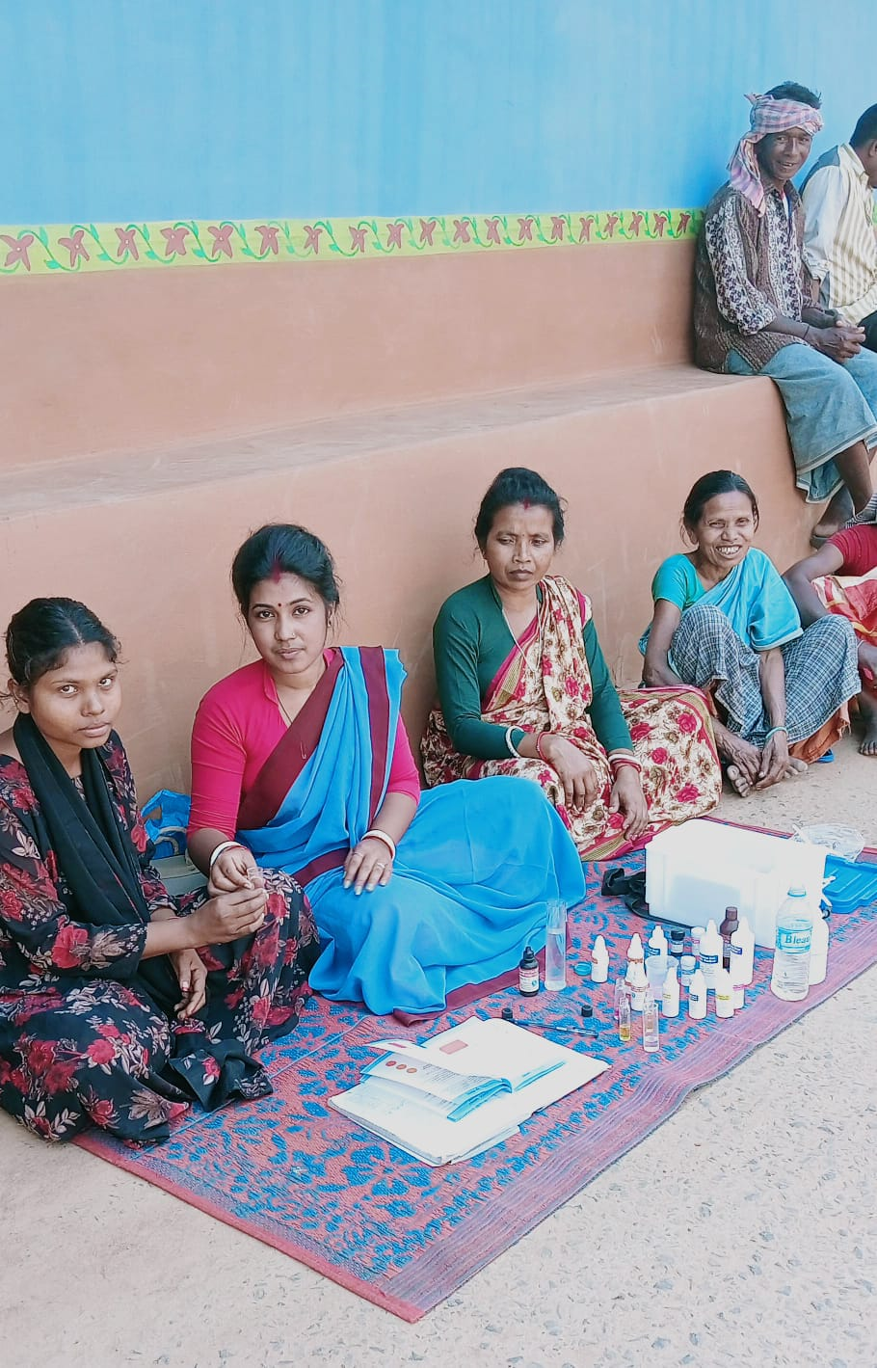

Thank you

