Slide 1

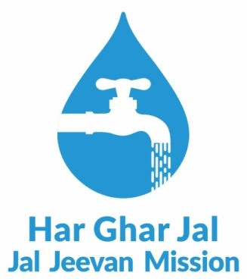
Jal Jeevan Mission
Collectors Peyjal Samvad
Leh-Ladakh District

Slide 2
Leh Ladakh District Overview
Coverage Matrices | Status
Total No. of Household | 21,688
FHTCs provided as on 27th Nov, 2025 | 21,505 (99.16 %)
Total no. of villages | 115
No. of HGJ village reported | 109 (95%)
No. of HGJ Certified Villages | 100
No. of Water Testing Laboratories | 05 Labs

Slide 3




Monitoring and Implementation of Jal Jeevan Mission Schemes
The successful implementation of Jal Jeevan Mission in Leh District has been driven by a robust monitoring framework that combines institutional strengthening, ground-level verification, transparency mechanisms, and social accountability. This multi-layered approach ensures effective delivery and long-term sustainability of water supply schemes.
Institutional Framework & Planning
Physical Verification & Ground-Level Monitoring
Formation of Block Level Water and Sanitation Committees (BLWSC) to decentralise planning and oversight
Physical inspections conducted in every village to verify actual status and quality of work on the ground
Training programmes provided to PRIs to build their capacity for effective monitoring and management of JJM works
Panchayati Raj Institutions specifically trained to monitor JJM projects, ensuring local ownership
Details from physical verifications uploaded to portal for public access
Transparency & Public Grievance Redressal
Social Accountability & Audit
Dedicated online grievance portal launched for registering and tracking complaints
Mandatory village-level social audits conducted to involve community in reviewing work, expenditures, and outcomes
Toll-free number and WhatsApp service to make grievance mechanism accessible to all beneficiaries
Reports from social audits updated on public portal, ensuring accountability to villagers
Note: JJM Ladakh Grievances Dashboard link: https://jaljeevanladakh.in/grievance_register
Social Audit report and Physical Verification report are available for general public via https://jaljeevanladakh.in/report

Slide 4





Effective IEC Plans and Its Implementation
Information, Education, and Communication (IEC) activities formed the backbone of community engagement under JJM in Leh District. A strategic, multi-channel approach was adopted to ensure awareness reached every household, fostering participation and behavioural change at the grassroots level.
Grassroot-Level Outreach
IEC campaigns were carried out directly in villages to ensure people received clear and practical information about water supply schemes and their benefits.
Engagement of Implementing Support Agency (ISA)
An ISA was engaged to conduct various IEC activities and support field execution, bringing technical expertise and implementation capacity.
Strategic IEC Planning
Activities were planned with focused strategies to improve awareness, participation, and behavioural change amongst community members.
Special Month-Long Campaign – Jal Jeevan Maah
A dedicated campaign was organised for one month to promote Jan Bhagidari (people's participation) and strengthen community involvement in
water management.
Focus Group Discussions (FGDs)
FGDs were conducted at the village level to understand local issues and encourage active community dialogue on water security.
Multi-Channel Communication Strategy
Different communication channels were used to spread key messages widely and effectively, including wall paintings, hoardings and banners, quiz and debate competitions at schools, short informative videos, TV and radio shows, newspaper advertisements, and brochure and pamphlet distribution.

Slide 5
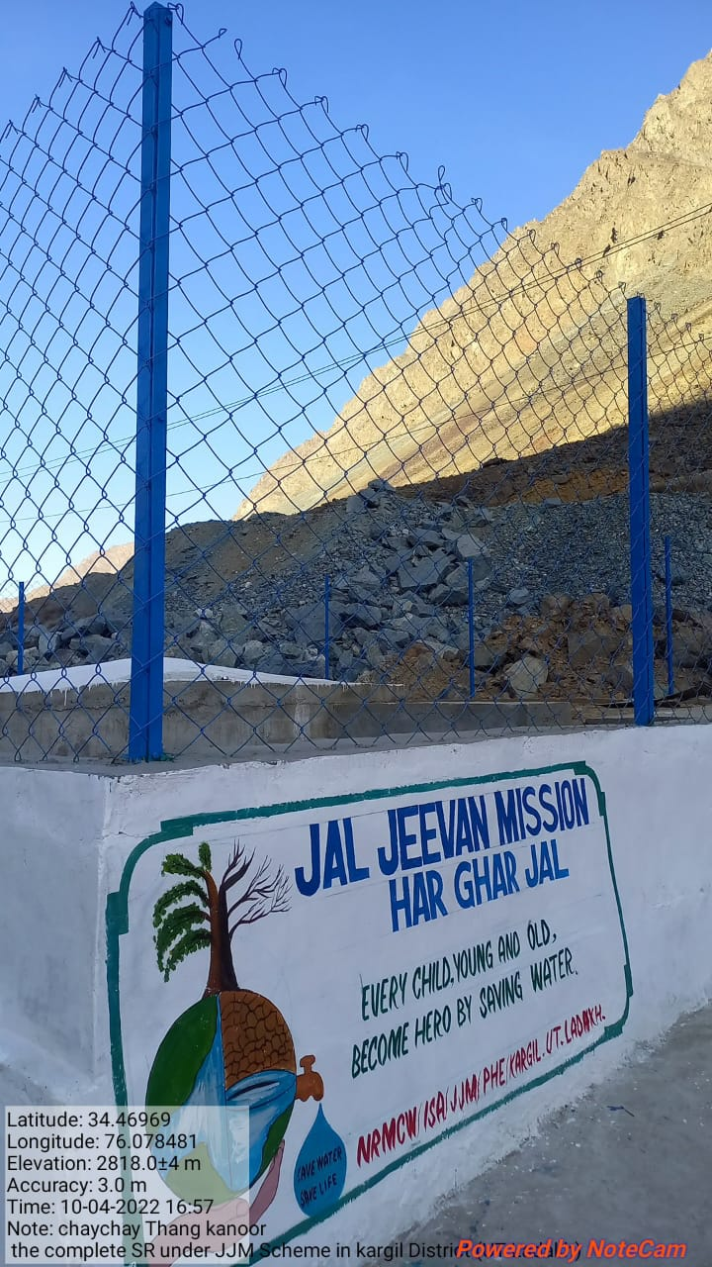
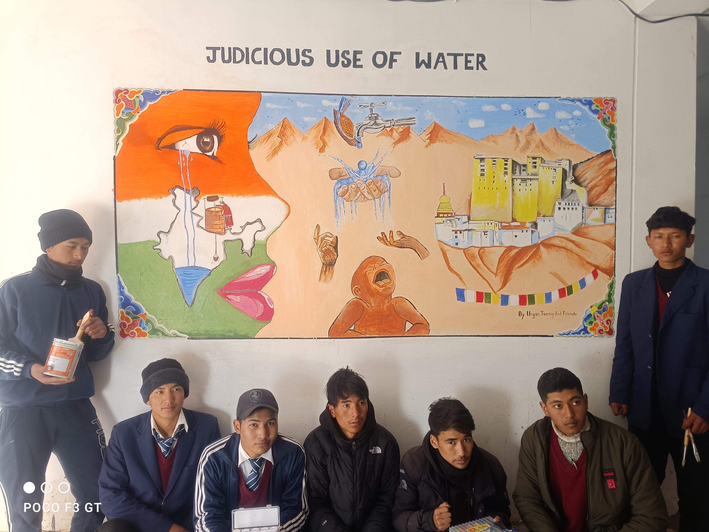
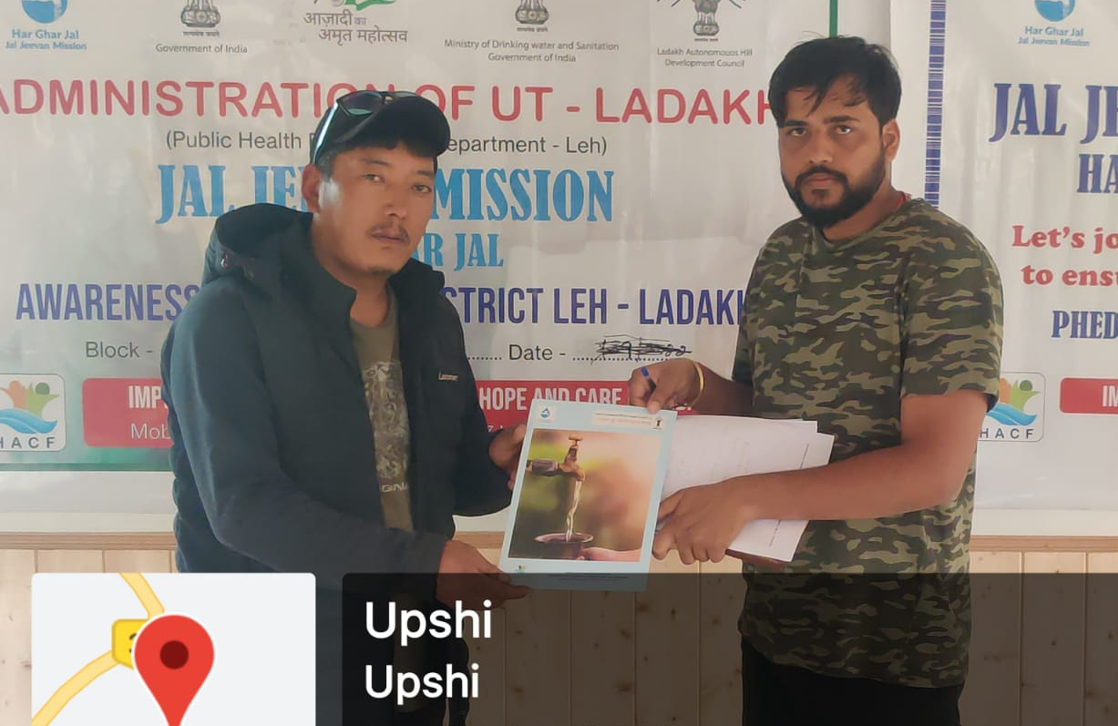
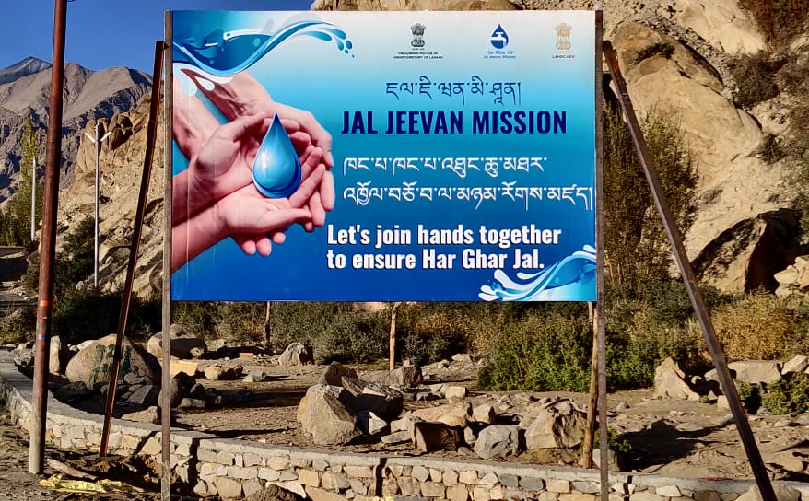
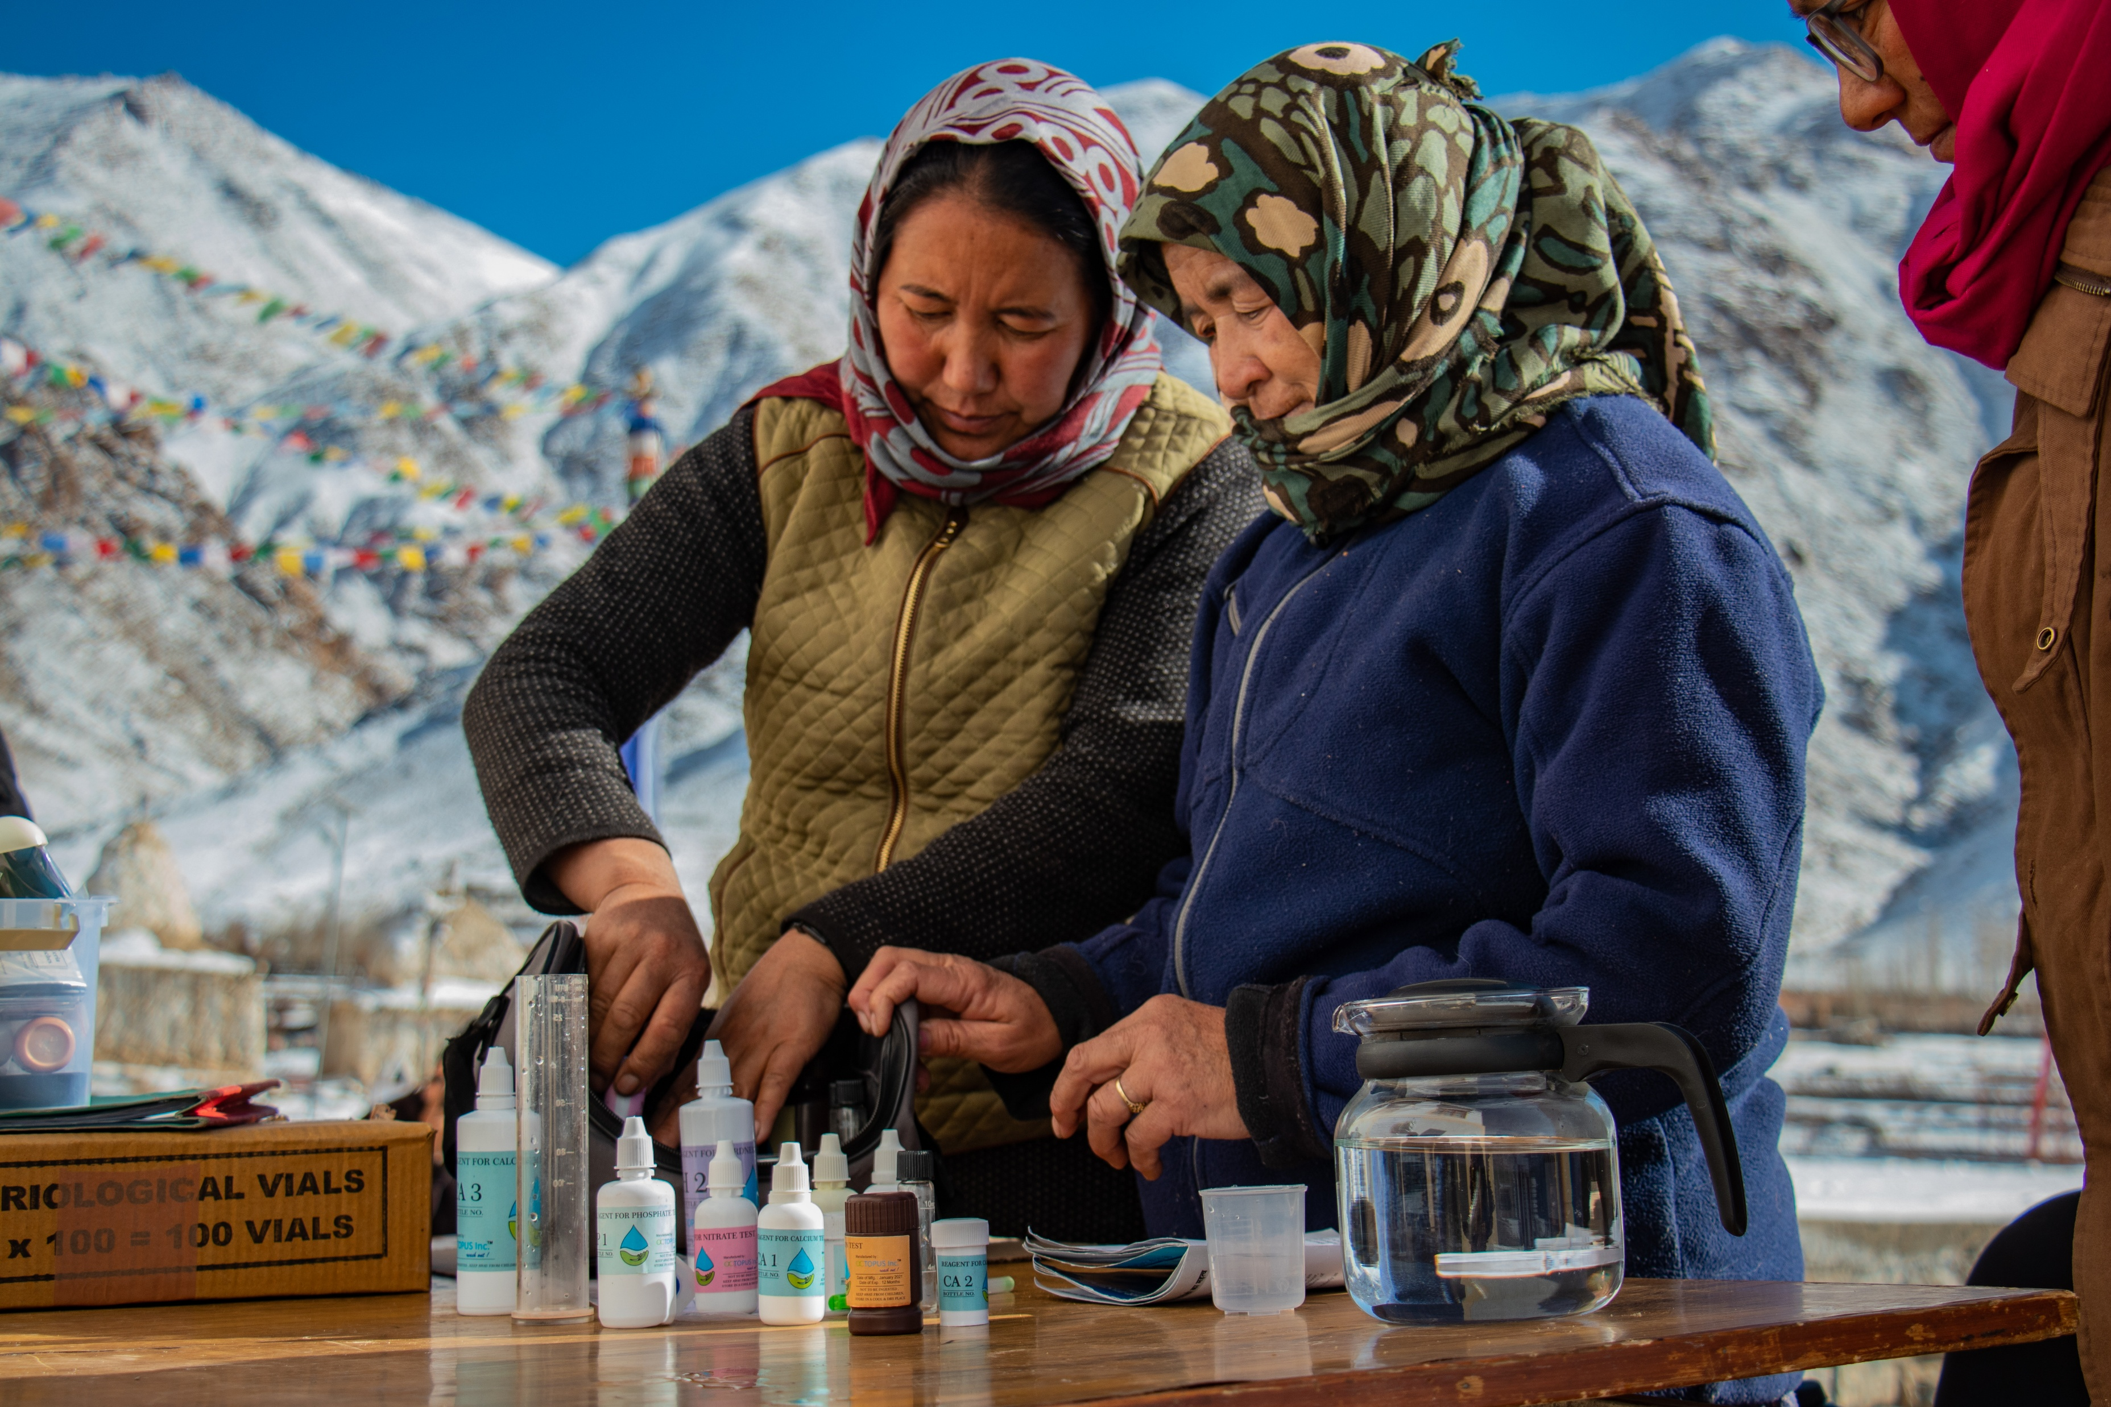
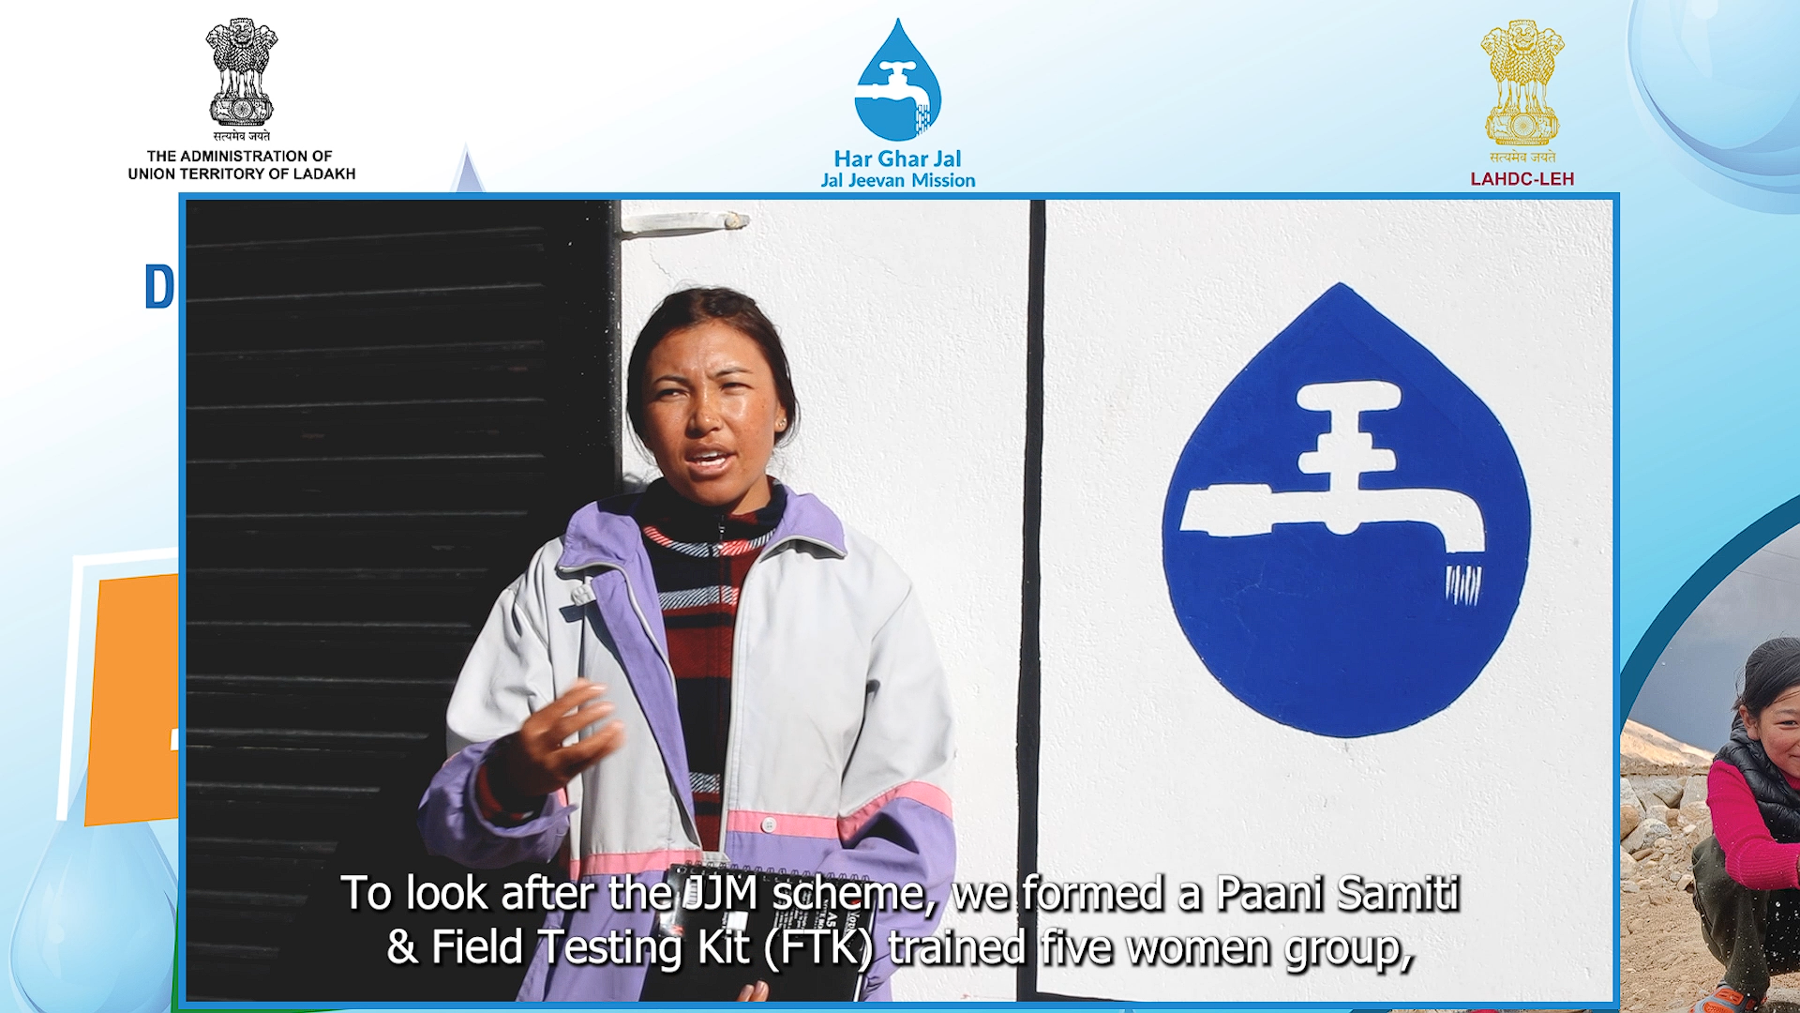
IEC Activities
These images capture the spirit of community participation, from school-based awareness programmes to village-level meetings, wall paintings spreading key messages, and direct engagement with beneficiaries across Leh District.

Slide 6
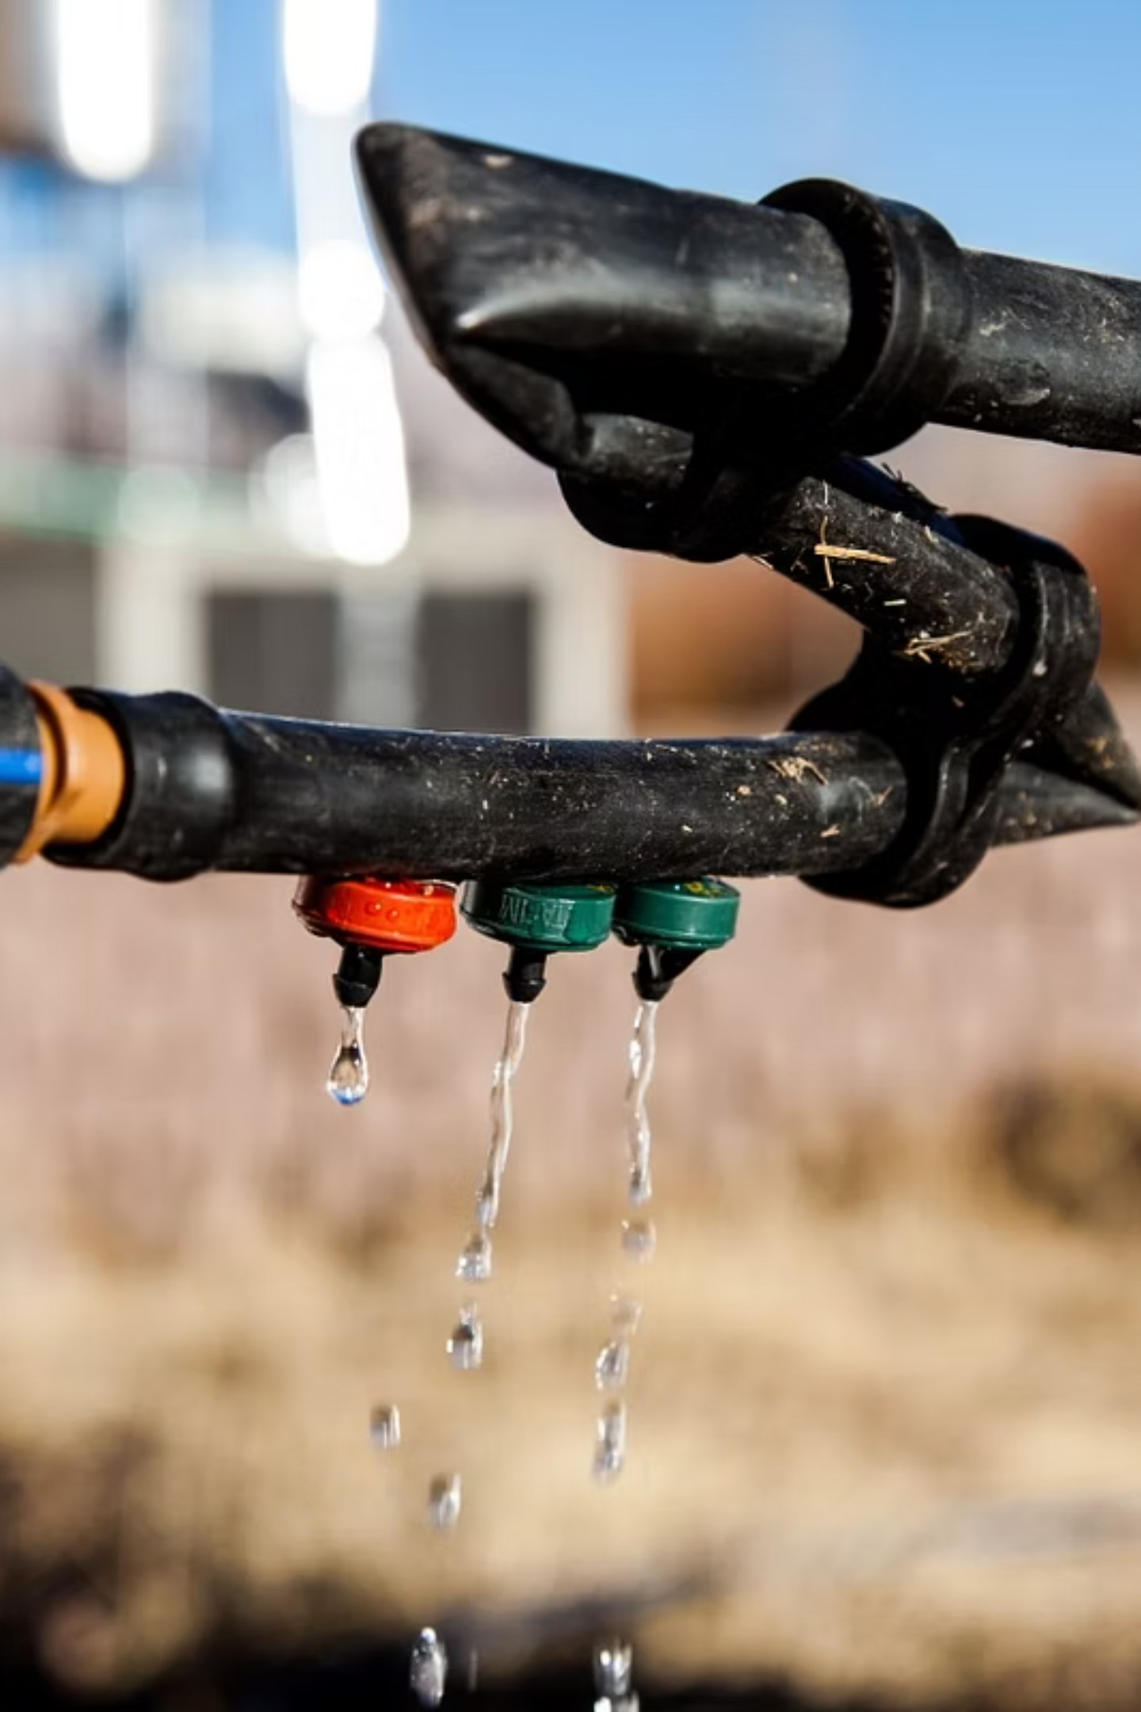
Bringing Safe Drinking Water in Matho Village
Through a Unique Dripper Pipe Network Under JJM
An innovative and sustainable approach to water supply in challenging terrain, ensuring 24×7 water availability to every household through pressure-regulated dripper technology.

Slide 7


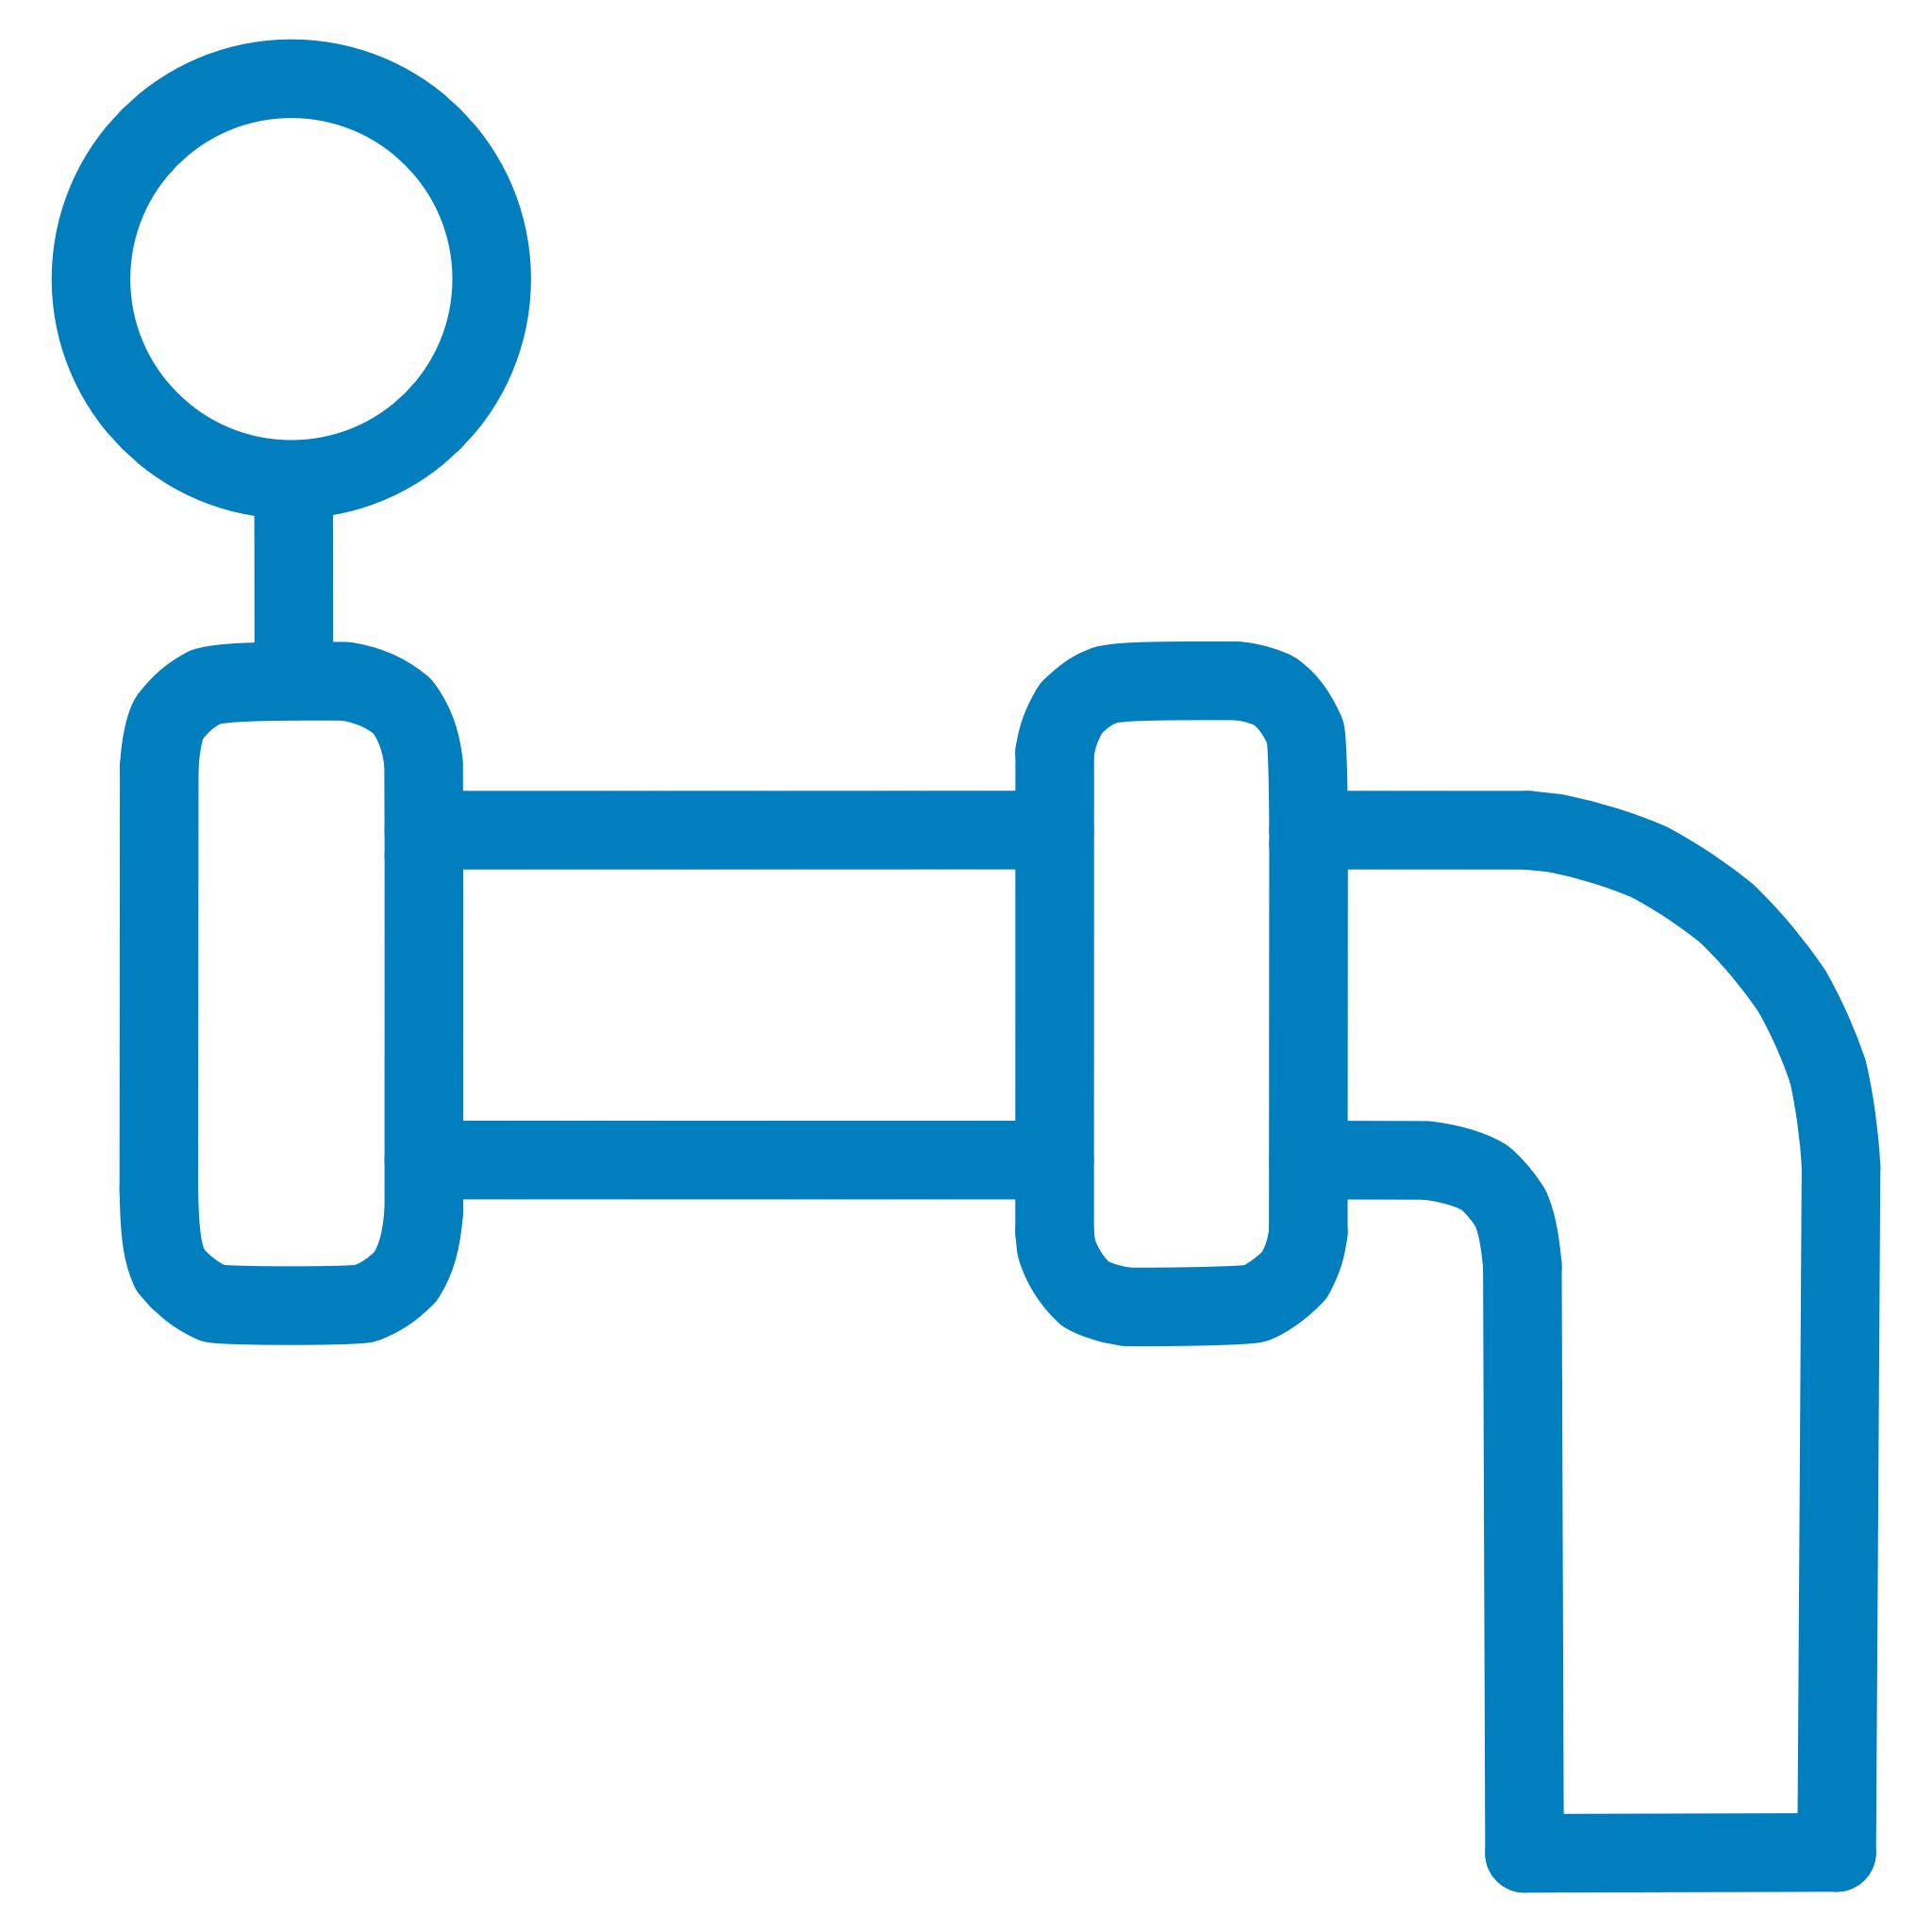



Description of the Project
The Matho Village Water Supply Scheme represents one of the most innovative solutions under Jal Jeevan Mission, designed specifically to address the unique geographical and climatic challenges of the Ladakh region. This project demonstrates how technology and local needs can be combined to create sustainable water delivery systems.
Project Location
Coverage & Connections
Matho Village is situated in Chuchot Block, Leh District, in the high-altitude terrain of Ladakh. The village faces extreme weather conditions including sub-zero temperatures during winter months.
A total of 357 water connections have been provided, covering all households, schools, health posts, and the monastery in the village, ensuring universal access to safe drinking water.
Infrastructure Scale
Service Level
The total length of the pipeline network is 63 kilometres, carefully designed to navigate the challenging topography and ensure water reaches every corner of the village.
Every household is provided 70 litres per capita per day (lpcd) on a 24×7 basis, meeting and exceeding the JJM service delivery norms for adequate water supply.
Unique Innovation
Project Investment
This is one of the most unique projects in its conception: water is supplied through drippers in a controlled manner, preventing wastage and ensuring equitable distribution based on household size.
The total project cost is ₹6.64 crores, representing significant investment in sustainable water infrastructure that will serve the community for decades to come.
Key Achievement: The water supply system operates continuously 24×7 throughout the year, even during harsh winter conditions when temperatures drop significantly below freezing point.

Slide 8
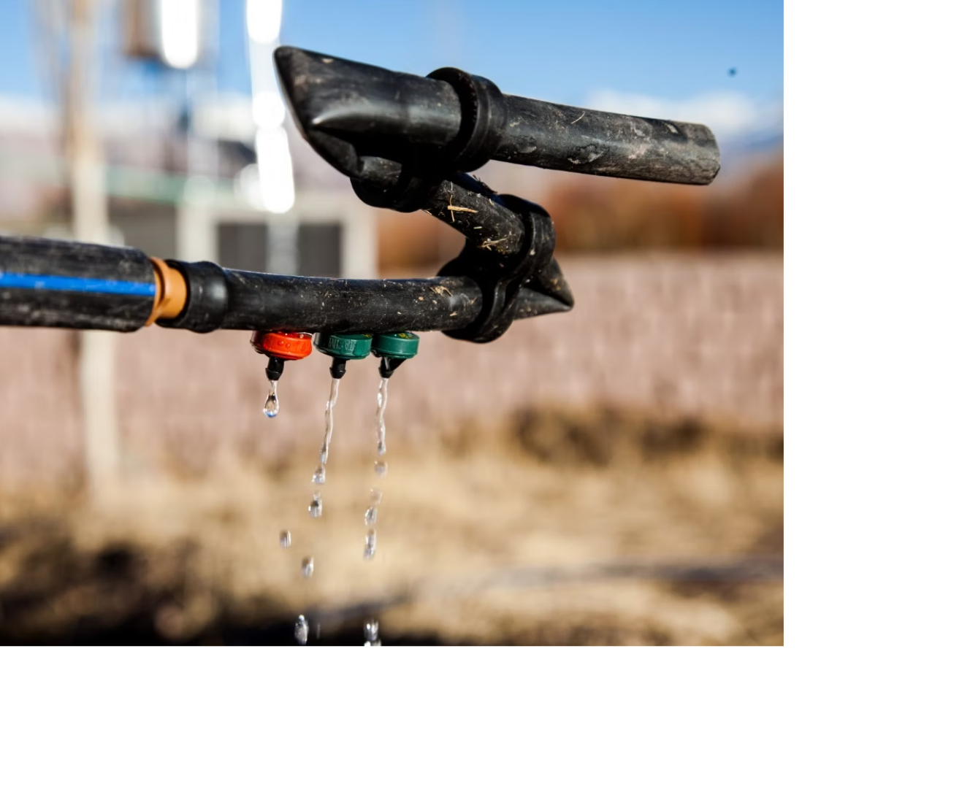
Dripper-Regulated Flow System
How the Dripper Technology Works
The heart of Matho's water supply system lies in its innovative use of dripper technology. Drippers regulate water pressure throughout the network, ensuring a constant, controlled flow to each household. The system features a self-cleaning mechanism that prevents clogging and maintains consistent performance.
Perforated HDPE pipes wrapped with special fabric have been used to tap water at the spring source, ensuring water quality is maintained from source to household. The flow rate is predetermined and corresponds to the number of people in the household, ensuring fair and equitable distribution.
Dripper Colour Coding System:
Red Drippers: 2 litres per hour = 48 litres in 24 hours
Green/Grey Drippers: 8 litres per hour = 192 litres in 24 hours
Green Drippers: 8 litres per hour = 192 litres in 24 hours
This colour-coded system ensures a fair and consistent water supply based on household size, eliminating disputes and ensuring transparency in water distribution.

Slide 9

The Connection to Houses
01
02
Pipeline Entry
Controlled Flow Delivery
A dedicated pipe arrives at each house from the main distribution network, ensuring individual household connectivity and accountability.
The dripper provides a constant small flow of water throughout the day, calculated based on household requirements and number of residents.
03
04
24-Hour Tank Filling
Strategic Tank Placement
The continuous slow flow fills up a household storage tank over a 24-hour period, ensuring adequate water availability for daily needs.
The storage tank must be placed inside the house or in a greenhouse to prevent freezing during harsh winter months when temperatures plummet well below zero.
Winter-Proofing Strategy: Indoor tank placement is critical in Ladakh's extreme climate. This design choice prevents water from freezing and ensures year-round supply, even when outdoor temperatures drop to -20°C or below.

Slide 10
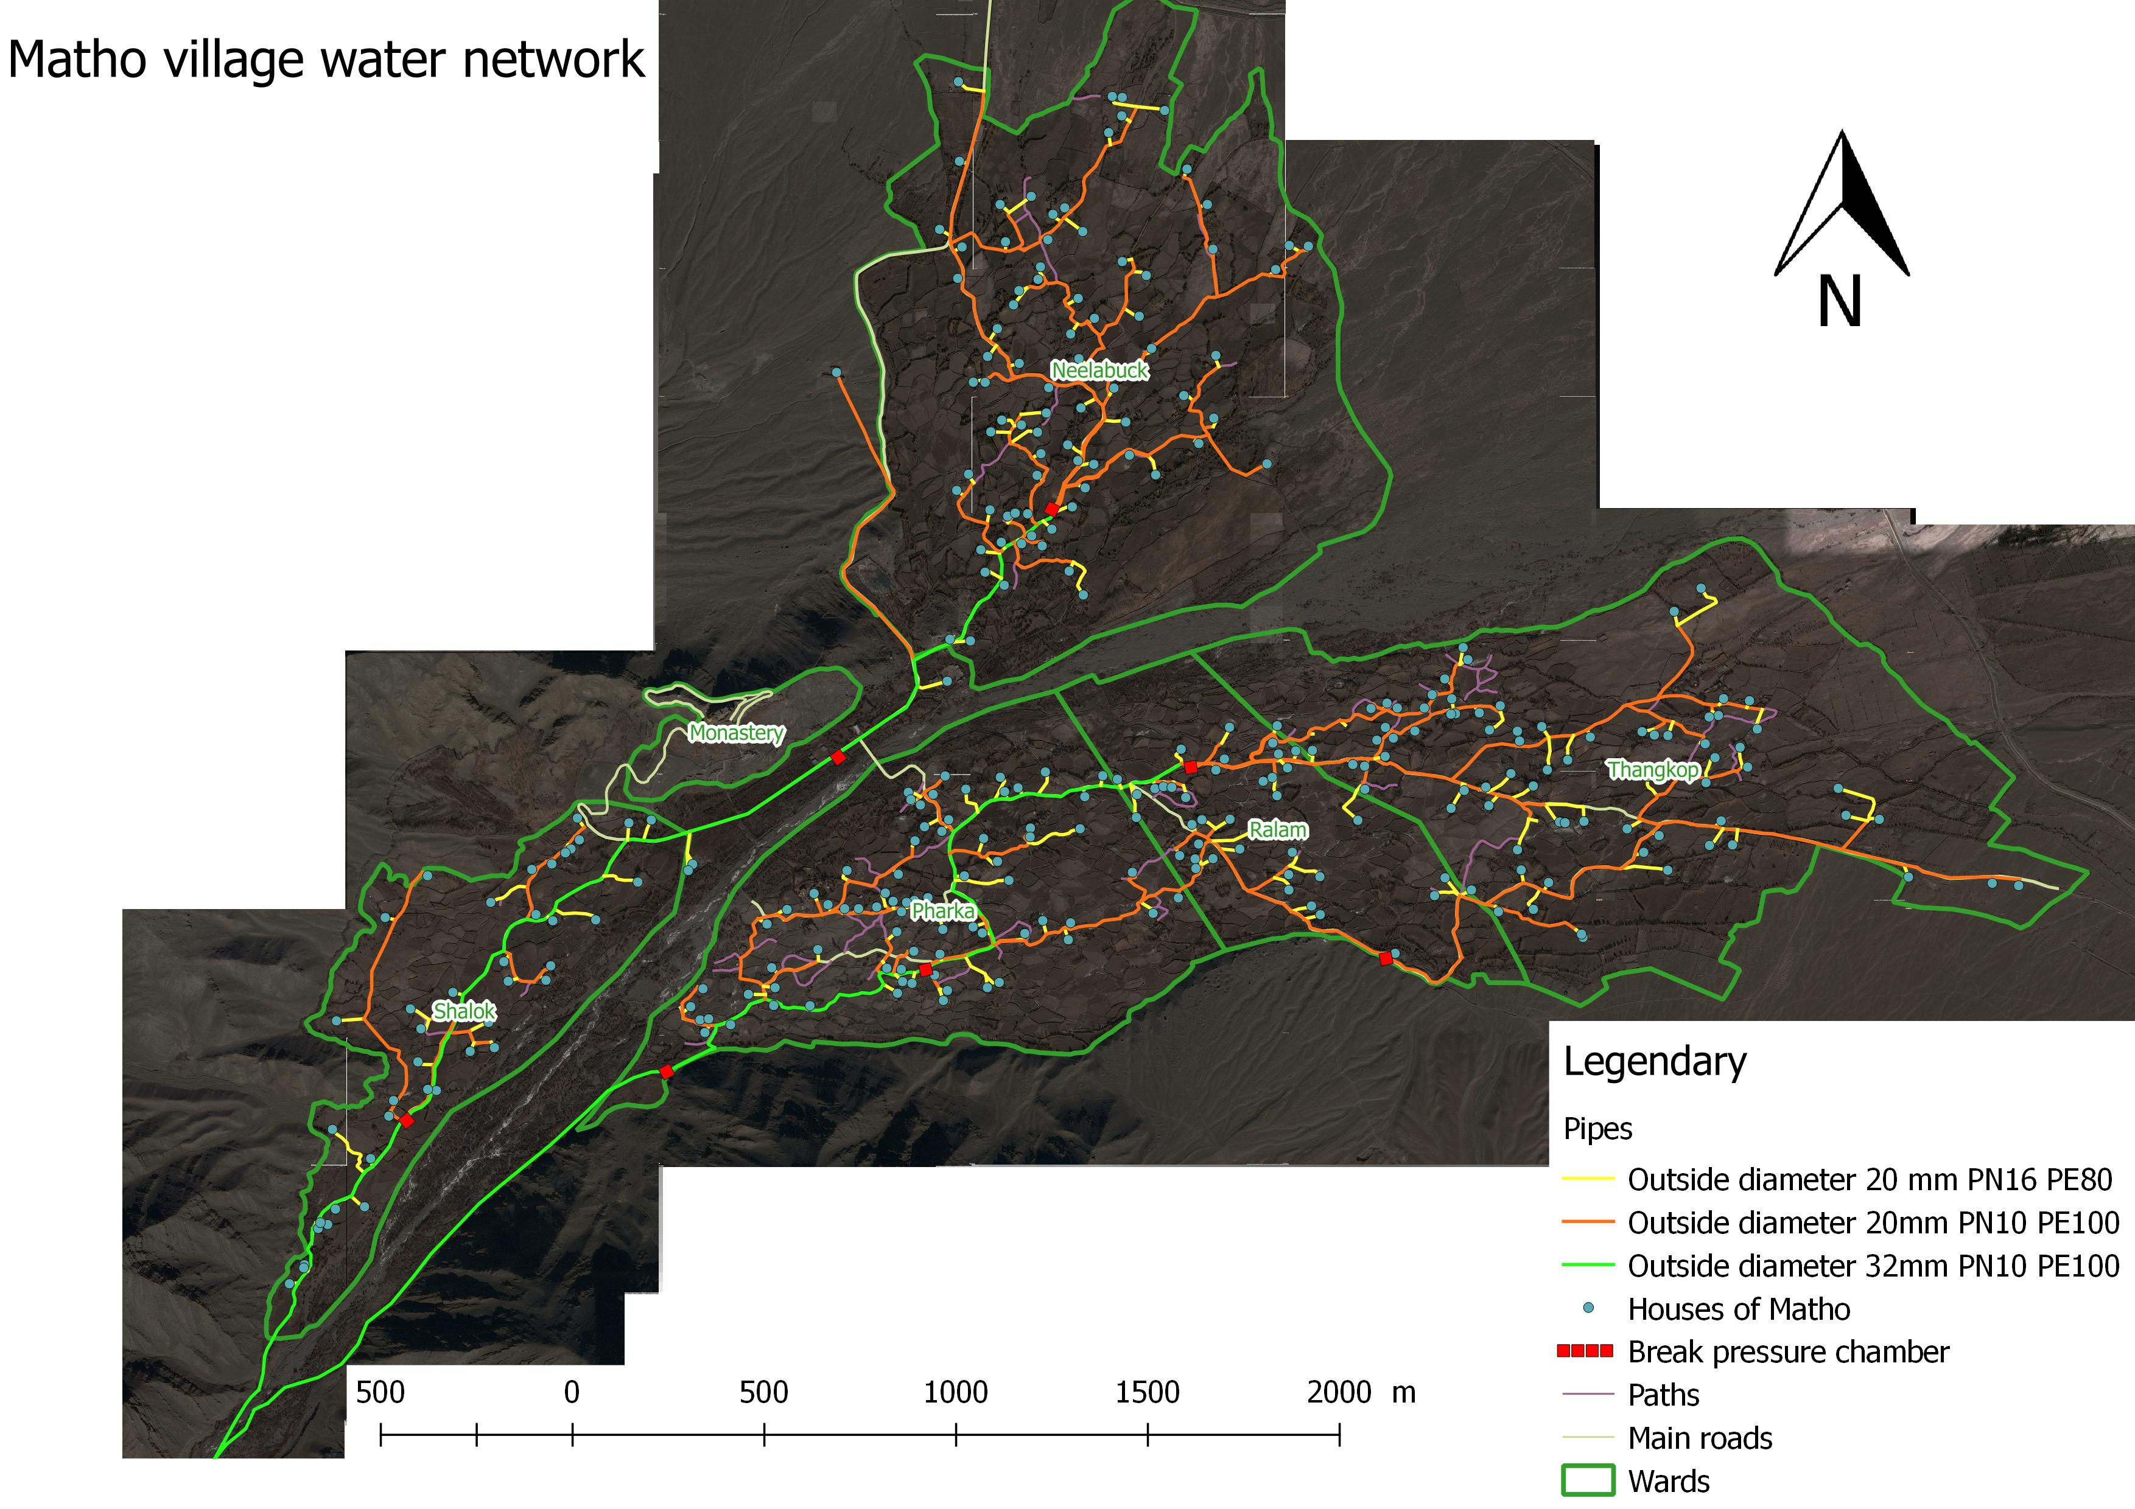
Innovative Water Distribution Network Design
Key Design Features
Tree-Based Network Architecture
Our system utilizes a hierarchical tree structure, ensuring efficient, balanced, and equitable water distribution from the central pipeline to every section of the village.
Optimized Dual Branch Distribution
The main line strategically splits into two distinct branches, significantly enhancing hydraulic balance, improving network redundancy, and simplifying maintenance operations for uninterrupted service.
Main Line with Break Pressure Chambers
Strategic Break Pressure Chambers (BPCs) are integrated into the main pipeline to meticulously regulate water pressure, guaranteeing a consistent and controlled flow across the entire network, even over varied elevations.
Pristine Natural Spring Source
Water is collected directly from high-altitude natural mountain springs using perforated HDPE pipes, preserving its purity and preventing contamination from source to tap.
Household Tank with Smart Controls
Each household's storage tank is equipped with pressure-regulating drippers and precise water meters, facilitating equitable monitoring, accurate consumption tracking, and fair distribution among all users.
Technical Achievement Highlight
Our network design successfully navigates challenging mountainous terrain and extreme climate conditions, ensuring
year-round access to clean water through innovative pressure management and robust infrastructure.

Slide 11



General Idea About the Network
The Matho water supply scheme has been engineered with three core principles in mind: preventing freezing in extreme cold, ensuring safe water quality, and guaranteeing equal distribution. Each design element serves these critical objectives.
Preventing Freezing
Ensuring Safe Water
Equal Distribution Per Person
Challenge: Ladakh experiences temperatures as low as -30°C in winter, which can freeze water pipes and disrupt supply.
Challenge: Maintaining water quality from source to tap in a long distribution network.
Challenge: Ensuring fair water access and preventing disputes in the community.
Solution:
Solution:
Solution:
Low pipe diameter with high velocity prevents bacterial growth
Controlled flow through colour-coded drippers delivers fixed amount of water per household
Continuous flow of water through drippers prevents stagnation and freezing
HDPE (High-Density Polyethylene) pipes used throughout to prevent contamination
No wastage of water through metered, regulated supply
All pipes are buried below the frost line at a depth of 5 feet
Filters installed at strategic points to protect drippers from clogging and maintain water purity
Water conservation achieved through awareness and physical constraints on flow
Household tanks must be kept inside heated spaces or greenhouses
Eliminates disputes as each household receives predetermined allocation
The Matho scheme demonstrates how intelligent engineering can overcome extreme environmental challenges whilst ensuring equity, sustainability, and reliability in water supply.

Slide 12
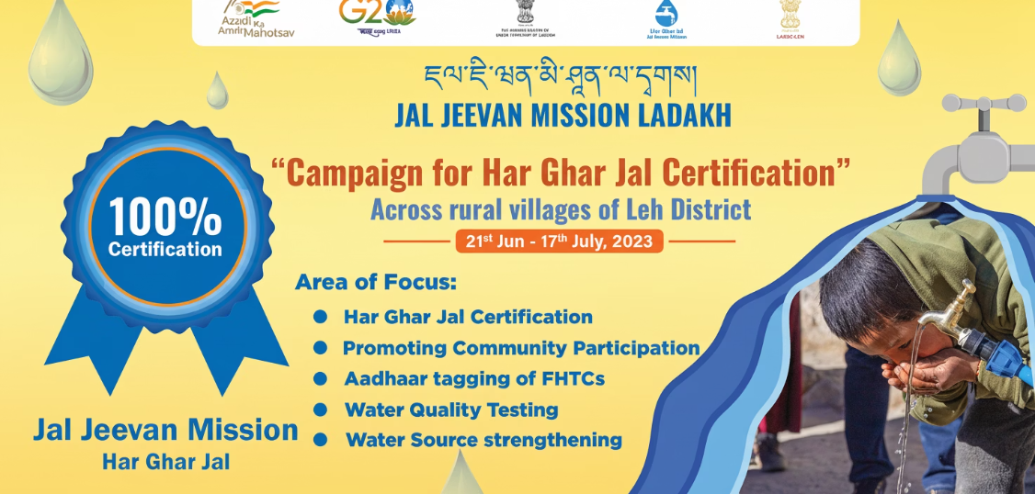
Roadmap to Har Ghar Jal Certification
Achieving Har Ghar Jal (HGJ) certification in Leh District required a systematic, community-focused approach. This process validates that functional household tap connections are in place, delivering adequate quantity and quality of water consistently.
1. Launch Focused Campaign
A dedicated initiative, "Campaign for Har Ghar Jal Certification", was launched to ensure all eligible villages in Leh District
received formal recognition for achieving universal household water connections.
2. Prioritise Community Participation
Village communities were actively involved to verify service delivery on the ground, fostering transparency, trust, and
ownership among beneficiaries.
3. Timely Submission Process
Coordination mechanisms ensured all required certificates were submitted promptly to district and state authorities,
preventing delays in the certification timeline.
4. Achieve HGJ Certification
This coordinated effort systematically led to successful Har Ghar Jal Certification across all eligible villages, validating
universal coverage under JJM in Leh District.
Certification Impact
HGJ certification provides formal recognition of achievement, significantly boosts community confidence, ensures accountability in service delivery, and serves as a vital model for other districts.

Slide 13
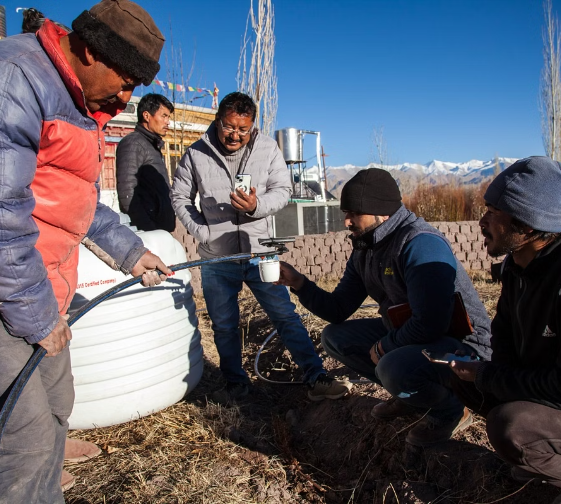
Field visit and inspection by officials, demonstrating the importance of ground-level monitoring and verification in ensuring quality implementation of JJM schemes across Leh District.

Slide 14

Thank
You

