Slide 1


PEYJAL SAMVAD
Ri-Bhoi District

Slide 2
Ri Bhoi District Framework
Deputy Commissioner
Cum
Chairman, DWSM
Superintending Engineer, PHE
Cum
Member Secretary, DWSM
Divisions
Nongpoh Division
Umsning Division
Jirang Sub-Division
Nongpoh Sub-Division
Umsning Sub-Division
Bhoirymbong Sub-Division
VWSCs - 102
VWSCs - 200
VWSCs - 164
VWSCs - 115

Slide 3
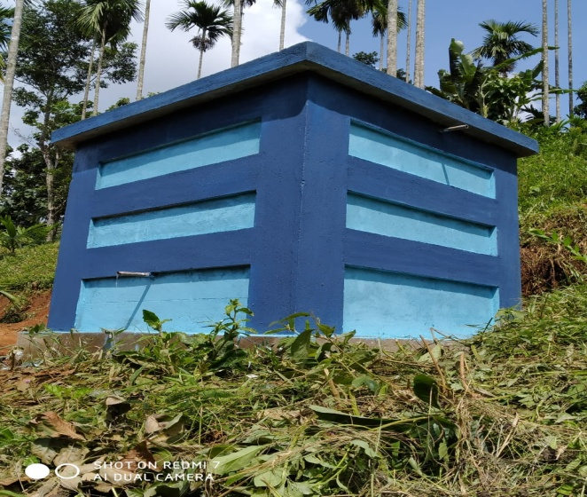
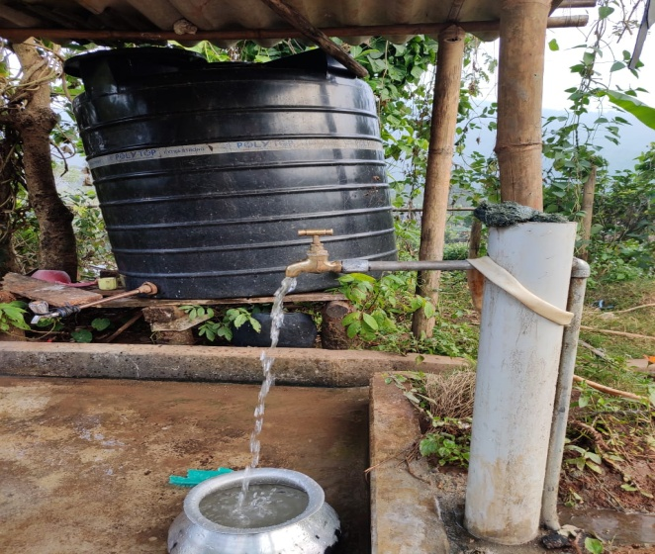
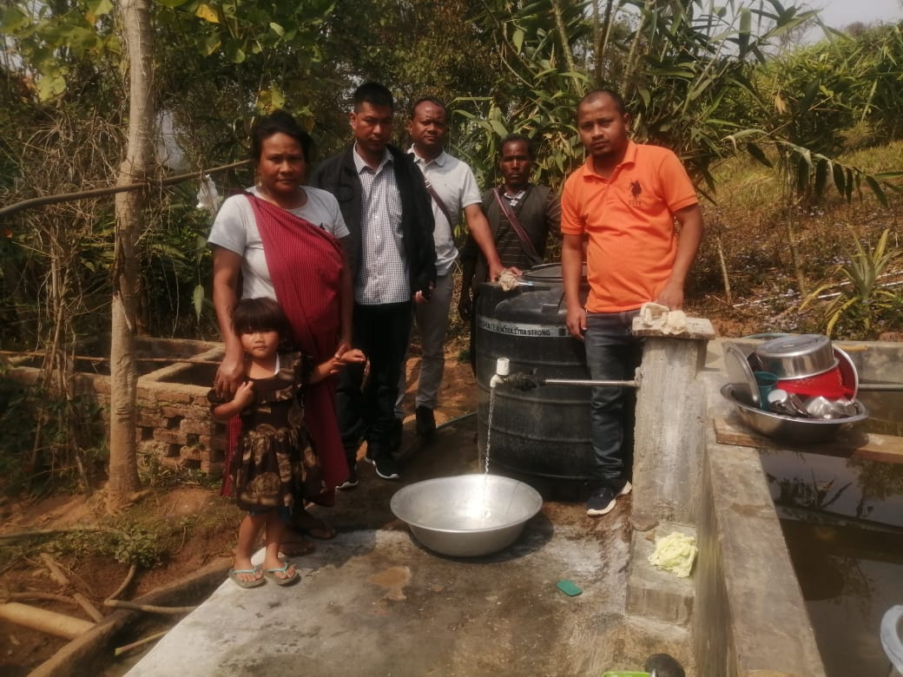
Coverage of FTHCs before JJM As of 15th Aug 2019 | Coverage of FTHCs since the launch of JJM As of 24th Nov 2025
No. of Households - 62918 | No. of Households- 62918
FTHCs – 1075 (2%) | FTHCs – 53730 (85.4%)

Slide 4

Block-wise Household Connection Progress
SL NO | DIVISION | Block | Total Households | Total Household connections reported till (24/11/2025) | % of total households connections with PWS reported till (24/11/2025) | Balance | Target for completions
1 | NONGPOH | JIRANG | 7689 | 7583 | 98.62% | 106 | March, 2026
2 |  | UMLING | 21518 | 13731 | 64% | 7787
 |  | UMSNING | 966 | 966 | 100% | 0
3 | UMSNING | UMSNING | 17246 | 16422 | 95.22% | 824
4 |  | BHOIRYMBONG | 15499 | 15028 | 96.96% | 471
Total |  |  | 62918 | 53730 | 85.40% | 9188

Slide 5
Availability of drinking water in Schools, AWCs & Health Centers
Name of the Block | Schools Details |  |  |  | AWCs Details |  |  |  | Health Centre Details
 | Total Nos. of Schools | Nos. of Schools with Tap Connection | % | Balance | Total Nos. of AWCs | Nos. of AWCs with Tap Connection | % | Balance | Total Nos. of HCs | Nos. of HCs with Tap Connection | % | Balance
Umling | 439 | 338 | 76.99% | 101 | 163 | 119 | 73.01% | 44 | 8 | 8 | 100% | 0
Umsning | 20 | 20 | 100.00% | 0 | 9 | 9 | 100% | 0 | 0 | 0 | - | 0
Jirang | 167 | 166 | 99.40% | 1 | 74 | 74 | 100% | 0 | 3 | 3 | 100% | 0
BHOIRYMBONG | 203 | 188 | 92.61% | 15 | 54 | 51 | 94.44% | 3 | 4 | 4 | 100% | 0
UMSNING | 307 | 246 | 80.13% | 61 | 127 | 101 | 79.53% | 26 | 9 | 9 | 100% | 0
Total | 1136 | 958 | 84.33% | 178 | 427 | 354 | 82.90% | 73 | 24 | 24 | 100% | 0

Slide 6
STATUS OF REPORTED AND CERTIFIED HAR GHAR JAL
District Name | Division | No. of villages | No. of Har Ghar Jal Village
 |  |  | Reported | Certified
Ri-Bhoi | Nongpoh | 311 | 252 | 85
 | Umsning | 271 | 239 | 82
 | Total | 582 | 491 | 167

Slide 7
Water Quality Testing
Water Quality Monitoring: Water quality is strictly and regularly monitored by the Department through systematic testing following standard protocols for ensuring supply of safe drinking water for all villages. Water testing are conducted at Divisional & Sub-Divisional Laboratories and also at the Village/Community level.
Water Testing at the Village/Community Level: Each villages should have five trained women for testing water samples using the portable water field testing kit.
Total No. of Villages | No. of villages where 5 women have been trained using FTK | No. of FTK Users | Total No. of Divisional Laboratories | Total No. of Sub-Divisional Laboratories | No. of NABL accredited Laboratory | Total No. of WTP’s
581 | 581 | 1131 | 1 (Nongpoh Divisional Lab) | 3 (Patharkhmah, Umsning & Bhoirymbong Sub Divisional Lab) | 1 (Nongpoh Divisional Laboratory) | 145

Slide 8
WATER QUALITY SURVEILLANCE – Training Of Women Using FTKs At Village Levell
Sl.No. | District name | Division name | Block Name | Total no. of villages | Number of FTK users | No. of villages where women have been trained using FTK | % of villages covered wherein women have been trained using FTK | No. of women trained using FTKs | No. of villages wherein no women trained using FTK | % of villages wherein no women trained using FTK
1 | Ri Bhoi | Nongpoh | Jirang | 102 | 98 | 102 | 100% | 514 | 0 | 0
 |  |  | Umling | 200 | 347 | 200 | 100% | 850 | 0 | 0
 |  | Umsning | Umsning | 164 | 325 | 164 | 100% | 737 | 0 | 0
 |  |  | Bhoirymbong | 115 | 184 | 115 | 100% | 538 | 0 | 0
TOTAL |  |  |  | 581 | 954 | 581 | 100% | 2639 | 0 | 0

Slide 9
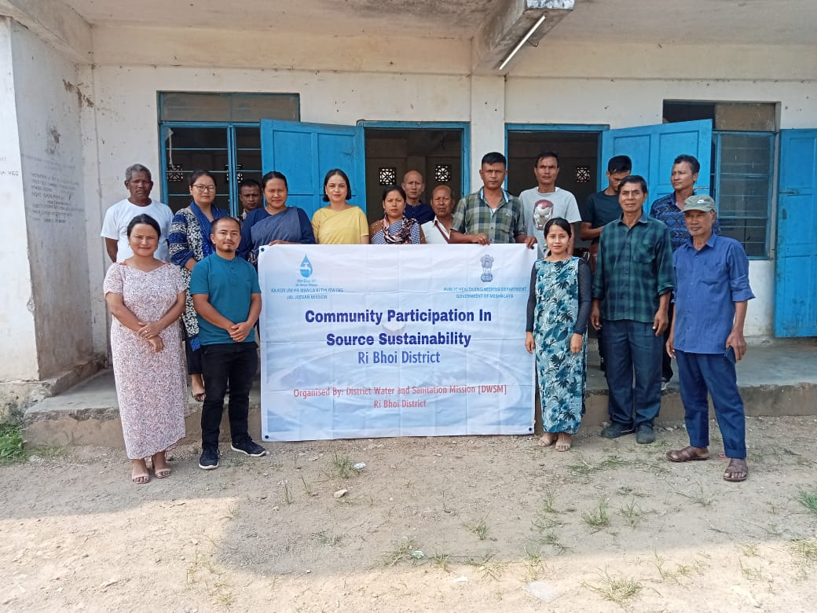
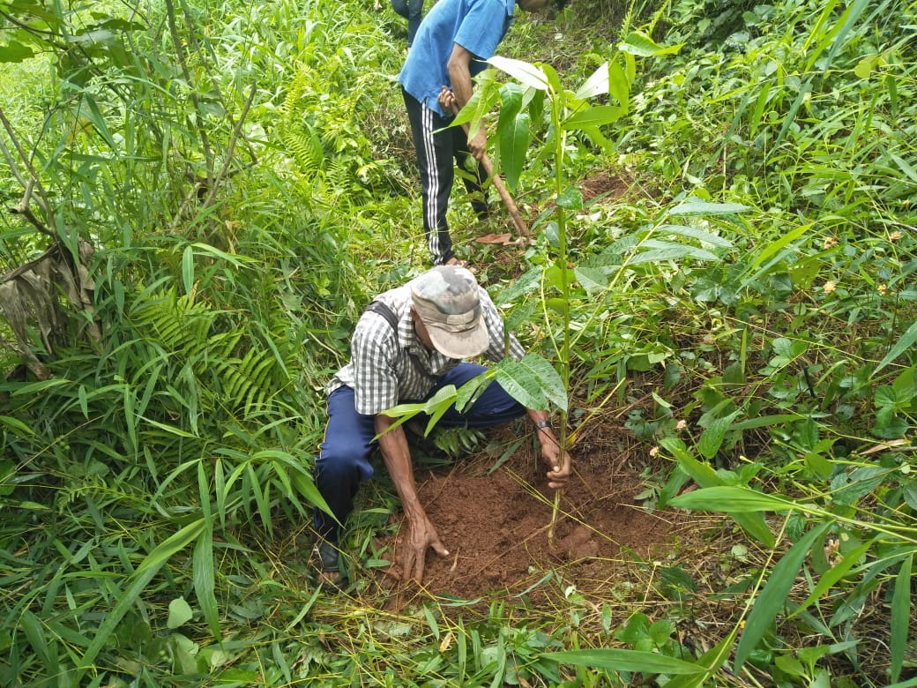
Best Practice on Source Sustainability
Initiatives
To foster ownership, improve local management and ensure long-term availability of clean water
Action
Awareness Programs on Water Source Sustainability measures and its importance.
The VWSC’s in collaboration with different frontline Departments took initiative actions towards water source conservation by availing tree saplings and their plantation near the catchment areas.
Construction of fencing nearby the water sources through involvement of community participation by making use of locally available resources.

Slide 10
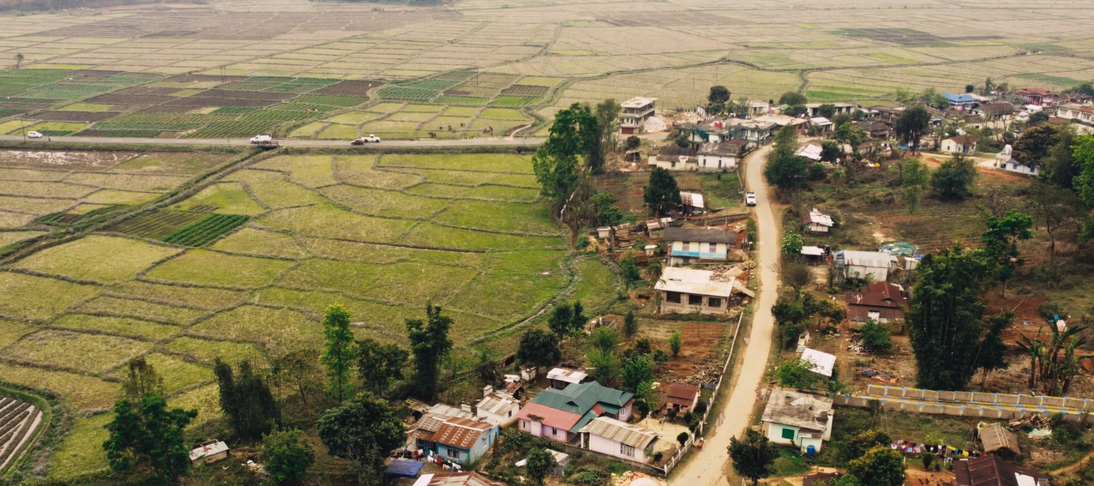
SUCCES STORIES
(VIDEO)
On
Pahamjri
Village

Slide 11
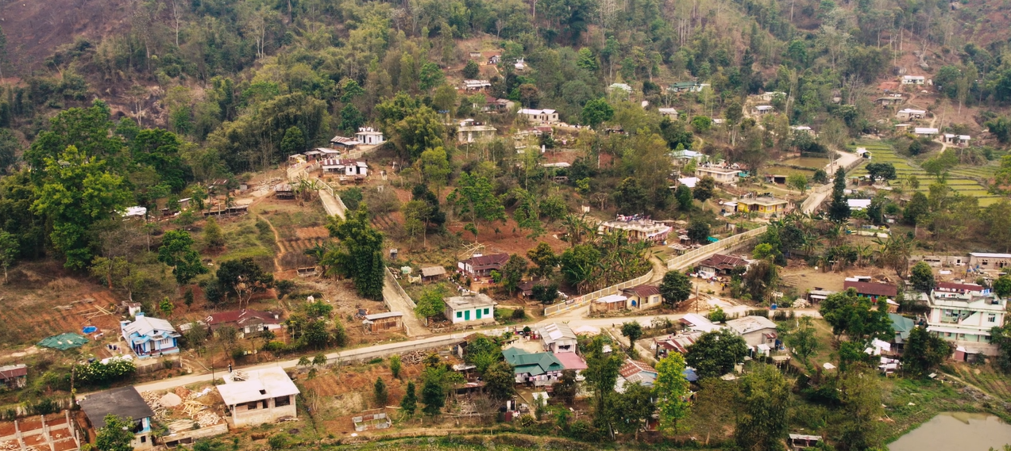
THANK YOU

