Slide 1
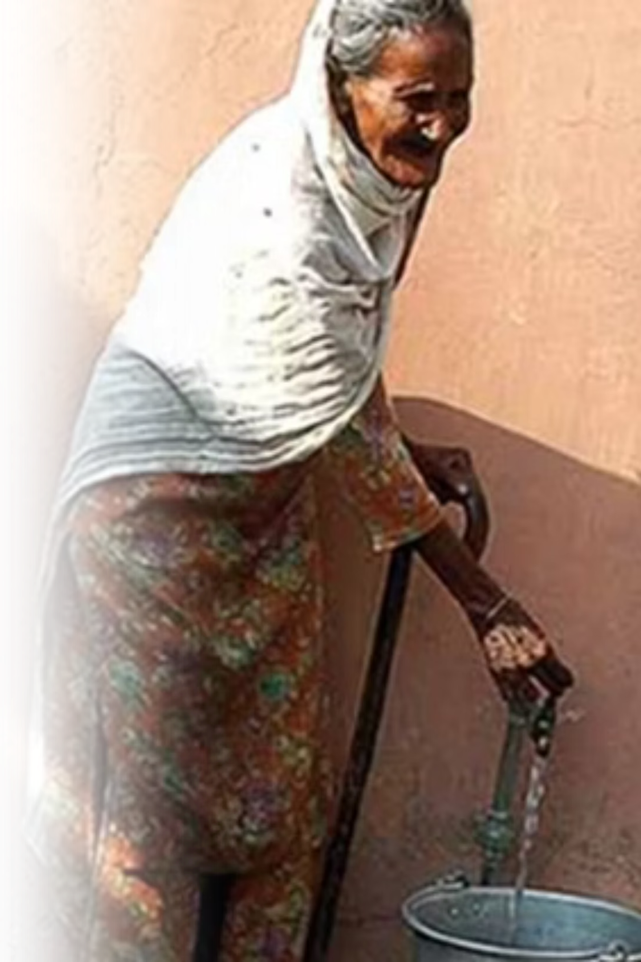
PEYJAL SAMVAD
District Water & Sanitation Mission (DWSM) SAS Nagar
Presented by: IAS Komal Mittal, District Collector, SAS Nagar

Slide 2
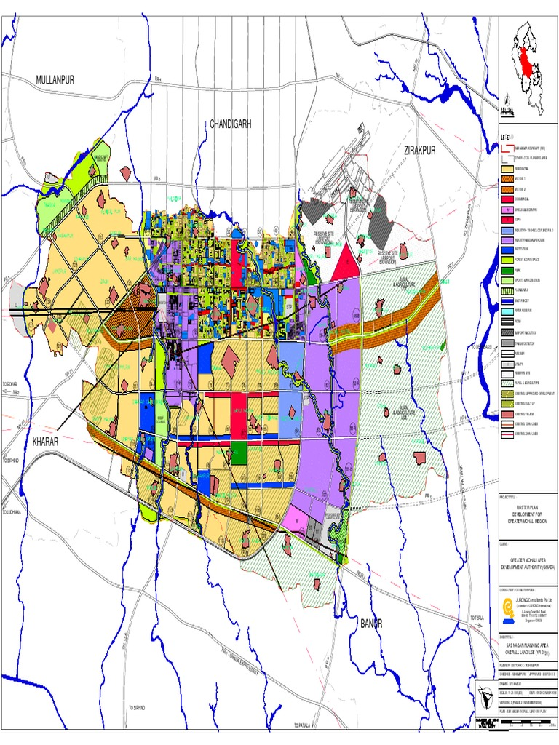
District Overview: Complete Coverage Achievement
SAS Nagar district has achieved a transformative milestone in water accessibility, establishing a foundation for sustained public health improvements across the entire region. Our comprehensive approach ensures no household is left behind.
82,024
100%
340
Total Households Served
FHTC Coverage Rate
Har Ghar Jal Villages
Every household connected with safe water
Universal access to Functional Household Tap Connections
All Gram Panchayats certified with complete coverage
731
Schools Connected
Ensuring safe water for educational institutions
438 Anganwadis equipped with functional tap water connections, ensuring safe drinking water access for young children during critical developmental years. This 100% Functional Household Tap Connections (FHTC) achievement represents more than infrastructure—it's a commitment to health, dignity, and community well-being.

Slide 3
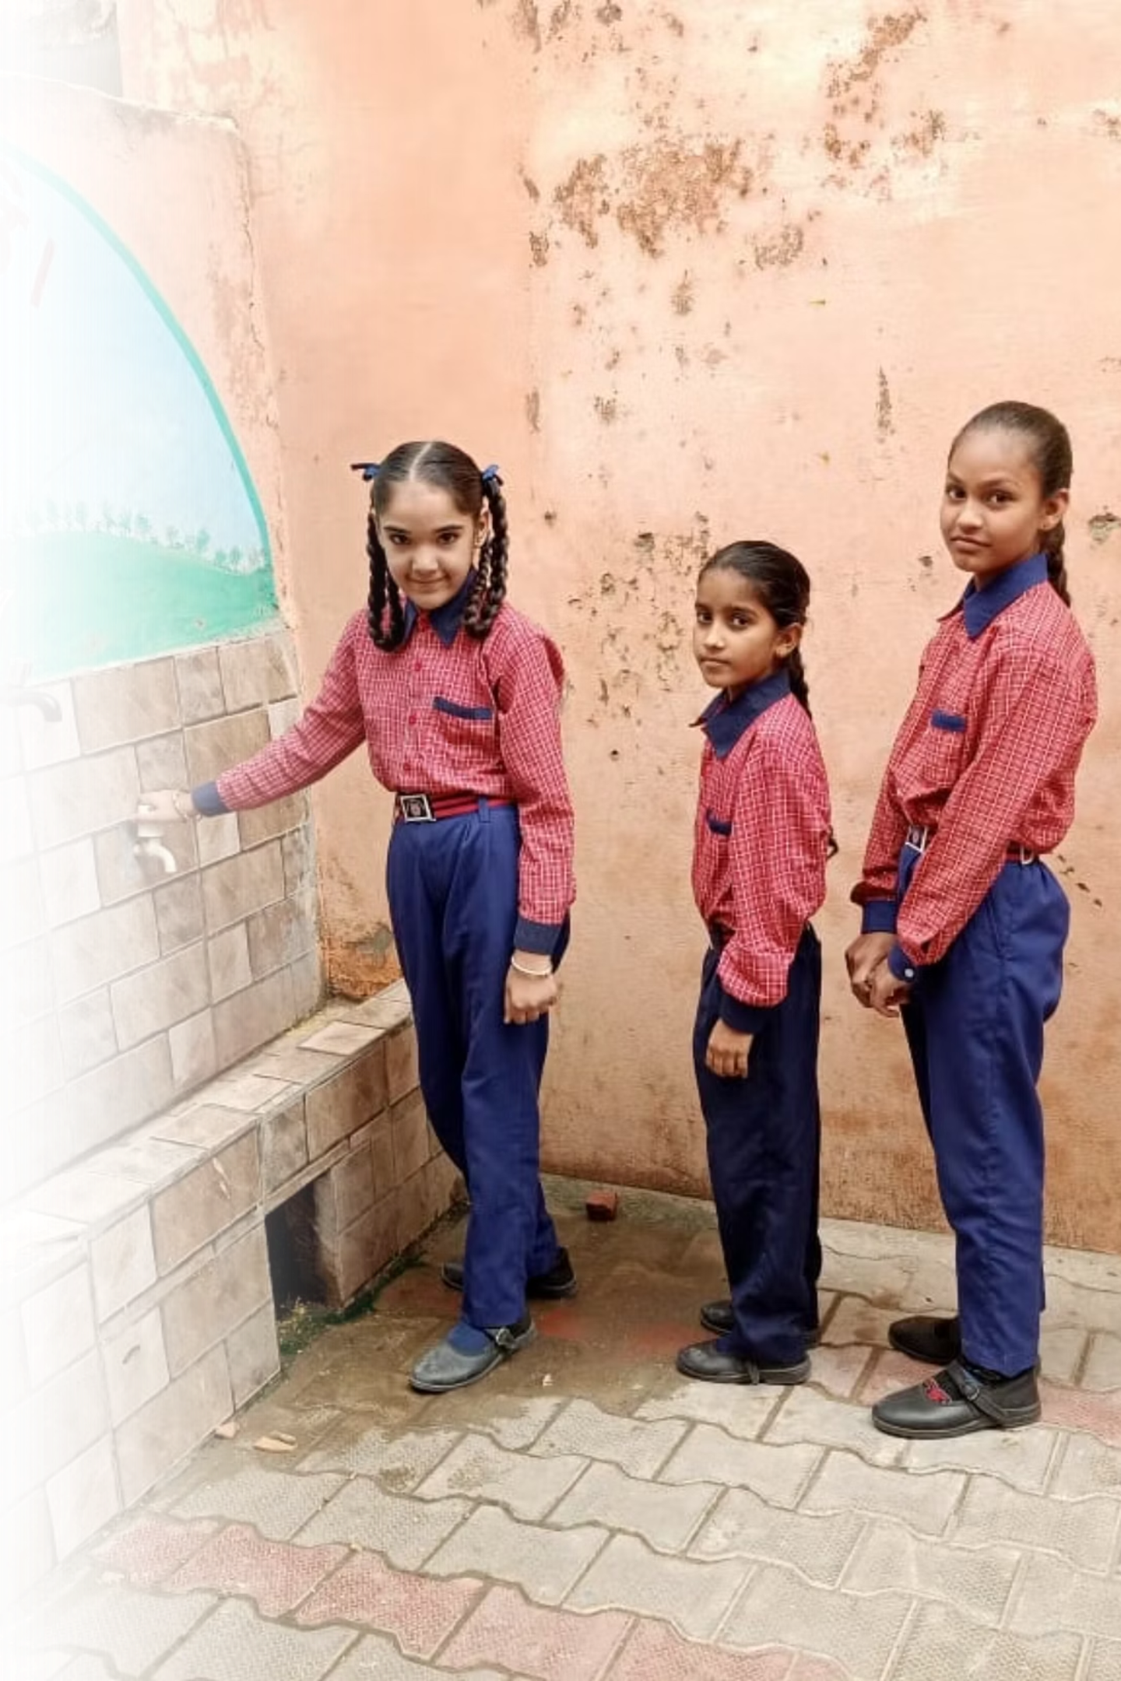
Key Achievements: Transforming Water Access
Our journey towards universal water access has been marked by significant milestones, bringing tangible benefits to every corner of SAS Nagar.

Slide 4
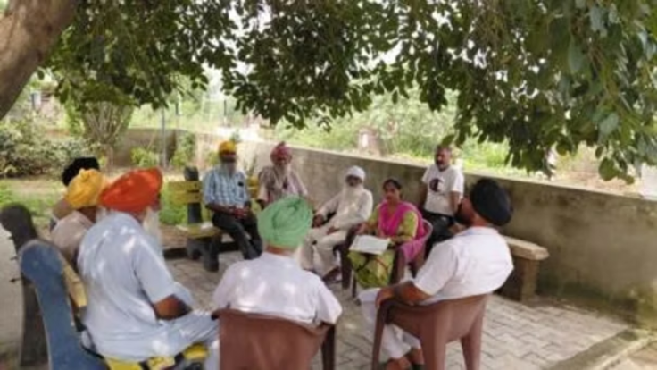
Planning and Implementation Strategy
Strategic Planning Framework
Implementation Structure
Our comprehensive approach begins with detailed planning at both district and village levels through District Action Plans (DAP) and Village Action Plans (VAPs). This dual-layer planning ensures local needs are addressed while maintaining district-wide coordination and consistency.
Implementation is carried out through Gram Panchayat Water and Sanitation Committees (GPWSCs) with dedicated technical support from the Department of Water Supply (DWS). This partnership ensures effective execution and sustainable operation.
FY 2025-26 Pipeline
We are planning to commission 34 new schemes for the fulfillment of potable water requirements. These represent continued investment in infrastructure expansion and service quality enhancement.

Slide 5




Source Sustainability & Convergence
Ensuring long-term water security requires strategic planning, recharge infrastructure, and collaboration across government schemes. District SAS Nagar has developed a comprehensive District Water Conservation Plan focused on source strengthening.
Conservation Initiatives
Multi-Scheme Convergence
Capacity Building
Working with Jal Shakti Abhiyan, we've undertaken greening efforts including plant cultivation and Nanak Bagichi development.
Collaboration with MGNREGA, Forest Department, and Swachh Bharat Mission has restructured recharge pits, check dams, and rainwater harvesting systems.
Training programs for source sustainability build local expertise in water conservation techniques and community-based resource management.

Slide 6
Har Ghar Jal: Historic Achievement
First in Punjab, Sixth in India
Universal Piped Water Connections
100% piped water connections to all households by July 2020—a transformative milestone.
Pioneering Leadership
SAS Nagar is 1st across Punjab and 6th in India to achieve this ambitious target.
Complete Documentation
100% Har Ghar Jal certificates uploaded on the ejalshakti portal for transparent verification.
Adequate Water Supply
80% of households receive over 70 LPCD, meeting recommended standards for hygiene.
Consistent Service Delivery
100% of households receive potable water regularly, ensuring reliability.

Slide 7

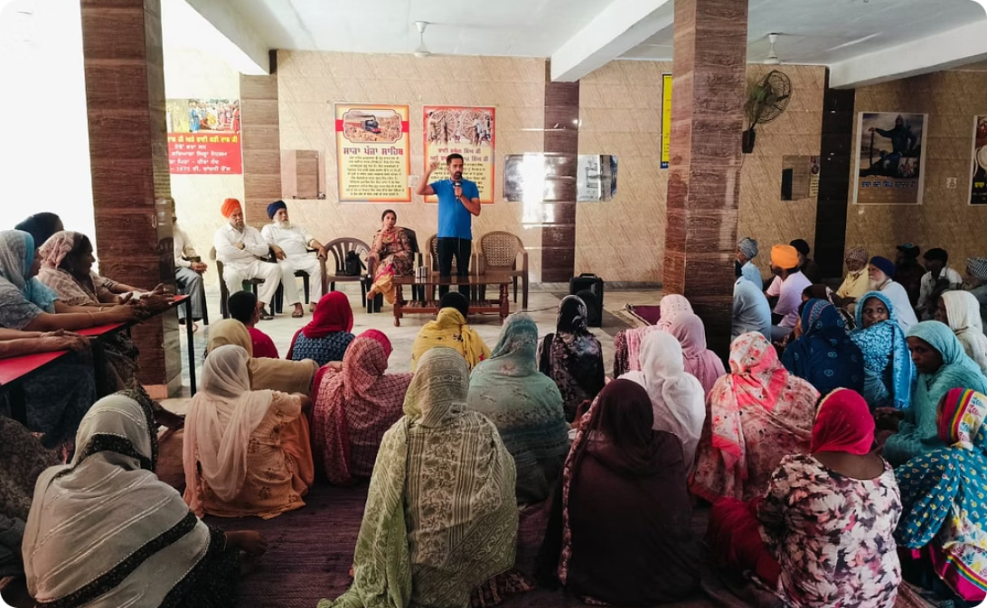
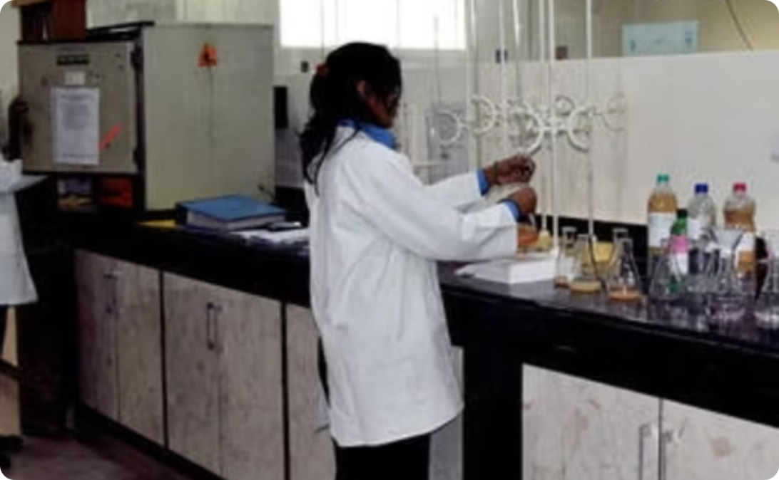
Har Ghar Jal Certification Process
Official Declaration
Community Engagement
Quality Assurance
340 Gram Panchayats declared Har Ghar Jal villages by July 31st, 2025.
Regular GPWSC and community meetings maintain dialogue and address concerns.
Continuous emphasis on functionality, water quality testing, and service level compliance.

Slide 8
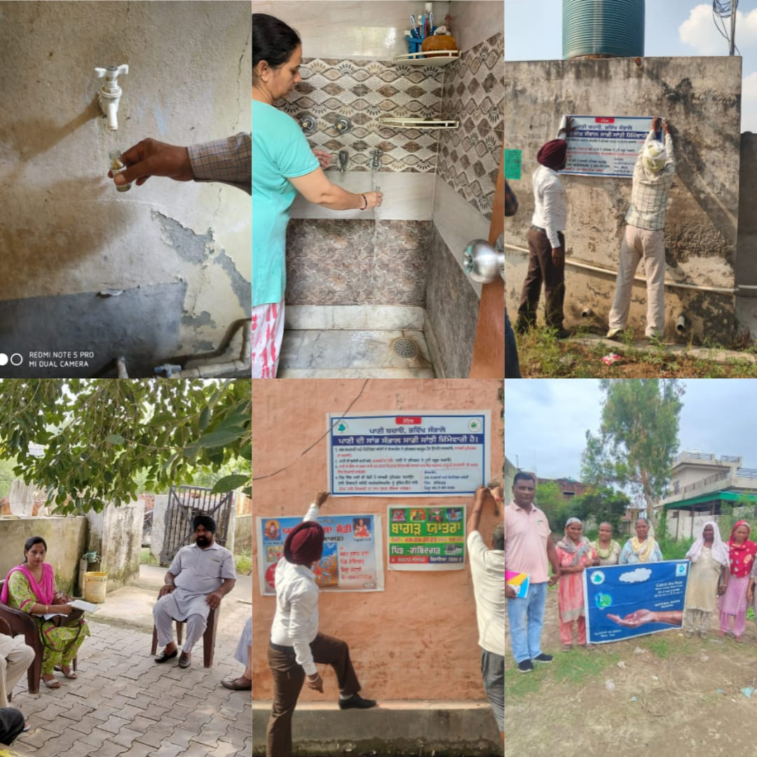
Monitoring and Supervision Mechanism
Effective monitoring ensures continuous improvement, rapid problem resolution, and sustained service quality. Our multi-layered approach combines technology, regular review, and community feedback.
01
02
Monthly Review Meetings
IMIS Portal Integration
District-level meetings track progress, identify bottlenecks, and coordinate action plans.
Real-time monitoring through the Integrated Management Information System provides transparent, data-driven insights.
03
Grievance Redressal System
Citizens report issues via SNK Shikayat Nivaran Kendra 24×7, WhatsApp groups, and field visits.

Slide 9
Functional Regional Water Testing Laboratory
Ensuring Safe Water Quality Across SAS Nagar
Our Mission
The Regional Water Testing Laboratory is a cornerstone of public health, dedicated to comprehensive water quality monitoring and analysis under the District Water & Sanitation Mission.
Strategic Impact
State-of-the-art testing facilities
Advanced analytical capabilities
Regular monitoring programmes
Swift response mechanisms
Community health protection
Transparent reporting systems
Comprehensive Testing Program
Pre-monsoon and post-monsoon water testing, alongside a mobile testing van, ensures year-round water quality and brings capabilities directly to communities.

Slide 10
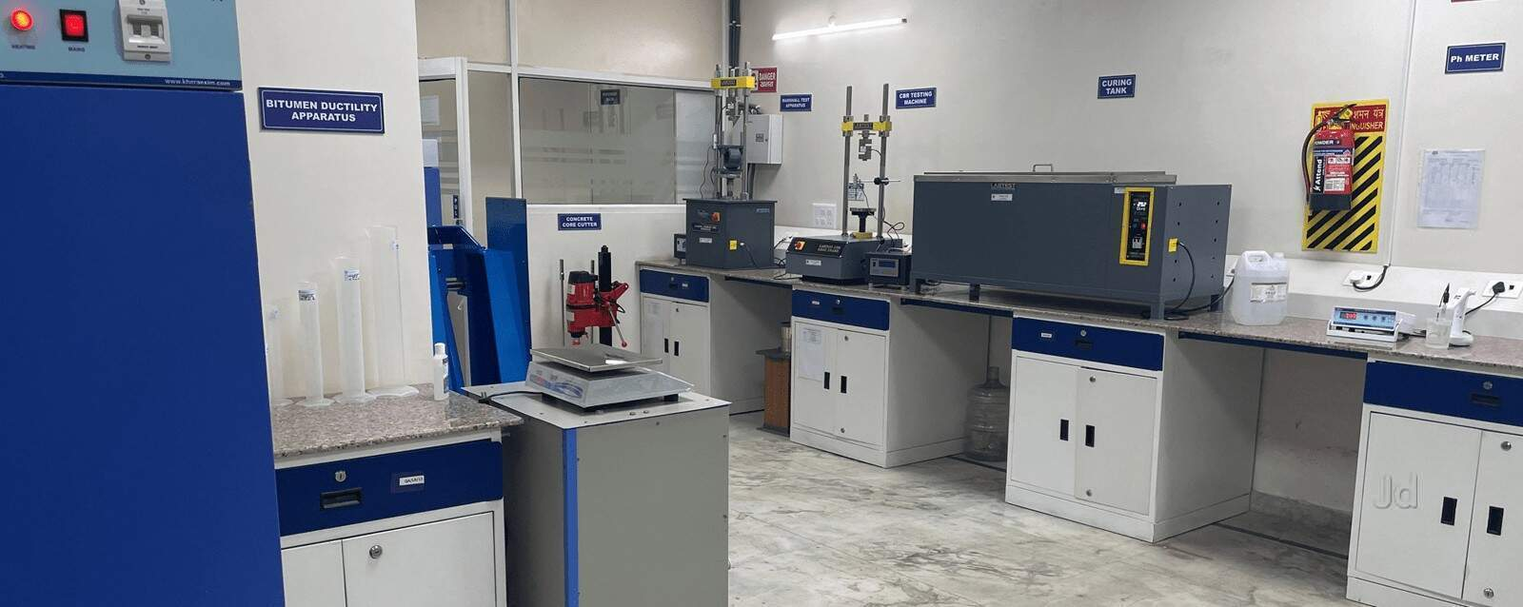
Regional Water Testing Laboratory
Our state-of-the-art facility combines cutting-edge technology with expert scientific oversight to deliver comprehensive water quality assessments. Through continuous monitoring and rigorous testing protocols, we safeguard the health and well-being of communities across SAS Nagar.
Advanced Testing
Quality Assurance
Bacteriological and chemical analysis capabilities.
ISO-compliant testing procedures and protocols.
Expert Team
Qualified scientists and technical specialists.

Slide 11
Thank You

