Slide 1

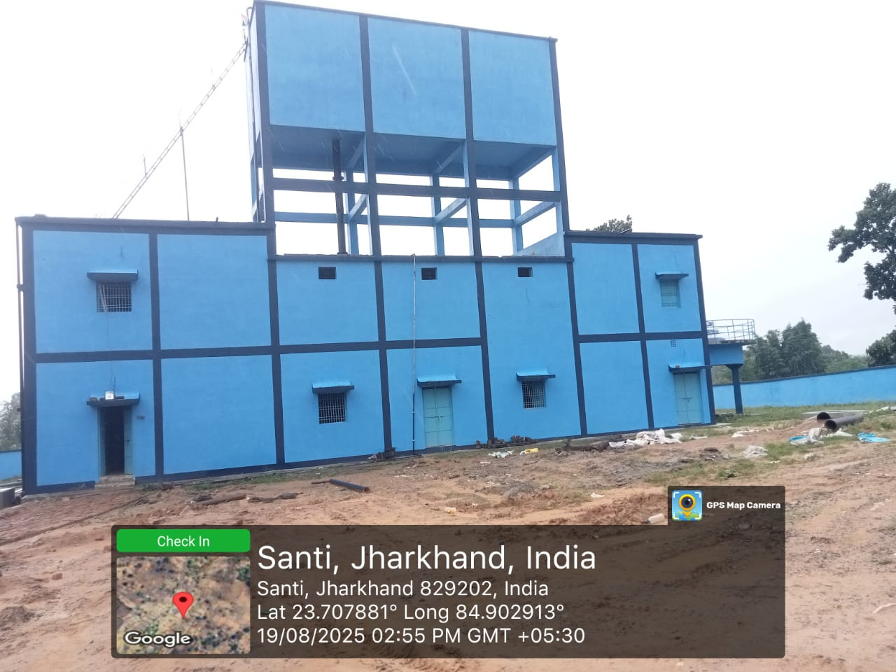
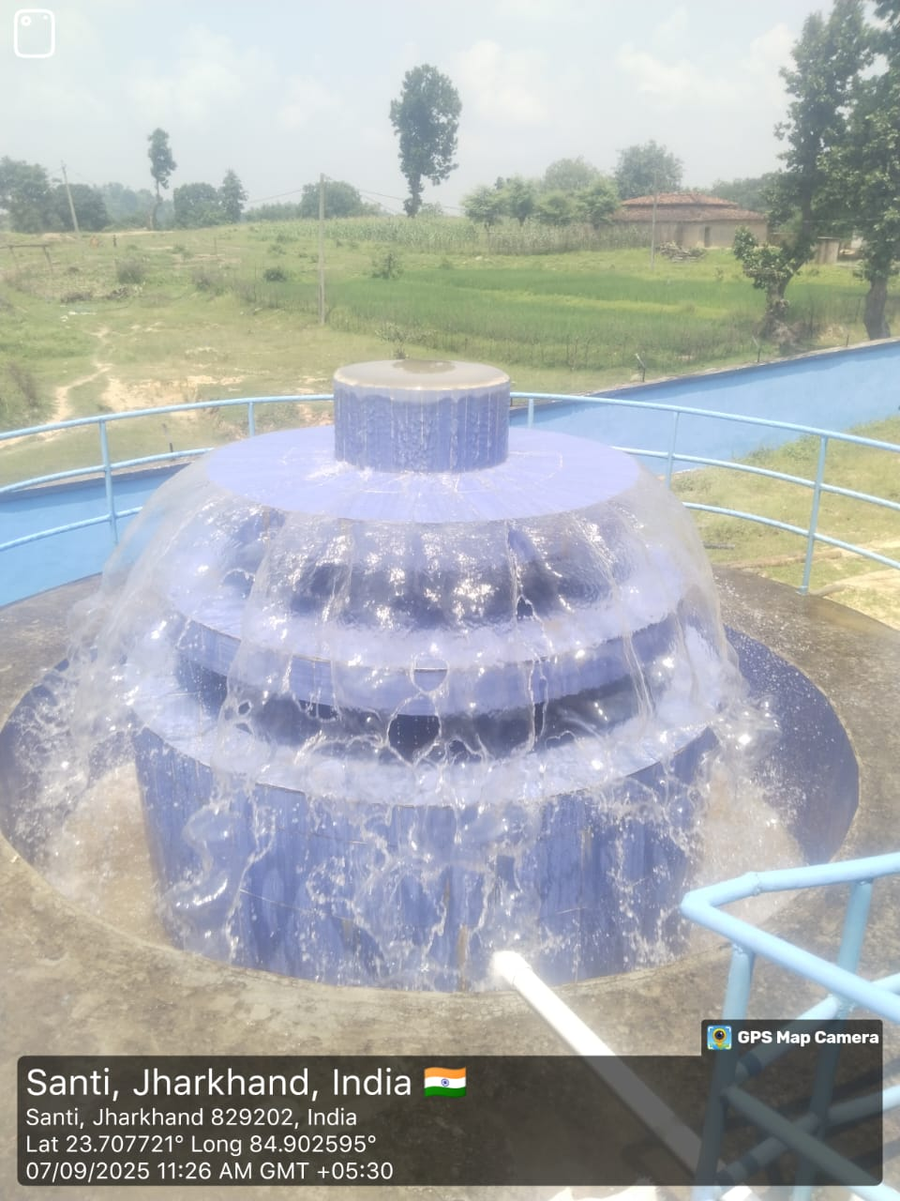
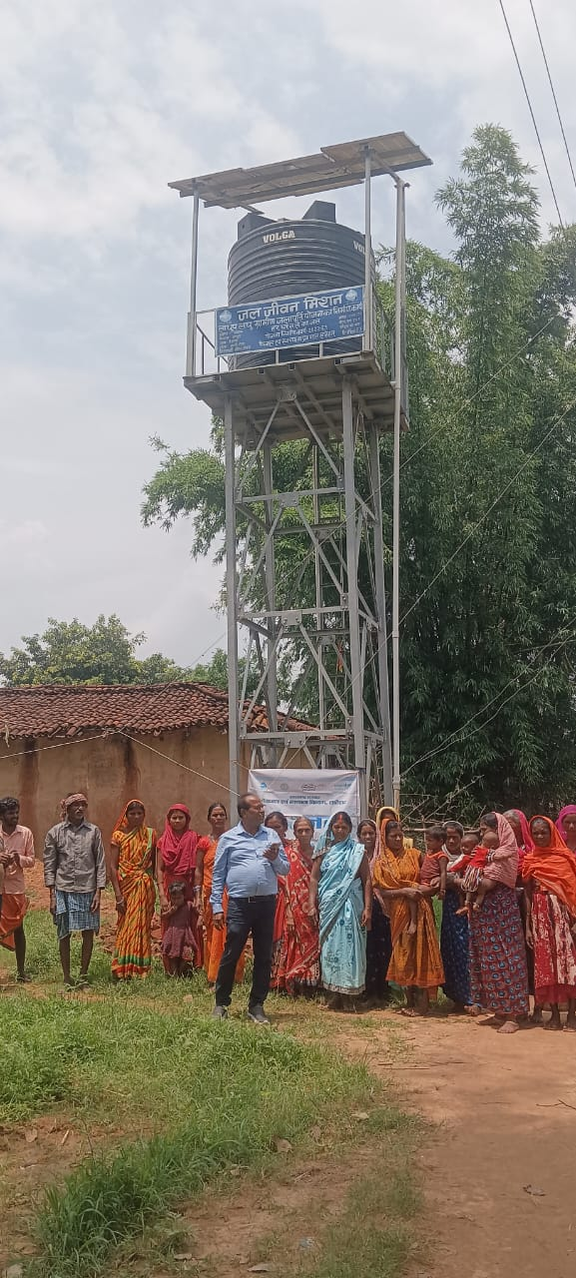
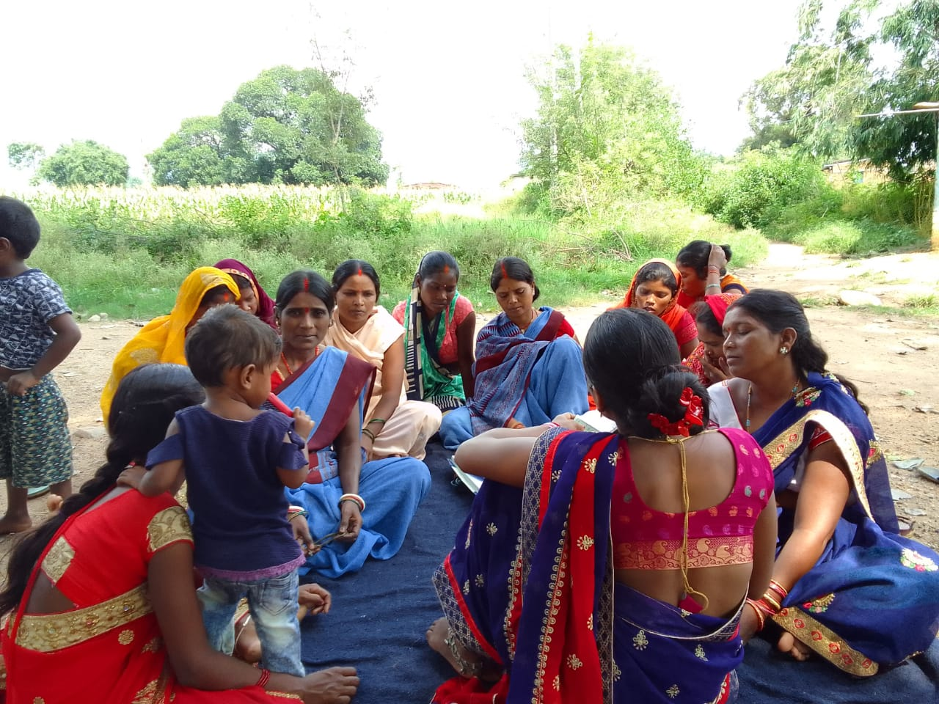
Peyjal Samvad with District Collectors
District-Latehar
Topic: Handover of Scheme to VWSC
Date: 11-12-2025
Drinking Water & Sanitation Department, Govt. of Jharkhand

Slide 2
Jal Jeevan Mission: FHTC Coverage

Slide 3
Progress of Schemes and HGJ Villages
No. of Schemes under JJM | Total Schemes as per IMIS | Physically Completed Schemes as per IMIS | Physically Completed Schemes Handed Over to VWSCs as per IMIS
Details in No. | 6959 | 4143 (60%) | 4121 (99%)
Status of Village Coverage
Total Villages | Villages with 100% | Har Ghar Jal Reported Villages | Har Ghar Jal Certified Villages
752 | 412 (55%) | 395 (96%) | 344 (87%)

Slide 4
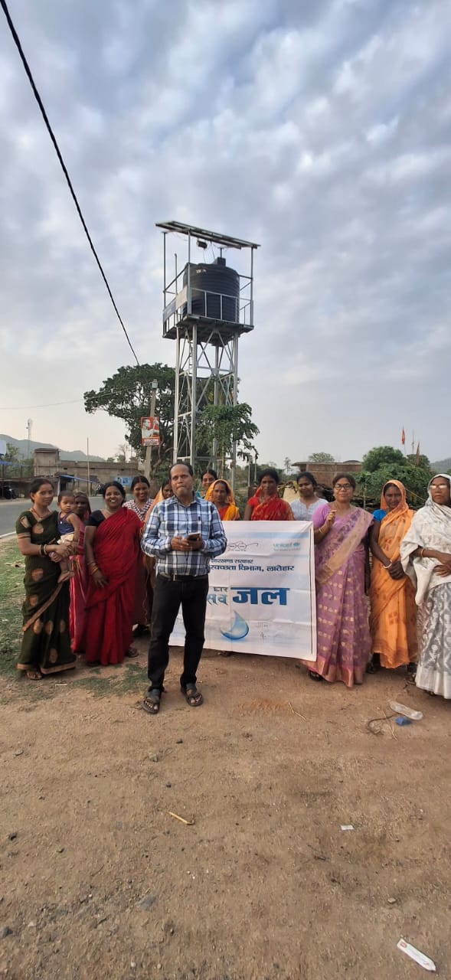
Handing Over Schemes to VWSCs
Long-standing water scarcity: Villagers in Latehar struggled for years to access clean drinking water, relying on a distant hand pump that frequently ran dry.
Daily hardship: Women and children walked long distances every morning to fetch limited water, accepting it as a routine burden.
Intervention by Jal Jeevan Mission: The situation began to improve when the Jal Jeevan Mission initiated work in the village.
Infrastructure development: Engineers, technicians, and the DWSD team laid pipelines, constructed water tanks, and installed household tap connections.
Scheme completion: After months of effort, the piped water supply system was ready.
Final step pending: The most crucial step was the formal handover of the schemes to the Village Water & Sanitation Committee (VWSC) for community ownership and management.

Slide 5

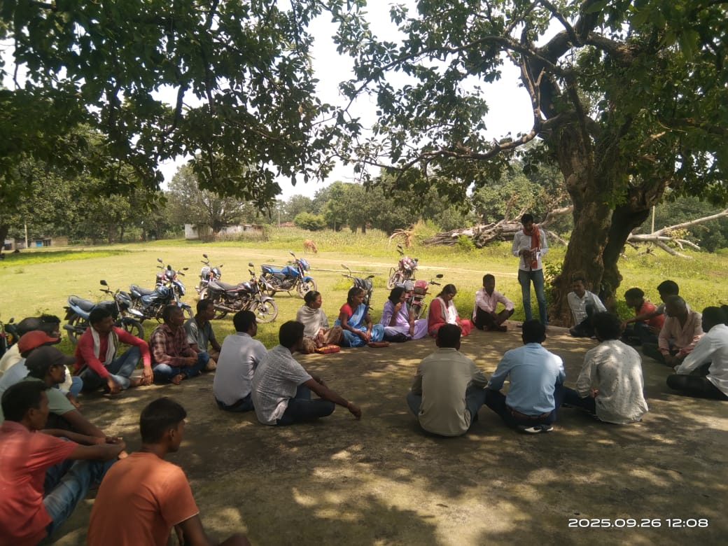
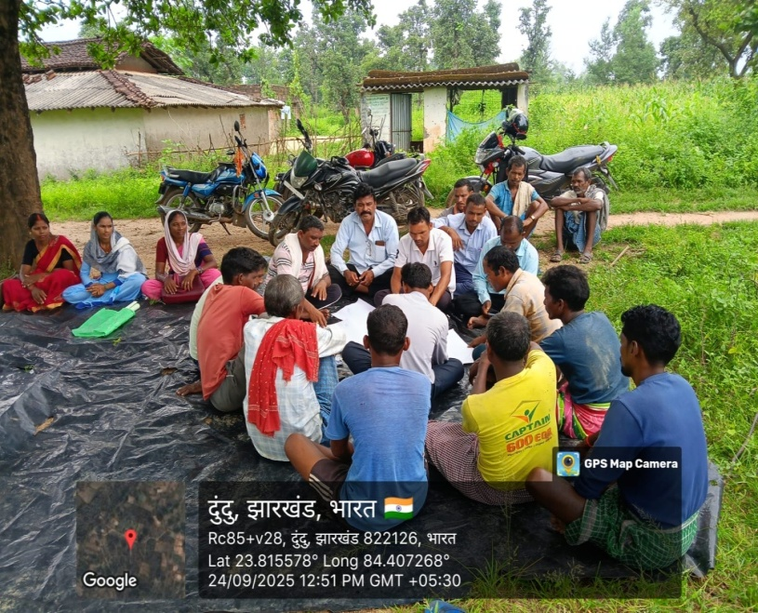
People's Participation
Organizing Gram Sabha for handing over schemes:
Gram Sabha: Convened specifically to formalize the handover of the water supply scheme.
Community participation: villagers, VWSC members, and local leaders present.
Officials' Participation: Block team, engineers, and Panchayati Raj representatives.
Schemes documents: Schemes Asset register, Completion Certificate, technical drawings, and O&M details.
Roles and responsibilities: Outlining VWSC responsibilities for operation, maintenance, and tariff collection.
Formal handover: Signing documents and handing over schemes to the VWSC.
Community awareness: Water conservation, equitable distribution, and reporting issues.

Slide 6
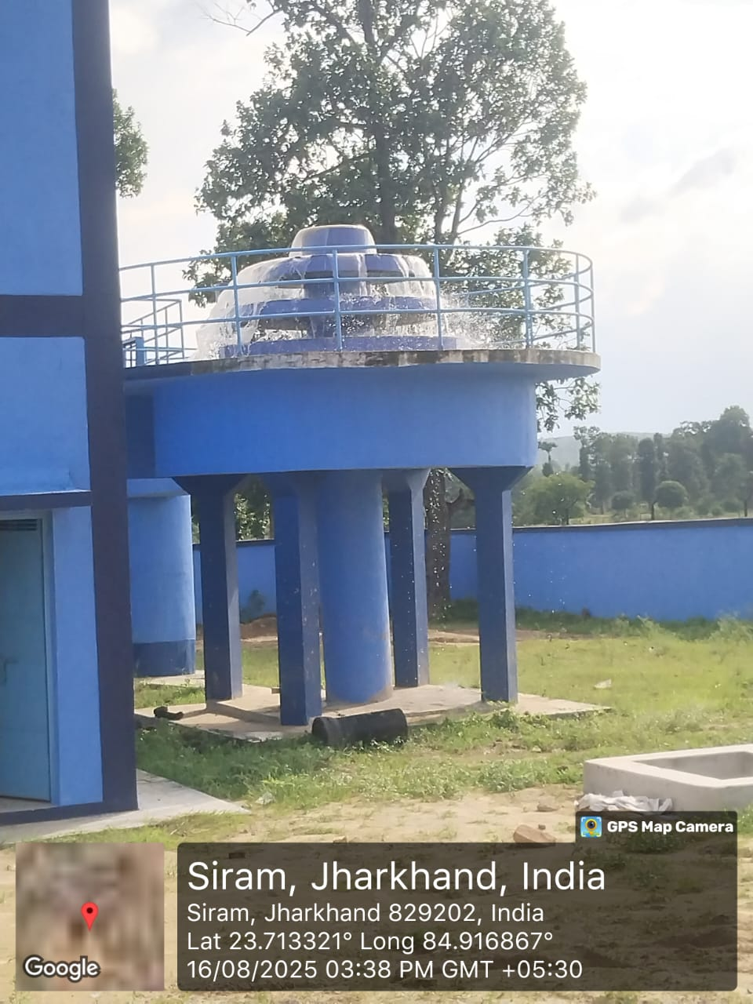
Sustainability
VWSC conducts regular meetings to manage the water scheme. Water tariff is fixed and collected for sustainable O&M by VWSCs. Proper record-keeping is maintained for transparency by VWSCs. Water quality is tested periodically. Skilled operators are engaged to run the system smoothly. Grievances are resolved through the Jhar-Jal Portal and district mechanisms. Villagers feel proud as they manage their own water supply scheme. Video on Interaction with Gram Pradhan/ Mukhiya When a community takes ownership, even the smallest resource becomes a source of strength and progress. Handover is not the end — it is the beginning of responsibility, sustainability, and development.

Slide 7

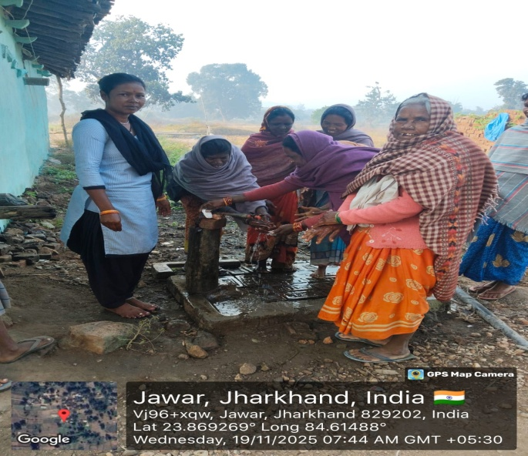
Thank you

