Slide 1


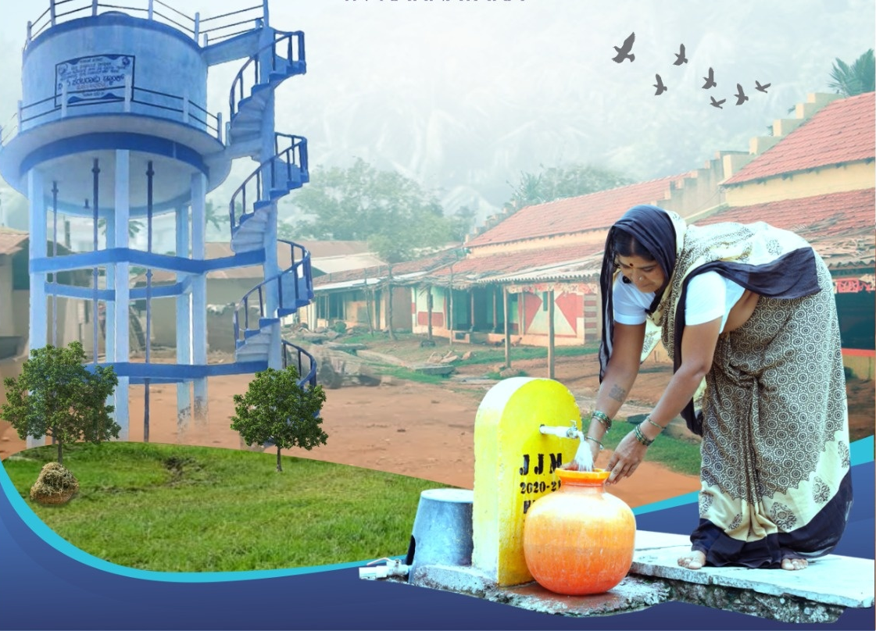
Government of Karnataka
Rural Development and Panchayat Raj Department
Rural Drinking Water and Sanitation Department
Sustainable Rural Water Supply in Karnataka
24/7 water supply system
Date: December 2025
PRESENTED BY:
Name:
Designation:
District:
State:
Shri Gangadharaswamy G M, I.A.S
Deputy Commissioner
Davanagere
Karnataka

Slide 2
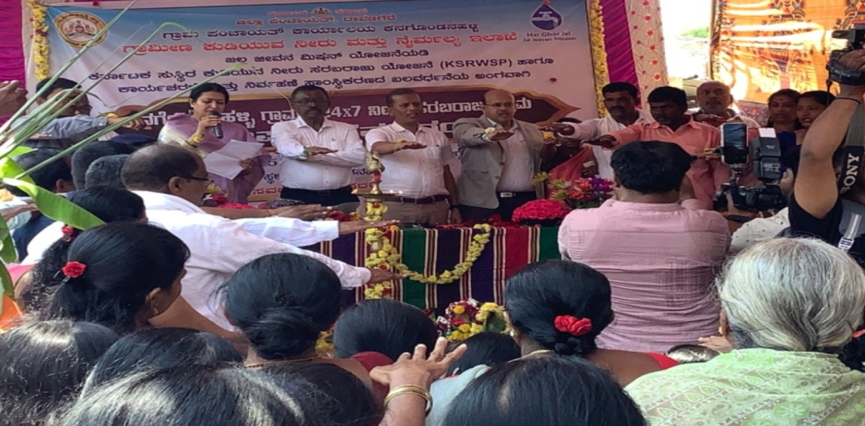
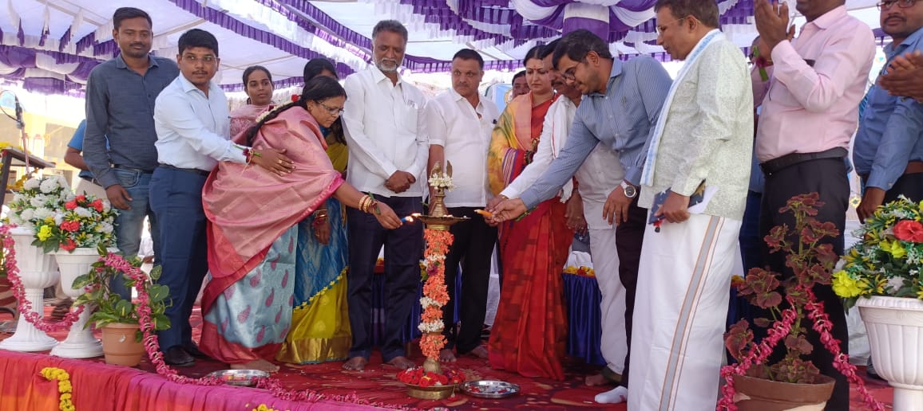
Davanagere – A model District in declaration of 24/7 Water Supply in Karnataka
Proposed villages in Karnataka: 925
24/7 water supply Declared Villages in Karnataka: 209
In Davanagere, Declared 57 (45 Revenue Villages and 12 Habitation ) Villages as 24/7 Water supply villages.
Target set to Declare 100 villages as 24/7 water supply villages in Davanagere.
Sl.No | District | No Of Villages Declared as 24*7
1 | Davanagere | 45
2 | Shivamogga | 20
3 | Bagalkote | 16
4 | Koppal | 14
5 | Belagavi | 12
6 | Kodagu | 11
7 | Ballari | 10
8 | Vijayanagar | 10
9 | Hassan | 9
10 | Chikkaballapura | 8
11 | Bengaluru Rural | 5
12 | Bengaluru Urban | 5
13 | Dharwad | 5
14 | Kolar | 5
15 | Mandya | 5
16 | Mysuru | 5
17 | Vijayapura | 5
18 | Haveri | 4
19 | Bidar | 3
20 | Chitradurga | 3
21 | Gadag | 2
22 | Chamarajanagara | 1
23 | Dakshina Kannada | 1
24 | Kalaburagi | 1
25 | Raichur | 1
26 | Ramanagar | 1
27 | Udupi | 1
28 | Yadgir | 1
 | Grand Total | 209

Slide 3
24/7 Water supply - APPROACH AND METHODOLOGY
Feasibility Phase - Feasibility Study
Triggering Phase – Repair works to meet 24/7, Community triggering, O&M policy adoption.
Follow-up Phase - Meter reading and record keeping, User level consumption analysis
Sustainability Phase
Monthly tariff collection by SHG
Daily Monitoring through Google analytics.

Slide 4
THE PROCESS FOLLOWED
Capacity building on 24/7 implementation :
Trainings and Orientation
GP/VWSC Strengthening
Community Monitoring & Digital Governance
Sl. No | Date | Achievement/Event
1 | 27 to 28 th July 2025 | Orientation on 24/7 water supply to all Technical and Panchayat raj staff
2 | 04 th to 07 th April 2025 | 4 Days Residential Training on Implementation of 24/7 water supply to Technical and Panchayat raj staff
| 9LPM , 7M | Water Quality as per BIS Standard | 55 LPCD |
Longevity 30 Yrs | Affordable Tariff | Piped Water Supply
Minor Repairs & Maintenance
SHG as Service Provider
24X7 WATER SUPPLY
FHTC & Meter Monitoring
Water Conservation & Security
Water Quality Monitoring & Surveillance
Tariff Fixation, Realization & Expenditure

Slide 5
MISSION 100 - 24X7 WATER SUPPLY
Criteria considered in Monitoring of 24/7 water supply villages
100
Analysis of water usage at consumer level.
Analysis of Non-Revenue water.
Daily Pumping hours.
Analysis of O&M cost/expenditure in 24/7 water supply village v/s Intermittent water supply village.
Electricity charges.
Bulk water meter reading
Villages targeted for sustainable 24X7 water supply
57
Villages declared with 24X7 water supply. 45 Revenue Villages and 12 habitation .
69066
People targeted to be benefited with the scheme
14894
FHTCs to be monitored to institutionalize the scheme

Slide 6
Sl No | Challenges Faced | Recommended Actions to overcome/Rectification
1 | Water logging in and around the bore well and OHT’s | Clearing the water-logged area and vegetation growth.
2 | Leakages, cracks or damages | Replace or Repair the damaged infrasturcture.
3 | Damaged/Bypass Volumetric Water Meter | Behavioral Changes by Communication to Community.
4 | Pump house and cables not maintained well | Replace or Repair.
5 | Lack of awareness about water and water meter | Information Education Communication to Community
6 | Maintenances challenge after handing over | Adoption of O&M Policy & Conducting regular meetings.
7 | Some part of wire mesh on air vent got damaged on OHT | Rectification of damages in OHT

Slide 7
Outcomes of 24/7 water supply in Davanagere - Reducing Non-Revenue Water, Reduction Water Consumption in KL & Reduction Pumping Hours
Sl. | Taluk | Village | Before Declaration NRW | After Declaration NRW | Before Declaration Water Consumption | After Declaration Water Consumption | % of Reduction Water Consumption in KL After Declaration | Before Declaration Pumping Hours | After Declaration Pumping Hours | % of Reduction Pumping Hours
1 | Honnali | Hanagavadi | 42% | 31% | 210 | 161 | 23.33 | 8 | 6 | 25
2 | Honnali | Ghantyapura | 54% | 21% | 177 | 145 | 15.24 | 10 | 6 | 40
3 | Harihara | Kadlegondi | 32% | 10% | 96 | 75 | 10 | 7 | 5 | 28.6
4 | Harihara | Salaganahalli | 29% | 9% | 88 | 68 | 9.52 | 7 | 4 | 42.9
5 | Channagiri | Melanayakanakatte | 32% | 6% | 89 | 65 | 11.43 | 10 | 5 | 50
6 | Channagiri | Thilineera Katte | 35% | 13% | 90 | 74 | 7.62 | 8 | 6 | 25
7 | Nyamathi | Danihalli | 40% | 29% | 160 | 111 | 23.33 | 10 | 6 | 40
8 | Nyamathi | Madapura | 31% | 14% | 89 | 74 | 7.14 | 8 | 5 | 37.5
9 | Davanagere | Dyamenahalli | 30% | 16% | 110 | 85 | 11.9 | 7 | 5 | 28.6
10 | Davanagere | Kashipura | 40% | 20% | 190 | 145 | 21.43 | 8 | 6 | 25
11 | Channagiri | Halli Mallapura | 40% | 16% | 90 | 76 | 6.67 | 8 | 5 | 37.5
12 | Channagiri | Giriyapura | 20% | 15% | 75 | 64 | 5.24 | 7 | 6 | 14.3
Conscious use of water by Community
Reduction in Leakage of water at Pipelines & FHTCs
Overall,13% Reduction in Water Consumption After Declaration
Overall, 33% Reduction in Pumping hours After Declaration
Reduction in Electricity charges

Slide 8
Outcomes of 24/7 water supply based on analysis of pilot declared villages
Reducing Non-Revenue Water – 17% reduction
Leakage control
Reduction in Electricity charges
Conscious use of water - 13% Reduction in Water Consumption.
Equitable distribution and enough pressure
Reduction in Pumping hours - 33% Reduction
Better service level
Stops contamination
Consumer satisfaction
The life of the network increases
Time for rewarding activities.

Slide 9
Actions taken for Making O&M of Rural water supply schemes Sustainable
VWSC (water bank) accounts are opened
O&M policy has been adopted in GPs.
Details of Water Tariff collection captured in Panchatantra 2.0
Annual O&M Budget preparation
Software based Volumetric billing.
Capacity building of RDWSD & PR staff through FLL & feedback foundation trainings.

Slide 10

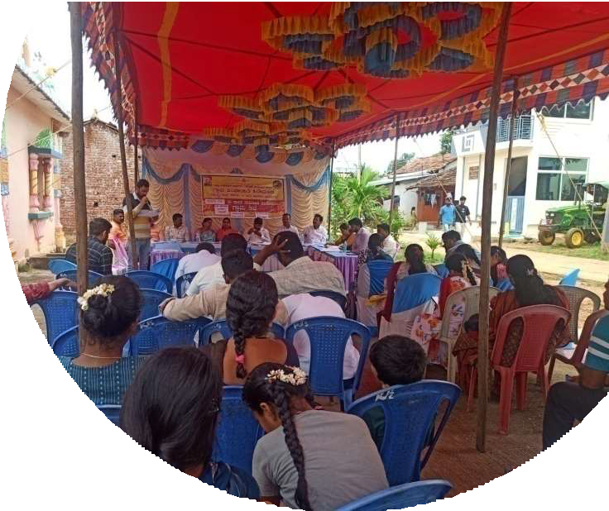

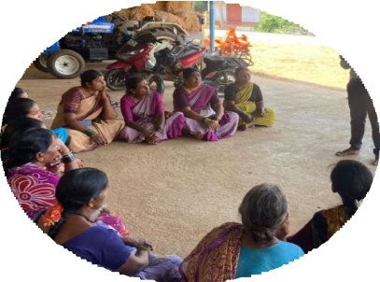
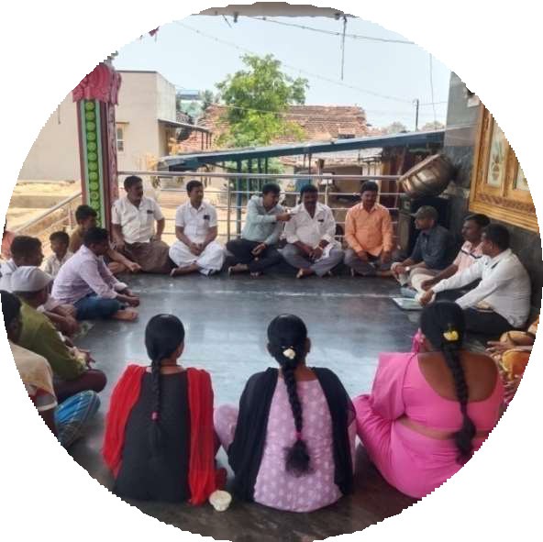
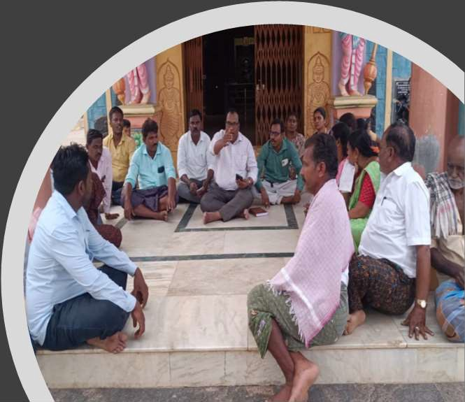

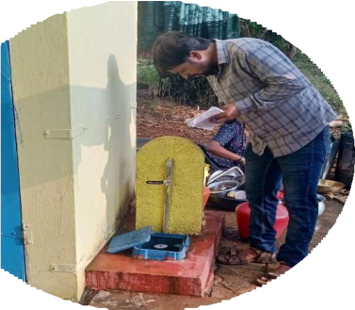


THE PROCESS FOLLOWED FEASIBILITY PHASE
GP members/PDO/VWSC meeting on selection of their village for 24/7 water supply
Baseline survey & Gap analysis.

Slide 11
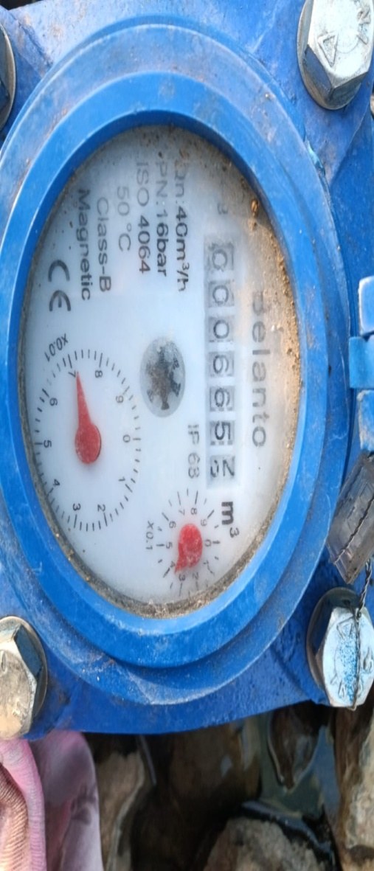
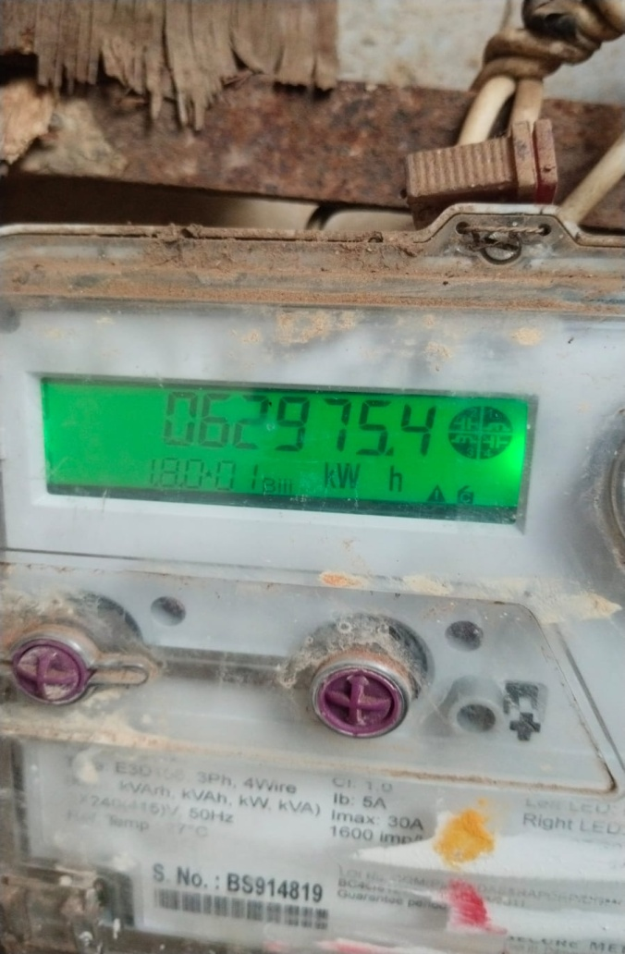
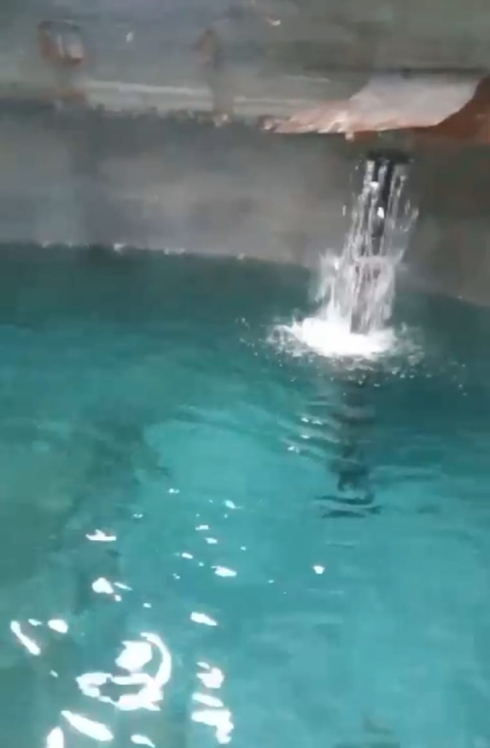
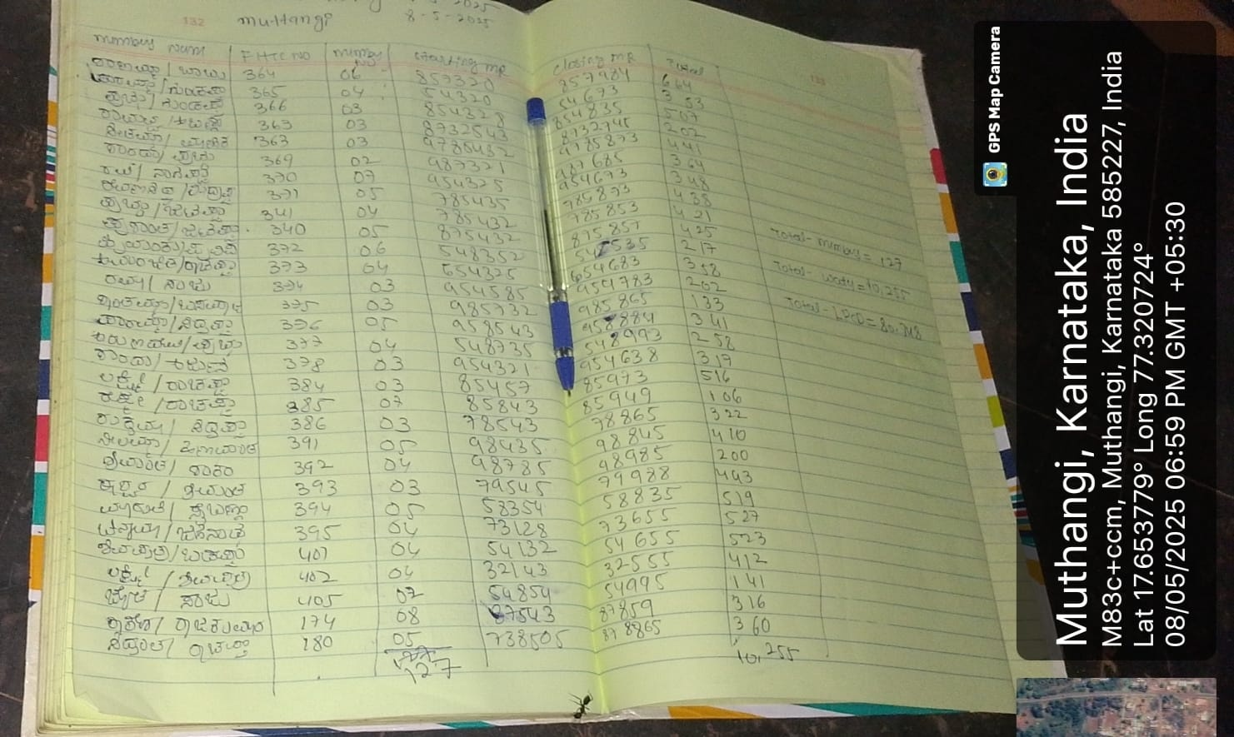
THE PROCESS FOLLOWED
FOLLOW-UP PHASE
BULK WATER METER READING
ELECTRICITY METER READING
FREQUENCY OF FILLING OF OHT [2 times/day]
USER WATER CONSUMPTION ANALYSIS
WATER CONSUMPTION ANALYSIS

Slide 12

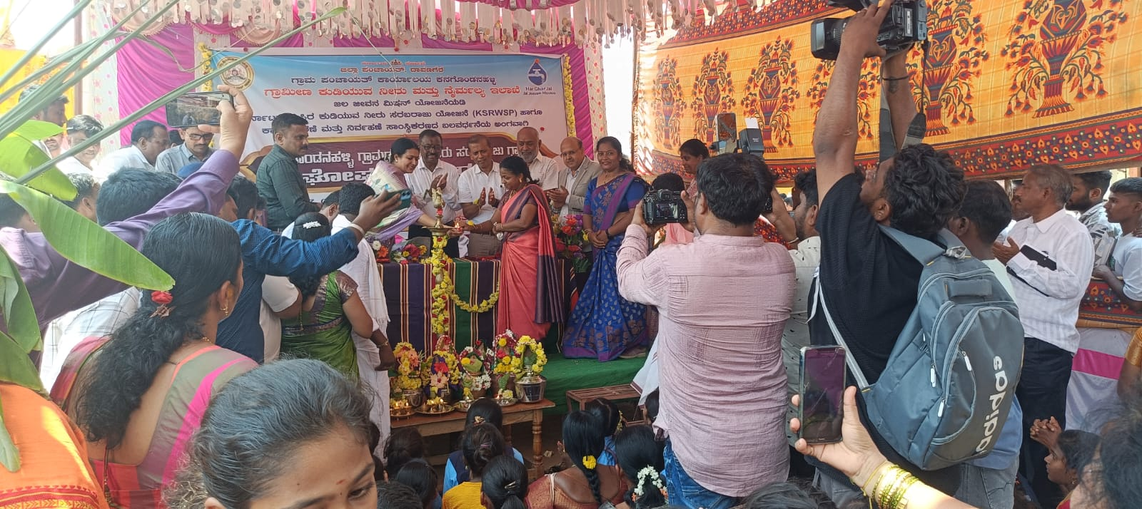
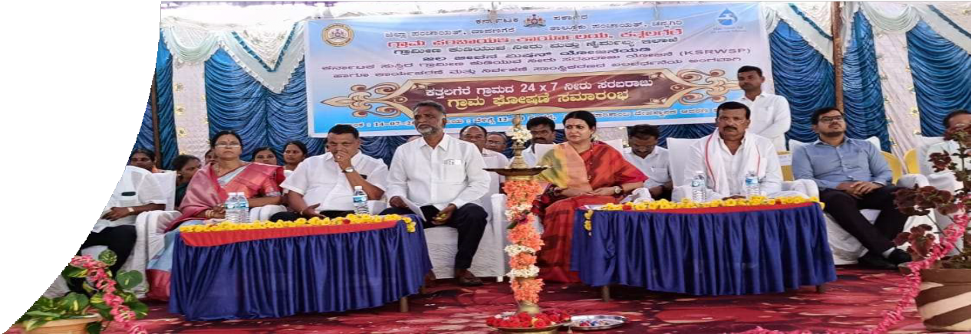
24/7 Village Declaration in presence of Honourable MP, MLA,MLC, DC, CEO,GP President, Dept Officers & Beneficiaries

Slide 13
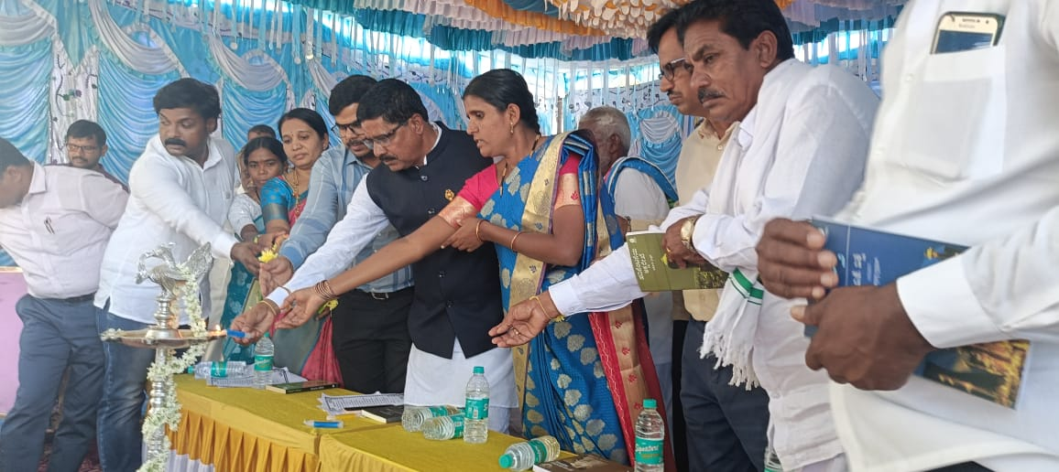
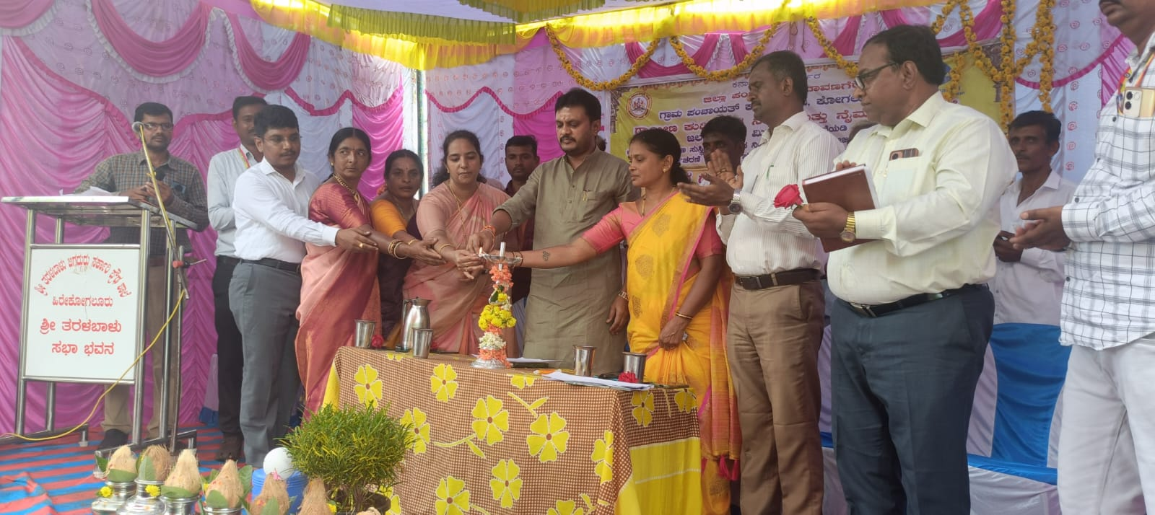
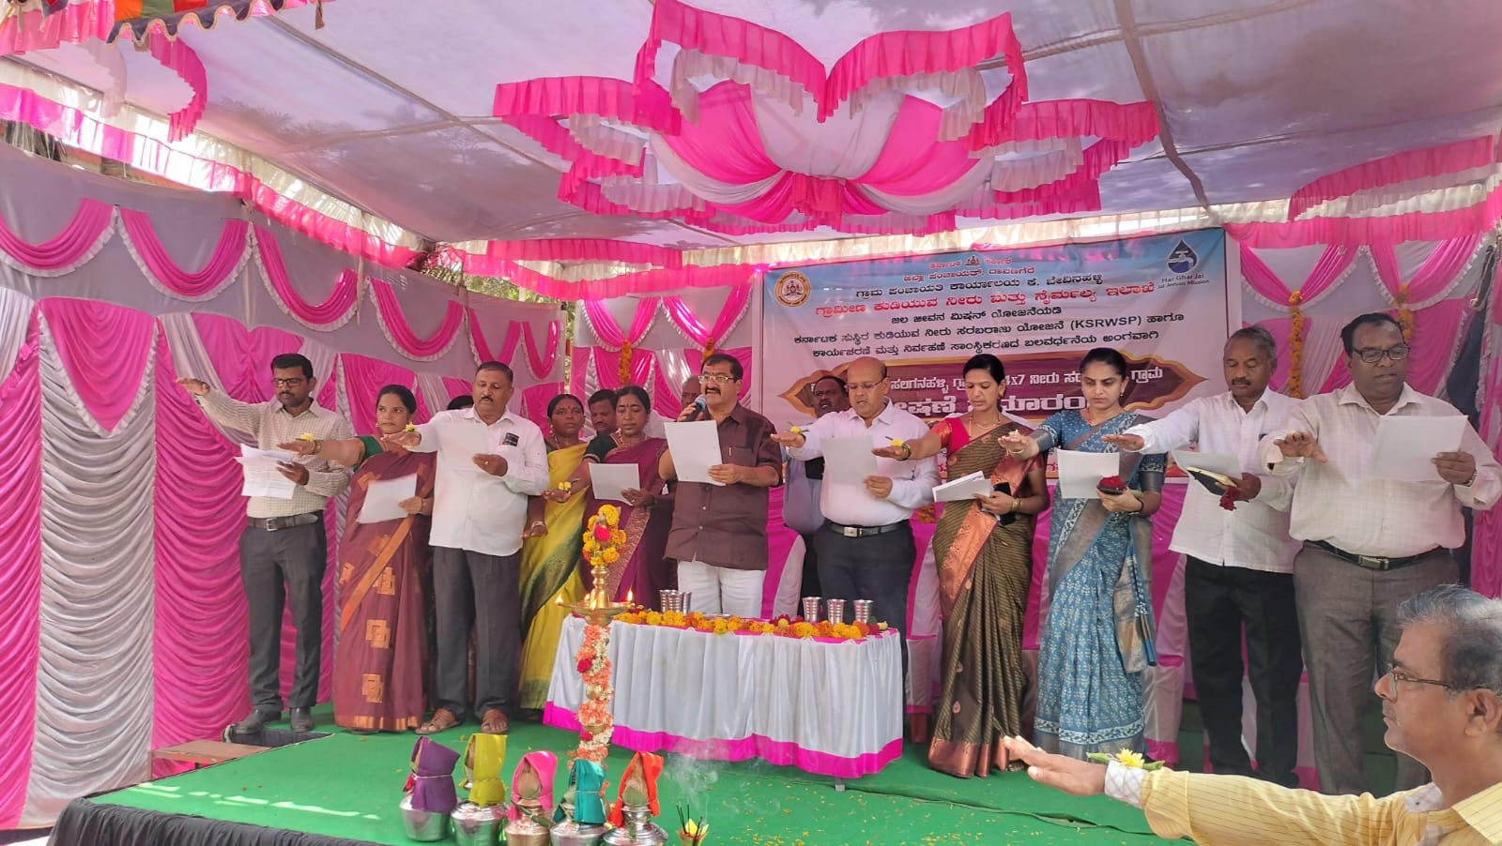
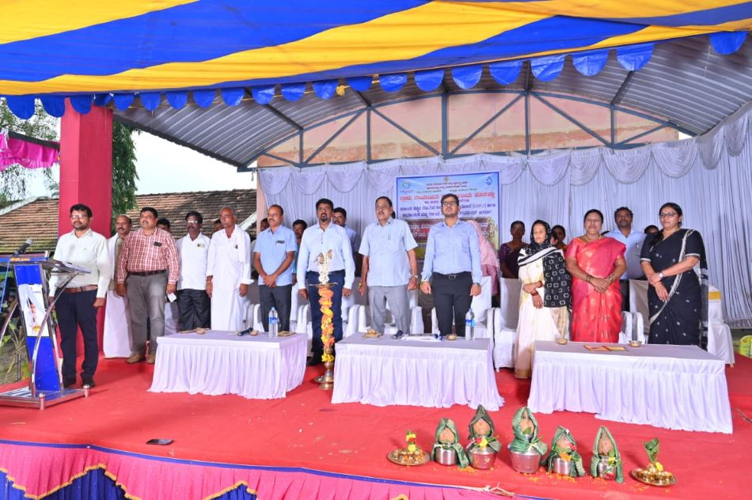
Inauguration Programme by Public Representatives such as Honourable Minister’s,MP ,MLA’s ,MLC’s,DC,CEO,GP President and Members

Slide 14
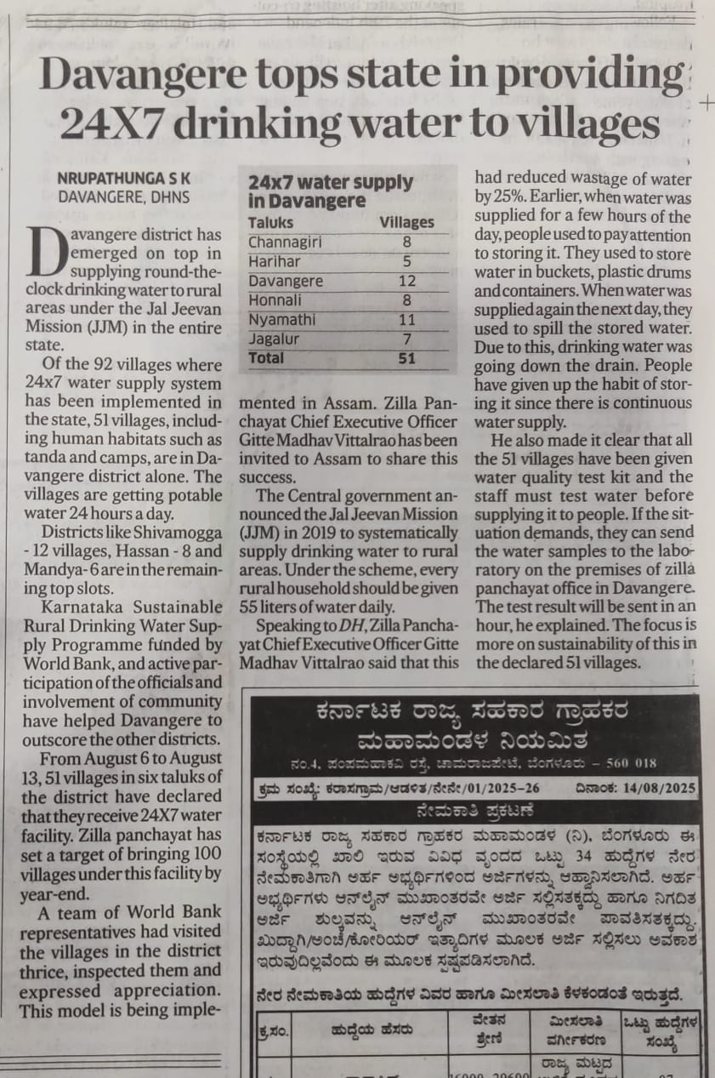
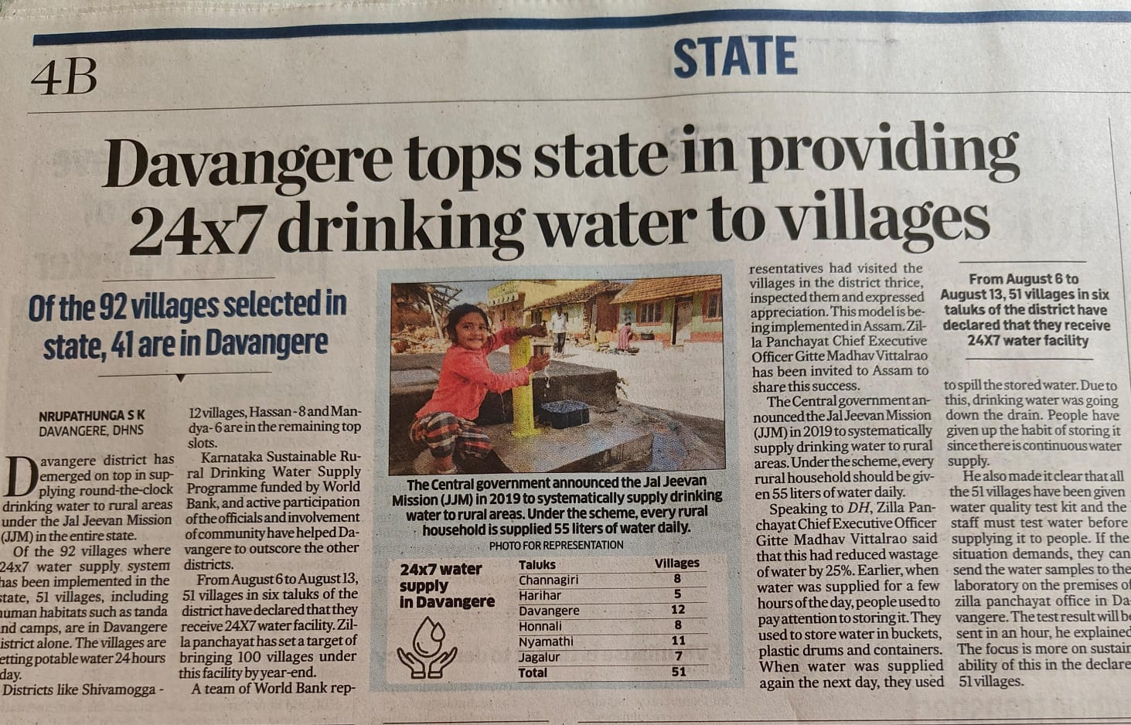
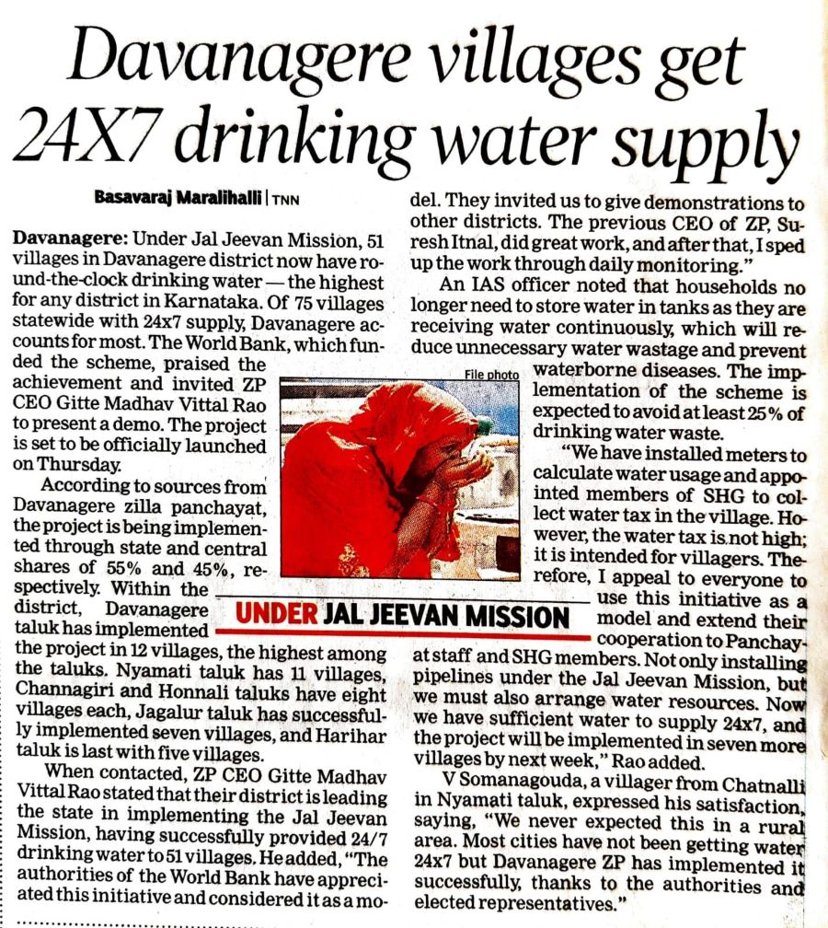
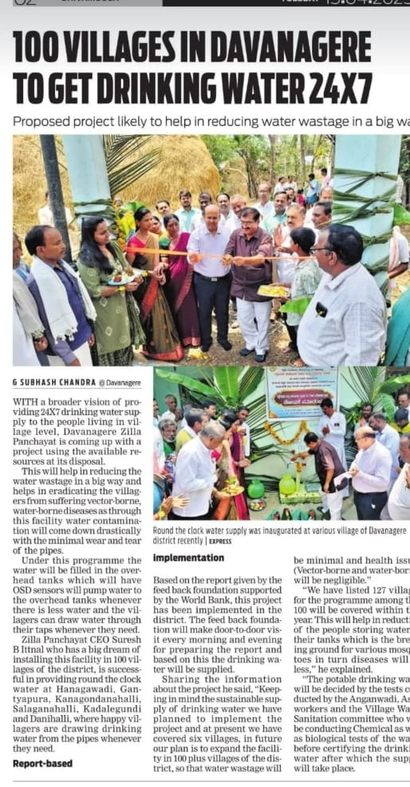
Media Coverage

Slide 15
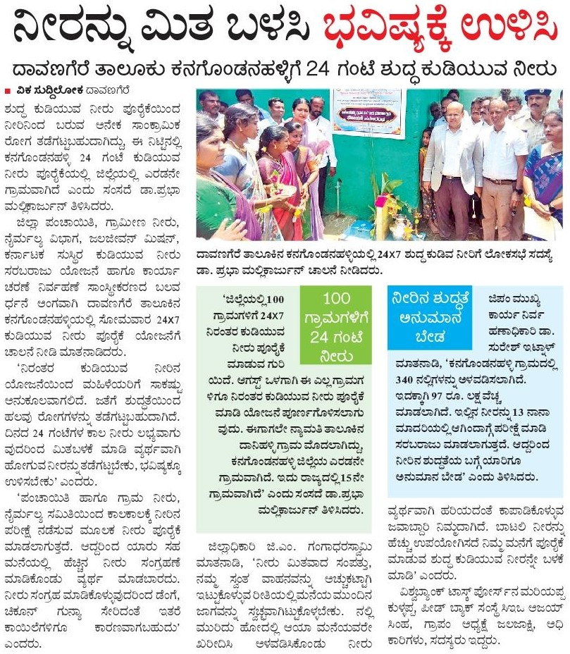
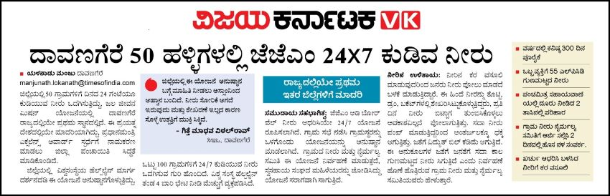
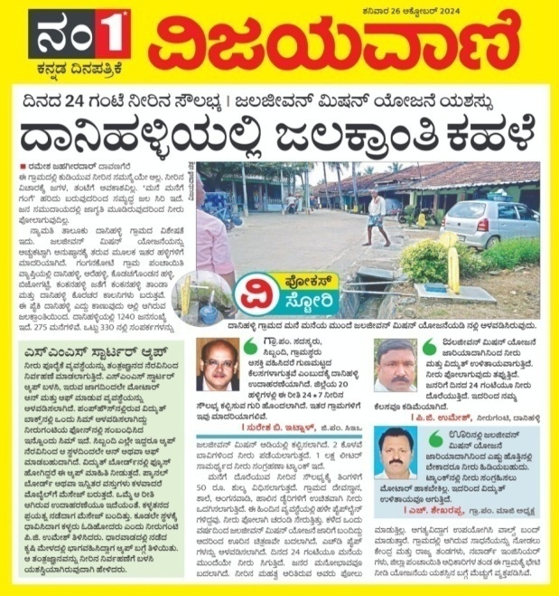
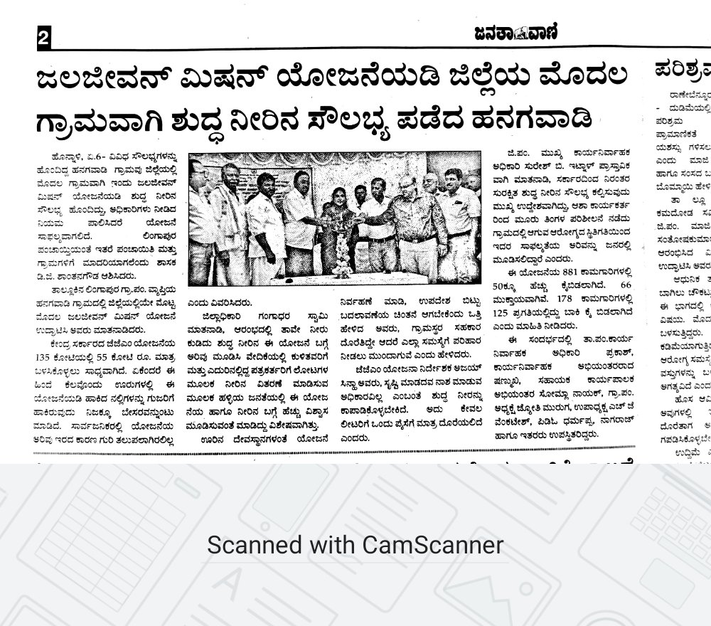
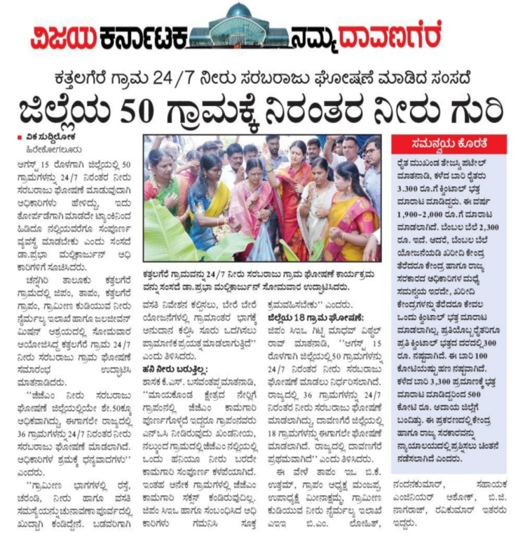
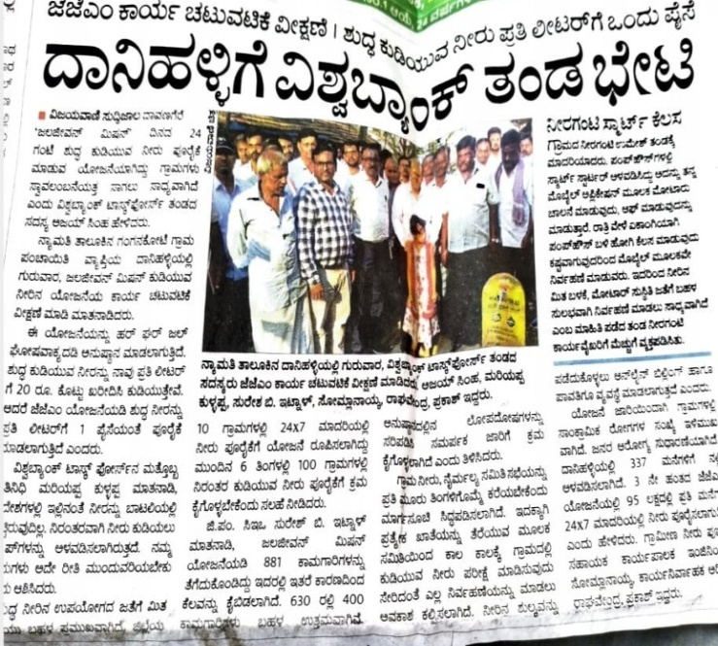
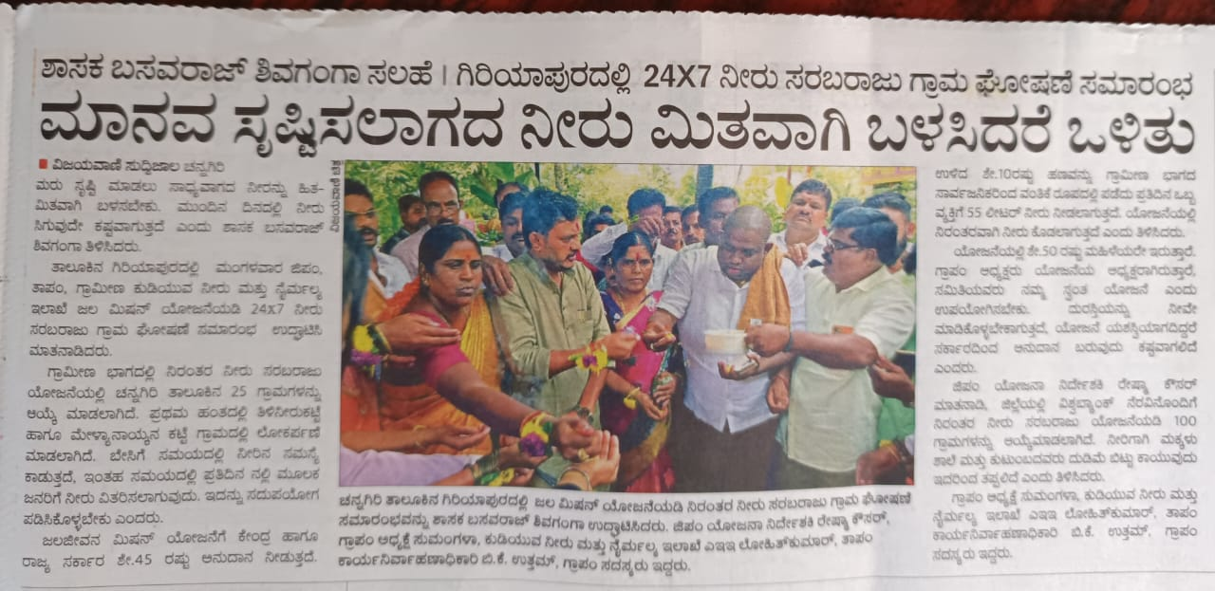
Media Coverage

Slide 16
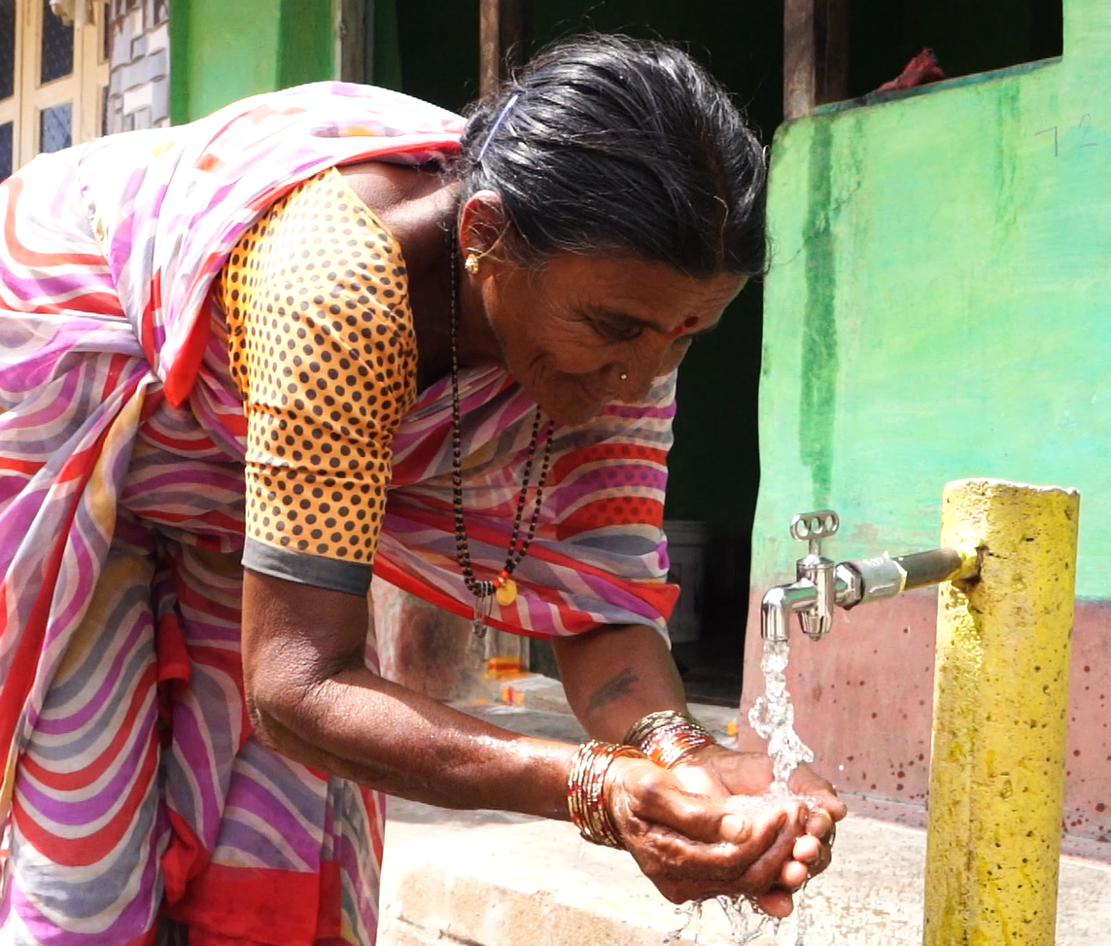

Transformation towards
sustainable water supply
24/7 water supply village

