Slide 1

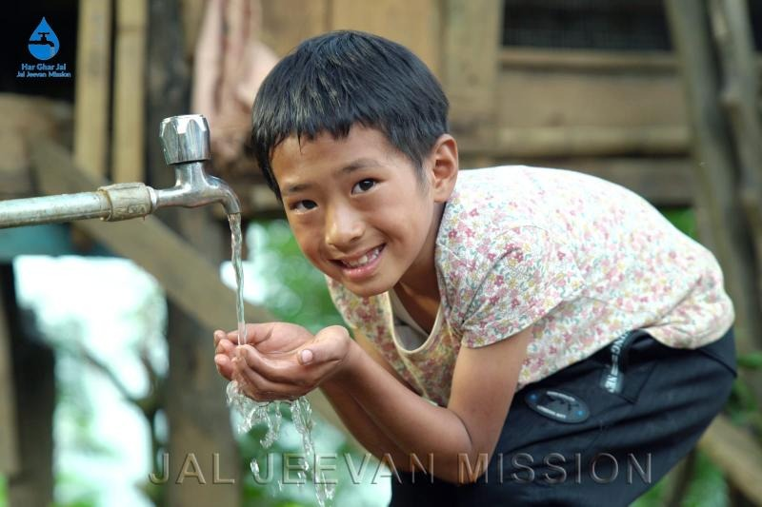
Peyjal Samvad with District Collectors:
District-Kamjong District, Manipur.
Success story
On Jal Jeevan Mission(JJM)
in Kamjong District, Manipur. Date: 11-12-2025
District Water & Sanitation Mission, Kamjong District, Manipur.

Slide 2
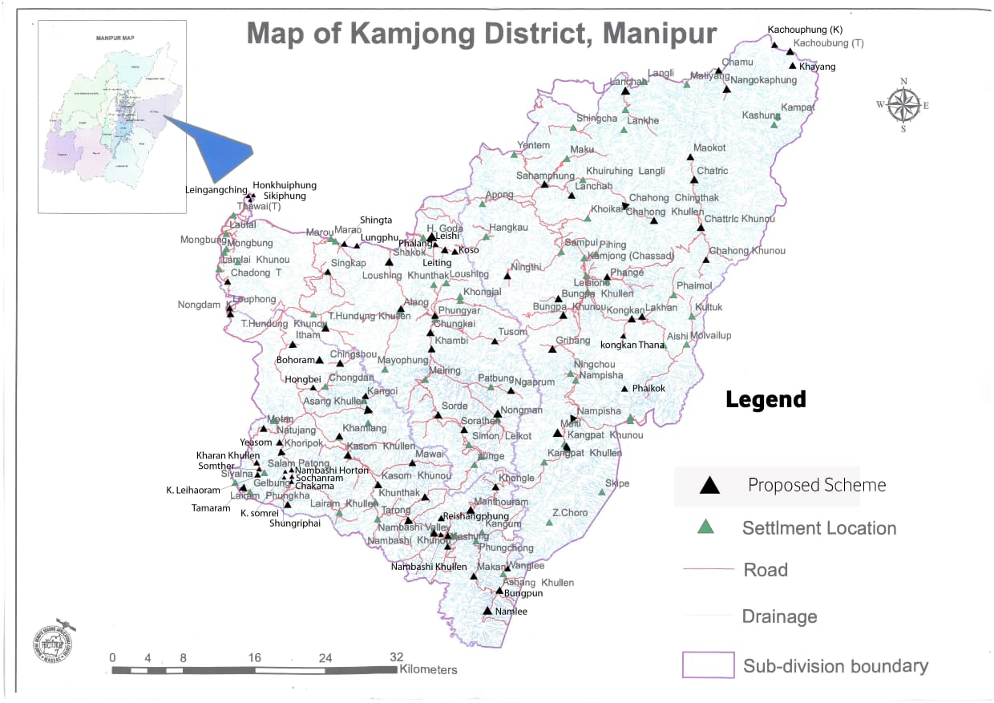
Jal Jeevan Mission in Kamjong District: Manipur
 | No. of Block | 4 Nos.
 | No. of Gram Panchayat | 118 Nos
 | No. of Village | 121 Nos
 | No. of Habitation | 143 Nos.
 | Total Population | 62578
 | Total Household as per IMIS | 11334 HHs
 | FHTC provided as on November 2025 | 8323 HHs (73%)
 | Har Ghar Jal Certified Villages | 24 Nos
.

Slide 3
Details of Water Supply Schemes Taken up in Kamjong District by PHED Manipur
Sl. No. | Name of Scheme | No. of scheme | No. of village to be covered | Targeted Households | Functional Household Tap Connection (FHTC) provided | Remark
1 | Jal Jeevan Mission(JJM) | 55 | 41 | 4607 | 4407 | 95% (Targeted timeline of completion is May 2026)
2 | External Aided Project funded by New Development Bank(NDB) | 88 | 80 | 6727 | 3916 | 58% (Targeted timeline of completion is May 2026)
3 | Total | 143 | 121 | 11334 | 8323
Progress of Har Ghar Jal(HGJ) village
Name of scheme | Total No. of Villages. | Har Ghar Jal Reported Villages | Har Ghar Jal Certified Villages
JJM | 41 | 12 | 24(58%) (Targeted timeline of completion is May 2026)
NDB | 80 | - | Work in progress (Targeted timeline of completion is May 2026)
Total | 121 | 12 | 24

Slide 4
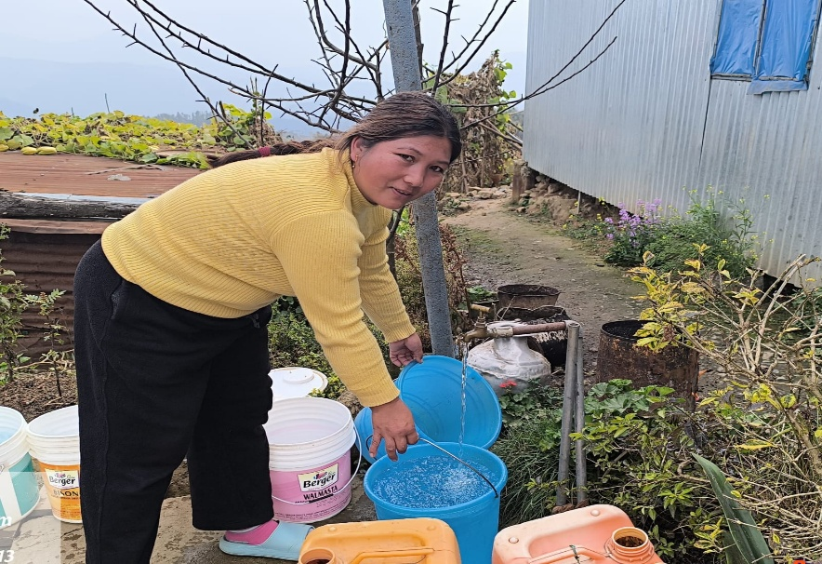
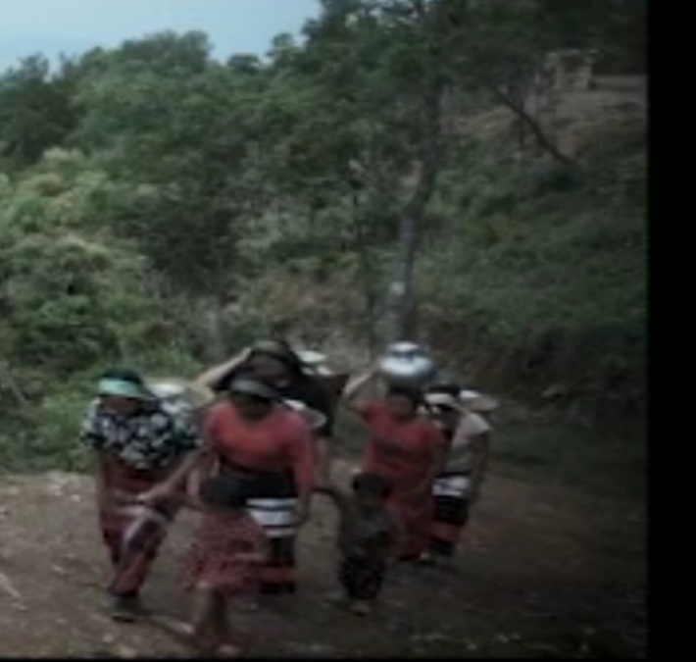
Prior to Jal Jeevan Mission
Many of the existing water supply scheme were under capacity and hence the water demand was exceeding the available supply Public depend on water supply by water tanker Fetched water by headload from spring source Depend on public hydrant/stand post system At the time of Jal Jeevan Mission inception, only 19% households in Kamjong District, Manipur, had access to tap water.

Slide 5
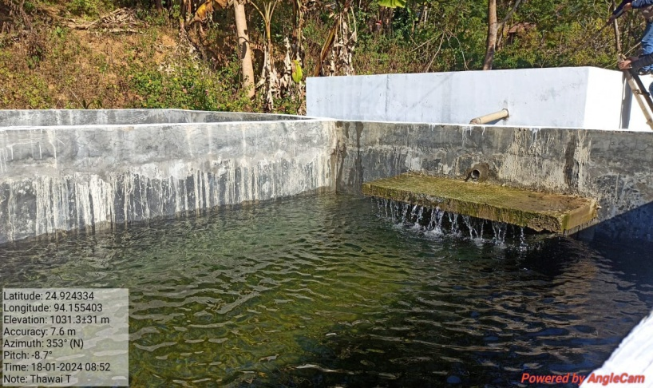
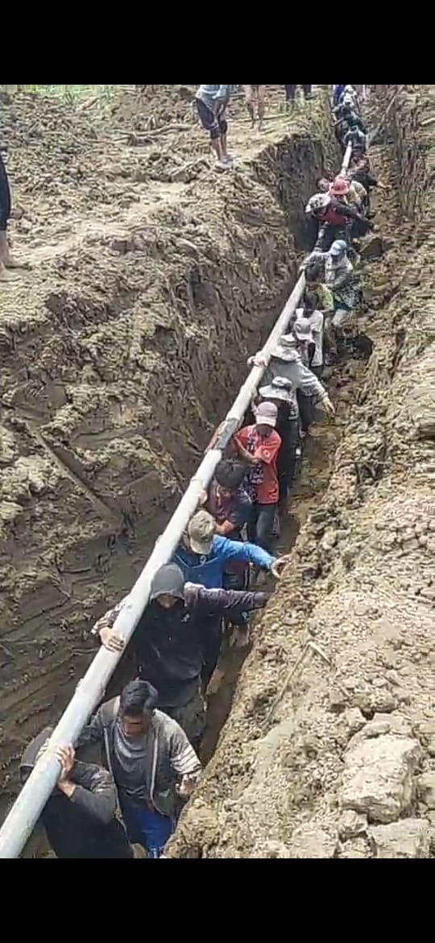
Success of Jal Jeevan Mission in Kamjong District
The shortfalls and difficulties of village water supply system got a revamping improvement under Jal Jeevan Mission. Most of the existing Water Supply schemes got augmented to the supply level of 55lpcd and new schemes are constructed under JJM Through awareness activities under IEC, the sense of ownership and genuine community participation increases. Households are provided with Functional Household Tap Connection(FHTC). The FHTC coverage has improved from 19% to 73% under JJM with a targeted timeline for full coverage by May 2026. 36 villages have become HGJ village with 24 villages as HGJ certified village with targeted timeline for HGJ district by May 2026.

Slide 6
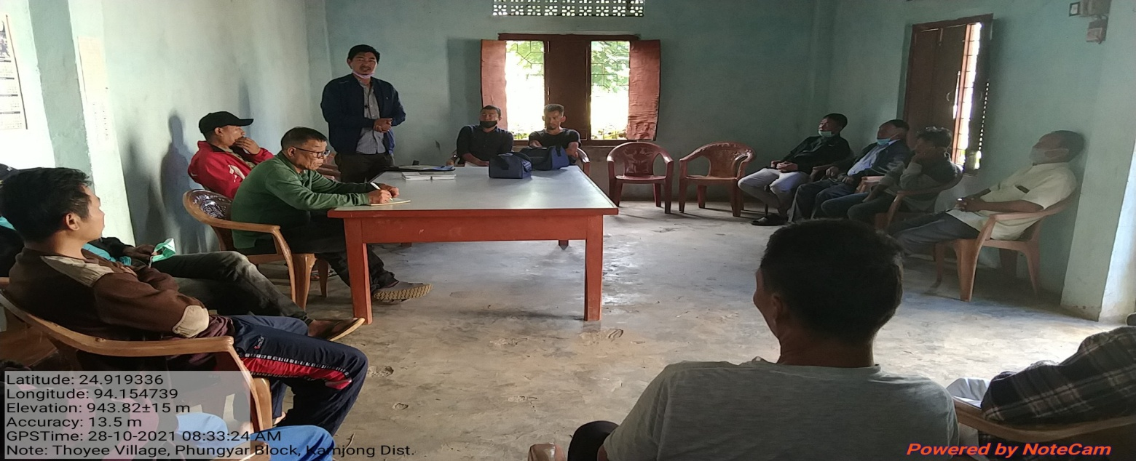
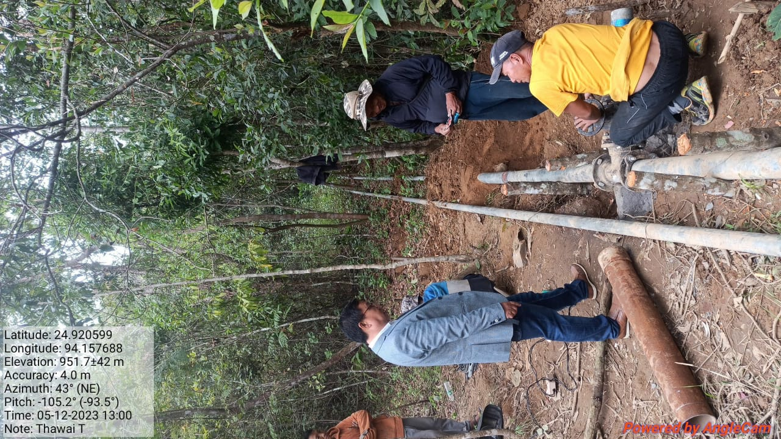
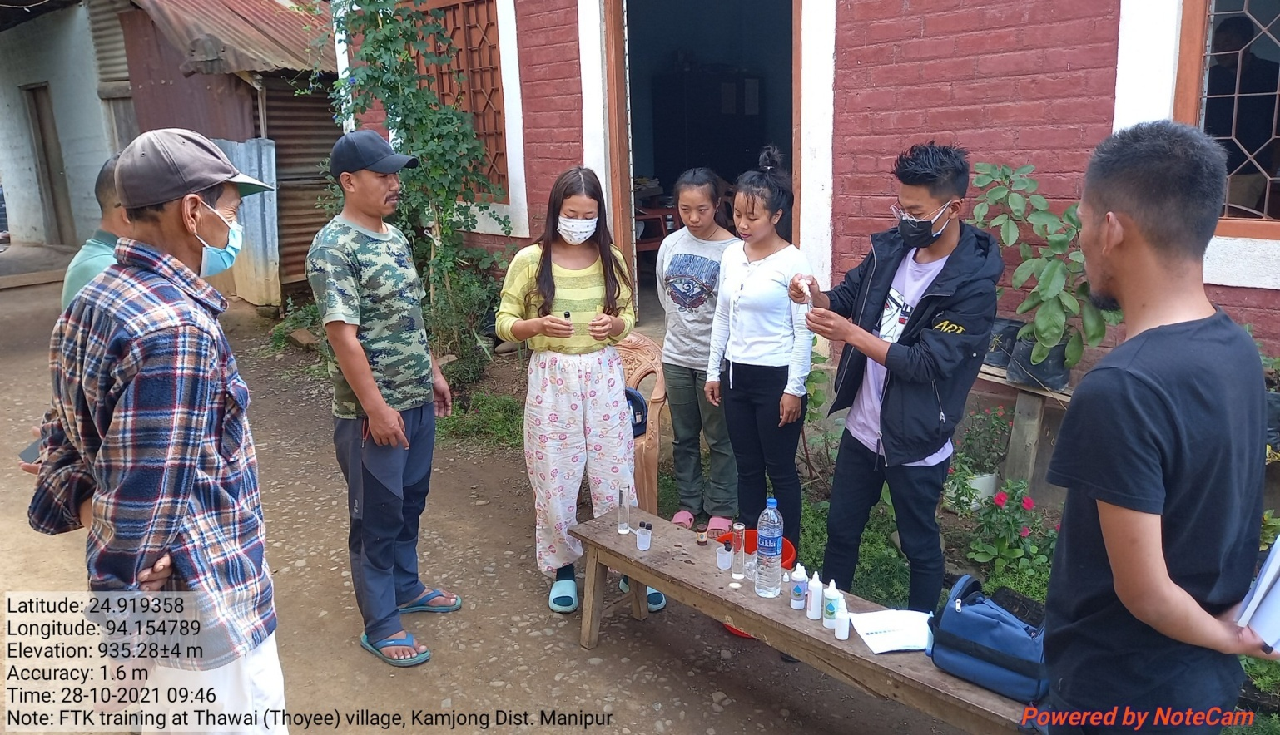
Village Water & Sanitation Committee(VWSC) in the implementation of Jal Jeevan Mission
Village Water & Sanitation Community (VWSCs) are empowered to operate and maintain in-village water supply systems. The VWSCs also collect water tariff monthly at nominal fixed rate from households for O&M works and to ensure functionality of FHTCs. The 5(five) trained women members of VWSCs also performed regular water quality testing by using FTK Restoration of pipeline by trained fitter

Slide 7
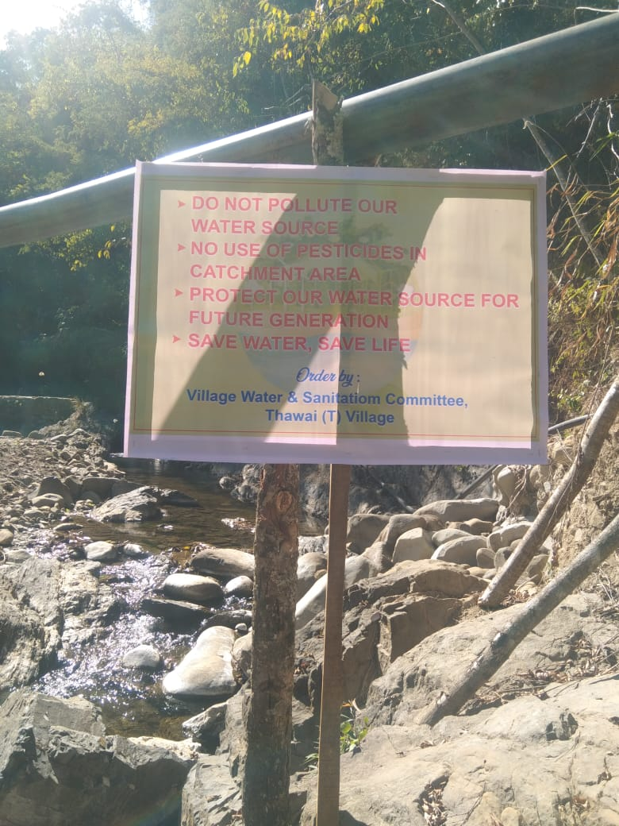
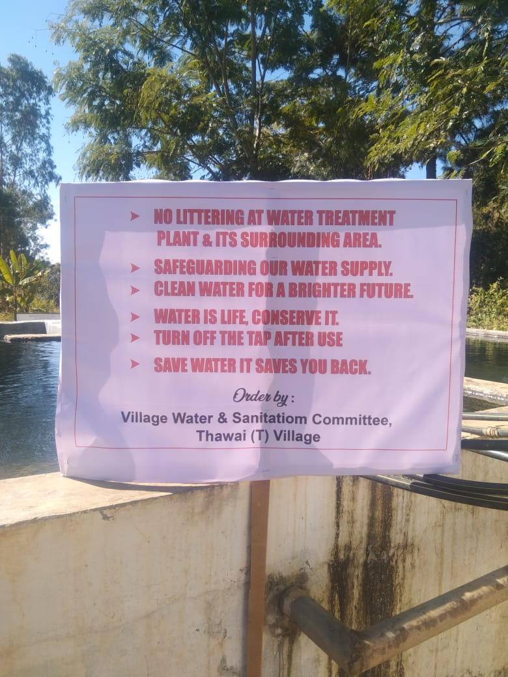
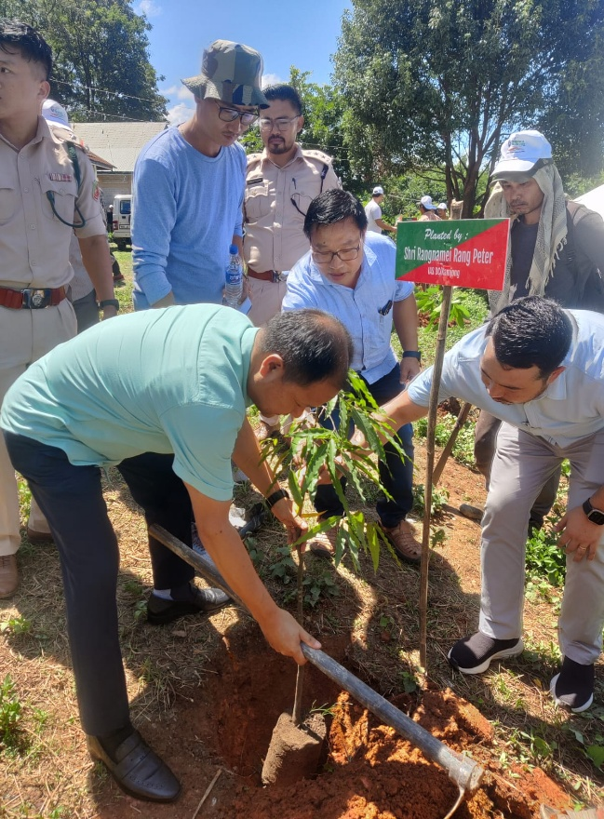
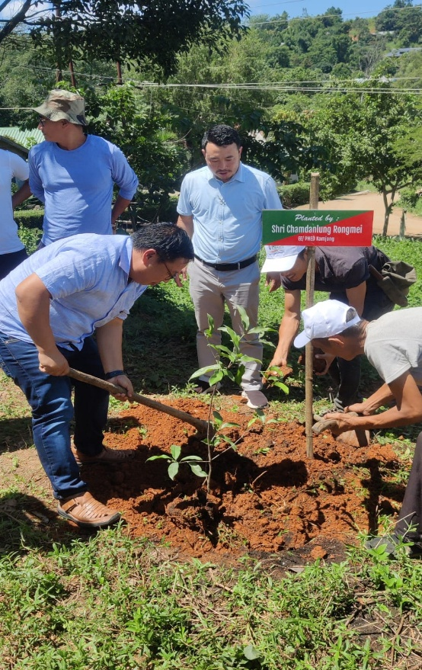
Sustainability
Success of village water supply systems depends largely on sustainability of water source(s). Strict prohibition are regulated to protect and conserve water sources/. Hoarding with Messages on protection of water source are installed at Intake points & WTPs. Do not pollute our water source No use of Pesticides in catchment area Protect our water source for future generation Save water save life No deforestation in catchment area No fishing/hunting in catchment area Turn off the tap after use, etc. Plantation of trees are done at water source and Water Treatment Plant Site.

Slide 8
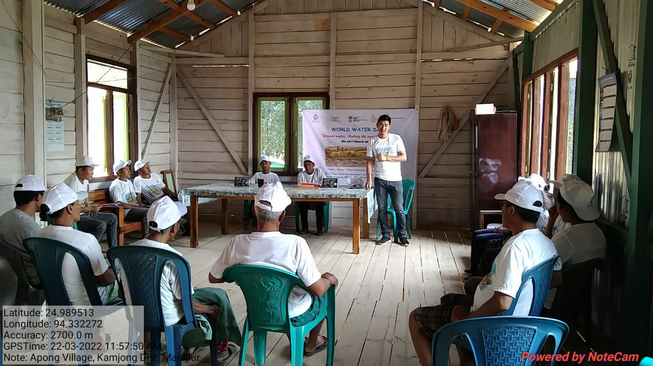
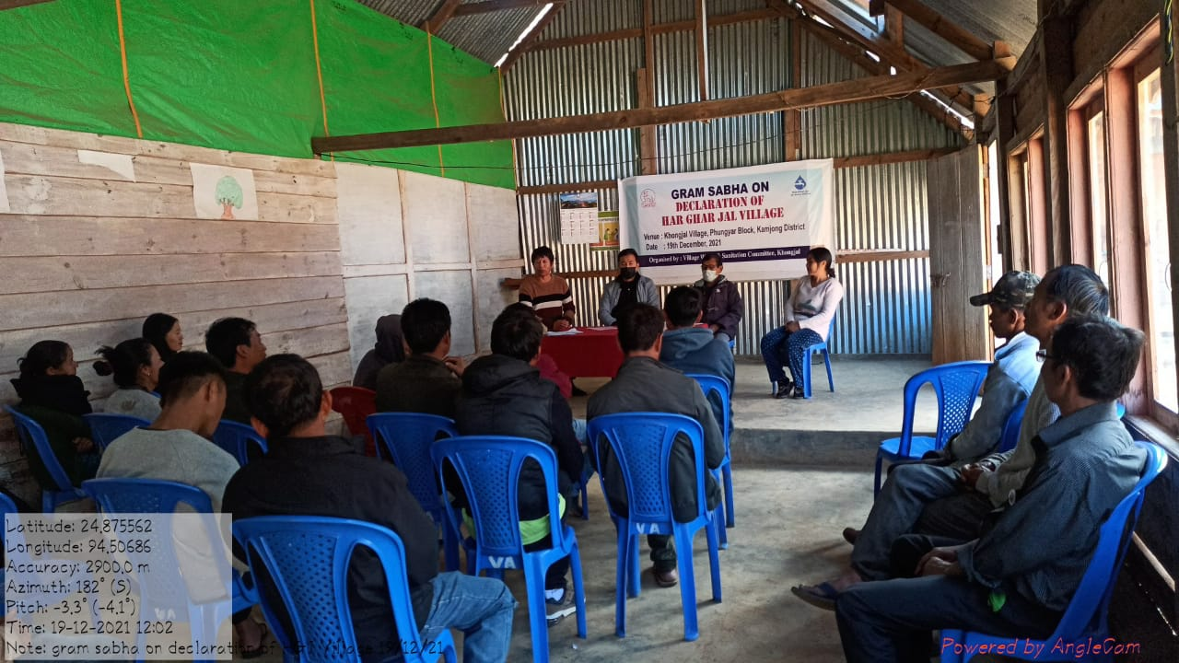
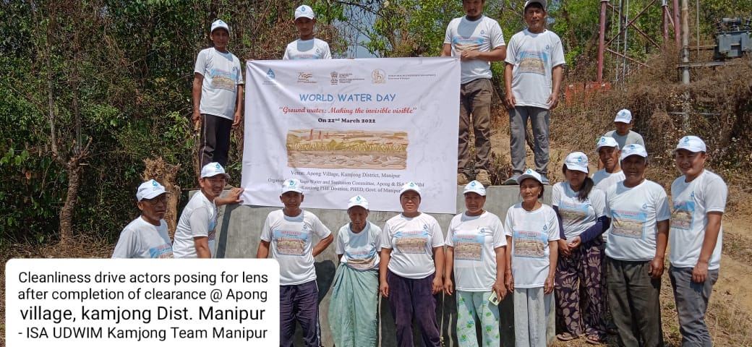
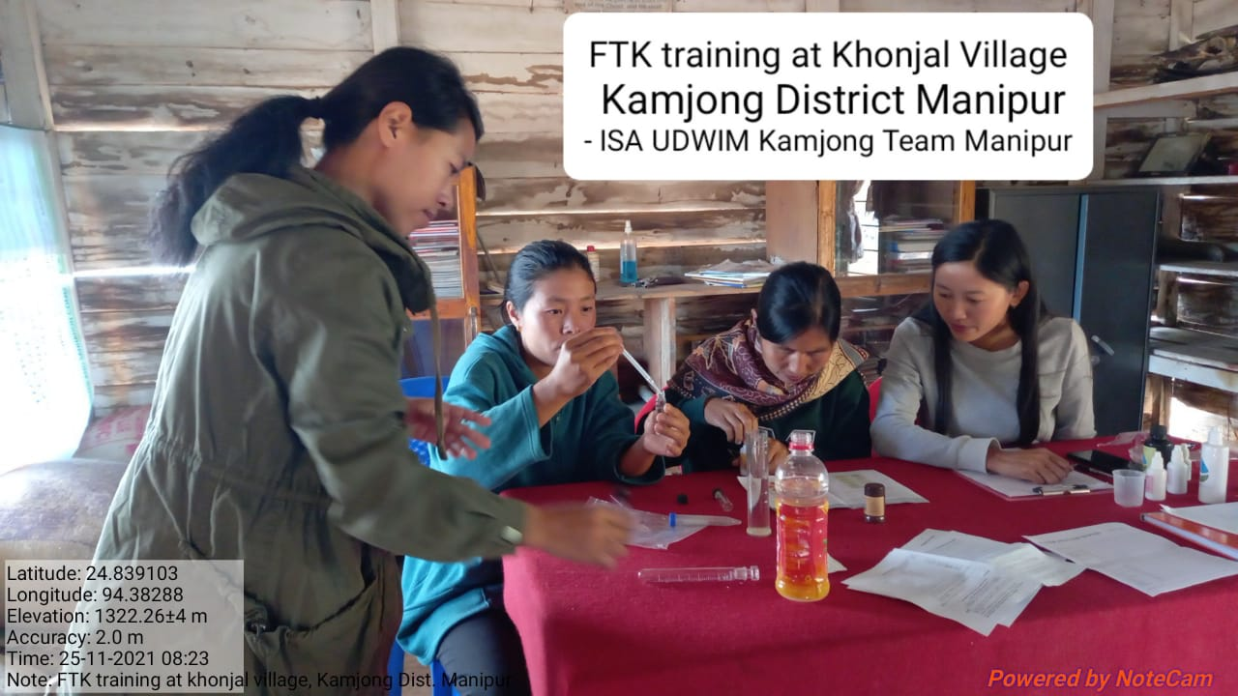
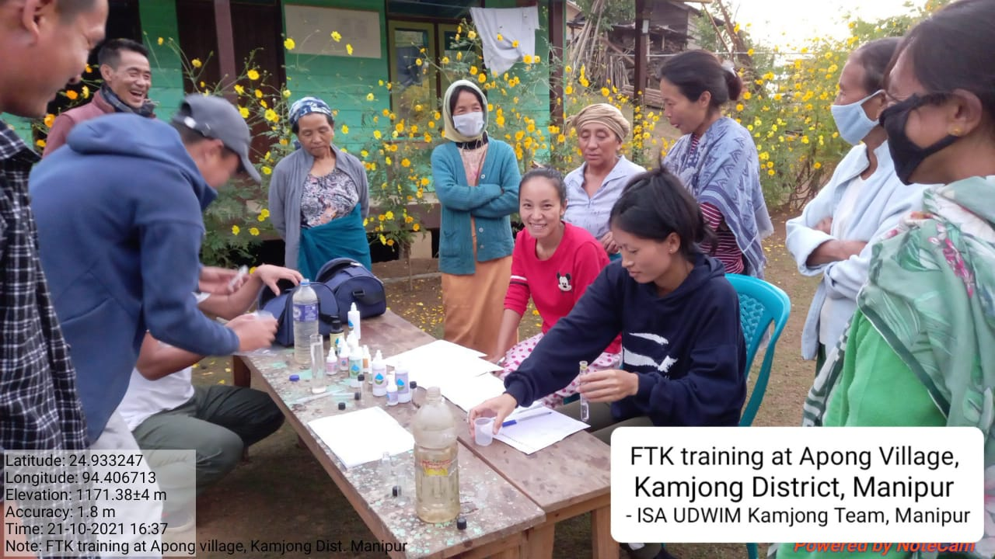
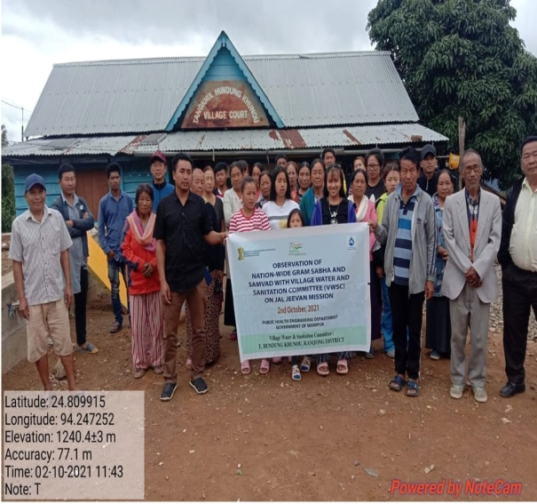
Activities undertaken
Water Testing at Field is done using FTK by VWSCs at Villages
IEC programme : Awareness programme is regularly conducted at villages

Slide 9
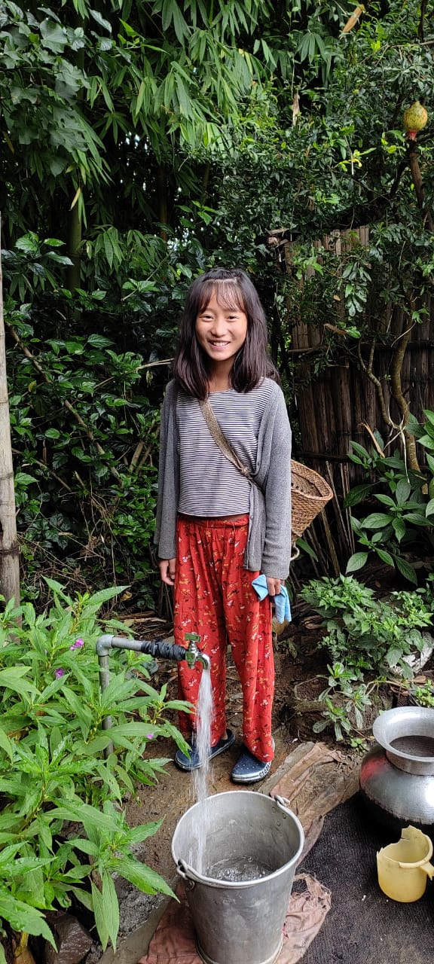
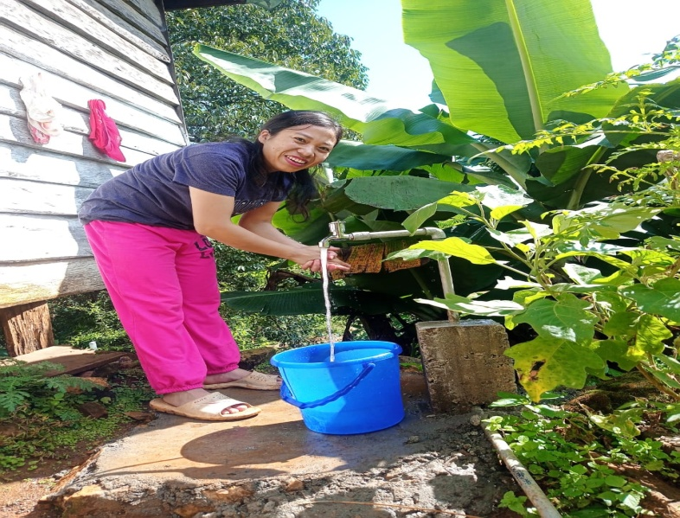
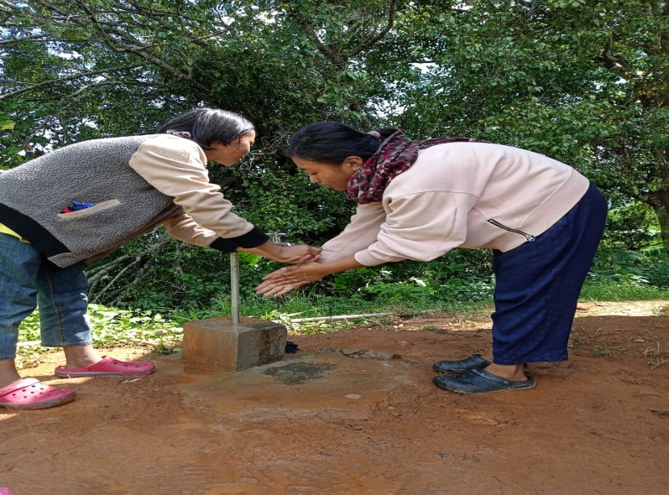
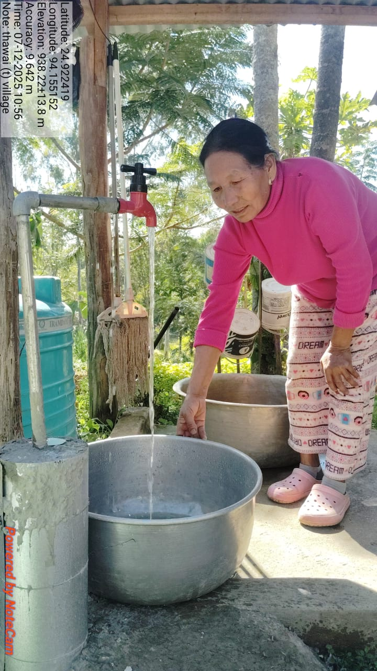
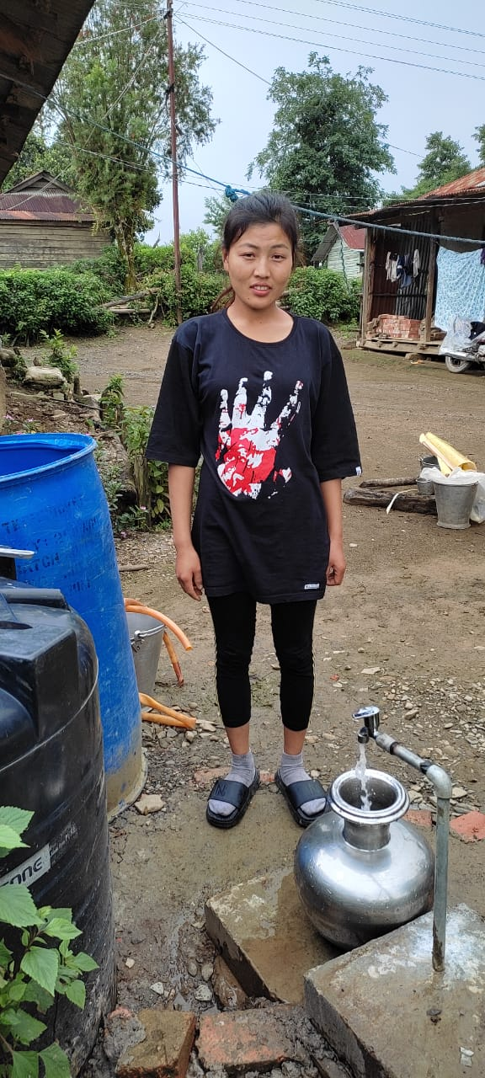
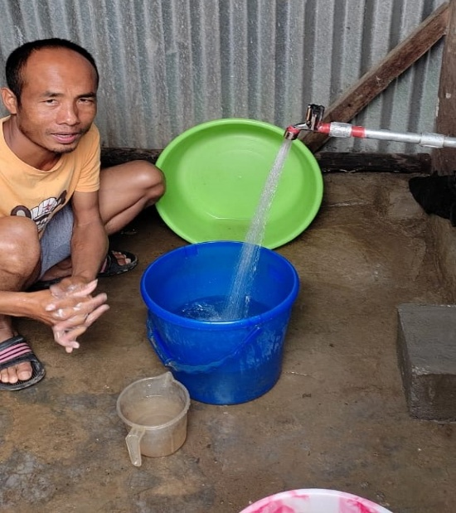
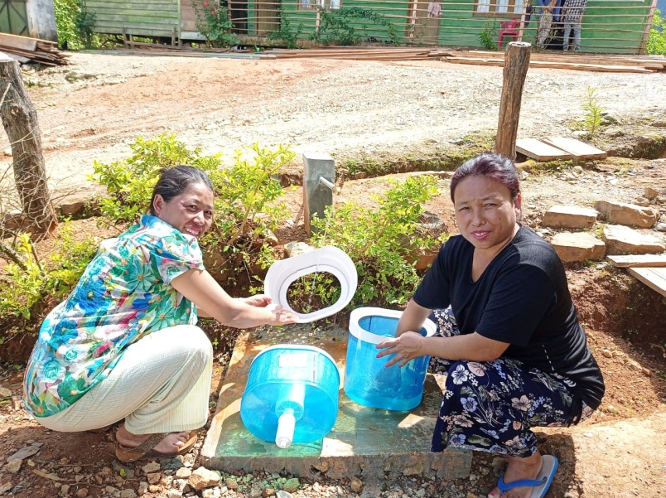
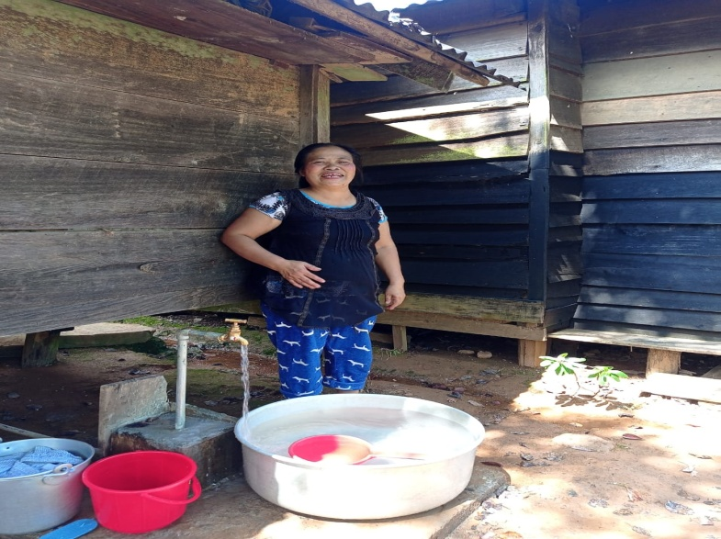
Providing “Functional Household Tap Connection (FHTC)”
Good Quality selected Photograph wit
Good Quality selected Photograph with Metal Tap
Good Quality selected Photograph with Metal Tap
Good Quality selected Photograph with Metal Tap

Slide 10
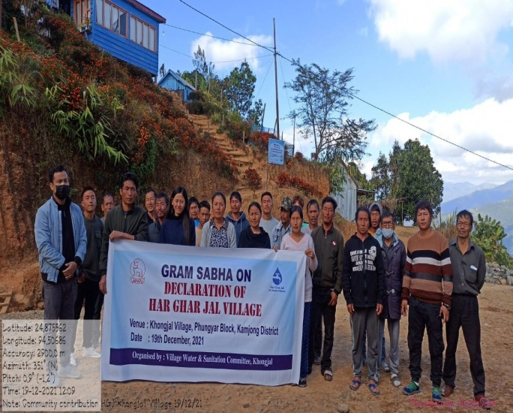
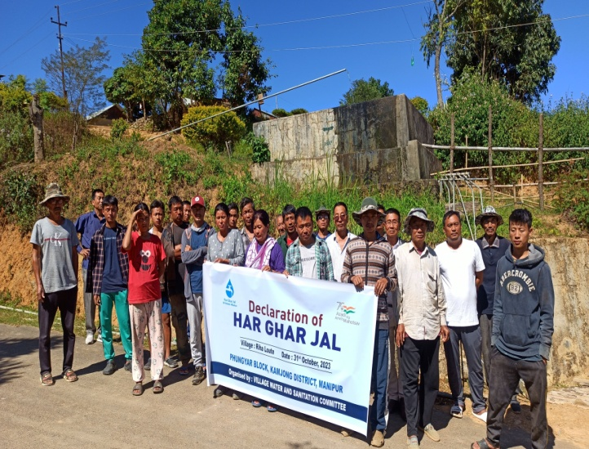
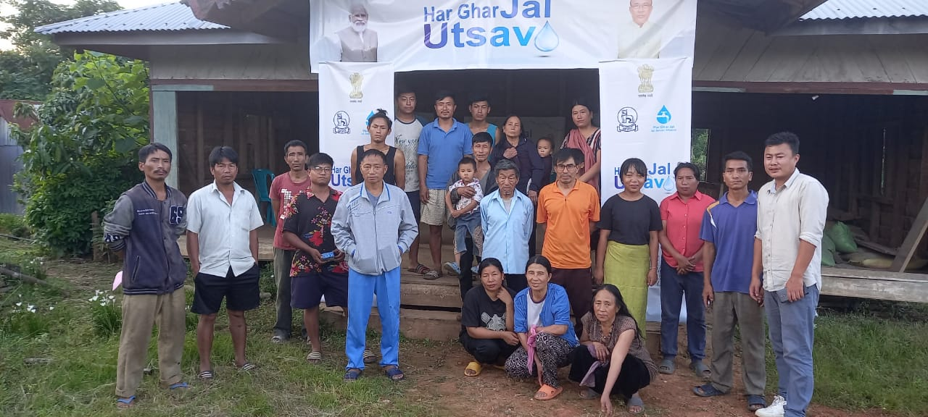
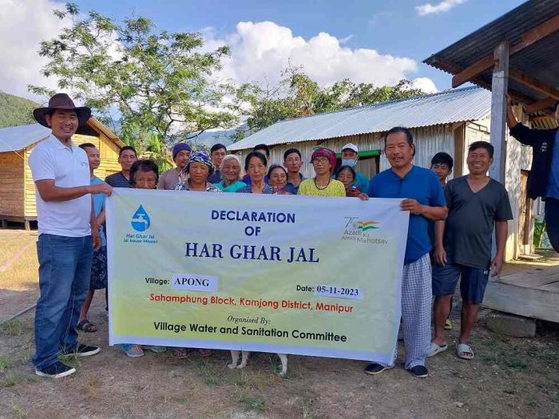
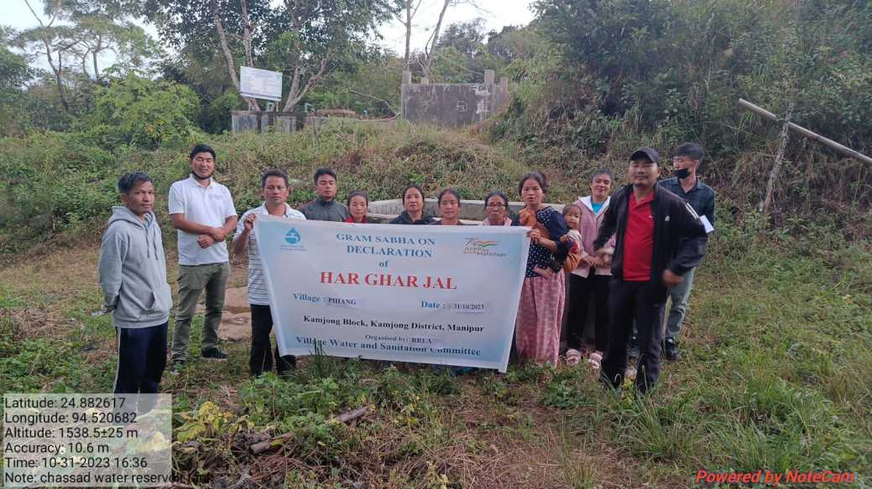
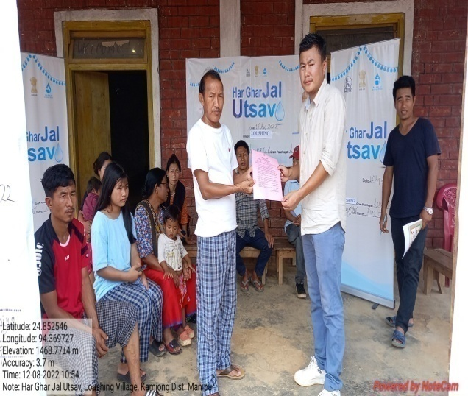
Declaration of Har Ghar Jal Village

Slide 11
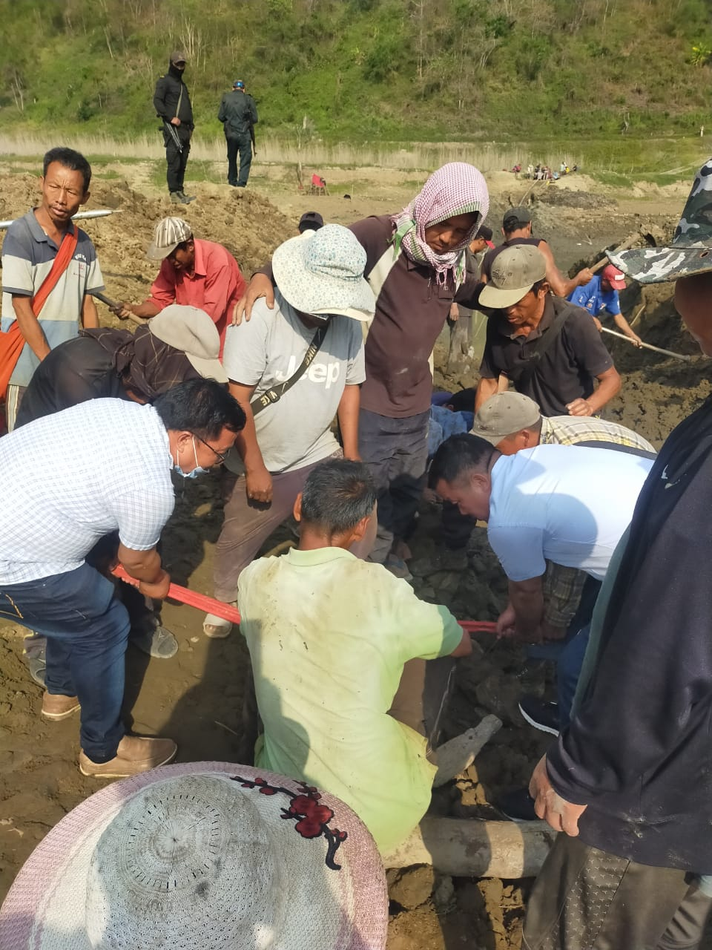
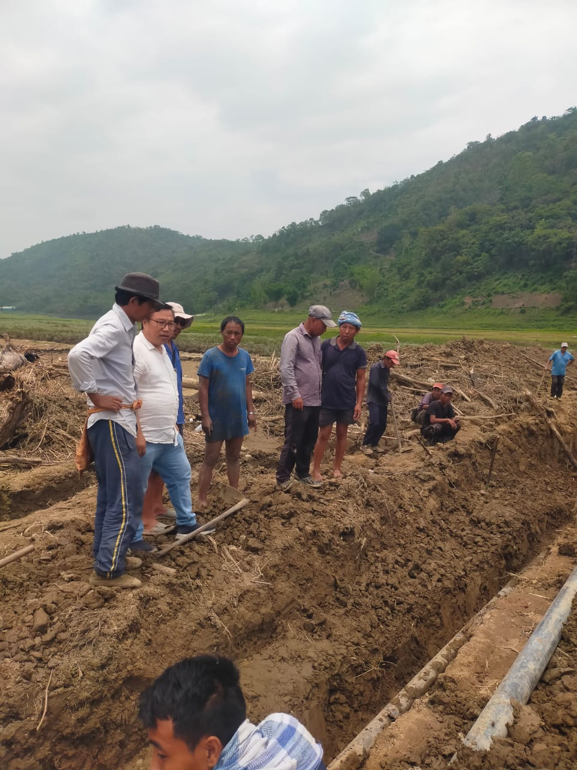
Public Participation: Successful Restoration of damaged pipelines by public participation

Slide 12
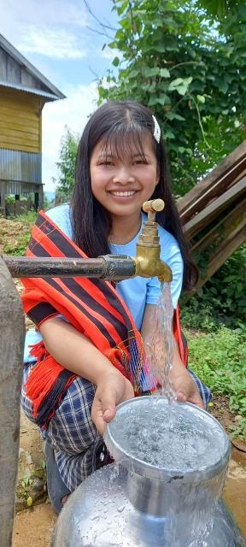
THANK YOU

