Slide 1

Implementation of JJM Schemes in Rural Areas of District Haridwar
(Peyjal Samvad 11-12-2025)
District Administration, Haridwar
Presented by: Mr Mayur Dixit, I.A.S. Collector‑cum‑District Magistrate, Haridwar

Slide 2
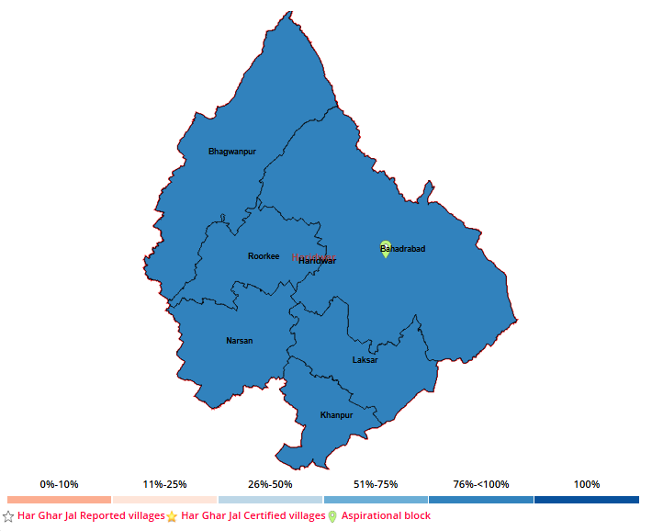
Overview of Projects in District Haridwar
No of House holds: 249343
House holds covered as on date: 239425
Percentage of FHTC Coverage: 95.99%
No. of villages certified as HGJ: 263
No of GPs certified as HGJ: 148
Total Panchayats: 310
No. of Households covered with FHTC on 15 Aug 2019: 15321
No. of FHTC Provided from 15 Aug 2019 to 10 Dec 2025: 224104
No of GPs Reported as HGJ: 193
No. of villages Reported as HGJ: 328
Percentage of HGJ Certified Panchayat: 76.68%
Percentage of HGJ Certified Panchayat: 80.18%
Total villages: 473

Slide 3
Mega PWS Projects under Haridwar District
Key Metrics & Progress
Blocks: 6
Villages: 473
Total Projects: 375
Total Projects Physically Completed: 299
Population: : 7138536
Total Households: 249343
FHTC Connections Provided: ≈ 239425
out of 375 Projects 299 Projects Physically Completed out of 375 Projects in Haridwar District. Rest 76 Projects will be completed till 31-03-2026

Slide 4
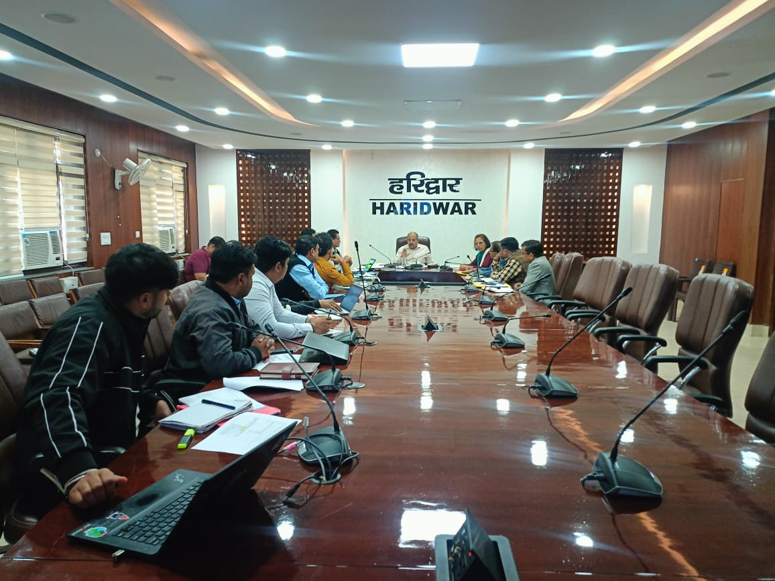
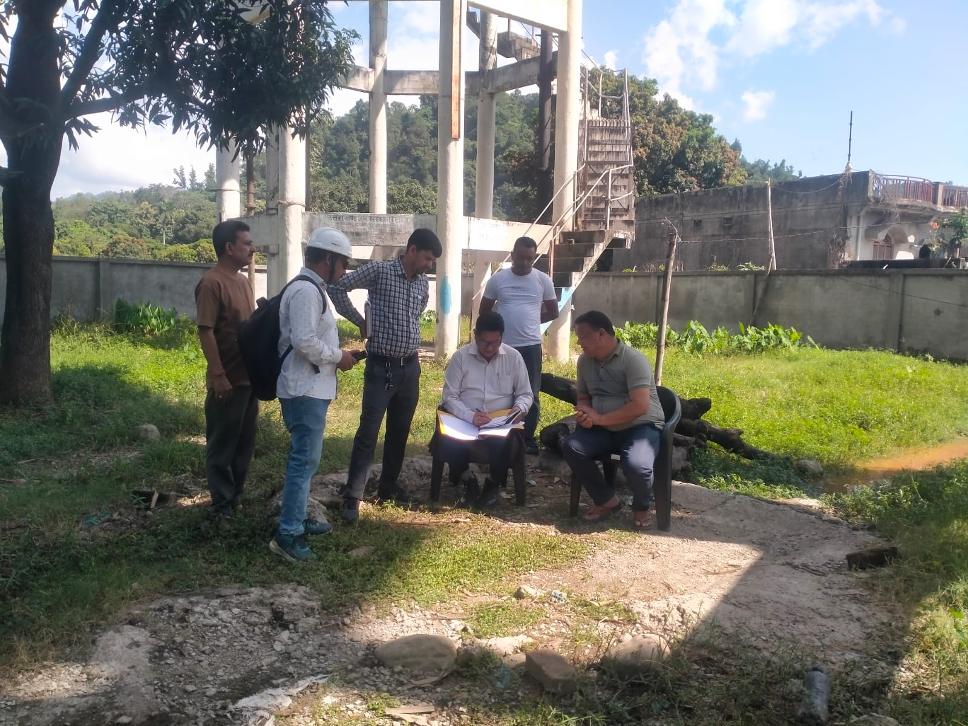
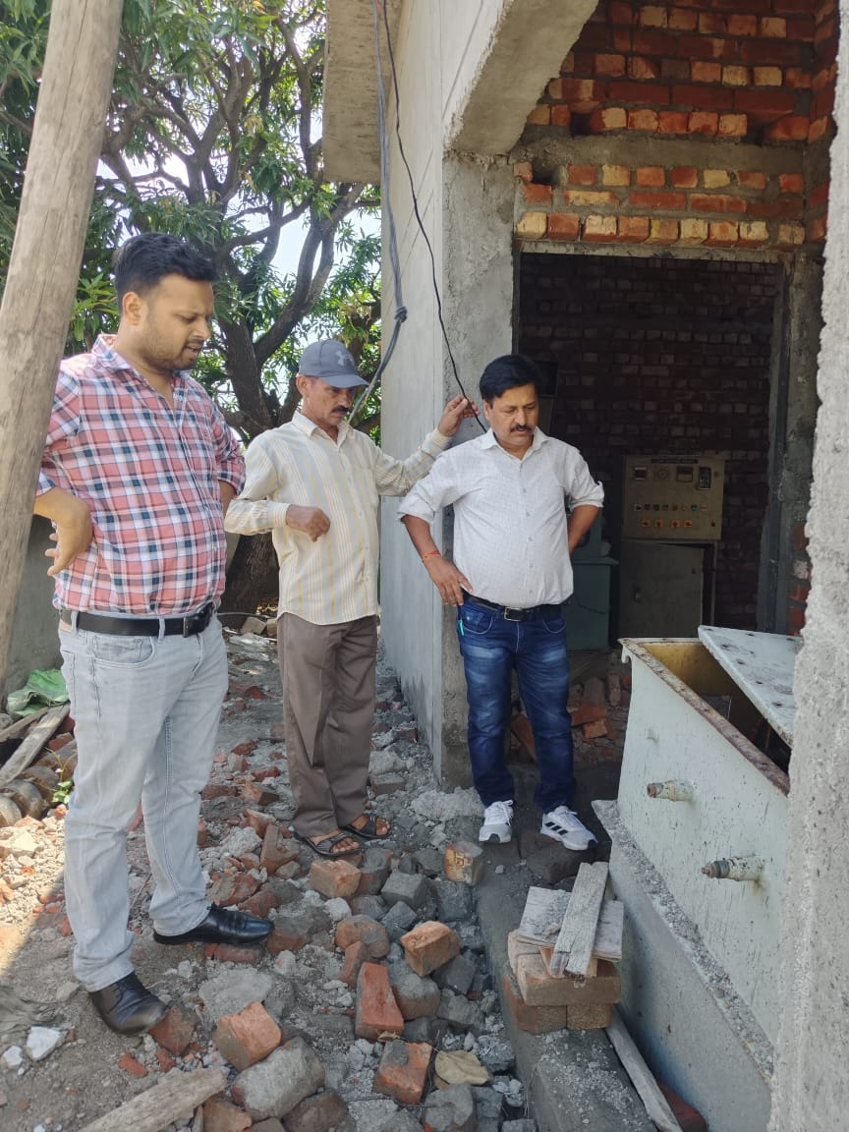
🔍 Monitoring and Implementation
🔍 Monitoring
Regular Supervision by SDOs , JE/AEs and Third Party inspection
Regular site visit by SE / EEs.
Fort- night review meeting by SE / EEs with their official Staffs and Contractors.
Monthly review meeting is being conducted in the chairmanship of CDO and district Collector.

Slide 5
✅ Quality Assurance
Regular Quality Checking through inspection prior to / during execution of works on daily basis.
TUV SUD South Asia and QACA 02 Third party agencies are being engaged for regular checking of construction quality of schemes.
Regular Inspection of schemes are being Done by the T.P.I. Agencies on regular basis and after that MPR is being submitted to Implementing Agencies for Rectification and is being done and for the same ATR/FCR is being submitted to SWSM for Finalization in due time.
S.No | Name of Implementing Agency | No. of works Allotted to TPI | No. of inspected works till date | No. of reports submitted by TPI | No. of Final ATR submitted to TPI by IA | ATR Progress %
1 | UJS Haridwar | 136 | 136 | 134 | 116 | 86.56
2 | P.I.U. Amrut Roorkee | 106 | 106 | 105 | 89 | 84.76
3 | CD Haridwar | 133 | 133 | 133 | 109 | 81.95
Total |  | 375 | 375 | 372 | 314 | 84.40

Slide 6
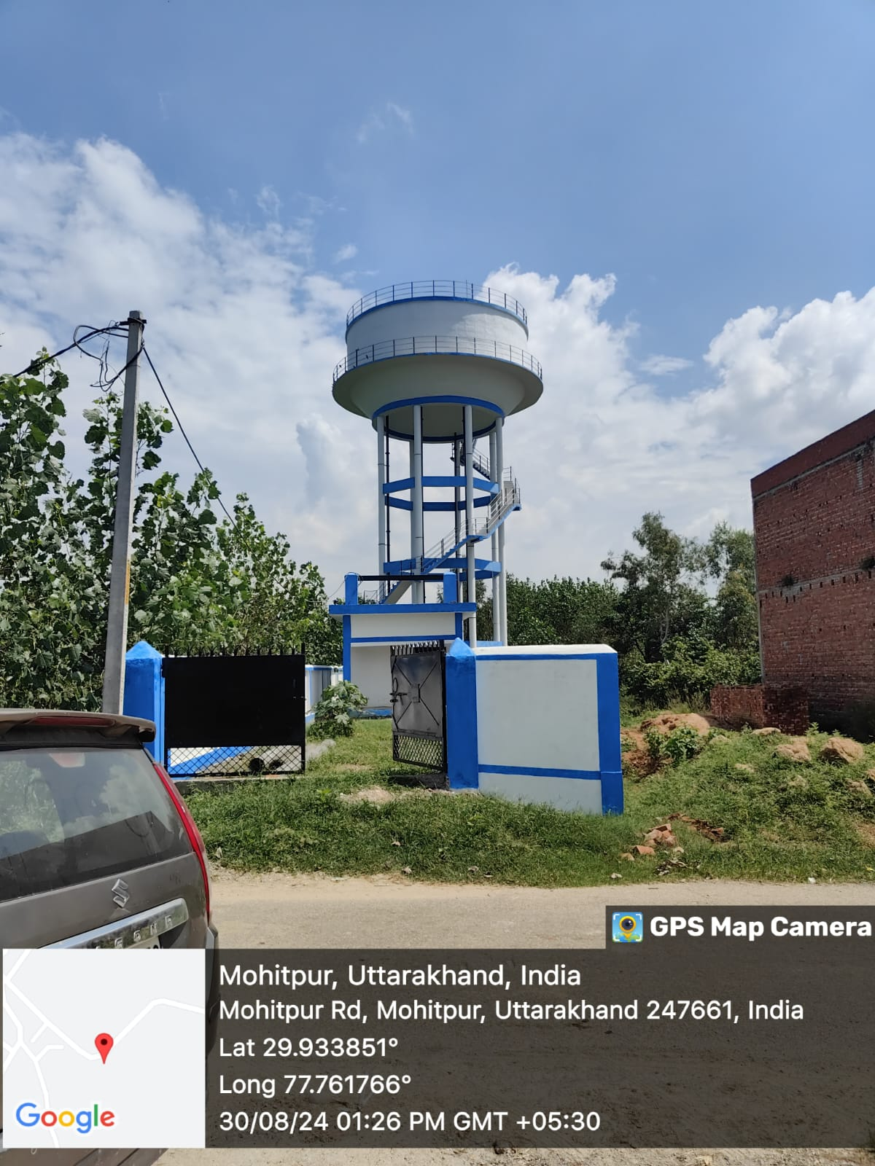
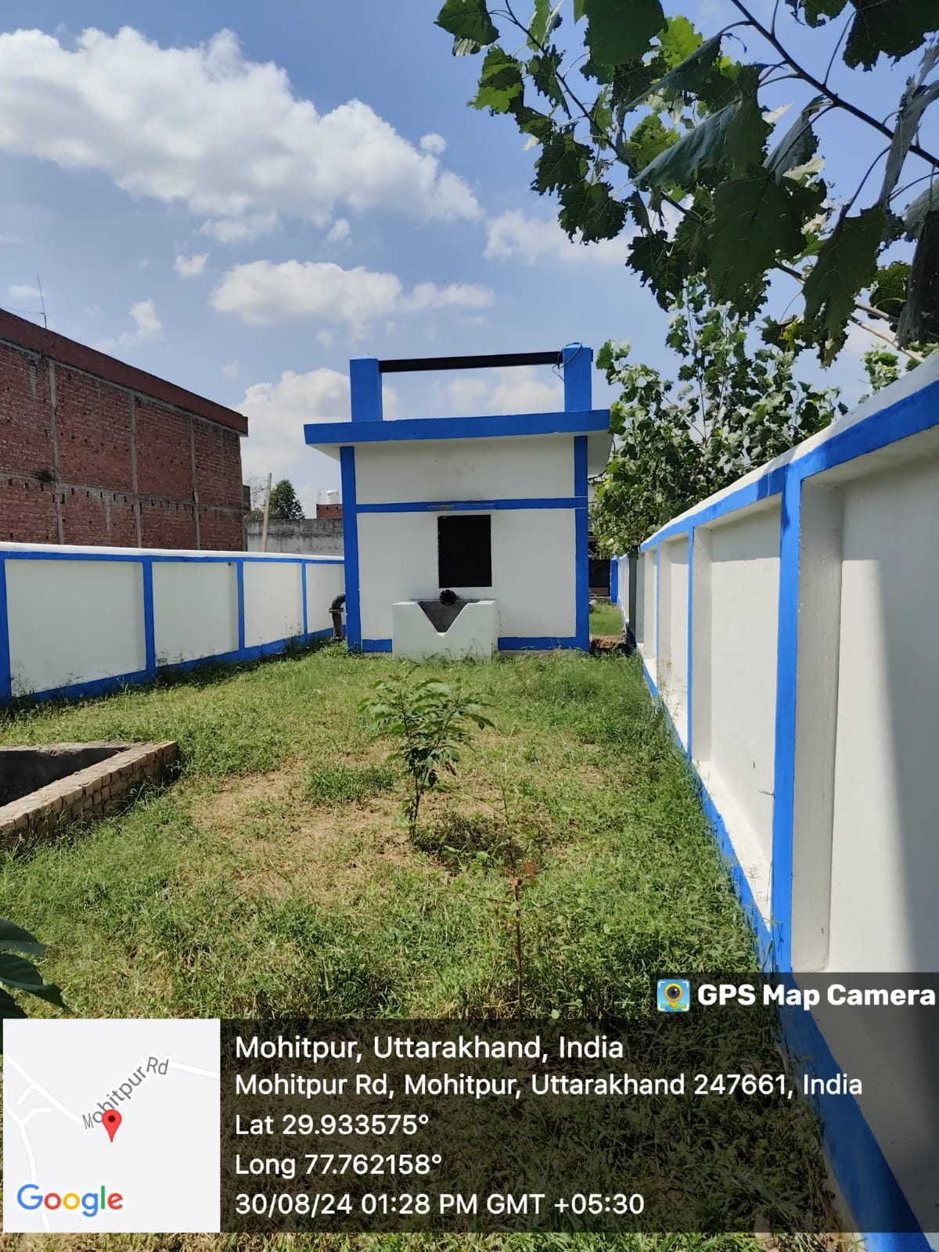
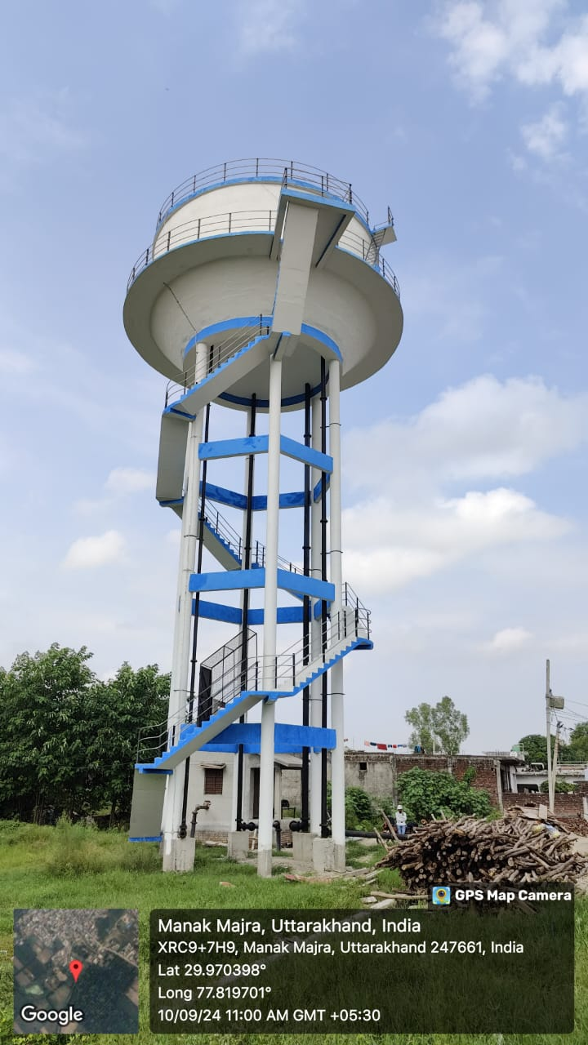
🔧 Handover & O&M
In District Haridwar all Schemes are tube-well based. And according to the directions from SWSM the schemes must be run by Uttarakhand Jal Nigam and Uttarakhand Jal Sansthan Departments.
O&M Policy is pending for Approval from State Govt.
At present O&M is being done by Jal Nigam and Jal Sansthan Departments.
Sirchandi W/S Scheme OHT-400 K.L, Staging 18 Mtr and Pump House
Manak Mazra W/S Scheme OHT-250 K.L, Staging 18 Mtr

Slide 7
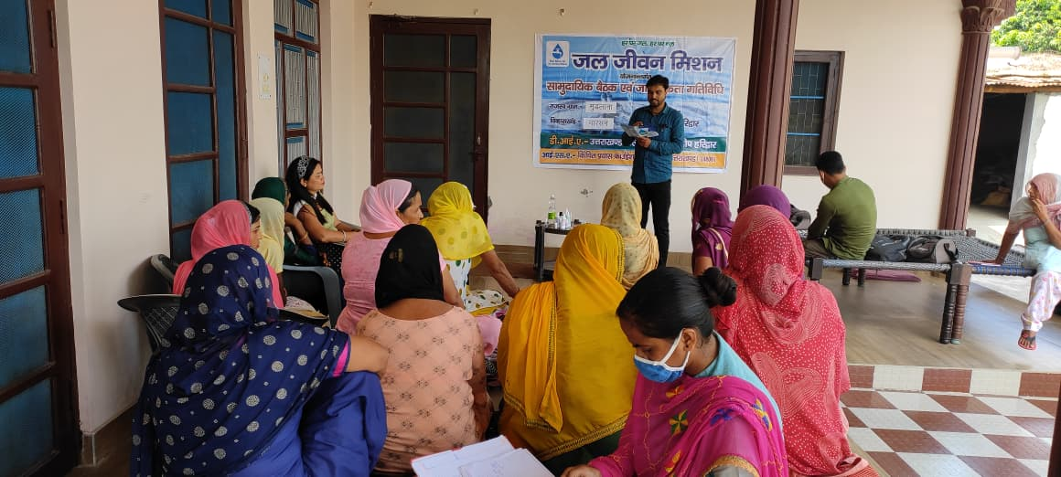
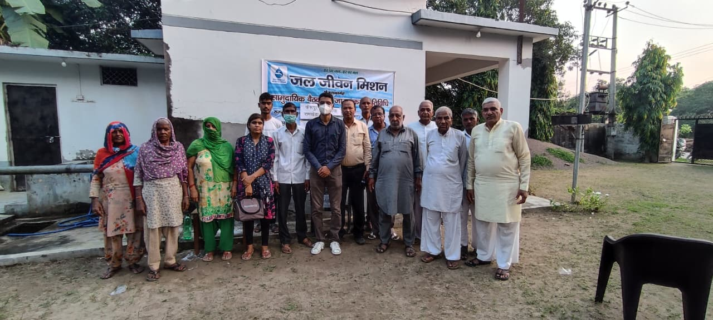
IEC Plans & Effectiveness
📢 Community awareness on water user Charges collection
💧 Education to minimize wastage of water
🤝 Engagement of stakeholders through campaigns
🌱 Promotion of Jan‑bhagidari for sustainable use
🌱 For Collection of Community Contribution.

Slide 8
Best practices adopted in the project
During Execution:
Efficient land & site acquisition through inter-dept coordination with the help of local administration.
For 246 Schemes Panchayat land handed over by Panchayat’s within 3 months of application
Rapid ROW clearance & dispute resolution
ROW permission for NHAI Road and railway crossings cleared within 3 months
All disputes cleared in time with complete coordination of district administration
During Operations and Maintenance
Regular monitoring and service in fixed timeframe
Leak detection & repair within 24 hours with documentation
Routine disinfection & cleaning of mains and WTP
Disconnection of unauthorized connections
Regular water quality & residual chlorine testing.
Engaging Local villager's to insure the optimum utilization of treated portable water

Slide 9
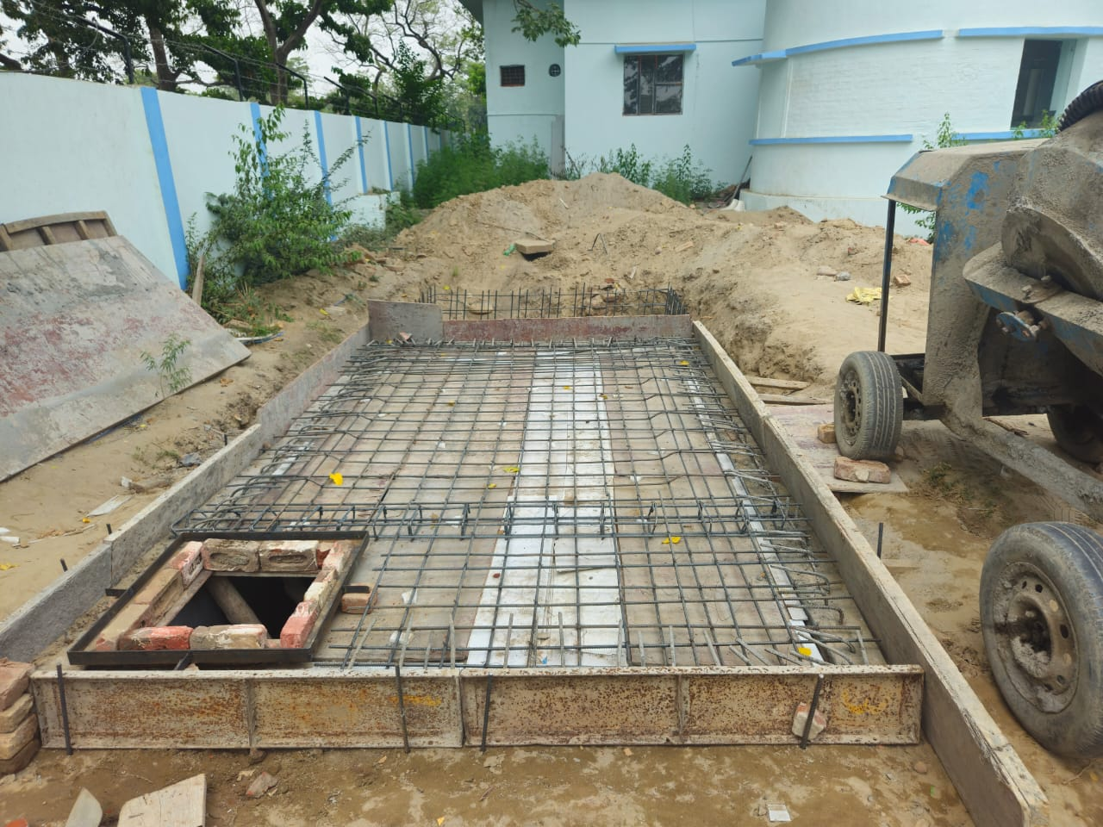
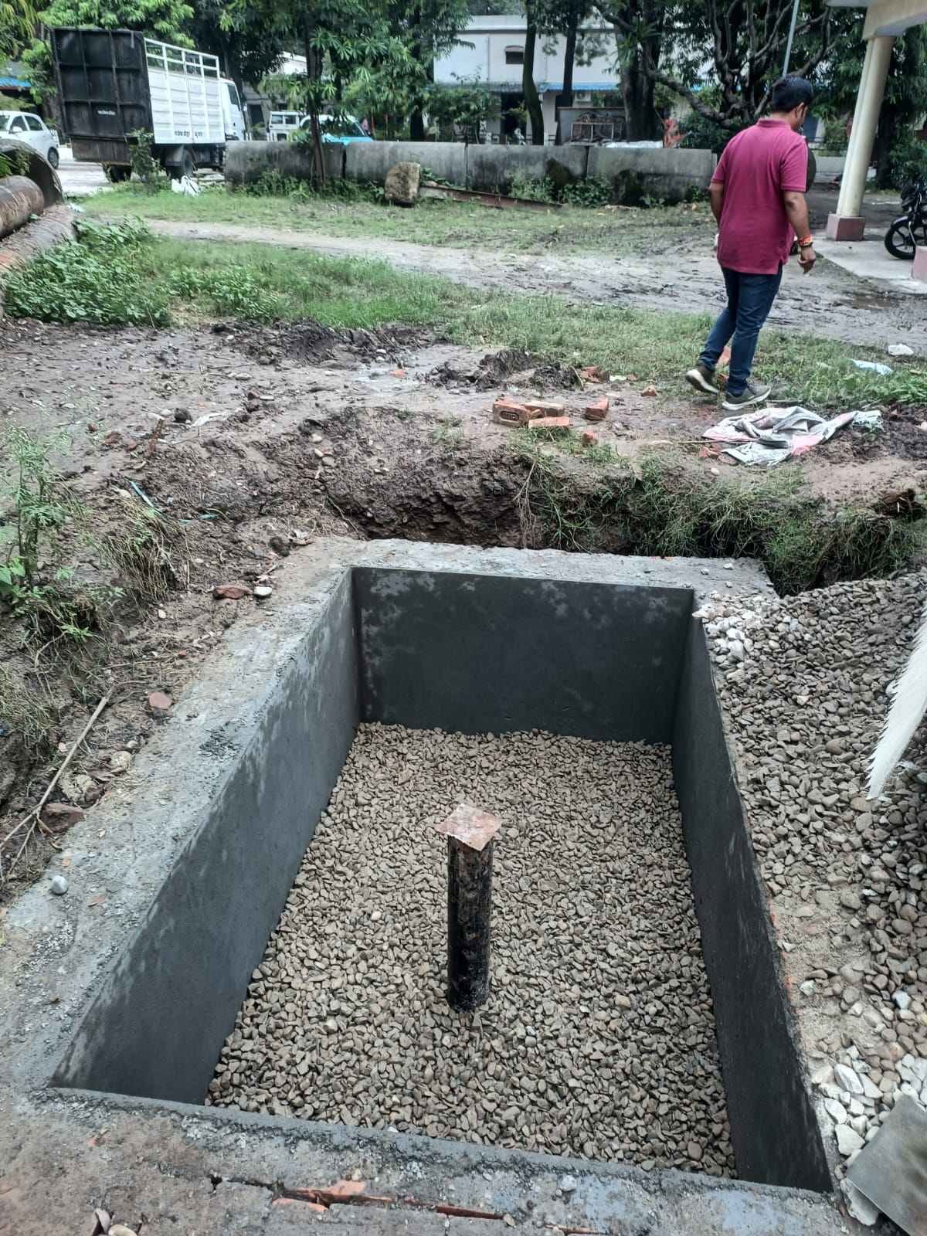
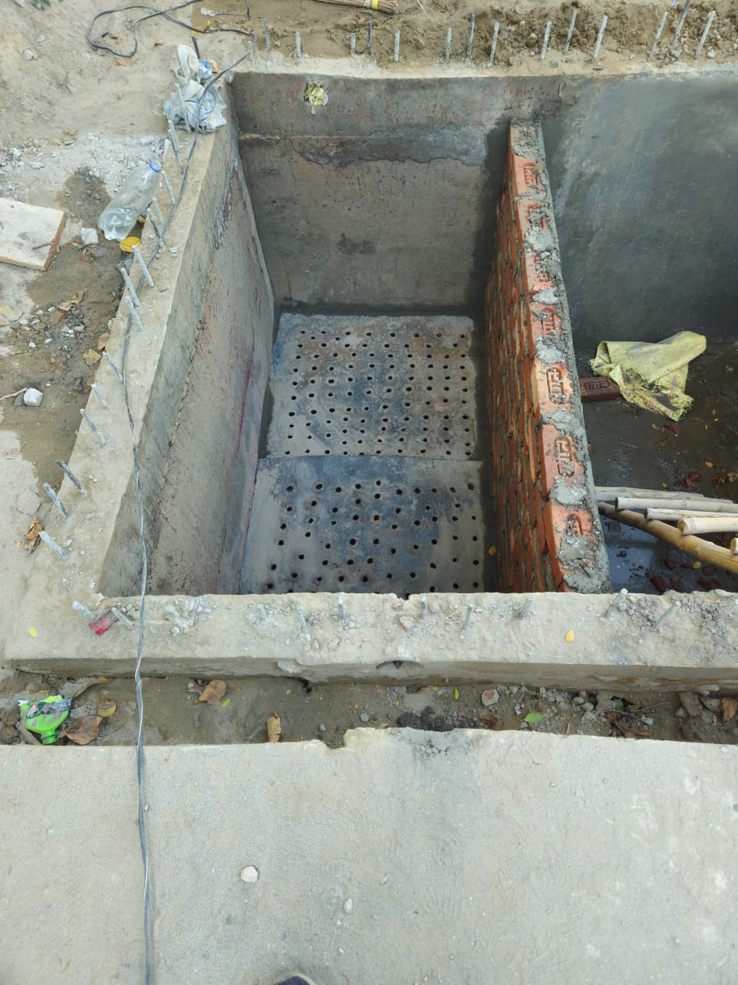
Source Sustainability of PWS Schemes
💧 Recharge
11 Nos. of rainwater harvesting structures constructed by Uttarakhand Jal Sansthan Haridwar for recharge of tubewells.

Slide 10
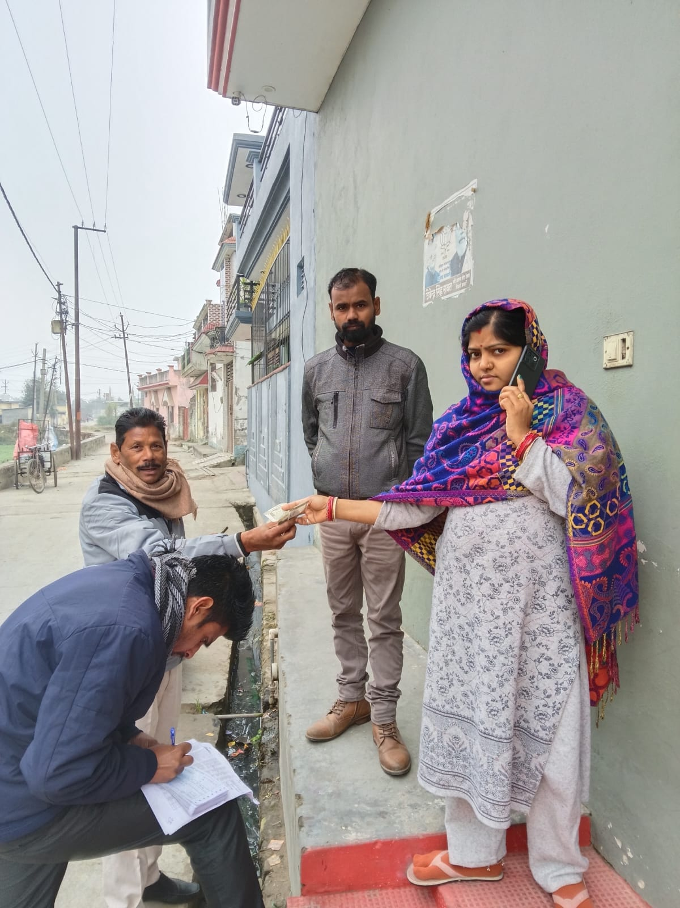
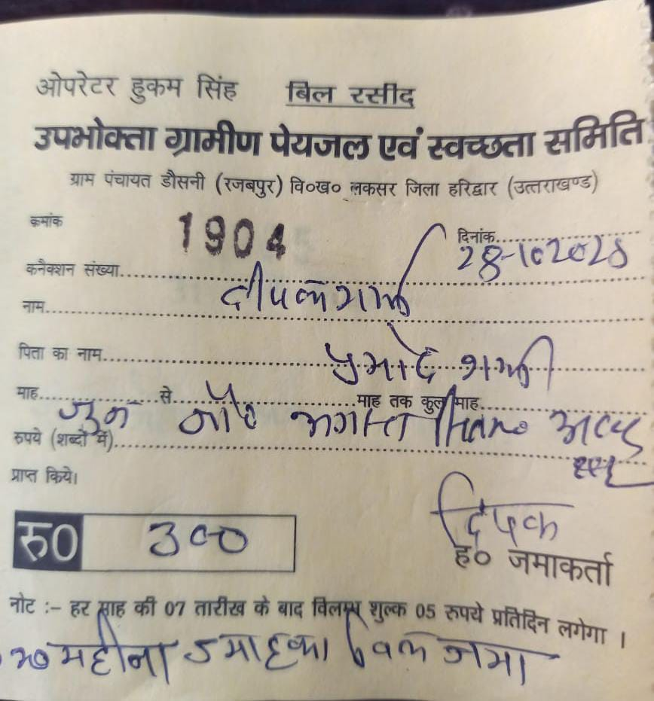
Best Practices in Water user charges Collection by VWSCs
Case Study 1
Case Study 2
Block: Laksar
Block: Laksar
GP: Dausani
GP: Dausani
Village: Dausani
Village: Rajabpur
Households: 184
Households: 264
Tax/HH: Rs.60/-
Tax/HH: Rs.60/-
Est. Collection: Rs.1,32,480
Est. Collection: Rs.1,90,080
Avg. Collection: Rs.1,05,719
Avg. Collection: Rs.1,39,822
Collection Rate: 79.80%
Collection Rate: 73.56%
Utilisation: Energy dues, sanitation & salaries
Utilisation: Energy dues & salaries
Door‑to‑door collection, proper receipts and complete transparency in utilization and regular follow ups ensure community trust and high compliance.
At Present minimum user charges of RS. 60.00/- Per month is being made and the process is on.

Slide 11
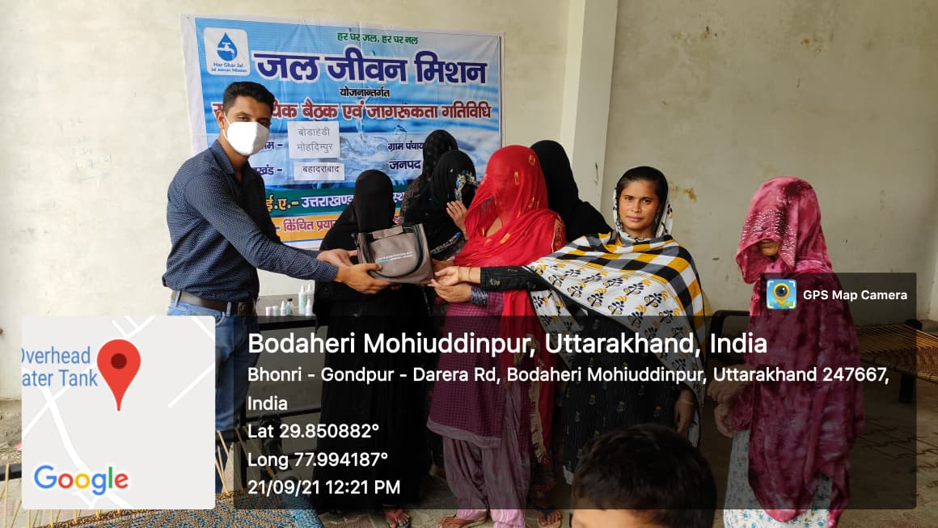
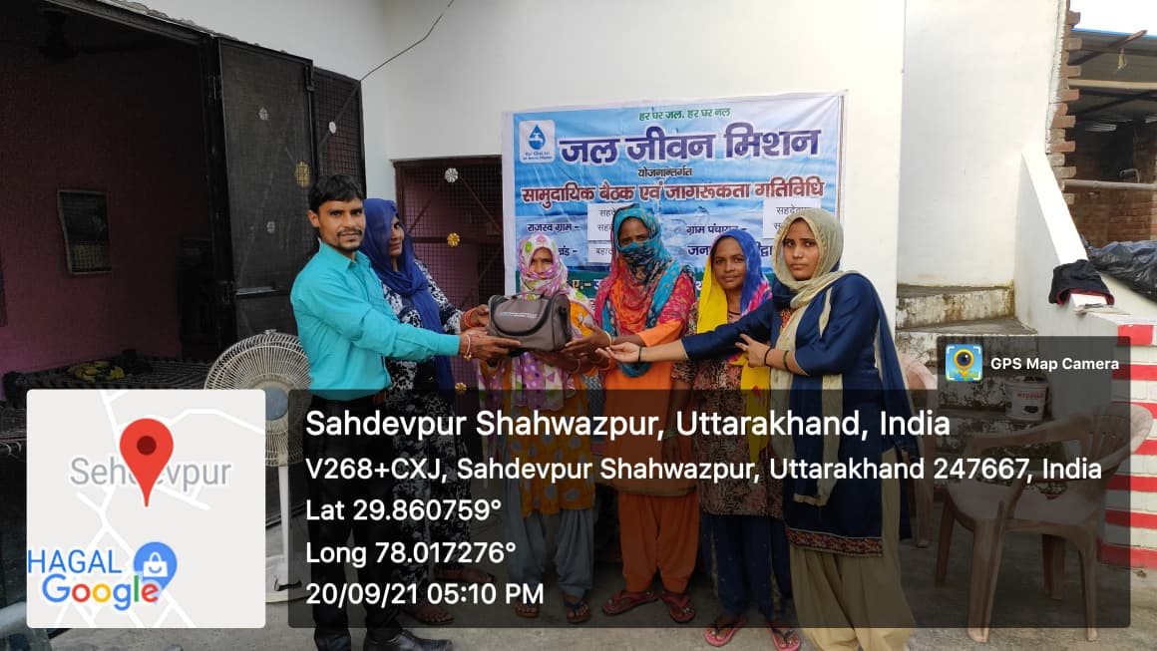
SHG Engagements for Water Quality
👥 Identify SHG groups for water sample collection
🎓 Train SHGs at block level with lab assistants
🧪 FTK testing and upload results to WQMIS
🧪 05 Womens from each village is being provided FTK Kit and they are being trained by the Department for Water Quality Testing and uploading the results on WQMIS Portal.

Slide 12
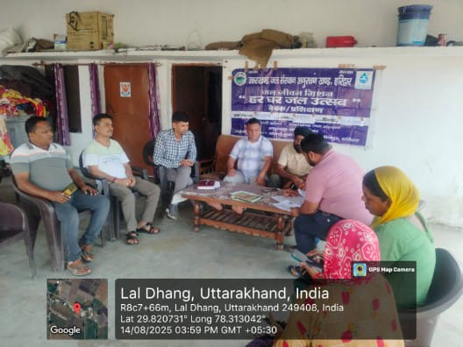
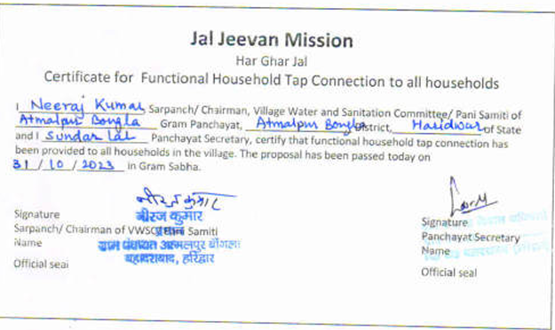
Har Ghar Jal Certification
Special Gram-Sabha meeting is being organized to declare village as HGJ village.
After meeting of Har Ghar Jal Certification HGJ Certificate and Meeting Video is being uploaded on JJM-IMIS portal.
Timely Circulation of Roaster for Har Ghar Jal Certification issued by district collector
All HHs, school, AWC, etc of the village are covered and saturated
Har Ghar Jal Certified Villages authentication is being conducted through other department officials by the direction of District Collector.

Slide 13
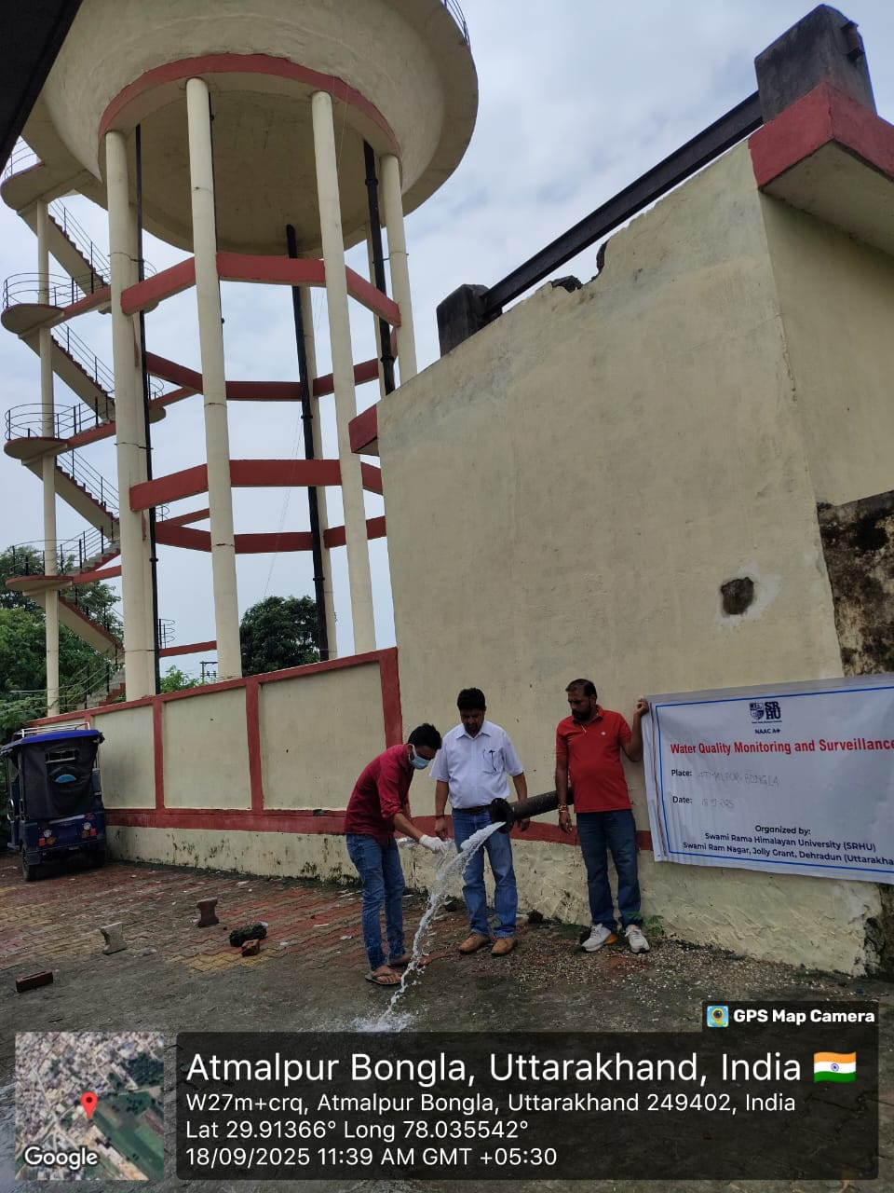
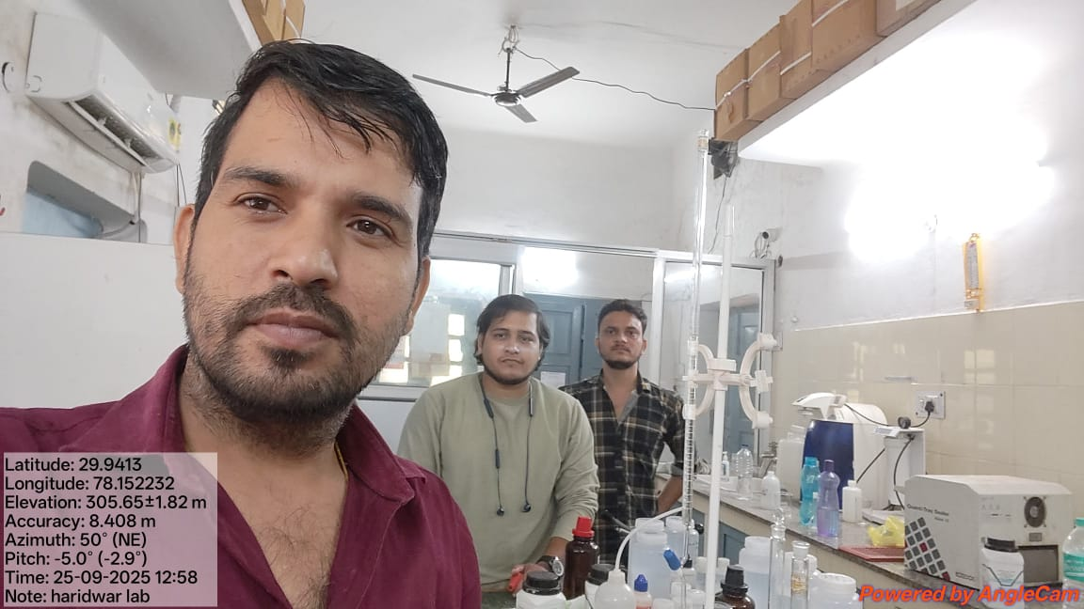
Water Quality Surveillance
🏭 Testing in one divisional lab two time in a
year(Pre Monsoon and post Monsoon)
( NABL accredited)
🧪 FTK testing by SHGs
✅ Cross‑checking 3.5% of samples in
state lab

Slide 14
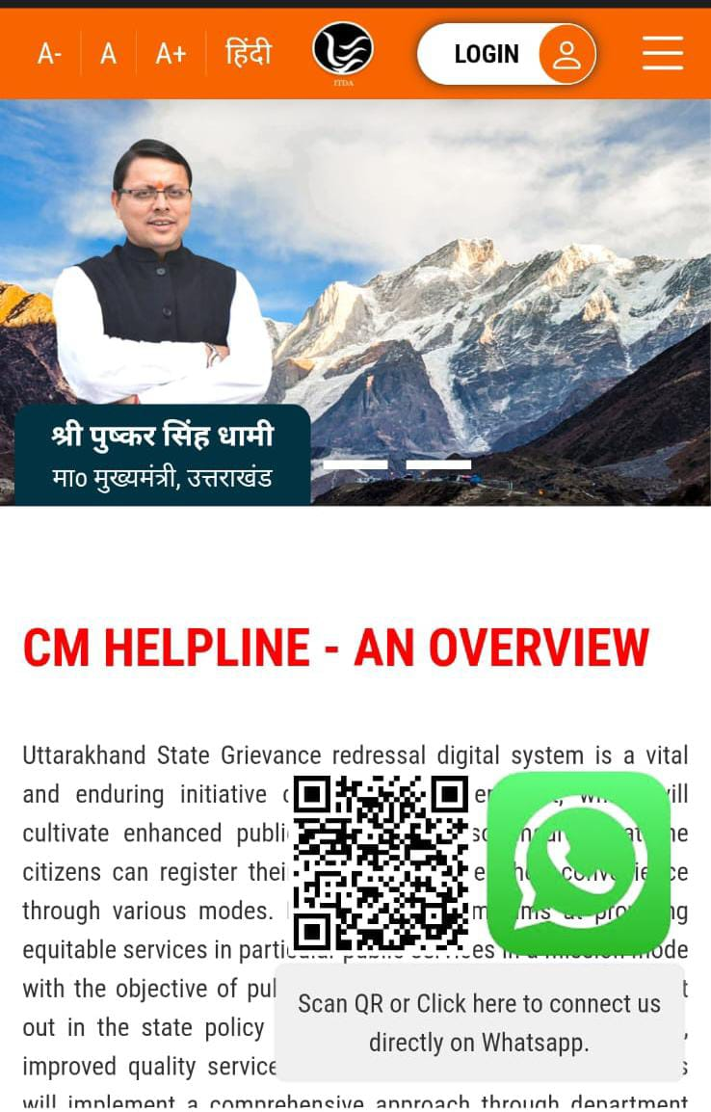
Grievance Redressal
☎️ Departmental helpline Number 18001804100 is open for grievances 24×7
☎️ CM Helpline Portal is open 24×7 for public grievances redressal
⚡ TWs are to be repaired within 48 hours
⚡ Minor repairs to be done within 3 days
⚡ Major repairs to be done within 7 days
Monitoring
⚡ CM Helpline complaints are being monitored by DM on every Monday and every month it is being monitored by CM Uttarakhand
⚡ For rectification of complaints on CM Helpline category L1,L2,L3 and L4 officers are regularly Monitoring for the disposal of complaints.

Slide 15
Thank You
Together towards a sustainable water future
District Administration, Haridwar | Jal Jeevan Mission

