Slide 1

PUBLIC HEALTH ENGINEERING DEPARTMENT HARYANA
Welcomes You

Slide 2

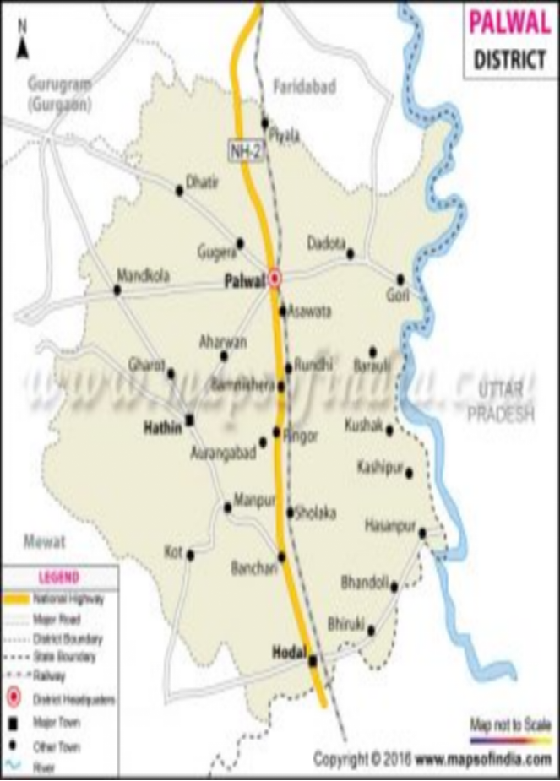

Slide 3
WHAT IS RANNEYWELL
History of Ranneywell :
Ranney well were invented by Leo Ranney a Petroleum Engineer in Texas Oil field city of St. Helens, during the year 1920, his idea was to gather larger quantity of oil.
The 1stRanney well of water supply was dug in London, England 1933.

Slide 4
Ranney Wells in India – History, Locations and Benefits
1. Introduction
A Ranney well, also known as a radial collector well, is a groundwater abstraction system constructed in river flood plains. It collects naturally filtered river water through horizontal laterals laid in sandy aquifers. In India, Ranney wells are considered a strategic source for bulk and reliable urban water supply.
2. Timeline of Ranney Wells in India
1970–1980 (Introduction Phase)
Ranney well technology was introduced in India during the 1970s due to rapid urbanization, increasing pollution in surface water sources, and the need for dependable bulk water supply.

Slide 5
3. Locations of Ranney Wells in India
Yamuna Flood Plain:
Delhi (Palla area), Sonipat, Panipat, Yamunanagar, Faridabad–Palwal belt.
Ganga Flood Plain:
Kanpur, Prayagraj, Varanasi, Patna, Bhagalpur.
Other River Basins:
Godavari (Nashik, Nanded), Narmada (Jabalpur, Bharuch).
4. Typical Ranney Well Configuration
Collector well diameter: 6 – 9 mtr.
Depth: 25 - 40 mtr.
10 no. Laterals inserted in one layer .
30 mtr. Approximately Screen Pipe inserted in 1 no. lateral.
Discharge: 8–12 MLD (site dependent)

Slide 6
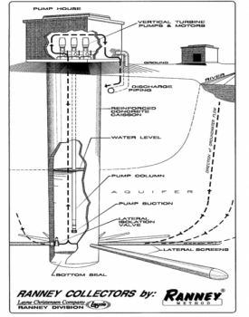

Slide 7
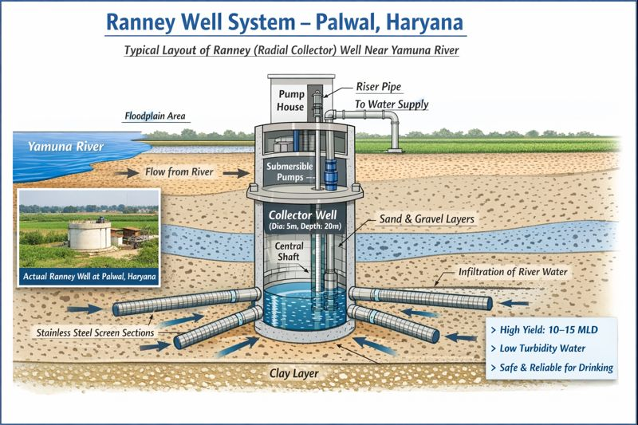

Slide 8
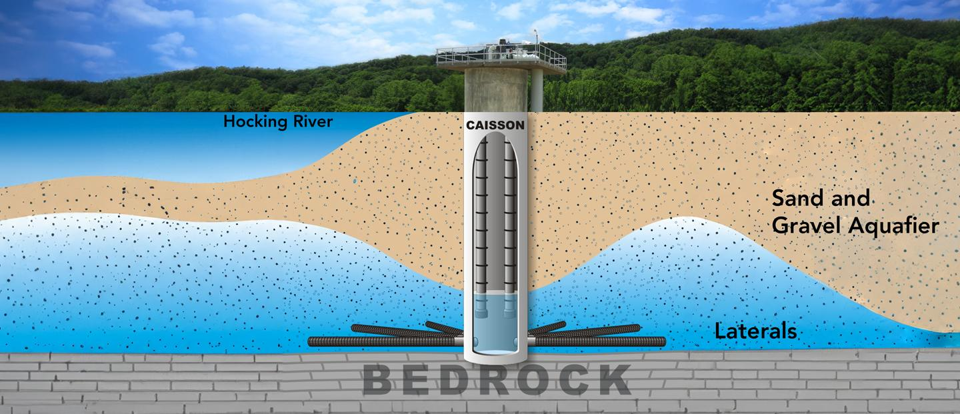

Slide 9
5. Benefits of Ranney Wells
• Natural filtration through sand and gravel
• Low turbidity and reduced bacterial contamination
• Protection from direct river pollution
• High and stable yield even in summer
• Better chemical quality than tubewells
• Lower long-term Operation &Maintenance cost
• Sustainable source with continuous river recharge
Greater screen length, screen surface, and capacity per well.
Concentration of operation requires minimal land acquisition.
Relatively low draw- down and use of efficient, high capacity pumps results in long term savings in energy consumption.
Less road construction, electrical and mechanical controls, and associated pipe line as compared to battery of tubewells.
One Ranney Well of 10.0 Mld (Million Litres per Day)capacity is equivalent to 30-40 Nos. tubewells in the same area.

Slide 10
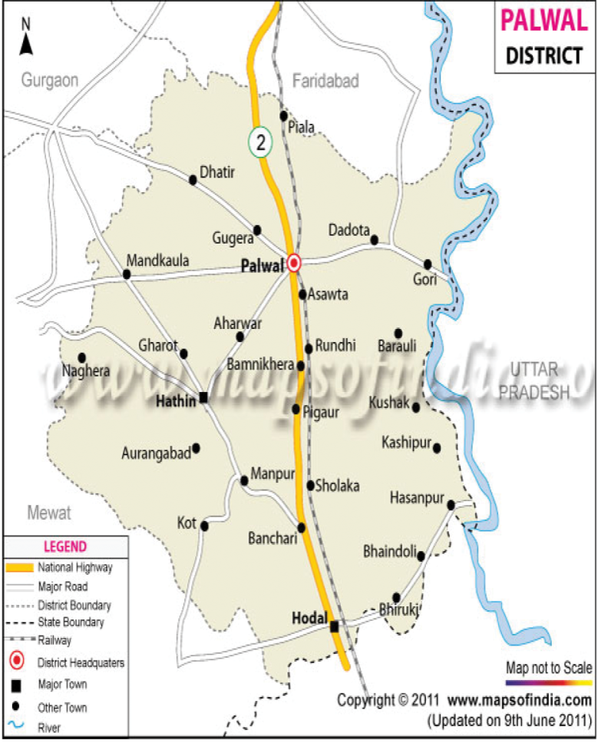
DISTRICT PALWAL
Geographical Area:- 1,368 sq km
Altitude:- 195 Mtr (639 ft)
Latitude:- 28.40 deg N
Longitude:- 76.59 deg E
Population (Census 2011):- 10,40,493
Average Temperature:- 34.4 deg C
Average Annual Rainfall:- 454 mm
Number of Villages:- 263
Number of blocks:- 6 Nos. (Palwal,Hodal, Hathin, Hassanpur, Prithla,Badoli)
Profile:- Palwal became the 21st district of Haryana State on 15 August 2008 Palwal city as its headquarters.
Geography & Climate:- Palwal is located in the southern part of Haryana . It shares a geographical boundary with Mewat, Aligarh, Gurgaon, Faridabad and Delhi.

Slide 11
Existing Drinking Water position in Project Area
Earlier drinking water in the 84 villages of project area is supplied @ 55 LPCD (Litre per capita per day) by installing 136 No. tube wells near by villages in which the water Quality is deteriorating and quantity is reducing day by day.
84 villages covers:-
29 villages of Prithla block
38 villages of Palwal block
17 villages of Ballabgarh Block

Slide 12
Necessity of Project
Name of Project :-Augmentation Drinking water supply scheme in quality affected 84 No. Villages of Prithla & Palwal Block of Distt. Palwal & Ballabgarh Block of Distt. Faridabad from Yamuna flood plain by construction of Ranneywell and deep Tubewell in village Mohna.
Estimated Cost Rs.184.30.00 Crore
“Initially, water supply was being operated through tubewells. Over time, issues related to poor water quality, including high turbidity, iron content, and bacteriological concerns, were observed. In order to overcome these issues and to provide safe, reliable, and sustainable drinking water, the department adopted Ranney (Radial Collector) Well technology in the Yamuna flood plain area.”
Presently drinking water in the 84 villages of project area is supplied @ 70 LPCD (Litre per capita per day) by installing of 2 No. Rannewells and 2 No. tube wells nearby Yamuna flood plains.
The water abstracted from the Ranney Wells is conveyed to 2 Nos. Main Boosting Stations (MBS) and further distributed through 7 Nos. Intermediate Boosting Stations (IBS), from where potable water supply is ensured to Villages of Prithla & Palwal Block of Distt. Palwal & Ballabgarh Block of Distt. Faridabad .”

Slide 13
This project provides water supply to following villages with population of 346975 (Designed for the year 2031) :-
29 villages of Prithla block
38 villages of Palwal block
17 villages of Ballabgarh Block
Further water is supplied to following villages by IBS :-
IBS Mandkol – 9 no. villages
IBS Dudhola – 14 no. villages
IBS Ratipur – 11 no. villages
IBS Dhatir – 14 no. villages
IBS Kairaka – 13 no. villages
IBS Prithla – 6 no. villages
IBS Bhanakpur – 17 no. villages

Slide 14
“After shifting to Ranney Wells, water quality and supply reliability have improved and public complaints related to drinking water have reduced significantly.”

Slide 15
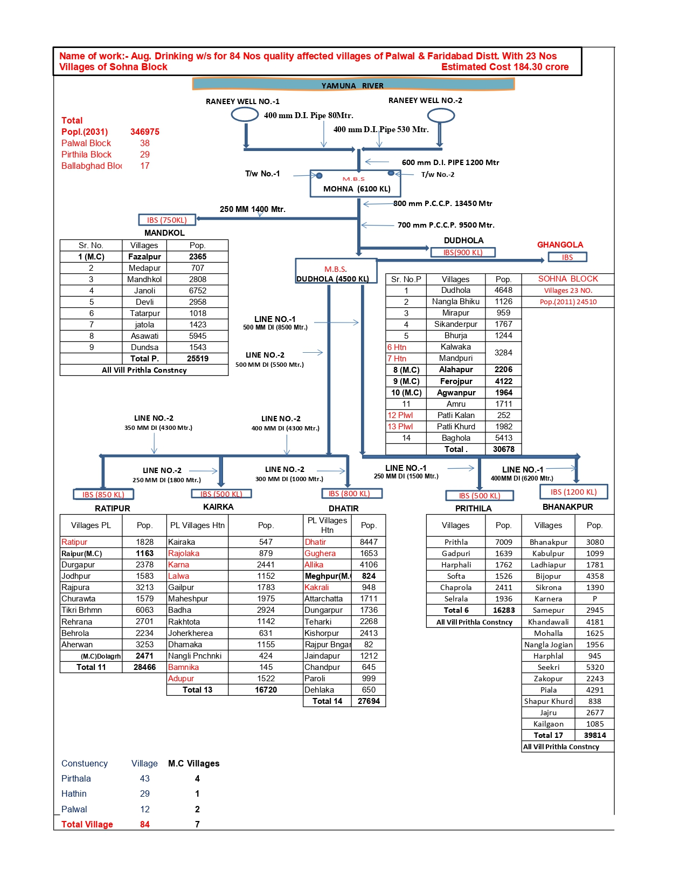
Flow Chart

Slide 16
PROJECT AT A GLANCE
CONSTRUCTION OF 2 NOS. RANNEY WELLS (20 mld), Tubewells (2 Nos.)
600mm i/d, (D.I. Pipe)1200 m
Main Boosting Station Mohna (UGT 6100 KL)
800mm I/d (Pre stressed Concrete Cylinder Pipe) PCCP Length:- 13450 M.
700 mm i/d (Pre stressed Concrete Cylinder Pipe) PCCP Length :-9500M
IBS Mandkol (750 KL)
MBS Dudhola (UGT 4500 KL)
7 nos. villages
2 nos. villages
IBS Dhatir (800 KL)
IBS Kairaka (500 KL)
IBS Ratipur (850 KL)
IBS Bhanakpur (1200 KL)
IBS Prithla (500 KL)
IBS Dudhola (4500KL)
14 No. villages
13 No. villages
11 No. villages
17 No. villages
6 No. villages
14 No. villages

Slide 17
The water quality of existing Ranney Wells (Village Mohna)
Sr. No. | Characteristics |  | Results of
 |  | Max. Permissible limit as per CPHEEO Manual | Ranneywell No.1 | Ranneywell No.2 | Remarks
 | Turbidity (NTU) | 0 | 0 | 0 | Potable
 | Colour (platinum cobalt scale) | Cl | Cl | Cl | Potable
 | Taste and odour | Agreeable | Agreeable | Agreeable | Potable
 | pH (Hydrogen Potential) | 6.50-8.50 | 7.59 | 6.74 | Potable
 | Total dissolved solids (mg/I) | 2000 | 796 | 253 | Potable
 | Total hardness (mg/l) as CaCO3 | 600 | 400 | 200 | Potable
 | Chlorides (as Cl) mg/l | 1000 | 360 | 110 | Potable
 | Alkanity (mg/ltr.) | 600 | 390 | 340 | Potable
 | Sulphates (as SO₄) mg/l | 400 | 92 | 43 | Potable
 | Fluorides (as F) (mgl/l) | 1.5 | 0.1 | 0.63 | Potable
 | Nitrates (as NO₃) (mg/l) | 100 | 1.14 | 0.49 | Potable
 | Calcium (as Ca) (mg/l) | 200 | 80 | 20 | Potable
 | Magnesium (as Mg) (mg/l) | 100 | 48 | 36 | Potable
 | Iron (as Fe) (mg/l) | 1.0 | 0.01 | 0.06 | Potable

Slide 18
Construction of
Ranneywell

Slide 19
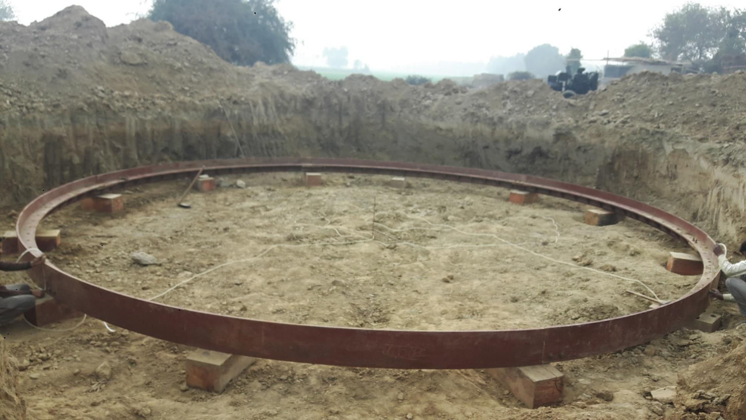
CUTTING EDGE

Slide 20
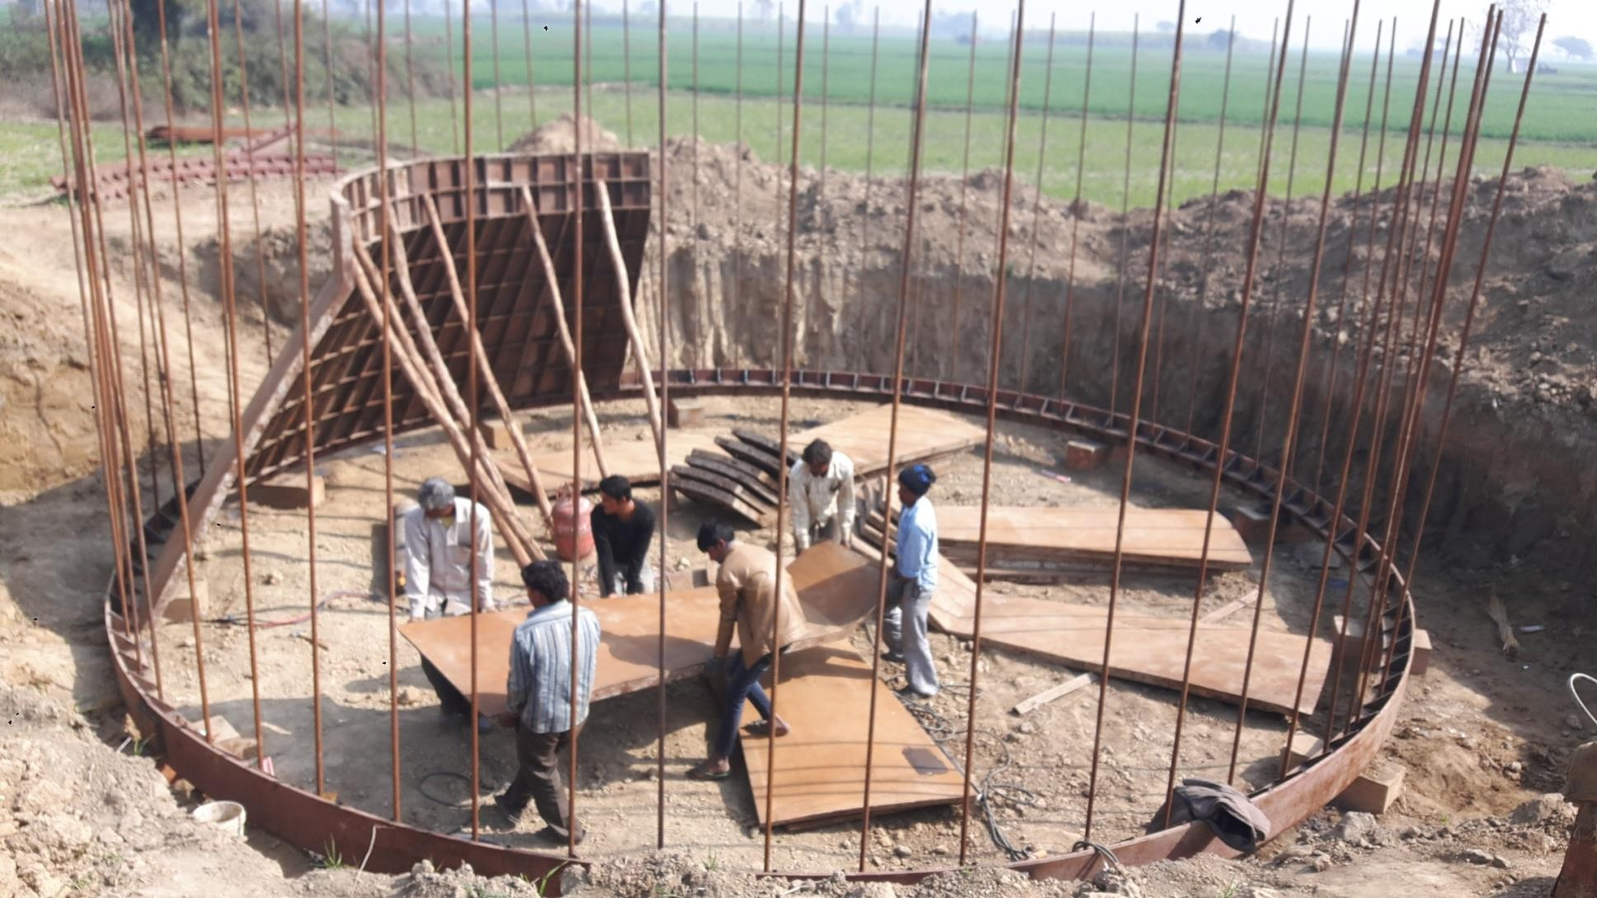
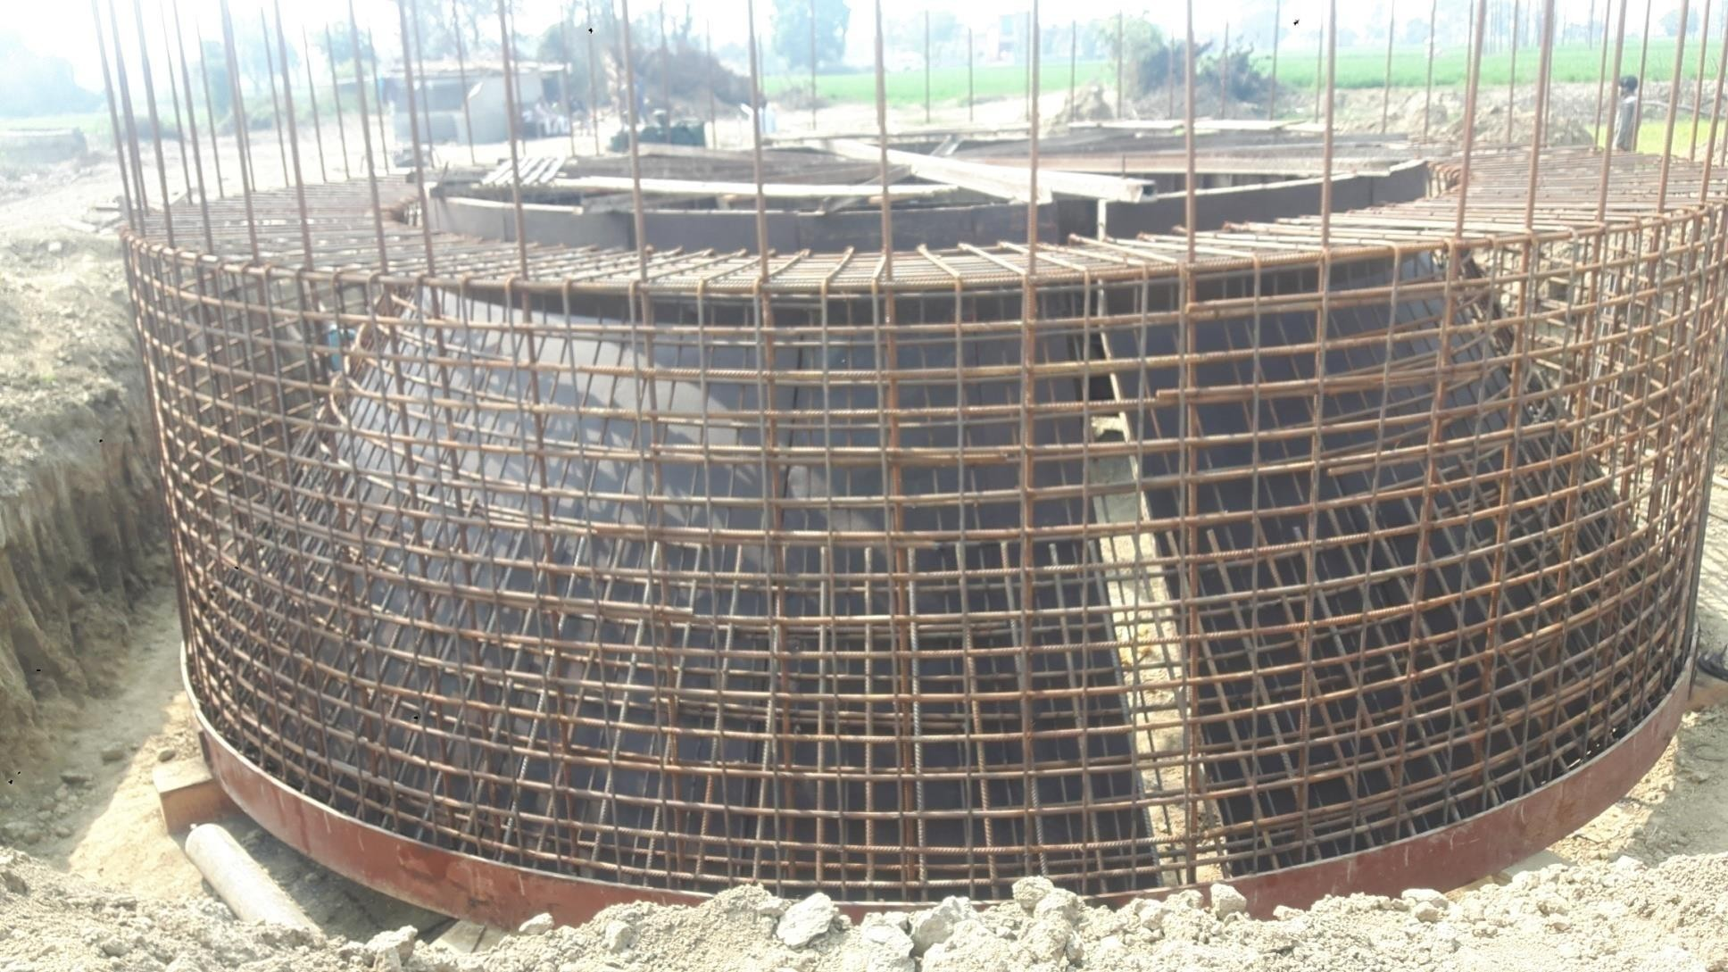
CUTTING EDGE INNER SHUTTERING

Slide 21

CUTTING EDGE STEEL

Slide 22
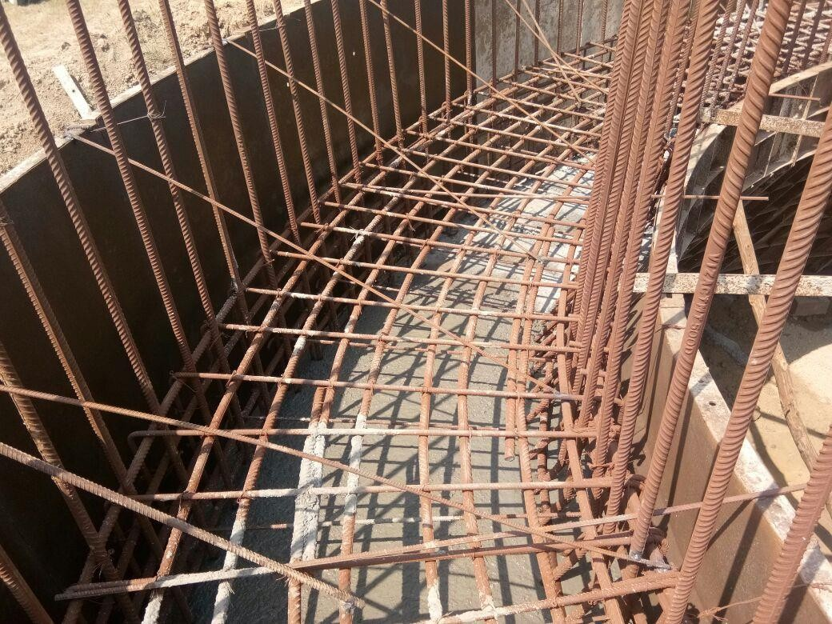
CUTTING EDGE CASTING

Slide 23
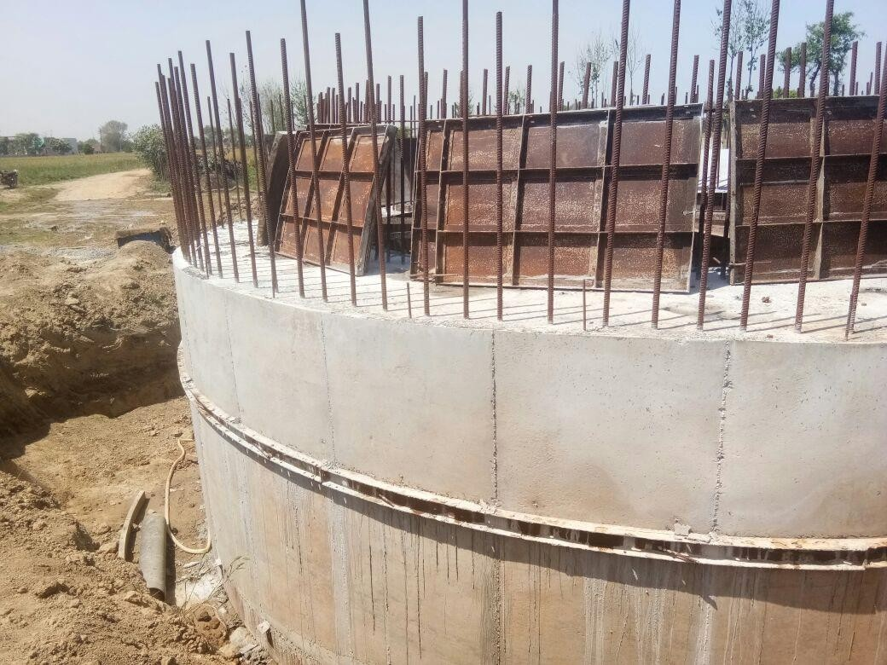
CUTTING EDGE AFTER CASTING

Slide 24
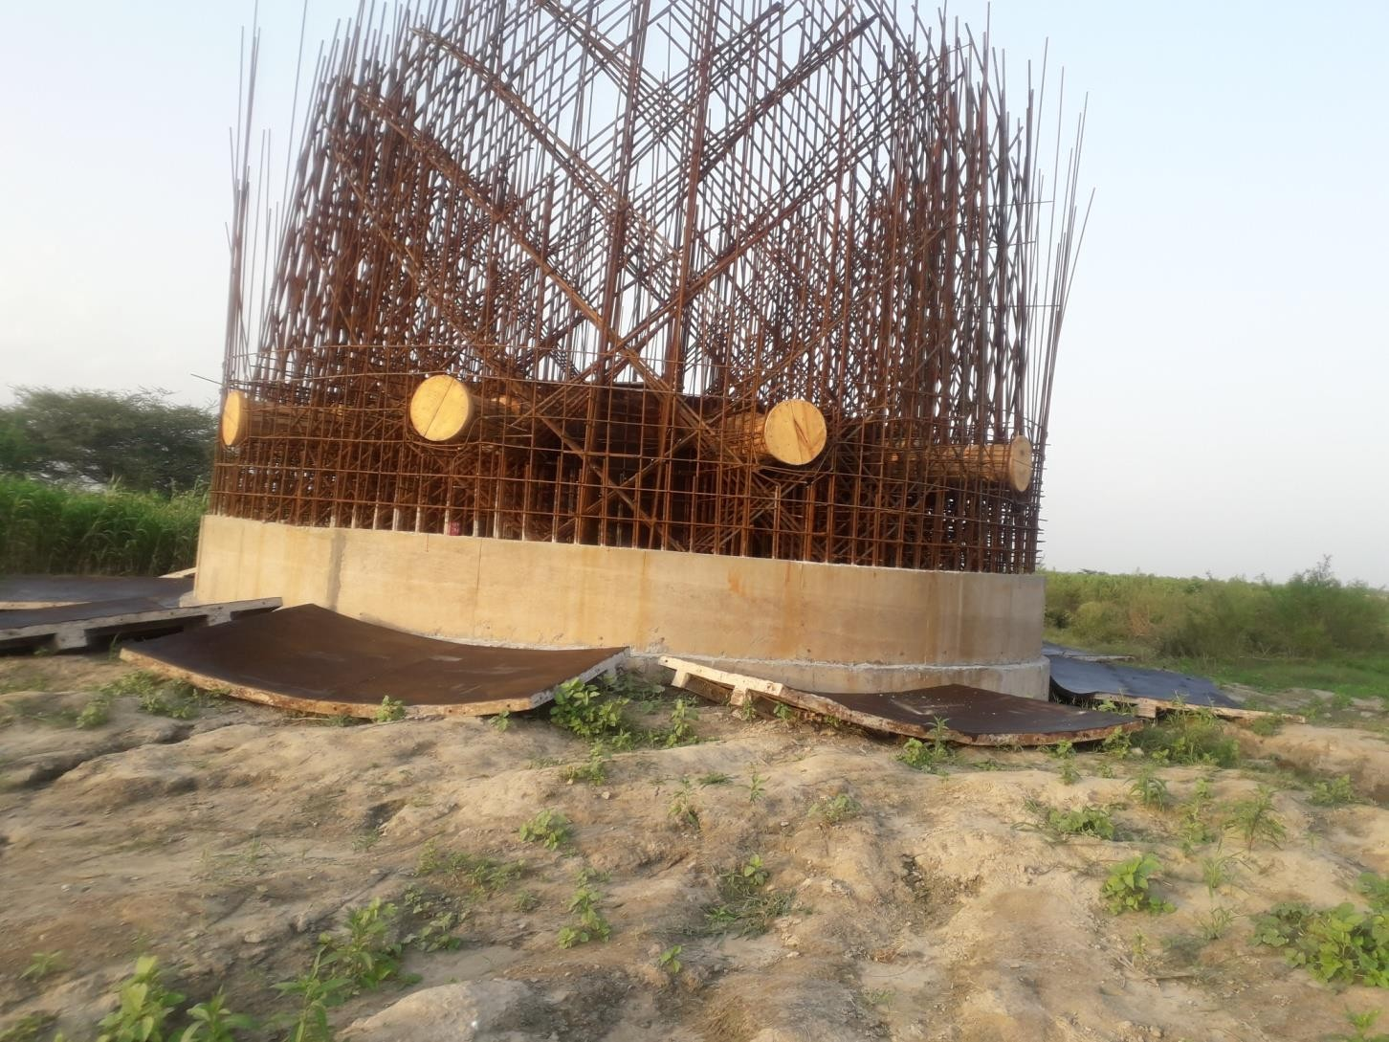
PORT HOLES 1st LAYER

Slide 25
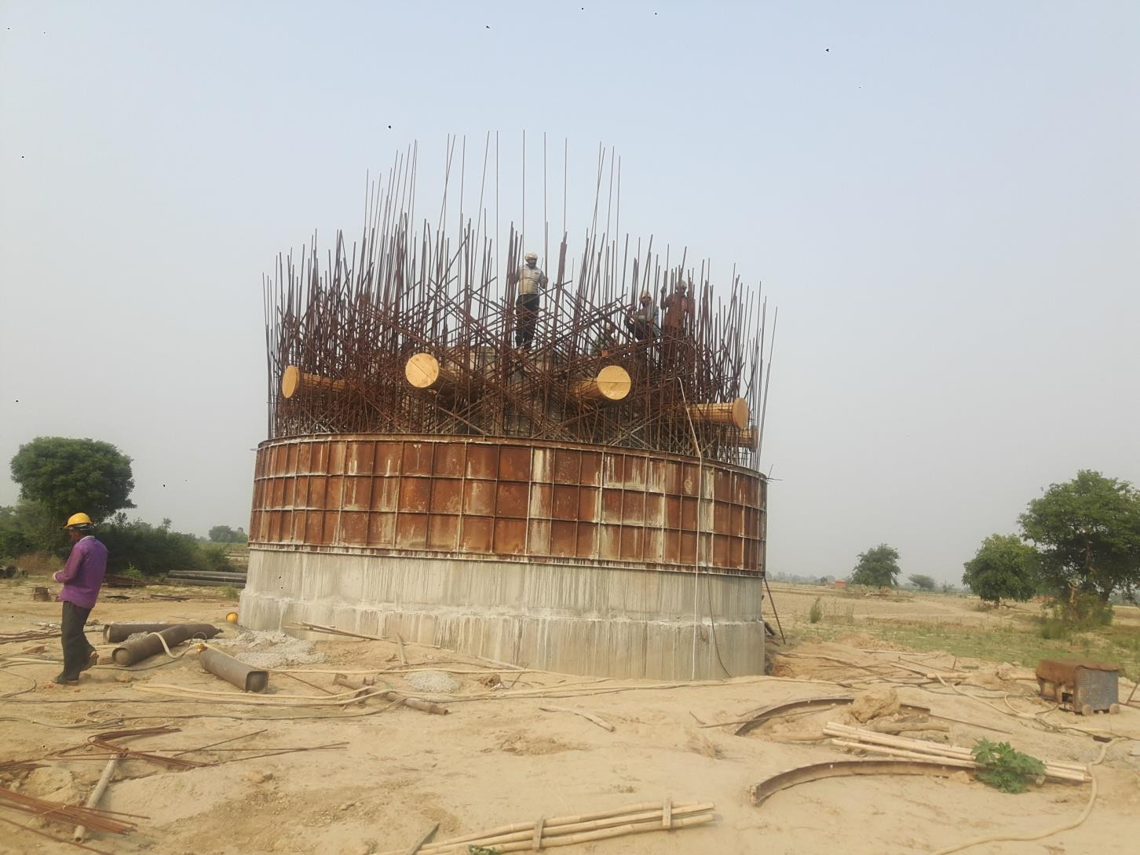
PORT HOLES 2ND LAYER

Slide 26
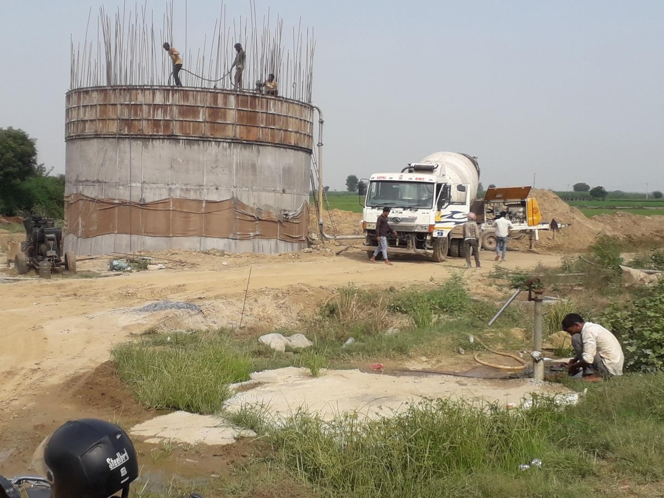
STEINING WALL CASTING

Slide 27
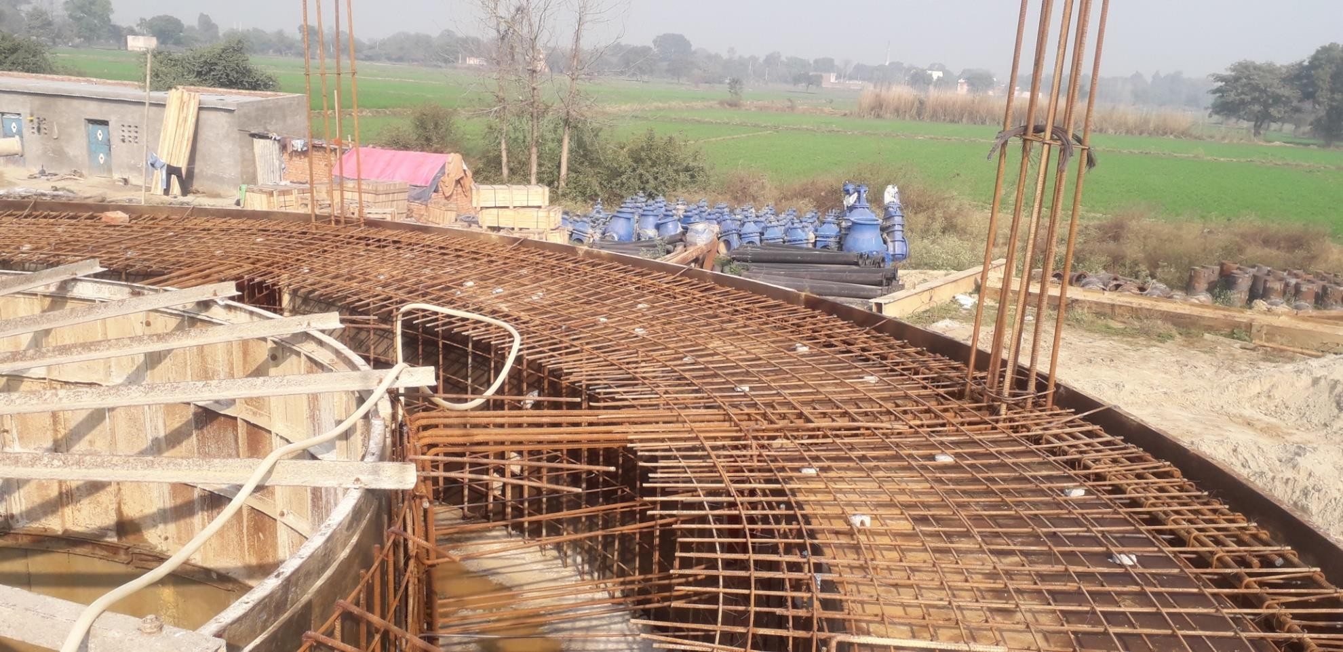
PLATEFORM STEEL

Slide 28
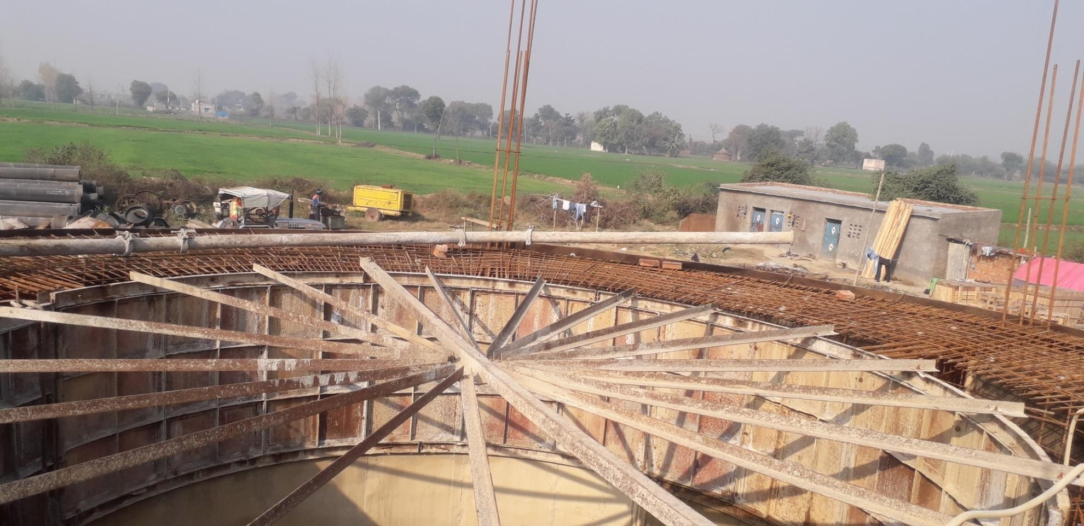
PLATEFORM STEEL AND CASTING

Slide 29
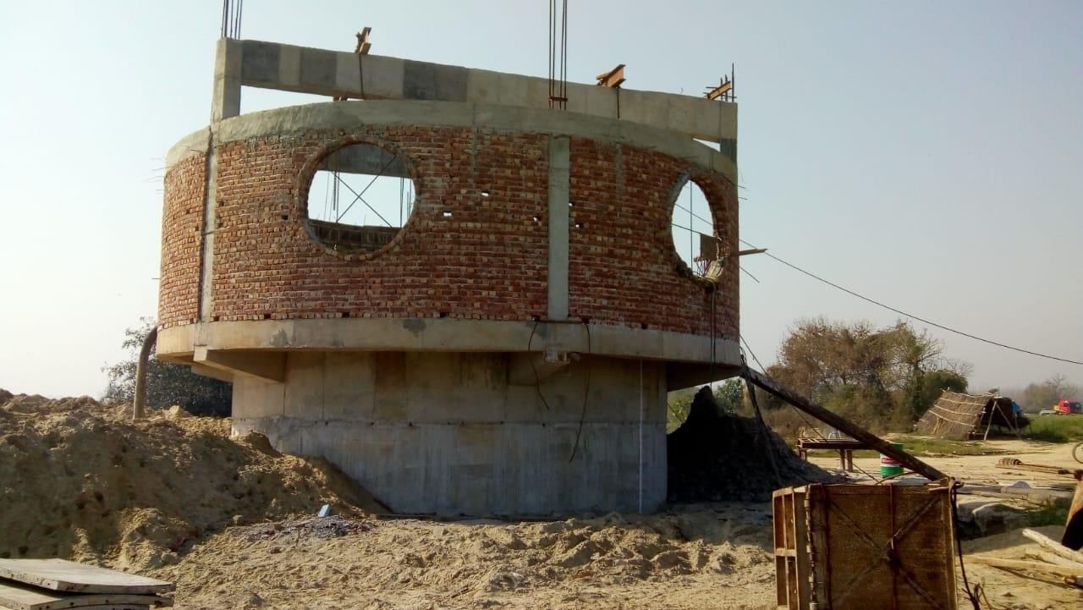
PUMP CHAMBER

Slide 30
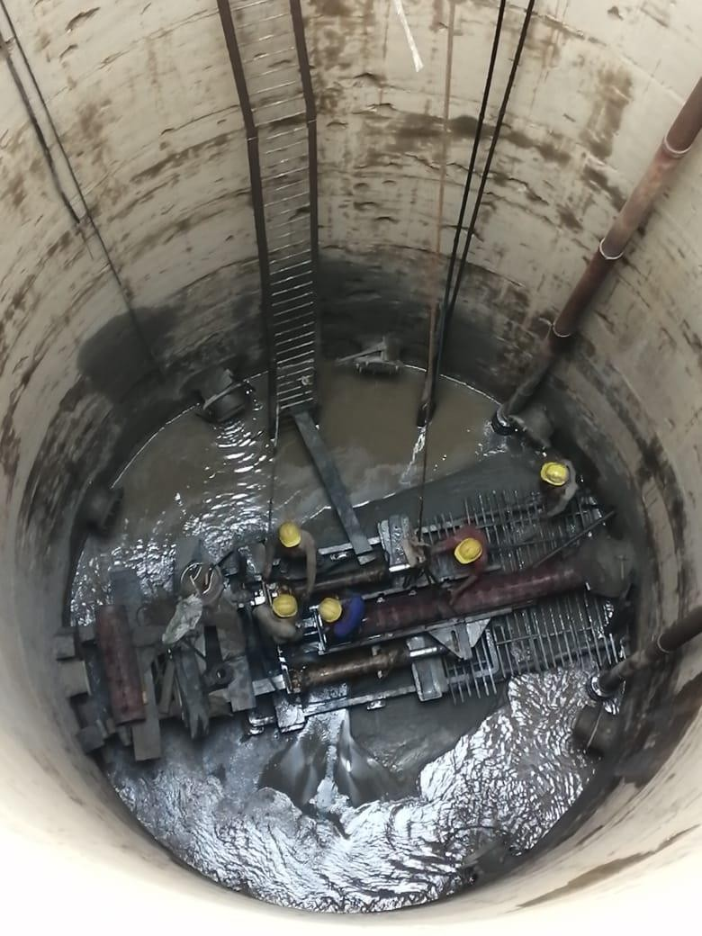
PUSHING OF STAINER PIPE

Slide 31
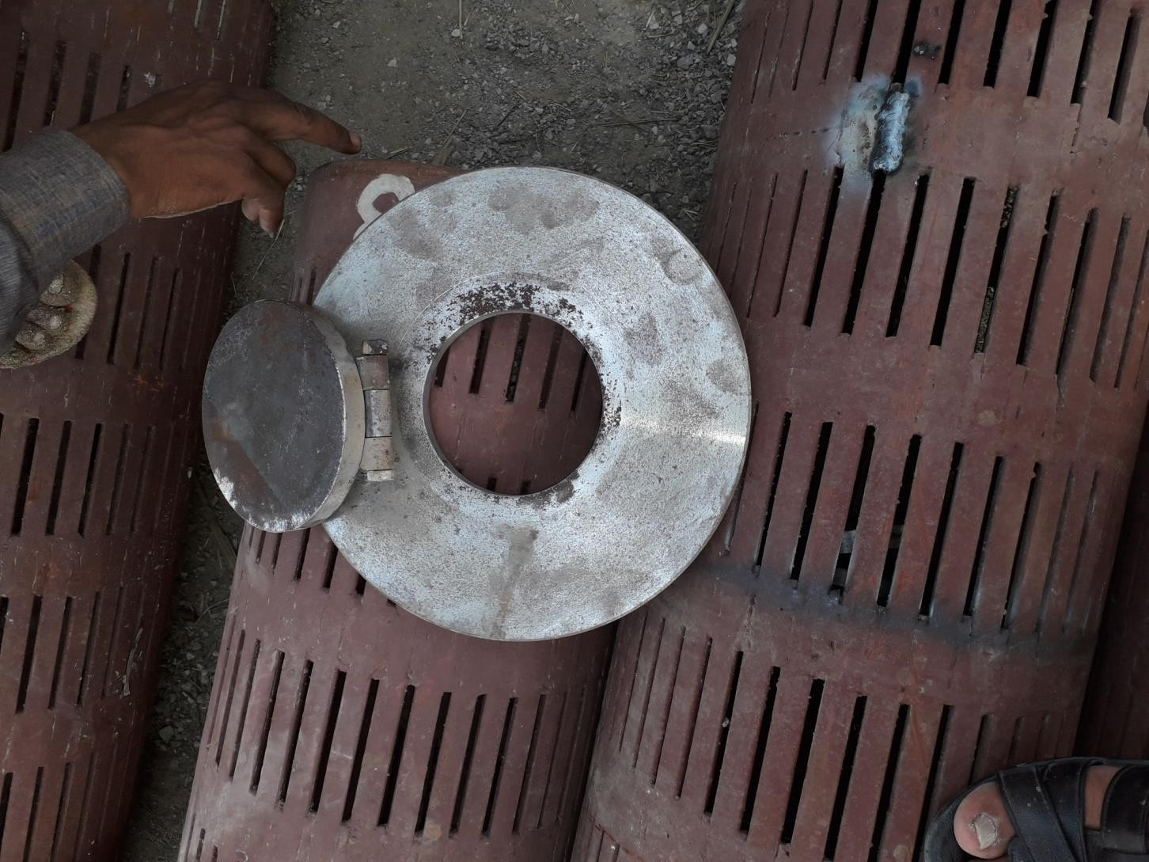
SAND VALVE AND STAINER PIPE

Slide 32
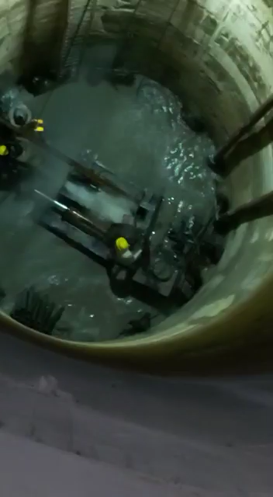
EXTRACTION OF DESANDING

Slide 33
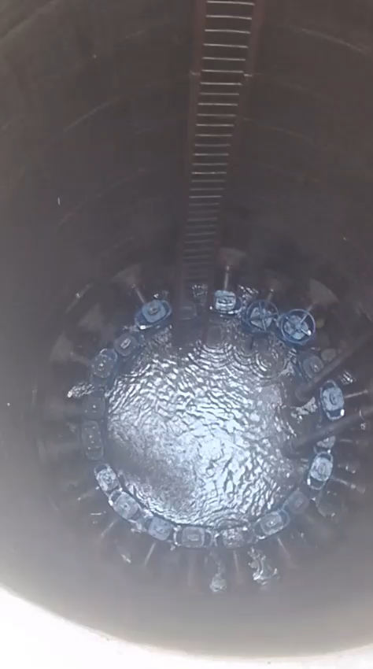
DE-SILTING

Slide 34
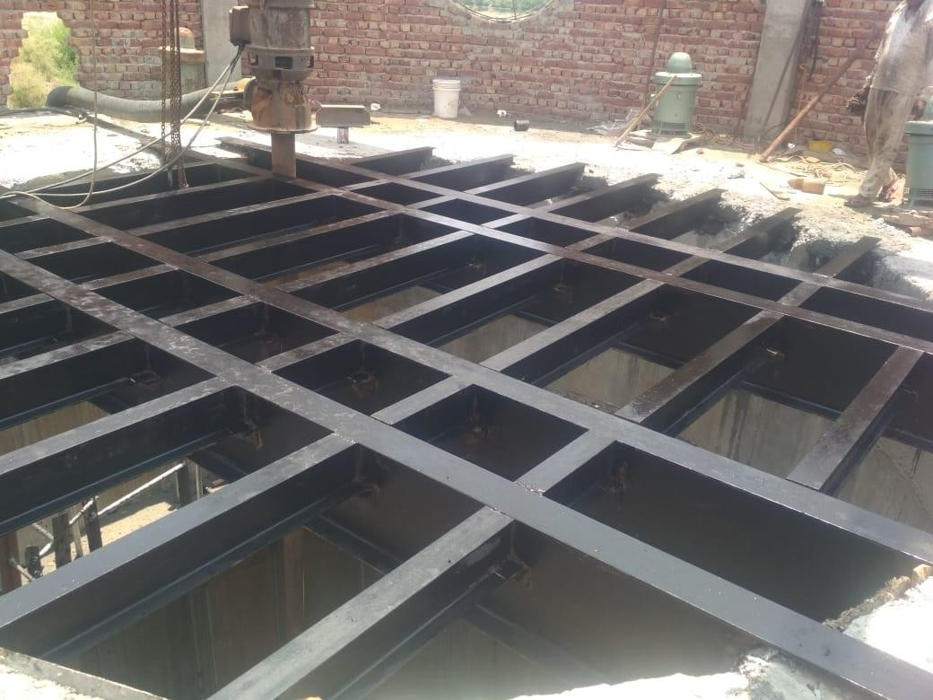
PLATEFORM FOR PUMPING MACHINERY

Slide 35
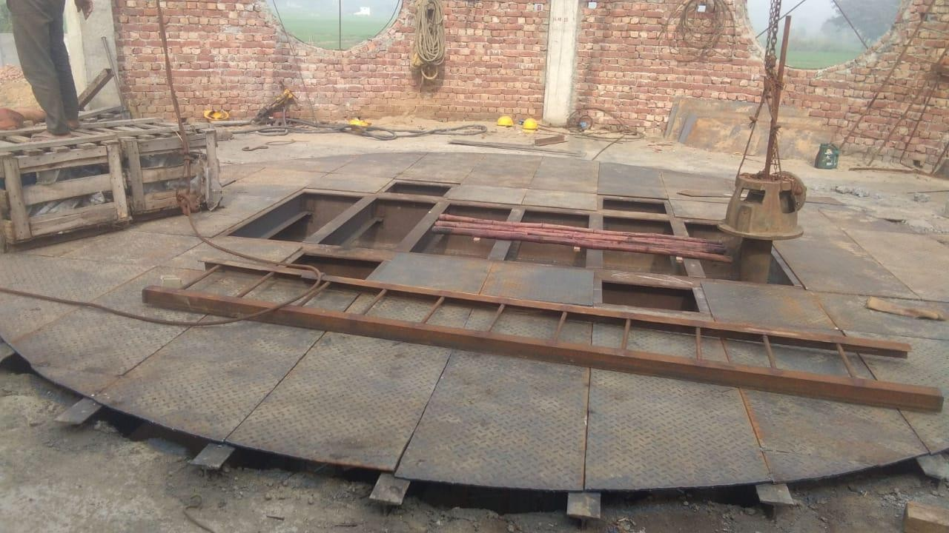
FOUNDATION OF PUMPING MACHINERY

Slide 36
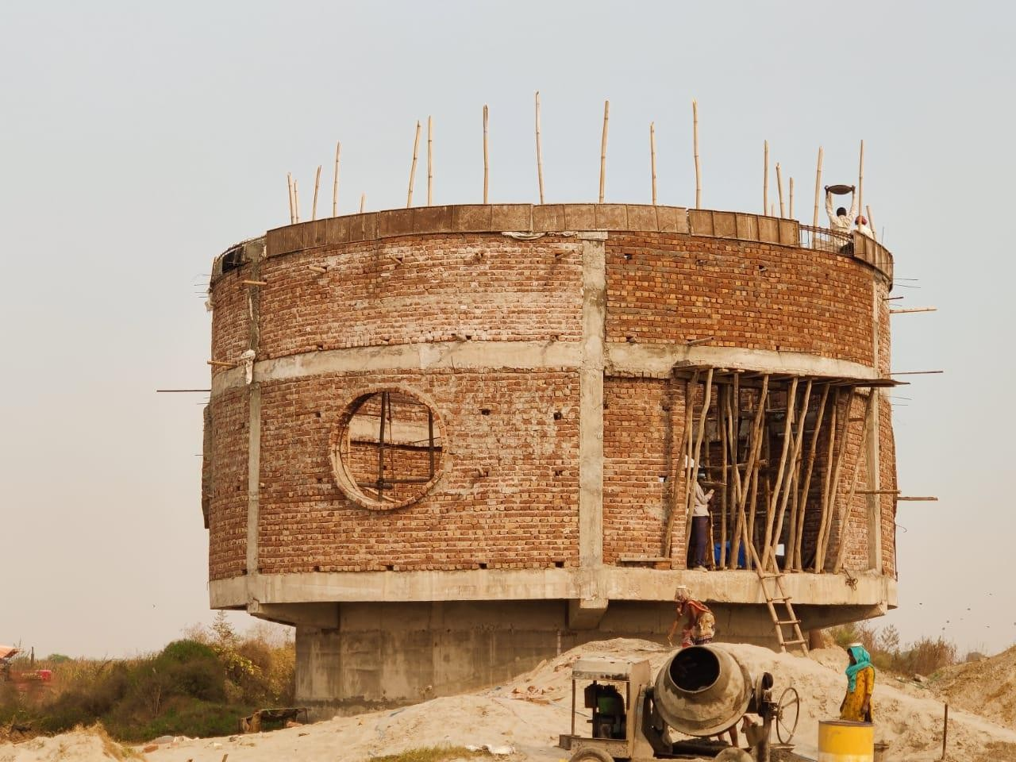
TOP BEAM CASTING

Slide 37
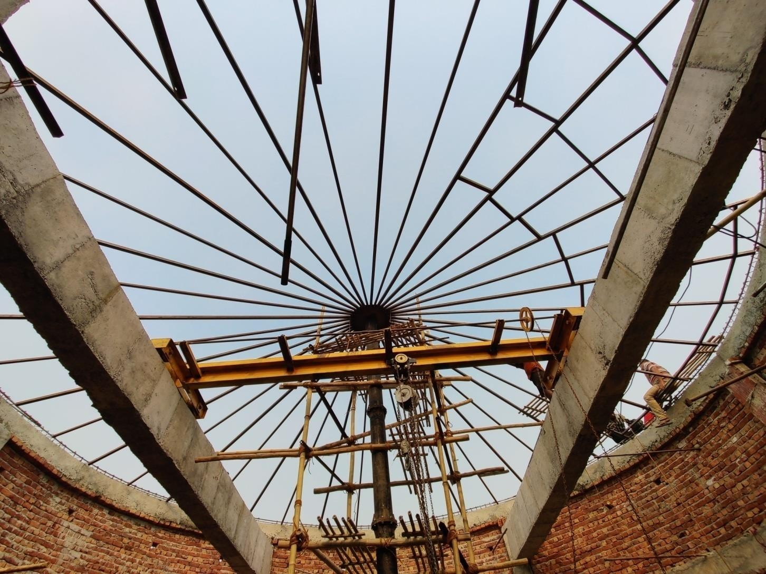
SHUTTERING OF ROOF

Slide 38
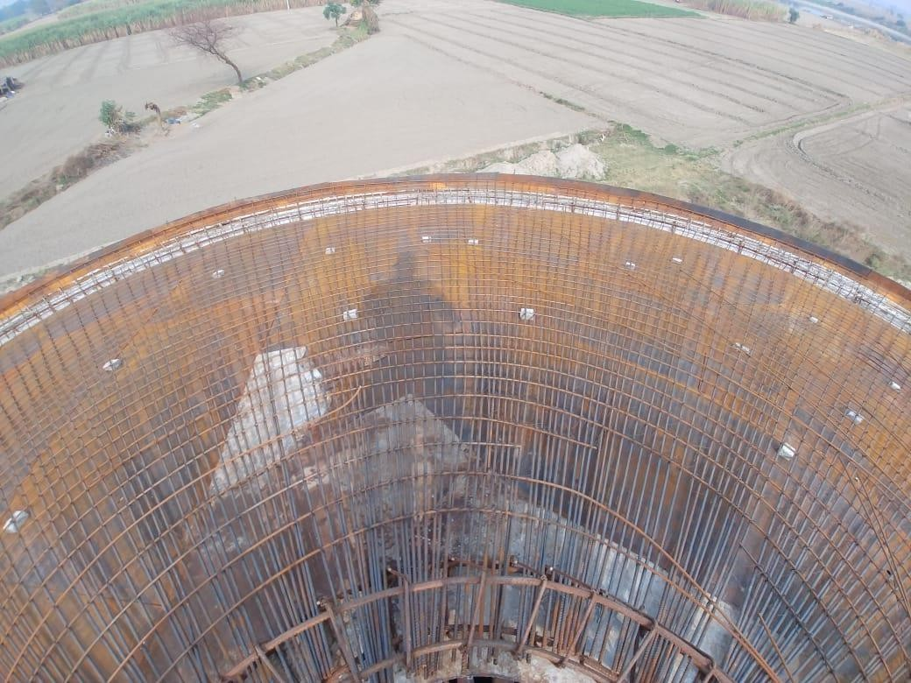
ROOF STEEL

Slide 39
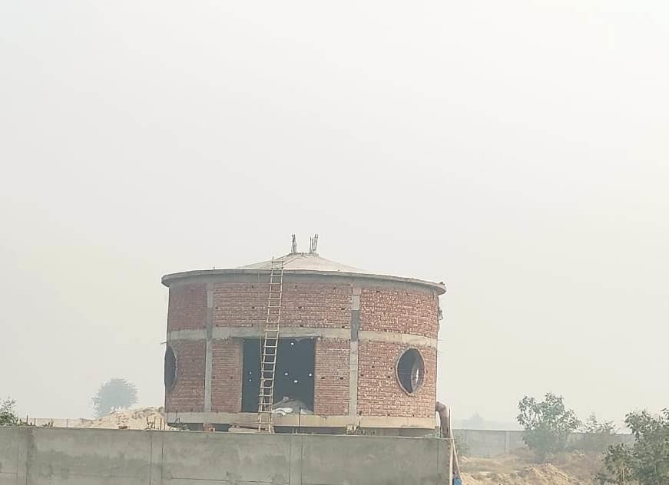
PUMP CHAMBER

Slide 40
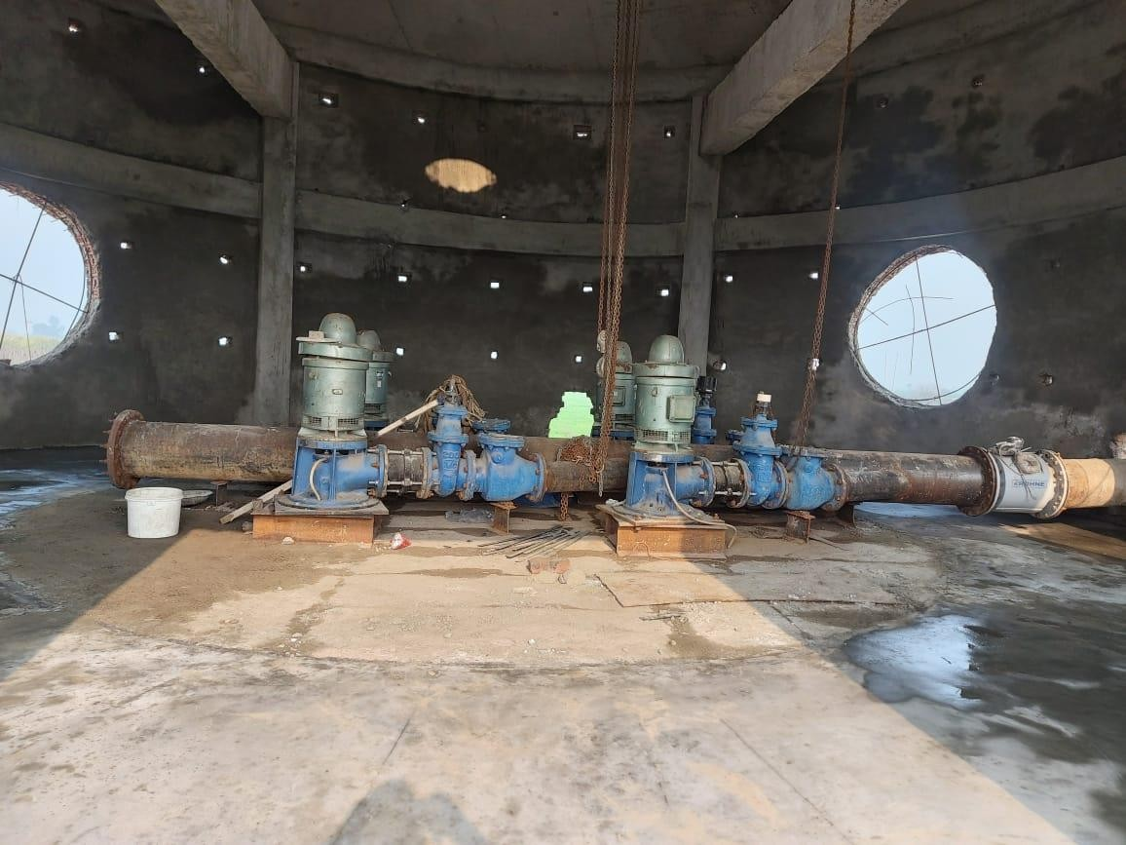
PUMPING MACHINERY

Slide 41
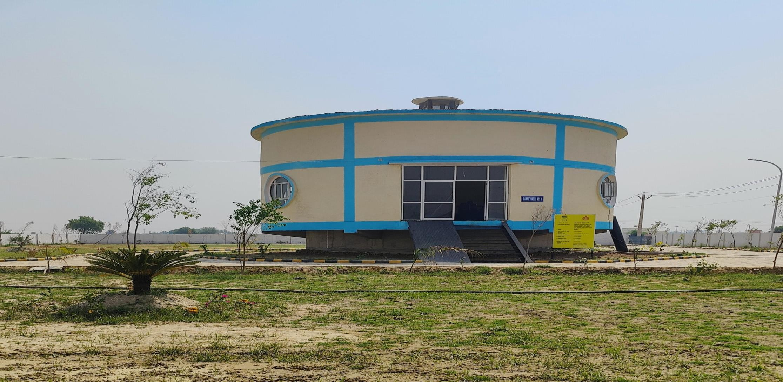
PUMP CHAMBER

Slide 42
THANK YOU

