Slide 1
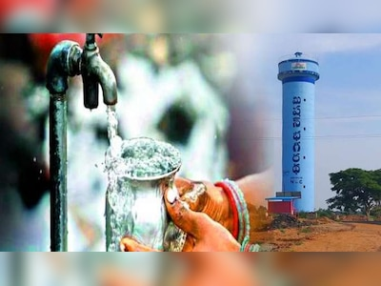
Welcome to
Collectors’ Peyjal Samvad
District Water and Sanitation Mission (DWSM)
Mahabubnagar District,
Telangana
Presented by
Smt Viziendira Boyi, IAS
Collector & District Magistrate
Mahabubnagar District
Telangana

Slide 2
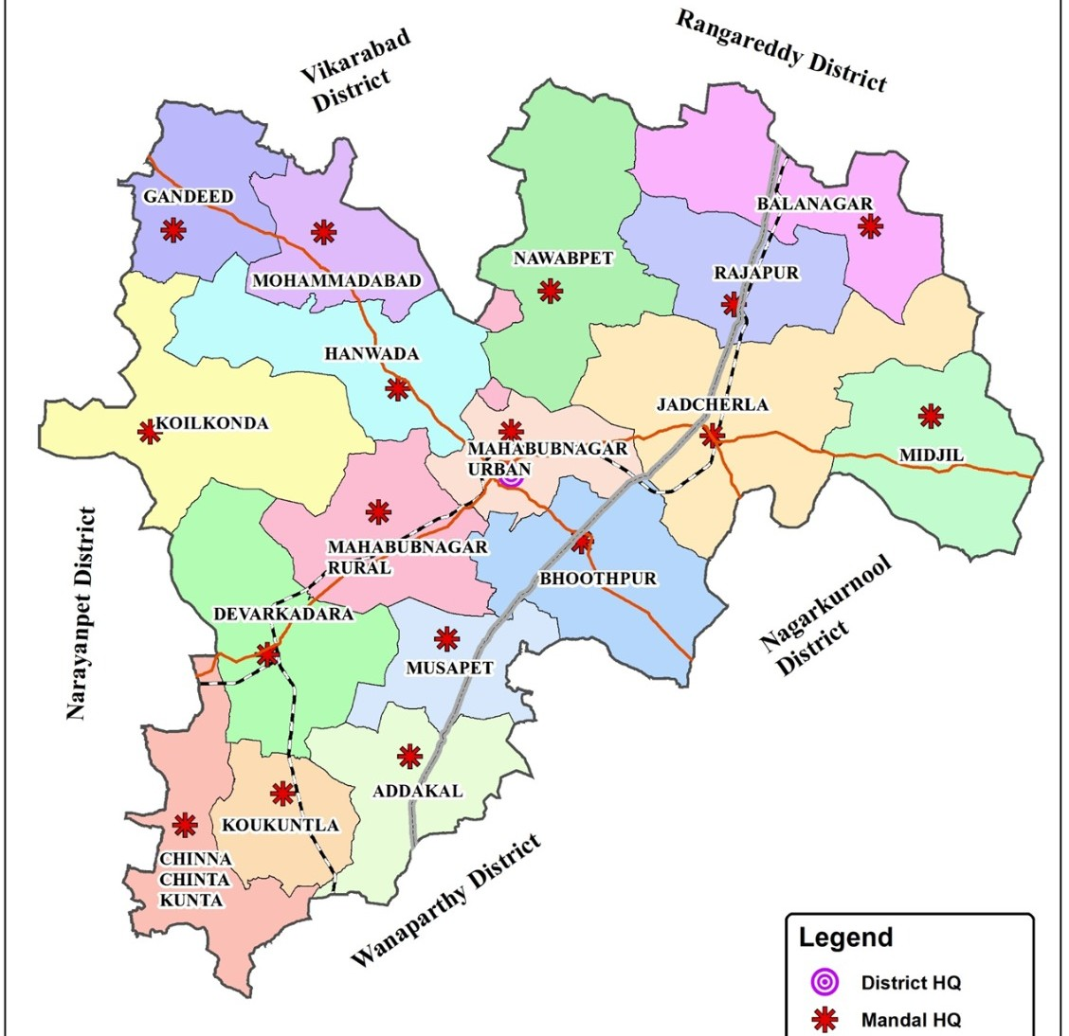
District at a Glance
District | Mahabubnagar
Parliament Constituency | 1
Mandals | 16
Gram Panchayats | 423
Revenue Villages | 307
Habitations | 852
Urban Local Bodies | 4
Population as per 2011 Census | 9,19,903
Urban | 3,19,346
Rural | 6,00,557
Geographical Area (Sq.Kms) | 2,737.96
Average Annual Rainfall (mm) | 608.80

Slide 3
Drinking Water Scenario prior to Mission Bhagiratha
Though Krishna river is flowing through the region, the major water source of drinking water and agriculture is ground water.
There were 876 PWS schemes and 4 CPWS Schemes in the District.
Over exploitation of ground water and frequent monsoon failures in past 3 decades: hundreds of villages suffered from drinking water scarcity.
Earlier, water supply was through PWS/ MPWS Schemes, Hand Pumps and Open wells which suffered due to depletion of Ground water table and unable to meet the water supply requirements.
As bore wells dried up, water supply made to 94 habitations through hiring of bore well sources and for 43 habitations through transportation.
The problem was not just the quantity but also the quality. Prior to 2014, there were 265 Quality Affected (QA) habitations in Erstwhile Mahabubnagar district.

Slide 4
Mission Bhagiratha Undertaken
Government of Telangana implemented Telangana Drinking Water Supply Project named Mission Bhagiratha (2015-2019) to provide safe, adequate, sustainable and treated drinking water for the entire Rural and Urban areas of the State. It envisaged to provide drinking water at the rate of
    100 LPCD for Rural areas
    135 LPCD for Municipalities
    150 LPCD for Municipal Corporations
    Meet Industrial requirements to an extent of 10% of treated water
Total Households (HHs) : 1,49,198
Households with FHTCs : 1,48,629
Households without FHTCs : 569 (After YDU Survey, FHTCs yet to
be provided)

Slide 5
Mission Bhagiratha Working Model
In Mahabubnagar district, Raw water is drawn by Pumping/Gravity from various sources to 8 Water Treatment Plants (WTPs) at various locations.
After due treatment of raw water at WTPs, Clear water supplied to OHBRs/GLBRs/BPTs by Pumping/Gravity through Primary transmission lines and the water is being supplied to Rural & Urban OHSRs by Gravity/Pumping.
The treated water is chlorinated throughout the day continuously to avoid bacteriological contamination. The physical and bacteriological tests are conducted for the treated water for 24/7 to supply quality drinking water to all the habitations.
All habitations including QA habitations were covered under Mission Bhagiratha in the year 2019.
During execution, the services of M/s WAPCOS were utilized as Third Party Implementing (TPI) Agency from the stage of vetting, commissioning and up to stabilization of drinking water.

Slide 6
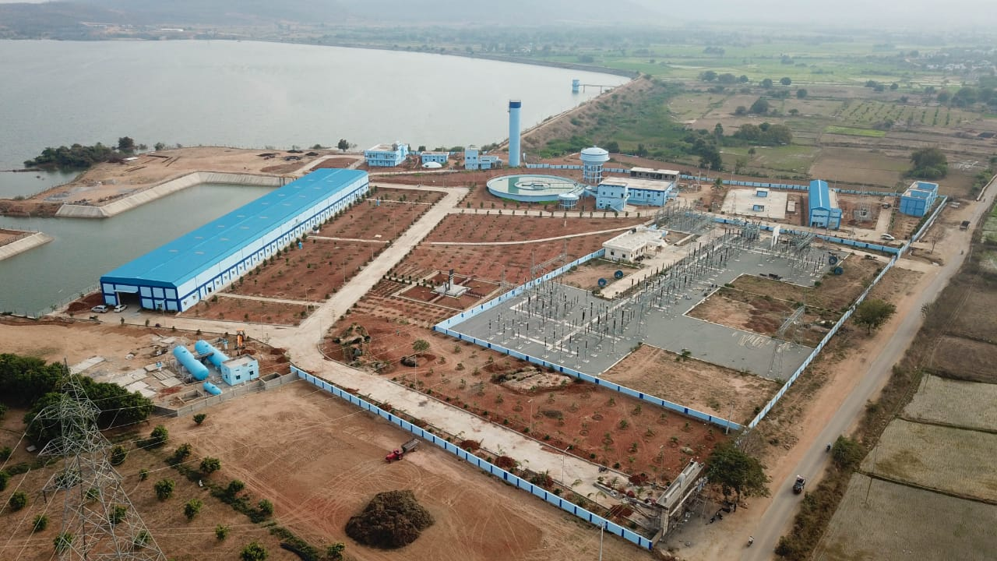
Details of Sources in Mahabubnagar District
The Raw water fed from the following sources to a total of (8) Water Treatment Plants (WTPs) at various locations. After due treatment, the Clear water is being supplied to a total of 852 Rural habitations and 4 Urban Local Bodies. The reliable and sustainable sources were identified.
Srisailam Back water fed to Yellore reservoir (Source – I)
  Capacity of Srisailam Reservoir : 215.80 TMC
  Capacity of Yellore Reservoir : 0.35 TMC
  No of WTPs : 05
  Habitations designed
    Rural : 669
    ULB : 04

Slide 7
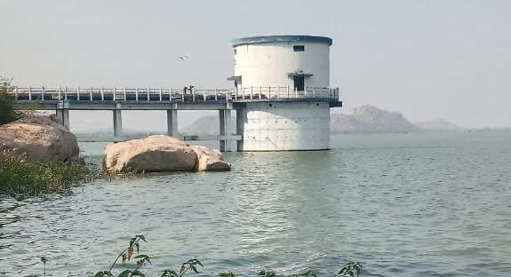
Koilsagar reservoir (Source – II) :
  Capacity of Koilsagar Reservoir : 2.277 TMC
  Water drawl for drinking water : 0.40 TMC
  No of WTPs : 03
  Habitations designed (Rural) : 168
Intake well in Koilsagar Reservoir

Slide 8
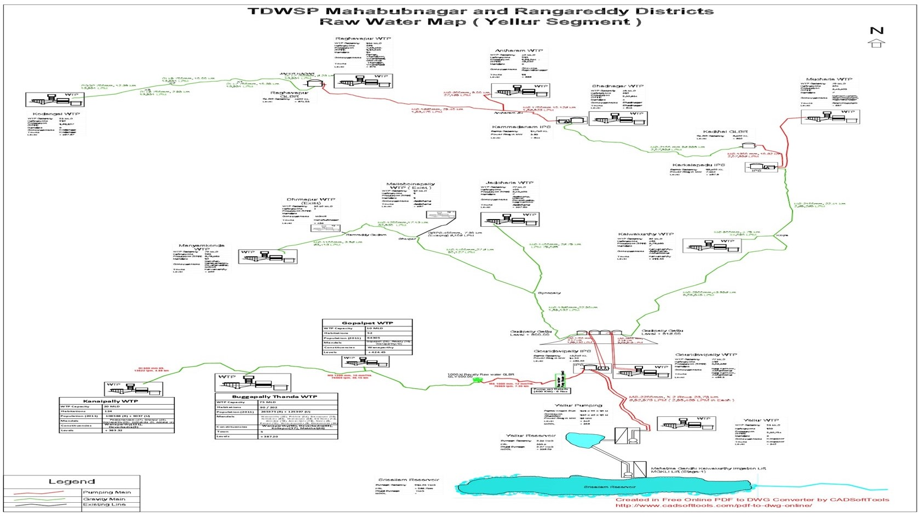

Slide 9
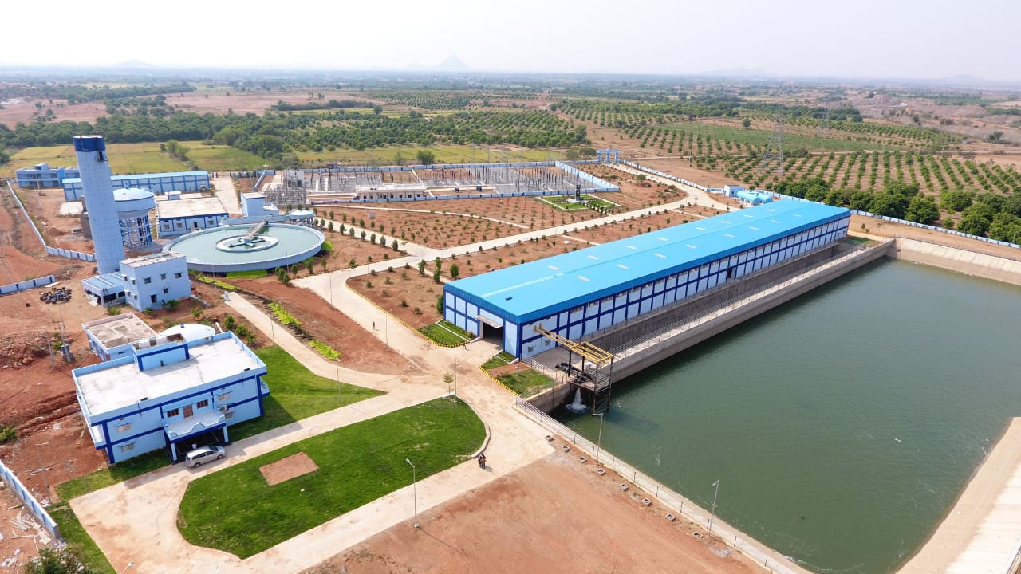
Head works at Yellore Segment

Slide 10
Protocols for Handover of Schemes
State Government issued detailed circular instructions on 01.02.2024 on Operation and Maintenance of drinking water assets.
The scheme is handed over to the Gram Panchayats for maintenance after completion of the Defect Liability Period (DLP) of 5 years
A map indicating the details of location of the OHSR, Anganwadis, Schools, GP Buildings, Primary Health Centre, length of the pipeline executed under the OHSRs, FHTCs fixed, valves fixed is handed over to Gram Panchayat.
Technical support is given to Gram Panchayats in maintaining the scheme.
The Gram Panchayats are maintaining the in-village water supply system from OHSR to FHTC which includes operations like chlorination, cleaning of OHSRs, providing new tap connections, repairs to pipelines, network maps, asset registers and FHTC details.

Slide 11
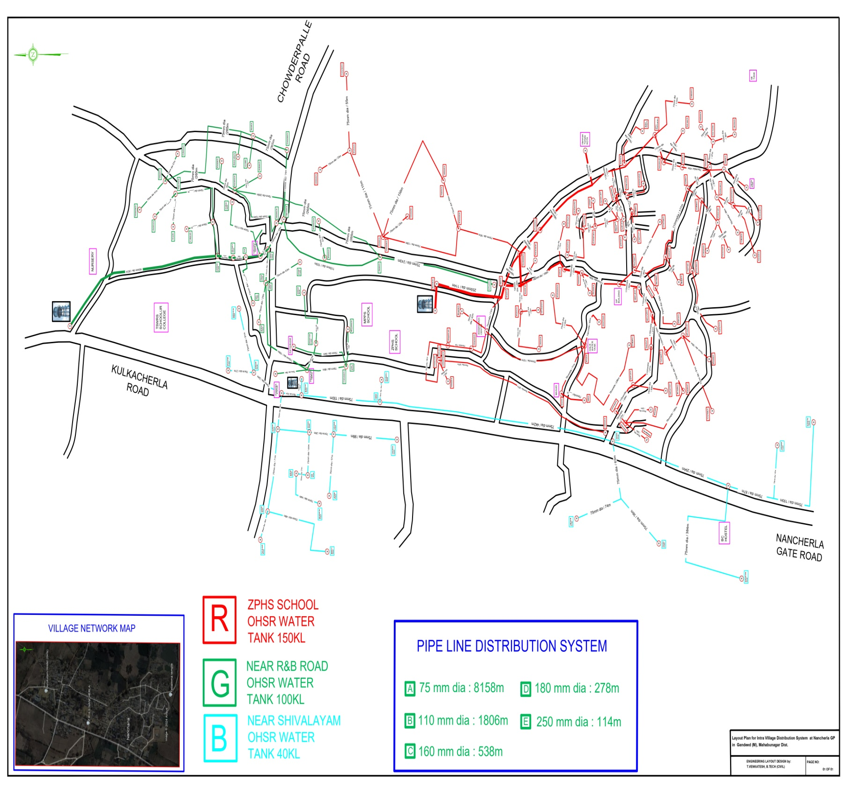
Village Distribution Network Map

Slide 12
Monitoring at Village Level
  The watermen in the village will ensure adequate & quality water.
  Eight Registers are being maintained at village level by GP/VWSC and the same are being monitored by the Field Engineers randomly during their visits
    1) Daily Bulk supply
    2) Grievances
    3) Residual Chlorine test results
    4) Cleaning of OHSRs/Service tanks
    5) New Household Connections
    6) Leakages/Damages/repairs
    7) Bleaching powder stock
    8) Drinking water connection beneficiary details

Slide 13
District Water and Sanitation Mission (DWSM 2.0)
DWSM User Accounts
All 3 User IDs created (District Collector, ZP CEO & EE MB-Intra).
DWSM Meetings
DWSM meetings are being conducted duly following G.O.Ms.No.14, Dt: 04.03.2021 of PR&RD (MB.III) Department, Telangana.
Minutes of meeting (MoM) of DWSM meetings are being uploaded in DWSM 2.0 (District Collectors Login).
DISHA Meetings
Drinking water supply subject is being reviewed with Hon’ble MPs in DISHA meetings and the Minutes of meeting (MoM) are being uploaded in DISHA portal.

Slide 14
Village Water and Sanitation Committee (vwsc)
VWSC committees to be re-constituted / formed with the newly elected Local body members duly following G.O.Ms.No.14, Dt: 04.03.2021 of PR&RD (MB.III) Department, Telangana.
VWSM Meetings
Till now, VWSM meetings are being conducted with the Special Officers and Panchayat Secretaries of the concerned GP/VWSC.
  Minutes of meeting (MoM) / Record of Discussions (RoD) of VWSM are being uploaded by concerned Panchayat Secretaries.
  Panchayat Secretaries were onboarding on VWSM dashboard through e-gramswaraj credentials.
  At present, trainings are being imparted to newly elected Gram Sarpanches by the State Govt.
  Jal Seva Aankalan (Functionality Assessment) is being planned initially in one GP of each Mandal which will be completed by 26th January 2026.

Slide 15
Best Practices - I
Daily Log sheets & Review
Daily Log sheets for quantity of water supply made to each service reservoir is being certified by the GP & MB Department in all the rural habitations. Based on the quantity supplied habitations are categorically called as Green Habs (Supplied @ 100 LPCD), Orange Habs (Below 100 LPCD) and Red Habs (No water supply).
The daily log sheets are being signed by the concerned GP Sarpanch & Panchayat Secretary to ensure whether they have received designed quantity to service requirements.
Identify the non supply and less supplied habitations to ensure remedial measures.
Based on the previous day log sheets, review is done and necessary instructions are issued to the field staff concerning to bring the vulnerable habitations into Green Habs category.
This makes all the stake holders responsible for water supply made/received.
The vulnerable habitations with less supply and No supply are properly planned to be brought into Green Hab status. The quantity of water supply made w.r.t water drawn is being assessed regularly.

Slide 16
Best Practices - II
During the Initial stages of treated water supply, Public refused to consume the treated water because of the odor resulting due to disinfection.
After conducting the IEC activities like awareness programs on water quality parameters & disinfection, now public are consuming the treated water without any hesitation.

Slide 17
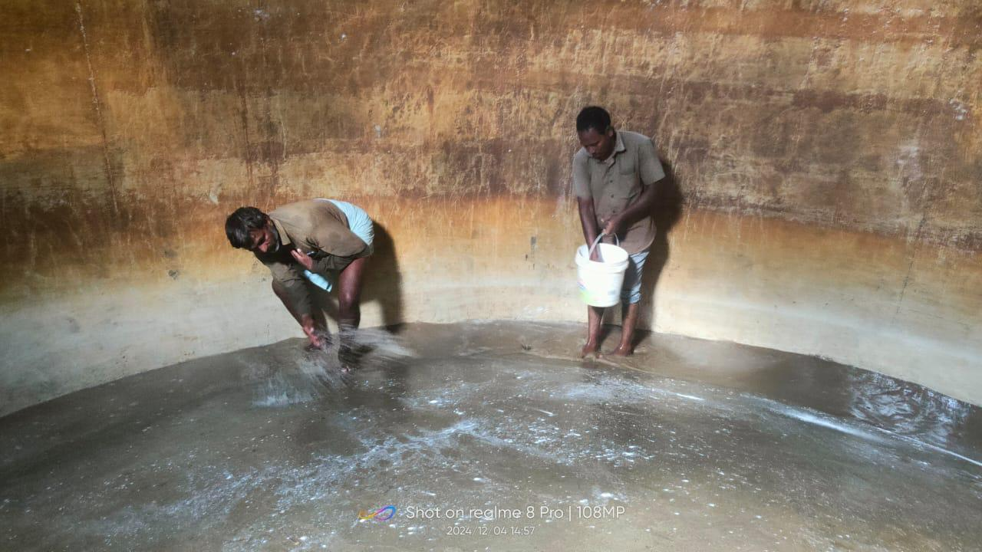
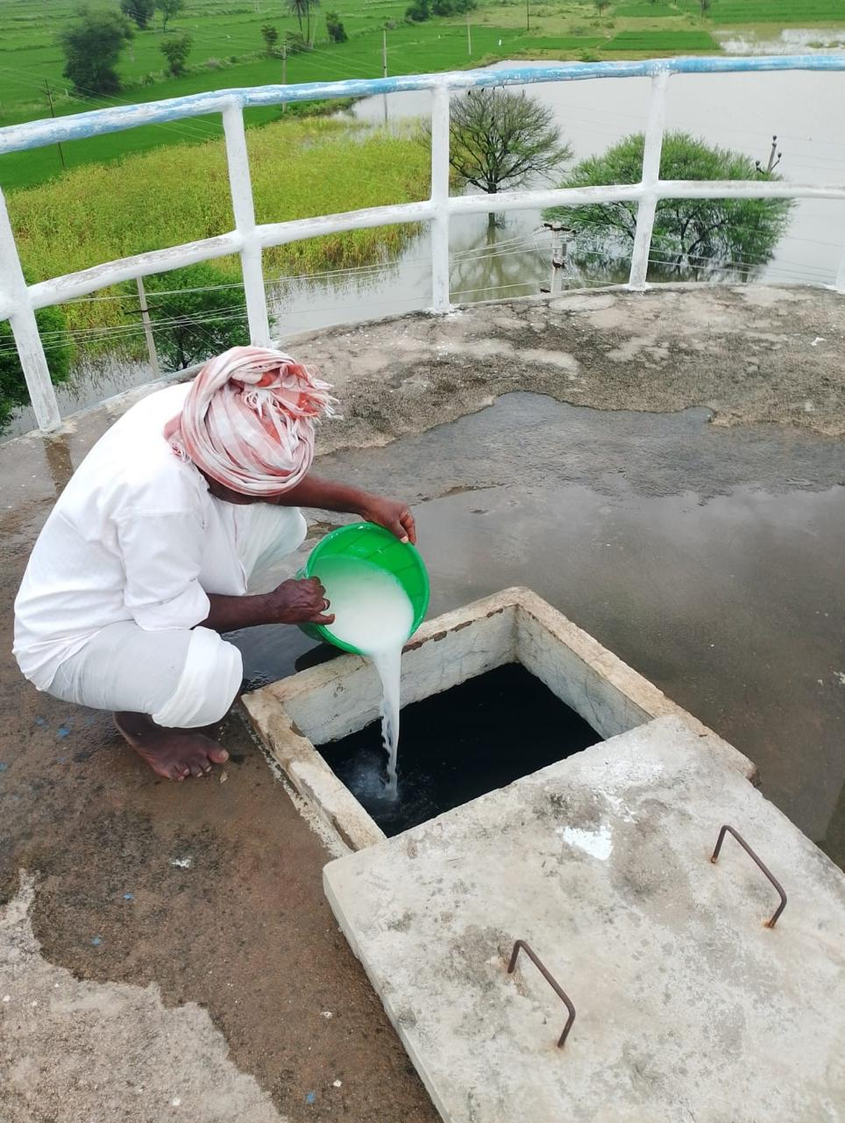
  Regular Chlorination is being taken up for every filling and ensured Residual Chlorine (Rc) within the permissible limits at three levels at Start, middle and at end point of households. The Cleaning of OHSRs are being taken up thrice in a month as per schedule.
Cleaning inside the OHSR with Bleaching Powder
Chlorination for OHSR at Village level

Slide 18
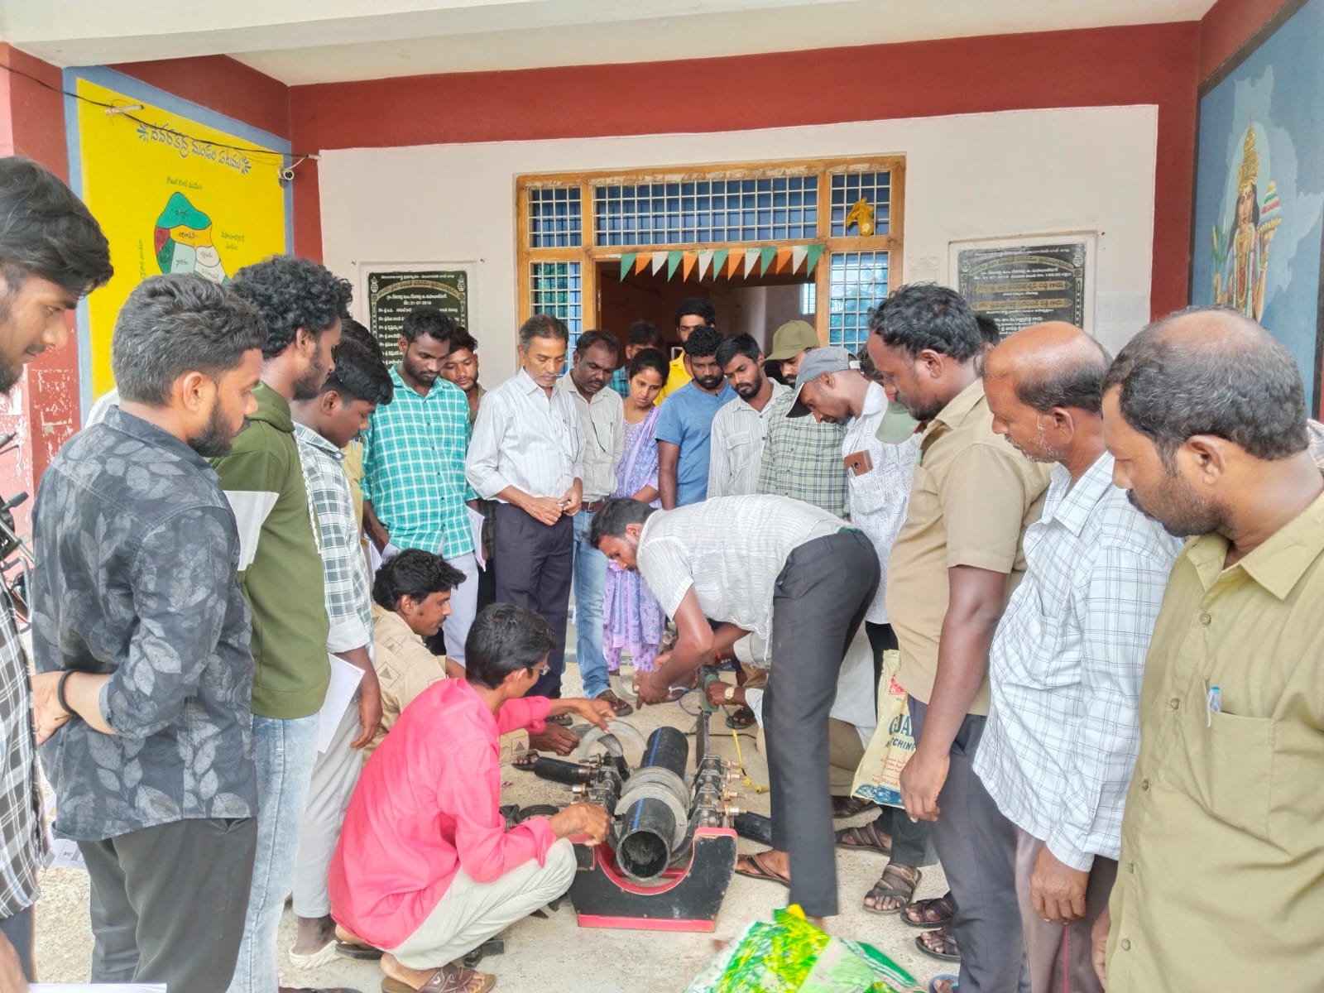
Best Practices - III
Earlier in a village, if any leakage occurred in the Pipeline, there were no skilled jointers to arrest the leakages. The Gram Panchayat used to call the Jointers from towns which are 20 to 30 Km away from the village. As a result, to arrest the minor leakages, it would take 2 to 3 days or week days.
To over come the issue, Mission Bhagiratha organized training programs to all the village watermen who look after distribution of water to households.
Now, the local watermen is arresting the leakages within the same day.

Slide 19
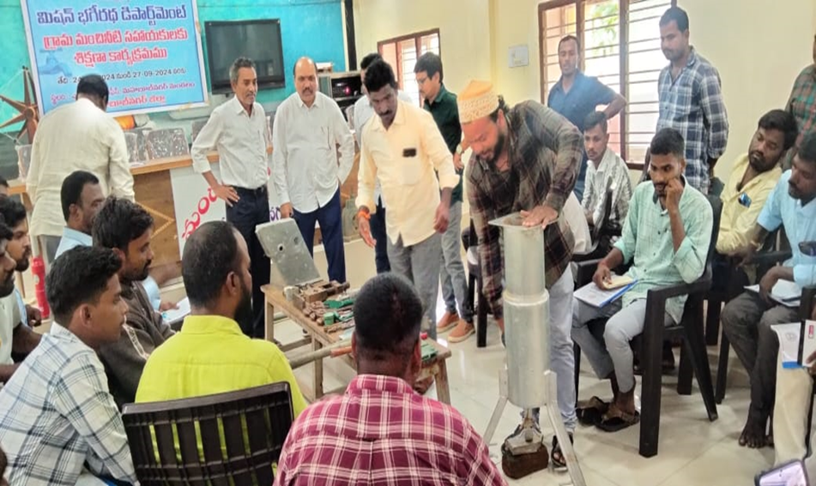
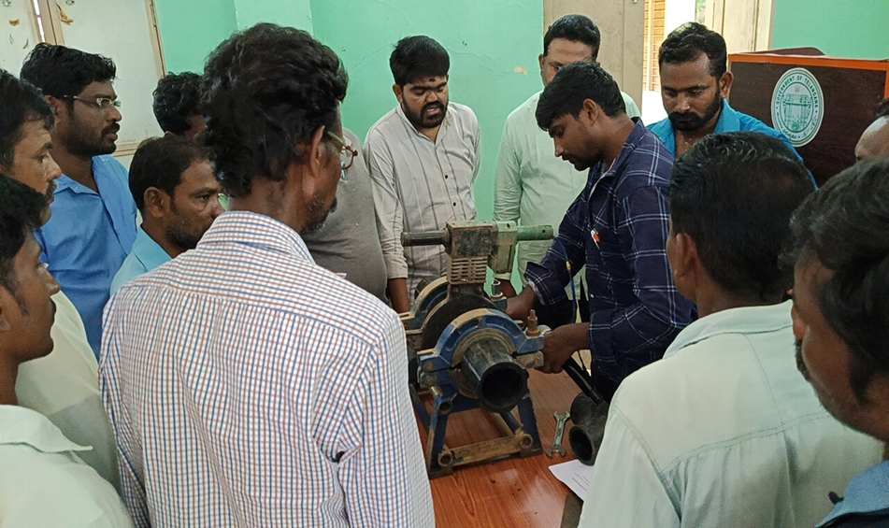
Training to the Water Supply Operators
  The existing waterman/any local person in each Gram Panchayat were identified as ‘Grama Manchineeti Sahayakudu’ and Block level training imparted in following areas
    Hand Pump/Bore well repairs
    Single phase/Three phase motor repairs including panel boards
    HHC tap repairs, Pipeline leakage arrests/ repairs/replacements
    Water Quality awareness
  532 Grama Manchineeti Sahayakulu were trained and equipped with these multi-skills and Certificates issued at District level.

Slide 20
Water Quality Surveillance
Two water quality laboratories are working in the district. One lab is functioning at District Headquarters at Mahabubnagar and is accredited by the NABL.
Quality of water supply made is assured by testing with Chloroscope for Residual Chlorine at GP level. WQMS Labs established are also monitoring periodically the quality of water supply made.
250 samples for Chemical analysis and 50 samples for Bacteriological analysis collected in a month and tests are conducted at the labs.
As a part of remedial measure, if any Bacteriological contamination is noticed, Chlorination is being taken up for OHSRs at Village level to ensure quality of drinking water.

Slide 21
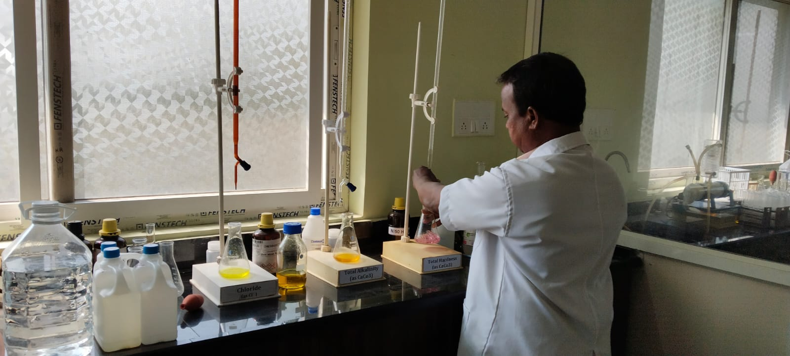
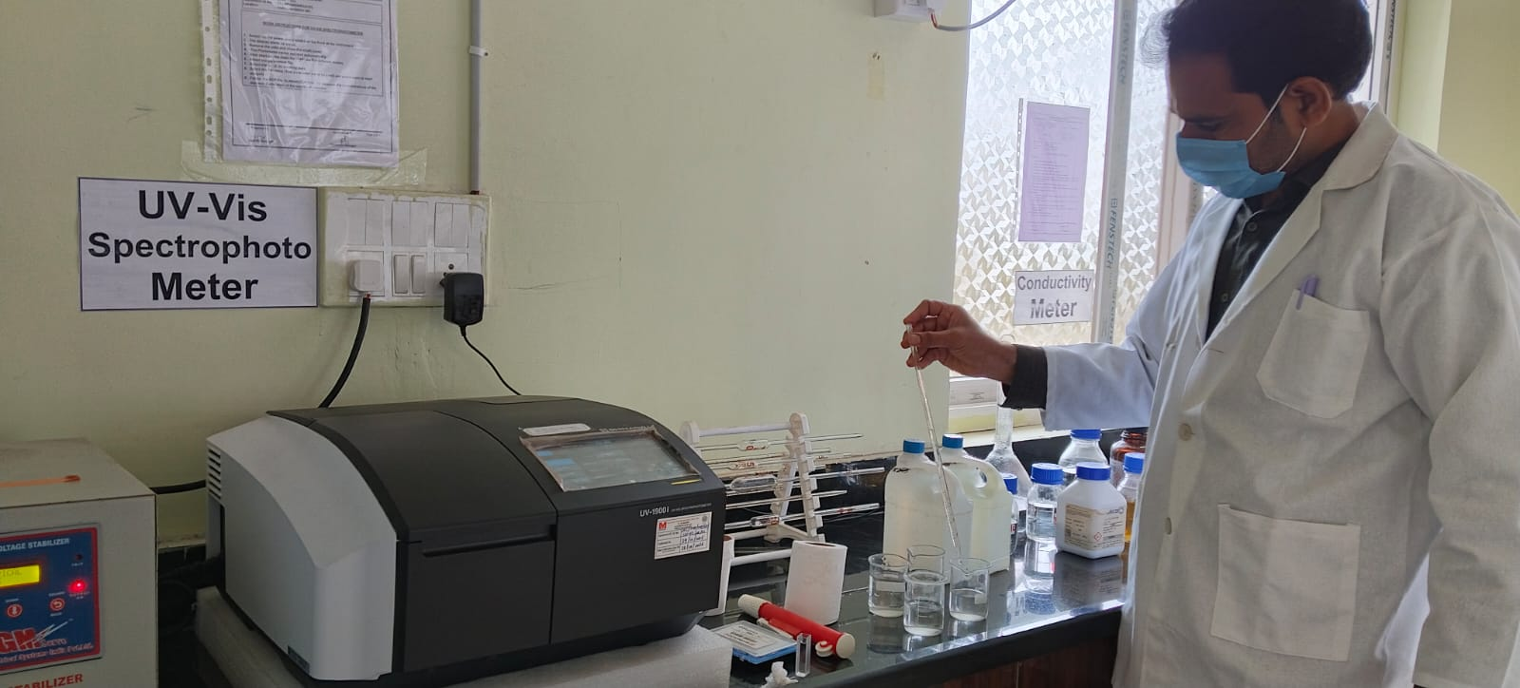
Alkalinity, hardness & Chloride test
Fluoride, Iron, Nitrate & Sulphate Test

Slide 22
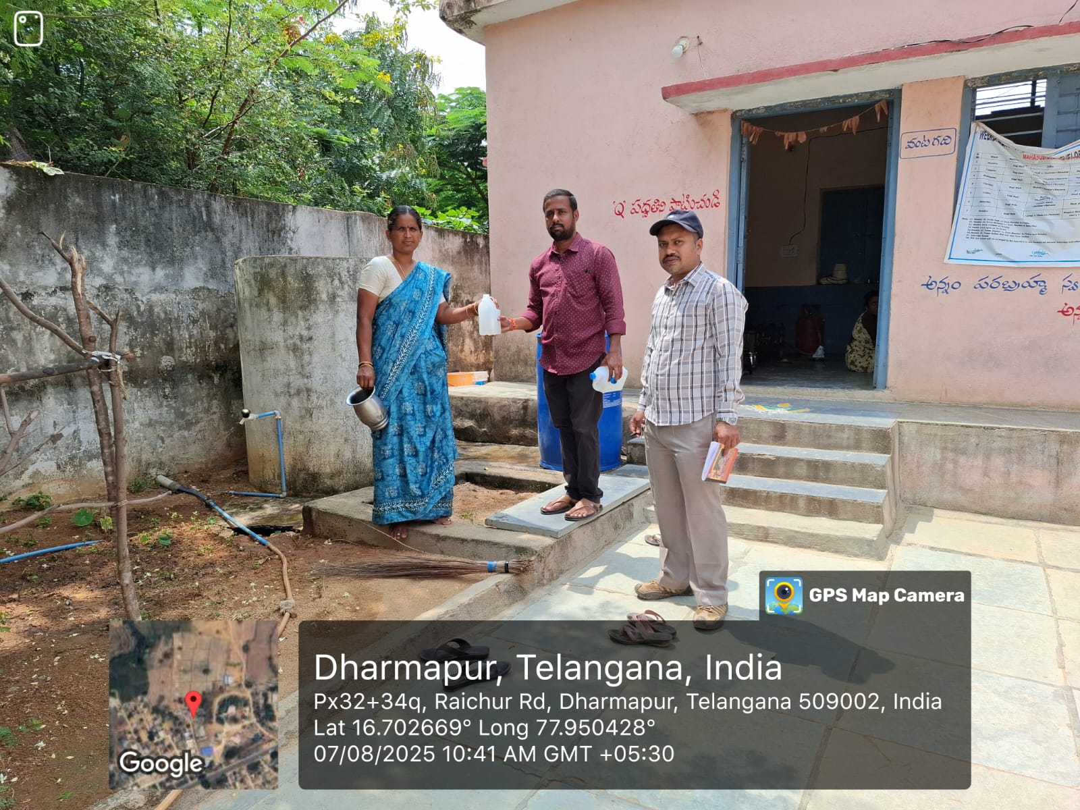
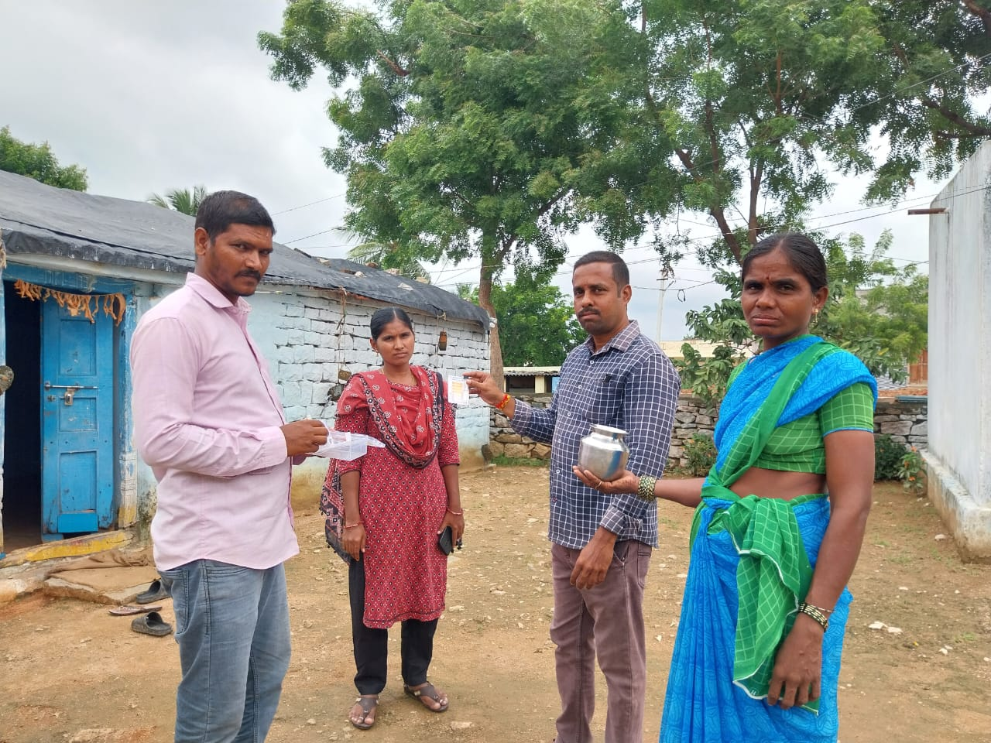
Drinking water sample collection
Residual Chlorine test at Household level

Slide 23
Public Grievance Redressal System
Grievances received in CPGRAMS portal are monitored and addressed on top priority.
Grievances received in CM & District Prajavani Monitoring System are also being monitored.
All grievances raised on social networking platforms are being redressed immediately.
Grievance register is being maintained at each Gram Panchayat office.
Contact numbers of the field staff are displayed at GP offices to contact for any Grievance.
Print media adverse news items are also being monitored and resolved
Exclusive wing at State level to monitor all grievances on daily basis with special drive.
Existing 24x7 Call center i.e. Toll Free No: 1916 are monitored daily and resolved on top priority.

Slide 24
PM Gati Shakti
Sl. | District | Mandal | No.of Habs | Total Network (Km) | Digitized Length (Km) | % Completed
1 | Mahabubnagar | Addakal | 23 | 86.128 | 86.128 | 100%
2 | Mahabubnagar | Balanagar | 103 | 150.832 | 150.832 | 100%
3 | Mahabubnagar | Bhoothpur | 33 | 82.922 | 82.922 | 100%
4 | Mahabubnagar | CC Kunta | 27 | 103.720 | 103.720 | 100%
5 | Mahabubnagar | Devarkadra | 23 | 86.099 | 86.099 | 100%
6 | Mahabubnagar | Gandeed | 49 | 126.550 | 126.550 | 100%
7 | Mahabubnagar | Hunwada | 78 | 102.451 | 102.451 | 100%
8 | Mahabubnagar | Jadcherla | 80 | 128.119 | 128.119 | 100%
9 | Mahabubnagar | Koilkonda | 111 | 171.422 | 171.422 | 100%
10 | Mahabubnagar | Koukuntla | 14 | 51.100 | 51.100 | 100%
11 | Mahabubnagar | Mahabubnagar (Rural) | 45 | 125.044 | 125.044 | 100%
12 | Mahabubnagar | Midjil | 38 | 94.872 | 94.872 | 100%
13 | Mahabubnagar | Mohammadabad | 56 | 119.630 | 119.630 | 100%
14 | Mahabubnagar | Moosapet | 19 | 66.263 | 66.263 | 100%
15 | Mahabubnagar | Nawabpet | 80 | 169.808 | 169.808 | 100%
16 | Mahabubnagar | Rajapur | 63 | 99.816 | 99.816 | 100%
 | Total |  | 842 | 1764.777 | 1764.777 | 100%

Slide 25
Thank You

