Slide 1
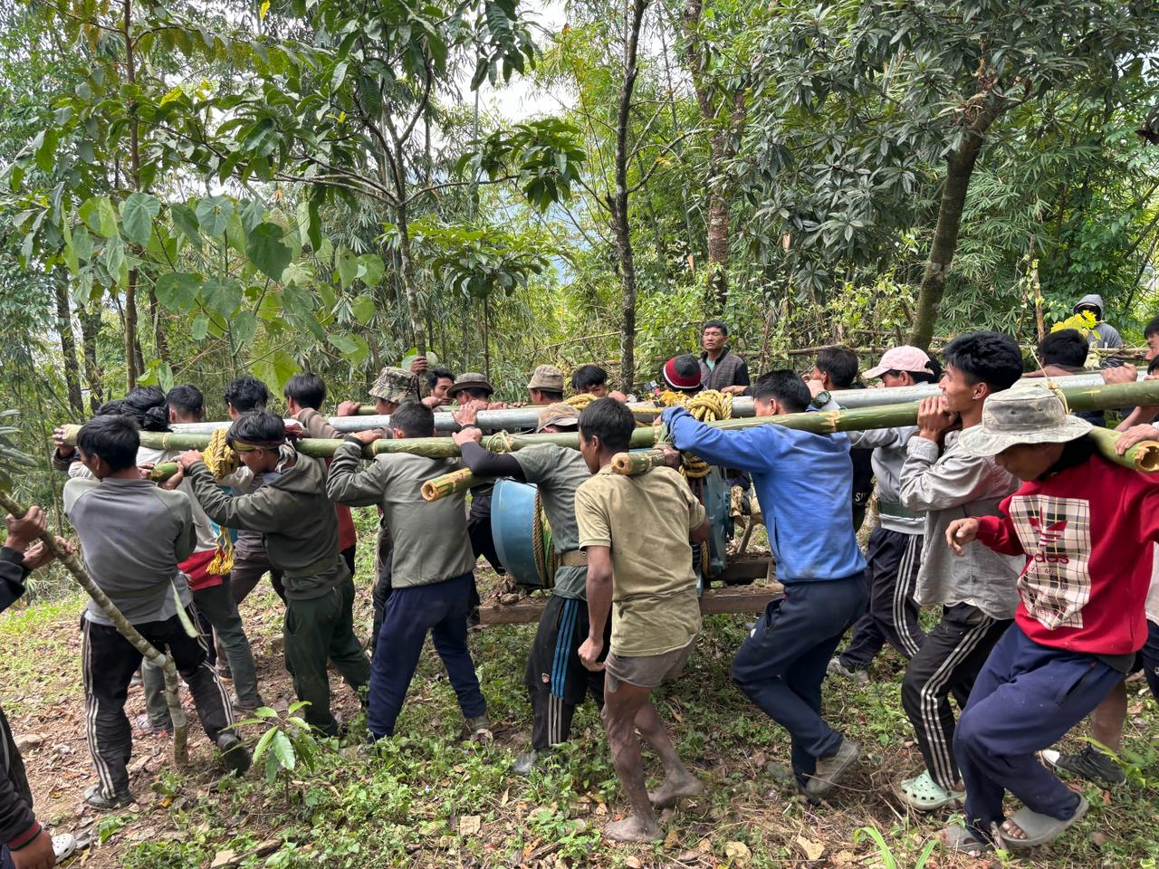
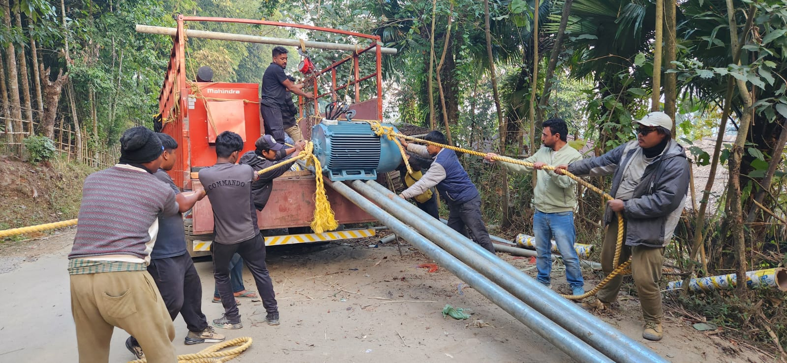
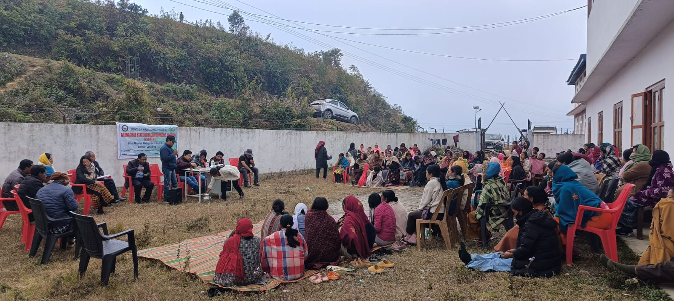
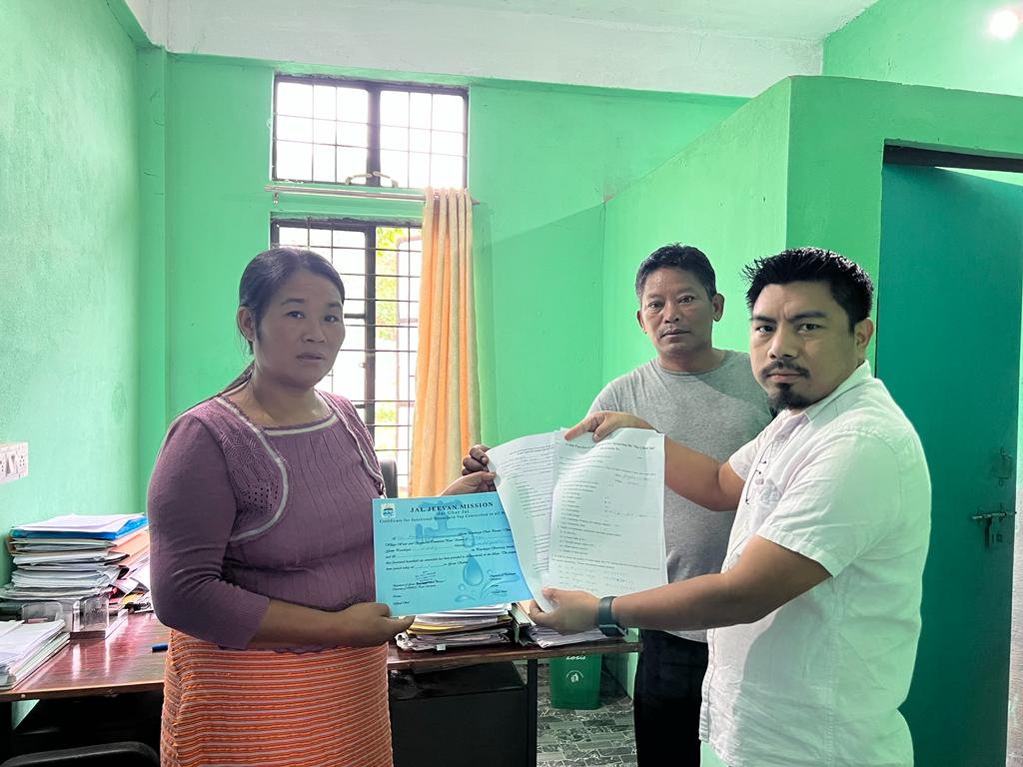
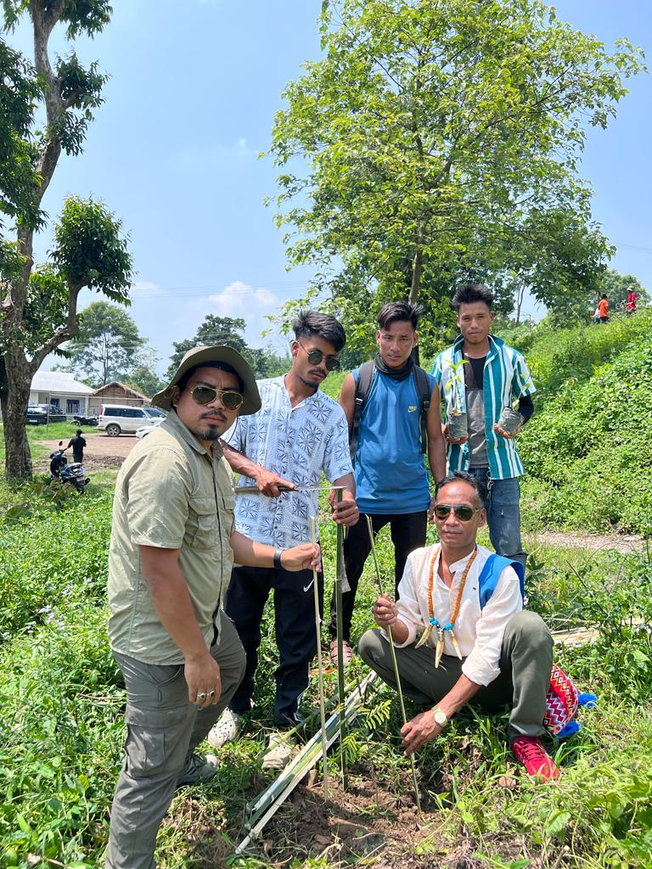
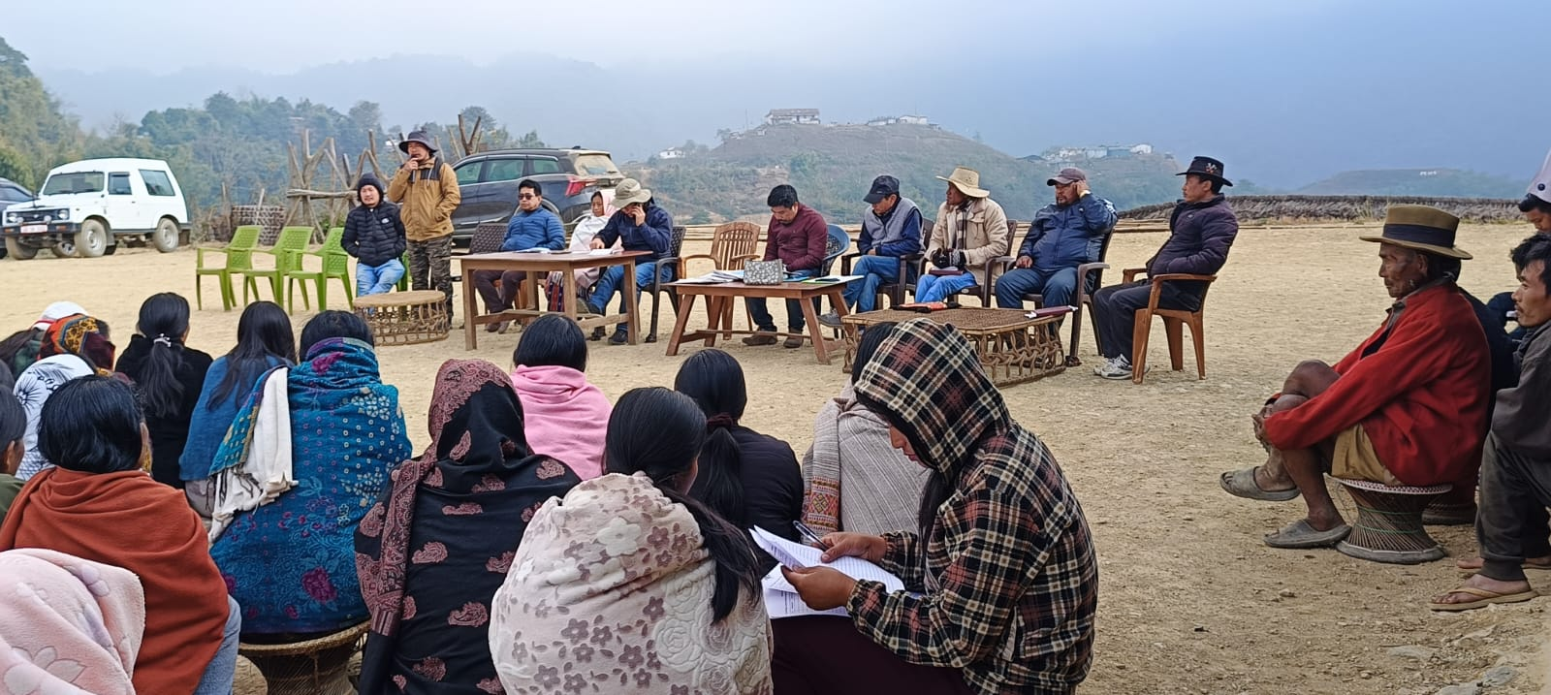
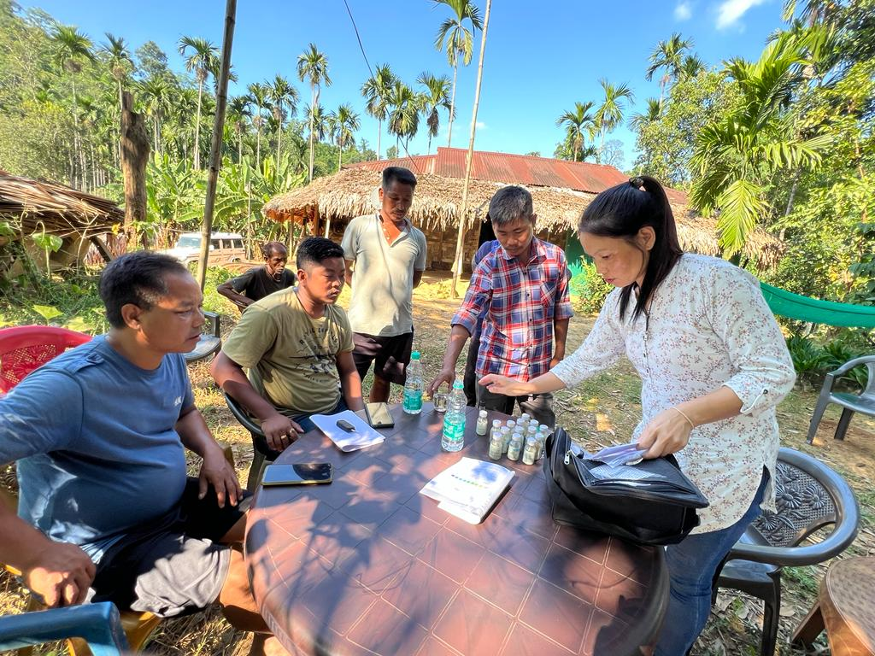
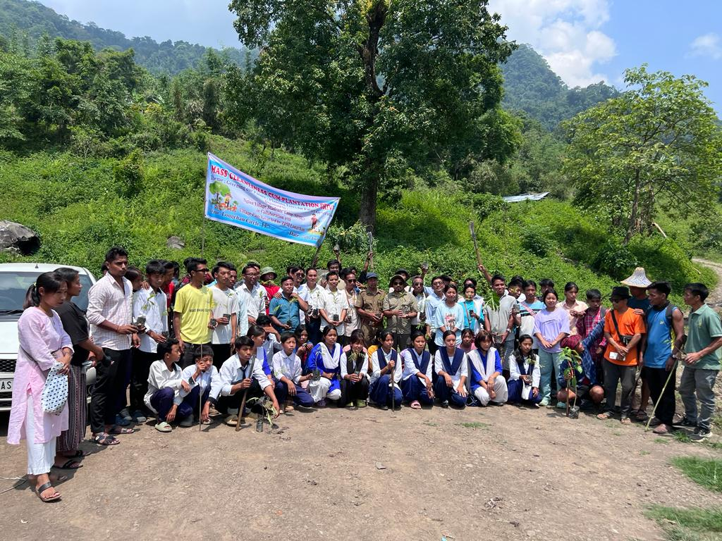
Peyjal Samvad Venue: DC conference hall Date:- 17/02/2026

Slide 2

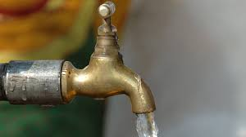
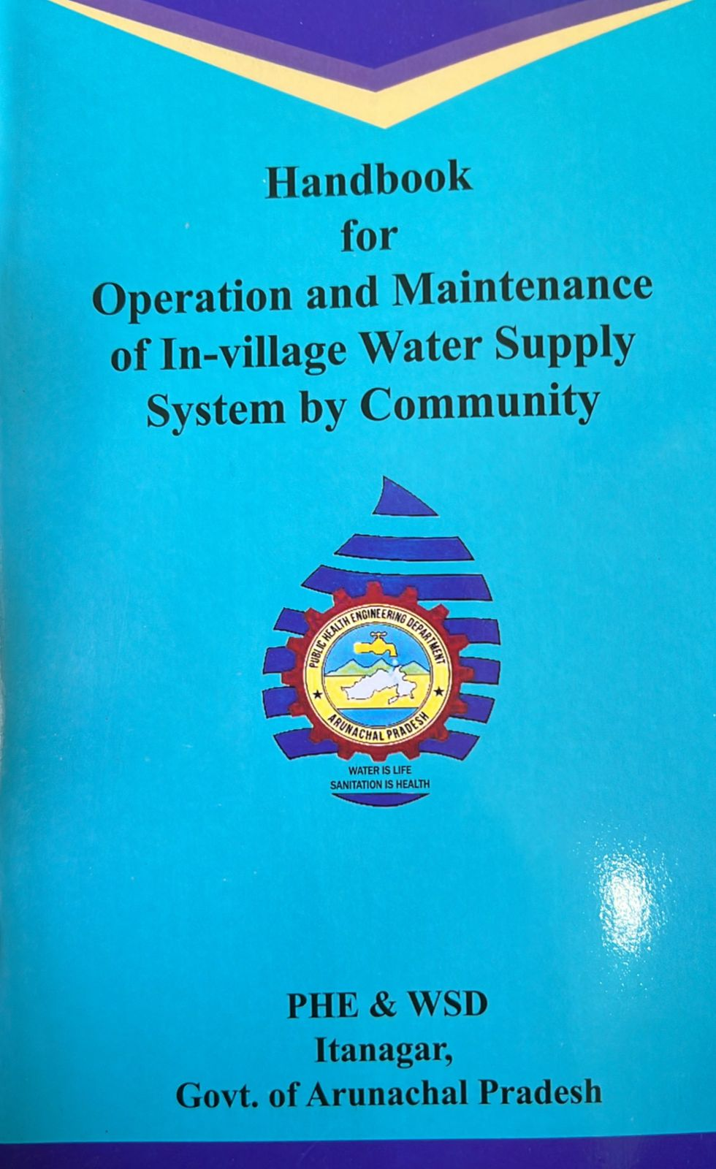




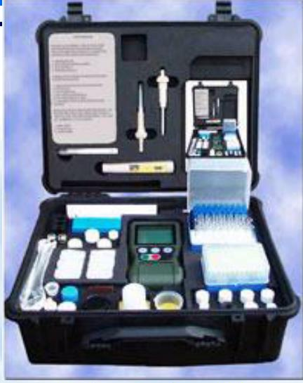



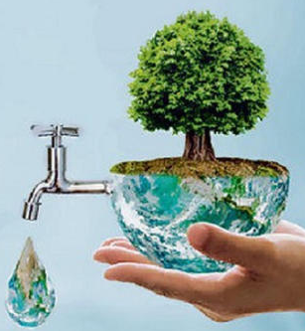



Best Practices in following areas
DWSM Monitoring and implementation
DWSM Monitoring and implementation
DWSM Best practices
DWSM issuance of protocols for handing over
DWSM may present any initiative for effective water quality surveillance
Community Participation of VWSC
DWSM effective IEC plan
DWSM issuance of protocols for handing over
DWSM best practice in real time
DWSM source sustenance plans.
DWSM initiatives in engaging SHGs/PACS
DWSM initiatives in engaging SHGs/PACS
DWSM effective IEC plan
Water Quality testing by VWSC members
DWSM may present any initiative for effective water quality surveillance
DWSM best practice in real time
DWSM Best practices
DWSM source sustenance plans.
Vision
Every rural household shall have assured drinking water supply in adequate quantity of prescribed quality on regular and long-term basis at affordable service delivery charges leading to improvement in living standards of rural communities.
Water Tariff collection by VWSC members

Slide 3
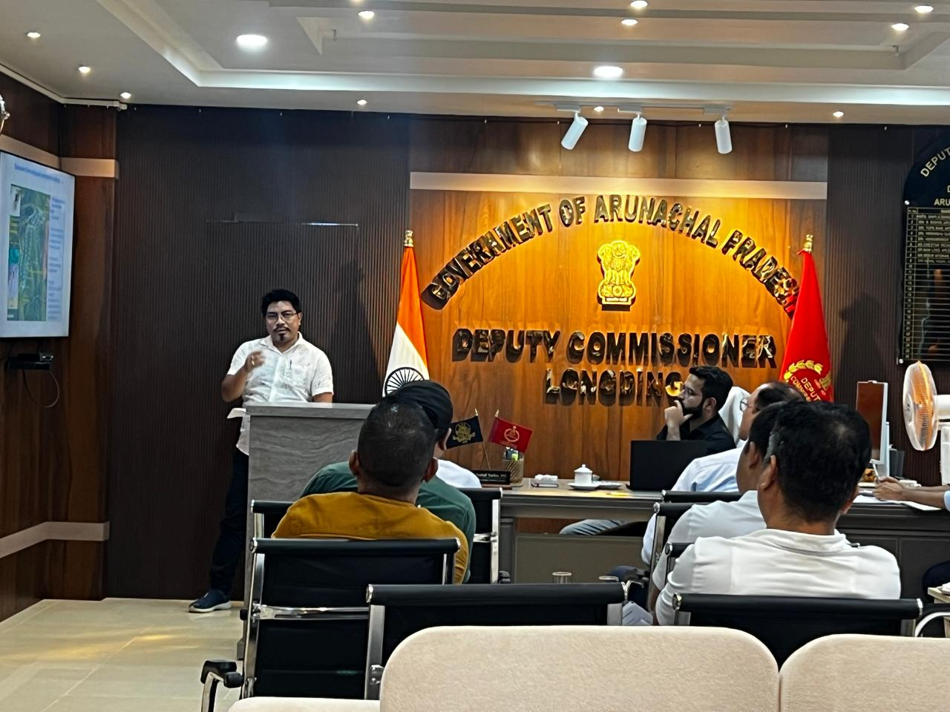
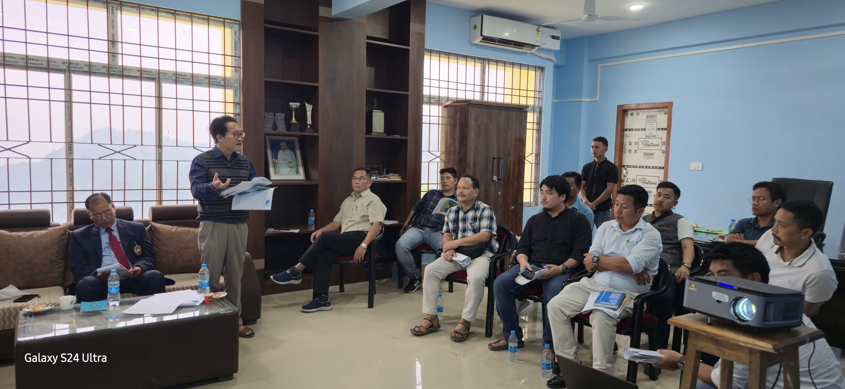
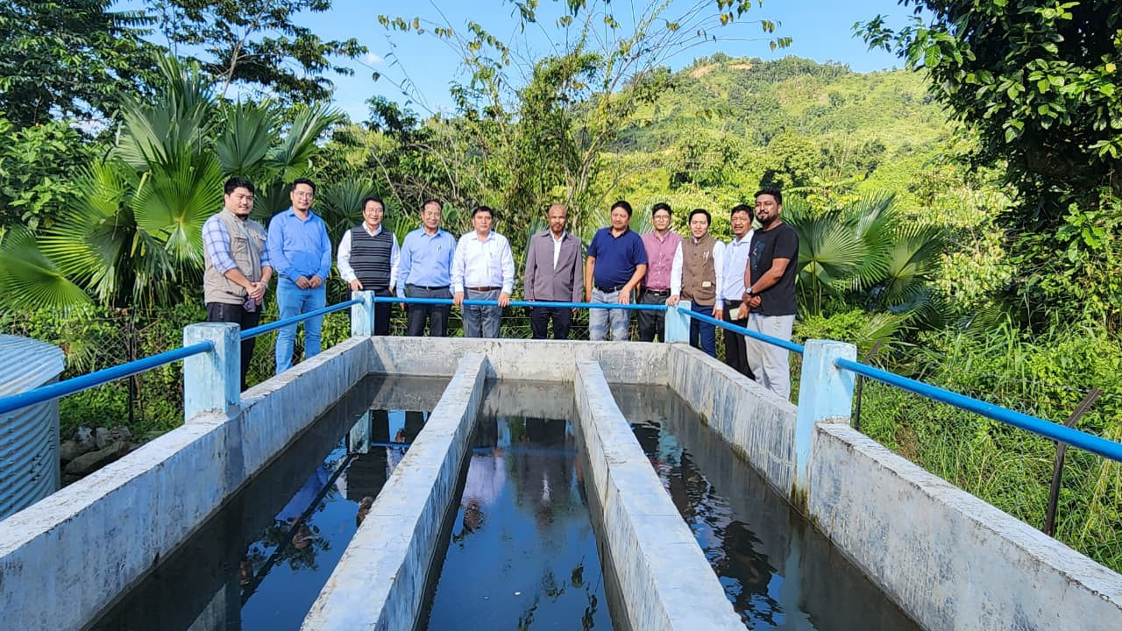
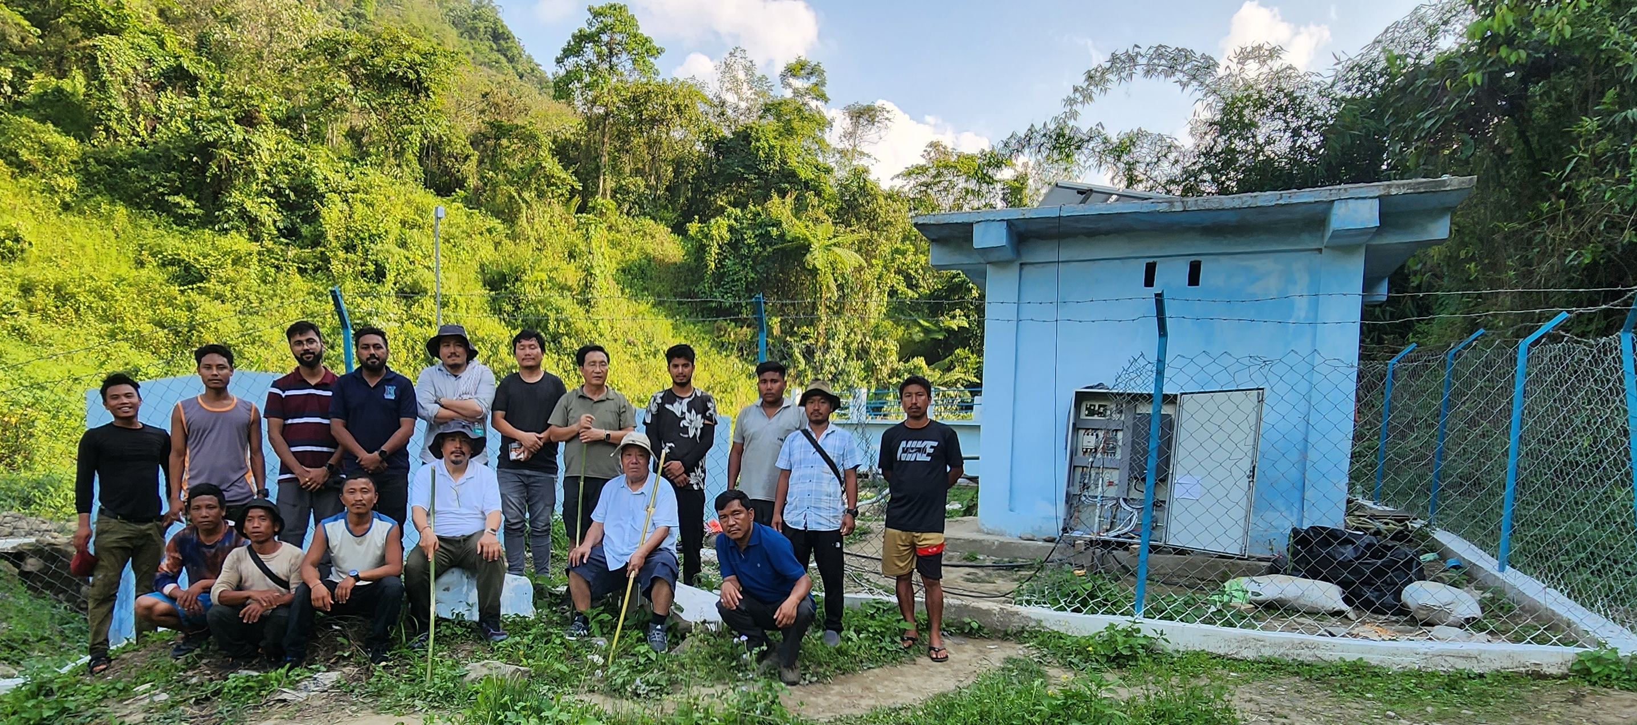
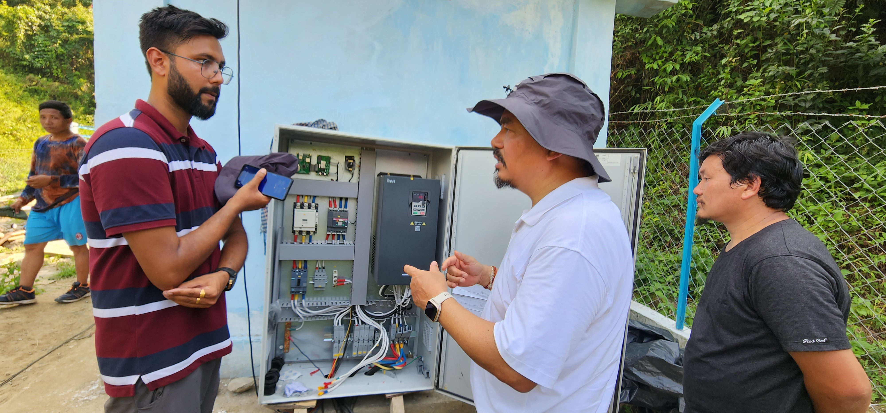
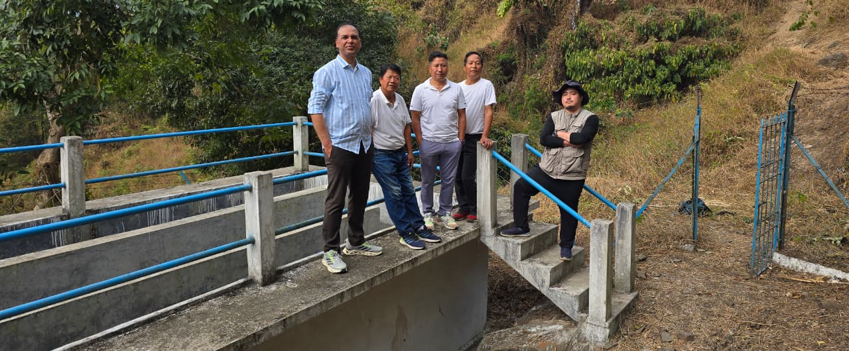
DWSM monitoring and implementation
District Action Plan
Source: Field observation by author
Timely DWSM meeting
Site Visit

Slide 4
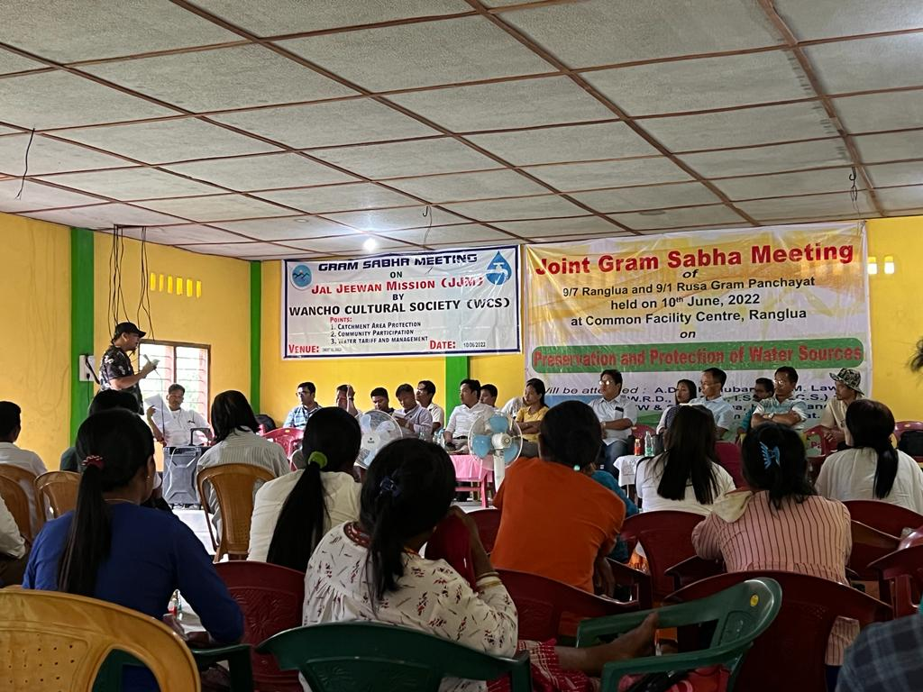
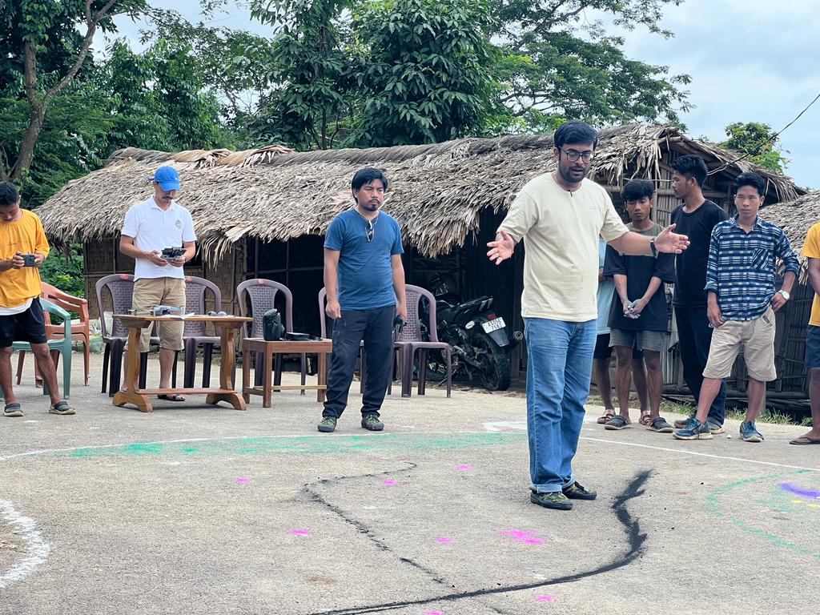
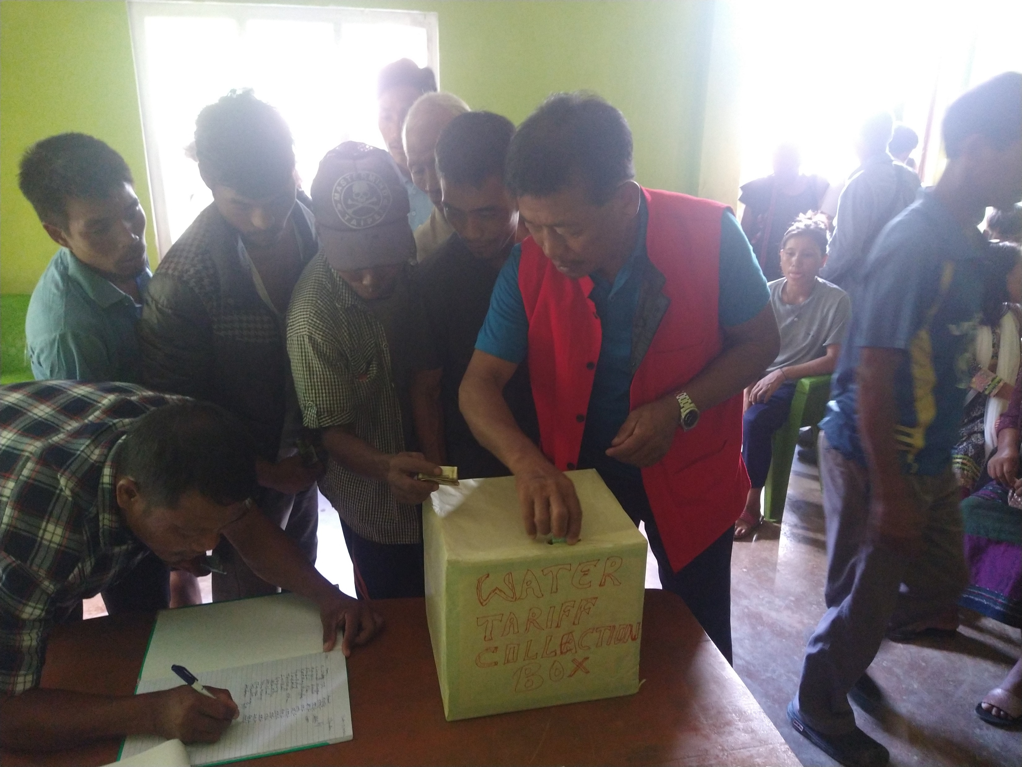

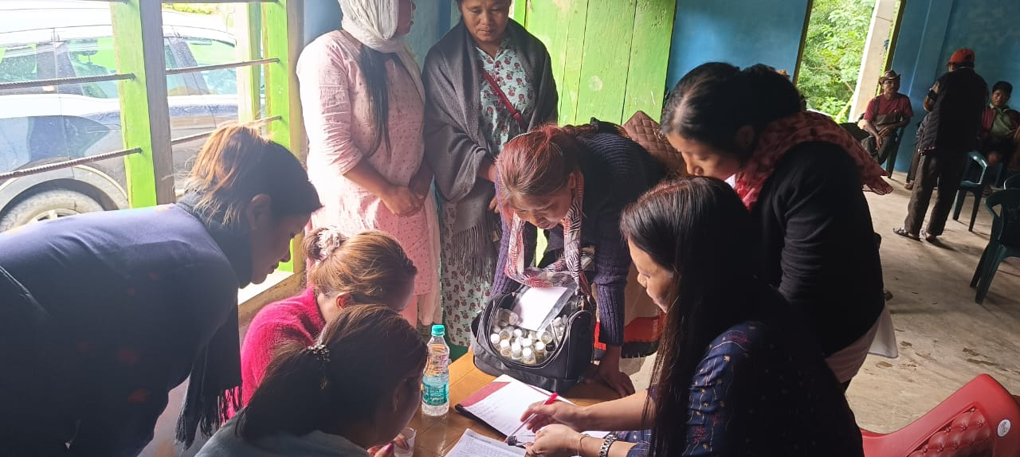
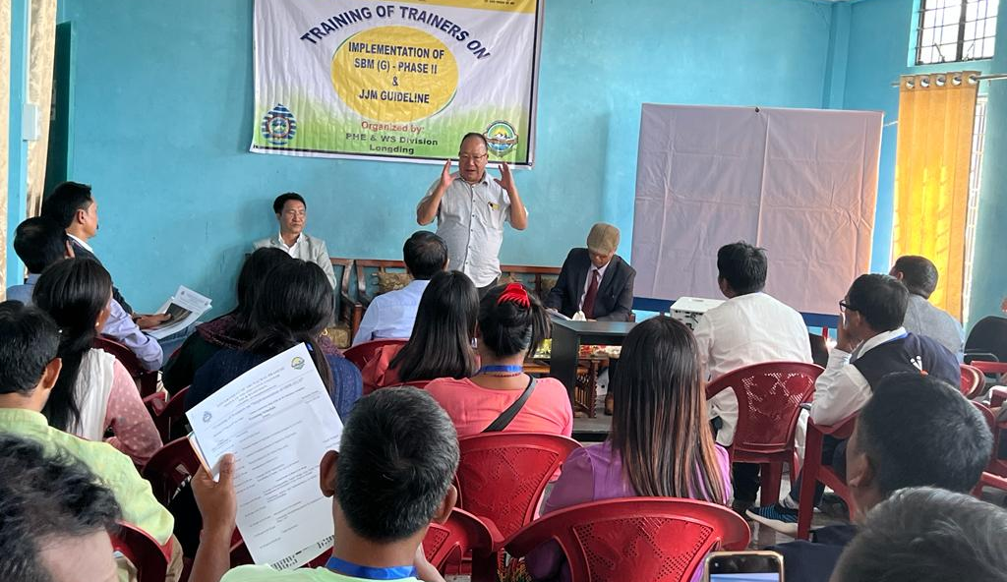


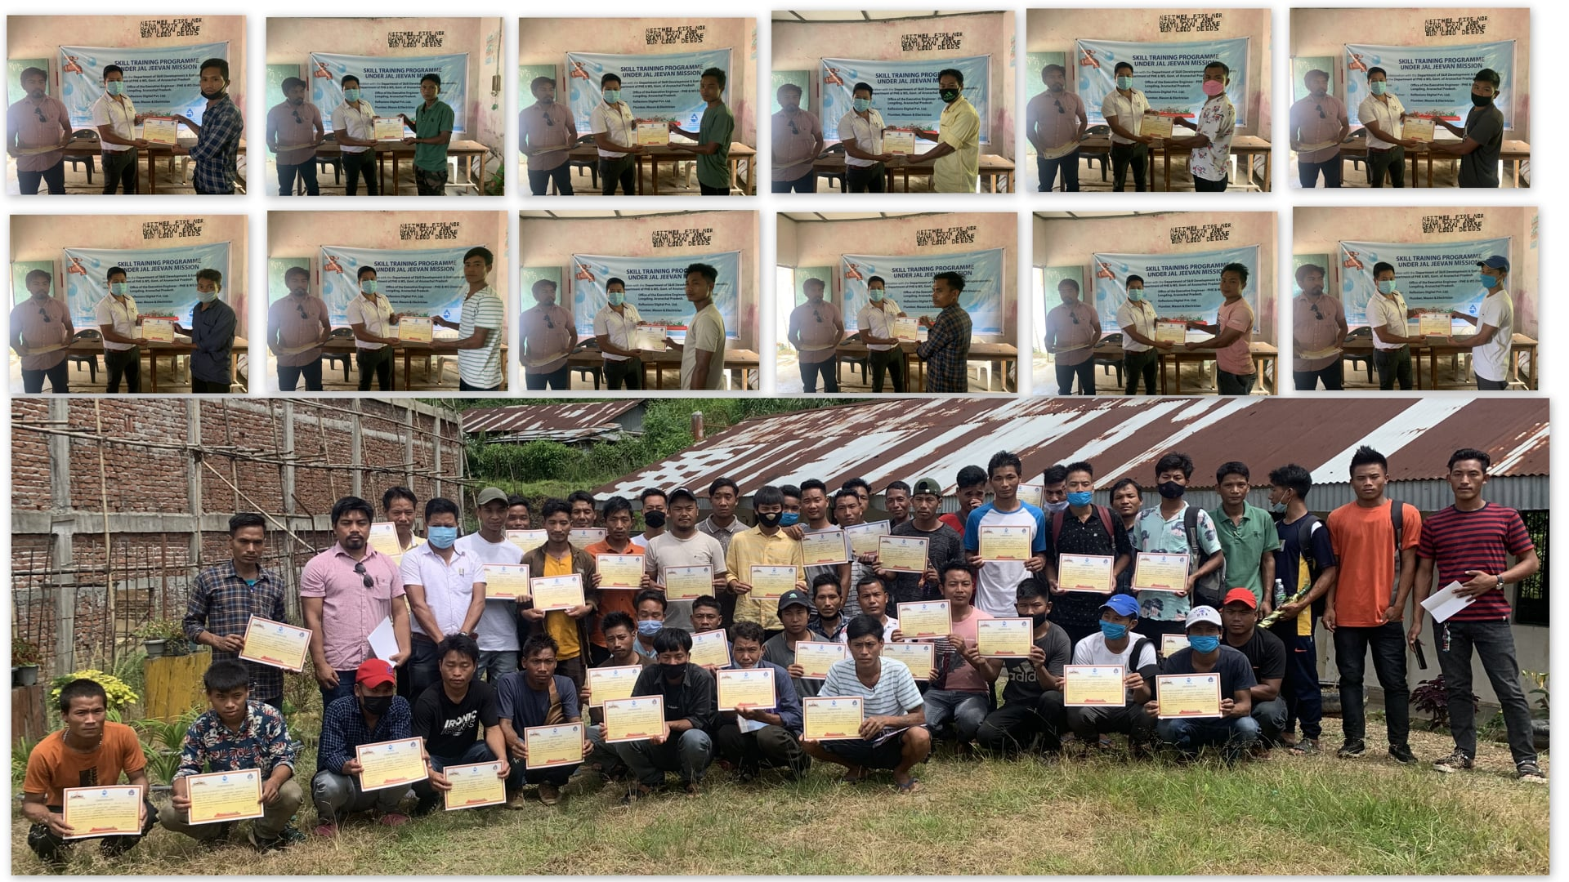
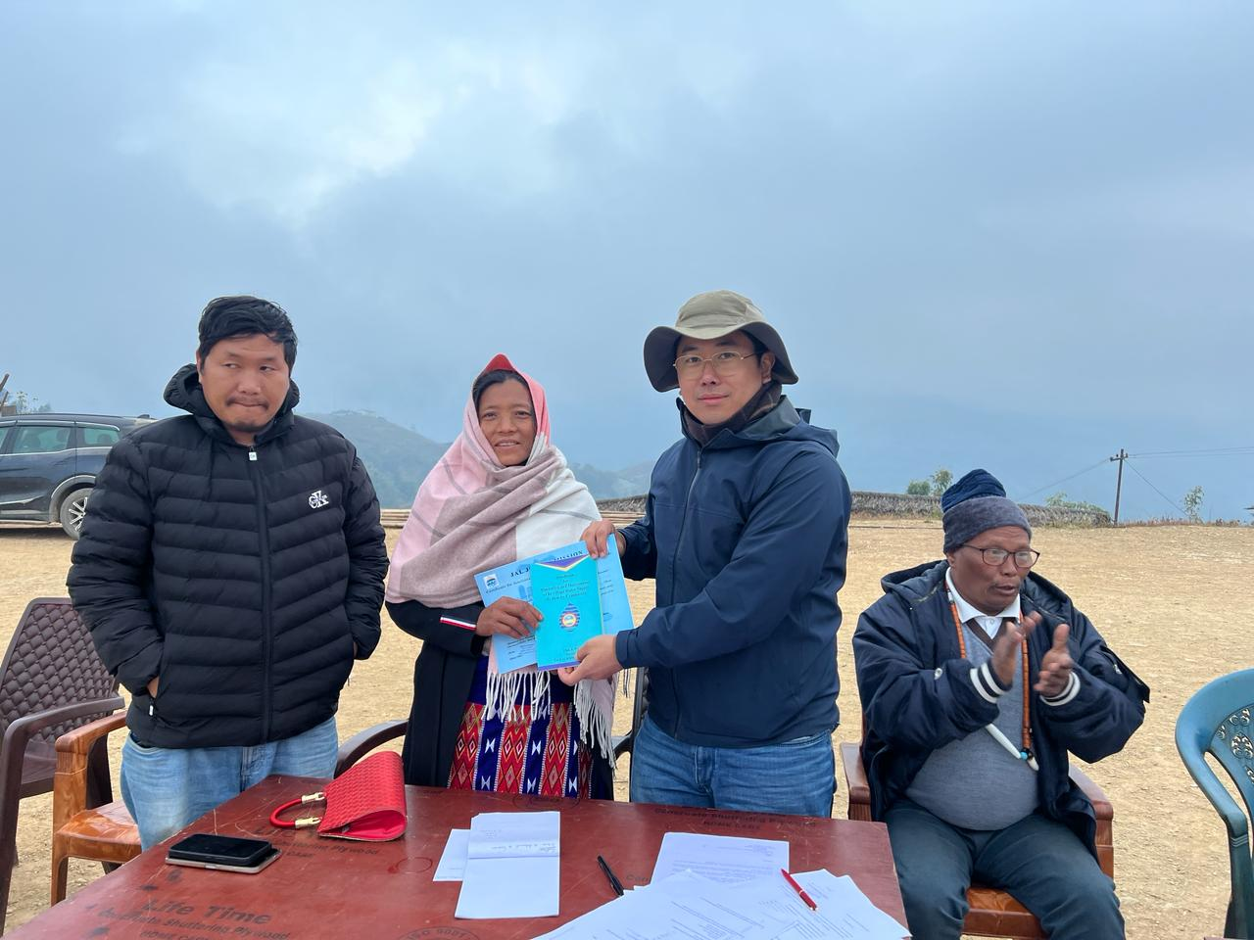
DWSM issuance of protocols for handing over on in village Water Supply assets
Key Indicators
IEC/BCC programs
Village level Gram Sabha activities
PRA activities on Jal Jeevan Mission
Water Tariff collection
Gram Sabha & PRA activities
Capacity building training of VWSC
Training of Plumber & Mason
FTK training of women groups
Training of trainers of VWSC
Water Tariff collection and FTK training
Handing of handbook for operation and maintenance of in village supply system
Training of Plumbers & Masons
Handing over of Har Ghar Jal Certificate & Handbook of O&M of water supply assets

Slide 5
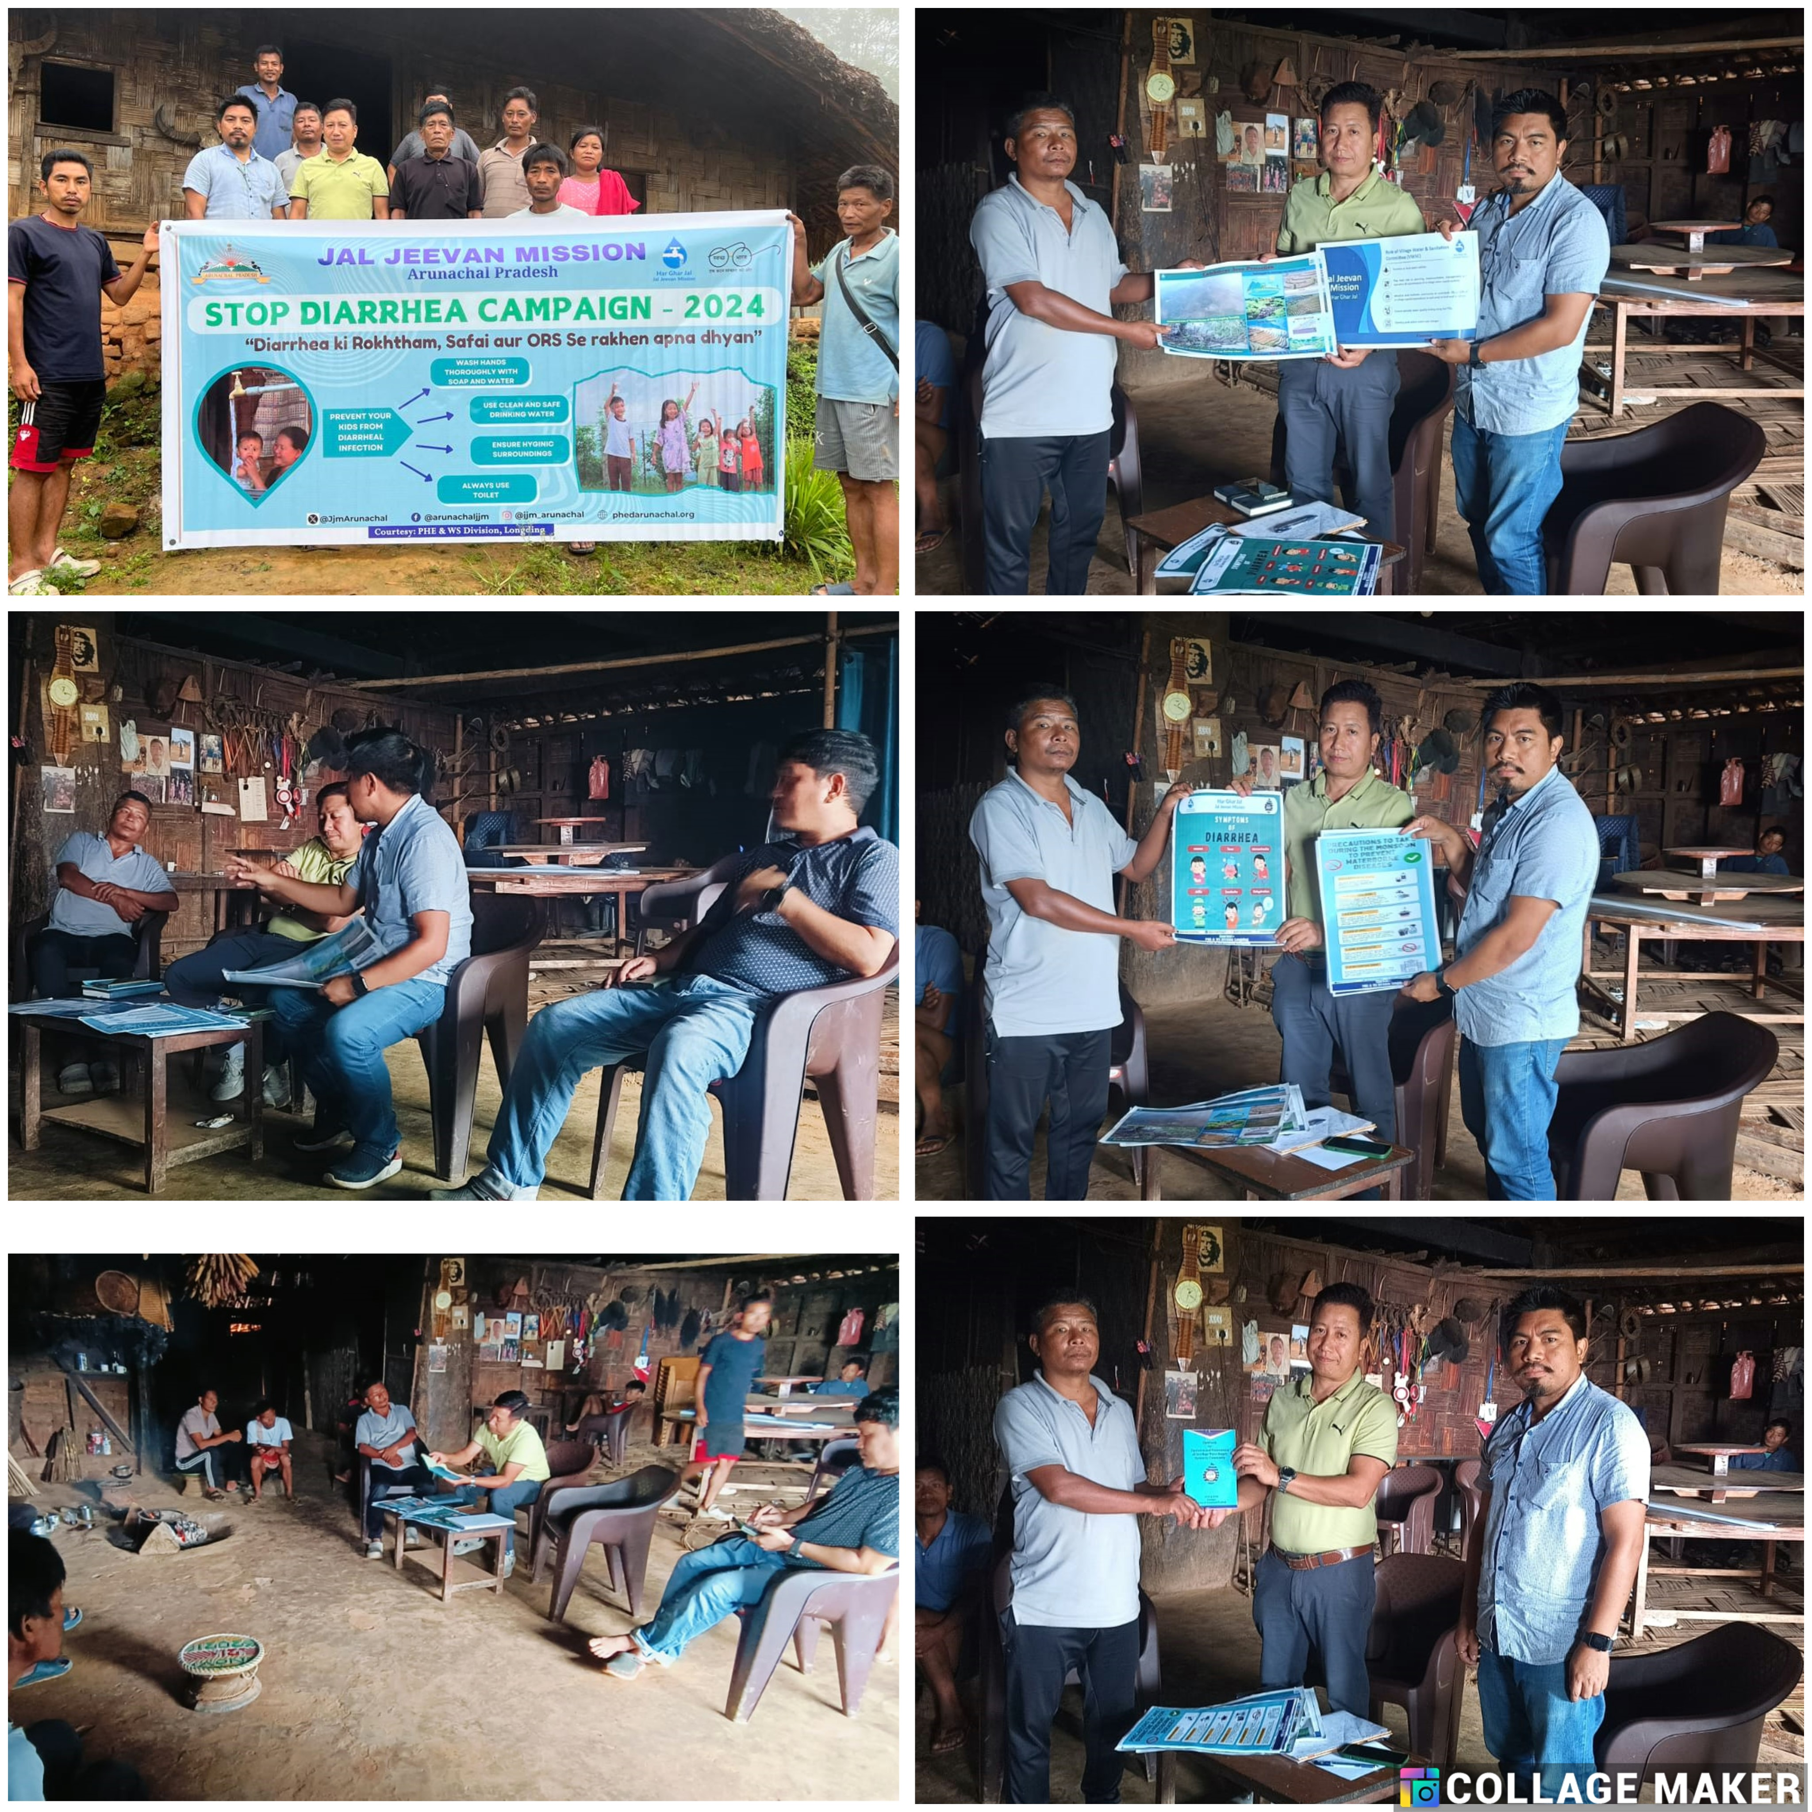
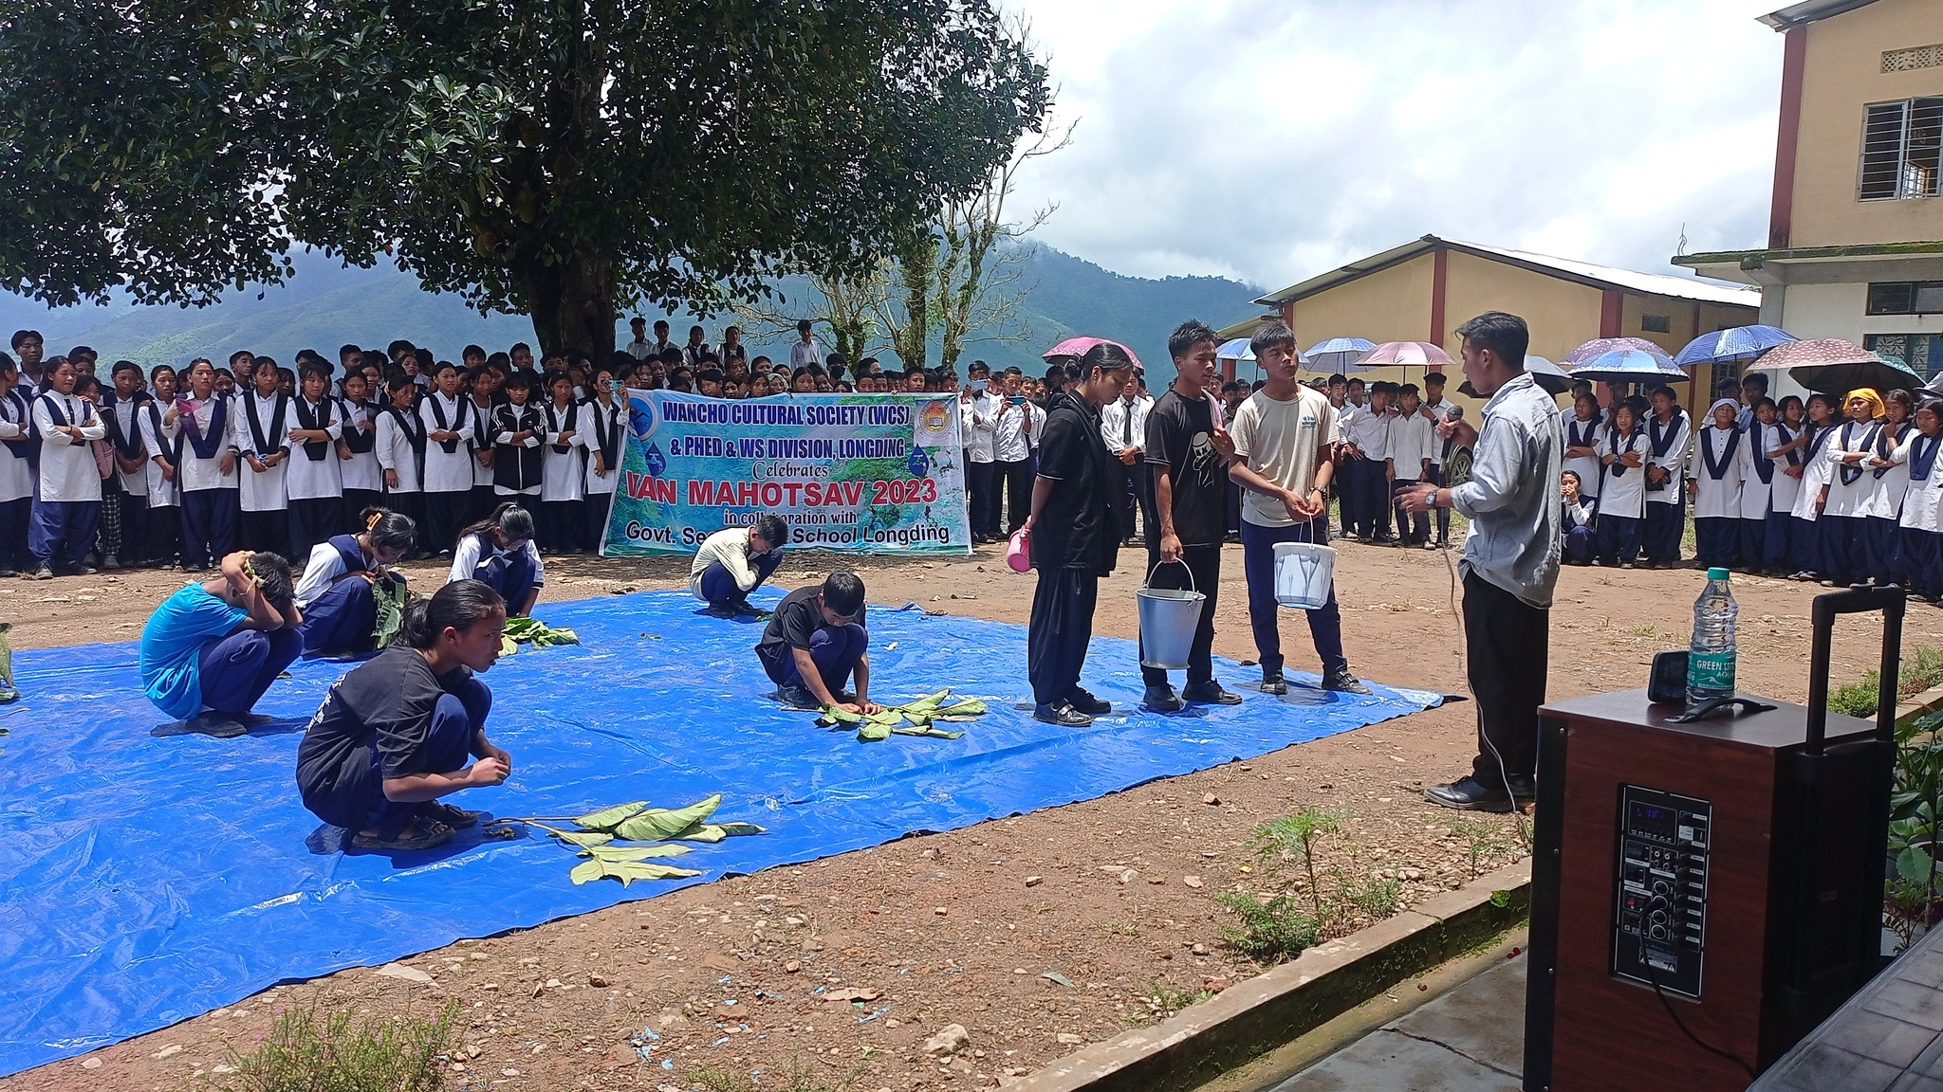
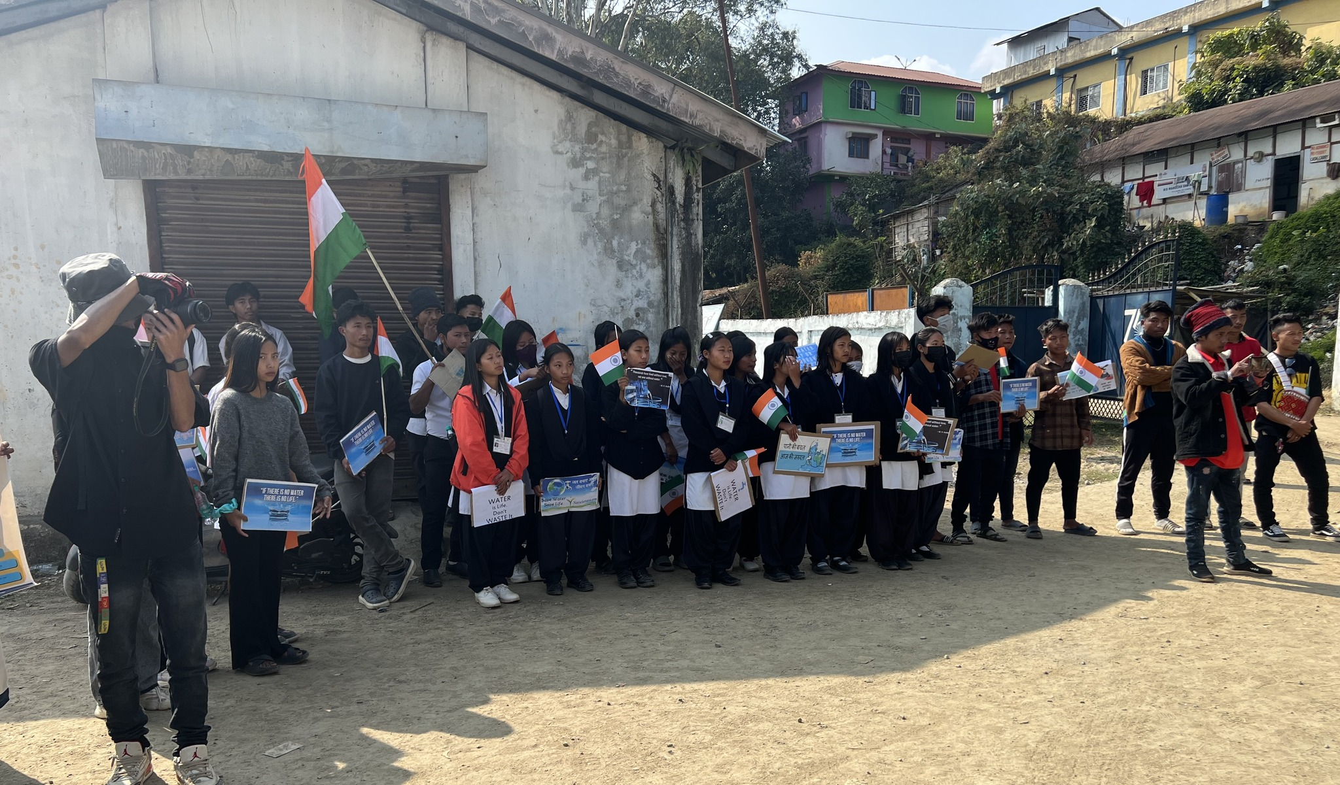
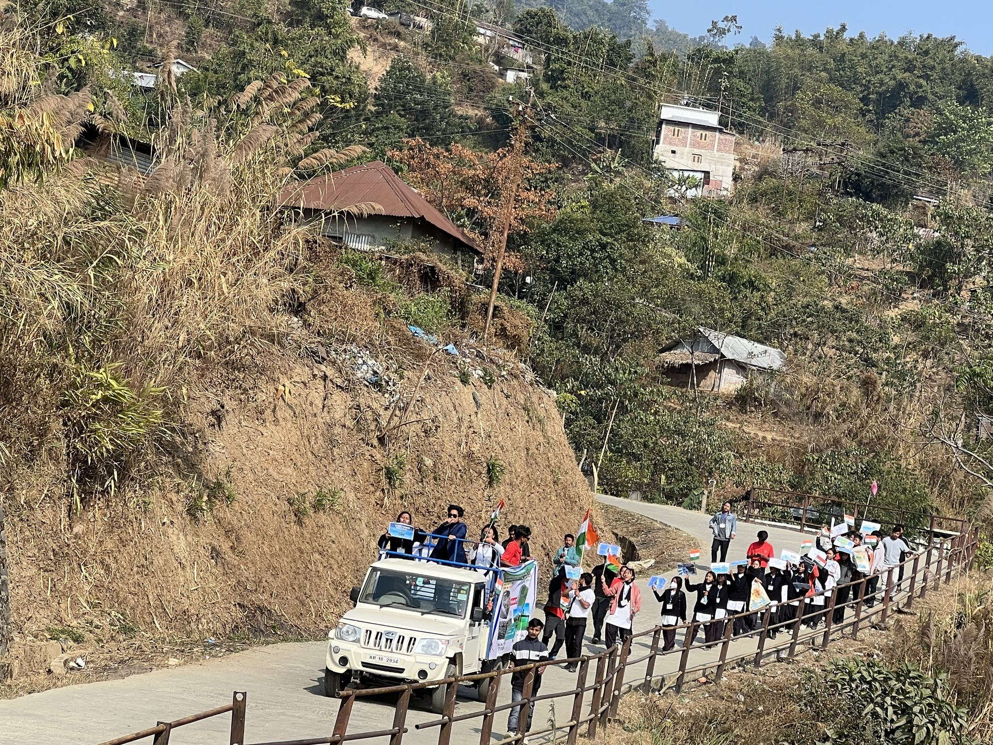
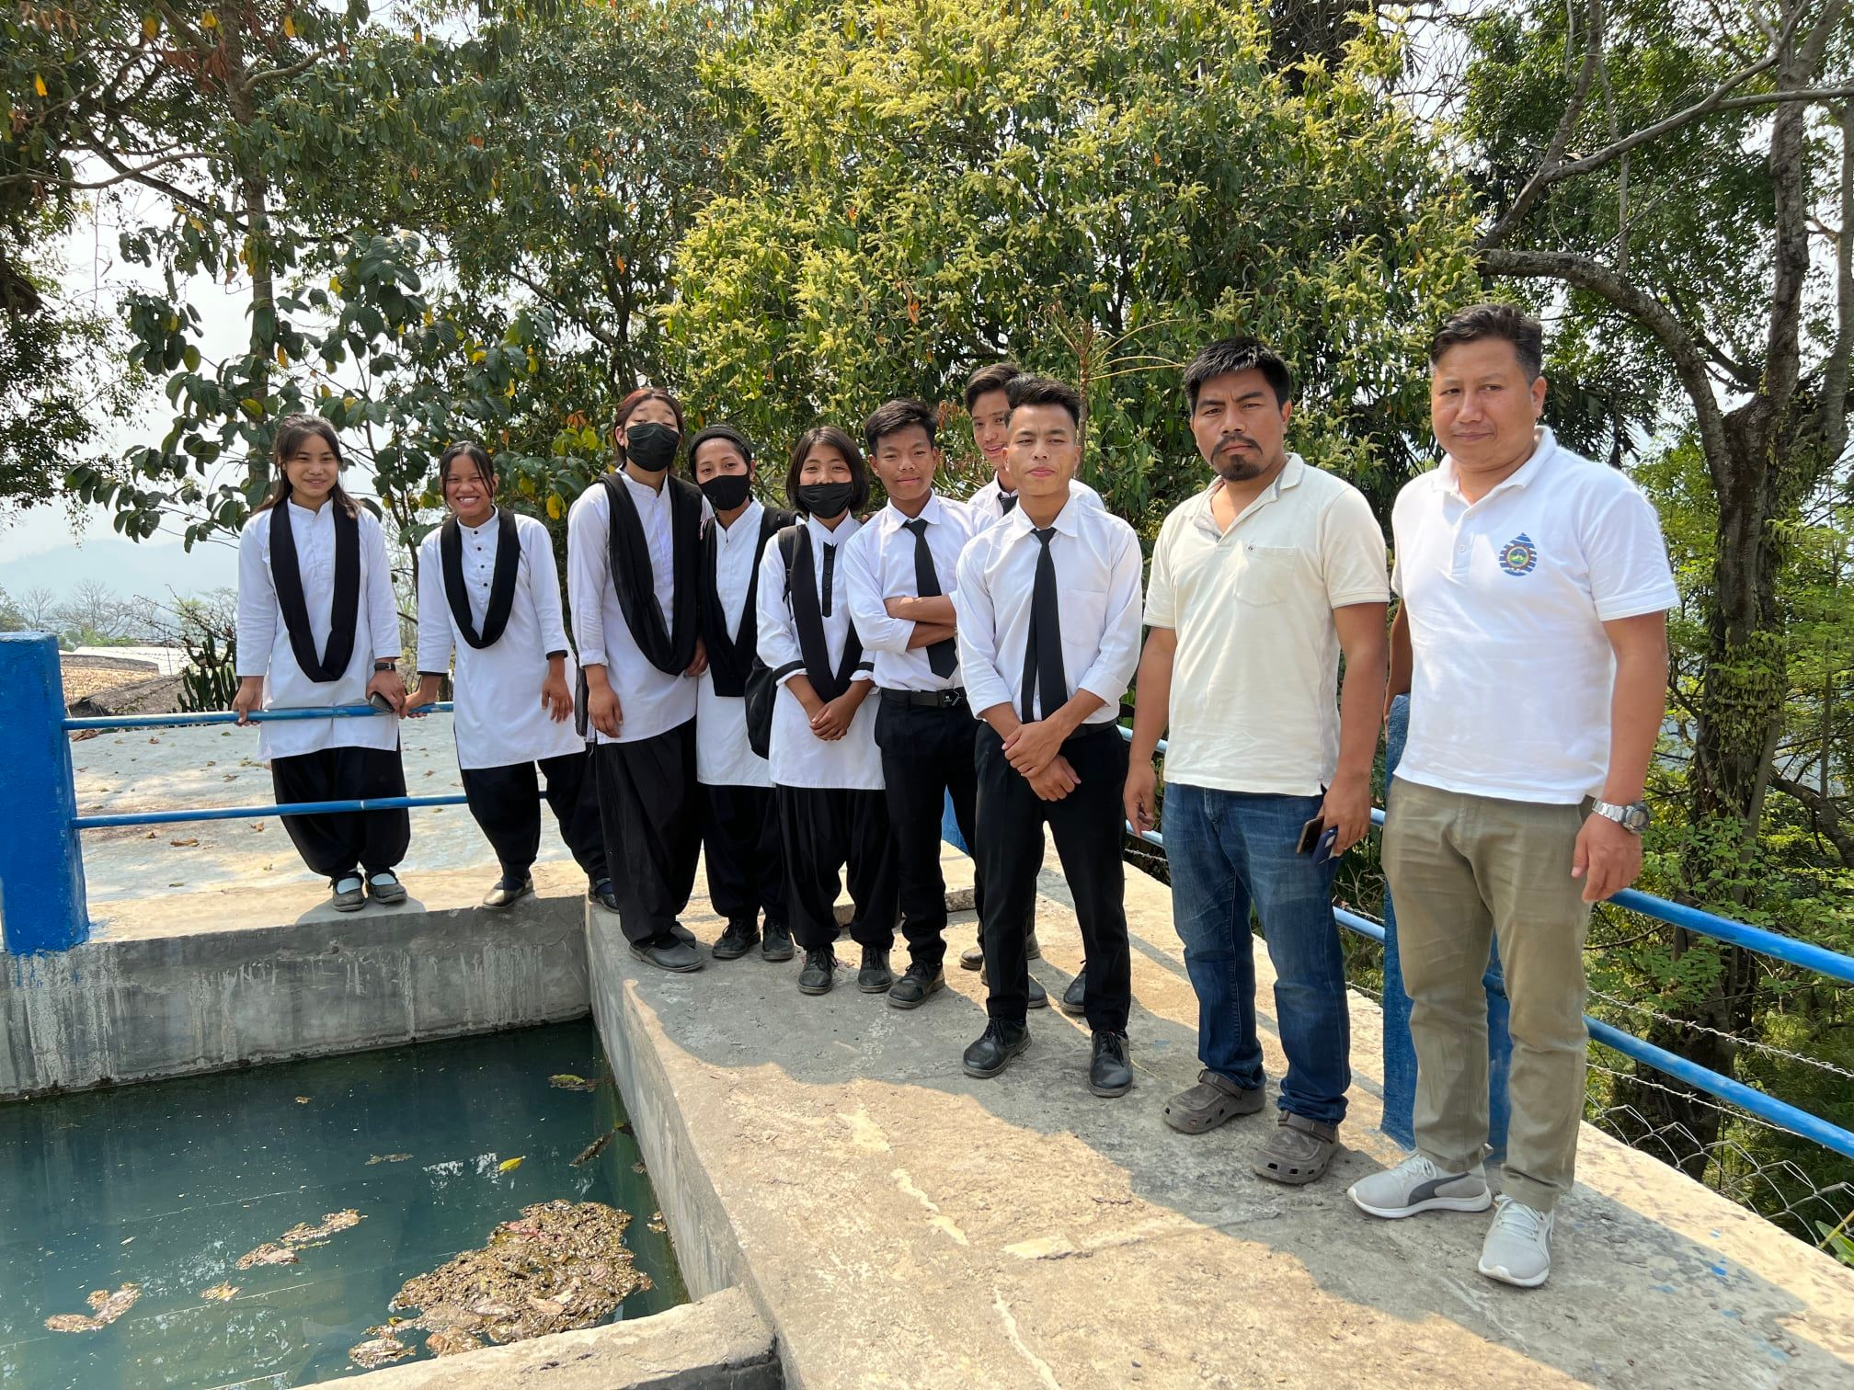
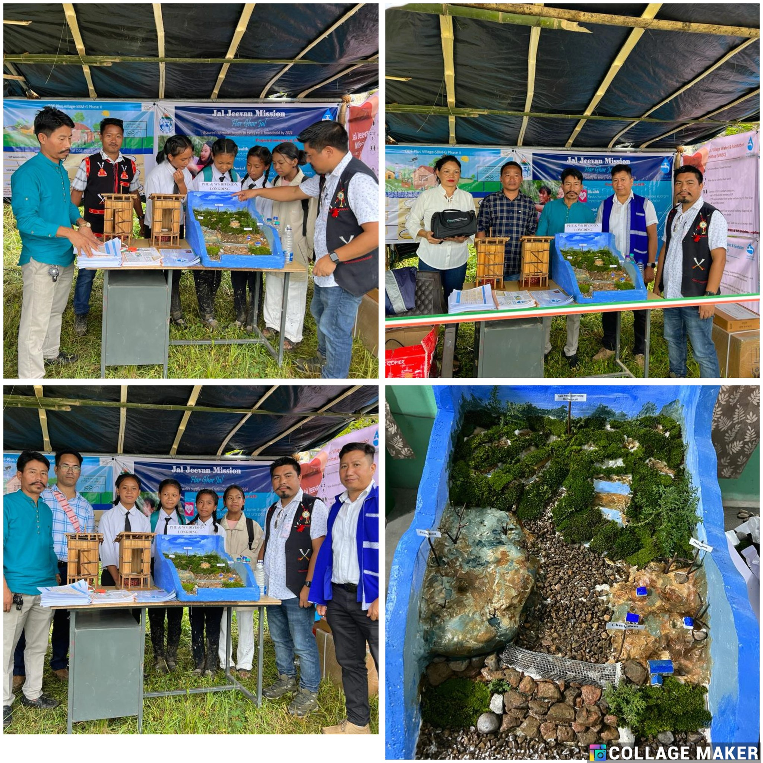
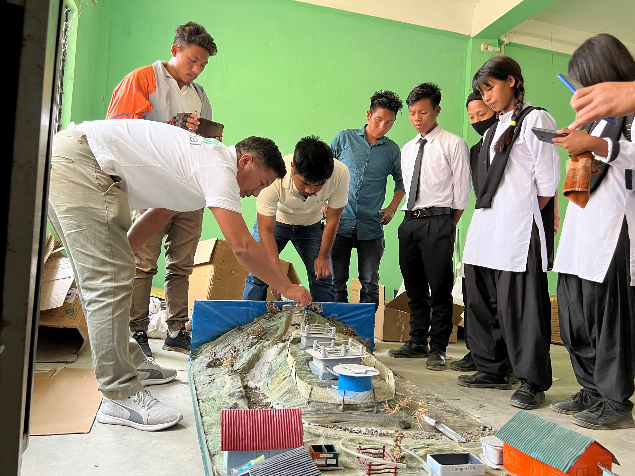
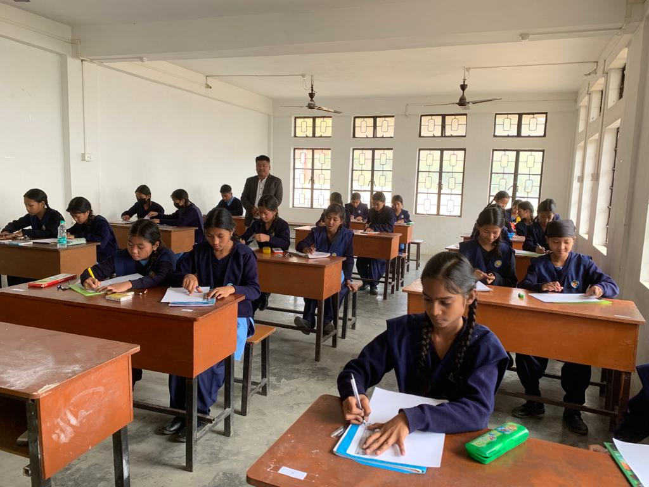
DWSM effective IEC plans and implementation
Activities done involving school students and health department
Exhibition on drinking water supply system through gravity and solar lift water system
Exhibition on catchment area protection and source rejuvenation through rain water recharge pits in catchment areas through live model in independence day and republic day.
Exposure tour of WTP of rural and urban water supply
Nukkad natak on water conservation and management
Drawing and essay competitions on JJM & SBM-G related activities.
Nukkad Natak
Stop Diarrhea campaign with health department
Rally with school childrens on JJM & SBM-G
Exposure tour of WTP
Exhibition of Rual piped water supply system
Essay and drawing competition
Exhibition of live model of lift watter supply system and source rejuvenation through rain water recharge pits

Slide 6
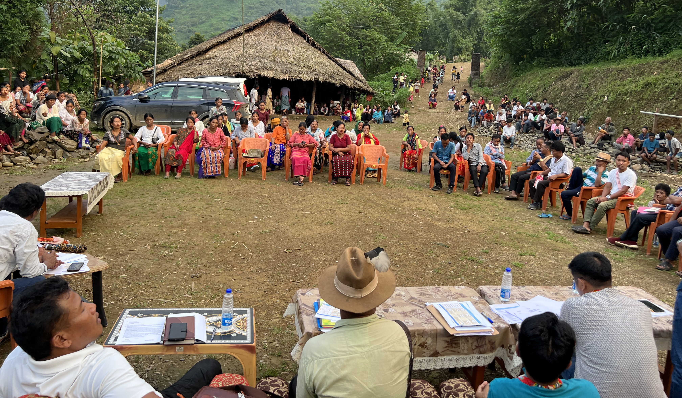
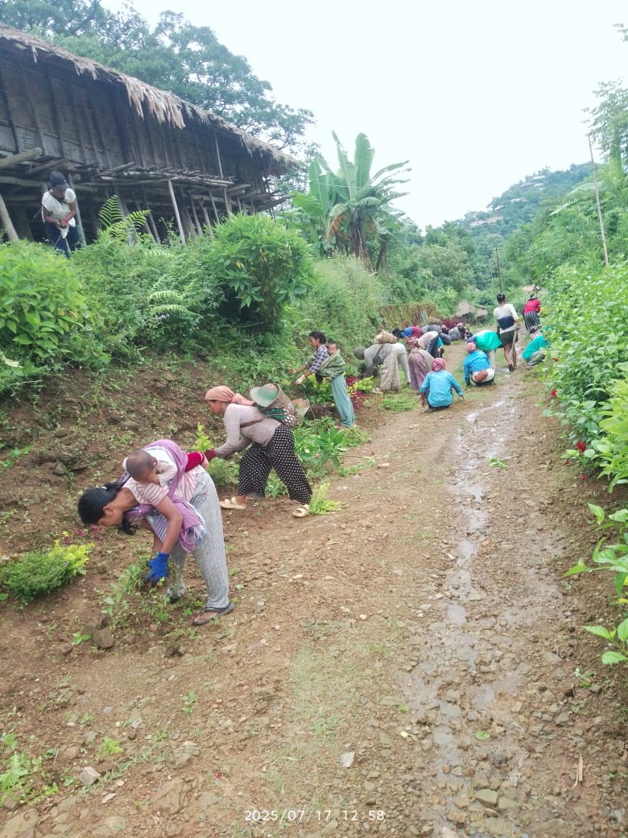
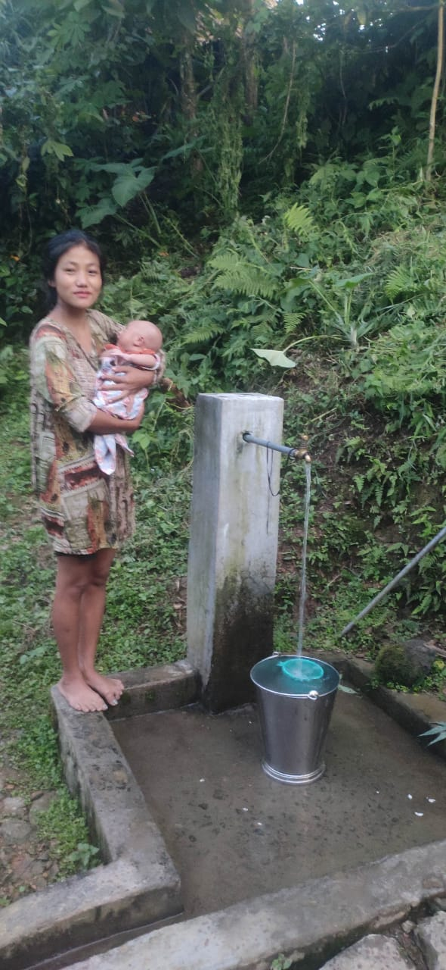
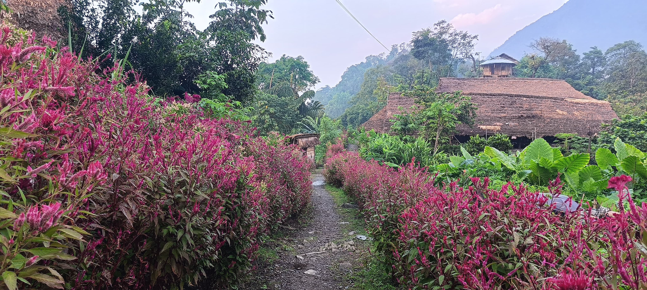
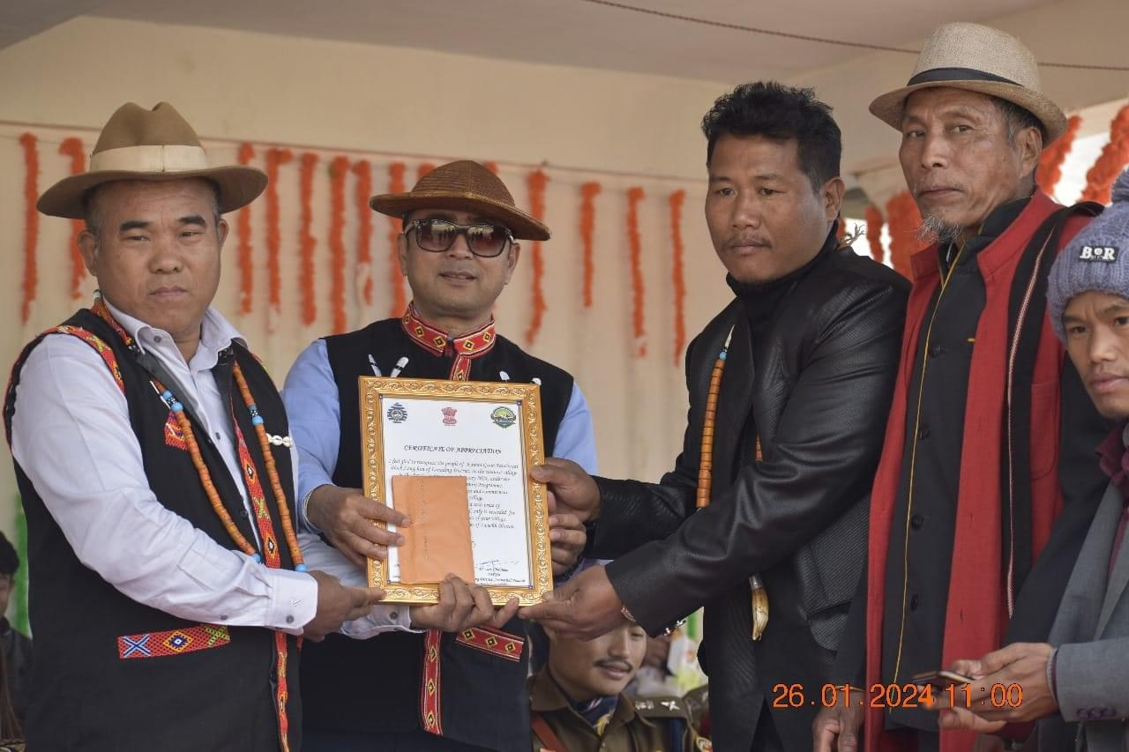
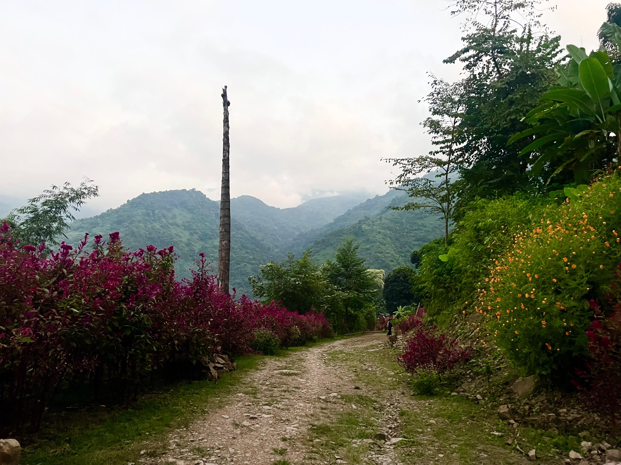
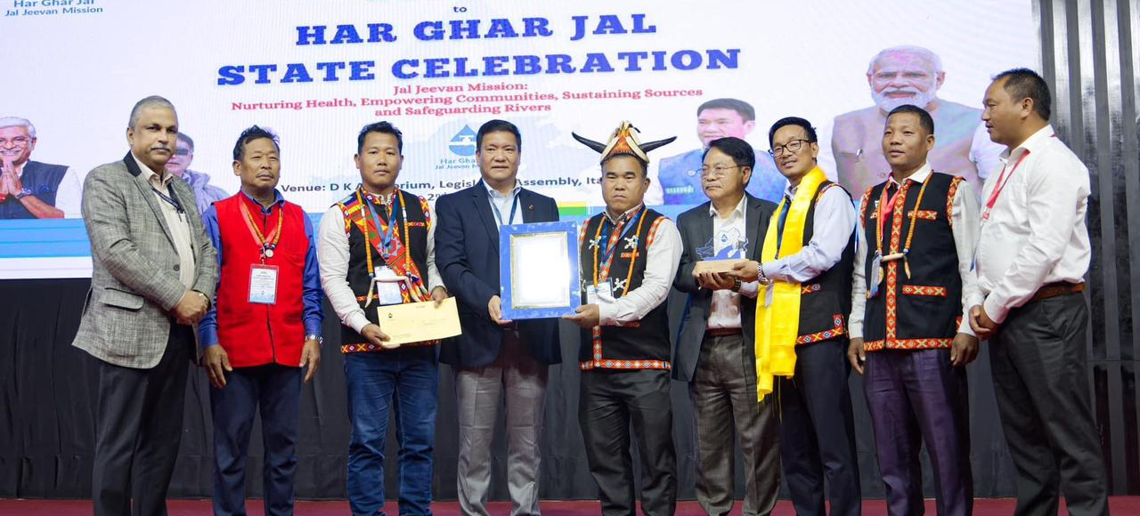
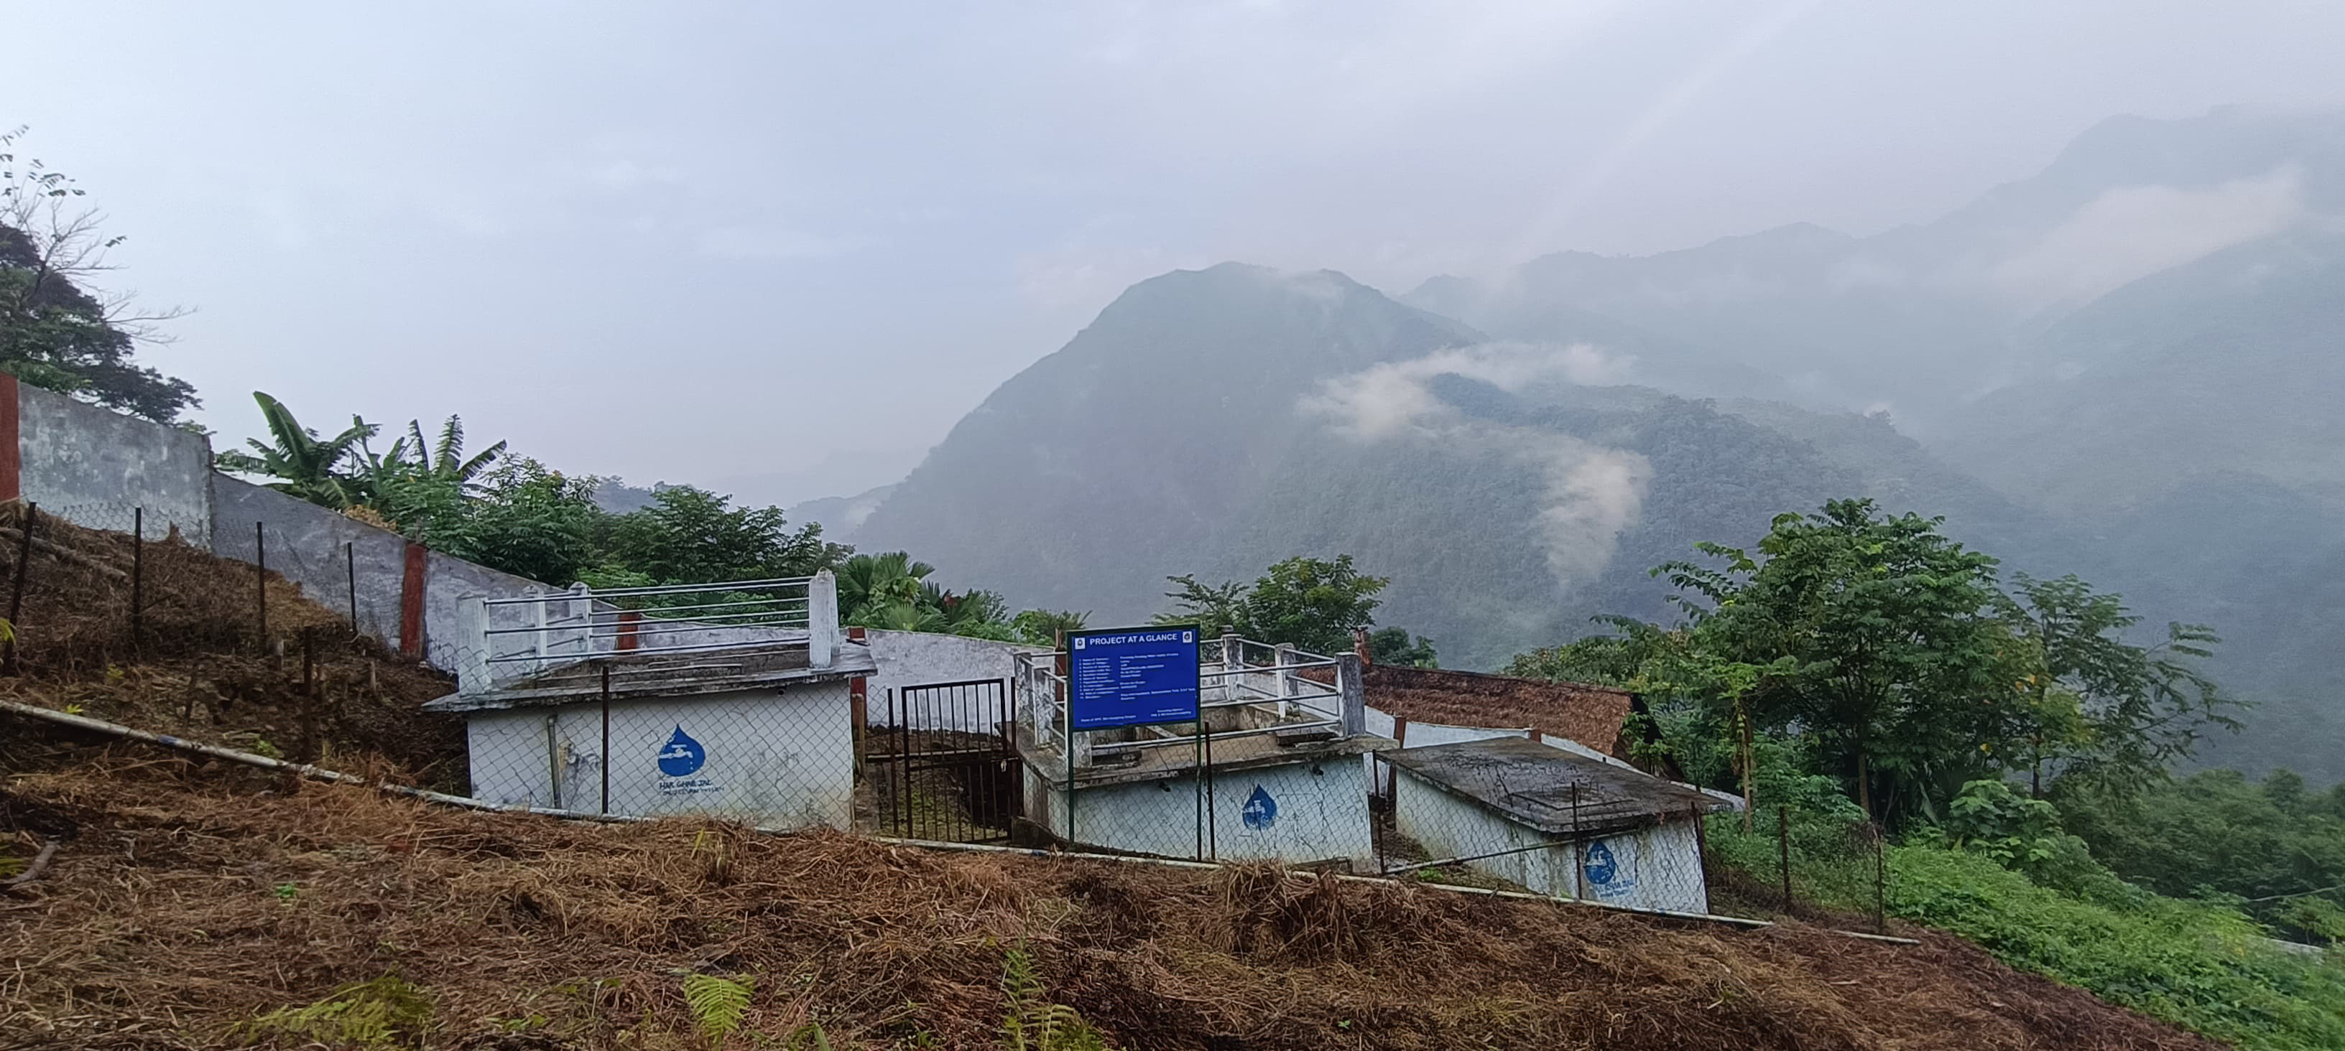
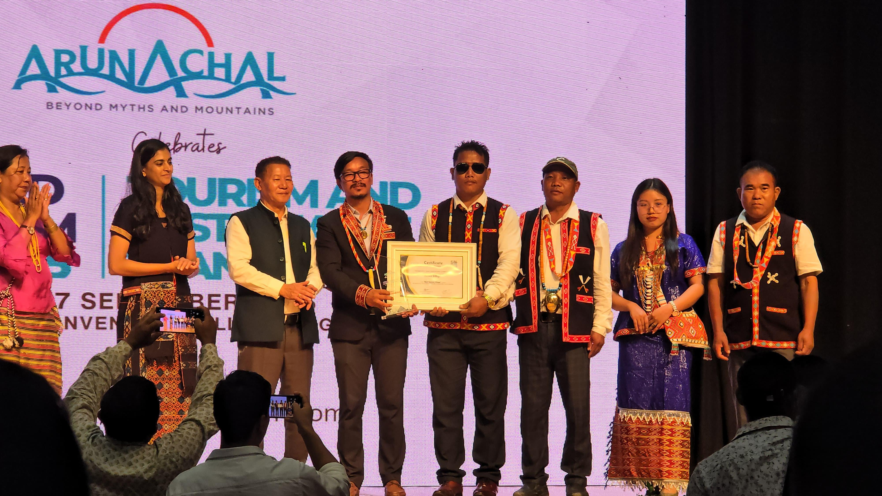
DWSM best practice in real time
Kaimoi Village
PERIPHERAL ACTIVITIES
Multiple gram sabha meetings and awareness campaigns
Active participation from village development committee, Village Water & Sanitation committee, Kaimoi women society and kaimoi student’s union.
Competition among 4 colonies of the village for cleanest colony award and most active worker.
Regular water tariff collection
Community ownership and O & M water supply assets.
Regular social services and beautification of village.
Finance Comission (14 and 15th FC) fund utilized for rain water recharge pit digging at catchment area.
IMPACTS
Behavioral Change in people
Ownership Feeling of SBM-G and JJM assets
Awareness of cleanliness and catchment area protection
Approximately 245 hectares area declared as catchment area and signed the resolution to protect it and officially submitted.
Kaimoi is a water surplus village
Awarded cleanest village in the district, most active VWSC, most active women society, swachh sujjal gaon and best tourism village of the state
Watershed management goals
Encourage terrace cultivation.
Implement rain water recharge pits, check dams, contour trenching along with afforestation in the catchment areas.
Focus on revenue generation for effective O & M of water supply assets
Source strengthening
10

Slide 7
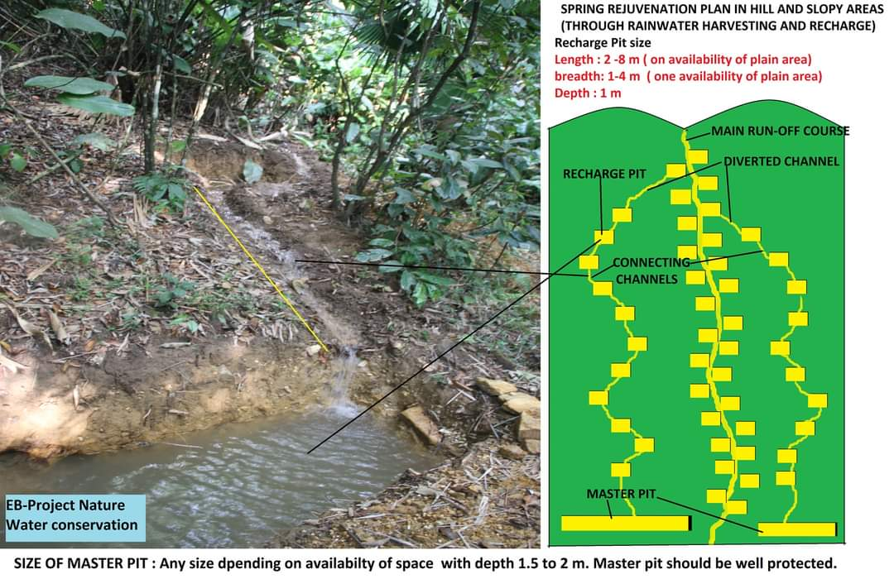
SOURCE SUSTENANCE PLANS

Slide 8
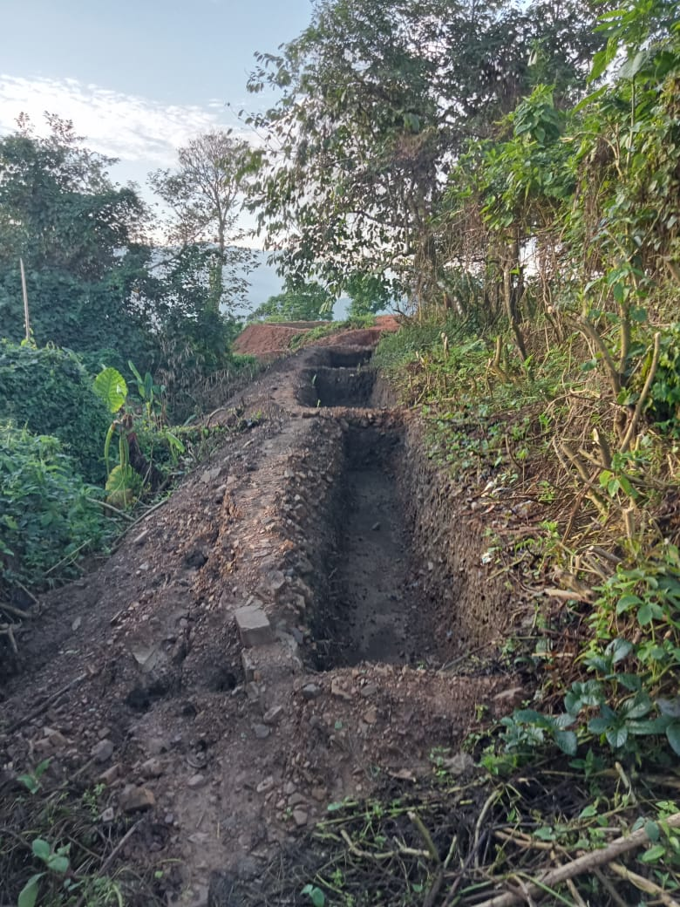
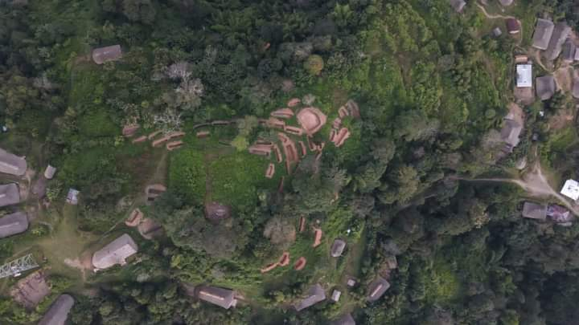
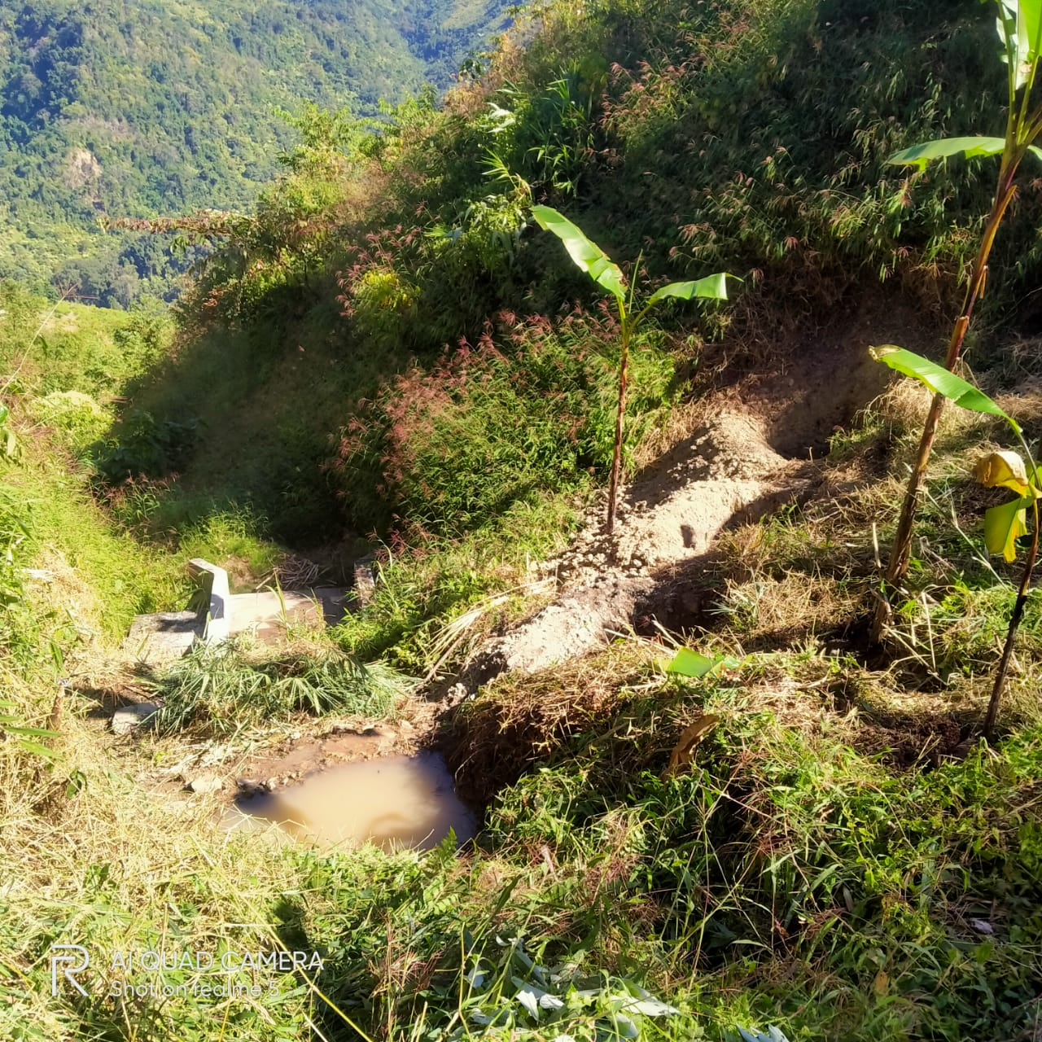
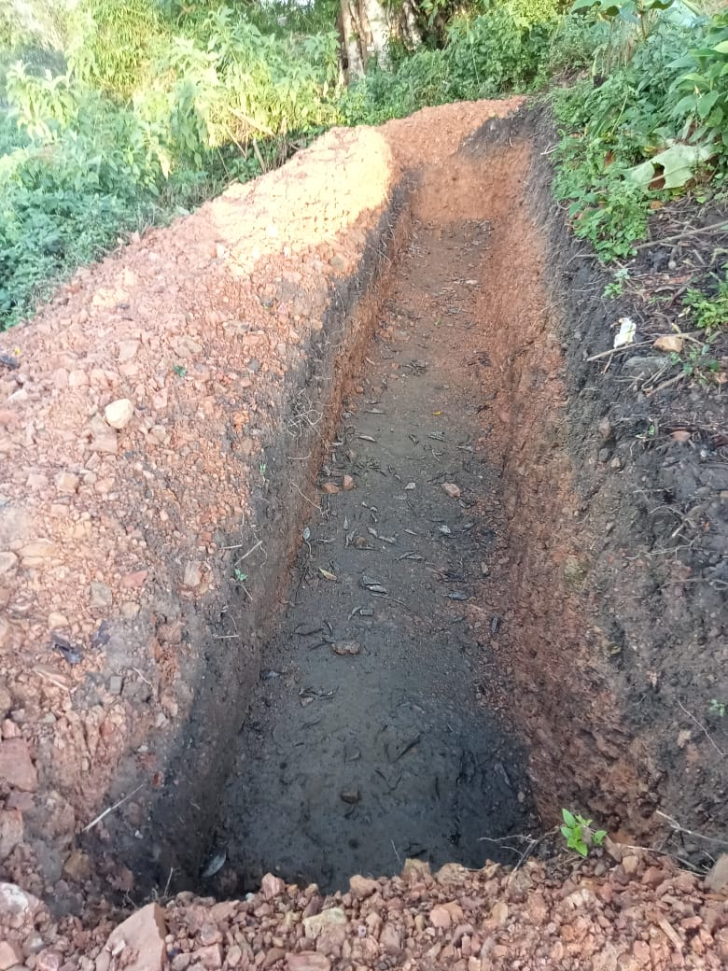
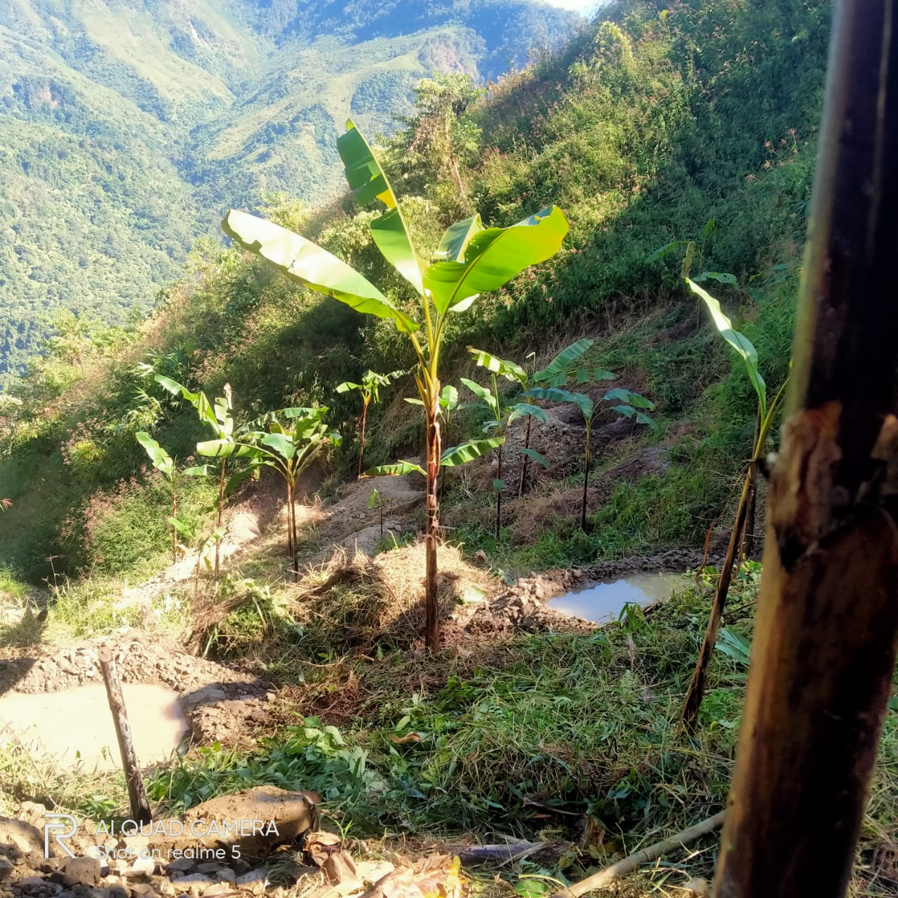
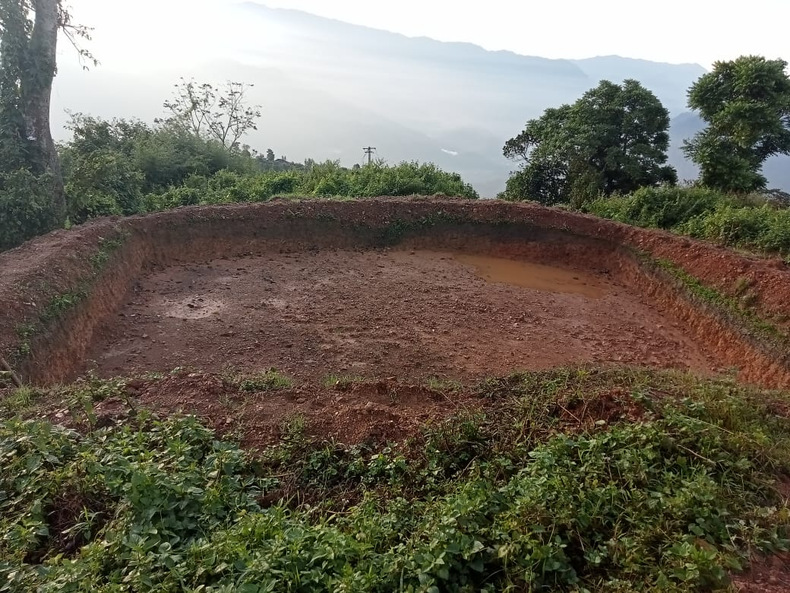
Recharge pit construction at Longdding District
A humble initiative already started at few villages in the district

Slide 9







DWSM SOURCE SUSTENANCE PLANS
Departments
Name of Scheme | Central/ State Government Department | Convergence Components
MG-NRGES | Department of Community & Rural Development | All water conservation activities under National Resource Management (NRM) component
Integrated Watershed Management (IWMP) | Department of soil and Water conservation | Restoring ecological balances by harnessing & conserving storm water. Rejuvenating the old & new water sources.
Rashtriya Krishi Vikash Yojana (RKVY) | Department of Agriculture | Watershed and spring shed management.
District Mineral Fund (DMF) | State & District | Water conservation activities on large scale.
15th Finance Commission | State & District | 60% of fund of 15th FC is allotted for WASH,
Compensatory Afforestation Fund Management and Planning Authority (CAFMP) | Forest Department | Afforestation, spring, watershed management and reviving the forest ecosystem.
Source of Finance
MAHA CAMPA Forest Department
VB-G RAM G
District Mineral Fund
Rashtriya Krishi Vikas Yojana (RKVY)
15th Finance Commision of India
Integrated watershed Management Programme (IWMP)
DWSM PLAN
In the DWSM meeting, it is discussed for convergence to work towards source strengthening/rejuvenation in the district.
Gram sabha meetings for notification of catchment area under: Arunachal Pradesh Protection of Drinking Water Catchment Areas Act, 2023
Kaimoi has submitted official resolution for protection of apprx. 245 hectares catchment area under the act.
Finance Commission (14 and 15th FC) fund may be utilized for rain water recharge pit digging at catchment area.
Farmers are encouraged to go for terrace cultivation wherever possible.
Afforestation may be prioritized at drinking water catchment areas.
Prioritize those village who voluntarily donate their land for catchment area protection and source rejuvenation
Aquifer/GIS mapping may be done for catchment area to trap maximum rain water for recharging underground aquifer.
Impounding reservoirs may be constructed at catchment areas for effective ground water recharge

Slide 10
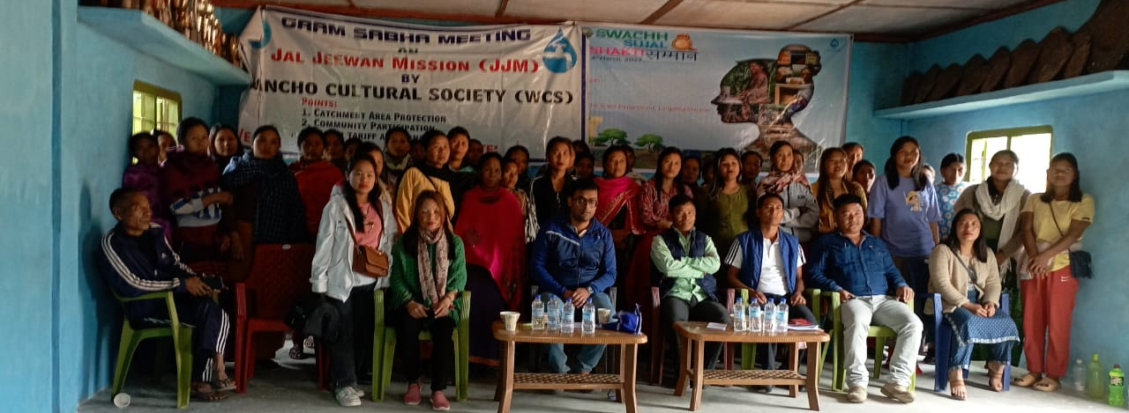






DWSM initiatives in engaging SHGs/PACS
During implementation of JJM Two ISAs were engaged for IEC/BCC campaign
First is Wancho Cultural Society (CBO)
Second is Zohai Tingsho Hutham (SHG)
They helped in IEC/BCC and community mobilization for successful implementation of JJM in the district.
They were discontinued after completion of JJM.

Slide 11








DWSM initiative for building effective water quality surveillance
Identification of group for training on FTK
Regular hands-on training of handling FTK and water quality testing and reporting.
Fixed incentives may be arranged for VWSC appointed plumber for O & M of water supply system and FTK trained person of the village from finance commission (14th & 15th)
Timely meeting of DWSM meeting with VWSCs for monitoring of their activities.
DWSM best practices
Commissioning of the scheme
Village survey and feed back to ensure 100 % FHTC.
HGJ certification in the gram sabha.
Handing taking of the WS assets to VWSC
10

