Slide 1
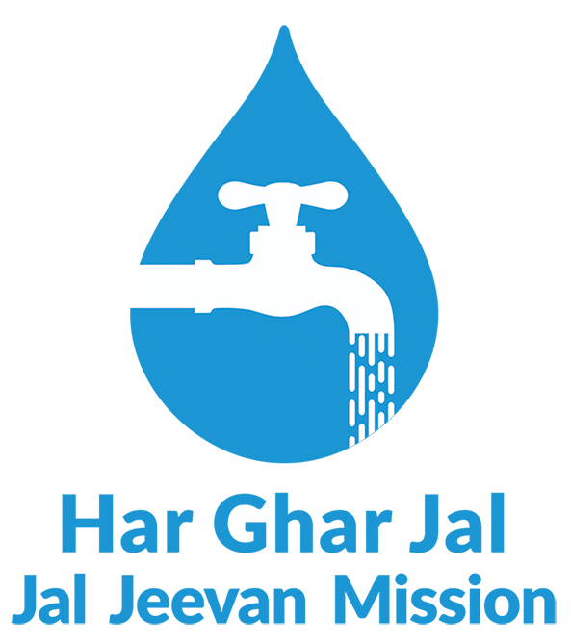

Jal Mahotsav
An Initiative for Jan Bhagidari- Sujal Gram
From National Dialogue to Village Action
"Water is Life - Let's Celebrate and Protect It Together"
17th February 2026
Ministry of Jal Shakti |
Department of Drinking Water and Sanitation
Jal Jeevan Mission - Har Ghar Jal

Slide 2

Jal Utsav: Background, Genesis & Core Philosophy
Prime Minister's Vision (December 2023)
"A tradition of 'Jal Utsav', similar to ‘Nadee Utsav', be developed to promote public sensitivity towards the importance of water"
In 3rd Chief Secretaries’ Conference, Hon’ble Prime Minister suggested creating “A tradition of Jal Utsav, similar to Nadi Utsav, be developed to promote public sensitivity towards importance of water.”
DDWS and NITI Aayog piloted Jal Utsav in 20 aspirational districts/blocks in November 2024.
The pilot successfully mobilised communities, PRIs, schools, and local groups on water conservation, water quality, and source sustainability.
Based on its success, Jal Utsav will now be celebrated annually as a people’s festival promoting pride, awareness, and collective responsibility for water.
Blending Culture, Tradition, and Community Spirit to Awaken Pride, Awareness, and Collective Responsibility for Water

Slide 3
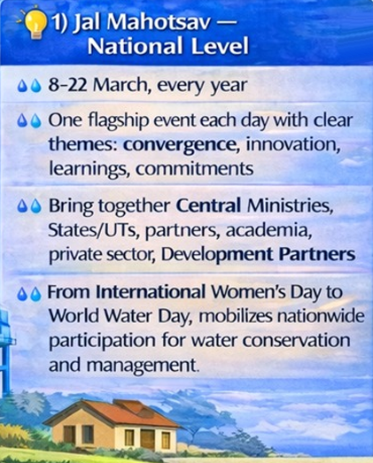
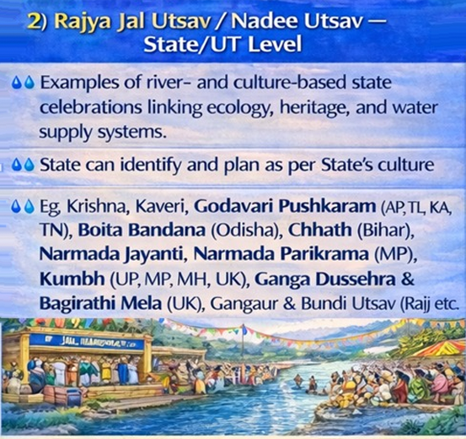
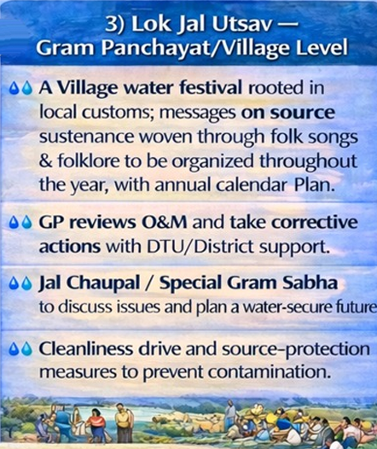
Jal Utsav: A People’s led Initiative for Water
Jal Mahotsav (National level ) • Rajya Jal Utsav/ Nadee Utsav (State level ) • Lok Jal Utsav (GP/Village level)
Why Jal Utsav
Water systems last only when people feel ownership not just when infrastructure is built. Jal Utsav turns emotion + culture into action for O&M, water quality and source protection

Slide 4
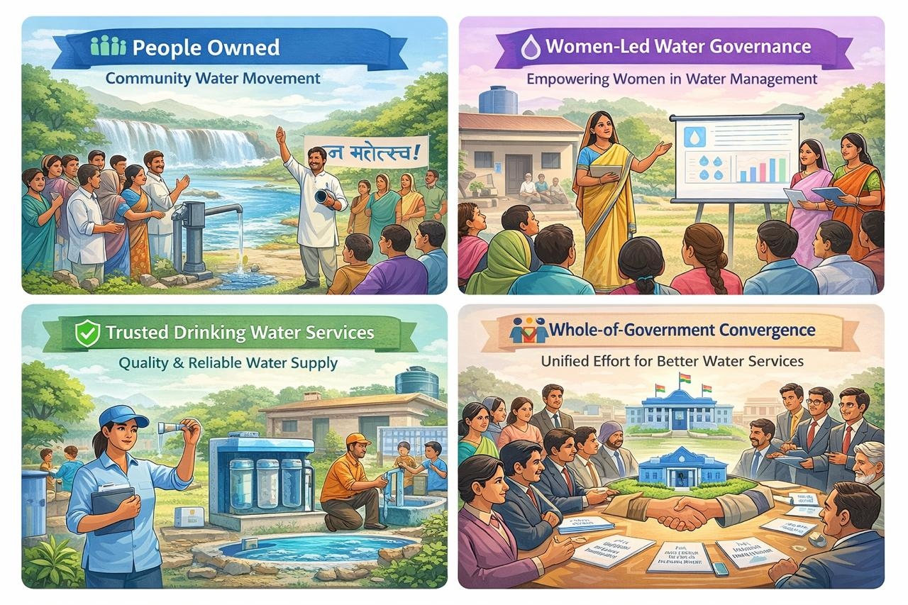


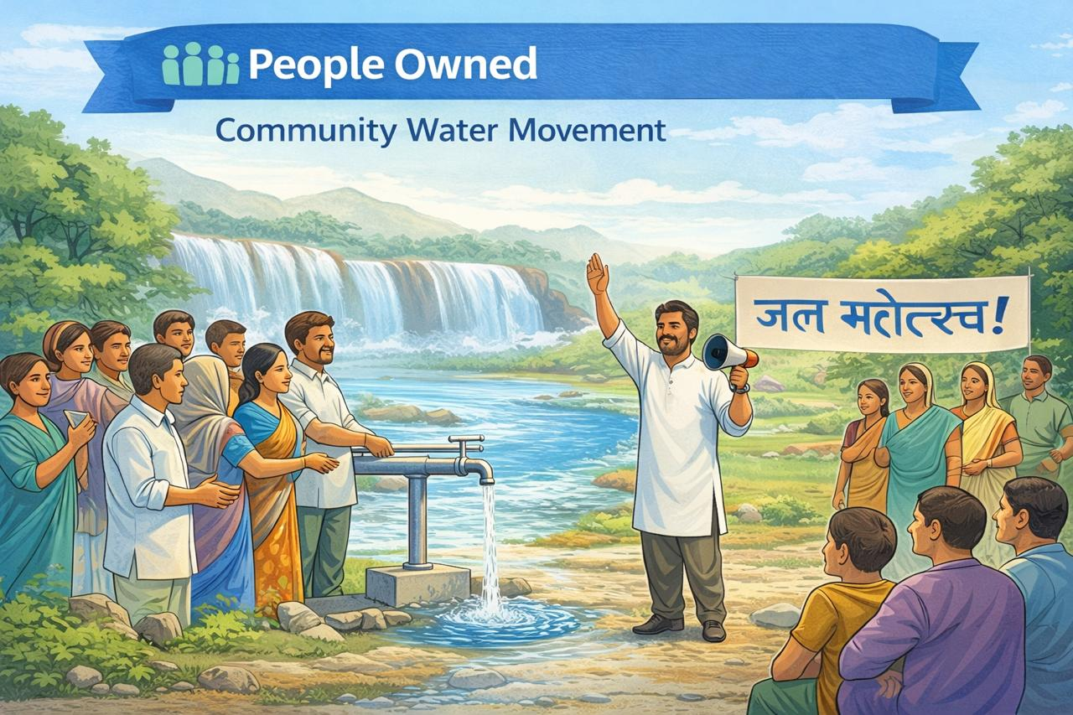
Key Objectives
Jal Mahotsav is a national people’s movement that celebrates water as a shared responsibility, people-owned, women-led, service-driven and sustained through collective action.
People Owned
Trusted Drinking Water Services
Jan Bhagidari for water as a shared responsibility
Focus on service quality, not just assets
Women Led Governance
Whole of Government Convergence
Women leading village drinking water services
Ministries, GPs & communities working together
Jal Mahotsav – Align with International Women’s Day (8th March) and World Water Day (22nd March)

Slide 5
Key Preparatory Activity
Meeting of the Hon’ble Minister of Jal Shakti with Panchayati Raj and PHED Departments of all States to review preparedness and provide strategic direction – Last week of February
Coordination meeting of DDWS with relevant Ministries and Departments (WCD, MoHFW, MoPR, MoHUA, etc.) to ensure inter-sectoral convergence and alignment

Slide 6
Overview of Activities
08 March 2026 – Inaugural Day (International Women’s Day): National launch of Jal Mahotsav highlighting women’s leadership and people‑led drinking water governance (virtual mode). 9/10/11 March – National‑Level Event: High‑level convergence event showcasing the impact of safe drinking water on women’s health, dignity, and empowerment. 11 March – World Plumber’s Day: Recognition of plumbers as key frontline service providers and strengthening local O&M skills for rural water systems. 22 March – Culmination Day (World Water Day): Closing of Jal Mahotsav with reflection on outcomes, learnings, and recognition of community and institutional contributions. Intervening Days: Focused activities on women’s capacity building, skill ecosystem strengthening, student-led water initiatives, and source sustainability actions.

Slide 7
Key Thematic Activities at State Level
S. No. | Themes | Participating Departments | Key Activities
1 | Celebrating Jal Arpan Diwas: Gaon ka Jal, Gon ke Hath | RWSD/PHED, Panchayati Raj and Rural Development | Celebrate Jal Arpan Diwas in Har Ghar Jal certified villages, ensuring proper O&M Complete handover in villages where schemes have already been commissioned Prioritize villages where schemes are about to be commissioned (ensure 15–30 days of trial run)
2 | Women led Water Quality Testing: Jal Jaanch Mein Nari Netrutva | SRLM, RWSD/PHED, Panchayati Raj | Training of Self Help Groups by SRLM Testing of sources to be done by trained FTK
3 | “Fix the Leak”, Skilled Hands for Sustainable Drinking Water Services | DDWS (JJM), State Departments of Technical Education, it is/Polytechnics/State Skill Missions (where applicable) | Sujal Gaon App: For VWSCs, FTK Committees and Operators: Supporting in Daily O&M operations; Issue reporting and Data-based decision-making
4 | Jal Sanchay-Jan Bhagidari Jan Bhagidhari se Pey-Jal Sanchay | RWSD/PHED, DoWR, Panchayati Raj and Rural Development, SBM – G | Cleanliness drive for protecting the source from contamination Constructing water recharge/harvesting structures
5 | I Am a Water Protector Main Bhi Jal Rakshak | State Education Department, RWSD/PHED, Skill development institutions (supporting role) | Capacity building of students to act as a Water Ambassadors

Slide 8
Thank You
Building Partnerships Changing Lives

Slide 9
Key Thematic Activities at National Level
S. No. | Themes | Participating Departments | Key Launches
1 | Celebrating Women’s Leadership in Safe and Secured Drinking Water Management. | WCD, MoHFW, NRLM | Jal Mahotsav Calendar (day-wise national programme) Compendium on women water leaders 4-5 videos related to women leadership
2 | Safe Water for Health and Nutrition Outcomes | DDWS (JJM), NHM, POSHAN 2.0 (Ministry of Women and Child Development), SBM (G) | Integrated Water, Health, Nutrition Impact Assessment Tool
3 | Building Skills and Livelihoods for Rural Water Sustainability | DDWS (JJM), AICTE, MSME, Skill development agencies and institutions | Finalise elective course framework Jal Seva Adhayan Report
4 | “Fix the Leak”, Skilled Hands for Sustainable Drinking Water Services | DDWS (JJM), MSDE, State Departments of Technical Education, State Skill Missions (where applicable) | Sujal Gaon App: For VWSCs, FTK Committees and Operators: Supporting in Daily O&M operations; Issue reporting and Data-based decision-making
5 | Women Led Community Action for Drinking Water Quality Assurance | DDWS (JJM), NRLM/SRLM (MoRD), Development partners supporting water quality | Short Handbook on Water Quality Testing using FTKs Training Video / AV Module on FTK Testing
6 | Water source sustainability | DDWS (JJM), Water Resources / CGWB, MoRD, MoPR, SBM (G), Agriculture & allied departments, NITI Aayog | Handbook on Regulations and Protocols for Source Protection by CGWB
7 | Main Bhi Jal Rakshak/ I Am a Water Protector | Ministry of Education, DDWS (JJM), Skill development institutions (supporting role) | MyGov social media campaign, “Main Bhi Jal Rakshak”, inviting school students and others to create short reels/videos on water conservation, leak prevention, and source protection.
8 | Back to Roots “My Village, My Water Source” | Ministers and elected representatives (wherever feasible), Senior officers of DDWS, PHED, Water Resources, Rural Development, Panchayati Raj, SBM(G), etc., District and block officials, Engineers, frontline workers, Jal Mitras | One inspirational song on JJM Selfie competition
9 | Capacitating GPs on Planning and Financial Management of RPWSS | MoPR, DDWS (JJM) | -
10 | Culmination of Jal Mahotsav – Celebrating Interdepartmental Convergence | NITI Ayog, DDWS (JJM), SBM, MoRD, NHM, MSDE, Agriculture and allied | National Convergence Report

Slide 10
Jal Mahotsav: 08th March, 2026 Inaugural Day
 | About the Day: Celebrating International Women’s Day with water Champions doing exemplary work across states
Day 1 | Theme: Nari Neer Shakti Divas (On International Women’s Day) Celebrating Women’s Leadership in Ensuring Safe and Secure Drinking Water through Effective Management Lead Department / Institution DDWS in collaboration with States RWSD/PHEDs and Panchayati Raj & Rural Development Objective To recognise women leaders who have ensured reliable and sustainable rural drinking water services and strengthened community water governance. | Hybrid Mode with National Inaugural by Honb’le MoJS, participated by All States MDs., District Teams, Engineers, GPs, VWSCs National level (2 Hours): Opening Session: “Sujal Gram Samvaad” Interaction with 2 Women Sarpanches (24×7 water villages) 2 Women Sarpanches (water-stressed areas) 2 Women District Collectors Key Launches: Jal Mahotsav Calendar (day-wise national programme) Compendium on women water leaders/Champions 4-5 videos related to women leadership State Level: Post Inaugural Session (2-3 Hpurs) (Optional) TBD State-level physical events encouraged (State/District HQs) Felicitation of women water leaders State-specific media engagement/Release of Compendium/Video Virtual events to be organized where physical events are not feasible

Slide 11
Jal Mahotsav: Day -2 (Options open for 9/10/11 March)
One-day national event format (9/10/11 March), subject to availability of Hon’ble President / Prime Minister.
Day 2 | Theme: हर घर जल से स्वस्थ जीवन और पोषण - Safe Water for Health and Nutrition Outcomes Celebrating women leaders, whose work in drinking water management has strengthened health and nutrition outcomes through programme convergence. Lead Department: NITI Aayog-led collaboration with DDWS, MoHFW, MoWCD and MoPR Objective To Integrate water and sanitation indicators into health and nutrition impact assessment. Programme Format: Hybrid Mode | National Level: (Inaugural Session) To be organized at Vigyan Bhawan, New Delhi Led by NITI Aayog, presided over by Hon’ble Prime Minister / Hon’ble President Physical participation of senior officials/MDs/State MDs/Director of the 4 Depts Physical participation of select women leaders, frontline workers, Panchayat representatives and programme functionaries. Felicitation of 6 women leaders, Officers who have demonstrated exemplary work of convergence from the three Depts. (A total 6). Documentary Video to be prepared for all 6 leaders. State level (Virtual link across country) Virtual participation nationwide, all stakeholders from 4 Depts.; live broadcast. Virtual interaction with 3 selected community leaders for exemplary work. Key Launches/Outcome Integrated Water–Health–Nutrition Impact Assessment Tool. Jal Ankalan Report Post Inaugural Session Discussions continue on Identifying Common Indicators to measure Programme Outcome

Slide 12
Jal Mahotsav: Day - 3 Women’s Capacity Building for Water Quality Testing
 | Programme Format: Hybrid Mode/Virtual: A National level dialogue led by NRLM/SRLM (physical/virtual) in which various Institutions including GPS/VWSCs/SHGs participate virtually.
Day 3 | Theme: Women-Led Community Action for Drinking Water Quality Surveillance Lead Department: National/State Rural Livelihood Mission Objective To institutionalize women-led community water quality testing across Gram Panchayats through JJM–NRLM/SRLM convergence. Other Departments/Institutions involved : Jal Jeevan Mission (DDWS) National Rural Livelihoods Mission (NRLM) State Rural Livelihood Missions (SRLMs) Selected Development Partners Self-Help Groups (SHGs) / women collectives VWSCs / Pani Samitis / Gram Panchayats | Design of the Dialogue: National Level Session 1: Formally launch the JJM–NRLM collaboration on water quality testing.. Session 2: Launch of FTK Capacity-Building Package: Short video/Handbook State level Session 3: State Action Roll-Out – SRLM, CLF & State PHED/RWSD Session 4: Community Action: FTK Testing at Gram Panchayat Level Session 5: Joint Roadmap & Way Forward Participants: (Virtual link across country) DDWS (JJM) NRLM/SRLM (MoRD) State JJM / PHED officials, Development partners involved in WQ CLFs and SHGs identified for Training GPs/VWSCs Key Launches/Outcome Joint commitment by JJM, AICTE and MSME Finalise elective course framework/Declare water supply services as an Elective Course

Slide 13
Jal Mahotsav: Day-4 (11th March) – World Plumbers Day
 | Programme Format: Dialogue & District Action for Building Skilled Workforce for RPWSS
Day 3 | Theme: “Plumbers as Nal Jal Mitra: Skilled Hands for Sustained Har Ghar Jal” Lead Department: Department of Drinking Water & Sanitation ( District Collector / District Magistrate Objective To recognise plumbers as frontline service providers and strengthen district-level plumbing skills by linking JJM with ITIs and local plumbers for sustained O&M of rural water supply. Supporting Institutions: State JJM / PHED / RWSD ITIs/ Polytechnics/Skill Development Missions / RSETIs (NRLM/MoRD) Water Management & Plumbing Skill Council Local plumbers’ associations / service providers Engineering (where available) | National Level Inaugral (World Plumbers Day) : (Virtual) Congratulatory message by Secretary, DDWS on the occasion of World Plumbers Day, extending best wishes to all districts for successful organisation of district-level plumber training and felicitation events. District level Session 1 Role of Plumbers in Sustaining Rural Water Services Session 2: ITI & Skill Institution Engagement Session 3: Dialogue with Plumbers & Field Operators Session 4: Way Forwar Participants: District Collector / Senior District Officials ITI Principals, Instructors and Trainees Practicing plumbers and Jal Mitras / Operators JM / PHED Engineers and Block-level officials Skill institutions and local service provider Key Outcome Recognition of ITIs / institutions supporting water-sector skilling

Slide 14
Jal Mahotsav: Day -5 - Dialogue for building skill ecosystem for RPWSS
 | Programme Format: Hybrid Mode/Virtual: A National level dialogue led by AICTE is organized (physical/virtual) in which various Institutions and departments participate virtually.
Day 3 | Theme: “Building Skills and Livelihoods for Rural Water Sustainability”. Lead Department: All India Council for Technical Education (AICTE) Objective To build skilled manpower for O&M of rural water schemes and promote water services as sustainable livelihoods. Supporting Institutions: Ministry of Jal Shakti / Jal Jeevan Mission Ministry of Micro, Small and Medium Enterprises (MSME) Water Management & Plumbing Skill Council (WMPSC) Skill development and technical institutions Academic and research institutions RSETI (NRLM/MoRD) | Design of the Dialogue: National Level Session 1 Framing the Skill Gap in Rural Water Services. Session 2: Academic Integration: Water Sector Curriculum Initiatives Session 3: MSME & AICTE: Skill Ecosystem Dialogue Session 4: Low-cost and affordable equipment/tools for water supply. Session 5: Joint Roadmap & Way Forward Participants: (Virtual link across country) State Technical Education Depts; ITIs , Polytechnics, Engineering Colleges State JJM / PHED officials, Private Sectors: MSMEs manufacturing water supply components; Service providers and start-ups in water O&M, Technology partners. Key Launches/Outcome Joint commitment by JJM, AICTE and MSME Finalise elective course framework/Declare water supply services as an Elective Course

Slide 15
Jal Mahotsav: Day – 6: Establishing Young Brigade for Protecting Water Sources
 | Programme Format: Hybrid Mode/Virtual: A National level dialogue led by Education Department and launch of National level REEL competition. This is to be followed up by field level actions by students..
Day 3 | Theme: Engaging school children under the “Main Bhi Jal Rakshak” campaign to build a nationwide cadre of young water custodians. Lead Department: Ministry of Education with support from Water Management & Plumbing Skill Council (WMPSC) Objective To jointly brief all States/UTs on the coordinated national campaign by NJJM and Department of School Education & Literacy. Other Departments/Institutions involved : Jal Jeevan Mission (DDWS) Department of Water Resources State Departments of School Education RWPF &other Development Partners | Design of the Dialogue: 1. Joint VC with all States/UTs : (Key messages, standardized information for student activities, Implementation steps and reporting mechanisms) States receive clear, unified guidance from NJJM & DoSEL for the 2‑day cascade. Strengthened collaboration between state water departments and education departments. Increased readiness for smooth rollout at district and school levels. Standardized messaging and activity planning across all states. Participants: (Virtual link across country) State JJM / PHED Officials State Education Departments SCERTs / DIETs District Education Officers Key Launches/Outcome Launch of “ Main Bhi Jal Rakshak Hun” Reel competition on myGov. System of award for selected REELS.

Slide 16
Jal Mahotsav: Day – 7 & 8: Back to Roots - A Nationwide Media & Jan Andolan Initiatives
 | Programme Format: Hybrid Mode/Virtual: A National People’s Action Day to mobilise Celebrities, leaders and citizens to go back to their village, lead visible, community-driven action for protection and stewardship of local drinking water sources.
Day 3 | Theme: ack to Roots – My Village, My Water A call to return to one’s village, take stock of local water sources, and contribute personally to their protection and improveme. Lead Department: DDWS in collaboration with Ministry of Information & Broadcasting (MoI&B) Objective To make the day a people-led movement by encouraging leaders to go back to their roots and lead source protection activities in their own villages. Other Departments/Institutions involved : Jal Jeevan Mission (DDWS) Department of Water Resources All other Departments who participated RWPF &other Development Partners | Design of the Dialogue: 1. Joint VC with all States/UTs : At the National & State Level: May be launched nationally by the Secretary, DDWS, with parallel State-level launches led by Secretaries/MDs (RWSD/PHED) to anchor leadership commitment across all levels. Senior officers of DDWS, PHED, Water Resources, Rural Development, Panchayati Raj, SBM(G), etc. District and block officials Engineers, frontline workers, Jal Mitras Public Influencers / Celebrities To visit their native or adopted villages to lead source protection and share authentic messages on water stewardship. State may select a few activities for the Day. Key Launches/Outcome Launch of REEL/Sefie Competition “ Back to Roots” on my Gov JJM Song – appealing people for valuing water

Slide 17
Jal Mahotsav: Day – 9: Panchayat Jal Niyojan Diwas (Panchayat Water Planning Day)
 | Programme Format: The day will be primarily field-oriented, with Gram Sabha and community-level activities conducted across villages, while all national-level guidance, alignment and preparations will be completed in advance..
Day 3 | Theme: When Gram Sabhas plan for water, sustainability becomes a local reality. Lead Department: Ministry of Panchayati Raj (MoPR) Objective To enable Gram Sabhas to discuss and plan sustainable financial management of drinking water services by integrating O&M and source sustainability priorities into GPDP, leveraging 16th Finance Commission grants. Other Departments/Institutions involved : Jal Jeevan Mission (DDWS) Department of Water Resources State Panchayati Raj & Rural Development Deptt. All other Departments who participated RWPF & Other Development Partners/CBOs | Design of the Day: 1. At the National level: DDWS & MoPR send Joint Advisory to States Special Gram Sabha organized and people discusses water as part of their Plan MoPR to enable Gram Sabha–led integration of drinking water planning into the GPDP utiltilixing 16th Finance Commission grant utilization A Planning template is issued. 2. At the State/District and Panchayat level on the Campaign Day Special Gram Sabhas are organized Water is being discussed and included in GPDP using FC grant Participants: District level Officials of PHED/DWSM,. Zila Panchayat, Rural Development, etc. Gram Panchayat, Sarpanch, Secretaries, Engineers, VWSCs, SHGs Key Outcome Financial Plan for JJM Scheme is prepared and integrated into GPDP

Slide 18
Jal Mahotsav: Day – 10: Jal Sanchay for Water Security
 | Programme Format: Hybrid Mode/Virtual: A National level dialogue led by DoWR (physical/virtual) in which various Departments and Institutions including GPS/VWSCs/SHGs participate virtually.
Day 3 | Theme: Converging Actions for Source Sustainability & Water Security Lead Department: Department of Water Resources, River Development, and Ganga Rejuvenation. Objective To align existing ministries, missions and programmes for coordinated protection and recharge of drinking water sources at village and aquifer levels under Jal Jeevan Mission. Other Departments/Institutions involved : Jal Jeevan Mission (DDWS) Department of Water Resources / CGWB Ministry of Rural Development Ministry of Panchayati Raj MoHUA | Design of the Dialogue: National Level (One Full Day Dialogue on convergence) Session 1: Principles of Jal Sanchay; importance in drinking water sustainability.. Session 2: Programme Mapping – What Each Programme Already Does Session 3: State Case Studies – Convergence in Action Session 4: Tools for Convergence & Decision-Making Session 5: Way Forward; Launch of Field Action for Next Day Participants: (Virtual link across country) State JJM / PHED State Water Resources / Groundwater State RD / Watershed Panchayati Raj Department District Administration and ULBs Sarpanch and VWSCs Key Launches/Outcome Hand book on Regulations and Protocols for Source Protection by CGWB Announcement of a Jal Sanchay Convergence Framework for States

Slide 19
Jal Mahotsav: Day – 15: World Water Day – National Culmination (Option -1)
 | Programme Format: National Culmination of Jal Mahotsav will be held at Vigyan Bhawan, New Delhi, proposed to be graced by Hon’ble Prime Minister of India.
Day 3 | Theme: Sustaining Har Ghar Jal through Convergence. Lead Department: NITI Aayog/DDWS Objective To mark the national culmination of Jal Mahotsav by reinforcing the importance of safe drinking water, recognising local leadership, and launching key national knowledge products for sustainable service delivery.. Other Departments/Institutions involved : Jal Jeevan Mission (DDWS) Department of Water Resources State Panchayati Raj & Rural Development Deptt. All other Departments who participated RWPF & Other Development Partners/CBOs | Design of the Day: Pey Jal/Sujal Gram Samvaad: 6 Selected District Collectors, Sarpanch and VWSCs share their experiences and exemplary work undertaken during Jal Mahotsav. Recognition of Exemplary Efforts: Felicitation of selected districts, women water champions and Community institutions for their contribution towards sustainable drinking water service delivery. Culmination Video: A brief film capturing the highlights, people’s participation and outcomes of Jal Mahotsav. Participants: The programme will be attended by Union Ministers / Ministers of State concerned, Senior officials of Government of India, Officials of state/UTs rural water supply departments, District Collectors / District Collectors/ District Magistrates, Representatives from Sujal Gram Panchayats, Women water leaders and community representatives, Development partners and other key stakeholders Key Outcome Release of Hand Book: Envisioning Rural Piped Water Supply in India – Towards Viksit Bharat 2047 Report of Jal Aankalan

Slide 20
Jal Mahotsav: Day – 15: World Water Day – National Culmination (Option -2)
 | Programme Format: National Culmination of Jal Mahotsav will be held at Vigyan Bhawan, New Delhi, proposed to be graced by Hon’ble MoJS.
Day 3 | Theme: Sustaining Har Ghar Jal through Convergence. Lead Department: NITI Aayog/DDWS Objective To mark the national culmination of Jal Mahotsav by reinforcing the importance of safe drinking water, recognising local leadership, and launching key national knowledge products for sustainable service delivery.. Other Departments/Institutions involved : Jal Jeevan Mission (DDWS) Department of Water Resources State Panchayati Raj & Rural Development Deptt. All other Departments who participated RWPF & Other Development Partners/CBOs | Design of the Day: Pey Jal/Sujal Gram Samvaad: 6 Selected District Collectors, Sarpanch and VWSCs share their experiences and exemplary work undertaken during Jal Mahotsav. Recognition of Exemplary Efforts: Felicitation of selected districts, women water champions and Community institutions for their contribution towards sustainable drinking water service delivery. Culmination Video: A brief film capturing the highlights, people’s participation and outcomes of Jal Mahotsav. Participants: The programme will be attended by Union Ministers / Ministers of State concerned, Senior officials of Government of India, Officials of state/UTs rural water supply departments, District Collectors / District Collectors/ District Magistrates, Representatives from Sujal Gram Panchayats, Women water leaders and community representatives, Development partners and other key stakeholders Key Outcome Release of Hand Book: Envisioning Rural Piped Water Supply in India – Towards Viksit Bharat 2047 Report of Jal Aankalan

Slide 21
Jal Mahotsav: Proposed Activities at Panchayat/Village level in line with National level
S. No. | Themes | Participating Departments | Key Activities
Day | Women-Led Drinking Water Quality Testing ”जल जाँच में नारी नेतृत्व | SRLM, RWSD/PHED, Panchayati Raj and Rural Development | Training of Self Help Groups by SRLM Trained women conducts WQ Test using FTK. Initial Testing : Free Residual Chlorine (FRC) & Turbidity
 | “Fix the Leak”, Skilled Hands for Sustainable Drinking Water Services “कुशल रखरखाव, सतत जल सेवा” A Campaign on World Plumber Day | RWSD/PHED/DGT State Departments of Technical Education/State Skill Missions ITIs | Joint village walk by ITI students, operators, plumbers and VWSCs Leak and fault identification (taps, pipes, valves, tanks) On-site demonstration and minor repairs (leak detection & basic maintenance)
 | Celebrating Jal Arpan Diwas: Community-Owned Village Water System “गाँव का जल, गाँव के हाथ” | RWSD/PHED, Panchayati Raj and Rural Development | Celebrate Jal Arpan Diwas in Har Ghar Jal certified villages. Complete formal handover of commissioned schemes as per Protocols. Conducts all preparatory activities including 15–30 days trial run in coordination with GP.

Slide 22
Jal Mahotsav: Proposed Activities at Panchayat/Village level level
 | Themes | Participating Departments | Key Activities
Day | Back to Roots – My Village my water “एक दिन, अपने गाँव के जल के लिए” | DDWS/DOWR RWSD/PHED, Panchayati Raj and Rural Development | Source visit & cleanliness drive Initiate recharge / protection works Community interaction & water pledge
Day -6 | Campaign with School Students: “I am a Water Custodian” “मैं भी जल रक्षक हूँ” (To be organized just after VC AT national level) | State Education Department, RWSD/PHED, Skill development institutions (supporting role) | Capacity building of students to act as a Water Ambassadors Students take pledge to become water Ambassador Students visits water supply schemes and take actions. Make Reels and Post.
Day 10 & 11 | Jal Sanchay for Water Security “जल संचय से जल सुरक्षा” | RWSD/PHED, DoWR, Panchayati Raj and Rural Development, SBM – G | Cleanliness drive for protecting the source from contamination Constructing water recharge/harvesting structures

