Slide 1
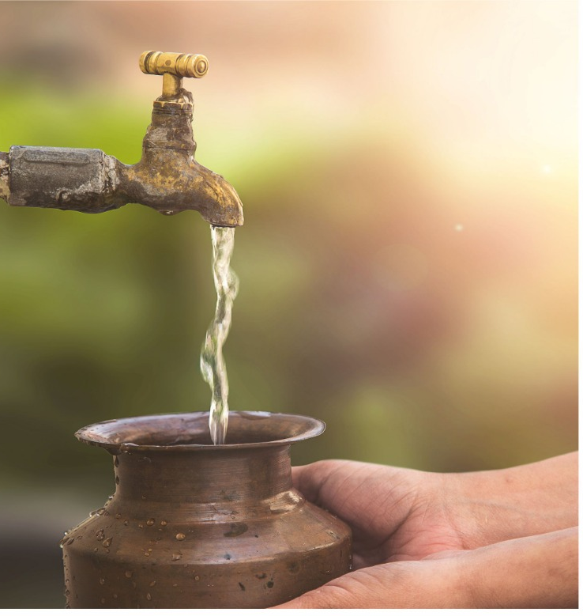
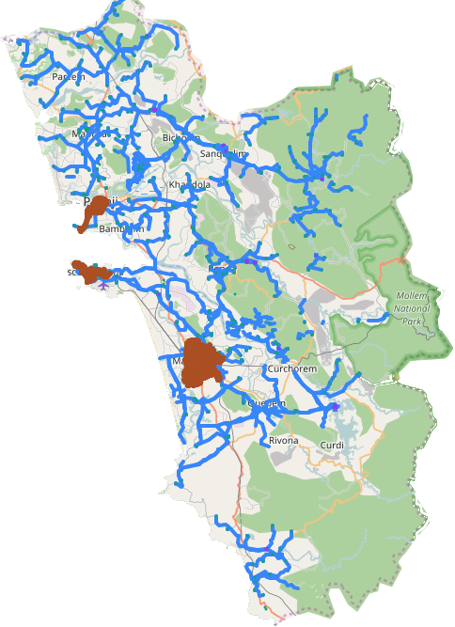
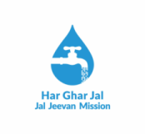


Technology in Drinking Water Supply– Goa Perspective
Ankit Yadav, IAS
District Magistrate & Collector , North Goa District
DEPARTMENT OF DRINKING WATER, GOVT. OF GOA

Slide 2
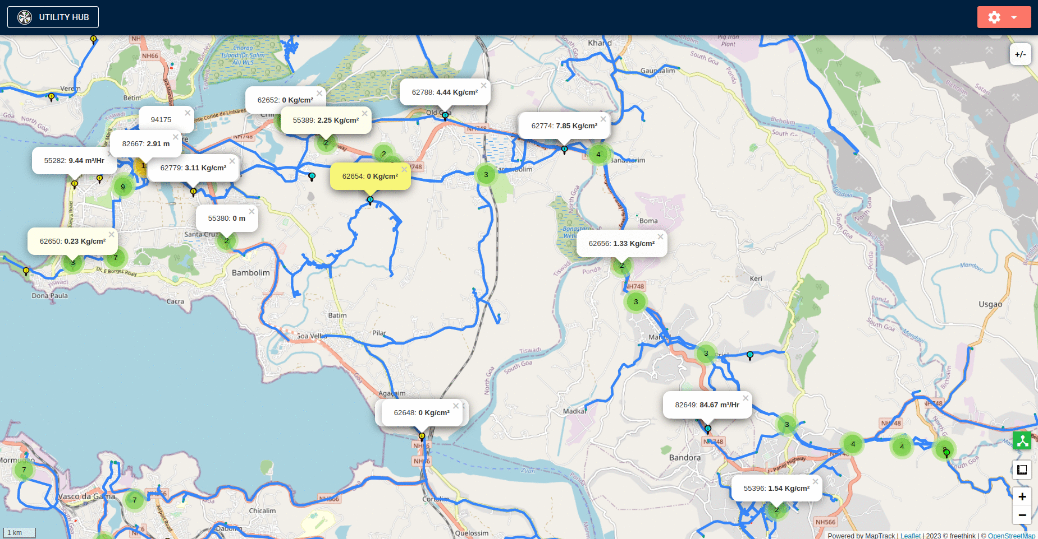
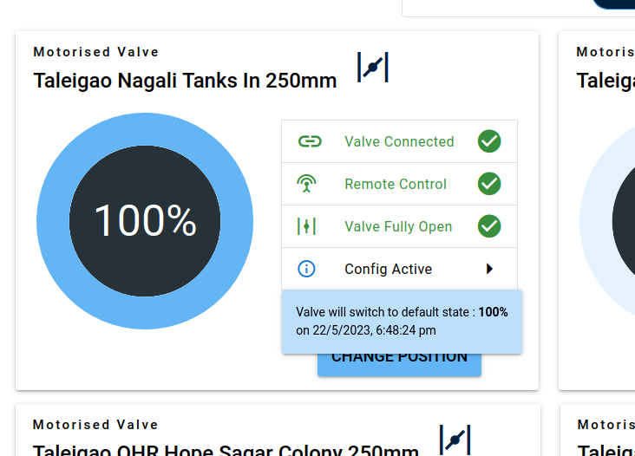
OUR ACHIEVEMENTS – where we stand today
100 % habitations have access to safe drinking water
State of Goa declared HGJ State on 2nd Oct 2020
Uniform access to Urban & Rural population
Supply Levels much better than the G.O.I norms ( 55 LPCD in Rural and 135 -150 LPCD in Urban)
Average Supply Levels in Goa for Rural is 82 LPCD and 143 LPCD for Urban

Slide 3
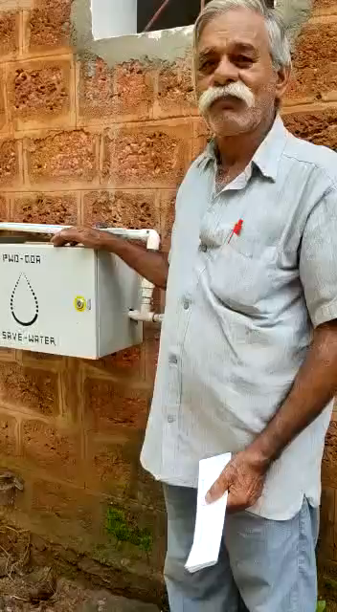
STATEMENT
Promoting “Ease of Living” (EoL) to achieve overall convenience, comfort and quality of life for citizens is a welcome step of the Union Government.
Primary focus is on ease of access to amenities vis-a-vis quality of service delivery.
Main aim is to achieve 100 LPCD in Rural Areas and 150 MLD in Urban areas with 24x7 water for all.
Present coverage is 26.54% with 24x7 water supply.
Voice of a happy beneficiary

Slide 4
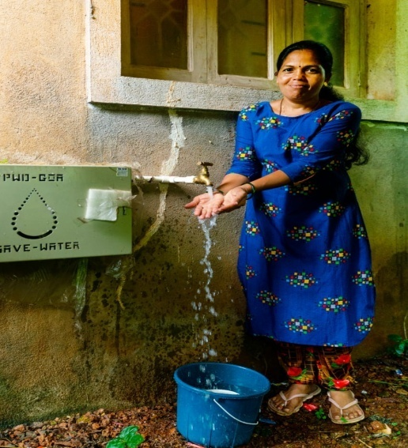
JAL JEEVAN MISSION – recap
As Goa was implementing State Scheme of providing FHTC, the scheme perfectly dovetailed with Jal Jeevan Mission.
During the period 2019-2024, under Jal Jeevan Mission State of Goa received sanctioned for more than Rs.120 Crores with Central Share of Rs.50 Crores.
96% of the water demand is through Regional Water Supply Scheme with surface water as a source to ensure its sustainability and minimal i.e at 4% dependence on ground water. Action Plan is being put in its place to achieve 100% drinking water facilities in the State through surface water as a source.
Now as the next important step, GOA is moving ahead to become SMART WATER UTILITY and Real Time Monitoring under IoT project at Village Level.

Slide 5
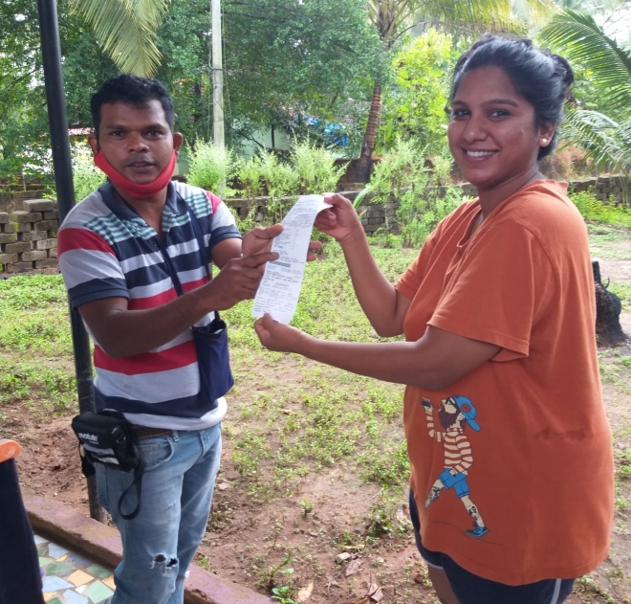
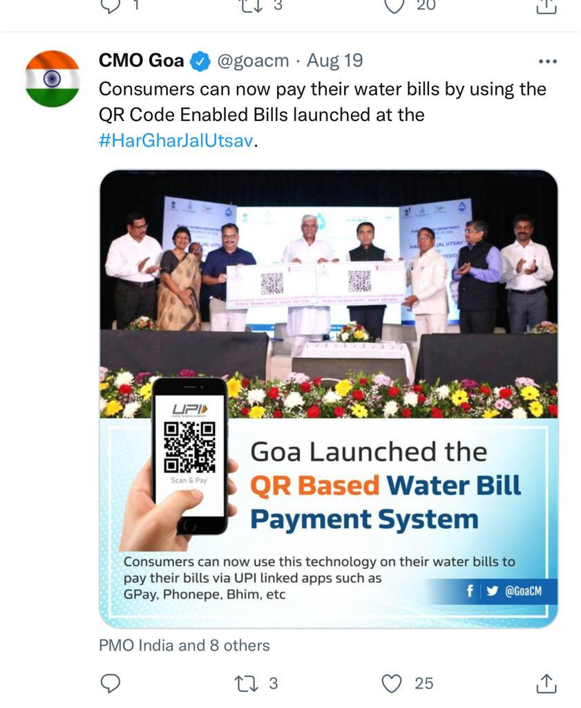
SMART WATER SUPPLY MANAGEMENT
Each and Every household is provided Water Supply through metered functional water tap connection and there is no discrimination between rural and urban population.
Goa achieved entire computerisation of water bills some time way back in 2000.
Common Water Tariff for both rural and urban population and is through on the spot billing which is a real time billing.
QR Code enabled bills are generated for payment of water bills & generating water bills through SMS, e-mail with all other digital payment options provided to the consumer which has also minimized the down time for revenue collection.

Slide 6
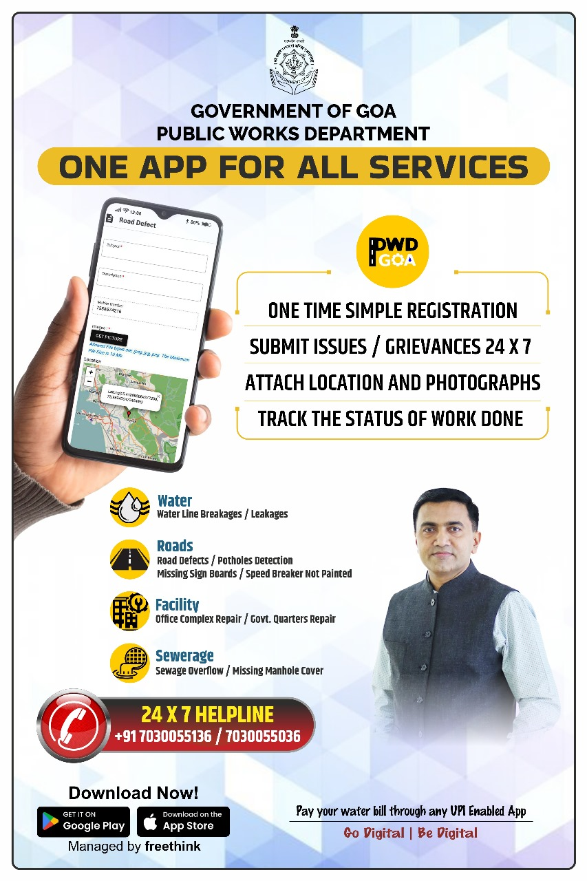
CITIZEN CENTRIC SERVICES
Mobile App is being developed to integrate all the services of Public Works Department into one single Mobile App.
Separate App for Water Supply Billing
Add ONs: (Water Supply and Sanitation)
Release of water connection, sewerage connection, road cutting permission , water leakages and other citizen centric services viz., change of name, category of connection, replacement of meter etc.,
PHE Helpline for 24x7 with GIS based public grievance
Water Supply Billing with IoT and view your water bill
All WTPs and STPs to come under ambit of SCADA management to achieve Smart Water Utility
E-governance of entire DDW
DEV BOREM KORUM

