Slide 1
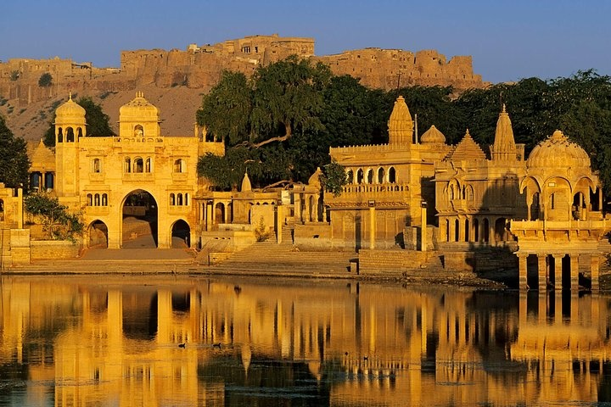


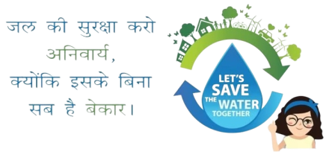
Jal Jeevan Mission under ministry of Jal Shakti
Collector’s Peyjal Samvad
FROM GRASSROOTS TO FOREFRONT
Dated : 17-02-2026
District Water & Sanitation Mission (DWSM) Jaisalmer, Rajasthan
Presented By:
Shri Pratap Singh, I.A.S.
Collector & District Magistrate,
Jaisalmer

Slide 2
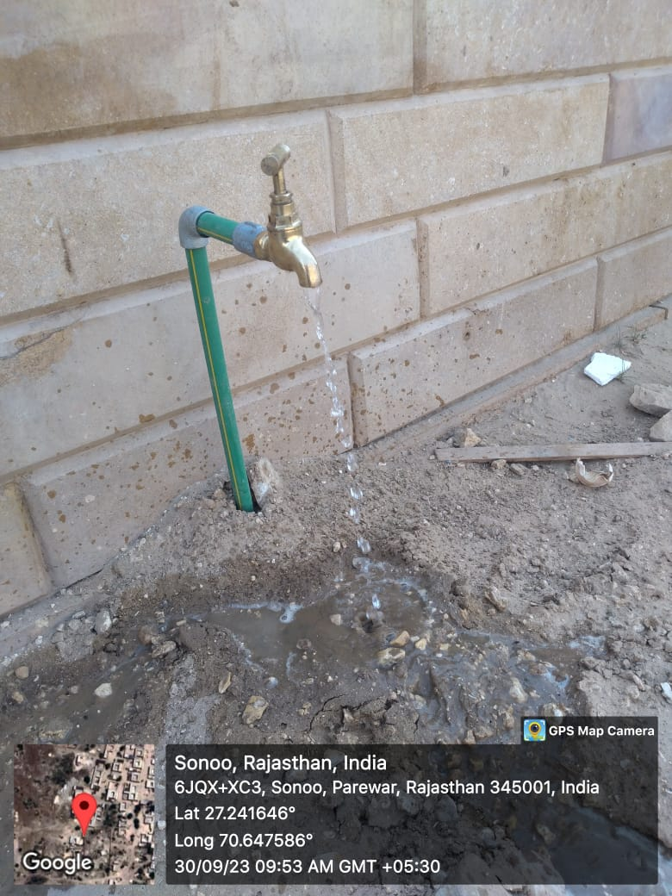
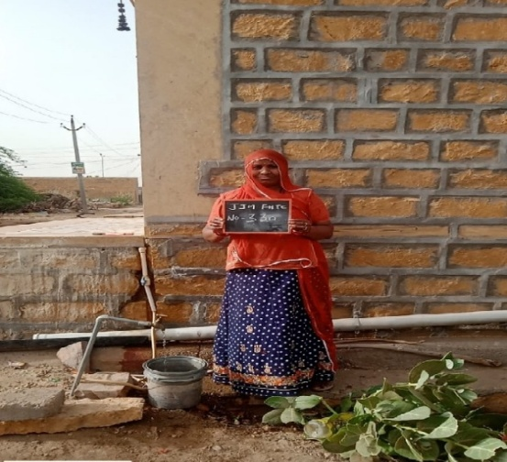
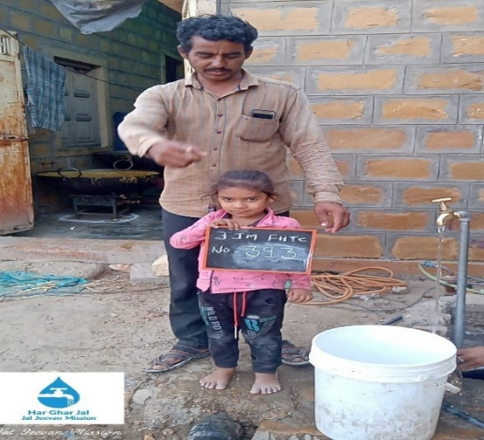
Geographical Scenario of Jaisalmer and present progress of Jal Jeevan Mission
Jaisalmer is situated in western part of India.
It is the largest district of the state with 38,401 sq km area.
Around 70 sq km. area is under urban region while 38,331 sq km. is under rural region.
Jaisalmer has a hot arid climate and is thus prone to extremes of temperature.
The temperature varies greatly from day to night in both summer and winter.
Total HHs – 1,22,958 having population of 6,69,919.
Coverage of FHTCs before JJM
( as of 15th Aug 2019)
Coverage of FHTCs since launch of JJM
( till Jan -2026)
FTHCs covered – 2,442 (1.99%)
FTHCs covered 61,317(49.86%)

Slide 3



Block-wise FHTCs progress under JJM in District Jaisalmer
S.No. | Block | Total Rural HHs | HHs Connections provided till FY 24-25 | HHs Connection provided during FY 2025-2026 |  |  |  |  |  |  |  |  |  |  | Total HHs connections till Jan –2026 | % Progress till Jan-2026 under JJM
 |  |  |  | Apr | May | Jun | Jul | Aug | Sep | Oct | Nov | Dec | Jan | Total
1 | Bhaniyana | 21956 | 8462 | 523 | 800 | 543 | 1014 | 15 | 0 | 46 | 718 | 600 | 0 | 4259 | 12721 | 57.94
2 | Fatehgarh | 23444 | 8704 | 0 | 36 | 22 | 0 | 0 | 0 | 0 | 0 | 0 | 0 | 58 | 8762 | 37.37
3 | Jaisalmer | 14947 | 4102 | 0 | 163 | 0 | 0 | 0 | 0 | 0 | 10 | 167 | 64 | 404 | 4506 | 30.15
4 | Mohangarh | 9569 | 3202 | 104 | 48 | 0 | 0 | 0 | 0 | 0 | 0 | 220 | 0 | 372 | 3574 | 37.35
5 | Nachana | 9482 | 5773 | 103 | 0 | 164 | 0 | 0 | 0 | 0 | 0 | 0 | 245 | 512 | 6285 | 66.28
6 | Sam | 22222 | 11160 | 191 | 232 | 0 | 0 | 14 | 0 | 122 | 105 | 120 | 3 | 787 | 11947 | 53.76
7 | Sankra | 21338 | 12415 | 258 | 178 | 52 | 75 | 8 | 0 | 0 | 393 | 143 | 0 | 1107 | 13522 | 63.37
Total |  | 122958 | 53818 | 1179 | 1457 | 781 | 1089 | 37 | 0 | 168 | 1226 | 1250 | 312 | 7499 | 61317 | 49.86

Slide 4
Availability of drinking water in Schools, AWCs, Gram Panchayat Building & Health Centers
Schools |  | Anganwari |  | Gram Panchayat Buildings |  | Health Centres
Nos. of Schools | Tap Connections | Nos. of Anganwari | Tap Connections | Nos. of Buildings | Tap Connections | Nos. of Health Centres | Tap Connections
1407 | 853 | 713 | 279 | 194 | 194 | 260 | 92
Water Quality Testing
Water Quality Monitoring: Water quality is strictly and regularly monitored by the Dept systematic testing standard protocols for ensuring supply of safe drinking water for all villages. Water testing are conducted at District level Laboratories (At Gajroopsagar Jaisalmer).
Water Testing at the Village/Community Level: Each villages have five trained women for testing water samples through portable water field testing kit (FTK).
Total No. of Villages | No. of Villages having 5 women trained for FTK | No. of FTK Users | Total No. of District Laboratories | Total No. of Block Laboratories | No. of NABL accredited Laboratory | Total No. of WTP’s
756 | 756 | 86 | 1 | 6 | 1 | 34

Slide 5
Best Practice on Source Sustainability
Initiatives
Promotion of conjunctive use of canal water and groundwater to reduce stress on a single source.
Integration of rainwater harvesting structures at village and institutional level.
Implementation of artificial recharge measures in critical groundwater blocks
Strengthening village-level storage capacity (2-3 days).
Action
Awareness programs on water conservation and groundwater protection.
Periodic pre- and post-monsoon groundwater monitoring.
Leakage control in transmission lines to reduce non-revenue water.
Active involvement of VWSCs in monitoring source performance and tariff collection.

Slide 6
VWSC Strengthening & Institutional Capacity
Challenge
Weak local O&M capacity, low user charges collection, limited technical skills
Technical Features / Capacity Actions
VWSCs formalized with 11-15 members, 50% women
Training topic are 1. Valve operation 2. Meter reading 3.Leak detection 4. Chlorination.
Monthly O&M registers and other financial books maintenance.
Impact
VWSCs operate schemes independently
Faster repairs, improved O&M discipline and tariff recovery

Slide 7
Challenges in Providing Water Supply in Jaisalmer Areas
Geographical Challenges
Operational Challenges
Institutional Challenges
  Desert terrain & shifting sand dunes
  Deep & declining groundwater levels
  High salinity & fluoride contamination
  Extreme heat & high evaporation
  Scattered & remote settlements
  Long transmission pipelines
  High O&M cost
  Frequent pump breakdowns
  Irregular power supply
  Canal closure dependency
  Limited financial allocation
  Shortage of technical manpower
  Procurement delays
  Weak monitoring mechanisms
  Inter-department coordination gaps

Slide 8
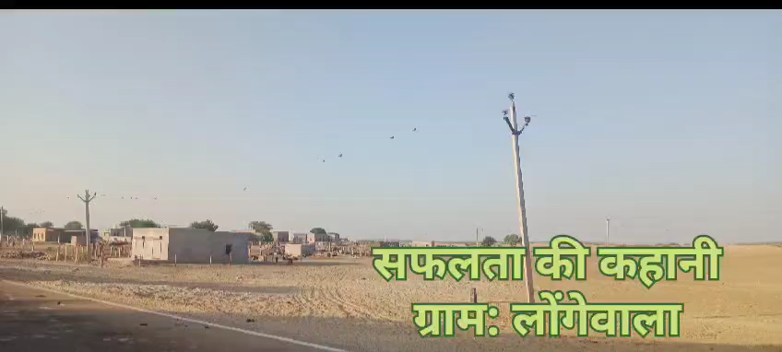
SUCCESS STORIES (VIDEO) ON LONGEWALA VILLAGE

Slide 9
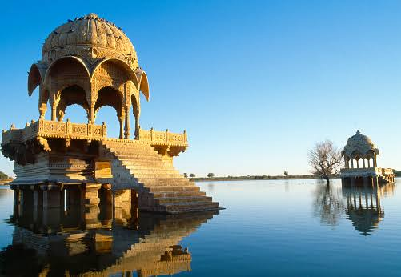
Thank You !

