Slide 1
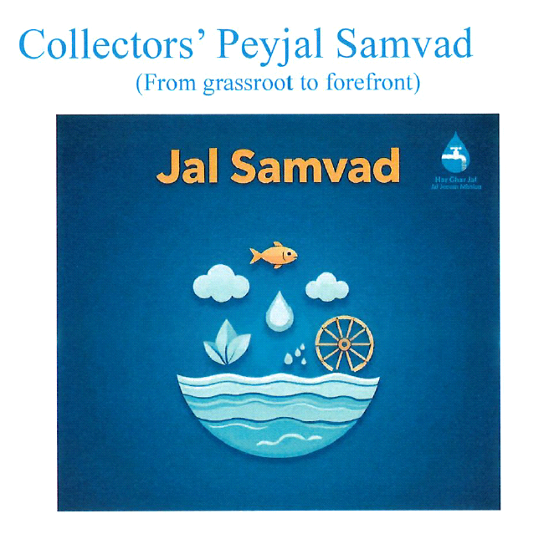
PWSS Functionality & Best Practises
DWSM
South Andaman District
A & N ISLANDS

Slide 2

JAL JEEVAN MISSION
OVERVIEW
No. of Schemes Sanctioned under JJM during 2020-21 / 2021-22 – 40 Nos.
of Rs.14.70 Crores.
Status of Work: All 40 schemes completed at a cost of Rs. 11.43 Crore
Fund Released by Ministry: 10.39 Crore
Expenditure made under JJM: 10.08 Crore
Requisition placed for balance fund = 1.35 Crores
FHTC details:
UT | No. of Rural Households | No. of Rural Households with piped water supply | % of Houses with Piped Water Supply | No. of Households with Individual Tap connections | % of Households with Individual Tap connections | Status
ANI | 0.62 lakhs | 0.62 lakhs | 100% | 0.62 lakhs | 100% | Saturated
UT | Total Villages | No. of ‘Har Ghar Jal’ Villages reported | % of ‘har Ghar Jal’ village | No. of Villages certified | % of villages certified | Status
ANI | 265 | 265 | 100% | 265 | 100% | Saturated

Slide 3
DISTRICT WISE FHTC COVERAGE UNDER JJM
Sl. No. | District | Villages | Population | Households
1. | South Andaman | 89 | 118862 | 28810
2. | North & Middle Andaman | 114 | 97885 | 24400
3. | Nicobar | 62 | 34868 | 8827
 | Total | 265 | 252204 | 62037
A&N Islands become 3rd among all states and UT to achieve 100% FHTC coverage on 22nd March 2021.
A&N Island become only State to be declared as Swachh Sujjal State in the country after 100% certification of Har Ghar Jal villages by Gram Panchyat on 16.09.2022.

Slide 4
WATER SUPPLY DIVISIONS
(South Andaman District)
S/No. | District | Divisions | Gram Panchayat | Villages | Population | Households
1 | South Andaman | PHED* | 09 | 29 | 50800 | 12162
 |  | RCD | 12 | 43 | 40674 | 9375
 |  | CD-I | 03 | 10 | 9355 | 2376
 |  | MID | 04 | 07 | 18033 | 4897
TOTAL |  |  | 28 | 89 | 118862 | 28810
Note : PHED provides bulk supply to SVPMC for covering SVP urban water supply
besides South Andaman rural.

Slide 5
DWSM Meeting to review Water Availability & Plan for Summer 2026
A meeting was held on 02.02.2026 at 1700 Hrs to discuss water availability and management for summer 2026, chaired by the Deputy Commissioner of South Andaman District, with various committee members in attendance.
PRI Members proposed several measures to augment water supply, including:
• Desilting and rejuvenating existing water sources.
• Increasing storage capacity in Mannarghat.
• Strengthening the Vasundhara Nallah Check Weir.
• Implementation of the Guptapara Water Supply Scheme.
• Construction of a Check Weir in the downstream of Sona Pahad Dam.
• Taking over water supply assets created by Zilla Parishad in Beodnabad Panchayat.
• Cleaning the Coast Guard Diggi.
Decisions Taken :
A dedicated complaint number will be established for reporting water supply damages and repair issues.
APWD will constitute a team to identify and rectify water leakage in the distribution network.
A technical team will inspect defunct water sources and initiate rejuvenation measures wherever feasible & undertake desilting of viable water sources to enhance water availability before the summer peak.

Slide 6
Best Practices South Andaman
Source Sustainability
De-silting of existing Reservoirs, Ponds etc & cleaning of wells before the onset of monsoon
Recharge wells through recharge pits
For FHTC sustainability, 29 Ponds of 158.68 ML capacity, 17 Bore wells of 1.60MLD and 02 Wells of 0.04 MLD completed. Further proposal for 07 Ponds of capacity 290 ML for FHTC sustenance.
2. Water Quality Monitoring & Community Testing
Regular testing of Drinking water is implemented through the Water Quality Information Management System (WQMIS) by testing at
a. Source, WTP, Distribution end
b. NABL Lab established at District level
3. Operation & Maintenance given top priority
Leak detection of main & distribution lines regularly carried out by APWD Deptt & complaints if any from the Villagers are promptly addressed to prevent wastage of water.

Slide 7
4. Water Conservation Awareness (IEC) activities
Survey as per standard format (In Schools & Institutions). Social water audit as per format has been circulated to all schools to evaluate consumption, identifying wastage & recommend efficiency improvements. This aims for behavioural change in better water management.
Training conducted by APWD to all School teachers for the awareness & assessment
Creating awareness through water concert, Nukkad Natak & Print Media
Awareness rally conducted by APWD on 21.01.2026
Water concert conducted on 03.02.2026 in Marina Park, SVP

Slide 8
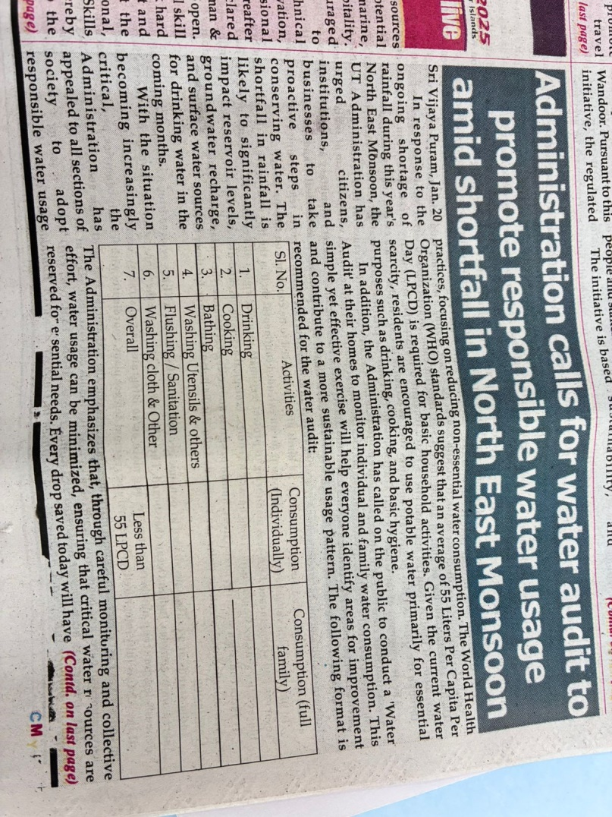
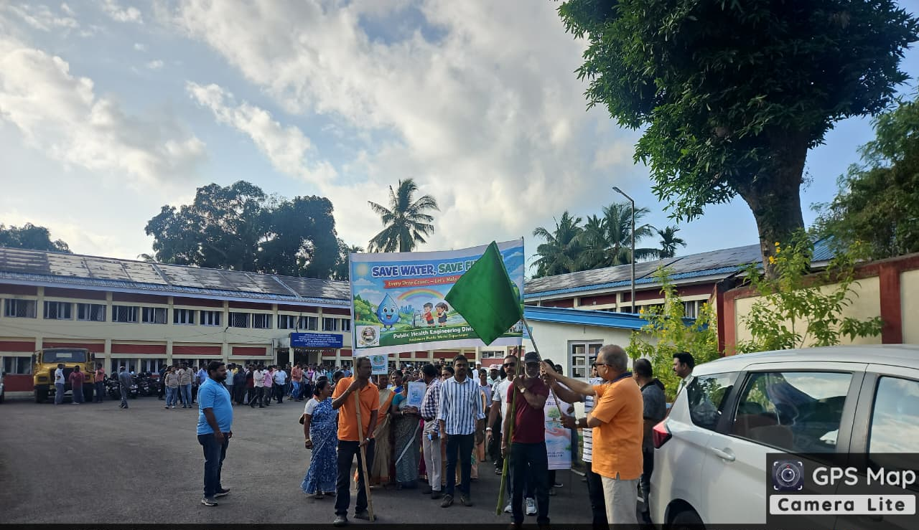
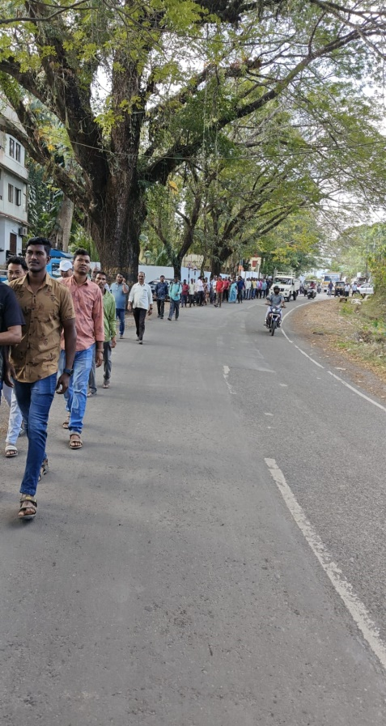
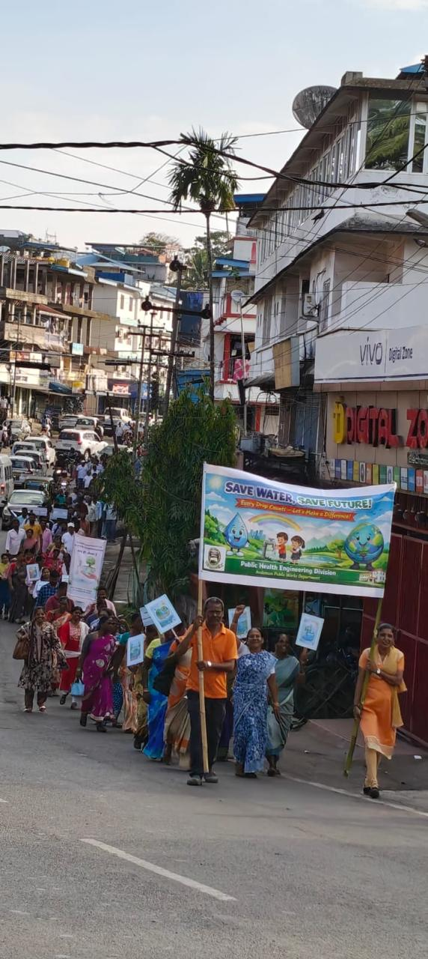
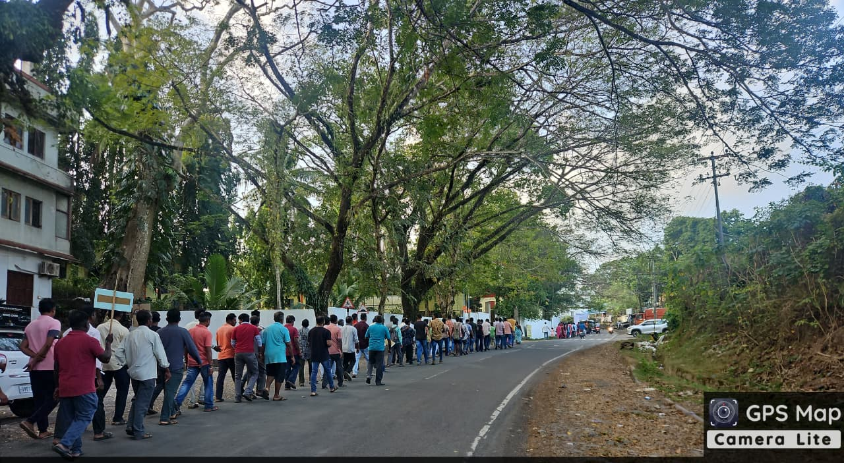
Awareness Rally (21.01.2026)
Awareness through (Print media)

Slide 9
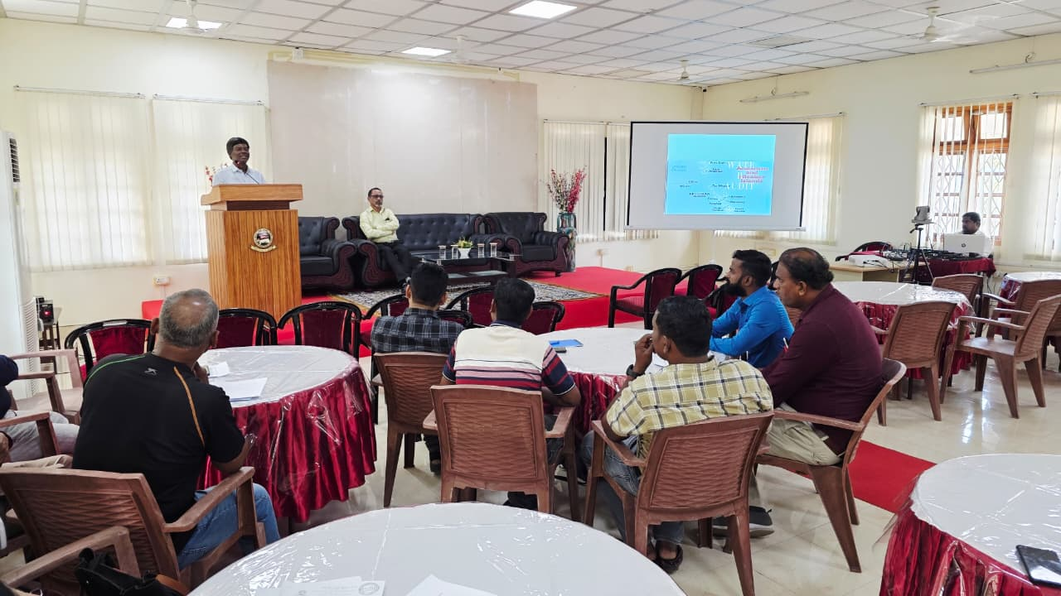
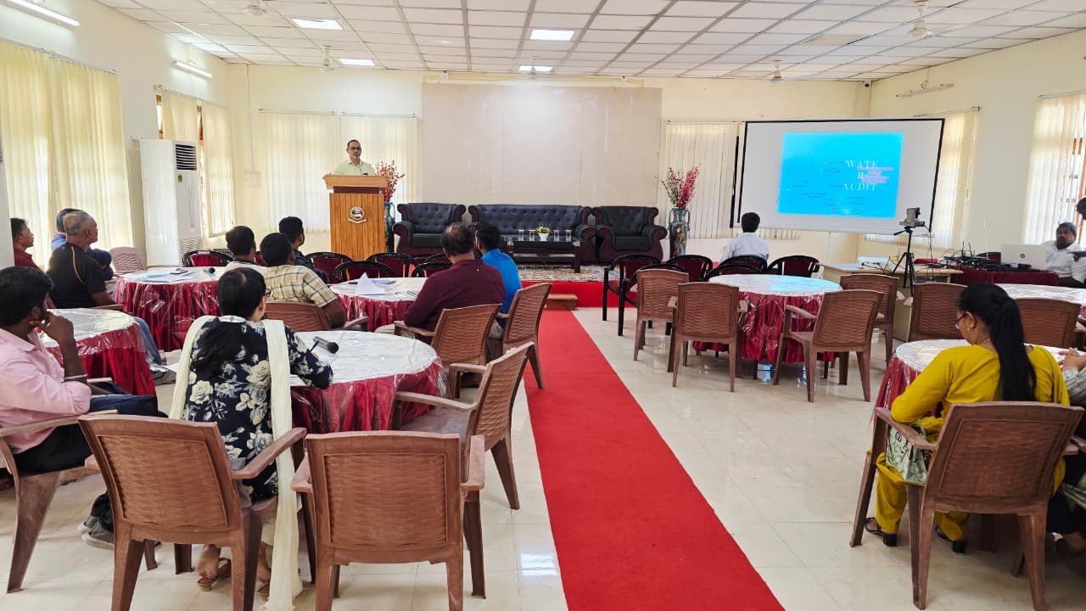
AWARENESS CAMPAIGN OF MASTER TRAINERS AT CE’s OFFICE COMPLEX

Slide 10
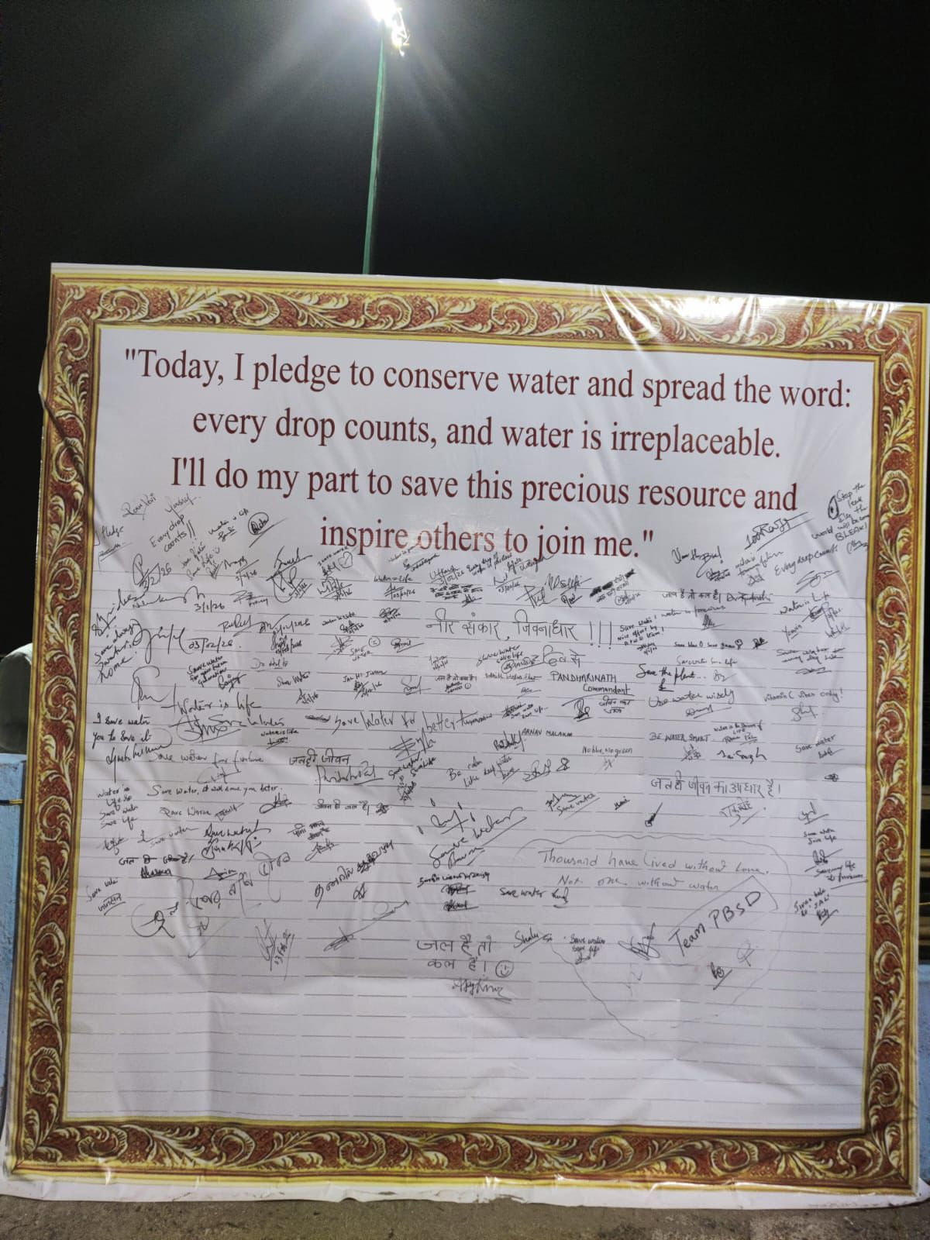
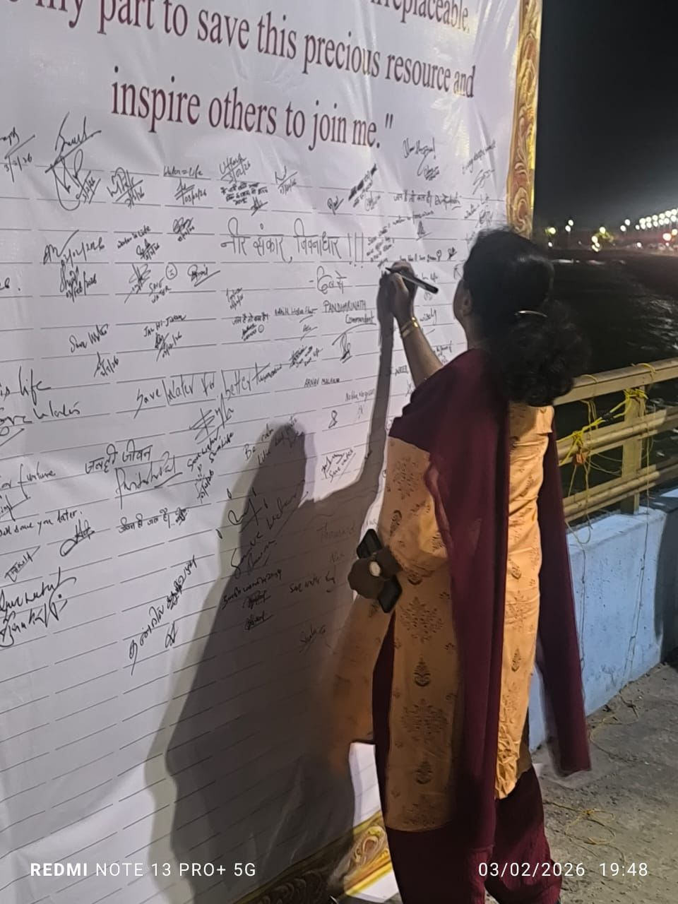
WATER CONCERT AT MARINA PARK

Slide 11
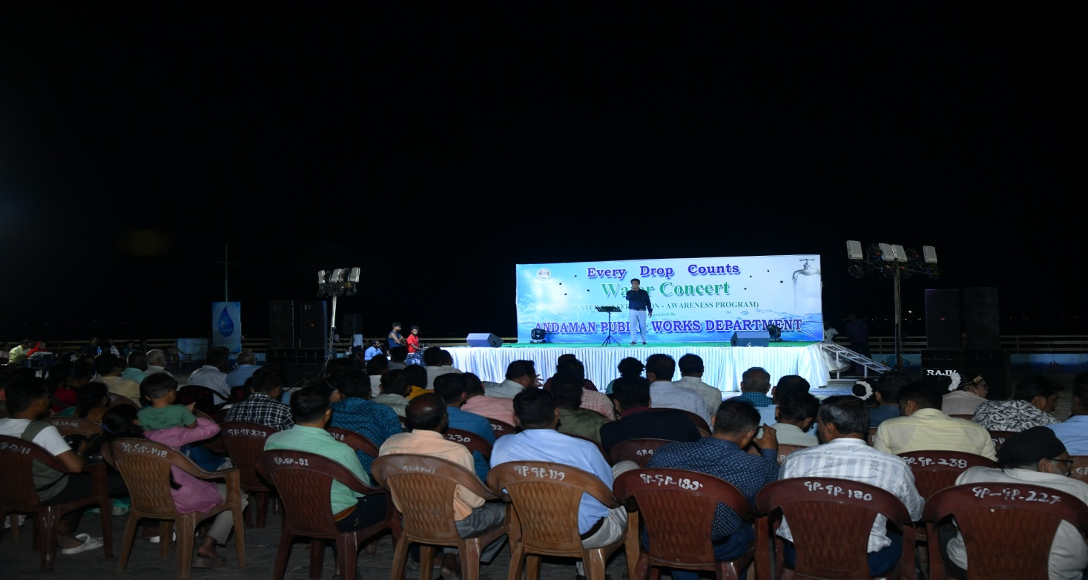
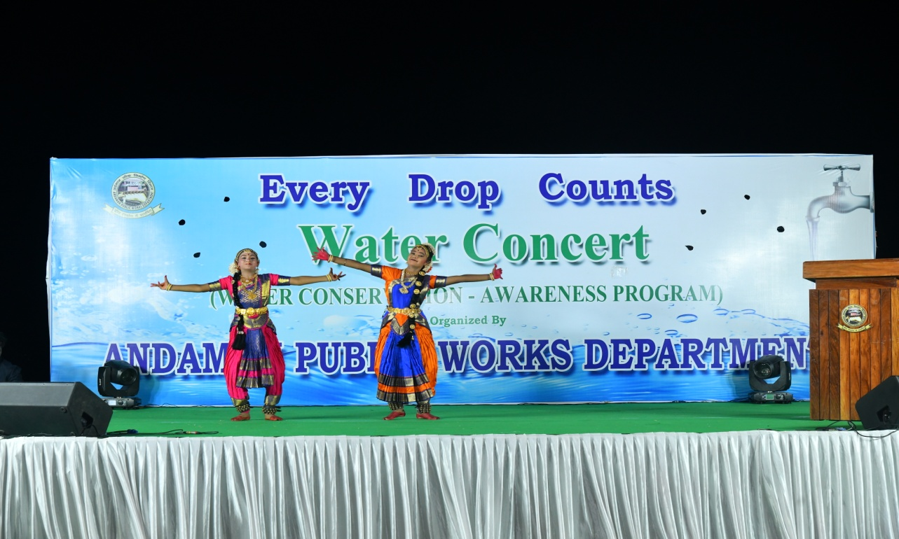
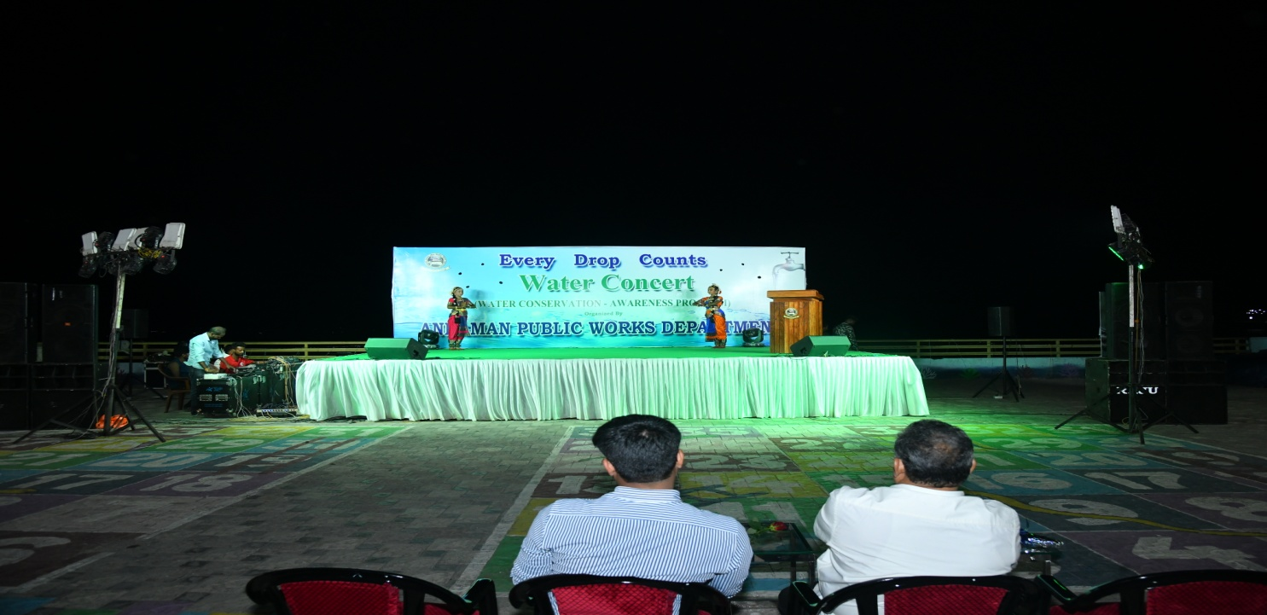
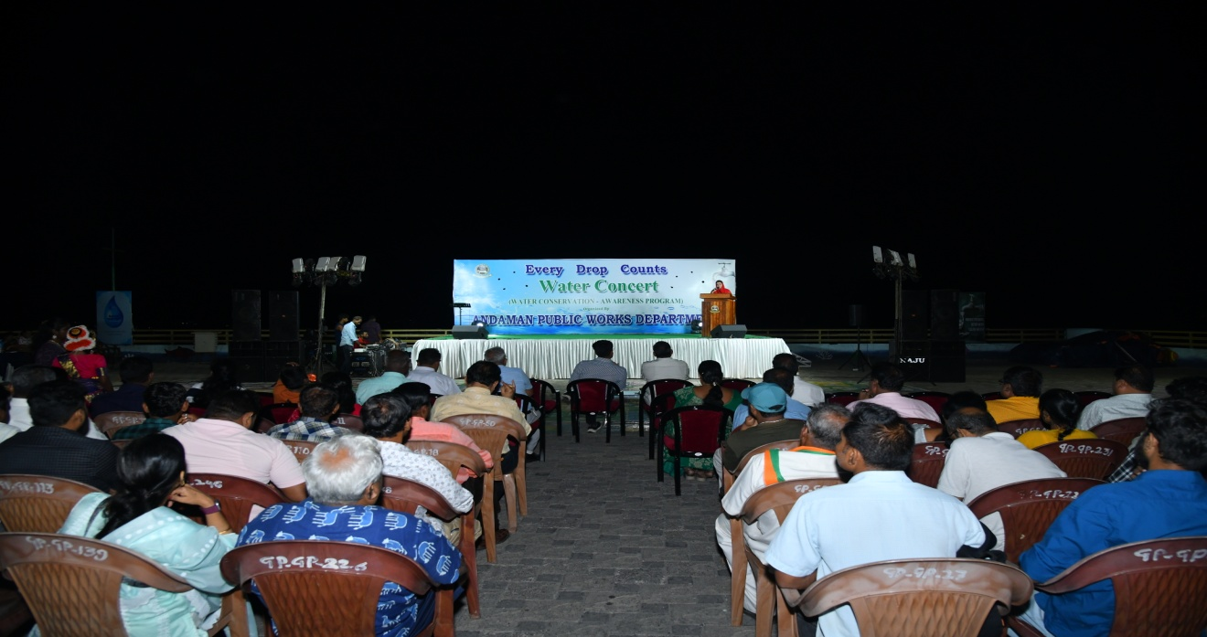

Slide 12
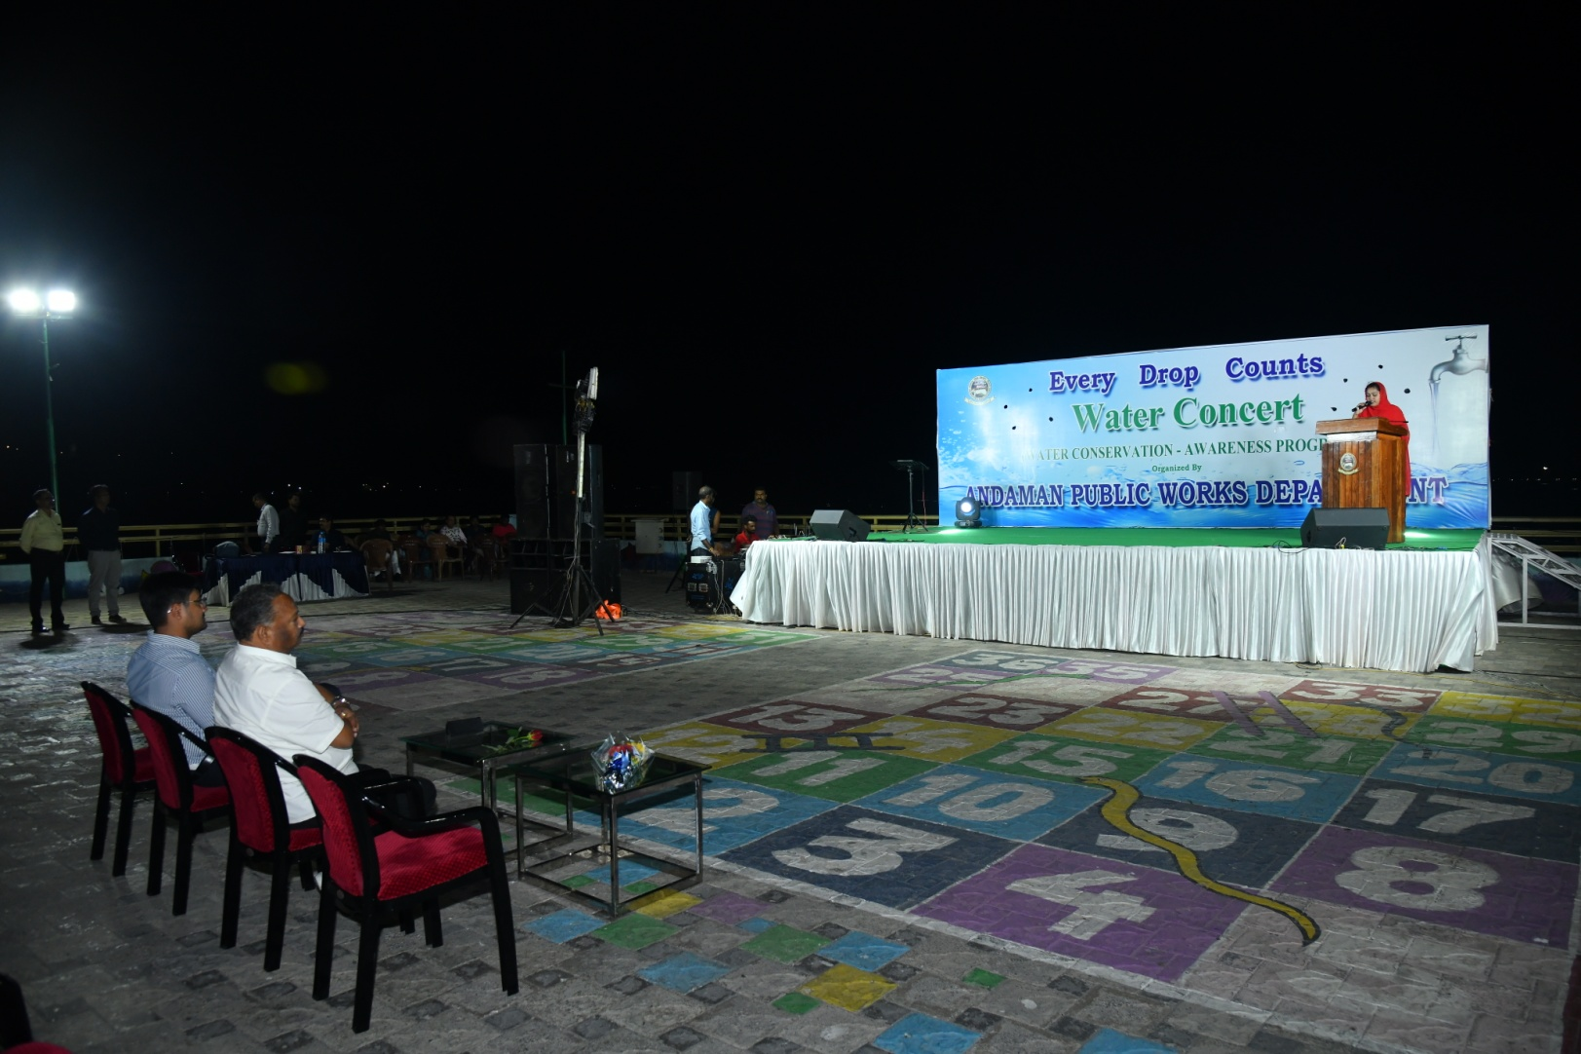
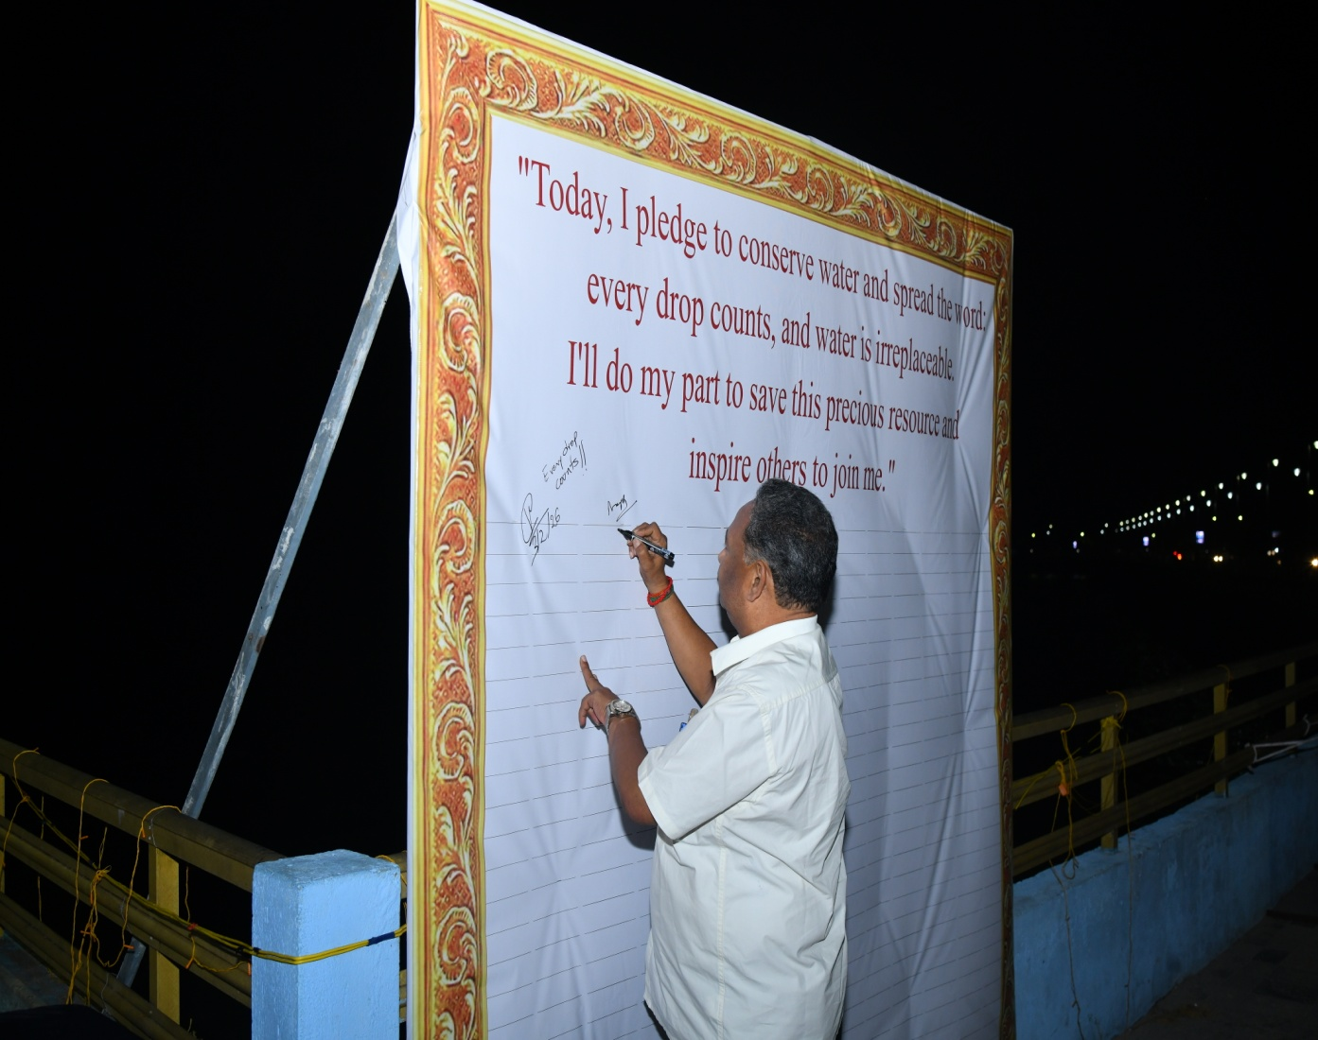

Slide 13
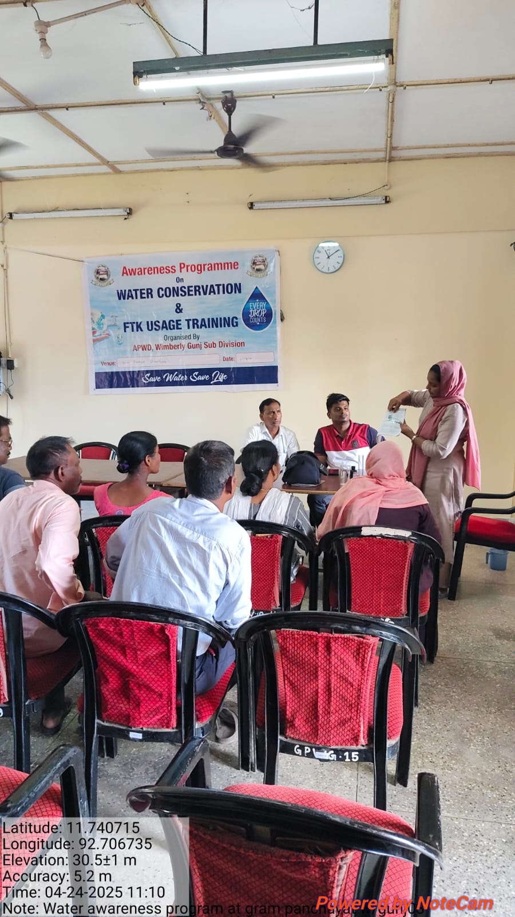
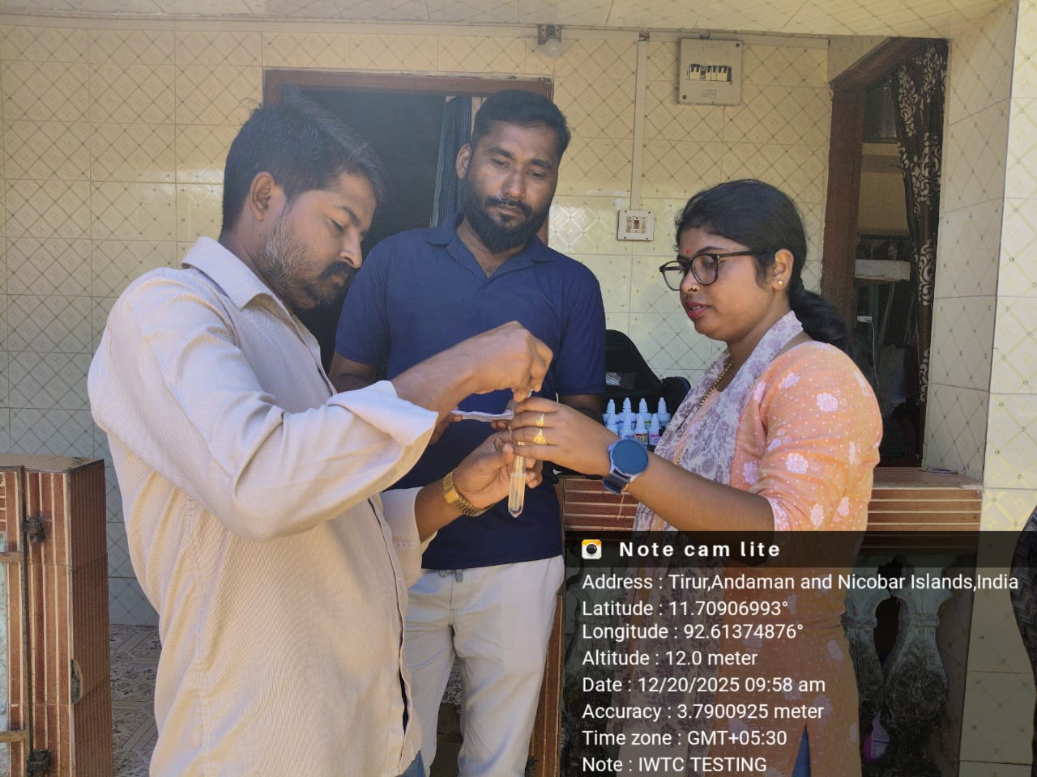
Glimpses of Water Quality Testing In site & Panchayats
Water being tested and compared in Panchayat office
Water being tested and compared on site

Slide 14
Thank You

Slide 15
FORMAT
Activity | Ltrs of Water used | No. of times activity done each day | Total water used by a person each day (litres) | No. of people in the household | Total household water consumption/ day
Wash hands and face
Bath
5-minute shower
Teeth cleaning (tap running very slowly - rather use a Mug)
Toilet Flushes
Drinking (Cup)
Washing dishes (Hand)
Dishwasher
Washing Machine (One 3 Kg Load)
Hand washing (1 Tub Load)
Leaking/ Dripping tap (1 Drop/ Second Each Day)
Cooking (Meal for Five people)
Total consumption per day

