Slide 1
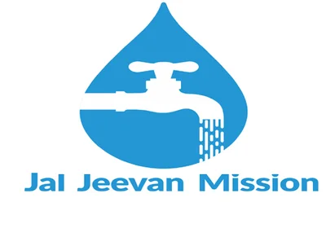

PEYJAL SAMVAD
District Water & Sanitation Mission (DWSM), Bahraich
February 17th, 2026
Presented by Akshay Tripathi ,DM and collector, Bahraich

Slide 2
District Overview
Bahraich district serves 5,54,464 households across 1,045 Gram Panchayat and village Councils as per IMIS, demonstrating significant progress in water accessibility and sanitation development.
Coverage Metrics Status
Total Household 5,54,464
FHTCs Provided 5,43,419
Overall coverage (%) 98.01
Har Ghar Jal Villages 1364 / 849
School with tap water 2623 / 2623
Anganwadis with tap water 3268 / 3268

Slide 3
Planning and Implementation
At the District level , District Water and Sanitation Mission (DWSM) is responsible for overall monitoring and implementation of JJM. The DWSM ensures the quality and timely completion of Jal Jeevan Mission (JJM) projects through a multi-pronged strategy that includes robust monitoring, community participation, and technical oversight. The DWSM is chaired by the District Collector and includes technical experts, making it the central body for project implementation and accountability at the district level.
For quality assurance –
1- Third-party inspections
2- Regular water quality monitoring (A-Lab testing B-Field testing)
For timely completion –
1- Project management support
2- Digital monitoring dashboards
3- Regular review meetings
4 - Inter-departmental convergence
5- District action plans (DAPs)

Slide 4
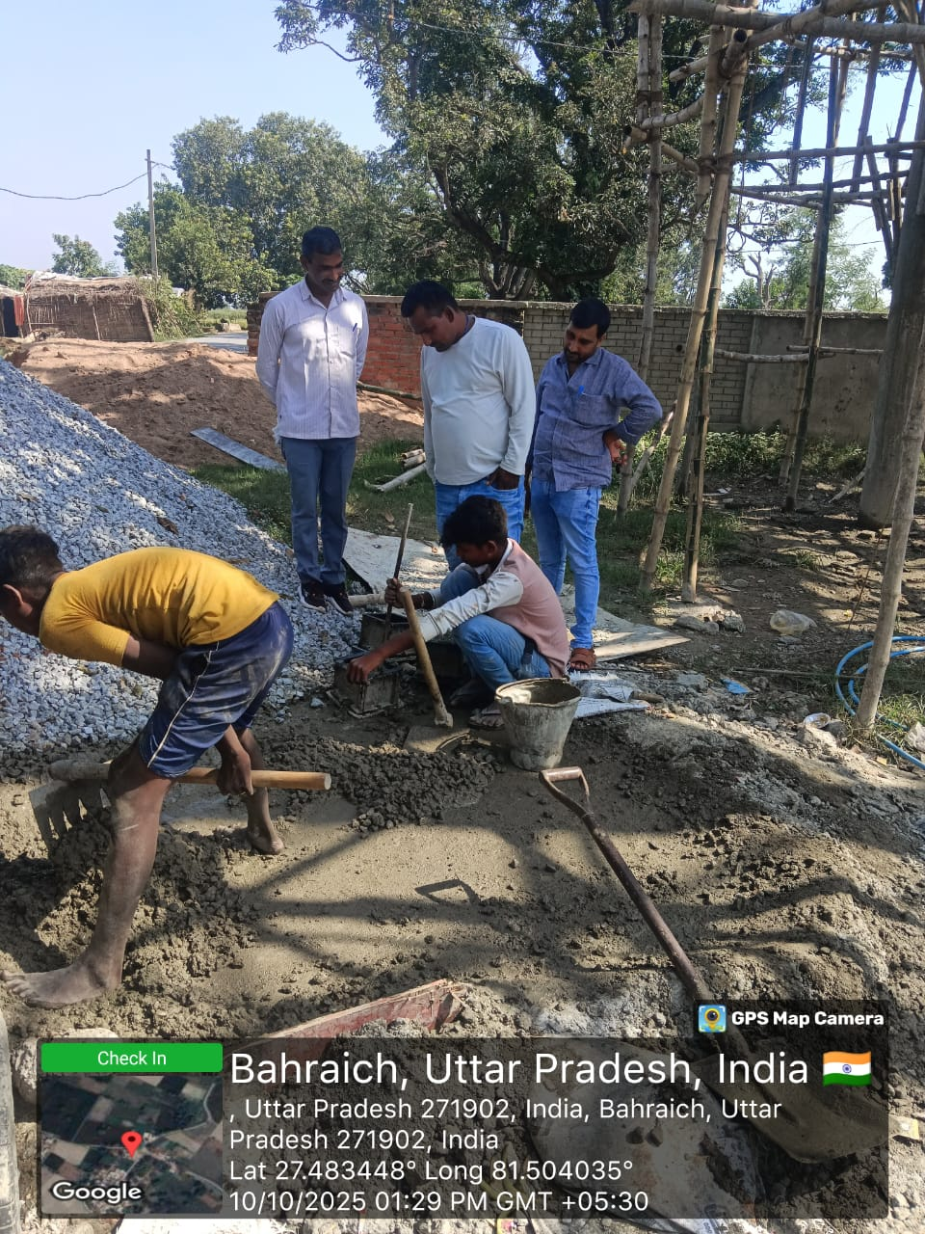
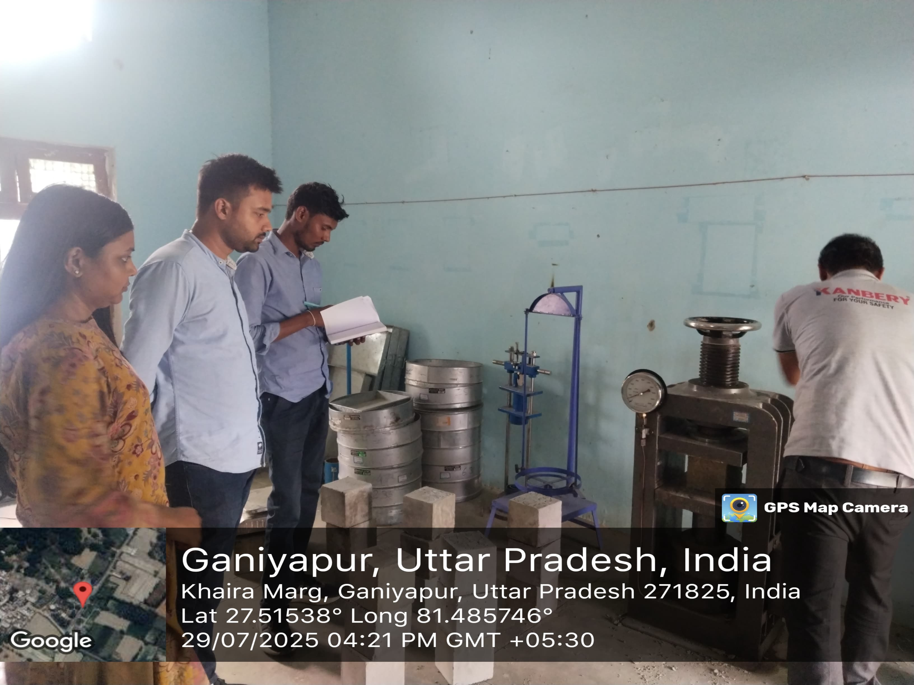
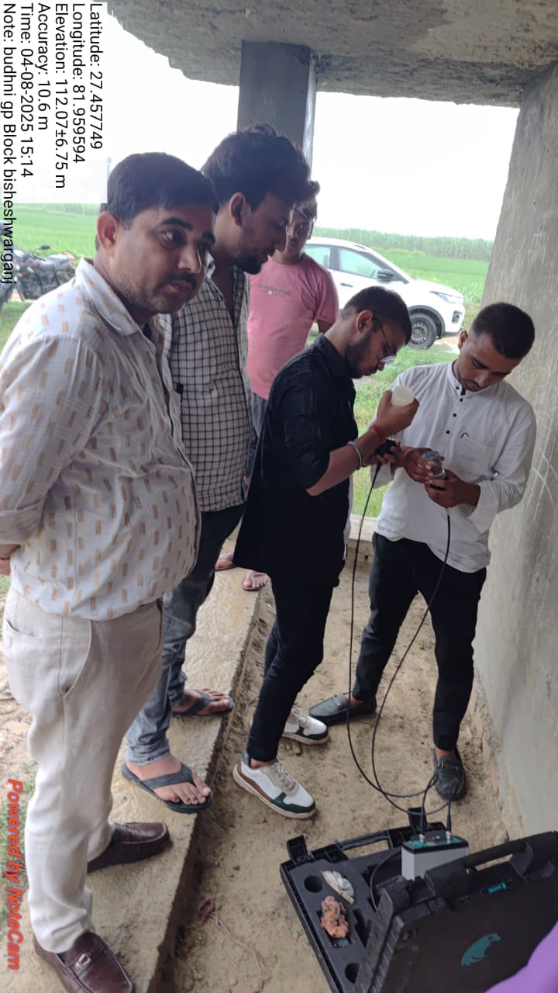
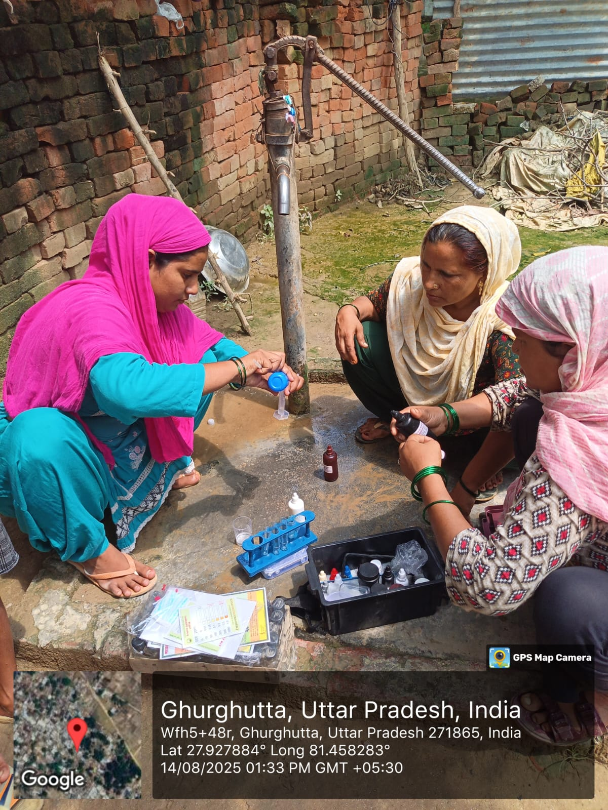
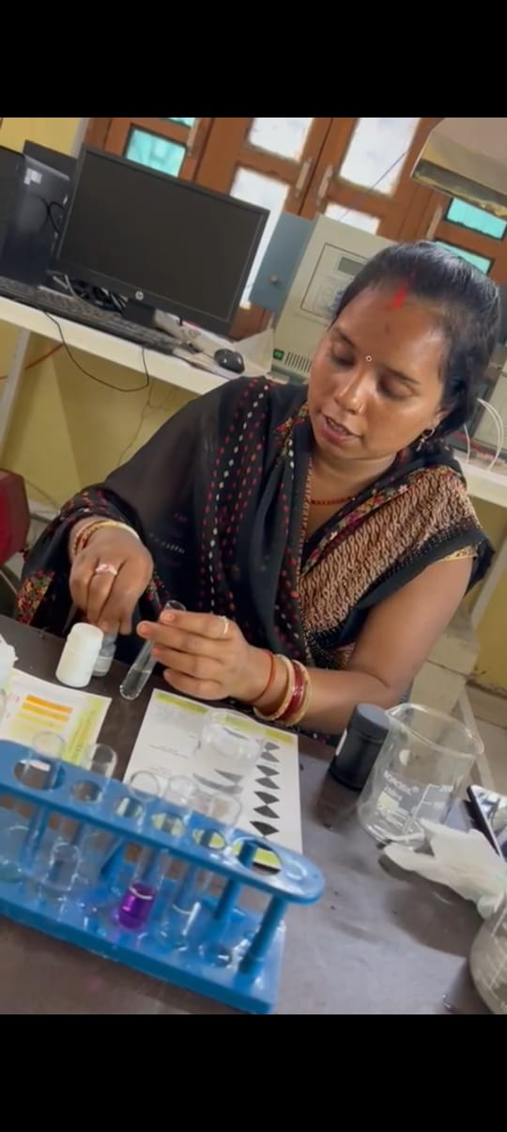
For quality assurance
Third-party inspections: During Civil/E&M work regular inspection done by TPI . Empanelled third-party agencies conduct independent inspections of project infrastructure to ensure the use of quality materials and proper construction.
TPI inspection during casting and cube molding Cube test at VPL lab in presence of AE & TPI NABL UPV NDT test in presence of AE & TPI
Regular water quality monitoring: The DWSM oversees regular testing of water samples at both the source and delivery points by-
A - Lab testing: District-level water testing labs, many of which are NABL-accredited, analyze water samples for contaminants.
B - Field testing: To empower the community, at least five women in each village are trained to use Field Test Kits (FTKs) for local testing.
Water test by FTK Women GP- Ghurghutta & Maghi Water test at UPJN Lab Bahraich
Block- Balaha

Slide 5
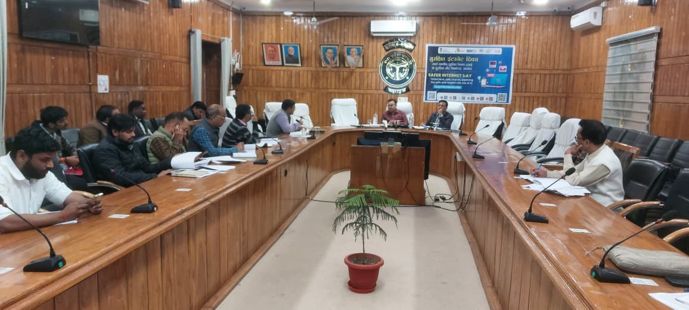
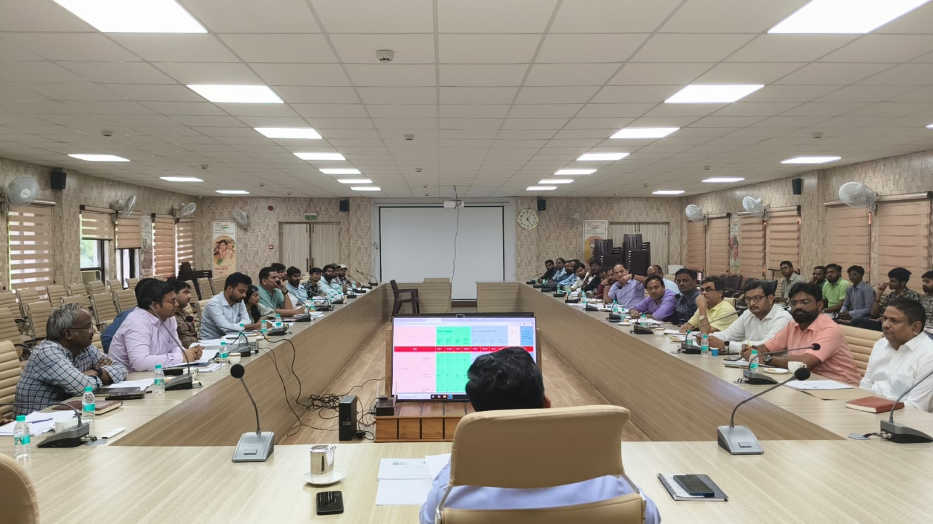
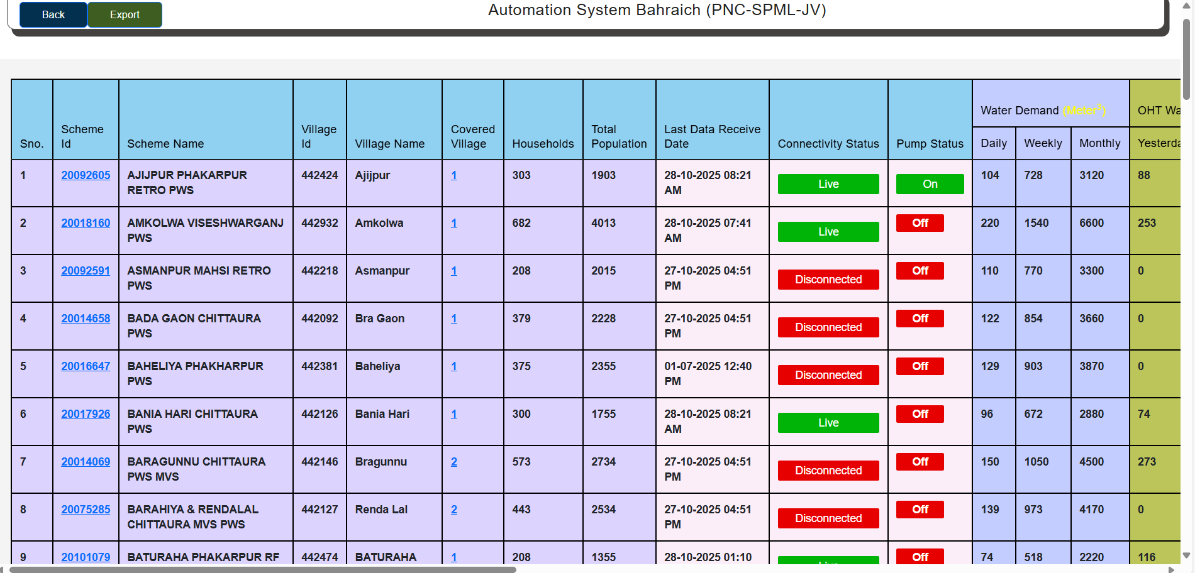
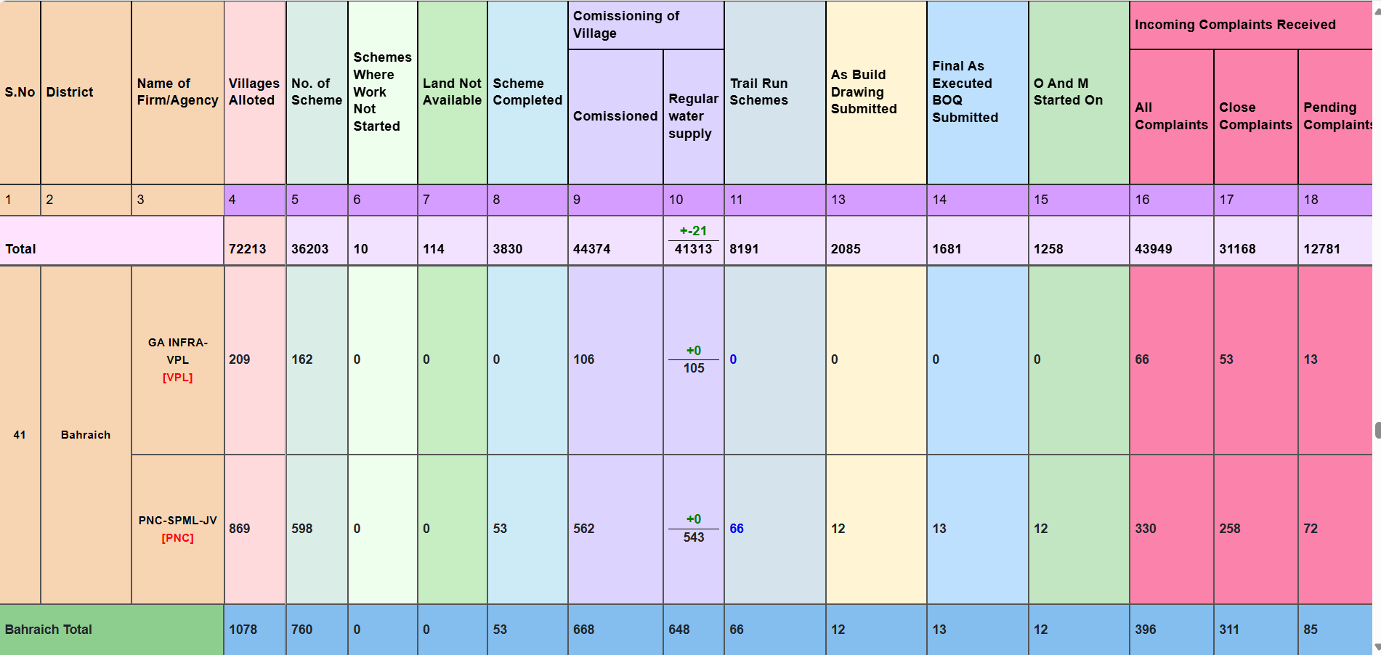
For timely completion
Regular review meetings: The DWSM holds monthly meetings to review progress and provide administrative and financial approval for in-village schemes. This provides a platform to address implementation challenges promptly.
Review meeting with EE UPJN and other officials Review meeting with EE UPJN , EE UPPCL and other officials
Inter-departmental convergence: DWSM coordinate with other government departments, such as Rural Development, Health, and Education, to pool resources and align project timelines for greater efficiency.
Digital monitoring dashboards: DWSM uses dashboard to instantly monitor the progress of projects in their district. This tool allows them to identify and address bottlenecks in implementation in a timely manner.
JJM UP dashboard for automation of scheme JJM UP dashboard for company progress

Slide 6
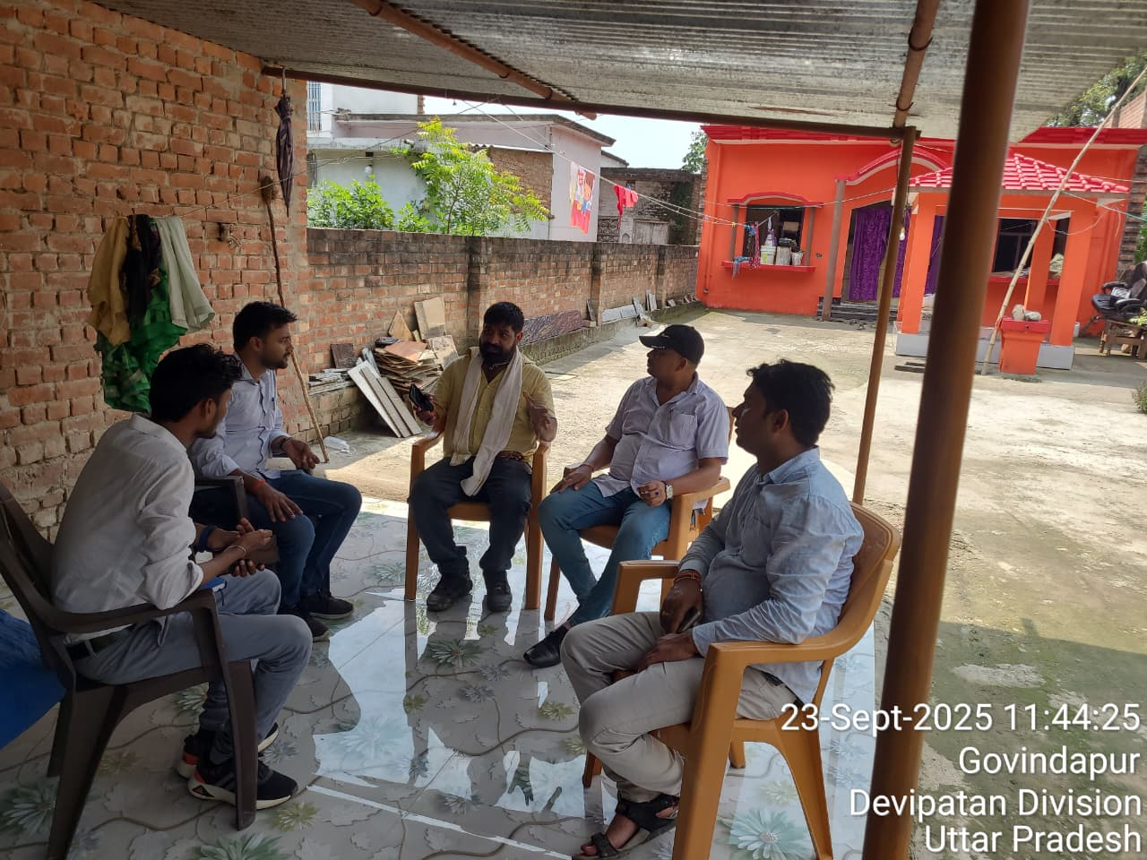
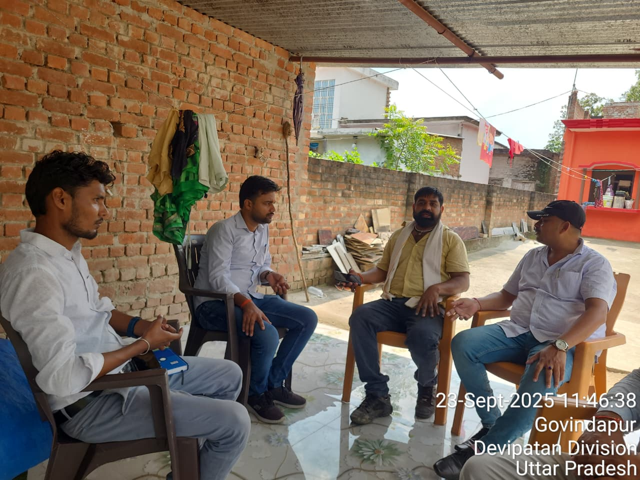
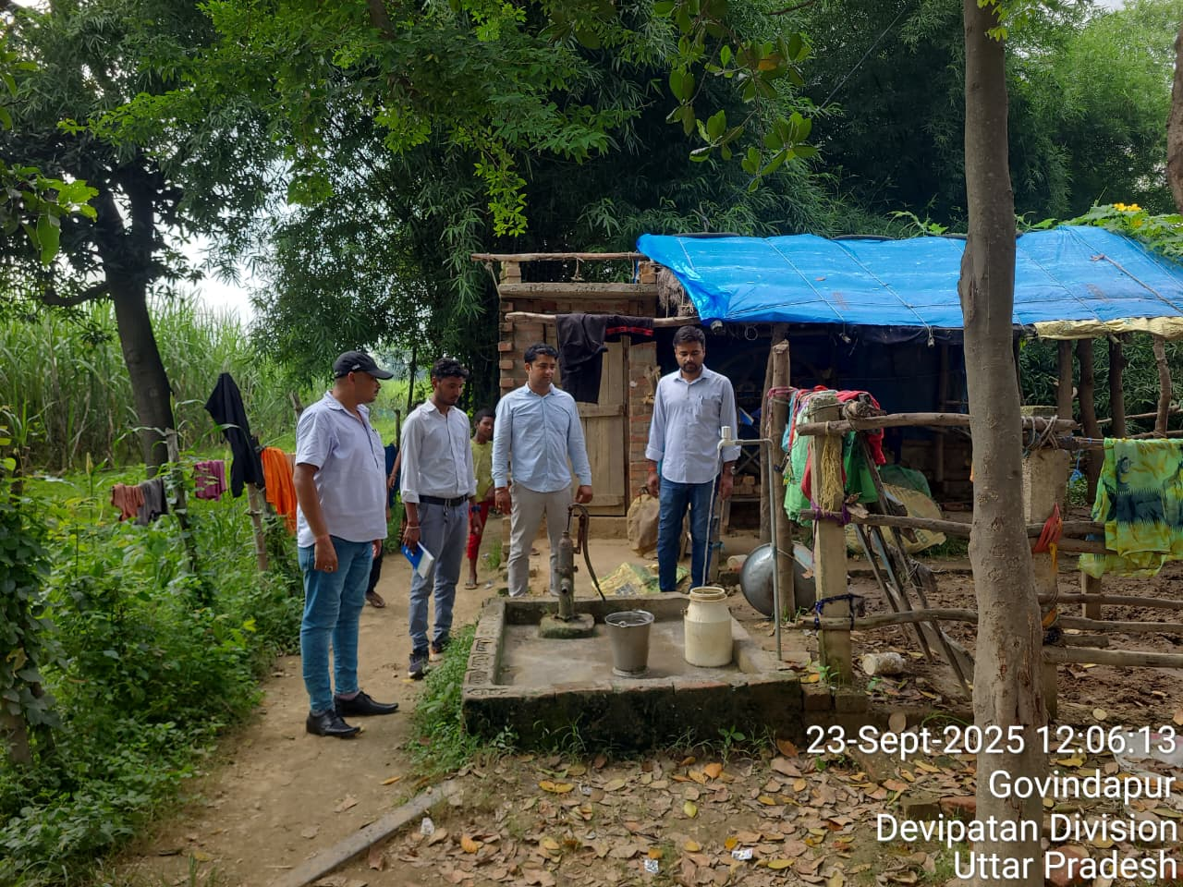
Protocols for handing over of village infra
The DWSM has developed and issued a comprehensive set of protocols and guidelines to facilitate the systematic handover of village-level Piped Water Supply (PWS) infrastructure to the respective Gram Panchayats (GPs).These protocols clearly outline the roles, responsibilities, and timelines for all stakeholders involved — including the DWSM, Implementing Support Agencies (ISAs), and the GPs , to ensure smooth transition and sustainable management of the water supply systems.
Key components of the protocol includes-. 1-Inventory and Documentation-Preparation of detailed asset registers covering all civil, electrical, and mechanical components of the PWS scheme.
Formal Handover Process-Execution of formal handover certificates between DWSM and GPs, ensuring accountability and transparency.
Joint Verification- Conducting joint inspections by DWSM and GP representatives before final handover.
Meeting between AE & Gram Pradhan before O&M (Handover Process) starts Inspection of GP by AE & TPI before O&M starts
GP- Rasoolpur Saraiya, Block- Chittaura

Slide 7
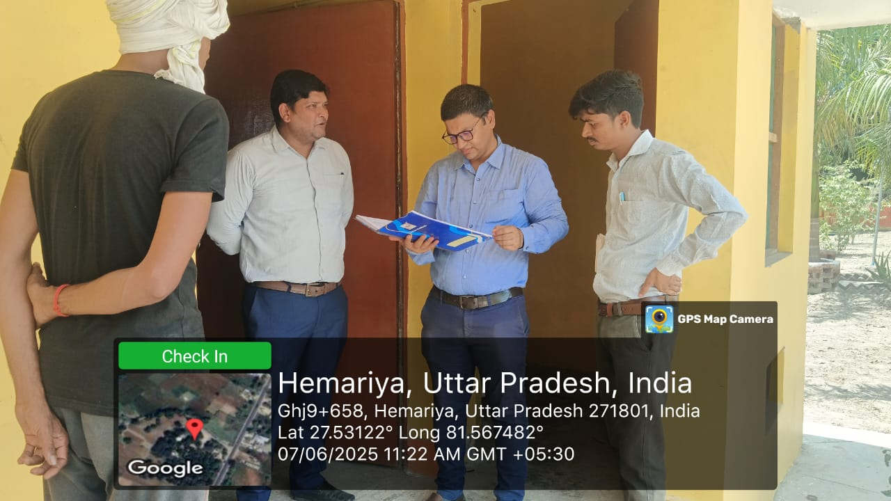
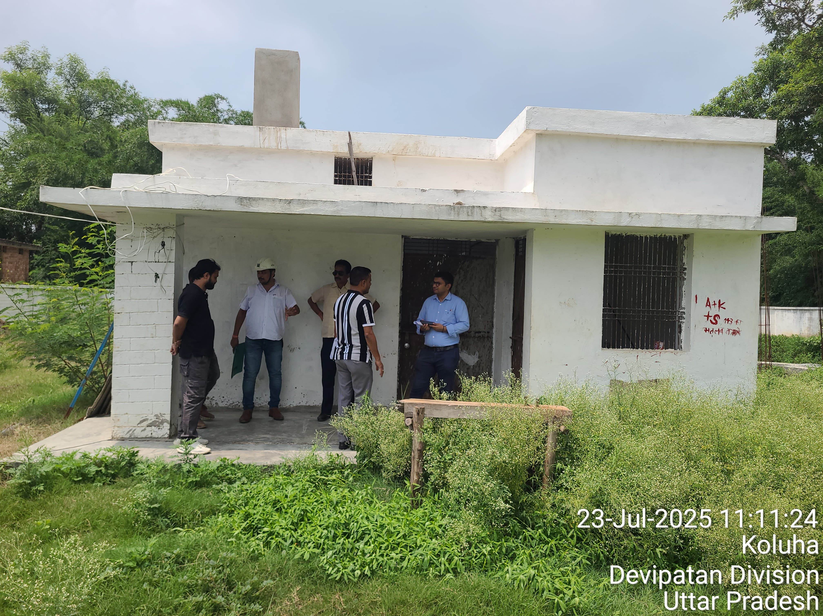
Capacity Building of GPs for Operation and Maintenance (O&M)
To ensure effective and sustainable management of PWS systems post-handover, DWSM has initiated a capacity building programme focused
on strengthening the technical, financial, and administrative capabilities of GPs and Village Water & Sanitation Committees (VWSCs).
The training modules cover:- Routine and preventive maintenance of PWS systems.
Water quality monitoring and reporting mechanisms.
Mechanism for Providing Technical Support to GPs
Recognizing the need for sustained technical assistance beyond the handover phase, DWSM has established a district-level technical support mechanism comprising engineers, water quality experts, and O&M specialists.
Periodic Technical Visits: Scheduled inspections and performance reviews of PWS systems.
Inspection of PWS scheme by EE UPJN Inspection of PWS scheme by EE UPJN
GP- Gajpatipur, Block- Tejwapur GP- khutena, Block- Payagpur

Slide 8
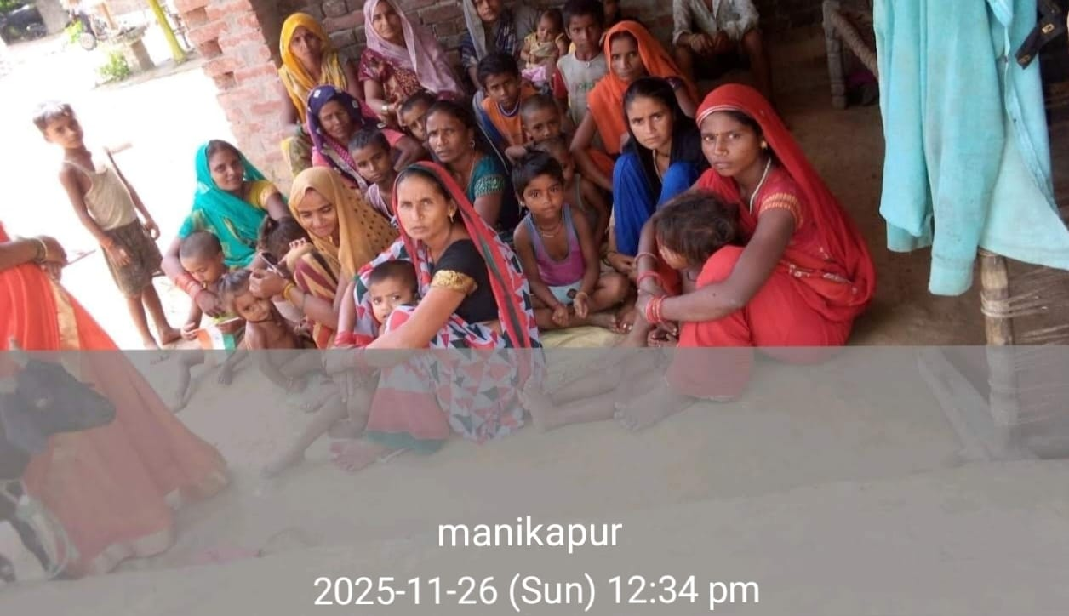
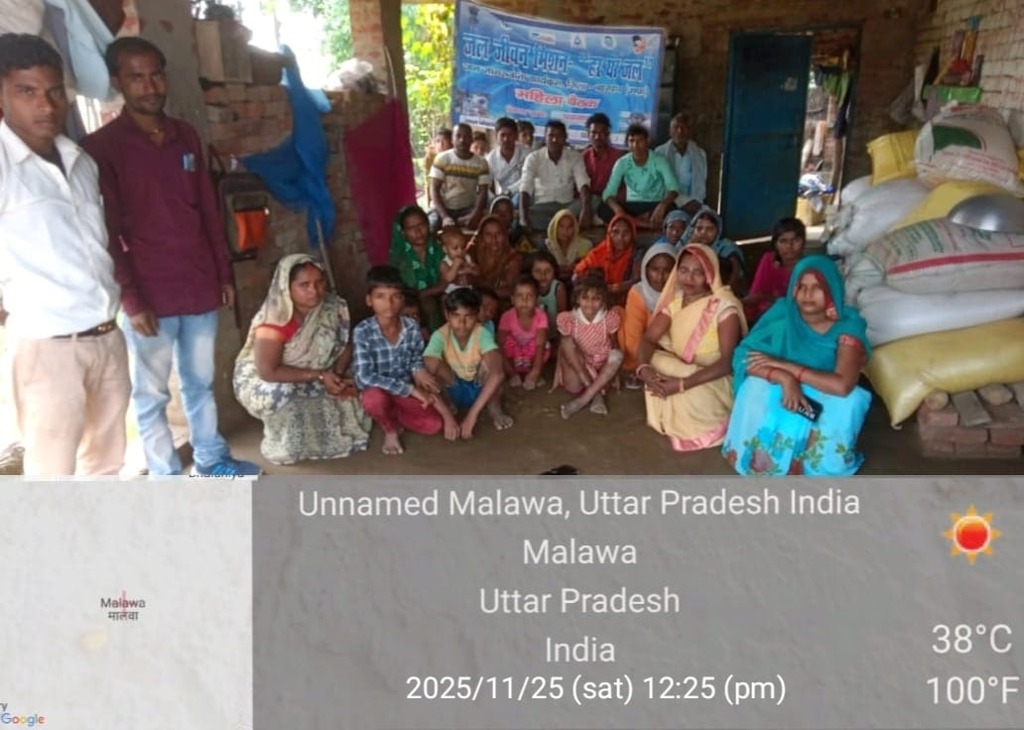
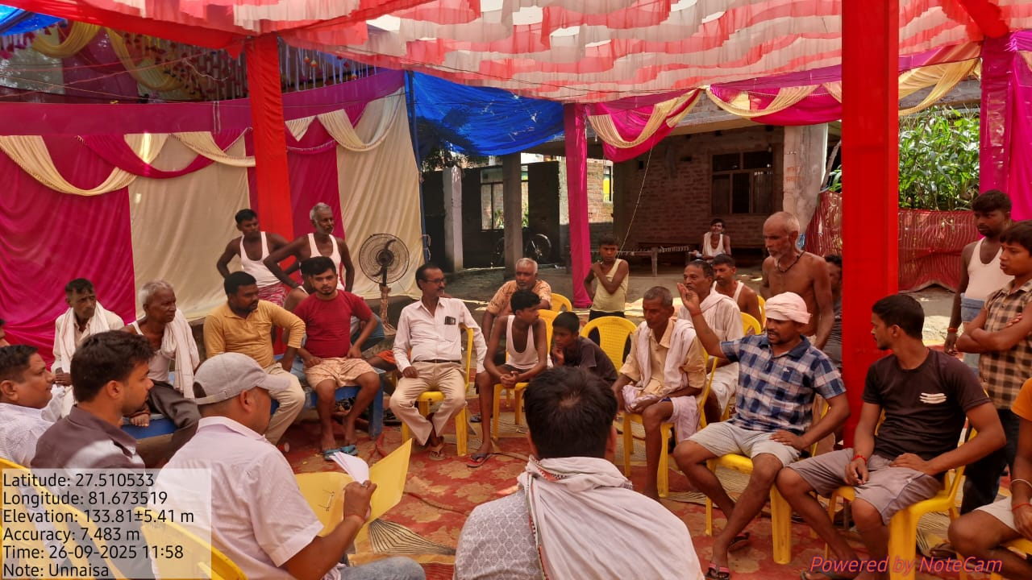
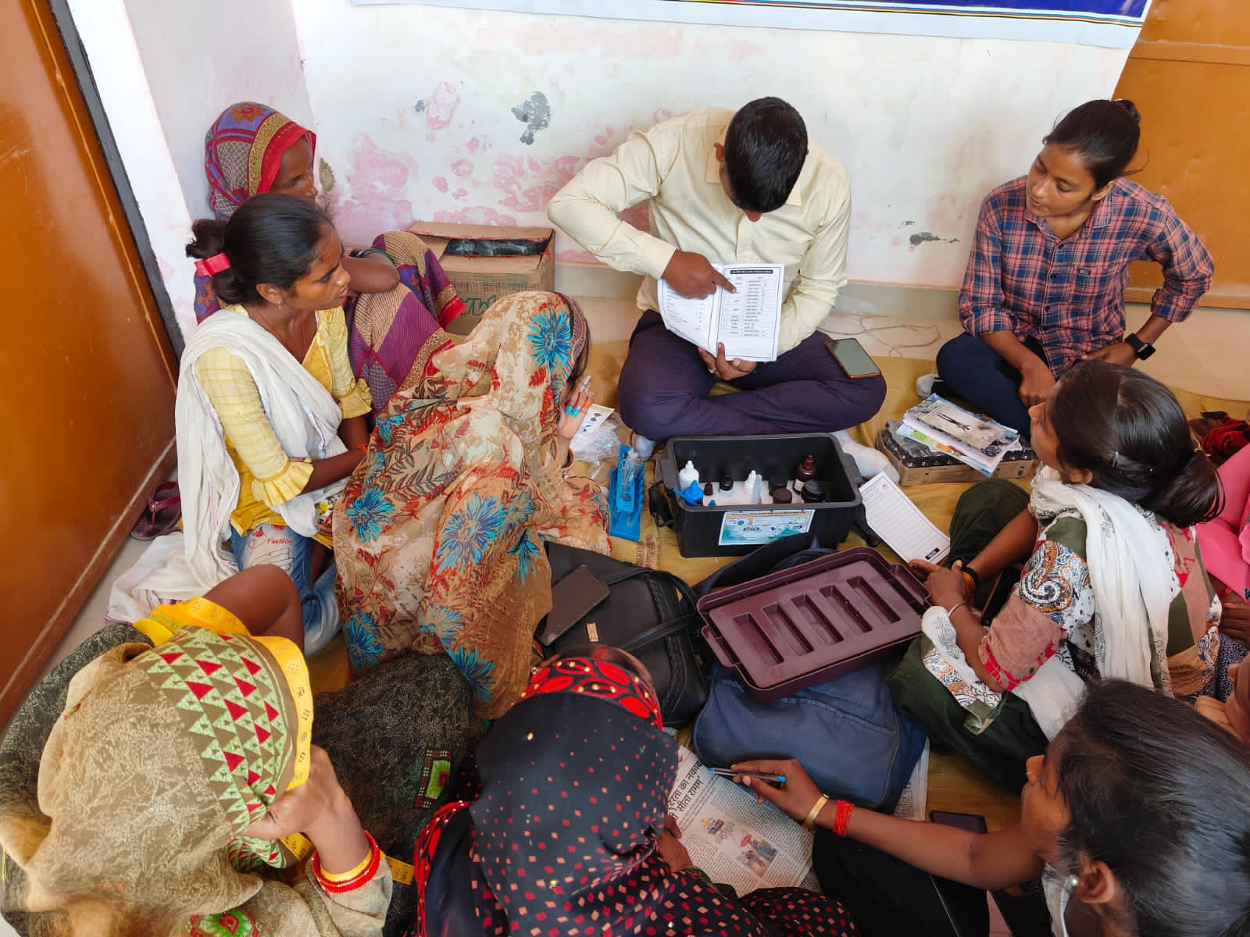
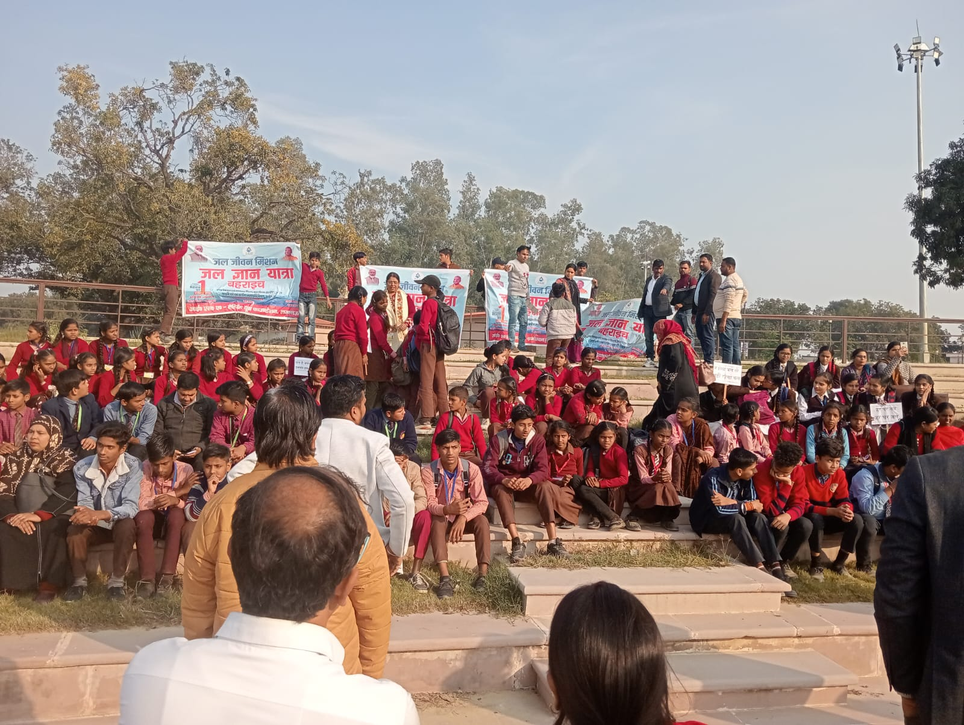
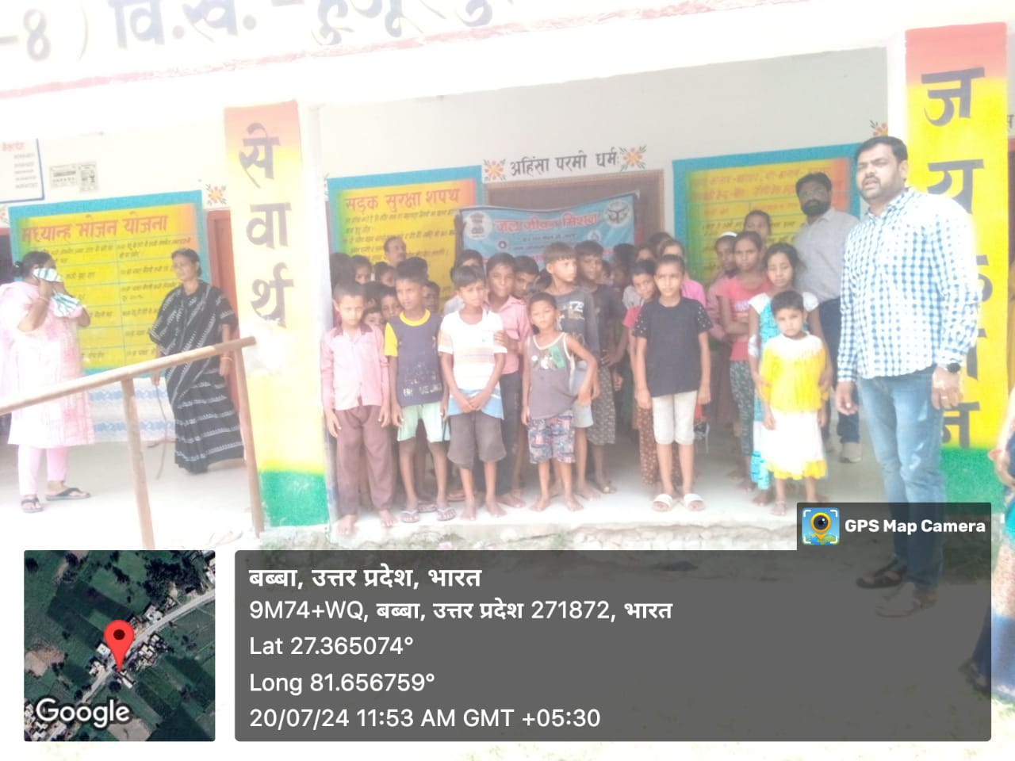
IEC & Community awareness
Building awareness and encouraging community participation are essential to the success and sustainability of water supply scheme.
IEC awareness programme IEC awareness programme AE, ISA meeting with GP about safe water practice GP- Manikpur Block- Payagpur GP- Malawa Block- Payagpur GP- Unnaisa Block- Chittaura
Efforts have been made to build a strong communication strategy through convergence with key departments. With the School Education and Health Departments, WASH awareness programs, School WASH Clubs, and handwashing campaigns are being conducted to inculcate safe water habits among children’s.
Awareness programme about safe water habits among children’s . GP- Babba , Block -Huzoorpur

Slide 9
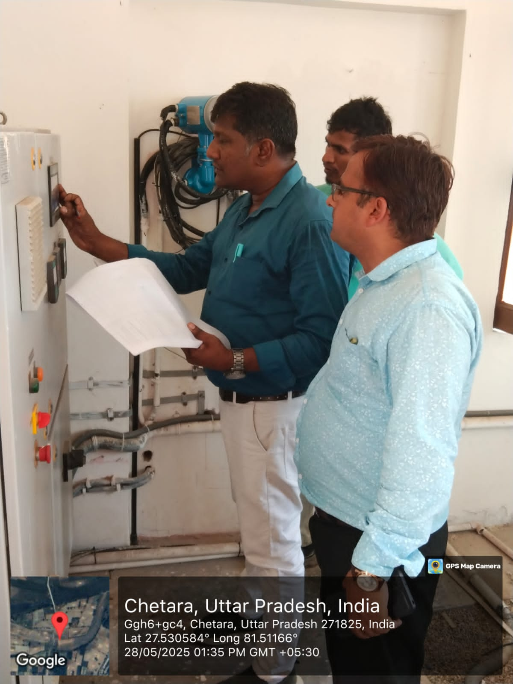
Institutional Good Practices (Governance and Oversight)
Regular Coordination :
Hold monthly DWSM meetings to review village-wise functionality status and progress of FHTC (Functional Household Tap Connections).
Roles and Responsibilities:
DWSM oversees planning , implementation, and monitoring of all PWS schemes.
Assign sub-division or block-level engineers responsibility for real-time data verification .
Empower GPWSC/VWSC (Village Water & Sanitation Committee) to maintain and report on daily operations.
Real-Time Monitoring
IoT / Sensor-Based Monitoring
Install smart flow meters, chlorine-residual sensors, and pressure loggers at critical points.
Integrate data with IMIS / Jal Jeevan Mission dashboards for real-time monitoring and alerts.
b) SCADA / Digital Dashboards
District-level SCADA or dashboards to track
Pump run hours/status
Chlorination/residual chlorine
Distribution network pressure, Consumer complaints & resolution status
Scada system inspection by TPI: GP- Chetra , Block- Tejwapur

Slide 10
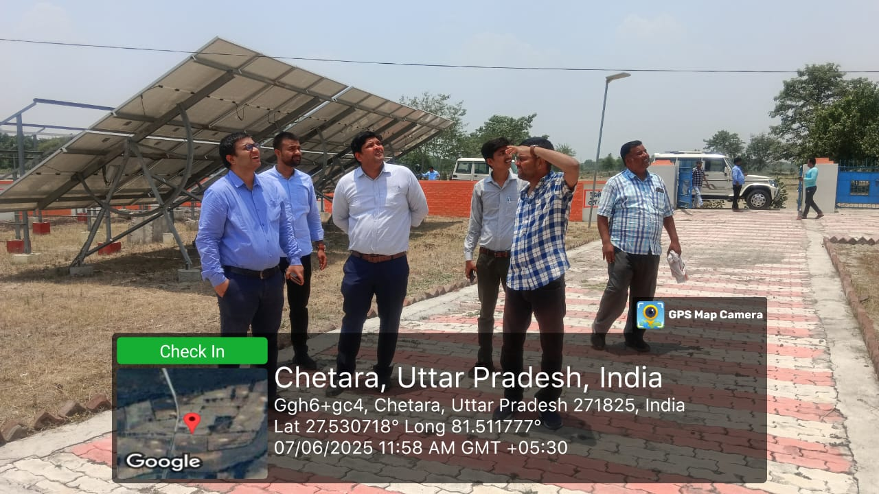
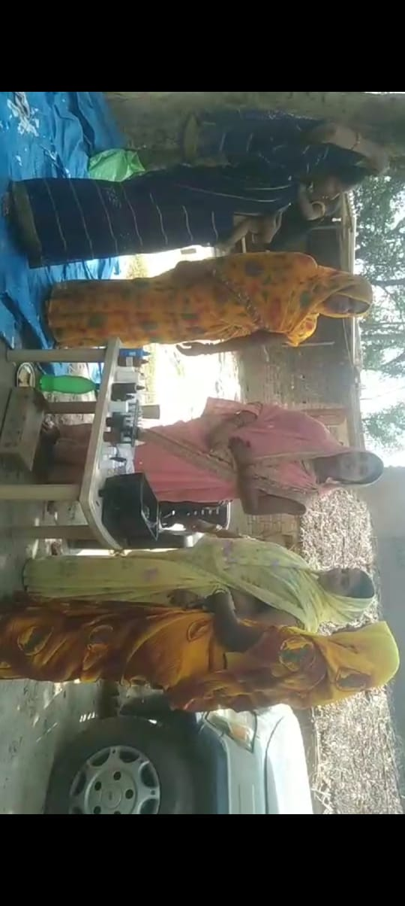
Periodic Functionality Assessments
Monthly and Quarterly Functionality Checks:- Conduct physical verification of:
1- Source yield and sustainability , Storage reservoir condition
2- Distribution network leakages, Household
tap functionality (minimum 55 lpcd
(Physical verification of PWS by EE UPJN GP-Chetra,Block-Tejwapur)
Water Quality Surveillance:-
Test water at source, distribution, and household level:
Quarterly: Laboratory analysis by District/Block Water Testing Labs
Monthly : Field test kits by VWSC
Enter all test results in the WQMIS (Water Quality Management
Information System)
(Water test by FTK women’s at GP- Gajpatipur, Block-Tejwapur)

Slide 11
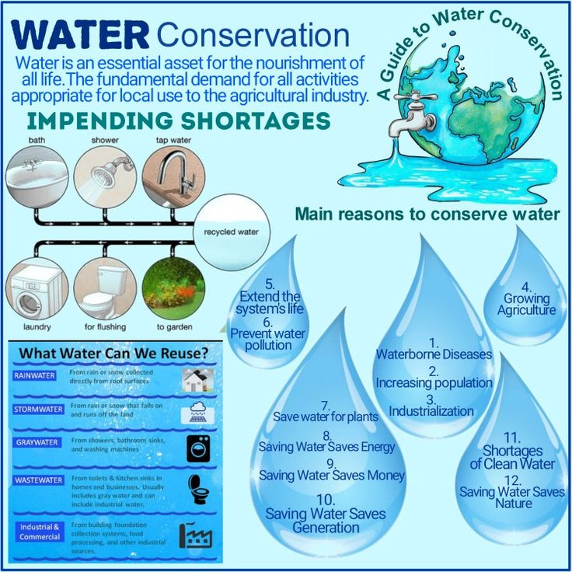
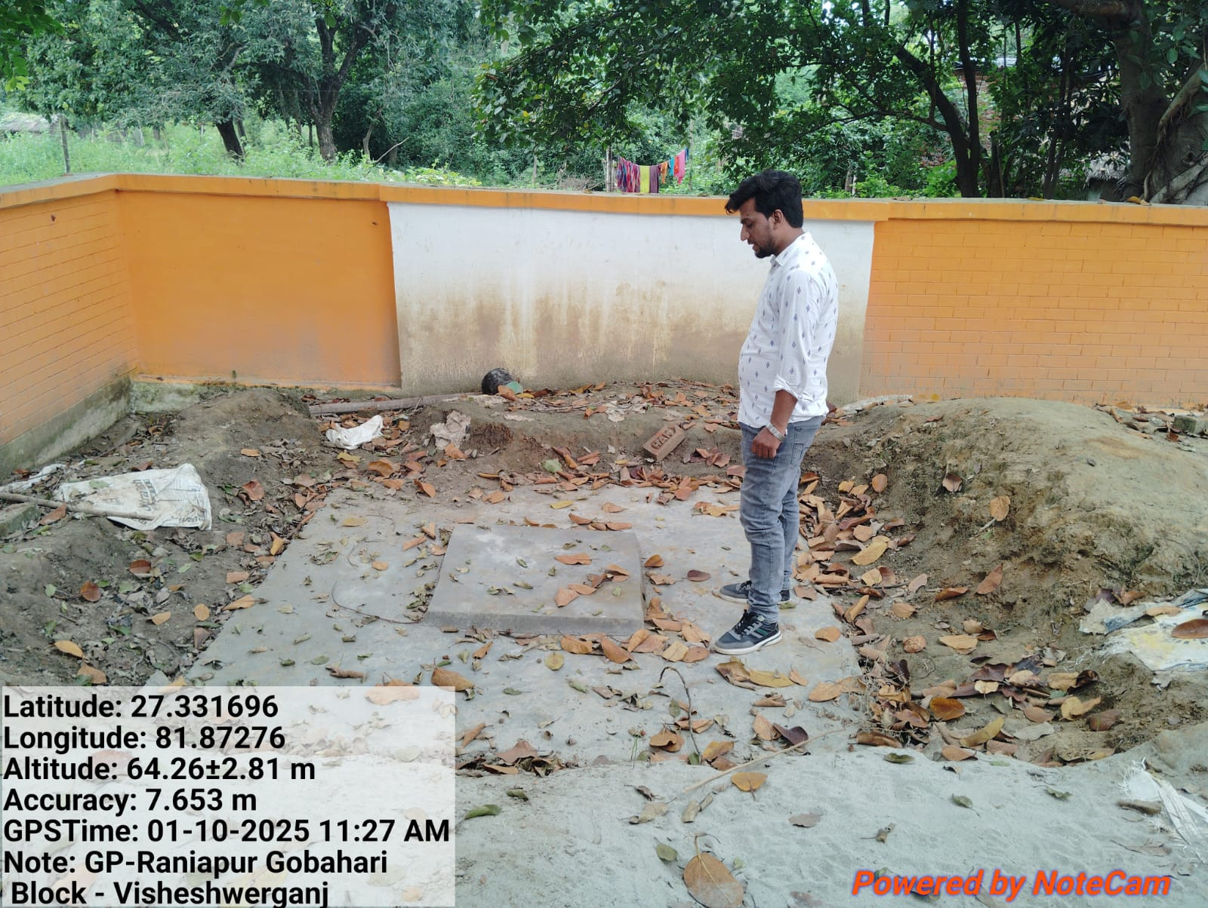
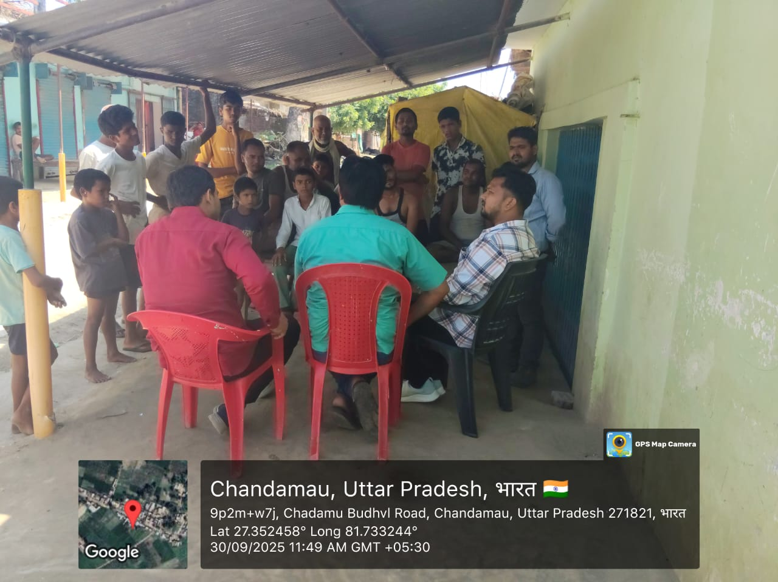
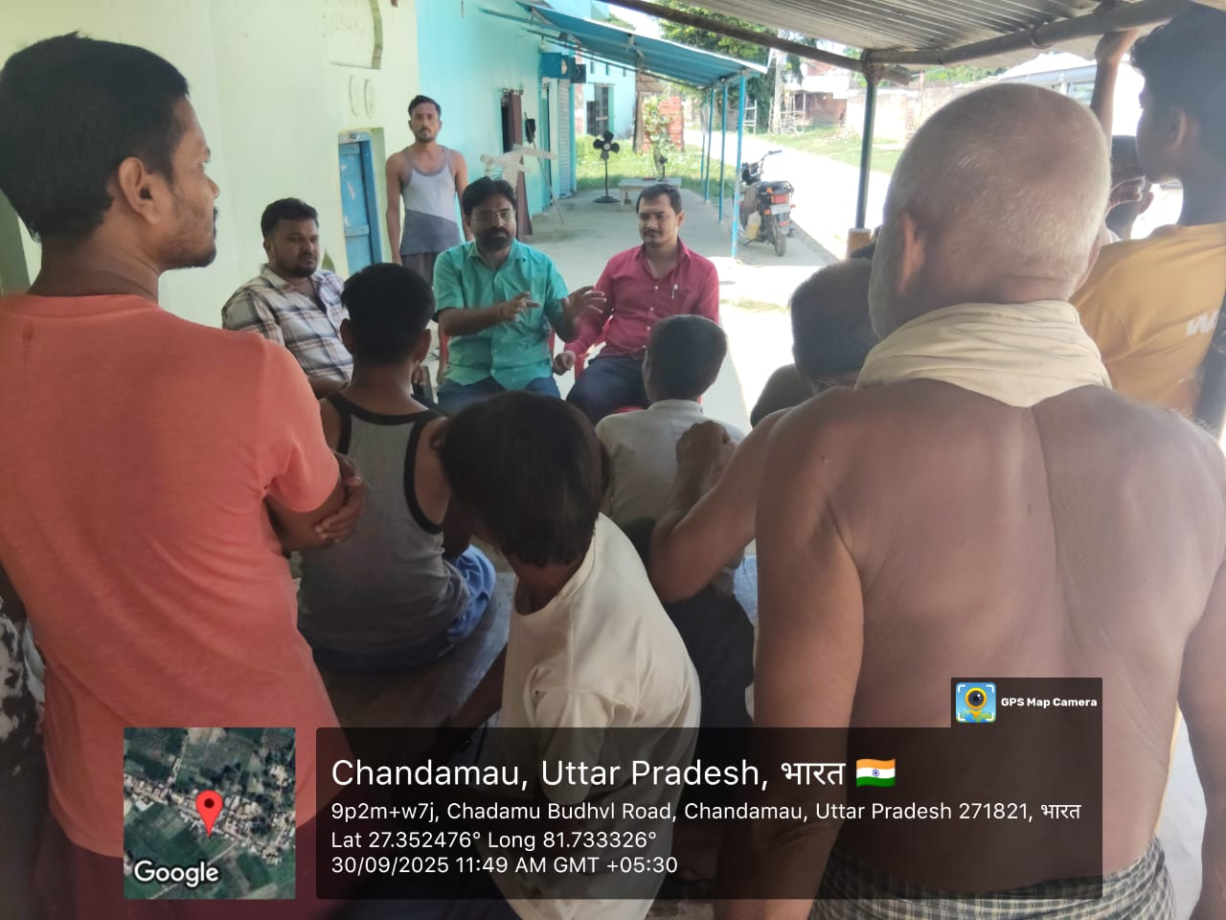
DWSM source sustenance plans
DWSM source sustenance plans focus on both traditional and modern water conservation and replenishment methods.
Key components includes:
Water conservation
Rainwater harvesting
Greywater management
Groundwater management
Watershed management
Recharge Pit at GP-Raniapur Gobrahi Block-Visheshwarganj
Strategies for implementation
Community-based approach
Capacity building
IEC activities
IEC awareness programme at GP-Gujara, Block-Visheshwarganj

Slide 12
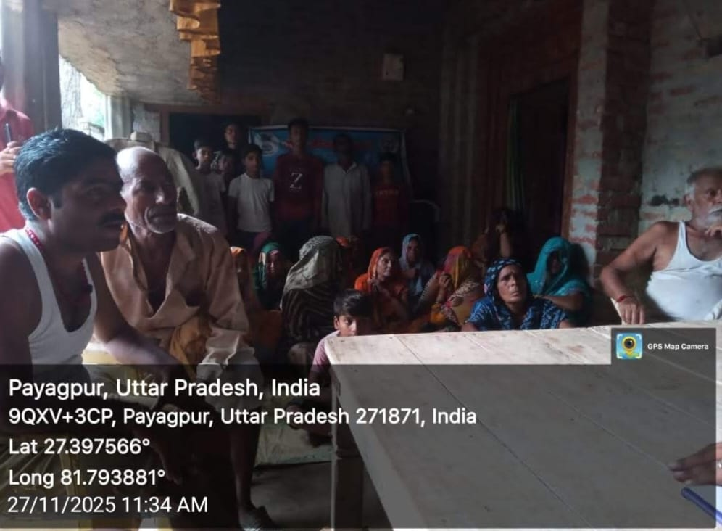
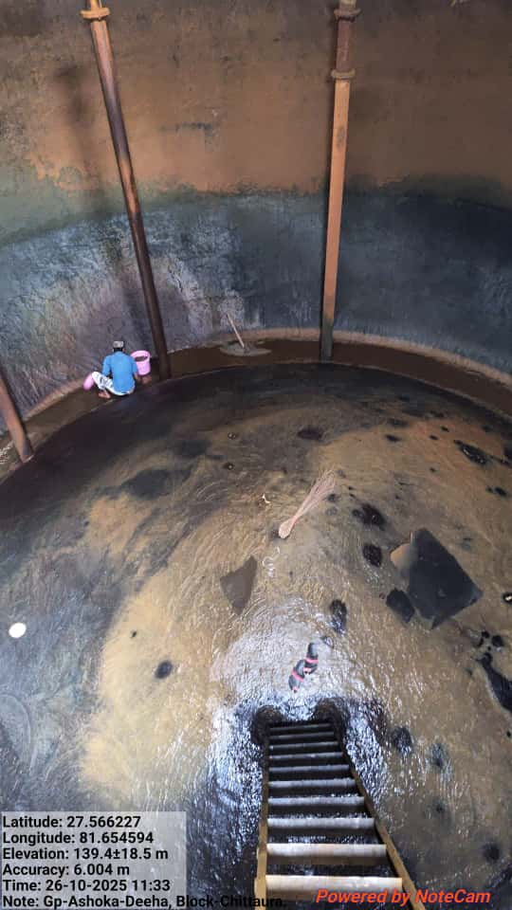
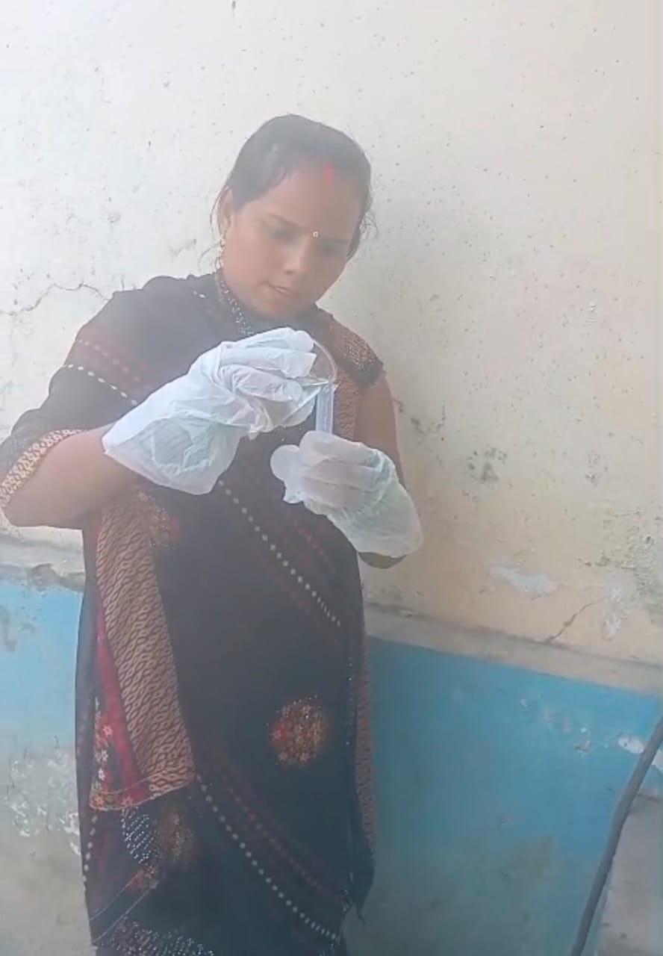
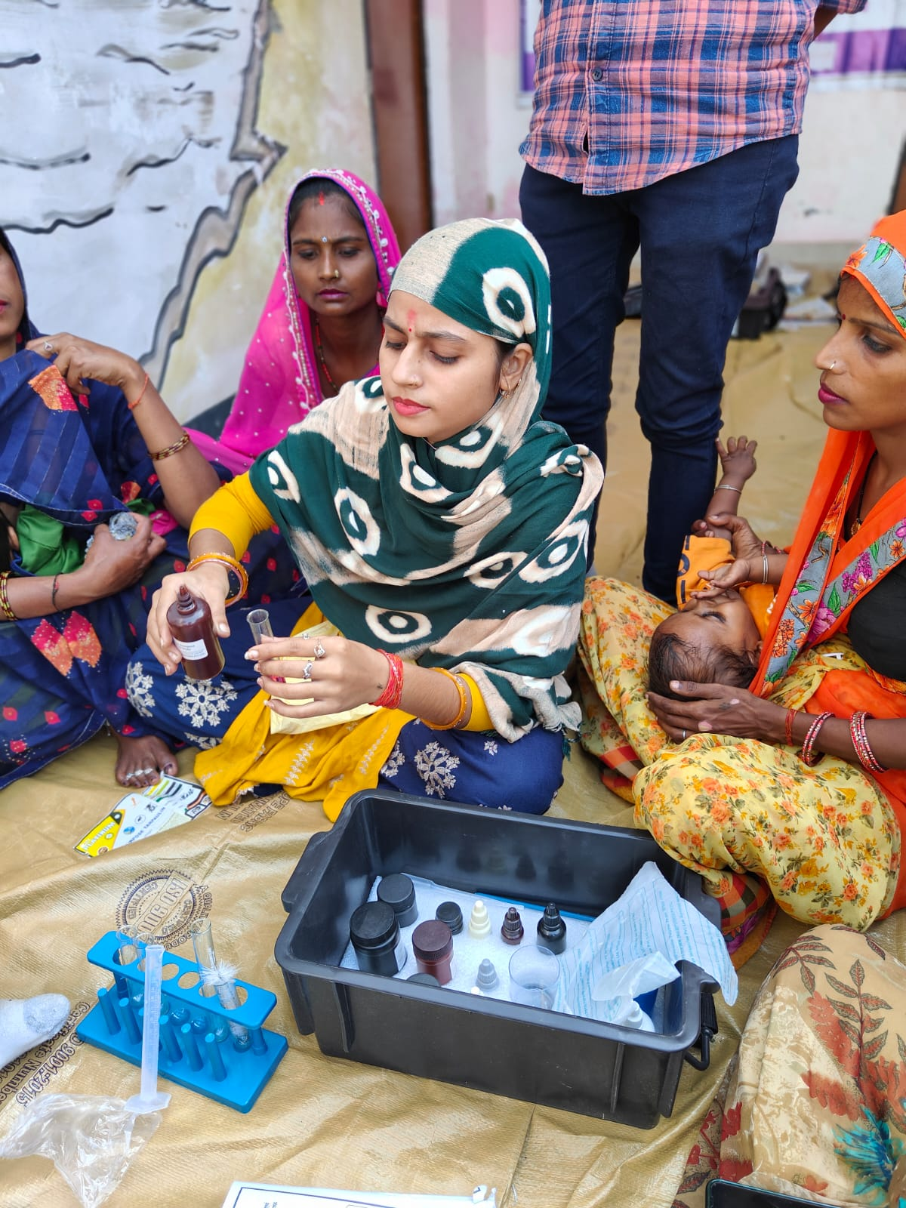
Effective water quality surveillance
Key Components of Effective Water Quality Surveillance
A. Institutional Framework
B. Water Quality Monitoring
C. Data Management and Analysis
D. Response and Control Measures
E. Community Involvement
Water Tank cleaning IEC conduct awareness programme for safe water handling
GP- Ashoka Deeha , Block-Chittaura GP- Sahasrava , Block- Payagpur
Water testing by FTK Women Water testing by FTK Women IEC conduct awareness programme for safe water handling
GP- Sarkhana, Block-Huzoorpur GP-Malawa , Block-Payagpur

Slide 13
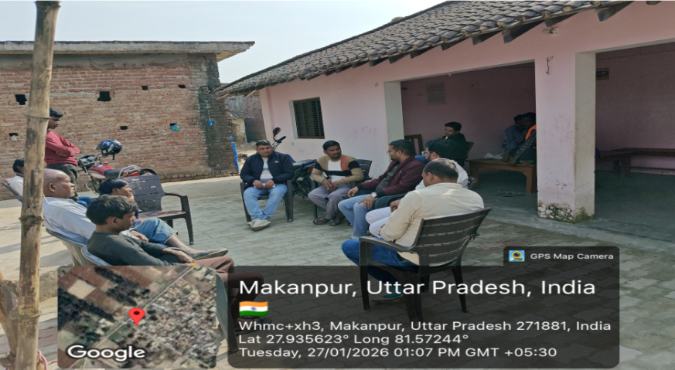
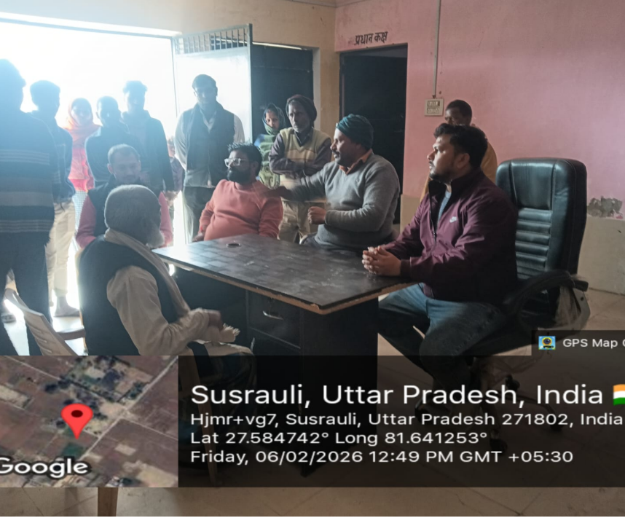
Best Practise in District
In the water supply schemes that have come under O&M, first of all a meeting is conducted at the village level in which the Gram Pradhan, Panchayat Secretary, Jal Nigam engineer, field engineer of the mentinance firm and other people of village participate.
A meeting is held at the block level in which a coordination meeting is held between the BDO, Jal Nigam Engineer, Maintenance Firm Engineer, in which planning is done regarding keeping the scheme regularly functional.
A call centre has been set up in Vikas Bhawan where people of the villages where schemes have been completed are called regularly to get feedback on whether they are getting supplies on time or not.

Slide 14
Thank You

